Slide 1
Health Threats in Tourism
European Institute of Innovation, Entrepreneurship and Technology
Lessingstraße 79, 13158 Berlin, Germany
Mahmoud Abdou| Berlin
      Lessingstraße 79,
      13158 Berlin, Germany
      Phone: +49 30 233618555
      Fax: +49 30 233618556
      Email: info@eiiet.com

Slide 2
Index
- The Evolution of Health Tourism
- The Evolution of Baths and Spas
- Health Tourism: A Geographical Exploration
- Contemporary Definitions

Slide 3
1- The Evolution of Health Tourism
    - Many visitors to modern-day health and wellness centres are often unaware of the cultural origins of the treatments they enjoy.
    - Visitors may not be aware that:
    - Indian Ayurvedic practices date back as far as 5000 BC (A system of traditional medicine that combines different treatments, e.g. yoga, massage, acupuncture, and herbal medicine) to boost health and wellbeing
    - Egyptian women in 3000 BC used cosmetics similar to those used today.
    - The earliest known writings about Chinese medicine date back to 1000 BC.
    - Despite its ancient origins, Chinese medicine is often viewed in Western societies as something ‘new’ and exotic.

Slide 4
1- The Evolution of Health Tourism
    - Health tourism may appear to be a new form of tourism, but this is not the case.
    - In reality, health tourism is one of the oldest forms of tourism.
    - Some types of health tourism, such as retreat visits, have been changing and evolving over time.
    - Other forms, like thermal tourism, are being (re)discovered in many parts of the world.
    - These forms seem new only because they are new to certain markets, while they remain traditional in other countries

Slide 5
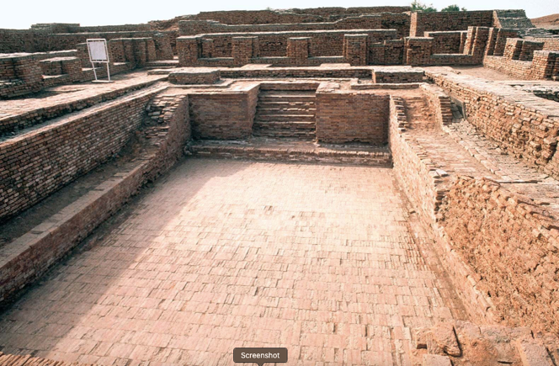
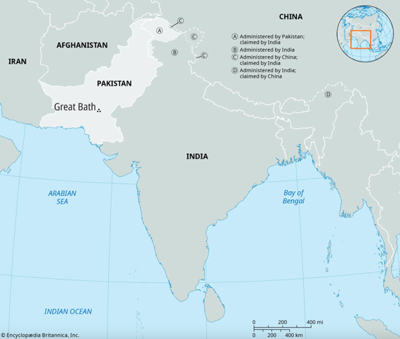
2- The Evolution of Baths and Spas
    - The most ancient evidence of bathing culture was found in the valleys beside the River Indus.
    - An ancient civilization in this region had developed water ducts, bathrooms, and bath pools.
    - Ancient Greek civilizations (from 700 BC) introduced cold water bathing for warriors.
    - Persians (600–300 BC) used steam and mud baths.
Great Bath, Mohenjo-daro, Pakistan.
Source: https://www.britannica.com/place/Great-Bath-Mohenjo-daro
Source: https://www.britannica.com/place/Great-Bath-Mohenjo-daro

Slide 6
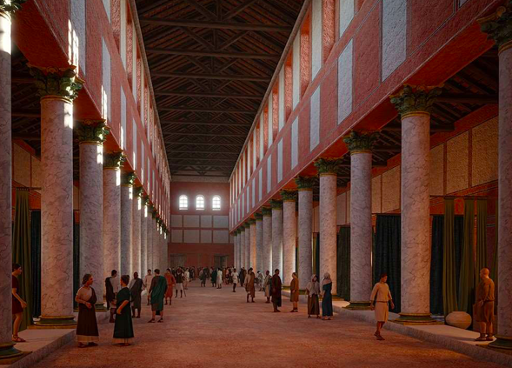
2- The Evolution of Baths and Spas
    - Thais (then Siamese) practiced massage as far back as 100 BC.
    - The Roman Empire left a significant legacy of public baths:
    - A notable example is the bath complex in Bath, Britain,
    established in 76 AD.
    - Thermal springs were discovered in destinations
    like Spa in Belgium (before 100 AD)
    and Baden-Baden in Germany (211 AD).
A reconstruction of Wroxeter’s bath-house basilica in about AD 200.
https://www.english-heritage.org.uk/learn/story-of-england/romans/roman-bathing/

Slide 7
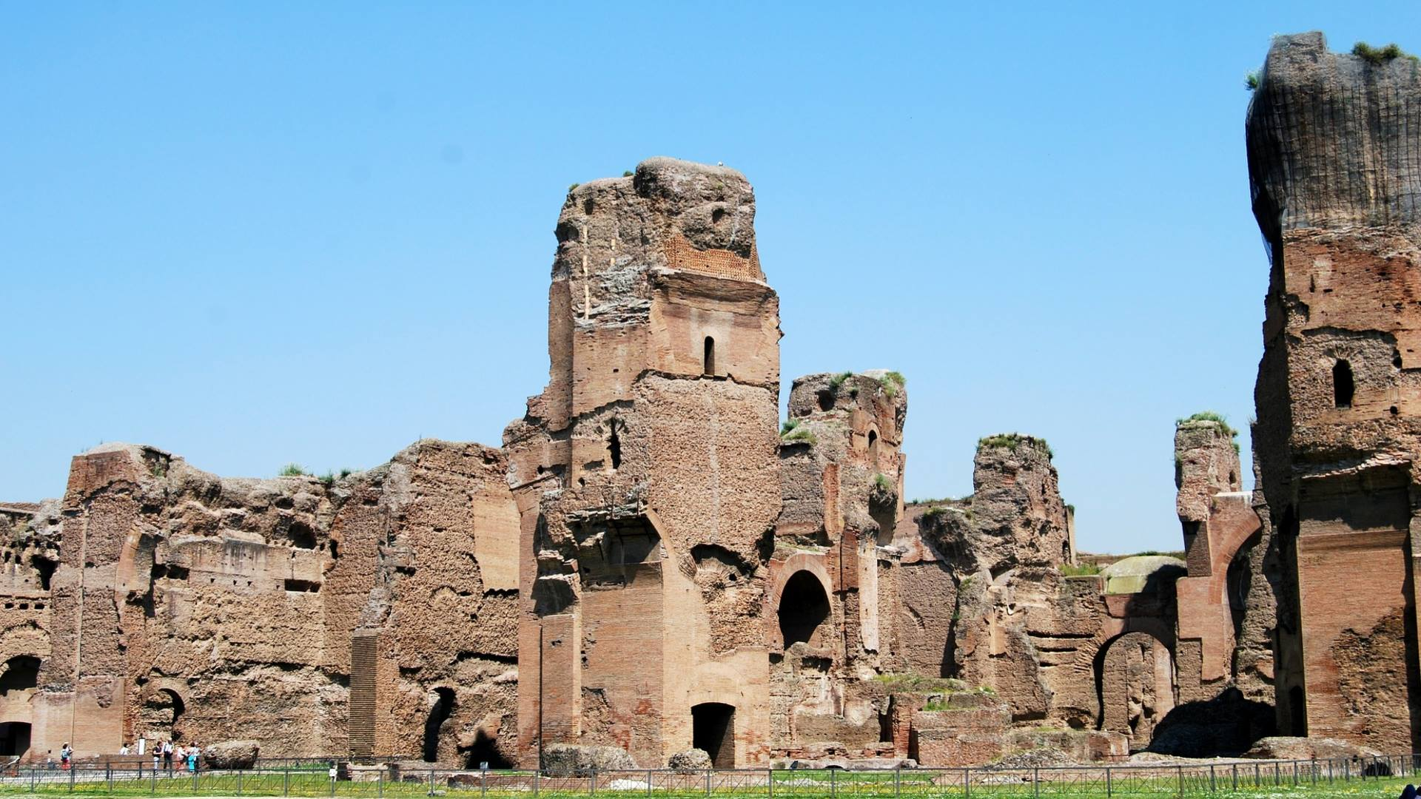
2- The Evolution of Baths and Spas
    - The Baths of Caracalla, located near Rome, were used for approximately three centuries.
    - They lost their water supply during the siege of Rome in 537 AD when the aqueducts were destroyed.
    - These baths had the capacity to
    accommodate between 6,000 and 8,000
    bathers per day.
    - During the Roman Empire (44 BC to 69 AD),
    Augustan society traveled extensively for
    health-related purposes.
https://www.turismoroma.it/en/places/baths-caracalla

Slide 8
2- The Evolution of Baths and Spas
    - Destinations included relaxing landscapes, seaside resorts, and hot springs.
    - Medical knowledge was limited, and the average lifespan was around 40 years.
    - Wealthy citizens often traveled in search of treatment or to recover in healthier climates.
    - Typical health-related trips during the Roman Empire included:
    - Sea voyages from Italy to Alexandria, Egypt.
    - Visits to mineral springs in modern-day locations like Vichy, Aix-en-Provence, Bath, and Wiesbaden.

Slide 9
2- The Evolution of Baths and Spas
    - The Ottoman Empire built Turkish baths as early as 800 AD.
    - British knights encountered Turkish baths during the Crusades in the 1200s.
    - Saunas appeared along the Baltic coast in Finland around 1000 AD.
    - In the 14th century:
    The first showers were developed in the baths of Bormio, Italy.
    Warm springs were discovered in Central Europe, including:
    Buda (now Budapest, Hungary).
    Carlsbad (now Karlovy Vary, Czech Republic).

Slide 10
2- The Evolution of Baths and Spas
    - By the 15th century, concerns arose in parts of Europe (e.g., Britain) regarding public bathing:
    Linked to the spread of diseases such as syphilis, leprosy, and the plague.
    Naked, mixed bathing was increasingly condemned as immoral, notably by the Bishop of Bath and Wells.

Slide 11
2- The Evolution of Baths and Spas
    - The Renaissance in Europe (16th century) saw a rise in balneotherapy (water therapy treatments) as a medical practice.
    - Italy became a center for such treatments, with famous:
    Sulphurous springs in Abano
    Mud baths in Padua, Lucca, and Caldiero
    - In 1553, the first European Spa Directory was printed in Venice, listing over 200 spas.
    - Elizabeth I promoted public bathing in Britain in 1571 to discourage travel to Spa in Belgium.
    - Many European monarchs supported spa visits for health and leisure.

Slide 12
2- The Evolution of Baths and Spas
    - In the late 18th century:
    Seawater was recognized for its health benefits.
    This marked the beginning of thalassotherapy, especially popular in France.
    - In the early 19th century:
    Modern massage techniques began developing, notably in Sweden.

Slide 13
3- Health Tourism: A Geographical Exploration
    - 3.1- Health Tourism In Europe
    - Health tourism in Europe has historically centered around spas and seawater treatments.
    - This is largely due to the abundance of thermal and mineral springs and coastal areas.
    - The word “spa” is believed to have originated from:
    The Latin phrase “sanitas per aqua” (health through water), or
    The Walloon word “espa” meaning fountain.
    It may also come from the town of Spa in Belgium, one of the earliest spa destinations.

Slide 14
3- Health Tourism: A Geographical Exploration
    - 3.1- Health Tourism In Europe
    - Hydrotherapy (water-based treatments) has traditionally been the core offering of European spas, focusing on health and physical well-being.
    - In recent years, there has been a rise in:
    Cosmetic and beauty treatments.
    Spiritual and psychological wellness activities.
    - As illness treatment needs decreased in Europe due to improved healthcare and preventative techniques:
    - Spas have shifted more toward relaxation and pampering rather than strictly medical treatments.

Slide 15
3- Health Tourism: A Geographical Exploration
    - 3.1- Health Tourism In Europe
    - The Romans built sophisticated baths throughout Europe, which were an essential part of their daily life.
    - These baths typically included:
    A series of baths with temperatures ranging from cool to hot.
    A final cold plunge pool.

Slide 16
3- Health Tourism: A Geographical Exploration
    - 3.1- Health Tourism In Europe
    - Many Roman (Latin) terms used for different types of baths are still used in modern spas today:
    Frigidarium – cool room
    Tepidarium – lukewarm room
    Caldarium – warm room
    Laconium – hot room
    - Roman baths were not only for hygiene and health but also served as social centers, where:
    People gathered to discuss politics, philosophy, and public matters
    They were especially important for soldiers and administrators as places of rest and social interaction

Slide 17
3- Health Tourism: A Geographical Exploration
    - 3.1- Health Tourism In Europe
    - Many of Europe’s historic spa towns were developed around healing springs between the 14th and 16th centuries, such as:
    Vichy in France
    - Initially, spa travel was primarily for royalty and nobility, but this declined as domestic bathing conditions improved

Slide 18
3- Health Tourism: A Geographical Exploration
    - 3.1- Health Tourism In Europe
    - By the end of the 18th century, spa treatments and sea bathing began to develop simultaneously.
    - By 1889, Spain alone had 188 spas.
    - Over time, the motivation for visiting spas shifted:
    Originally focused on health and medical cures
    Gradually evolved into a desire for leisure and recreation
    - As a result, many spas began to incorporate entertainment facilities, such as:
    Casinos
    Dance halls
    Other forms of social and leisure activities

Slide 19
3- Health Tourism: A Geographical Exploration
    - 3.1- Health Tourism In Europe
    - After World War II, spa resorts in Western Europe experienced stagnation.
    - In the UK, spas were already in decline by the 19th century, overshadowed by seaside resorts.
    - In contrast, in communist Central and Eastern Europe and the Soviet Union, spas entered a new phase of development:
    - Treatments were sponsored mainly by the state or trade unions.
    - Facilities were built specifically for health and therapeutic purposes.

Slide 20
3- Health Tourism: A Geographical Exploration
    - 3.1- Health Tourism In Europe
    - In Finland, one of the compensations for wounded soldiers after World War II was veteran spa rehabilitation.
    - A system was created offering regular rehabilitation periods of 1–3 weeks, fully funded by the state.
    - Finland’s “golden spa age” occurred in the 1800s:
    By the early 1890s, Finland had the highest spa density in Europe.
    Despite this, there were only a few natural spas (i.e., thermal/mineral waters).

Slide 21
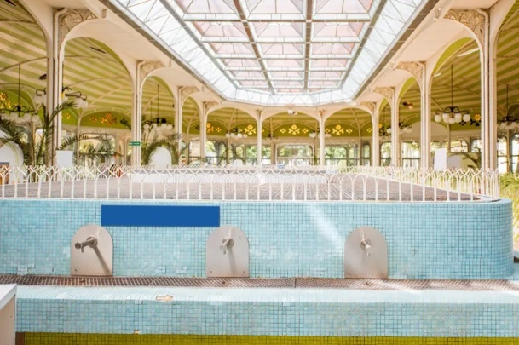
3- Health Tourism: A Geographical Exploration
    - 3.1- Health Tourism In Europe
    - Case Study: Vichy, France
    - Vichy waters have been known for their healing benefits for nearly 2,000 years, dating back to Roman times.
    - By the 17th century, they were used to stimulate natural defense mechanisms.
    - During the reigns of Louis XIV and Napoleon III:
    - The town and spa were renovated.
    - Vichy became not only a place for therapeutic treatments
    but also one of pleasure and sophistication, earning the nickname
    “the second Paris”.

Slide 22
3- Health Tourism: A Geographical Exploration
    - 3.1- Health Tourism In Europe
    - Case Study: Vichy, France
    - It was crowned “the queen of Spa towns”, while Baden-Baden in Germany was considered the “king”.
    - Today, Vichy waters are used for various medical and wellness purposes, including:
    Rheumatology
    Gastroenterology
    Dermatological and dermocosmetic care

Slide 23
3- The Health Tourism: A Geographical Exploration
    - 3.1- Health Tourism In Europe
    - Case Study: Vichy, France
    - In the 1990s, Vichy expanded its focus on spa therapy using Thermal Spa Waters, returning to a blend of health, beauty, and mind-body balance.
    - Modern spa offerings include:
    A nutritional and slimming program with on-site treatments and 6-month post-treatment online follow-up.
    A rotation of international massage styles.
    Various rituals and themed wellness experiences.
    Short-term wellness escapes, such as 2-day packages.
    Treatments designed to enhance skin softness and complexion.

Slide 24
3- Health Tourism: A Geographical Exploration
    3.2- Health Tourism in Middle East and North Africa
    - Arabian medicine was initially influenced by Greek and Roman practices.
    - However, by the Dark Ages in Europe, medical advancements in Arabia surpassed those in Europe.
    - Today, the Middle East is a major growth region for medical tourism.
    - Ancient Egyptians focused extensively on treating eye diseases.

Slide 25
3- Health Tourism: A Geographical Exploration
    3.2- Health Tourism in Middle East and North Africa
    - It is believed that kohl eyeliner pencils were originally used to disinfect the eyes, rather than for cosmetic purposes.
    - Beauty cosmetics in ancient Egypt date back to 1400 BC and included:
    Skin oils
    Face creams
    Toothpaste
    Henna and hair dyes
    Perfumes

Slide 26
3- Health Tourism: A Geographical Exploration
    3.2- Health Tourism in Middle East and North Africa
    - Egyptians and Babylonians used bathing for both spiritual healing and physical health.
    - While European bathing focused on medical and physical health benefits, Egyptians believed that bathing was essential to achieving a higher level of spirituality through cleanliness and beauty.
    - Cleansing rituals in ancient Egypt included:
    Exfoliating and massaging the skin in a warm bath, often using yogurt and honey.
    It is said that Queen Cleopatra (69–30 BC) bathed in milk to keep her skin soft.
    This inspired the modern-day “Cleopatra Bath” treatment in spas.

Slide 27
3- Health Tourism: A Geographical Exploration
    3.3- Health Tourism in The Americas
    - When discussing spas in the Americas, it's important to distinguish between:
    Modern spas that have developed over the past 100 years in the USA, Canada, and parts of Central and South America.
    The traditional practices of indigenous peoples, which have existed for thousands of years before modern spas.
    - South America is home to thousands of hot springs and volcanic thermal waterfalls, found in places such as Costa Rica, Ecuador, and the Caribbean.
    Many of these natural features were traditionally used by indigenous peoples, such as the Incas.

Slide 28
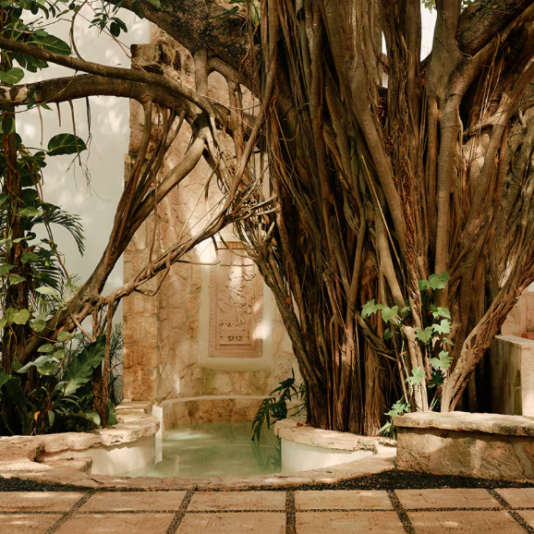
3- Health Tourism: A Geographical Exploration
    3.3- Health Tourism in The Americas
    - The influence of ancient civilizations can still be seen in
    modern spa practices throughout the region.
    - For instance, at Maroma Spa in Mexico, the orientation of the
    spa rooms follows Ancient Maya traditions.
    - This alignment is believed to allow positive energy from the
    planets and stars to flow into the rooms, which, according to
    Mayan spirituality, has a beneficial effect on both the soul
    and body of those who stay there.
https://www.guerlain.com/us/en-us/c/maroma-spa-by-guerlain-riviera-maya.html

Slide 29
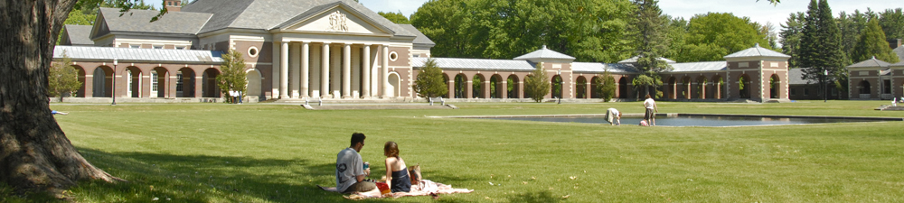
3- Health Tourism: A Geographical Exploration
    3.3- Health Tourism in The Americas
    - Case Study: Saratoga Springs
    - Saratoga Springs is one of the oldest spas in America, known for its natural carbonated mineral water.
    - Native Americans had been using the mineral springs since the 14th century, believing the springs had healing powers and were also sacred.
    - In the late 1700s, Sir William Johnson, a friend of the Native Americans, became ill and was transported to the springs to drink the water and bathe. He is believed to be the first white man to visit the springs.
Source: https://parks.ny.gov/parks/saratogaspa.

Slide 30
3- Health Tourism: A Geographical Exploration
    3.3- Health Tourism in The Americas
    - Case Study: Saratoga Springs
    - By the 1800s, Saratoga Springs had become a popular tourist attraction, and the water was being bottled and shipped around the world.
    - In the 1900s, the carbon dioxide from the waters was used to create Ice Cream soda fountains.
    - However, due to commercial companies, this led to the over-drilling of wells, and the waters began to run dry .
    - In 1908, the State of New York passed laws to limit the amount of pumping, and Saratoga Spa State Park was created to ensure protection and management of the area.

Slide 31
3- Health Tourism: A Geographical Exploration
    3.4- Health Tourism in Asia-Pacific
    - Asia’s wellness traditions follow a holistic approach, treating the body, mind, and spirit as one.
    - The focus is on identifying the root cause of a problem, rather than just treating symptoms.
    - Emphasis is placed on encouraging the body to heal itself naturally.
    - The approach is deeply rooted in tradition and spirituality.
    - Unlike other regions, it is not primarily based on natural assets (like mineral springs or climate), but on philosophical and spiritual healing systems

Slide 32
3- Health Tourism: A Geographical Exploration
    3.4- Health Tourism In Asia
    - The Japanese developed their own traditional spas known as ‘onsens’, based on natural thermal springs.
    - Japan’s first onsen opened in 737 AD near Izumo.
    - Centuries later, the first ‘ryokan’ (traditional inns) were established, offering:
    Fine food
    Comfortable accommodations
    Zen gardens
    Outdoor baths
    Indoor soaking tubs called cypress ofuro

Slide 33
4- Contemporary Definitions
    4.1- Health
    - The widely accepted definition of health comes from the World Health Organization (WHO, 1948):
    - "Health is a state of complete physical, mental, and social wellbeing and not merely the absence of disease or infirmity."
    - Saracci (1997) questioned this definition:
    He suggested the WHO’s definition resembles happiness more than health.
    He argued that existential issues—such as emotions, passions, personal values, and life's meaning—don't necessarily affect happiness or health directly.

Slide 34
4- Contemporary Definitions
    4.1- Health
    - These issues are not easily reducible to health problems.
    - Since 1948, the WHO has broadened its definition of health:
    - There is now more convergence between physical and mental health and broader concerns like wellness and lifestyle management.
    - WHO (1984) defined health as:
    “The extent to which an individual or a group is able to realize aspirations and satisfy needs, and to change or cope with the environment. Health is a resource for everyday life, not the objective of living; it is a positive concept, emphasizing social and personal resources as well as physical capabilities”.

Slide 35
4- Contemporary Definitions
    4.2- spirituality
    - Some authors argue that spirituality is central to wellness:
    - This marks a shift away from orthodox religion toward a more transcendent form of spirituality.
    - The word ‘spirituality’:
    Comes from the Latin word spiritualitas, an abstract concept.
    Related to the Greek word pneuma, meaning breath or the essence of life.

Slide 36
4- Contemporary Definitions
    4.2- spirituality
    - Spirituality is understood as a multi-dimensional concept, with different dimensions as follows:
    - Transcendent Dimension
    Belief in more than what is visible or material—may or may not involve belief in God.
    It includes the sense that personal power arises from harmonious connection with this higher dimension.
    -Meaning and Purpose in Life
    A deep confidence that one’s life holds meaning, usually emerging through a personal quest for purpose.
    Mission in Life
    A sense of responsibility to life itself—recognizing that in giving or "losing" oneself, one truly "finds" fulfillment.

Slide 37
4- Contemporary Definitions
    4.2- spirituality
    - Sacredness of Life
    The belief that all life is inherently holy and worthy of reverence.
    - Material Values
    An understanding that true and lasting satisfaction comes not from material possessions, but from spiritual richness.
    - Altruism
    A belief in social justice and interdependence—acknowledging that "no man is an island."

Slide 38
4- Contemporary Definitions
    4.2- spirituality
    - Idealism
    A commitment to realizing the highest potential in every area of life.
    - Awareness of the Tragic
    A profound recognition of human pain, suffering, and mortality—paired with an affirmation that life still holds value.
    - Fruits of Spirituality
    The tangible outcomes of spiritual development as seen in one’s relationships—with the self, others, nature, and a higher presence or purpose (the Ultimate).

Slide 39
4- Contemporary Definitions
    4.2- spirituality
    - Spirituality later developed to introduce only 4 dimensions
    - Meaning and Mission in Life
    Feeling confident that life is meaningful, which includes having a clear sense of mission or purpose.
    - Positive Potential and Spiritual Fulfillment
    A commitment to realizing one’s highest potential in all areas of life, rooted in the belief that spiritual values bring deeper satisfaction than material ones, and that spirituality permeates one’s relationship with self, others, and the world.

Slide 40
4- Contemporary Definitions
    4.2- spirituality
    - Interconnectedness and Compassion
    An awareness of the interconnected nature of all life, accompanied by sensitivity to the suffering of others and a deep emotional response to human tragedy.
    - Transcendence and Sacredness of Life
    A belief in the power of a transcendent dimension—feeling that life itself is sacred and that connecting with this higher reality brings personal benefit and harmony.

Slide 41
4- Contemporary Definitions
    4.3- Wellness
    - Wellness is introduces as “‘a special state of health comprising an overall sense of wellbeing which sees ‘Man’ as consisting of body, spirit, and mind and being dependent on his environment”.
    - It is also perceived as A state of health featuring harmony of the body, mind, and spirit, characterized by:
Self-responsibility | Physical fitness
Beauty care | Healthy nutrition
Relaxation | Meditation
Mental activity | Education
Environmental sensitivity | Social contacts

Slide 42
4- Contemporary Definitions
    4.3- Wellness
    - Wellness is a complex and multifaceted concept that encompasses various elements of human experience, including:
    Lifestyle choices
    Physical wellbeing
    Mental and emotional health
    Spiritual fulfilment
    Relationships with oneself, others, and the environment

Slide 43
4- Contemporary Definitions
    4.3- Wellness
    - Based on the above discussions, it can be argued that wellness integrates and balances all dimensions of life, including:
    Wellbeing
    Happiness
    Quality of Life (QoL)
    Holistic practices
    Spiritual beliefs

Slide 44
    Discussion
    In light of the interconnectedness between tourism and health, explain the evolution of health tourism in your country of origin, providing an example of a traditional bath or spa.

Slide 45
Thank you
      European Institute of Innovation, Entrepreneurship and Technology
      Lessingstraße 79,
      13158 Berlin, Germany
      Phone: +49 176 55524449
      Email: info@eiiet.com
Discover the world of eiIET

