Slide 1
Sociology of Tourism
European Institute of Innovation, Entrepreneurship and Technology
Lessingstraße 79, 13158 Berlin, Germany
Mahmoud Abdou| Berlin
      Lessingstraße 79,
      13158 Berlin, Germany
      Phone: +49 30 233618555
      Fax: +49 30 233618556
      Email: info@eiiet.com

Slide 2
Index
- Authenticity and Tourism
- Tourism Typologies
- The Advantages and Disadvantages of the Tourism Movement

Slide 3
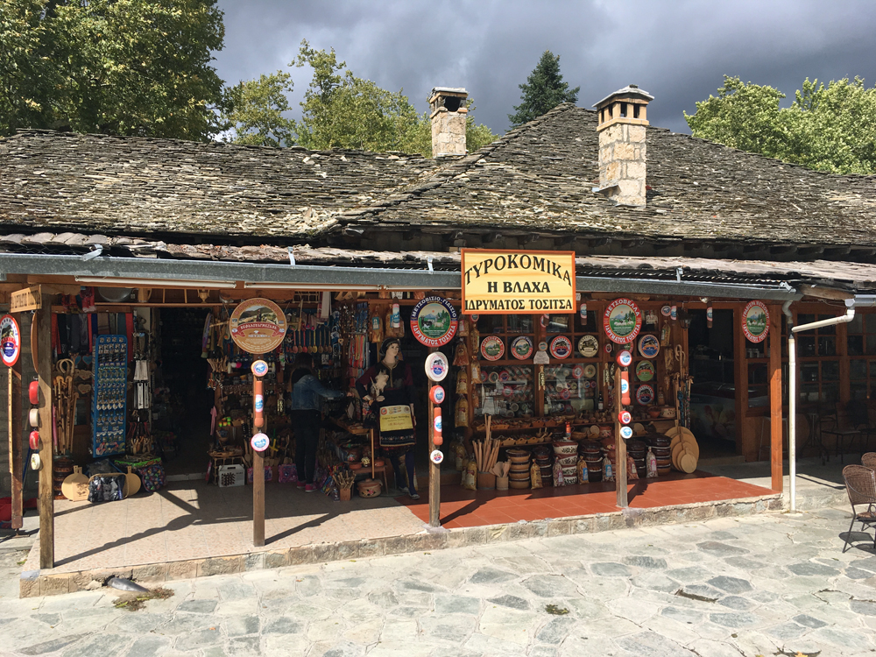
1- Authenticity and Tourism
    - Authenticity is recognized as a fundamental and universal value, serving as a key motivator for tourists to explore distant destinations and immerse themselves in experiences from different time-periods.
    - Authenticity can be defined as the quality of being
    "authentic," embodying what is "real" and "genuine”.
    - The concept of "genuineness" encompasses qualities
    such as the "real thing," "legitimacy," and "believability."
    - The meaning of "authentic" also extends to terms such
    as "veritable," "reliable," "original," and "unquestionable.

Slide 4
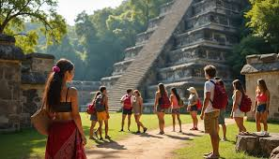
1- Authenticity and Tourism
    -Authenticity can be understood through different dimensions:
    - The objective (real).
    - The constructive (socio-political).
    - The existential (phenomenological).
      - The objective (real):
    - From the objective perspective, authenticity
    is seen as a scientific or historical "artifact,”
    meaning the original or, at the very least, a
    flawless imitation of it.
    - Authenticity exists independently of the tourist,
    being an inherent characteristic found within an
    object, such as a product, event, culture, relic,
    or place.

Slide 5
1- Authenticity and Tourism
    The constructive (socio-political):
    - Subjective constructivism using authenticity, emphasizes a mutual meaning-making process, where tourists actively construct their own interpretations in interaction with various environmental factors.
    - In such context, authenticity is experienced as something beyond an object.
    - Constructive authenticity, therefore, becomes a negotiable, contextual, and flexible judgment or evaluation, leading to diverse and multidimensional interpretations.
    The existential (phenomenological):
    - Authenticity is often associated with the local area (place of origin) as tourists are driven by the desire to experience a culture different from their own.
    - They seek "the real" or "the authentic" as a contrast to the artificial and unnatural aspects of everyday life.

Slide 6
1- Authenticity and Tourism
      Staged Authenticity:
    - Staged authenticity refers to carefully curated displays that are designed to appear as an entry into a genuine, behind-the-scenes world, when in reality, they are contrived front-stage performances.
    - This staging is often carried out for purposes such as generating revenue, sometimes referred to as "mining the tourists," and enhancing the "morbid appeal" of such sites.
    - So, it can be argued that staged authenticity refers to the idea that certain tourism experiences or cultural representations are deliberately crafted or "staged" for tourists, often to meet their expectations of what is authentic

Slide 7
2- Tourism Typologies
      2.1- Cultural Tourism:
    - The concept of past and present suggests that cultural tourism encompasses both the history and heritage of a place and its people, as well as their contemporary way of life.
    - It can be defined as “The movement of persons to cultural manifestations away from their normal place of residence, with the intention to gather new information and experiences to satisfy their cultural needs”.
    - Also, the World Tourism Organization (UNTWO) has defined cultural tourism as:
    “A type of tourism activity in which the visitor’s essential motivation is to learn, discover, experience and consume the tangible and intangible cultural attractions/products in a tourism destination. These attractions/products relate to a set of distinctive material, intellectual, spiritual and emotional features of a society that encompasses arts and architecture, historical and cultural heritage, culinary heritage, literature, music, creative industries and the living cultures with their lifestyles, value systems, beliefs and traditions

Slide 8
2- Tourism Typologies
      2.1- Cultural Tourism:
      Tourists can be categorized into three groups based on their engagement with cultural experiences:
      - culturally motivated,
      - culturally inspired,
      - culturally attracted’ tourists.
      Culturally motivated:
      - Tourists constitute a small yet highly desirable market
      segment.
    - These travelers are primarily drawn to a destination for
    its cultural offerings and are typically high-income
    visitors who spend multiple nights at their chosen
    location.

Slide 9
2- Tourism Typologies
      2.1- Cultural Tourism:
      Culturally inspired:
      - Tourists are attracted to internationally recognized cultural and heritage landmarks, such as Venice, Versailles, or the Alhambra in Granad.
      While some within this group may be "culturally motivated," many typically spend only brief periods at major cultural destinations and are less inclined to return to the same location, extend their stays, or explore lesser-known sites.
    Culturally attracted:
    -Tourists represent a significant day-trip market, visiting cultural attractions or attending cultural events simply because they are in the area.
    - However, the distinction between these three segments is not always clear-cut, and at different times of the year, "culturally attracted" tourists may align more with one of the other two categories of cultural tourists.

Slide 10
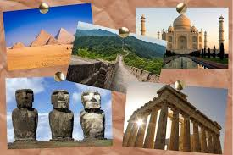
2- Tourism Typologies
    2.2- Heritage Tourism:
    - In 1972, UNESCO defined cultural heritage, focusing on monumental remains and collections with historic, artistic, or ethnological value.
    - Over time, this definition expanded to include traditions, performing arts, social practices, rituals, and knowledge related to nature. -
    - Today, cultural heritage encompasses both human
    culture and the natural environment.
    The term "cultural tourism" was introduced to describe
    travel that includes visits to both tangible and intangible
    cultural resources

Slide 11
2- Tourism Typologies
      2.2- Heritage Tourism:
      - Heritage tourism is a successful and multifaceted phenomenon that impacts various sectors, with time and location being key factors.
      - It is based on cultural and service values, providing travel experiences that meet visitors' expectations.
      - The concept brings together cultural identity and environmental significance to enhance destinations, evoking diverse emotions and meanings for different people.
      - Heritage tourism helps us understand the world around us, how we travel within it, and the connection between history, regional cultures, traditions, identities, and the places where these interactions take place. -

Slide 12
2- Tourism Typologies
    2.2- Heritage Tourism:
    - Heritage tourism focuses on interpreting and showcasing the past, often through historical landmarks, cultural traditions, and artifacts.
    -It is a subset of cultural tourism, emphasizing the connection between history and identity.
    -However, it can be complex and controversial, as the way history is represented often reflects political and ethical considerations.
    - The recognition of previously marginalized, minority, or ethnic groups in heritage narratives has brought attention to issues of inclusion and bias.
    - This politicization underscores the importance of balancing diverse perspectives in the storytelling of heritage.

Slide 13
2- Tourism Typologies
    2.2- Heritage Tourism:
    - Heritage tourism is not new; its roots trace back to ancient civilizations, like affluent Romans visiting Greek ruins for cultural enrichment.
    Medieval Pilgrimages:
    - Pilgrimages to sites like St. David's chapel or Canterbury Cathedral combined religious devotion with interest in historical events.
    The Grand Tour (17th Century):
    - Young European aristocrats traveled to classical sites, establishing a tradition of heritage-focused travel.
    Romantic Movement (18th Century):
    - The Romantic movement turned attention to distant, untouched natural landscapes, but also saw the emergence of ruins as places to be celebrated, venerated and consumed.
    -

Slide 14
2- Tourism Typologies
    2.2- Heritage Tourism:
    19th-Century Democratization:
    - In the early stages, heritage tourism was mainly accessible to the social elite. However, during the nineteenth century, it became more democratized.
    - The growing middle class began to follow in the footsteps of earlier Grand and Romantic tourists, thanks to organized tours, such as those developed by Thomas Cook
    Nation-Building and Heritage:
    - The rapid expansion of museums, known as the first museum boom, gave more people access to the past, framed by concepts like nation, class, and empire.
    - Starting in the nineteenth century, the public was encouraged to visit heritage sites as part of nation-building efforts to promote national history.

Slide 15
2- Tourism Typologies
    2.2- Heritage Tourism:
    20th-Century Growth:
    - Heritage tourism grew steadily in the early 20th century and saw a surge in the 1970s due to increased interest in the past.
    - This expansion is linked to global tourism growth post-WWII and the broader leisure boom.
    - Factors like societal alienation and uncertainty in late modernity contributed to this interest, as people sought to reconnect with an idealized past.
    - The rise of heritage tourism reflects broader changes in culture and the tourism industry, influenced by nostalgia and a reaction against modernity.

Slide 16
2- Tourism Typologies
    2.2- Heritage Tourism:
    Consumer Culture and Anti-Modernism:
    - In the 1980s, consumer culture embraced an anti-modern phase, leading to the rise of products with traditional or nostalgic themes.
    - The tourism industry responded by developing heritage attractions to meet the growing demand for experiences tied to the past, reflecting a cultural shift toward nostalgia.
    Shift to Post-Fordism:
    - Tourism transitioned from mass consumption towards more flexible and differentiated forms of tourist consumption
    - The outcome was an explosion of ‘new’ forms of tourism, sometimes referred to as niche tourism or post-mass tourism, which catered to the evolving preferences of the new middle class.

Slide 17
1- Authenticity and Tourism
      Late Modernity Context:
      - The rapid growth of heritage tourism in the 1980s ultimately became unsustainable due to an oversupply of similar attractions, leading to a decline in the sector.
      - Many heritage sites closed during the 1990s, and heritage tourism lost its popularity as new niche tourism forms emerged.
      - This shift marked the contraction of heritage tourism as a dominant travel trend. -

Slide 18
2- Tourism Typologies
      2.2- Heritage Tourism:
      The demand for heritage-based tourism stems from several factors:
      - Growing heritage awareness: People are more conscious of cultural and historical significance.
      - Expression of individuality: Engaging with historical settings allows personal expression.
      - Increased resources: Higher income, more free time, and better access to travel and cultural activities.
      - Escaping modern life: Seeking enriching experiences to balance contemporary demands.
      - Psychological continuity: Connecting with family or personal history provides a sense of stability and identity. -

Slide 19
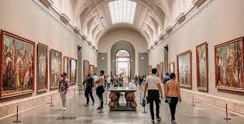

2- Tourism Typologies
      2.3- Art Tourism:
      - Art, as a broad aspect of culture, includes various creative disciplines such as visual and performing arts.
      - In the context of tourism, it brings style, culture, beauty, and a sense of continuity to life.
      - At the same time, tourism creates opportunities for new art forms to gain both financial and moral support, expanding the audience for the arts.
      - The relationship between art and tourism has been longstanding, with tourists frequently engaging with art from different centuries and cultures, and artists often traveling themselves.
      - The connection between the two has led to terms such as "arts tourists," "artists-tourists" (referring to artists as tourists), "tourists as inspiration for artists," and "tourist art."

Slide 20
2- Tourism Typologies
      2.3- Art Tourism:
      - Art tourism is a type of tourism where the primary focus of the trip is to visit art exhibitions, events, and engage with original art.
      - This includes visiting studios, artists' workshops, galleries, participating in plein-air activities, temporary "art residences" with specialized programs, and attending master classes in various art forms.
      - The goal is to familiarize tourists with the artistic life of a destination and provide opportunities for creative self-expression and engagement.
      - Art tourism can be broadly defined as; any travel activity centered around experiencing art. This includes individuals who travel specifically to view art in a particular location, as well as those who frequently or occasionally incorporate art-related visits into their broader itineraries, such as during holidays, tours, or other trips away from home.

Slide 21
2- Tourism Typologies
      2.3- Art Tourism:
      The importance of what can be termed "art tourism" has been increasing in recent years for several reasons:
      - It is closely linked to urban and regional revitalization, driven by a surge in art museum construction and the proliferation of urban festivals.
      - Art, particularly contemporary art, has become central to modern life, culture, design, creativity, and the development of cities and regions.
      - Additionally, major exhibitions, events, biennales, and festivals are gaining prominence, fueled by the widespread belief that tourism and cultural growth can significantly contribute to replacing the jobs, income, identity, and vitality lost through the decline of manufacturing, industry, and trade

Slide 22
2- Tourism Typologies
      2.3- Art Tourism:
      - Arts tourists are a key segment of cultural tourism, engaging in the "consumption of contemporary culture.”
      - These tourists, along with heritage tourists, are essential to the broader cultural tourism experience.
      - Arts tourists can be divided into two main groups based on their level of involvement with the arts in the visited destination:
      1- Arts-core tourists:
      These travelers primarily visit a destination for its arts. They include:
      Primary arts-related tourists: Whose main purpose is to attend a performance.
      Multi-primary arts-related tourists: For whom the arts are a significant part of the visit, but there are other reasons for their travel.

Slide 23
2- Tourism Typologies
      2.3- Art Tourism:
      2-Arts-peripheral tourists:
      These travelers visit a destination for non-arts-related reasons but engage with the arts during their stay. They are classified as:
      - Incidental arts-related tourists: Whose main reason for visiting is not the arts, but they decide to attend a performance before arrival.
      - Accidental arts-related tourists: Who have no prior interest in attending a performance and make the decision to do so after arriving.

Slide 24

2- Tourism Typologies
      2.4- Rural Tourism:
      - While rural tourism may have limited importance on a larger scale, it can significantly impact the development of specific rural areas.
      - The multiplier effect tends to be stronger in these regions, as the appeal of the rural lifestyle often boosts demand for local products.
      - Moreover, tourists visiting these areas can boost their appeal in the eyes of the local community, fostering pride and self-esteem.
      - Therefore, if rural tourism is well-planned,
      managed, and marketed, it can greatly contribute to
      economic, social, and cultural development.
      - However, it should not be viewed as a solution to
      all the challenges faced by rural areas.

Slide 25
2- Tourism Typologies
      2.4- Rural Tourism:
      - Definitions of rural tourism are varied, spanning from encompassing “all tourism activities in a rural area” to focusing on highly specialized tourism products closely linked to “rurality,” such as “agro-tourism.
      Rural tourism units should ideally meet the following criteria:
      - Location: Situated in rural areas.
      - Functionality: Reflect the unique characteristics of rural life, including open spaces, natural resources, and traditional practices.
      - Scale: Operate on a small scale.
      - Character: Maintain a traditional character, growing organically and gradually.
      - Local Control: Managed and controlled by local people.

Slide 26
2- Tourism Typologies
      2.4- Rural Tourism:
Motivations behind the Rural Tourism:
-The appeal of rural areas for tourism and recreation is partly based on the image of "rurality"—a sense of tradition and authenticity that represents a romanticized idea of "the good old days," a simple and pure lifestyle, intact nature, and the perfect harmony between humans and their natural surroundings.
- This motive is often linked to personal family roots and the desire to visit relatives in rural areas, especially as many of these visitors have migrated to urban areas for economic and professional reasons.
- This type of tourism tends to foster a strong connection with the rural destination, which can lead to greater loyalty from visitors.

Slide 27
2- Tourism Typologies
      2.4- Rural Tourism:
      - Other reasons for visiting rural areas include recreational activities that need large, open spaces and are connected to nature.
      - Urban residents often seek to be close to nature for health and mental well-being.
      - The aesthetic value of the landscape plays a big role in drawing visitors, as it offers a peaceful and attractive environment to reconnect with nature.
      - Lastly, people may be drawn to rural areas by the desire to explore new aspects of rural life and nature, as well as to try exciting new activities.
      - The desire to experience something different, away from their everyday environments, often motivates them to seek out the unique experiences that rural destinations offer.

Slide 28
2- Tourism Typologies
      2.5-Eco-Tourism:
      - The Ecotourism Society (1991) described ecotourism as “Responsible travel to natural areas which conserves the environment and sustains the well-being of the local people”.
      It is also assumed that ecotourism encompasses the appreciation of nature and the respect and engagement with traditional cultures found within natural areas.
      - Ecotourism, while small-scale, can sometimes disadvantage local and indigenous populations due to external control and exploitation of undeveloped regions.
      - Although Western influence may bring advancements, tourism expansion into remote areas often disrupts local ecosystems and cultures.
      - However, ecotourism can mitigate such impacts by promoting sustainable practices, educating locals on environmental conservation, and encouraging the use of local resources, which helps reduce economic leakage.

Slide 29
2- Tourism Typologies
      2.5-Eco-Tourism:
      - One key issue with ecotourism is the misuse of its label by tour operators, particularly in the 1990s, known as the “Decade of Ecotourism.”
      - Without an international monitoring system, some operators engaged in "greenwashing," using eco-friendly claims as marketing tactics.
      - As highlighted by Tourism Concern, this misrepresentation undermines sustainability efforts.
      - To truly achieve its goals, ecotourism must be managed with care and sensitivity, ensuring that practices align with ecological and cultural preservation rather than merely serving profit-driven interests.

Slide 30
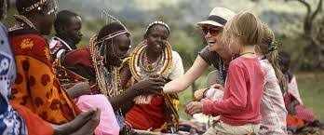
2- Tourism Typologies
      2.6- Indigenous Tourism
      - Indigenous tourism involves activities where indigenous people actively participate, either by showcasing their culture or engaging as entrepreneurs or artists.
      - Interest in indigenous tourism is driven by the unique cultural identity of the hosts, which also serves as a competitive advantage in the global tourism market.
      - An increasing number of tourists are engaging in "special interest" holidays that involve active participation in cultural activities such as painting, photography, pottery, or cookery.
      - These experiences are often set in rural areas with interesting landscapes.

Slide 31
2- Tourism Typologies
      2.6- Indigenous Tourism
      - Many of these tourists prefer staying with local families or on farms to enhance the authenticity and rusticity of their experience.
      - This trend has contributed to the rising popularity of farm tourism, or "agro-tourism," particularly in countries seeking to diversify their tourism offerings, such as Greece, Italy, Spain, and Portugal.
      - Tourism forms like ecotourism, jungle tours, hill trekking, and wildlife tourism, which once attracted small groups, have become mainstream.
      - These activities often involve interactions with local or indigenous communities, including tribal groups.
      - As a result, the environmental, social, and cultural impacts in these settings are significant and require careful management to mitigate harm and ensure sustainability.

Slide 32
2- Tourism Typologies
      2.6- Indigenous Tourism:
      - Tourism presents opportunities for Indigenous communities to increase awareness and appreciation of their intangible cultural heritage.
      - It allows individuals to reconnect, rediscover, or reinforce their identities through engagement with traditional practices, such as dance, crafts, and art.
      Revitalization of Indigenous Languages
      - Tourism can encourage the learning and preservation of Indigenous languages, which are vital to sustaining cultural identities and intangible heritage.
      - It offers a means to support the development, revitalization, and preservation of endangered languages globally, addressing a critical issue for many Indigenous communities.

Slide 33
2- Tourism Typologies
      2.6- Indigenous Tourism:
      - Additionally, the value of indigenous peoples' traditional lands is increasing due to the scarcity of unspoiled landscapes.
      - However, widespread cultural tourism significantly impacts indigenous societies, leading to acculturation, irreversible environmental damage, and the commodification of local culture.
      - Indigenous communities face challenges similar to those experienced by other societies in this context.

Slide 34
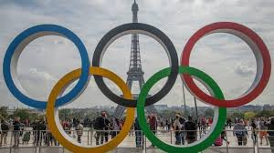
2- Tourism Typologies
      2.7- Sport Tourism:
      - sports tourism can be seen as a significant cultural, social and economic phenomenon.
      - Sport encompasses a wide range of activities, whether formal or informal, competitive or recreational, active or passive.
      - It involves individuals either as participants or spectators. Active participants engage directly in the competition or activity, while passive participants observe as spectators.
      - Some sports and activities, such as mountaineering or
      running, are often pursued individually, highlighting
      the diverse nature of sporting experiences.

Slide 35
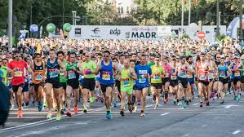
2- Tourism Typologies
      2.7- Sport Tourism:
      - Sports tourism refers to a form of tourism where individuals travel to either observe sporting events as spectators or actively participate in them.
      - These activities often include both commercial
      and non-commercial events of a competitive
      nature, offering unique travel experiences
      centered around sports.
      - Sport can also be understood as a social,
      economic, and cultural phenomenon that
      emerges from the unique interaction between
      activity, people, and place.

Slide 36
2- Tourism Typologies
      2.7- Sport Tourism:
      - Sports and tourism share a strong, complementary relationship, with sports tourism emerging as one of the fastest-growing sectors in the industry.
      - Increasingly, tourists seek sports activities during their travels, whether as the primary purpose or as an additional experience.
      - Sporting events of all types and scales attract participants and spectators alike, with destinations often incorporating unique local elements to create authentic experiences.

Slide 37
2- Tourism Typologies
      2.7- Sport Tourism:
      - Sporting events can be categorized as either multi-sport, such as the Olympic Games, or single-sport, like the FIFA World Cup.
      - These events may involve active participation for athletes and passive enjoyment for spectators.
      - Sports tourism, which is increasingly popular, encompasses travel related to various sporting events and activities.
      - It offers participants opportunities to engage in specific sports such as skiing, swimming, fishing, or hunting.

Slide 38
2- Tourism Typologies
      2.7- Sport Tourism:
      - Sports tourism also involves traveling to attend or participate in sporting events across different countries and regions.
      - This type of tourism can be further classified into professional tourism and amateur tourism.
      - Sports tourism attractions are destinations offering tourists opportunities to engage with sports-related activities and sights.
      - These attractions can be natural, such as parks, mountains, and wildlife, or manmade, including museums, stadiums, and retail stores

Slide 39

2- Tourism Typologies
      2.7- Sport Tourism:
    Mega sporting events, such as the Olympics and World Cups, can serve as powerful catalysts for tourism development, driving destination branding, infrastructure growth, and generating significant economic and social benefits when effectively managed.
    Also, sport tourism is an effective tool for addressing poverty and unemployment, increasing economic growth, and enhancing the social welfare of communities, particularly in underdeveloped nations.

Slide 40
2- Tourism Typologies
      2.8- Gastronomy and Wine Tourism:
      - Gastronomy has evolved from being a supplementary sector to tourism into a central component of destination identity, now holding a significant place in the image of many destinations.
      -Each cuisine has unique characteristics, with some local foods becoming more famous than their places of origin.
      - Culinary heritage, cuisine, and foodways are vital aspects of living cultures, especially in developing countries.
      -They reflect the geography, history, religion, and culture of a region or nation.
      -Food evokes emotions and experiences that connect people to both the past and present traditions of a community, contributing to socio-cultural identities.

Slide 41
2- Tourism Typologies
      2.8- Gastronomy and Wine Tourism:
      -There is increasing interest in food and wine tasting as tourist activities, particularly those centered on nature, rural life, and traditions tied to the land.
      - This has led to the inclusion of local ingredients, food preparation practices, and the cultural significance of cuisine in heritage tourism.
      - Gastronomy offers authentic encounters with different cultures, which is why many destinations are now creating experiences based on food and culinary traditions.
      - These experiences often involve gastronomic trails and routes, allowing tourists to taste and compare products from various regions.

Slide 42
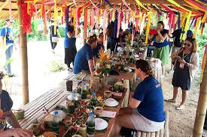
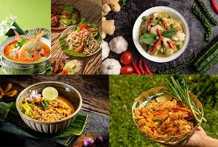
2- Tourism Typologies
      2.8- Gastronomy and Wine Tourism:
      - Experiencing local cuisines means engaging with a new culture, which is a key motivator for tourists seeking authenticity and cultural heritage.
      - Regional cuisines represent the identity, values, and social connections of a community, creating heritage meanings through traditional food supply chains that connect human geography, local landscapes, and the environment.

Slide 43

2- Tourism Typologies
      2.9- Dark Tourism:
      - Dark Tourism, sometimes referred to as Thanatourism, has been established as a specialized area of study since 1996.
      - For many years, humans have been drawn to sites and events associated with death, disaster, suffering, violence, and killing.
      - Locations linked to these themes often exert a dark fascination on visitors and are frequently connected to crime scenes and both lawful and unlawful acts.
      - Dark tourism is a broad term that encompasses the phenomenon of visiting sites linked to mass killings, genocide, and death.

Slide 44
2- Tourism Typologies
      2.9- Dark Tourism:
      - The way in which society interprets or overlooks these sites is influenced by a mix of ideologies, commercial interests, political agendas, and social acceptability.
      - Dark tourism refers to visiting sites associated with death, tragedy, or historical atrocities.
      - These locations, such as concentration camps, massacre sites, battlefields, or cemeteries, serve as memorials to past events.
      - Unlike entertainment-focused attractions, dark tourism often has an educational and reflective purpose.

Slide 45


2- Tourism Typologies
      2.9- Dark Tourism:
      -Tourism and death share a curious relationship.
      - While death and acts of mass killing typically serve as deterrents to the development of certain destinations, in other cases, these events become the primary reason for visitation.
      - Dark tourism sites related to crime have been identified as significant attractions, with the connection between crime and its ability to draw visitors encouraging them to engage with memories of death, trauma, or suffering.

Slide 46
2- Tourism Typologies
      2.9- Dark Tourism:
      Dark tourism activities can be categorized into five possible types:
      -Witnessing public enactments of death:
      - Observing events or rituals that depict death in a public setting.
      Witnessing re-enactments of death:
      Viewing dramatized or recreated events involving death, such as historical battle re-enactments.
      Visiting sites of individual or mass deaths:
      - Traveling to locations where deaths have occurred, such as battlefields or disaster sites.

Slide 47
2- Tourism Typologies
      2.9- Dark Tourism:
      Seeing symbolic representations of death:
      - Observing art, exhibits, or symbols that depict or represent death.
      Visiting memorials or internment sites:
      - Traveling to locations like cemeteries, memorials, or sites dedicated to remembering the deceased.
      - Dark tourism attractions reflect both demand and serve as sites of commemoration, historical reference, and narrative legacies.

Slide 48
2- Tourism Typologies
      2.9- Dark Tourism:
      -These destinations often become some of the few remaining elements that honor victims and preserve their testimonies. In such contexts, the content and the interpretation of these narratives are crucial for understanding a shared past.
      - In the modern world, education and the learning experience are often used to justify and explain the motivations behind the development and visitation of such sites.
      - The concept of travel as an educational journey to new and unexplored destinations is commonly associated with discussions of modernity.
      - More recently, advancements in communications technology, reporting, and real-time communication have amplified awareness of 'dark' destinations, making them more accessible and prominent to potential visitors.

Slide 49

3- The Advantages and Disadvantages of the Tourism Movement
      The Positive Socio-Cultural Impact of Tourism:
      - Stimulus for Conservation and Heritage Preservation: Tourism can provide funding for preserving natural environments and cultural heritage.
      - Renewal of Cultural Pride: Tourism can help revive local traditions and foster pride in cultural identity.
      - Revitalization of Customs and Traditions: Tourism can encourage the continuation of cultural practices.
      - Cross-Cultural Exchange and Integration: Tourism facilitates interaction between different cultures, promoting understanding and integration.

Slide 50
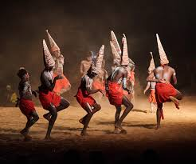
3- The Advantages and Disadvantages of the Tourism Movement
      The Negative Socio-Cultural Impact of Tourism
      Influence on Traditions and Customs:
      - Tourism predominantly affects the traditions, customs,
      and values of indigenous societies rather than tourists.
      - Local communities are constantly exposed to changing
      visitors, while tourists often shift destinations.
      - Even seasonal or intermittent tourism has long-term
      effects on the social and cultural fabric of host societies.

Slide 51
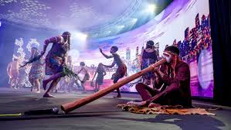
3- The Advantages and Disadvantages of the Tourism Movement
      The Negative Socio-Cultural Impact of Tourism
      Cultural Drift and Demonstration Effect:
      - Seasonal tourism in countries like Greece and Turkey leads to cultural drift, where locals temporarily adapt their behavior to tourists but revert after the season ends.
      - The demonstration effect encourages locals to adopt tourists' languages, foods, fashions, and entertainment preferences, contributing to cultural homogenization.

Slide 52
3- The Advantages and Disadvantages of the Tourism Movement
      The Negative Socio-Cultural Impact of Tourism
      Inter-Generational and Gender Conflicts:
      - Strictly religious, patriarchal, or close-knit societies face challenges like inter-generational conflicts, with younger generations embracing global lifestyles and older ones preserving traditions.
      - Women's roles may shift, empowering them in some cases but causing conflict in patriarchal societies, particularly when women become the primary breadwinners.

Slide 53

3- The Advantages and Disadvantages of the Tourism Movement
      The Negative Socio-Cultural Impact of Tourism
      The Commodification of Culture
      - Many tourists, including long-term backpackers, develop a preference for Western-style comforts such as fast food, alcohol, and brand-name products.
      - This demand forces destinations to cater to tourists’ tastes, often at the expense of local goods and services.
      - Excessive demand for local products may lead to mass production, which can commodify and commercialize local culture.

Slide 54
3- The Advantages and Disadvantages of the Tourism Movement
      The Negative Socio-Cultural Impact of Tourism:
      Tourist Demand for Traditional Events and 'Staged Authenticity':
      - Tourists often seek to participate in or spectate traditional activities and events, creating tension between preserving the authenticity of these practices and commercializing them for tourism.
      - Many traditional events and rituals are performed outside their original cultural context for tourists, leading to "staged authenticity."
      - While authenticity matters to tourists, it is more important that local communities are comfortable with their role as performers and entertainers.
      - Some religious or spiritual practices may not be suitable for tourist entertainment and should be respected for their cultural and spiritual significance.
      - The local community's willingness to commodify their culture for tourism purposes varies, and not all communities may feel comfortable with this process

Slide 55
3- The Advantages and Disadvantages of the Tourism Movement
      Mechanisms of Cultural Change
      - Permanent cultural changes are more likely to occur when tourism becomes a continuous and deeply integrated part of the local economy and society.
      - Tourism is just one of several factors that contribute to changes in the social and cultural fabric through:
      Cultural Drift:
      - Temporary changes in locals' behavior while interacting with tourists, disappearing once tourists leave.
      - Typically observed in seasonal tourism settings.
      Acculturation:
      - Permanent cultural shifts passed down generations, often occurring in non-seasonal tourism where the influence is pervasive and locals are receptive.

Slide 56
3- The Advantages and Disadvantages of the Tourism Movement
      The Economic Impacts of Tourism
      The Positive Economic Impacts of Tourism
      - Improved Standard of Living: Tourism offers populations better living standards by boosting local economies.
      - Creation of Employment: Tourism creates jobs in various sectors.
      - Foreign Exchange Earnings: Tourism brings in money from visitors, boosting the economy.
      - Expansion of Other Economic Sectors: Tourism can stimulate growth in other sectors, like agriculture, retail, and services.
      - Infrastructural Development: Tourism can lead to improved infrastructure such as roads, airports, and public facilities.

Slide 57
3- The Advantages and Disadvantages of the Tourism Movement
      The Negative Economic Impacts of Tourism
      Economic Leakages and Imported Goods:
      - Catering to Western-style preferences can lead to economic leakages, as profits often flow to foreign companies instead of staying within the local economy.
      - Tourists tend to demand Western-style amenities, particularly in large hotel chains and all-inclusive resorts, increasing the reliance on imported goods and services.
      - In small island economies like the Caribbean or South Pacific, inter-island linkages can be strengthened, but there remains a significant need to import goods, contributing to economic leakages.

Slide 58
3- The Advantages and Disadvantages of the Tourism Movement
      The Negative Economic Impacts of Tourism
      Threat to Local Products and Commodification:
      - As locals adopt Western-style products, traditional goods may decline or disappear, weakening local industries.
      - Excessive tourist demand for local products can lead to mass production, which risks commodifying and commercializing local culture.
      Tourism as a 'Quick Fix' Solution and Neglect of Local Needs:
      - Governments often view tourism as a quick solution to economic challenges, aiming to elevate their global standing and attract foreign investment.
      - This emphasis on rapidly increasing visitor numbers can lead to the neglect of environmental, socio-cultural impacts, and local community needs, as national agendas take precedence.

Slide 59
3- The Advantages and Disadvantages of the Tourism Movement
      The Negative Economic Impacts of Tourism
      Loss of Control and External Investment:
      - Governments may hand over control of tourism development to international consultants and agencies, relying on their expertise.
      - In poverty-stricken areas, foreign investment becomes appealing, but local entrepreneurs may struggle to afford inflated land and property prices, increasing dependence on external capital.

Slide 60
Thank you
      European Institute of Innovation, Entrepreneurship and Technology
      Lessingstraße 79,
      13158 Berlin, Germany
      Phone: +49 176 55524449
      Email: info@eiiet.com
Discover the world of eiIET

