Slide 1
Sustainable and Eco-Friendly Practices in Hotels
European Institute of Innovation, Entrepreneurship and Technology
Lessingstraße 79, 13158 Berlin, Germany
Presenter Vaibhav Sai Sri| Berlin
      Lessingstraße 79,
      13158 Berlin, Germany
      Phone: +49 30 233618555
      Fax: +49 30 233618556
      Email: info@eiiet.com

Slide 2

Index
Introduction to Sustainability in Hospitality
Importance of Sustainable Practices
Key Areas of Focus for Eco-Friendly Hotels
Energy Conservation Initiatives
Waste Management Strategies
Water Conservation in Hotels
Sustainable Construction and Design
Economic and Social Impact of Sustainability
Challenges in Adopting Sustainable Practices
Case Studies: Leading Green Hotels
Future Trends in Sustainable Hospitality
Conclusion

Slide 3
Introduction to Sustainability in Hospitality
Definition:
    Integration of eco-friendly practices into hotel operations.
Evolution:
    From luxury amenities to sustainable value.
Goals:
    Reduce carbon footprint, conserve resources, and promote eco-tourism.
Example:
    Carbon-neutral stays as a selling point.

Slide 4
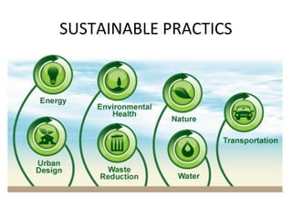
Importance of Sustainable Practices
Environmental Protection:
    Mitigating climate change and resource depletion.
Cost Efficiency:
    Lower operational costs through energy-saving measures.
Brand Reputation:
    Aligning with eco-conscious traveller values.
Regulatory Compliance:
    Meeting government sustainability mandates

Slide 5
Key Areas of Focus for Eco-Friendly Hotels
Energy Efficiency:
    Use of renewable energy sources.
Waste Reduction:
    Recycling and waste management programs.
Water Efficiency:
    Smart water usage and rainwater harvesting.
Local Sourcing:
    Supporting local suppliers for food and materials.

Slide 6
Energy Conservation Initiatives
Solar Panels:
    Renewable energy for operations.
LED Lighting:
    Reducing electricity consumption.
Smart Systems:
    AI for temperature and energy control.

Slide 7
Waste Management Strategies
Zero-Waste Programs:
    Reducing waste sent to landfills.
Composting:
    Organic waste management for gardens.
Recycling Initiatives:
    Segregation and reuse of materials

Slide 8
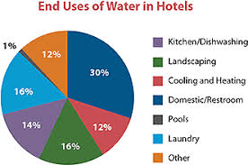
Water Conservation in Hotels
Low-Flow Fixtures:
    Faucets, showers, and toilets.
Water Recycling:
    Treating and reusing wastewater.
Rainwater Harvesting:
    Collecting water for landscaping.
Example:
    Marriott’s 20% water usage reduction program.

Slide 9
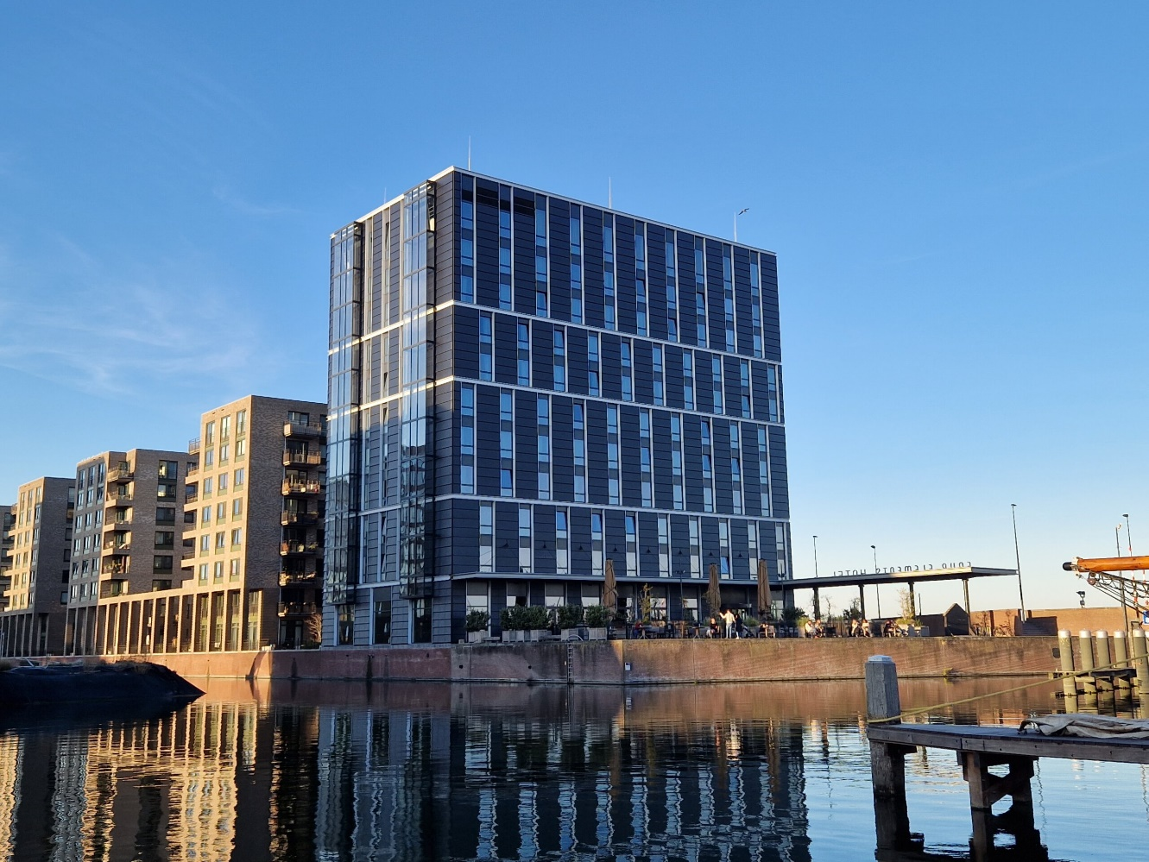
Sustainable Construction and Design
Green Building Certifications:
    LEED, BREEAM.
Eco-Friendly Materials:
    Bamboo, recycled glass.
Smart Building Technologies:
    Efficient energy and water systems.
Example:
    A zero-energy hotel in Amsterdam.

Slide 10

Challenges in Adopting Sustainable Practices
High Initial Costs:
    Investment in technology and infrastructure.
Lack of Awareness:
    Among staff and guests.
Operational Complexity:
    Managing sustainable initiatives.
Government Policies:
    Variations in regulations worldwide.

Slide 11

Case Studies: Leading Green Hotels
Six Senses:
    Integrating wellness and sustainability.
Hilton’s LightStay Program:
    Tracking environmental performance.
The Green House Hotel:
    100% sustainable practices.

Slide 12
Future Trends in Sustainable Hospitality
Carbon-Neutral Hotels:
    The rise of climate-positive initiatives.
Eco-Luxury:
    Combining opulence with sustainability.
Smart Technologies:
    AI-driven efficiency in operations.
Partnerships:
    Collaboration with local communities for sustainability.

Slide 13
Conclusion
    Sustainable practices in hotels reduce environmental impact and operational costs.
    Energy, water, and waste management are key focus areas for eco-friendly hospitality.
    Challenges like high initial costs can be overcome with innovation and commitment.
    Sustainable hotels enhance brand reputation and attract eco-conscious travelers.
    A greener hospitality industry is achievable through collaboration and action.

Slide 14
Thank you
      European Institute of Innovation, Entrepreneurship and Technology
      Lessingstraße 79,
      13158 Berlin, Germany
      Phone: +49 176 55524449
      Email: info@eiiet.com
Discover the world of eiIET

