Slide 1

Culturally adaptive meal planning for international tourists: Enhancing global hospitality through nutrients
Monika
DE240057
European Institute of Innovation, Entrepreneurship, and Technology

Slide 2
Global eco-tourism trend
Due to tourists' desire for genuine, sustainable encounters with nature and culture, ecotourism is expanding quickly.
In eco-tourism destinations, travelers place a high value on cultural immersion, ethical behavior, and well-being.
The significance of inclusive and culturally aware meal preparation
It's necessary to accommodate a variety of dietary requirements, such as vegan, diabetic, gluten-free, and religious.
Cultural respect, safety, and guest satisfaction are all improved by inclusive meal planning.
Food fosters trust and has a big impact on the entire trip.
Create meal plans for foreign visitors to ecotourism destinations that are culturally sensitive.
Discuss meal customization, nutrition, and sourcing issues.
Give your local hospitality partners communication templates.
Maintain cultural and health norms while increasing visitor satisfaction.
Significance
Goal

Slide 3

Dietary Needs
A vegan abstains from all animal products, such as dairy, eggs, and meat. requires careful planning to guarantee that there is an adequate supply of calcium, iron, B12, and protein. frequently motivated by health, environmental, or ethical considerations.
Meals low in sugar and refined carbohydrates are necessary for diabetics to control their blood glucose levels. For energy control, a diet rich in fiber, protein, and healthy fats must be balanced.
Gluten-free: Steers clear of barley, rye, and wheat. vital for people with gluten sensitivity or celiac disease. Prevention of cross-contamination is essential.
Halal, which is allowed by Islamic law, and Kosher, which is required by Jewish dietary law, are examples of religious restrictions. Food sources, ingredients, and preparation techniques must adhere to religious regulations.

Slide 4
Destination Overview
First destination: Kyoto, Japan
culinary culture centered on the use of fresh, in-season ingredients and their presentation (e.g., kaiseki).
Challenges: Traditional cuisine has few vegan and gluten-free options.
Tourists: Many Asian and Western tourists with a range of dietary requirements.
Second destination: Morocco's Marrakech
Traditional dishes like couscous and tagines are part of a rich, spicy cuisine.
Challenges: It is simple to ensure halal compliance, but vegan and diabetic options need to be modified.
Visitors: Mostly Middle Eastern and European tourists with dietary requirements related to their health and religion.
Third destination: Cusco, Peru
Meat-based dishes, potatoes, and quinoa are all part of Andean cuisine.
Challenges: Limited knowledge of gluten-free cooking in local kitchens; altitude affects digestion.
Travelers: Adventure and eco-tourists have a strong need for wholesome, flexible meals.

Slide 5
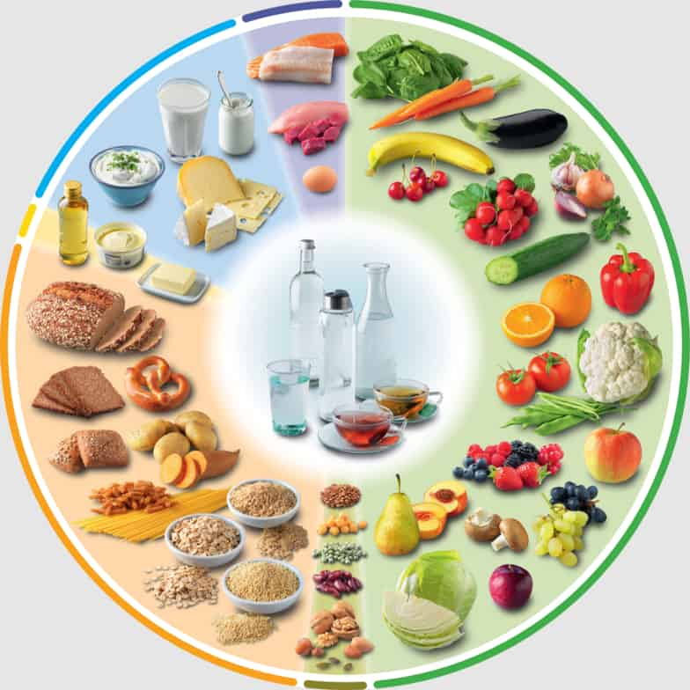
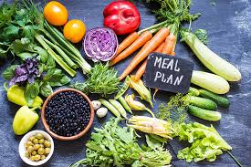
Meals for Vegans:
Vegetable sushi, grilled eggplant with soba noodles, and miso soup with tofu and seaweed.
Put an emphasis on seasonal, plant-based ingredients.
Diabetic Foods:
Steamed veggies, grilled fish, brown rice, and sugar-free condiments.
a focus on portion control and foods with a low glycemic index.
Meals Without Gluten:
Replace rice, buckwheat, and soy sauce with tamari.
Steer clear of hidden gluten in broths and sauces.
Highlights of Nutrition:
complies with WHO recommendations for balanced protein, fiber, and healthy fats.
lower levels of sugar and sodium.
Cultural and Sourcing Difficulties:
limited labeling for gluten-free products.
There may be hidden animal products in traditional recipes.
Communication barriers with local food vendors.
K
Y
O
T
O
J
A
P
A
N
M
E
A
L
P
L
A
N

Slide 6
M
A
R
R
A
K
E
C
H
M
O
R
O
C
C
O
M P
E L
A A
L N
Meals for Vegans:
Lentil soup, chickpea and vegetable tagine, and couscous cooked in vegetable broth with almonds and raisins.
Steer clear of meat-based stocks and ghee.
Diabetic Foods:
Cucumber and tomato salad, grilled chicken skewers, and herbed quinoa.
Turmeric and cinnamon are used to naturally control blood sugar.
Meals Without Gluten:
Lamb stew (thickened with chickpea flour), roasted vegetables, and millet or rice-based substitutes for couscous.
Highlights of Nutrition:
rich in antioxidants and fiber from vegetables, legumes, and spices.
in accordance with WHO dietary guidelines.
Cultural and Sourcing Difficulties:
Meat-centered customs may clash with vegan requests.
Locally, gluten-free alternatives are uncommon.
In street food and spice markets, clear labeling is uncommon.

Slide 7
C
U
S
C
O
P
E
R
U
M
E
A
L
P
L
A
N
Vegan Dishes:
Avocado-topped quinoa salad, Andean herb-infused potato stew, and sautéed indigenous vegetables.
protein that comes from quinoa and legumes.
Diabetes Meals:
quinoa pilaf, steamed yucca, grilled trout, and herbal tea.
a focus on meals that are high in fiber and low in sugar to manage energy levels at high elevations.
Gluten-Free Recipes:
The emphasis is on naturally gluten-free staples like corn, potatoes, and quinoa.
Steer clear of snacks and sauces made of wheat.
Highlights of nutrition:
Rich in vital minerals, complex carbohydrates, and antioxidants.
appropriate for high-energy travelers and WHO-compliant.
Challenges in Sourcing and Culture:
Few people are aware of gluten-free foods.
Because altitude alters digestion, lighter meal options are necessary.
Specialized ingredients might be scarce in rural kitchens.

Slide 8
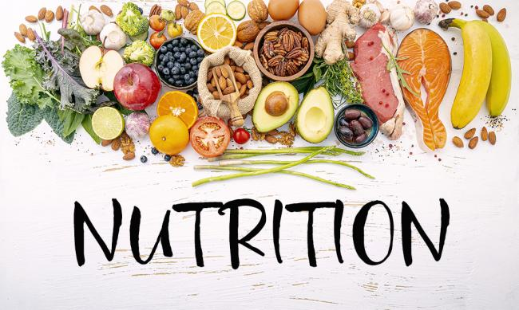
Nutrition and Health Considerations
aligns with the balanced nutrition dietary guidelines set forth by the WHO.
focuses on diabetic-safe ingredients, protein for vegans, and calorie restriction.
focuses on dietary intake of macro and micronutrients and awareness of allergens.
Encourages the use of safe and hygienic food preparation techniques.
Encourages dietary variety for the general well-being and contentment of visitors.

Slide 9

Guidelines
Suggests educating employees about food safety and hygiene.
Emphasizes accurate labeling and appropriate handling of allergens.
Promotes adaptable menus that allow for ingredient substitutions.
Encourages consideration for dietary and cultural preferences.
Intends to enhance communication between foreign visitors and kitchen employees.

Slide 10

Communication Template
Standardized dietary request forms are available in Spanish, French, and English.
Allows visitors to confidently and clearly express their dietary needs both before and during their visit.
Overcomes the language barrier that separates local hospitality staff from foreign visitors.
Improves food service precision and safety, especially for dietary restrictions and religious beliefs.
Ensures that employees are ready and encourages courteous, welcoming hospitality practices.

Slide 11
Real world case studies
Includes inclusive meal planning examples from Club Med and Marriott.
Demonstrates how international brands accommodate diets that are gluten-free, halal, vegan, and diabetic.
Displays the outcomes of employee training initiatives and menu customizations.
Demonstrates how inclusive business practices boost client loyalty and satisfaction.
Confirms that the suggested meal plans are workable and practical.

Slide 12
Challenges and solutions
Identifies typical problems:
Limitations on the sourcing of ingredients
Barriers caused by language
Risks of cross-contamination
suggests specific remedies:
Instructions for employees regarding dietary and cultural requirements
Employing multilingual staff
Using local, certified suppliers
Proposes adaptable, modular meal plans to accommodate personal tastes.
Promotes creativity and cultural awareness in ecotourism culinary tactics.

Slide 13
Recommendations
Teach employees safe preparation methods and cultural food awareness.
Create robust local supplier networks to obtain a variety of high-quality ingredients.
For clarity, use multilingual menus and communication tools.
Create food policies that are centered on nutrition and in line with WHO guidelines.
Encourage menu flexibility and customization to accommodate a variety of dietary requirements.

Slide 14
Conclusion
1. Safety, contentment, and inclusivity
The main objective is to serve inclusive, dietary restriction-safe, and satisfying meals so that all foreign visitors are made to feel valued, cared for, and fed.
2. Food as a Bridge Across Cultures
Food bridges cultural divides; inclusive meal planning promotes cross-cultural understanding through cuisine by allowing visitors to enjoy and respect local customs while also attending to their dietary requirements, whether personal or religious.
3. Experience Is Improved by Adaptive Planning
Flexible meal planning that takes into account a range of dietary requirements enhances visitor satisfaction, lowers risks, and guarantees a flawless dining experience that complies with cultural and health standards.
4. Request for Action
To provide courteous, flexible, and globally aware hospitality, tourism providers should make inclusive food practices a standard practice. This can be achieved through staff training, local partnerships, and multilingual tools.

Slide 15

References
Mahan, L. K., & Escott-Stump, S. (1984). Krause’s Food, Nutrition, & Diet Therapy. http://ci.nii.ac.jp/ncid/BA64605581
Ashkenazi, M., & Jacob-Ashkenazi, J. (2001). The essence of Japanese cuisine: an essay on food and culture. Choice Reviews Online, 38(09), 38–5002. https://doi.org/10.5860/choice.38-5002
Wittenberg, M. M. (2013). The Essential Good Food Guide: The Complete Resource for Buying and Using Whole Grains and Specialty Flours, Heirloom Fruit and Vegetables, Meat and Poultry, Seafood, and More. Ten Speed Press.
Medicine, N. a. O. S. E. A., Division, H. a. M., & Board, F. a. N. (2016). Meeting the dietary needs of older adults: Exploring the Impact of the Physical, Social, and Cultural Environment: Workshop Summary. National Academies Press.

