Slide 1
Budgeting and Forecasting in Cost Accounting
European Institute of Innovation, Entrepreneurship and Technology
Lessingstraße 79, 13158 Berlin, Germany
Presenter - Vaibhav Sai Sri| Berlin
      Lessingstraße 79,
      13158 Berlin, Germany
      Phone: +49 30 233618555
      Fax: +49 30 233618556
      Email: info@eiiet.com

Slide 2
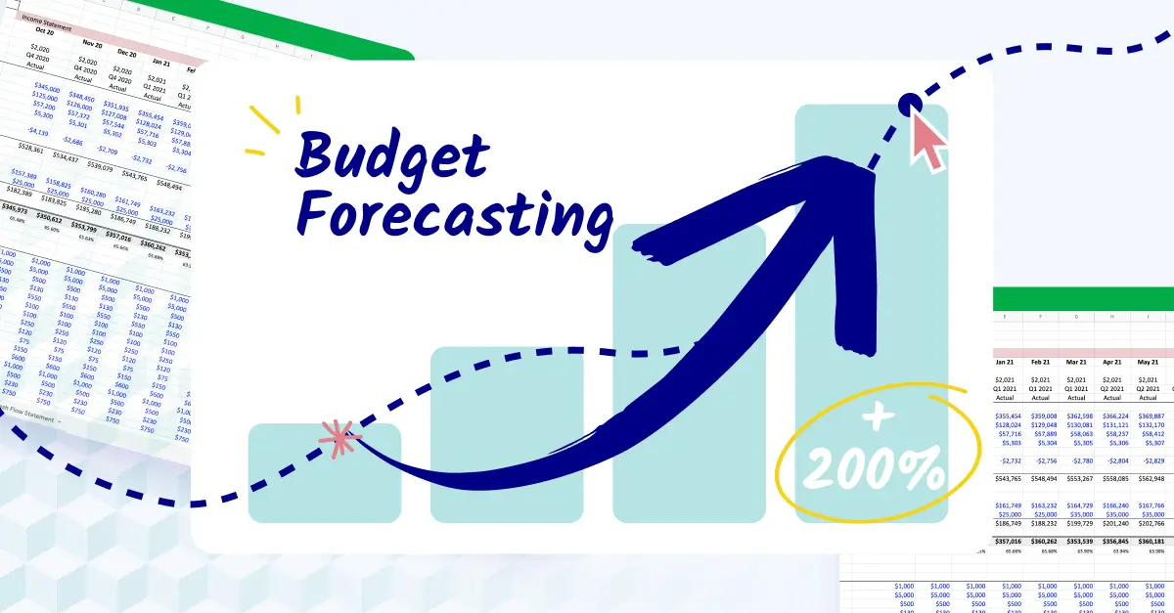
Index
Introduction to Budgeting and Forecasting
Types of Budgets
Forecasting Techniques
Linking CVP Analysis to Budgeting
Case Study 1: Manufacturing Firm
Case Study 2: Retail Business
Case Study 3: Service Industry
Interactive Activity
Conclusion

Slide 3
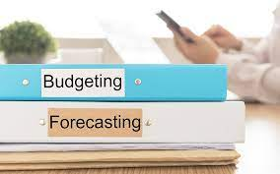
Introduction to Budgeting and Forecasting
      Definition -
Budgeting: Preparing detailed financial plans for the future.
Forecasting: Predicting future outcomes based on historical data and trends.
      Importance -
Ensures resource allocation aligns with business objectives.
Facilitates financial discipline and proactive decision-making.
      Key Differences :
      Budgets are fixed for a period.
      while forecasts are updated periodically.

Slide 4
Types of Budgets
Operational Budgets :
Focus on day-to-day activities.
Examples: Sales budgets, production budgets.
      Financial Budgets:
Cover broader financial planning.
Examples: Cash flow budgets, capital expenditure budgets.
      Static vs. Flexible Budgets:
Static: Fixed numbers regardless of actual performance.
Flexible: Adjusts for variations in activity levels.

Slide 5
Forecasting Techniques
      Qualitative Methods -
      Expert judgment, market research, Delphi method.
      Quantitative Methods -
      Time-series analysis, regression analysis, moving averages.

Slide 6
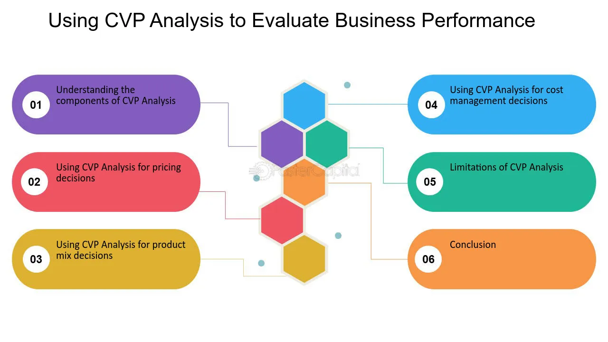
Linking CVP Analysis to Budgeting
CVP analysis provides insights into cost behaviour and profitability, forming a foundation for budgeting.
Applications:
Determining sales targets.
Planning for changes in fixed and variable costs.

Slide 7

Case Study 1: Manufacturing Firm
Scenario:
A furniture manufacturer produces tables priced at $200 each.
Fixed costs: $50,000/month.
Variable costs per table: $120.
Current production capacity: 1,000 tables/month.
Objective:
Prepare a budget to maintain operations and explore profit impacts if production increases by 20%.

Slide 8
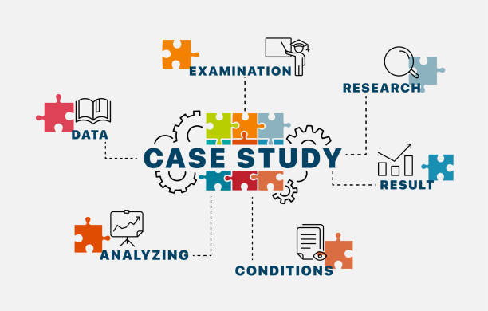
Case Study 2: Retail Business
Scenario:
A bookstore plans its annual budget with the following details:
Average sales per book: $25.
Contribution margin: 40%.
Fixed monthly costs: $8,000.
Objective:
Predict profits for a 10% increase in monthly sales and assess the impact of introducing a new product line.

Slide 9

Case Study 3: Service Industry
Scenario:
A digital marketing agency provides services at $1,000/project.
Fixed costs: $20,000/month.
Variable costs: $500/project.
Average monthly projects: 30.
Objective:
Develop a flexible budget to accommodate fluctuating demand (±20%).

Slide 10

Interactive Activity
Scenario:
A startup sells eco-friendly water bottles:
Fixed costs: $15,000/month.
Selling price: $20/bottle.
Variable cost: $12/bottle.
Tasks:
Calculate the break-even sales.
Prepare a budget for a 25% increase in sales.
Discuss strategies to reduce the break-even point.

Slide 11
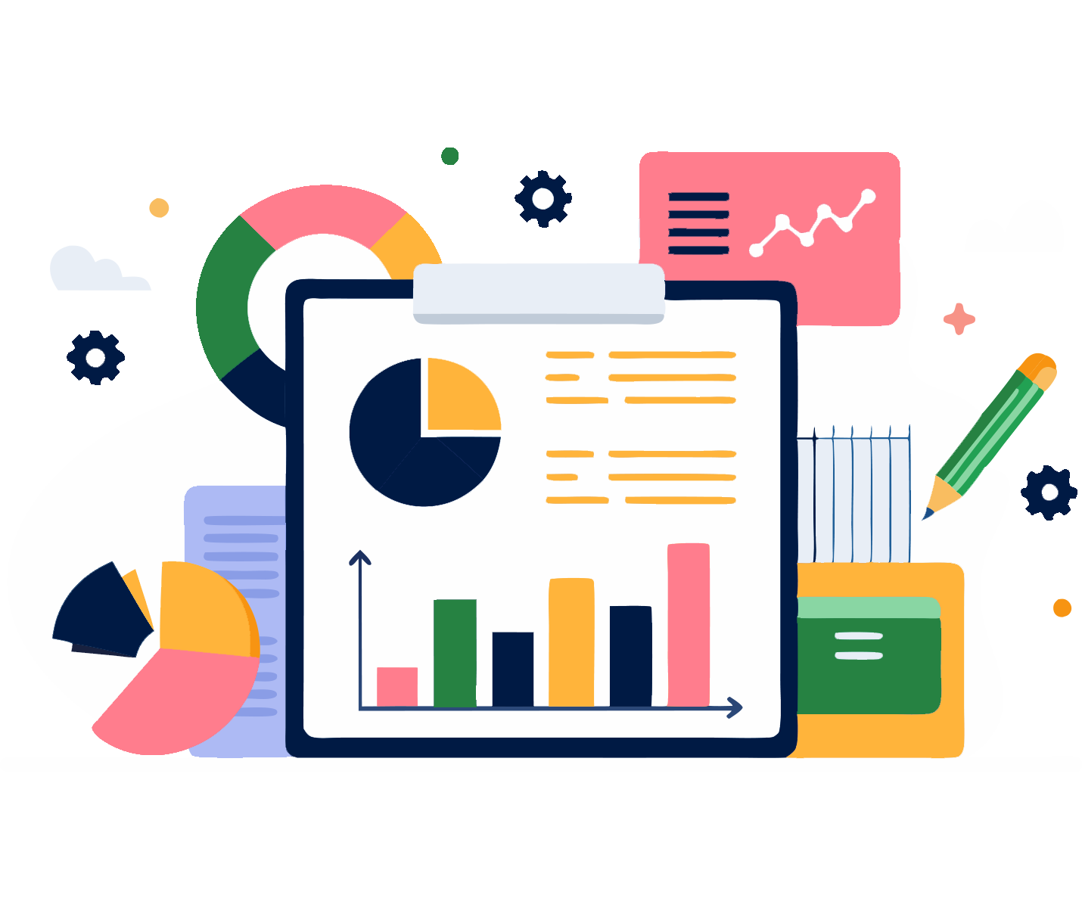
Conclusion
Budgeting and forecasting ensure informed decision-making and financial control.
Combining CVP insights with robust planning leads to enhanced profitability.
Businesses must embrace adaptability in their budgeting processes for modern challenges.

Slide 12
Thank you
      European Institute of Innovation, Entrepreneurship and Technology
      Lessingstraße 79,
      13158 Berlin, Germany
      Phone: +49 176 55524449
      Email: info@eiiet.com
Discover the world of eiIET

