Slide 1
Quality and Sustainability in Tourism and Hospitality
European Institute of Innovation, Entrepreneurship and Technology
Lessingstraße 79, 13158 Berlin, Germany
Mahmoud Abdou| Berlin
      Lessingstraße 79,
      13158 Berlin, Germany
      Phone: +49 30 233618555
      Fax: +49 30 233618556
      Email: info@eiiet.com

Slide 2
Index
Quality and the Accommodation Sector
The Gaps Model of Service Quality
Tools for Assessing Service Quality and Satisfaction

Slide 3

1 Quality and Quality and the Accommodation Sector
- The destruction of a 120-years old Andraos Palace in Luxor.

Slide 4
1- Quality and the Accommodation Sector
      - A fundamental element of both domestic and international tourism
      - Supports tourist activity by offering rest, security, and convenience
      - Exists in various forms:
      - Directly influences tourist satisfaction, length of stay, and destination choice
Hotels | resorts
Hostels Vacation rentals | Guesthouses

Slide 5
1- Quality and the Accommodation Sector
      1.1- Characteristics of the Accommodation Sector
      A- Highly Fragmented and Diverse
      - Hotels, hostels, resorts, B&Bs, vacation rentals, etc.
      Diverse in:
      - Size: From small inns to global chains
      - Style and Location: Urban, rural, beachfront, luxury, boutique
      - Ownership: Independent, franchised, chain-operated
      - Services: Vary from basic lodging to full-service luxury experiences

Slide 6
1- Quality and the Accommodation Sector
      B- Tourism accommodation is a sub-sector of the international hospitality industry
      Hospitality consists of two main services:
      - Overnight accommodation:
      For people staying away from home
      - Food and beverage services
      For people eating away from home

Slide 7
1- Quality and the Accommodation Sector
      C- Accommodation: Part of the Tourism Experience
      - Accommodation is not just a component of the tourism product, but a core part of the tourism experience
      - Goes beyond tangible elements (room, bed, meals)
      - Involves intangible aspects like:
      Service quality
      Guest comfort and satisfaction
      Personalized attention
      Atmosphere and ambiance

Slide 8
1- Quality and the Accommodation Sector
      1.2- Why Quality Management Matters in Accommodation
      Rising Industry Focus on Quality
      - The emphasis on delivering quality tourism experiences
      Service Delivery Shapes the Experience
      - Quality at the “moment of truth” is crucial to how guests perceive their stay
      Management Controls Quality
      - Despite external pressures, quality remains within managerial control
      - Highlights the need for consistent standards and training

Slide 9
1- Quality and the Accommodation Sector
      1.3- The challenges of the Accommodation Sector
      A- Investment Perspective
      High Capital Investment Required
      Return on Investment is Critical
      B - The Role of Physical Structure in Hotel Success
      Physical Environment Matters
      Not Just a Service Business
      Ongoing Investment is Essential

Slide 10
1- Quality and the Accommodation Sector
      C- Spatial Fixity of Accommodation and Need for Adaptation
      Accommodation is Spatially Fixed
      Surrounding Environments Change
      Adaptability is Crucial
      D- Cost Structure and Economic Sensitivity
      High Fixed Costs
      Revenue Must Cover Fixed and Variable Costs
      Strong Link to Economic Conditions

Slide 11
1- Quality and the Accommodation Sector
      E- Perishability and Revenue Management in Hotels
      Core Product is Perishable
      Key Management Task
      F- Branding in the Hotel Industry
      Strategic Importance
      Builds Customer Loyalty
      Drives Profitability

Slide 12
1- Quality and the Accommodation Sector
      1.4- The Role of Quality and Tourism Accommodation
      A- Quality Linked to Long-Term Success
      - Directly impacts return on investment
      - Influences market share and competitiveness
      - Quality as an Essential Ingredient
      Drives customer satisfaction and loyalty
      Supports sustainable business growth

Slide 13
1- Quality and the Accommodation Sector
      B- Accommodation’s Role in the Tourist Experience
      Tourist Experience is Multifaceted
      Comprised of tangible and intangible elements
      Some factors are uncontrollable
      Accommodation is Central
      Often a key part of holiday experiences
      Its quality and service are controllable and manageable

Slide 14
1- Quality and the Accommodation Sector
      C- Service Inseparability in Tourism Accommodation
      Inseparability Defined
      Production and consumption of services happen simultaneously
      Services are contact-dependent
      “Moment of Truth”
      The quality of service delivery at the point of interaction shapes the tourist experience
      Crucial to manage frontline staff and guest interactions

Slide 15
1- Quality and the Accommodation Sector
      1.5- Human Resources and Quality Management
      - Service Quality Culture
      Essential to build a culture focused on service quality
      Achieved through effective HR policies
      - Key HR Policies to Support Quality
Selection | Training and development
Empowerment Rewards | Teamworking

Slide 16

2- The Gaps Model of Service Quality

Slide 17

2- The Gaps Model of Service Quality
      - Identifies areas for improvement in tourism services
      - Compares customer expectations vs. perceptions
      - Provides a structured approach to evaluate satisfaction
      - Highlights where service delivery falls short
      - Supports better alignment with customer needs

Slide 18
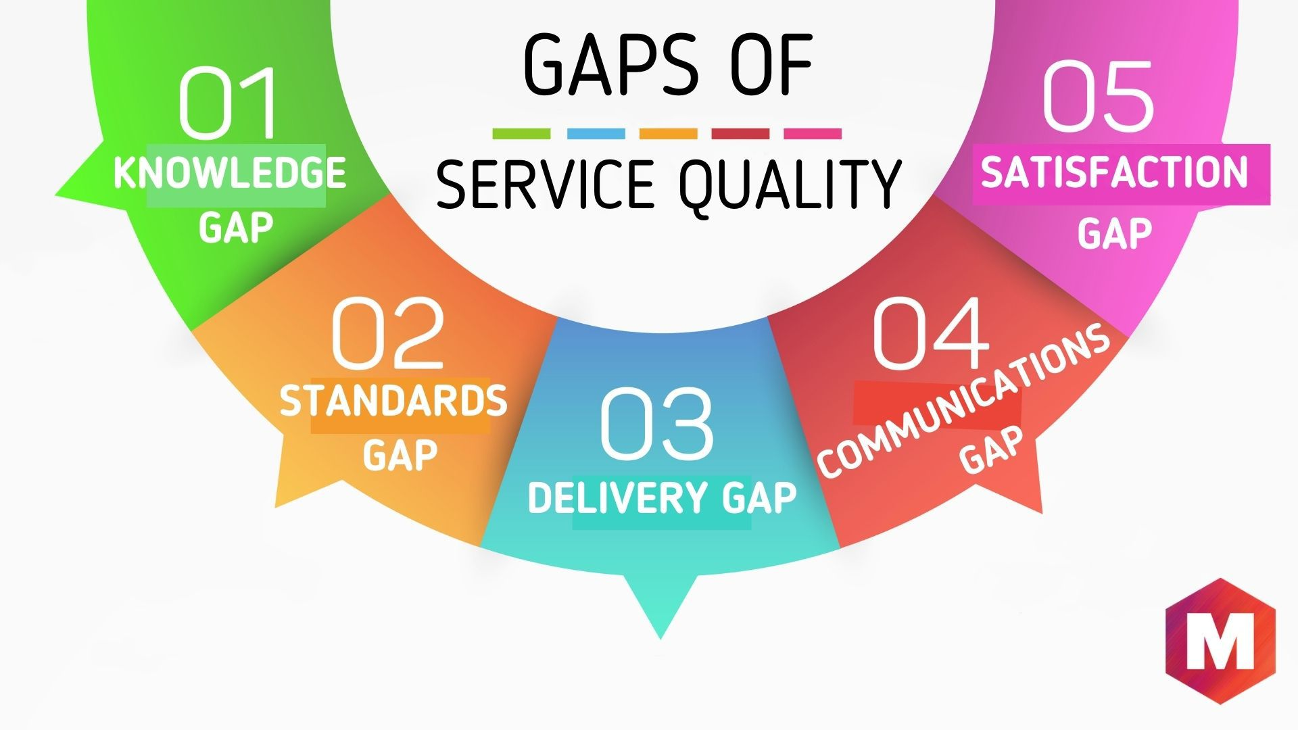
2- The Gaps Model of Service Quality
Gap 1: Customer Expectations vs. Management Perceptions
- Definition - Gap 1 occurs when there is a difference between: What customers expect from the service What management thinks customers expect - In other words: Management does not fully understand what customers want.

Slide 19
2- The Gaps Model of Service Quality
Gap 1: Customer Expectations vs. Management Perceptions
- Why does Gap 1 occur? Limited management–customer interaction Poor communication between employees and management Insufficient market research Failure to listen to customer complaints

Slide 20
2- The Gaps Model of Service Quality
Gap 1: Customer Expectations vs. Management Perceptions
- How can Gap 1 be closed? Improve market research Improve communication Listen to customer complaints Increase management–customer interaction Reduce management levels

Slide 21
2- The Gaps Model of Service Quality
Gap 2: Management Perceptions vs. Service Specifications
- Definition - Gap 2 occurs when there is a difference between: Management's understanding of customer expectations The service standards and specifications established by the organization - Meaning: Management may know what customers want but fails to translate this knowledge into clear service standards and procedures.

Slide 22
2- The Gaps Model of Service Quality
Gap 2: Management Perceptions vs. Service Specifications
- Why Does Gap 2 Occur? Lack of management commitment to service quality Lack of customer service standards Poorly defined service levels Failure to regularly update service standards

Slide 23
2- The Gaps Model of Service Quality
Gap 2: Management Perceptions vs. Service Specifications
How Can Gap 2 Be Closed? Set clear service quality goals Standardize service delivery policies Strengthen customer-centred service standards Measure staff performance Regularly review and update standards

Slide 24
2- The Gaps Model of Service Quality
Gap 3: Service Standards vs. Actual Service Delivery
- Definition - Gap 3 occurs when there is a difference between: The service standards established by management The service actually delivered by employees - In other words: The organization knows how the service should be delivered, but employees do not consistently deliver it according to the required standards.

Slide 25
2- The Gaps Model of Service Quality
Gap 3: Service Standards vs. Actual Service Delivery
Why Does Gap 3 Occur? Weak human resource policies Mismatch between supply and demand Lack of employee training Lack of teamwork Inappropriate job design

Slide 26
2- The Gaps Model of Service Quality
Gap 3: Service Standards vs. Actual Service Delivery
How Can Gap 3 Be Closed? Improve recruitment Set clear hiring standards Train and educate employees Improve employee retention Improve teamwork Empower employees

Slide 27
2- The Gaps Model of Service Quality
Gap 4: Service Delivery vs. External Communication
- Definition: - Gap 4 occurs when there is a difference between: The service actually delivered What the organization promises customers through external communication

Slide 28
2- The Gaps Model of Service Quality
Gap 4: Service Delivery vs. External Communication
- Why Does Gap 4 Occur? Overpromising Poor coordination between marketing and operations Lack of communication between departments Insufficient employee training

Slide 29
2- The Gaps Model of Service Quality
Gap 4: Service Delivery vs. External Communication
How Can Gap 4 Be Closed? Improve communication between departments Coordinate with marketing intermediaries Include employee input in promotional campaigns Manage customer expectations Ensure consistent service delivery

Slide 30
2- The Gaps Model of Service Quality
Gap 5: Customer Expectations vs. Service Perceptions
- Definition - Gap 5 is the difference between: What the customer expected What the customer actually perceived/experienced - It represents the customer's final evaluation of service quality.

Slide 31
2- The Gaps Model of Service Quality
Gap 5: Customer Expectations vs. Service Perceptions
Gap 5 can result from: Gap 1: Management does not understand customer expectations. Gap 2: Expectations are not translated into appropriate service standards. Gap 3: Employees fail to deliver according to the standards. Gap 4: Marketing promises more than the organization delivers. Customer misinterpretation: The customer misunderstands or interprets the service differently from what was intended.

Slide 32
2- The Gaps Model of Service Quality
Gap 5: Customer Expectations vs. Service Perceptions
Gap 5 can result from: Gap 1: Management does not understand customer expectations. Gap 2: Expectations are not translated into appropriate service standards. Gap 3: Employees fail to deliver according to the standards. Gap 4: Marketing promises more than the organization delivers. Customer misinterpretation: The customer misunderstands or interprets the service differently from what was intended.

Slide 33

3- Tools for Assessing Service Quality and Satisfaction

Slide 34
3- Tools for Assessing Service Quality and Satisfaction
      A- SERVQUAL Method
      - Evaluates service quality
      - Measures the gap between customer expectations and perceptions of service delivery
      - Evaluates dimensions such as reliability, responsiveness, assurance, empathy, and tangibles
      B- Importance–Performance Analysis (IPA)
      - Compares performance of service elements with their importance to customers

Slide 35
3- Tools for Assessing Service Quality and Satisfaction
      A- SERVQUAL: Usage and Components
      Usage:
      - Applied across various service sectors:
      Banks, call centers, TV repair companies
      Airlines, hotels
      Components:
      - 22 service attributes measured in a survey
      - Grouped into five key service quality dimensions:
SERVQUAL Methods
Reliability
Assurance
Tangibles
Empathy
Responsiveness

Slide 36
3- Tools for Assessing Service Quality and Satisfaction
      Reliability:
      - Consistency and dependability of service delivery
      - Employees should perform the service correctly the first time
      - Organization must honor promises:
      Accurate billing
      Timely service delivery
      Meeting other service commitments
SERVQUAL Methods
Reliability
Assurance
Tangibles
Empathy
Responsiveness

Slide 37
3- Tools for Assessing Service Quality and Satisfaction
      Assurance
      - Employees’ knowledge and courtesy
      - Ability to convey trustworthiness and instill confidence in customers
      Tangibles
      - Physical aspects of the service
      - Examples:
      Hotel rooms and facilities
      Staff uniforms and presentation
      Organizational materials: brochures, frequent-guest cards
SERVQUAL Methods
Reliability
Assurance
Tangibles
Empathy
Responsiveness

Slide 38
3- Tools for Assessing Service Quality and Satisfaction
      Empathy
      - Providing caring, individual attention to customers
      - Treat consumers as individuals
      - Examples:
      Addressing customers by name
      Remembering preferences and interests
SERVQUAL Methods
Reliability
Assurance
Tangibles
Empathy
Responsiveness

Slide 39
3- Tools for Assessing Service Quality and Satisfaction
      Responsiveness
      - Prompt service delivery
      - Staff are willing and ready to assist customers
      - Examples:
      Responding to requests quickly
      Handling problems and queries efficiently
SERVQUAL Methods
Reliability
Assurance
Tangibles
Empathy
Responsiveness

Slide 40
3- Tools for Assessing Service Quality and Satisfaction
      SERVQUAL Survey and Gap Analysis
      - Customers rate two aspects for each service dimension:
      Expected Service:
      - What customers expect from an excellent company
      Perceived Service:
      - How they perceive the actual service delivered
      - Differences between expected and perceived service reveal service quality gaps

Slide 41
3- Tools for Assessing Service Quality and Satisfaction
      - Example in a Hotel Setting:
Attribute | Expectation (1–10) | Perception (1-10) | Gap
Clean and comfortable room | 10 | 7 | -3
Staff are polite and helpful | 9 | 8 | -1
Prompt check-in | 10 | 10 | 0

Slide 42
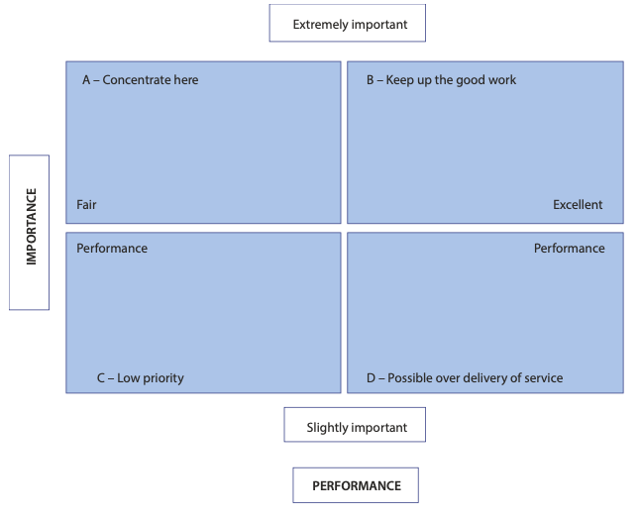
3- Tools for Assessing Service Quality and Satisfaction
      Importance–Performance Analysis (IPA)
      - Compares service performance with the
      importance of service elements to customers.
      - Helps identify areas needing improvement.

Slide 43
Thank you
      European Institute of Innovation, Entrepreneurship and Technology
      Lessingstraße 79,
      13158 Berlin, Germany
      Phone: +49 176 55524449
      Email: info@eiiet.com
Discover the world of eiIET

