Slide 1
Introduction to Financial Management
Lecturer: Mr. VSS
      European Academy of Advanced Studies
      113 Triq l-Imdina Hal Qormi,
      QRM 9016, Malta
      Email: info@eaas.mt

Slide 2
Learning Objectives
Define and articulate the scope and importance of financial management in business-aiding decisions.
Understand and describe the three principal financial statements.
Study the principal financial decisions taken in respect of investments, financing and the distribution of dividends.
Understand how financial planning, forecasting and budgeting are aimed at the corporate goals of growth and long-term stability.
Understand how financial management enhances strategic business decisions pertaining to growth, profitability, and control of risks.
Learn the unique financial management issues and opportunities in the tourism and hospitality industry.
Learn the basic techniques of financial analysis to appraise business performance, profitability and financial condition.

Slide 3
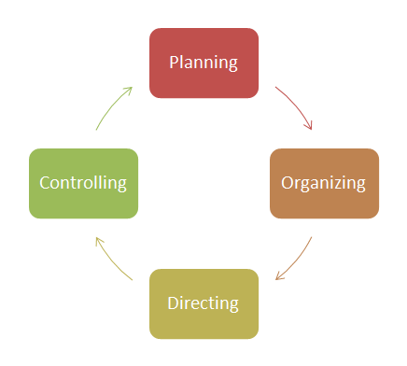
What is Financial Management (FM)?
The term financial management denotes the planning, organising, directing, and controlling of the financial facets of an organisation. It concerns the attainment of the organisation’s articulated goals and objectives.
Decision-making in financial management may pertain to investments, financing, and dividends. It aims at Optimising the utility of available resources, organising the uses and allocation of resources, and controlling the expenditure and resources to eliminate wastages.
Financial management and administration concern the management of functional and financial organisation risks. Specifically, financial management concerns the identification, assessment, and control of financial risks.

Slide 4

Role of Financial Management in Business
Budgeting: Budget and efficiently allocate financial resources.
Cost Control: Decreases cost of operations (labor, food, utilities).
Revenue Management: Employs pricing mechanisms to optimize revenues.
Cash Flow Management: Maintains with the day-to-day operations.
Investment Decisions: Invests in growth, both long-term and expansion.
Financial Analysis: Monitors results to help make better decisions.
Risk Management: Manages unpredictability (seasonality, crises)

Slide 5
Key Financial Statements
Income Statement: It communicates information on the extent to which a business has made good returns on its revenue over a specified period. It presents revenues followed by the costs and expenses incurred to derive a net profit or loss.
Key Components: It contains the Revenues, the Cost of Goods Sold (COGS) as well as Operating profit and, Strong>Net Income or Profit.
Balance Sheet: It is a consolidated presentation of a business’s assets, liabilities and equity.
Key Components: It has Assets, both current and non-current, Liabilities which comprise of short-term and long-term, as well as Shareholders’ Equity.
Cash Flow Statement: It explains the periodical inflow and outflow of cash as well as cash equivalents in a business. It breaks it down to operational, investment, and financing activities.

Slide 6
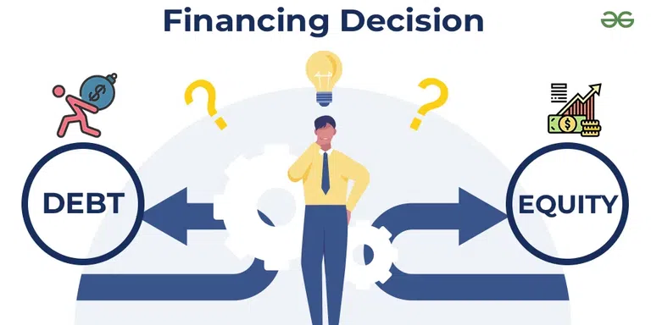
Financial Management Decisions
Investment Decisions: Long-term expansion entails the acquisition of new assets, entry into new markets, and financing new R&D activities. Expectations regarding risk and return, coupled with strategic fit, assist greatly in this regard.
Financing Decisions: Having to decide how to finance day-to-day activities of the business, be it through stock issuance, debt acquisition, or retained earnings, must be done with the proper mix of equity and debt.
Dividend Decisions: Balancing the apportionment of profits to shareholders and the reinvestment in the business is a crucial decision. This is due to the need to satisfy shareholders and ensure growth financing.

Slide 7
Key Financial Ratios for Decision-Making
Profitability Ratios: Demonstrate how profitability is generated in relation to sales, resources, and equity (i.e., Gross Profit Margin and Return on Assets) .
Liquidity Ratios: Show how short-term obligations are captured (i.e., Current Ratio and Quick Ratio) .
Leverage Ratios: Delineate how debt is leveraged to finance operations and the inherent risk involved (i.e., Debt to Equity Ratio).

Slide 8
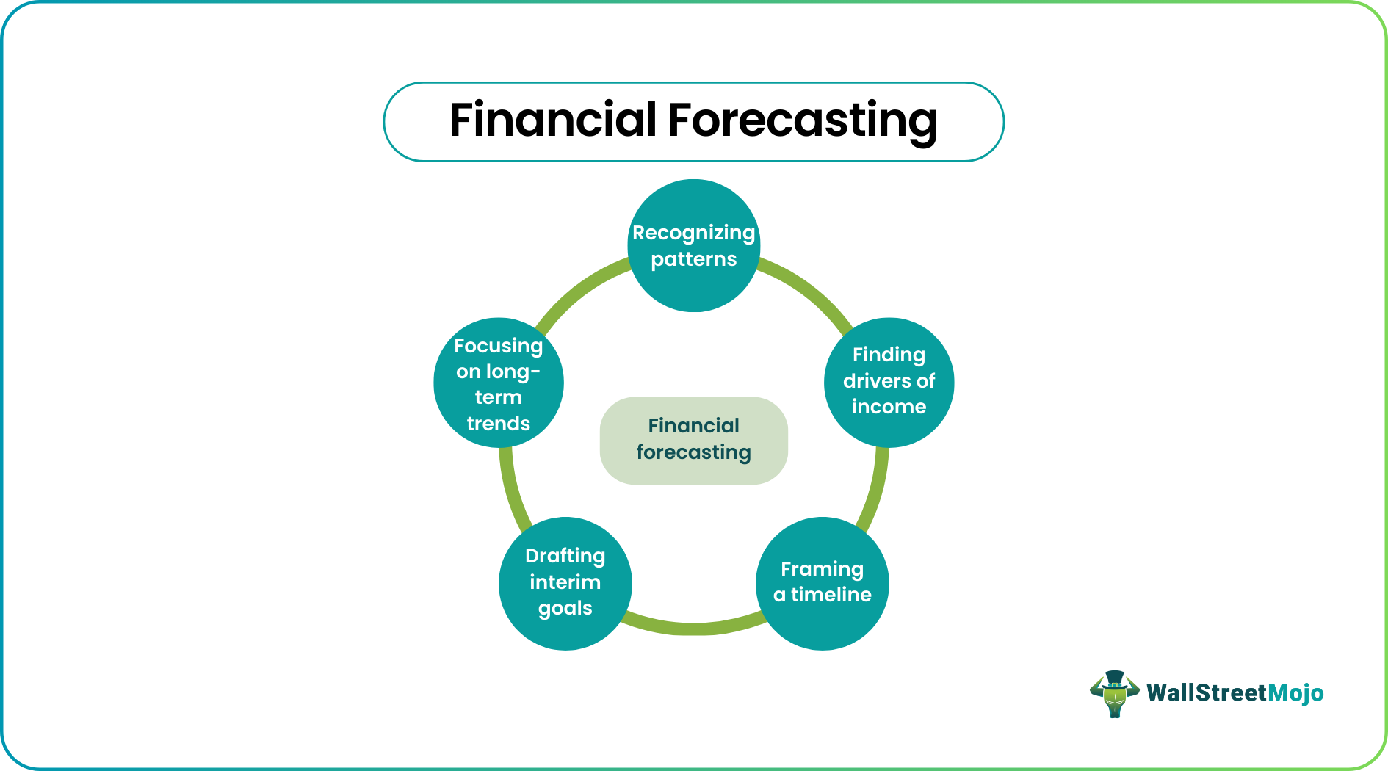
Financial Planning and Forecasting
Financial planning comprises estimating future financial results and formulating optimal approaches to meet various corporate goals.
Essential activities encompass forecasting sales and costs as well as planning for capital expenditures.
Budgets: Constitute one of the fundamental instruments in financial planning. They assist organisations in forecasting resource distributions in their budgets and maintaining financial equilibrium.
A master budget: Integrates and summarises all the subsidiary budgets (like sales, production, and cash flow budgets) and acts as an overall financial blueprint.

Slide 9
Financial Management Tools and Techniques
Budgeting : Developing financial strategies for both the immediate future and for several years down the line.
Financial Modeling: Utilising techniques in forecasting the future performance of finances.
Scenario Analysis: Assessing differing financial results generated by flexible predictive assumptions.
Sensitivity Analysis: Examining the impact of changes in crucial factors on the outcome of finances.
Breakeven Analysis: Identifying the level of revenue generated by the firm to confirm it meets the total cost needed to be covered, vital in establishing the pricing of the firm’s goods and services.

Slide 10
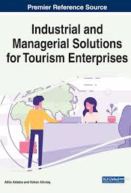
Role of Financial Management
The significance of having sound financial management in tourism and hospitality is because of the increased capital outlay and the seasonal variation of revenue.
Revenue Management: Financial managers must ensure revenue is optimised not only through dynamic pricing and cost management but also through yield management.
Capital Budgeting: Business in the tourism and hospitality industry always will have major capital investments in tourism and hospitality industries because of the building or upgrading their facilities and the financial management will help in establishing the economic viability of such investments.
Cash Flow Management: The cyclicality of the industry requires the meticulous planning and management of the inflow and outflow of cash.

Slide 11
Financial Management
Budgeting & Forecasting: Plans revenues and expenditures with seasonal demand in mind
Cost Control: Controls expenditures (food, labour, utilities) for the efficiency of the operation
Revenue Management: Applies dynamic pricing to optimise occupancy and profits
Cash Flow Management: Need to make sure we’re making our operations good day in and day out.
Investment Planning: Since it supports expansion (hotels, resorts, facilities, etc.)
Financial Analysis: Assesses performance through financial reports.
Risk Management: Manages the uncertainties (seasonality, economic fluctuations)

Slide 12

FM and Decision-Making
Financial management helps in making decisions in the tourism and hospitality industry by offering financial information to the management.
Decisions related to pricing, labor, cost management, and service development are made based on the financial data.
In the tourism industry, financial management helps in the effective management of cash flow related to the demand and supply pattern in the industry.
Financial management assists with short-term management decisions, for instance, tracking the budget expenditure based on performance measures.

Slide 13
Stakeholders and Financial Information
Stakeholders:
Owners/Shareholders – profits
Managers – decisions
Employees – wages, security
Customers – value for money
Suppliers – payments
Government – taxes
Investors/Lenders – returns, risk

Slide 14
Stakeholders and Financial Information
Financials:
Income Statement – profit/loss
Balance Sheet – the financial position
Cash Flow – movement of cash
Budgets – forecasting
Ratios – performing

Slide 15

Owners and Investors
Owners (shareholders)
The capital owners who provide the capital to begin and operate the business and take profits if the business is successful.
Desire profits and dividends
Interested in the growth of the company and the value of the company
Monitor the overall performance
Investor (Lenders/Outside Investors)
Add funds (loan or equity)
Focus on returns and risk
Assess financial strength and ability to pay
Decide using financial statements

Slide 16
Managers in Tourism and Hospitality
Roles and Responsibilities: Manage the daily activities and operations and ensure overall delivery of services at hotels, resorts and travels.
Financial focus:
Budgeting & cost control
Cash flow and revenue management
Investment appraisal
Decision Making: Plan, resource, and drive efficiency based on financial results
Aim: To increase the earnings whilst not compromising on quality of service.

Slide 17

Employees and Financial Stability
Role of the employees: Ensure the quality of service and the operational standards
Financial concerns:
Security of employment
Salaries and benefits on time.
Adequate pay during seasonal adjustments
Effect on Financial Health:
A productive workforce is a cost effective workforce
Engaged employees= Increases Revenue and Profit (up to 4 times more than disengaged employees)
Management Priority: To strike a balance between labour cost and business sustainability.

Slide 18
Lenders and Creditors
Lenders and creditors are stakeholders in businesses within the tourism and hospitality industry, as they provide loans, credit lines, and trade credit to operate businesses and invest in such industries.
Lenders (Banks/Financial Institutions):
Grant loans or lines of credit for business operations, growth, or remodels
Portray importance of ability to repay, interest, and financial strength
Creditors (Suppliers/Vendors):
Deliver goods and services on credit
Trust but pay timely
Financial Role:
Analyse financial reports to determine risk, and risk of default on financial obligations
Impact cash inflows and outflows and financial planning

Slide 19

Government and Regulatory Bodies
Policy Making: Formulate tourism policies and strategies
Regulation: Apply legislation, licensing and standards
Infrastructure: Upgrading of transport and public amenities
Revenue & Support: Tax and subsidy
Safety: Practice security and emergency management.
Environment: Advocate sustainability and conservation
Promotion: Advertise destinations worldwide

Slide 20
Financial Objectives of a Business
Profit Maximisation: Increase your income and cut your expenses to make more money
Cost Control: Control your working costs (labour, utilities, supplies)
Revenue Growth: Generate more sales through pricing policies, promotions and new services
Liquidity Management: Have enough cash to pay the bills.
Return on Investment (ROI): Make sure your investments (hotels, tours, facilities) pay off well.
Business Expansion: Use your profits to expand your services, locations, or capacity
Financial Stability: Having a strong financial position and low risk
Sustainability: Be profitable and environmentally and socially responsible in the long term.

Slide 21

Profitability as a Financial Goal
Definition: Capacity for earning more income than expenses
Significance:
Guarantor of business survival and growth
Draws investors and stakeholders
Enables expansion and enhancement of service
How to Go Profitably:
Boost occupancy rates and sales
Effective pricing (seasonal pricing, packages)
Expenses control and enhance productive efficiency

Slide 22
Liquidity and Cash Flow
Liquidity: To what extent can you pay your immediate maturing debts
Cash Flow: Cash moving in and out of a company or bank account
Importance:
Used in the day-to-day running of business
Handles seasonal variations
Management:
Keep a cash buffer
Track and predict cash flow
Goal: Prioritise smooth, consistent operations.

Slide 23

Financial Stability and Risk
Financial Stability: The capability to maintain stable yield and hold good its debts.
Risk: Chance of loss in value of investment because of factors, such as changes in demand or cost or crisis.
Key Risks:
Seasonal demand fluctuations and economic downturns
Natural pandemics and rising operational expenditure
Management:
Broaden the base of revenue generation
Keep costs down
Keep reserves and insurance

Slide 24
Ethical Financial Management
Definition: The aspect of financial control, with beliefs of transparency and accountability in minds.
Best Practices:
Financial reporting accuracy and reasonable prices with no hidden fees
Appropriate use of monies
Conformity with legal, regulatory and contractual obligations
Why does it matter:
Allows customers, and shareholders to have trust in the company
Reduces the risk of fraud and bribing offences and improves corporate image

Slide 25

Sustainable Financial Management
Perform Sustainability Evaluation: Pinpoint areas to be enhanced.
Set Sustainability Goals: They should be in line with your business goals.
Energy Conservation: Advertise the use of energy-saving devices.
Reduce Waste: Waste management~planning include recycling schemes.
Establish Sustainable Supply Chain: Make sure your suppliers meet the same environmental and social criteria.
Commit Appropriate Resources to Employee Training: Train your team about sustainability.
Monitor and report: Follow your progress and report on performance in sustainability.

Slide 26
Financial Management vs Accounting
Financial management and accounting are two terms that relate closely but have different applications in the context of tourism and hospitality businesses.
Accounting involves the process of preparing, classifying, and presenting financial transactions based on certain predefined formats or standards.
On the contrary, the management of funds in businesses relates to planning and decision-making using accounting. The management of funds in businesses is also known as financial management.
The tourism industry is one of the organizations in which the management of funds plays an important role in planning.
The management of funds in businesses differs from accounting in the sense that accounting is concerned with detail, while management of funds is concerned with decision-making.

Slide 27

Role of Financial Information
Decision-Making: It informs manager decisions in pricing, investment, and expansion
Performance Evaluation: Monitors revenue, costs, and profitability
Budgeting & Planning: We can use it to plan future operations, staffing, and marketing
Transparency & Accountability: Fosters confidence with investors, stakeholders, and regulators.
Risk Management: Detects financial risks and assists in risk mitigation,
Strategic Growth: Provide insights for long-term business strategies and continuable operations.

Slide 28
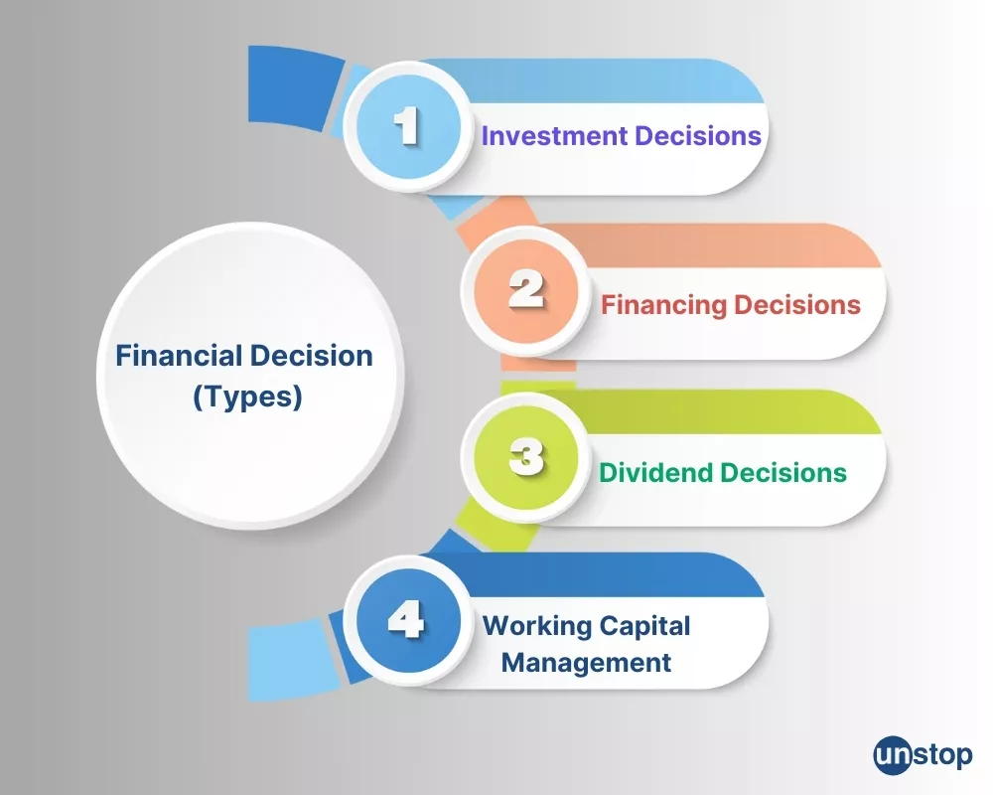
Types of Financial Decisions
Investement decisions: What, when and how much to buy in terms of assets and facilities.
Capital structure decisions: Competing sources of funds (debt, equity).
Dividend decision - retain earnings or share earnings with owners.
Working capital decisions: Cash, inventory, and short-term liabilities management

Slide 29
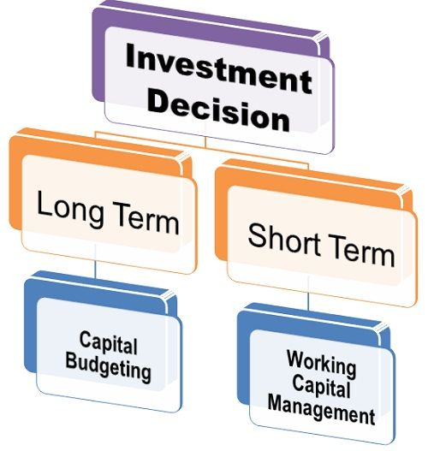
Investment Decisions
Capital budgeting (long-term investment): Allocation of funds to major assets and projects that contribute to long-term growth.
Examples: construction of a hotel, renovation of facilities, buying vehicles etc.
Working Capital Management (Short-Term Adjudication of Holdings): Money spent to run day-to-day operations efficiently
Examples include management of cash, inventory, receivables and payables.
Objective: Long-term and short-term resources are properly utilised for sustained growth and smooth operations.

Slide 30
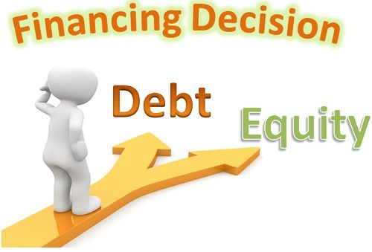
Financing Decisions
Objective: Determine the means for raising funds for the operation and expansion. it Sources of Finance
Equity: Owners/investors with no repayment obligation, ownership maybe diluted.
Debt: Loans/bonds, you keep your ownership, but you have to repay them.
Time Frame:
Short-term: Working capital (employees, inventory).
Long-term: Growth, renovations, land/equipment.
Capital Structure: A correct mix of Debt and Equity brings financial stability & profitability.
Factors affecting: Size of business, tourist patterns, risk tolerance, regulations.
Financial Risk: Don’t be over-levered, keep some liquidity for seasonal swings.

Slide 31

Operational Financial Decisions
Purpose: Perform routine financial operations to ensure business is running well.
Key Areas:
Cash Flow Management: Have sufficient cash on hand to cover daily outflows (personnel, supplies, utilities).
Revenue Management: Pricing, occupancy and sales maximisation.
Cost Control: Watch and cut business running costs.
Stock management: Balanced stocks of food, drink, facilities and disposables.
Short-term credit: Manage seasonal variations in cash flow and other short-term cash needs
Aim: To ensure liquidity, efficiency and profitability in the day-to-day operation.

Slide 32
Importance of Cash Management
Cash flow: Allocates enough money to keep the business running everyday.
Inventory Management: Prevents out-of-stock and excessive-amount situations.
Revenue Management: Increases revenue from multiple revenue streams.
Risk Reduction: It reduces the chance of cash drying up.
User Satisfaction: Satisfaction of users through quick payment of fees.

Slide 33
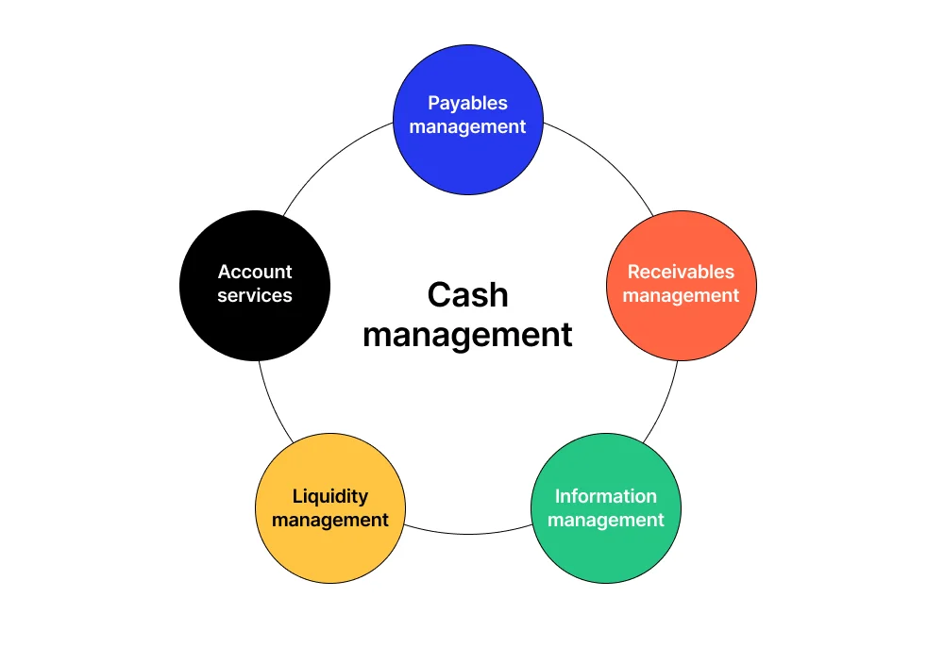
Importance of Cash Management
Receivables Management – Accelerate guest, OTA and client collections.
Account Payables – Manage and schedule payments to vendors.
Liquidity – Having sufficient cash on hand for day-to-day operations as well as unexpected emergencies.
Information Management – Timely and Accurate Cash Flow Reporting.
Account Services – The banking and transaction functions.

Slide 34

Budgeting
Revenue Estimation: Estimate the expected income based on past data, market trends, and seasonal variations.
Cost Accounting: Budget for fixed and variable costs, labor wages, maintenance, and marketing.
Cash Flow Planning: Ensure Cash is Available to Meet Short-Term Obligations during peak and off-peak seasons.
Contingency Planning: Allow for contingencies in the budget in case of unforeseeable expenses or downswings in demand, so it remains financially stable.
Performance Management: compare actual performance against a budget to identify variance and adjust the operations accordingly.
Regulatory Compliance: Ensure that budgeting aligns with local tax laws, employment regulations, and sustainability requirements in the European context.

Slide 35
Forecasting Financial Performance
Identifying Patterns: Identify seasonality, events, RevPar cycles and booking trends.
Finding drivers of income: Focus on room sales (Occupancy × Price), food/drinks, and extra services.
Framing a Time Line: Short-term(1-3m),medium-term(6-18m), long-term(3-5y) forecasts.
Drafting Interim Goals: Define KPIs clearly: revPAR growth, occupancy level, contribution margin.
Emphasising Long-Term Trends: AI pricing, sustainability, wellness, inflation and tech integration.

Slide 36

Financial Control
Definition: Conduct financial management for viability, efficiency, and sustainability.
Objectives: Winning liquidity, cost control, risk and decisions.
Components: Budgeting, reporting, cost control, audit, performance measures.
Tools: Ratios, variance analysis, forecasting, hospitality software.
Benefits: Smart decisions, less waste, happy guests, financial stability.

Slide 37
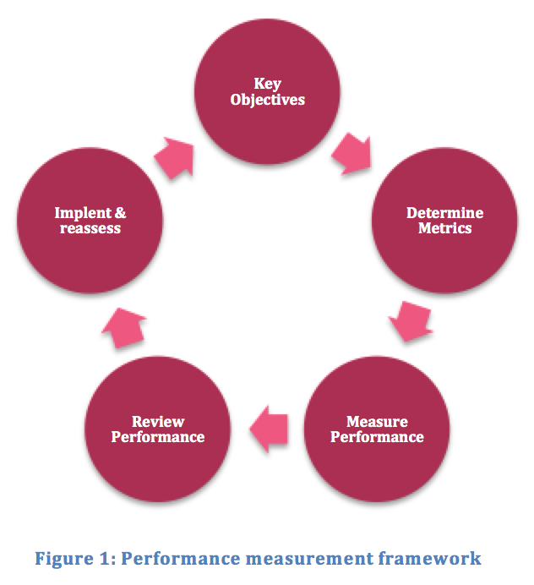
Performance Measurement
Key Objectives – Establish goals in the terms of revenue, satisfaction, and costs.
Identify Metrics – Select KPIs (RevPAR, ADR, Occupancy, NPS, GOPPAR).
Monitor Performance – Gather data periodically.
Evaluate Performance – Analyse results vs targets.
Action & Reappraise – Go for it and loop back.

Slide 38
Financial Ratios Overview
Category | purpose | Key ratios
Liquidity | Ability to pay short term obligations | Current Ratio, Quick Ratio
Profitability | Degree of profit generation | Net Profit Margin, Gross Profit Margin, ROA, ROE
Efficiency | Efficiency of resources and operations | Inventory Turnover, Asset Turnover, Occupancy Rate, RevPAR
Leverage | Stability of long-term finances | Debt-to-Equity, Interest Coverage
Performance (Hospitality-specific) | Operational and revenue efficiency | ADR, RevPAR, Guest Spend per Visit

Slide 39
Profitability Ratios
Definition: The ability to produce a profit relative to revenue, assets or equity.
Key Ratios:
Gross Profit Margin (GPM): GPM is the profit after direct costs (rooms, F&B).
Net Profit Margin (NPM): The bottom line i.e. overall profit of the company after all expenses.
Return on Assets (ROA): Earnings from the total assets.
Return on Equity (ROE): Profit versus owner’s investment.
Operating Profit Margin (OPM): Profit from operations before interest & taxes.
Use: Monitor performance to inform pricing, cost containment and investment decisions.

Slide 40
Liquidity Ratios
Current Ratio
Formula: Current assets / Current liabilities
Indicate general capacity to pay off its short-term debts.
Quick Ratio (Acid Test)
Formula: (Current Assets – Inventories) / Current Liabilities
More rigorous test (omits slow moving inventory such as F&B stock).
Cash Ratio
Formula: (Cash + Cash Equivalents) / Current Liabilities
Most conservative – cash only coverage; includes no accruals and no receivables, but only cash.

Slide 41
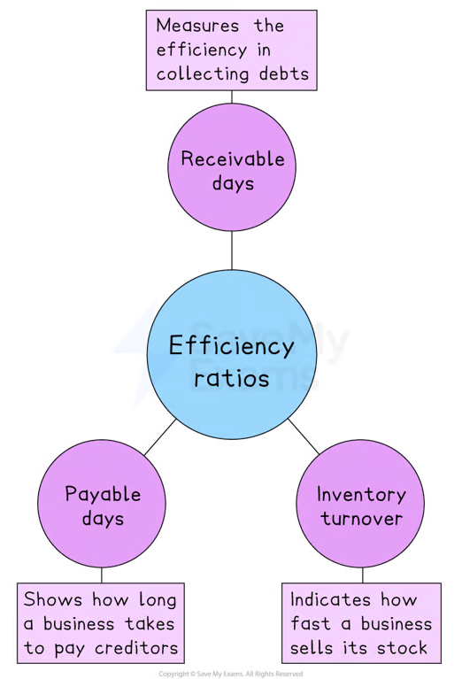
Efficiency Ratios
Receivable Days
Formula: (Receivables ÷ Revenue) × 365
Represents: At what speed are payments received from guests/OTAs.
Payable Days
Formula: (Payables ÷ Cost of sales) × 365
Indicates: The average length of time a company takes to pay its suppliers.
Inventory Turnover
Equation Cost of goods sold / average inventory
Represent: How fast are food, beverages and supplies turning.

Slide 42
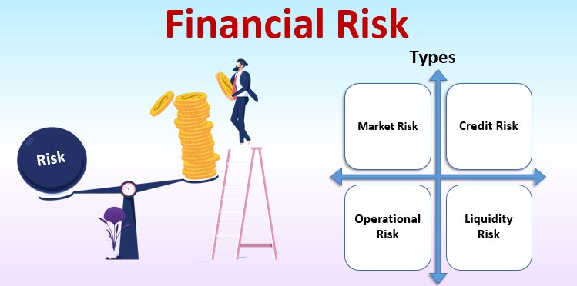
Financial Risk
Market Risk: Exchange rates fluctuations, cost of fuels and cycles of discretionary consumption.
Credit Risk: Risk of default by tour operators, OTAs or corporate event bookings on a massive scale.
Operational Risk: Quality-of-service failures, labor shortages, and systemwide technological failures.
Liquidity Risk: High fixed costs, seasonal cash flow, and perishable inventory.

Slide 43
Cost Structure in Hospitality
Fixed Costs: Don’t vary with occupancy or sales.
Such as: rent, insurance, salaries of permanent staff, property taxes.
Variable Costs: Depends on levels of occupancy and services.
Such as: food & beverage, utilities, cleaning pads, hourly wages.
Si-Variable / Mixed Costs: Part-fixed, part-variable.
Such as: power (base + consumption), staff overtime, maintenance contracts.
Other Considerations
Cost Control: Necessary to stay profitable in a “bleed out the demand” situation.
Cost distribution: Useful in product pricing, budgeting and financial analysis.
Profit Margins: Based on coping with high fixed and volatile variable costs.

Slide 44
Pricing Decisions
Pricing decisions are a critical component of financial management in tourism and hospitality, directly influencing revenue, profitability, and market competitiveness.
Managers must set prices that cover costs while remaining attractive to customers in a highly competitive and price-sensitive market.
Factors such as demand patterns, seasonality, customer expectations, and competitor pricing play a significant role in pricing strategies.
In tourism and hospitality, dynamic pricing is widely used to adjust rates based on occupancy levels, booking periods, and market conditions.
Financial analysis supports pricing decisions by assessing cost structures, break-even points, and expected profit margins. Pricing must also reflect perceived value and service quality to maintain customer satisfaction.
In the European context, pricing decisions are influenced by taxation, labor costs, and consumer protection regulations.

Slide 45
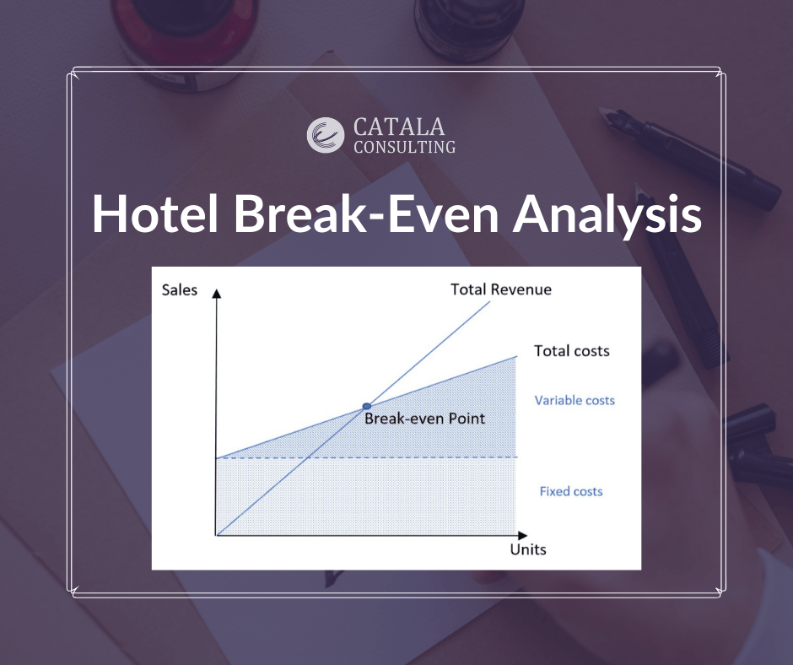
Break-Even Analysis
Breakeven Analysis: Identifies the point at which total sales = total costs.
Formula: Breakeven Units = Fixed Cost / (Unit Selling Price - Unit Variable Cost)
Purpose: To determine the minimum level of occupancy or sales required not to make a loss.
Application in Hospitality:
Hotel rooms, F&B outlets or events prices.
To guide labour and inventory according to anticipated occupancy.
Evaluate viability of new offerings or expansion.

Slide 46
Capital Investment Decisions
Infrastructure expenditure: Renovations for hotels, or new construction of hotels, resorts, restaurants, cafes and the like.
Technology Investment: Acquiring new technology, or systems, or software, and hardware (hotel management systems, online booking systems).
Remodel and restoration: Updating your manufacturing plant to meet the competition.
Capital expenditure: Purchase of new equipment, furnishings and fixtures by restaurants, bars and other hospitality outlets.
Sustainability Investments: Solar panel installation, energy­ efficient systems, waste management programs – and a whole lot more environmentally friendly initiative sustainable investments.)
Marketing and brand expenditure: Launch of marketing scheme, rebrand the company, new logos and Web site, etc.).

Slide 47

Time Value of Money
Present Value (PV): Determines if the future cash flow from a hotel is sufficient for occupying the hotel today, paying operating expenses and recouping the initial investment in the hotel.
Future Value (FV): Determines the growth of Sinking Funds FF&E for property refits occurring in 5–10 years.
Discounting: For volatility; the value of future tourism income is discounted because it is subject to seasonal and global (political, financial, etc.) risk.
Interest Rates: The cost of debt is influenced by these for asset-heavy hospitality investments.

Slide 48
Role of Financial Managers
Financial Manager: They responsible for the anticipation, the direction and the control of an hospitality enterprise's financial operations, to achieve maximum profit and position in the financial market.
Main Functions:
Cash flow and liquidity management.
Spending control and expenses monitoring.
Investing and financing decisions.
Financial reporting and regulatory compliance.
Risk management, cost reduction and profitability analysis.

Slide 49

Financial Management in Hotels
Hotel Financial Management: Financial management of hotels revolves around planning, managing and controlling of the financial resources to achieve profitability, liquidity and growth.
Primary Focus:
Budgeting: Seasonal and yearly income/cost plans.
Cost Control: Fixed, variable, and mixed costs.
Revenue Management: Dynamic pricing, occupancy optimisation.
Cash Flow Management: Provide money for daily work and investing.
Investment decision: Renovations, expansions, or new services.
Financial Reporting: Monitor performance and inform management decisions.

Slide 50
Financial Management
Financial Management in T&H: The planning, direction and control of financial resources to achieve profitability, liquidity and sustainable growth.
Main areas:
Budgeting & Forecasting: Yearly and seasonal financial forecasts.
Cost Control: Fixed costs, variable costs and semi-variable costs.
Revenue Management: Dynamic pricing and occupancy maximisation.
Cash flow management: ensuring availability of cash for operations and investment.
Investment and financing decisions: renovations, expansions, loans.
Financial Reporting & Analysis: Monitor performance to make better decisions.

Slide 51
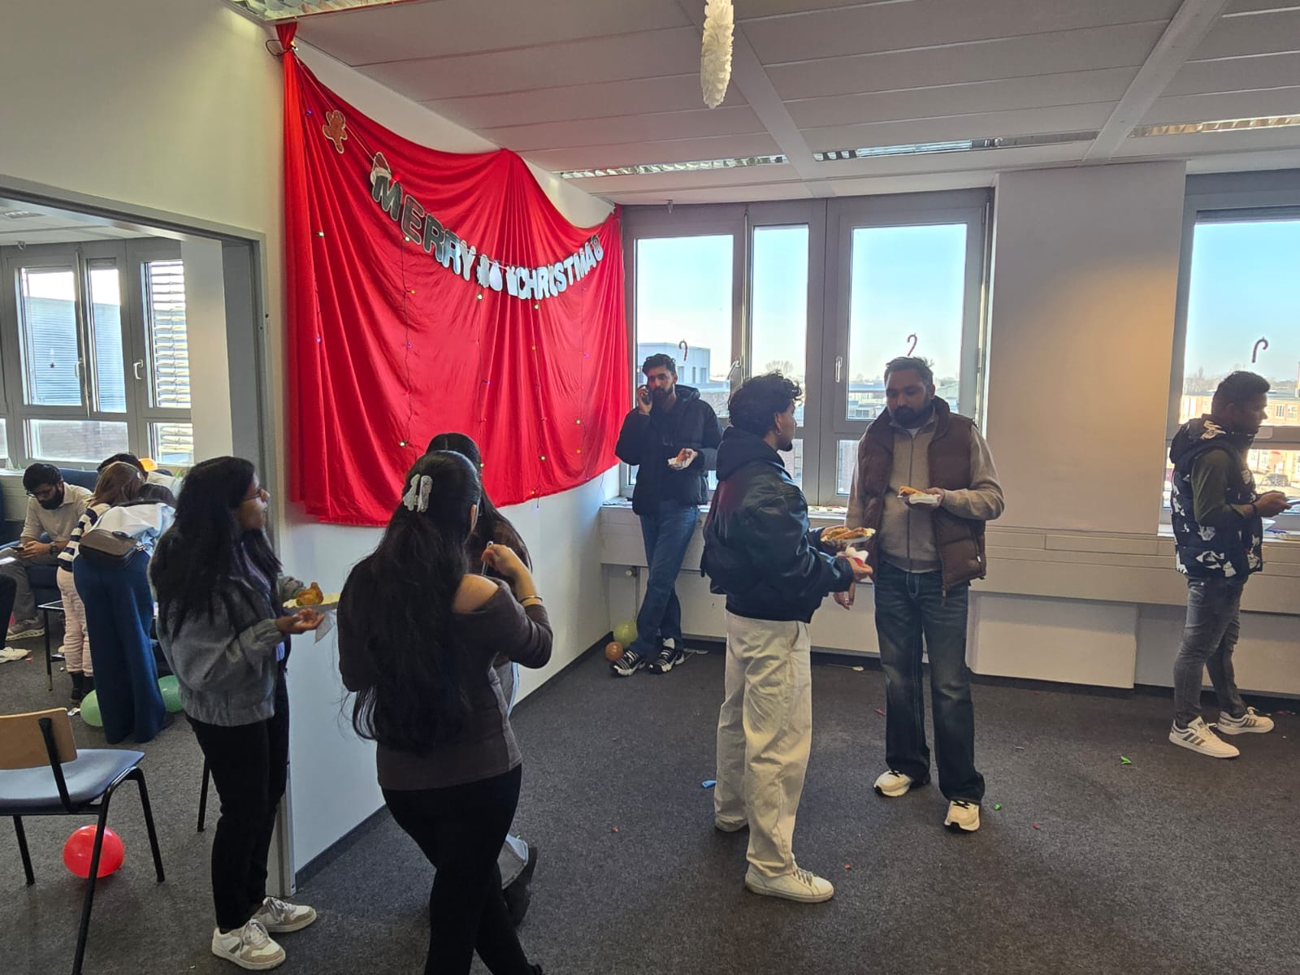
FM in Events and Attractions
Finance Management Events and Attractions: Planning and control of resources in events and attractions to ensure the financial success of the event.
Highlights:
Budgets & Forecasting: Project expenses, ticket sales, sponsorships.
Cost Control: Venue, staff, equipment and running costs.
Revenue Management: Ticket prices, packages, merchandise sales.
Turn Cash Flow: Have money for pre-event preparations and event operations.
Investment Decisions: Equipment, Marketing campaigns, and Additional Attractions Development.
Financial Reporting: Monitor actual performance against planned performance for accountability.

Slide 52
Role of Financial Transparency
Trust Building: Enhances credibility and trust with stakeholders.
Risk Management: Improved forecasting and financial risk mitigation.
Accountability: Encourages responsible financial management and accountability.
Investor Confidence: Attracts investors and the potential to raise more funds.
Regulatory Compliance: Aids in the compliance of financial rules and regulations.

Slide 53

Digitalisation and Financial Management
Digitalisation & Financial Management: Application of technology to the finance planning, control, and decision-making processes in tourism and hospitality.
Highlights:
Real-time Income & Expense Tracking: Automate your tracking profits and key business metrics.
Pricing and Revenue Management Tools: Automated yield, demand and dynamic pricing forecasting.
Money Flow & Payments: electronic payments, bookings online.
Control Costs & Efficiency: Digitally track inventory, labor and operating expenses.
Compliance & Audit: Tax, VAT and regulatory compliance with automated surveillance.

Slide 54
Financial Management and Strategy
Strategic Planning Assistance: Financial management ensures the availability of information that will aid in the definition of the overall long-term strategies of the business.
Investment Alignment: Financial analysis also helps ensure that capital investment is aligned with business strategy in relation to growth, digitalization, and sustainable goals.
Cost Leadership and Differentiation: Financial analysis helps in deciding whether it is more profitable to maintain cost leadership or go for differentiation.
Risk Management: Financial planning enables a strategic analysis of financial risks and formulates strategies to address such risks to achieve business goals.
Performance Monitoring: The use of financial metrics to measure strategic progress and shape strategic plans according to actual results achieved.
European Strategic Context: Financial strategy must fit into the overall European legislation framework and strategy of funds supporting sustainability.

Slide 55
Financial Management and Sustainability
Long-Term Value Creation: By linking finance and sustainability in financial planning, financial management accentuates value for the economy, environment, and society in the longer term.
Sustainable Investment Decisions: (Energy efficiency investment) This aspect evaluates investments in areas success.
Cost Savings through Sustainability: Resource efficiency translates into lower costs and ultimately higher profits.
Risk Compliance Management: The budgeting process also deals with risks relating to the environment or regulations concerning sustainability.
Green Financing Sources: Green financial practices increase access to EU funds and other green financial sources.
Stakeholder & Reputation Profile/Risk: Integrating financial management & sustainability will improve trust & reputation.

Slide 56
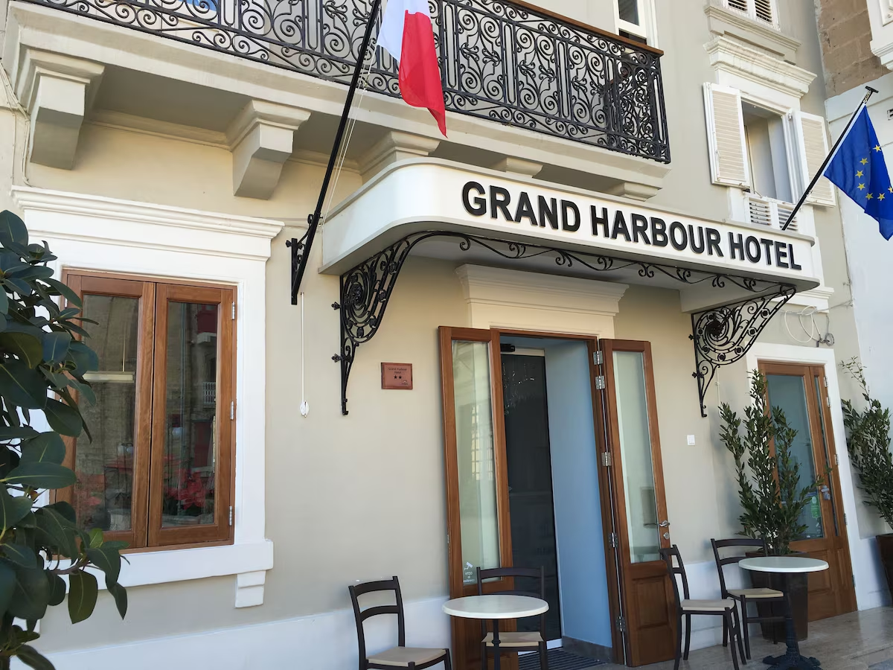
Case Study: Financial Management-The Grand Harbour Hotel, Malta
Challenges: Seasonal fluctuations in revenue, high expenses, and marginal reporting.
Financial strategies: Budgeting & forecasting, cost control, KPIs reporting, investment evaluation, dynamic pricing.
Results: Occupancy ↑ 61→71%, ADR €128→€145, RevPAR €78→€103, GOP 29→38%, increased profitability and off-season resilience.
Key Takeaways: Applying discipline to budgeting, KPIs, investments, and pricing will help you reap financial success.

Slide 57
Discussion Questions
Why is financial management so important for businesses?
What does the fluctuating demand pattern across EU regions imply for budgeting and financial planning in enterprises?
To what extent would labour regulations and minimum wage policies of the EU impact cost structures for businesses?
What risks does Industries face in business aspects when it operates under different tax and VAT systems across multiple European countries?
Why is cost control more difficult in-service industries like tourism than in manufacturing?
How do financial ratios support managerial decision-making in European organizations?
To what extent can digitalization contribute to enhancing the financial transparency and efficiency performance of businesses?

Slide 58
Key Takeaways
Every industry needs financial management, but in the tourism and hospitality sectors, the management of capital investments and the management of cash flows are particularly important.
Learning how to read financial statements, how to make decisions on which investments to pursue, and which risks to hedge will facilitate the growth of a business in a sustainable manner.
Effective financial planning and forecasting will allow a business to navigate difficult times and will aid the business in reaching its objectives in the long-run.

Slide 59
Assessment Activities
Click the link below to access the Assessment Activities.
Assessment_Activities_BATHM\M 08 WS 01 Introduction to Financial management.docx

Slide 60
Learning References
Atrill, P., & McLaney, E. (2020). Financial Management for Decision Makers (9th ed.). Pearson Education.
Investopedia. (n.d.). What Are Liquidity Ratios? Retrieved from https://www.investopedia.com/terms/l/liquidityratios.asp
Business Perspectives. (n.d.). Liquidity, leverage, and solvency: What affects profitability? Retrieved from https://www.businessperspectives.org/index.php/journals?controller=pdfview&item_id=15493&task=download
Journal of Economics and Business Analytics. (2021). Profitability, liquidity, leverage ratio analysis of internet financial reporting. Retrieved from https://www.journalajeba.com/index.php/AJEBA/article/download/368/735/732
Saudi Journal of Economics and Finance. (2020). The effect of working capital, liquidity and leverage on profitability. Retrieved from https://www.saudijournals.com/media/articles/SJEF_41_28-35.pdf

Slide 61

Thank you
Discover the world of EAAS

