Slide 1
Operations Management in Hospitality
European Institute of Innovation, Entrepreneurship and Technology
Lessingstraße 79, 13158 Berlin, Germany
Mahmoud Abdou| Berlin
      Lessingstraße 79,
      13158 Berlin, Germany
      Phone: +49 30 233618555
      Fax: +49 30 233618556
      Email: info@eiiet.com

Slide 2

Index
1- Characteristics of Intermediaries
2- The Choice of Distribution Channels

Slide 3
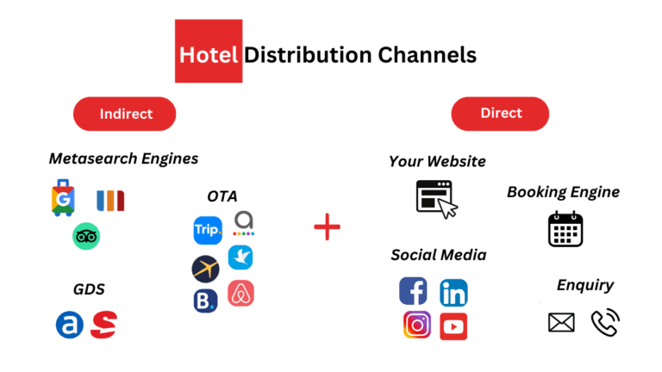
1- Characteristics of Intermediaries
    - Each distribution channel has:
    Different cost structures
    Different commission levels
    Different customer segments
    Not all channels are equally profitable

Slide 4
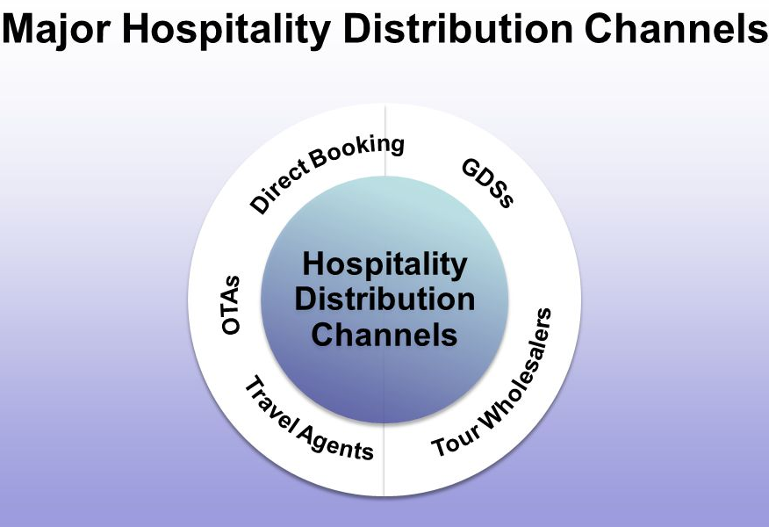
1- Characteristics of Intermediaries
    1- Global Distribution Systems (GDSs)
    - Electronic platforms linking hotels with:
    Travel agencies
    Tour operators
    Other intermediaries
    - Widely used in professional travel distribution

Slide 5
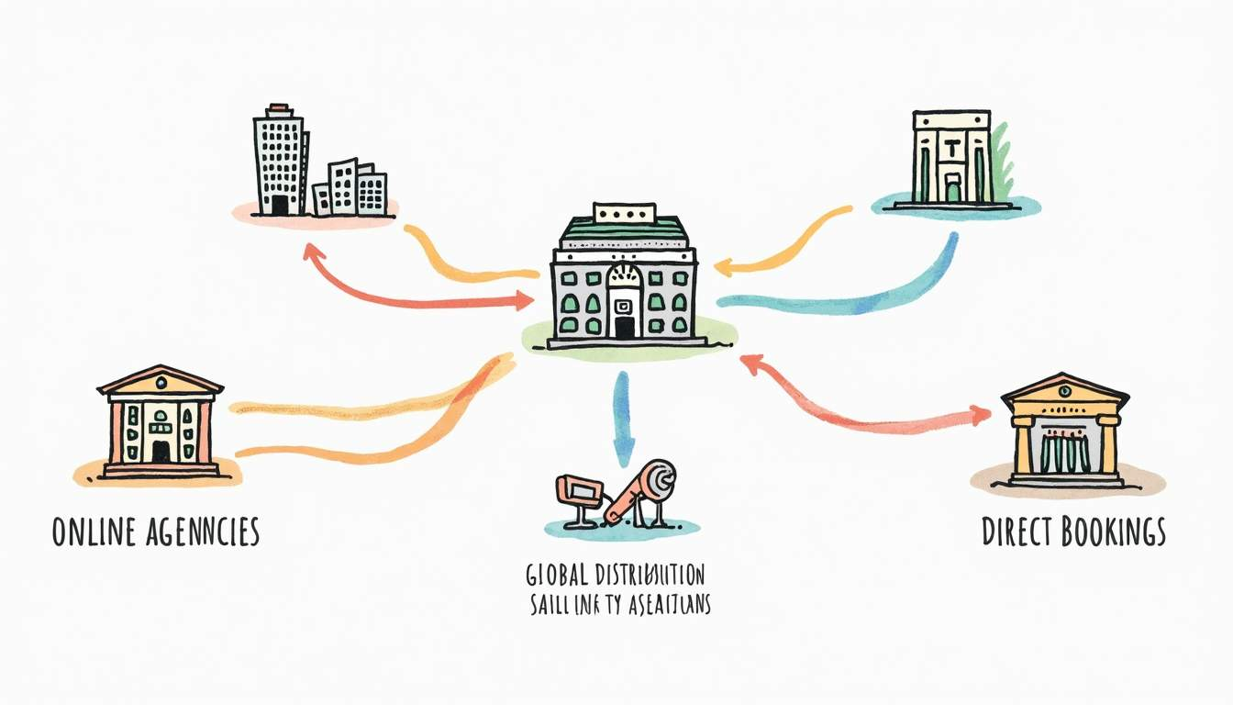
1- Characteristics of Intermediaries
    - How GDSs Work:
    - Hotels upload:
    Room availability
    Prices
    Booking terms
    - Travel agencies make bookings via the GDS
    - Bookings guaranteed by:
    Corporate credit card
    IATA number of the agency

Slide 6
1- Characteristics of Intermediaries
    - How GDSs Work:
    - Payment and Commission Structure
    - The guest pays directly to the hotel at the property
    - Hotel pays:
    Booking fee to the GDS
    Commission to the travel agency

Slide 7
1- Characteristics of Intermediaries
    - Advantages of GDSs:
    - Single contract provides access to:
    Thousands of intermediaries worldwide
    - High global visibility
    - Reduced need for multiple contracts
    - Disadvantages of GDSs
    - High commissions and distribution fees
    - Expensive to maintain as a sales channel

Slide 8
1- Characteristics of Intermediaries
    - Suitable Hotel Types
    - Best suited for:
    Medium and large hotels
    Middle- and high-category properties
    - Especially popular with:
    Hotel chains
    All major hotel chains are present in GDSs

Slide 9
1- Characteristics of Intermediaries
    2- Travel Agencies in Hotel Distribution
    - Travel agencies operate under different licenses
    - Their role depends on whether they act as:
    Tour operators
    Travel agents

Slide 10
1- Characteristics of Intermediaries
    A- Tour Operators (Merchant Model)
    - Operate on a merchant model
    - Receive net rates from hotels
    - Add a mark-up and resell rooms
    - Sell:
    Directly to customers
    Via travel agents
    To other tour operators
    - The hotel is paid by the tour operator, not the customer

Slide 11
1- Characteristics of Intermediaries
    B- Travel Agents (Agency Model)
    - Operate on an agency model
    - Sell rooms at hotel-set prices
    - Receive a commission
    - Act as intermediaries between:
    Hotel
    Final customer

Slide 12
1- Characteristics of Intermediaries
    C- Agencies with Mixed Licenses
    - May work:
    As tour operators with some hotels
    As agents with others
    -Use different business models depending on contracts

Slide 13
1- Characteristics of Intermediaries
    3- Online Travel Agencies (OTAs)
    - Operate exclusively online
    - Target mainly direct customers
    - Use:
    Merchant model
    Agency model
    - Offer hotels:
    Flexible pricing
    Flexible room allotments

Slide 14
1- Characteristics of Intermediaries
    3- Online Travel Agencies (OTAs)
    A- Commissions and Risk
    - OTAs often charge high commissions
    Example: Booking.com (15%–18%)
    - Guests usually pay directly at the hotel
    - Lower financial risk for hotels:
    No delayed payments from intermediaries

Slide 15
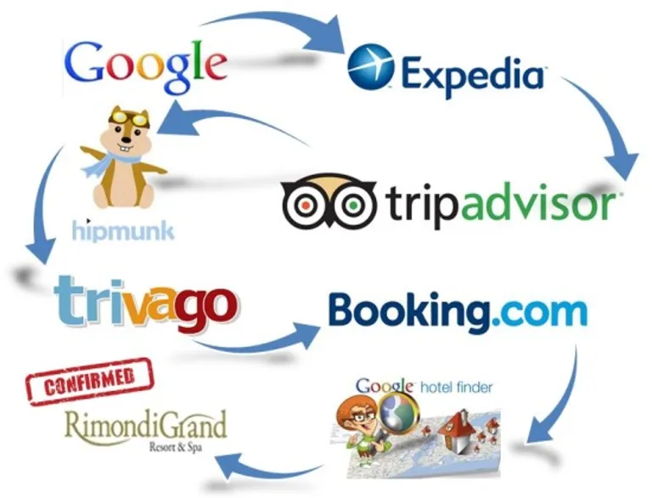
1- Characteristics of Intermediaries
    3- Online Travel Agencies (OTAs)
    B- White Labels in Hotel Distribution
    - Used by GDSs and many OTAs
    - Involve integrating a booking engine into:
    Another travel agency’s website
    - Part of modern distribution channel strategies

Slide 16
1- Characteristics of Intermediaries
    3- Online Travel Agencies (OTAs)
    C- How White Labels Work
    - Customer books a hotel on a travel agency’s website
    - Booking is processed directly through:
    - GDS or OTA reservation system
    - The partner agency acts as the sales interface

Slide 17
1- Characteristics of Intermediaries
    4- Group Buying Websites in Hotel Distribution
    - Online platforms connecting:
    Hotels (sellers)
    Direct customers (buyers)
    - Used as a distribution channel in the hotel industry

Slide 18
1- Characteristics of Intermediaries
    4- Group Buying Websites in Hotel Distribution
    A- Key Characteristics
    - Offer highly discounted rates
    Often 50% or more
    - Deals available for a limited time
    Usually less than 7 days
    - Designed to encourage quick booking decisions

Slide 19
1- Characteristics of Intermediaries
    4- Group Buying Websites in Hotel Distribution
    B- Original Concept of Group Buying Required:
    - A minimum number of buyers
    - Credit card guarantees
    - Ensure demand before the deal became active
    Current Practice
    - Minimum buyer requirement often removed
    - Platforms now function as:
    Special offer websites
    Flash-sale platforms

Slide 20
1- Characteristics of Intermediaries
    4- Group Buying Websites in Hotel Distribution
    C- Short-Term Benefits of Group Buying Websites
    - Attract customers through:
    Heavily discounted rates
    - Financially efficient in the short run
    - Useful for:
    Filling unsold rooms
    Stimulating demand quickly

Slide 21
1- Characteristics of Intermediaries
    4- Group Buying Websites in Hotel Distribution
    C- Short-Term Benefits of Group Buying Websites
    - Attract customers through:
    Heavily discounted rates
    - Financially efficient in the short run
    - Useful for:
    Filling unsold rooms
    Stimulating demand quickly

Slide 22
1- Characteristics of Intermediaries
    4- Group Buying Websites in Hotel Distribution
    D- Potential Long-Term Risks for Hotels
    - Repeated deep discounts may:
    Damage the hotel’s price image
    Create unfavourable customer price expectations
    - Customers may:
    Expect similar low prices in the future
    Resist paying full or regular discounted rates

Slide 23

2- The Choice of Distribution Channels

Slide 24
2- The Choice of Distribution Channels
    Factors Influencing Distribution Channel Choice:
    - Several factors influence the choice of distribution channel
The Choice of Distribution Channels
Characteristics of the hotel product
Company Characteristics
Characteristics of distributors
Characteristics of the target market
Competition

Slide 25
2- The Choice of Distribution Channels
    1- Characteristics of the hotel product
    - Specialised Hotel Products
    - Examples include:
    Golf hotels
    Casino hotels
    Spa & wellness hotels
    Themed hotels
The Choice of Distribution Channels
Characteristics of the hotel product
Company Characteristics
Characteristics of distributors
Characteristics of the target market
Competition

Slide 26
2- The Choice of Distribution Channels
    1- Characteristics of the hotel product
    - Implications for Channel Selection
    Specialised hotel products require:
    Specialised distribution channels
    - Typically involves:
    Tour operators
The Choice of Distribution Channels
Characteristics of the hotel product
Company Characteristics
Characteristics of distributors
Characteristics of the target market
Competition

Slide 27
2- The Choice of Distribution Channels
    1- Characteristics of the hotel product
    - Role of Specialised Intermediaries
    - Possess:
    A targeted customer base
    Expertise in selling niche products
    - Able to reach:
    The “right customers” for the product
The Choice of Distribution Channels
Characteristics of the hotel product
Company Characteristics
Characteristics of distributors
Characteristics of the target market
Competition

Slide 28
2- The Choice of Distribution Channels
    2- Company Characteristics and Distribution Channel Choice
    - Distribution decisions depend on:
    Size of the company
    Ownership structure
    Marketing strategy
The Choice of Distribution Channels
Characteristics of the hotel product
Company Characteristics
Characteristics of distributors
Characteristics of the target market
Competition

Slide 29
2- The Choice of Distribution Channels
    2- Company Characteristics and Distribution Channel Choice
    - Large Hotel Chains:
    - Develop own reservation systems
    - Customers can book:
    Multiple properties
    Through a single brand website
    - Large property portfolios increase:
    Website attractiveness
    Customer convenience
The Choice of Distribution Channels
Characteristics of the hotel product
Company Characteristics
Characteristics of distributors
Characteristics of the target market
Competition

Slide 30
2- The Choice of Distribution Channels
    2- Company Characteristics and Distribution Channel Choice
    - Advantages of Chain Websites:
    - Offer:
    Exclusive promotional rates
    Guaranteed room availability
    - Benefits often available:
    Only through direct booking
    - Encourage customers to bypass intermediaries
The Choice of Distribution Channels
Characteristics of the hotel product
Company Characteristics
Characteristics of distributors
Characteristics of the target market
Competition

Slide 31
2- The Choice of Distribution Channels
    3- Characteristics of distributors
    - Key aspects:
    Size
    Market coverage
    Marketing strategy
    Booking and purchasing criteria
The Choice of Distribution Channels
Characteristics of the hotel product
Company Characteristics
Characteristics of distributors
Characteristics of the target market
Competition

Slide 32
2- The Choice of Distribution Channels
    3- Characteristics of distributors
    - Market Coverage and Target Markets
    - Distributors should match:
    Hotel’s target customer market
    - Example:
    Seaside hotel targeting Russian tourists
    Requires contracts with agencies operating in Russia
The Choice of Distribution Channels
Characteristics of the hotel product
Company Characteristics
Characteristics of distributors
Characteristics of the target market
Competition

Slide 33
2- The Choice of Distribution Channels
    3- Characteristics of distributors
    - Positioning Compatibility
    -Distributor positioning must align with:
    Hotel product type
    - Low-cost tour operators:
    Not suitable for boutique or luxury hotels
    - Mismatch can damage:
    Brand image
    Customer expectations
The Choice of Distribution Channels
Characteristics of the hotel product
Company Characteristics
Characteristics of distributors
Characteristics of the target market
Competition

Slide 34
2- The Choice of Distribution Channels
    4- Characteristics of the target market
    - Focus on:
    Customer type
    Booking preferences
    Customer Booking Preferences:
    - Different customer segments prefer:
    Different booking channels
    - Hotels must understand:
    How their target customers book
The Choice of Distribution Channels
Characteristics of the hotel product
Company Characteristics
Characteristics of distributors
Characteristics of the target market
Competition

Slide 35
2- The Choice of Distribution Channels
    4- Characteristics of the target market
    A- Online-Oriented Customers prefer:
    Online reservations
    OTAs and booking platforms
    - Hotel strategy:
    Presence in multiple online reservation systems
The Choice of Distribution Channels
Characteristics of the hotel product
Company Characteristics
Characteristics of distributors
Characteristics of the target market
Competition

Slide 36
2- The Choice of Distribution Channels
    4- Characteristics of the target market
    B- Tour-Operator-Oriented Customers prefer:
    Package holidays
    Organized travel
    - Hotel strategy:
    Contracts with tour operators
The Choice of Distribution Channels
Characteristics of the hotel product
Company Characteristics
Characteristics of distributors
Characteristics of the target market
Competition

Slide 37
2- The Choice of Distribution Channels
    5- Competition
    - Competitive environment affects:
    Distribution strategy
    - Revenue managers should monitor:
    Competitors’ distribution channels
    Competitors’ channels can be used to:
    Assess effectiveness
    Assess efficiency of own distribution network
The Choice of Distribution Channels
Characteristics of the hotel product
Company Characteristics
Characteristics of distributors
Characteristics of the target market
Competition

Slide 38
2- The Choice of Distribution Channels
    5- Competition
    - Imitation Is Not Required:
    - Hotels do not need to use the same channels as competitors
    - Channel choice must align with:
    Hotel strategy Target customers
    - Strategic Insights from Competitors
    - Competitor analysis can:
    Reveal unused distribution channels
    Suggest alternative market access options
The Choice of Distribution Channels
Characteristics of the hotel product
Company Characteristics
Characteristics of distributors
Characteristics of the target market
Competition

Slide 39
Thank you
      European Institute of Innovation, Entrepreneurship and Technology
      Lessingstraße 79,
      13158 Berlin, Germany
      Phone: +49 176 55524449
      Email: info@eiiet.com
Discover the world of eiIET

