Slide 1
Recreation
European Institute of Innovation, Entrepreneurship and Technology
Lessingstraße 79, 13158 Berlin, Germany
Mahmoud Abdou | Berlin
      Lessingstraße 79,
      13158 Berlin, Germany
      Phone: +49 30 233618555
      Fax: +49 30 233618556
      Email: info@eiiet.com

Slide 2
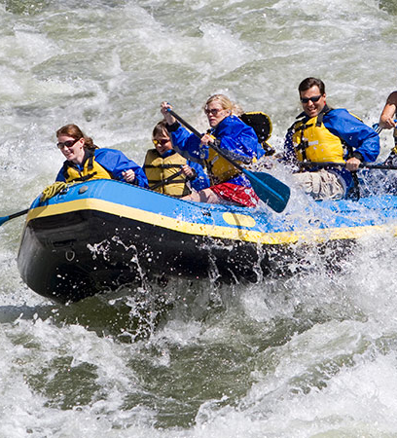
Index
- Motivations for Recreational Participation
- Personal Values of Recreational
Involvement Leisure Constraints
Recreation Supply
Recreation and Leisure-Service Providers

Slide 3
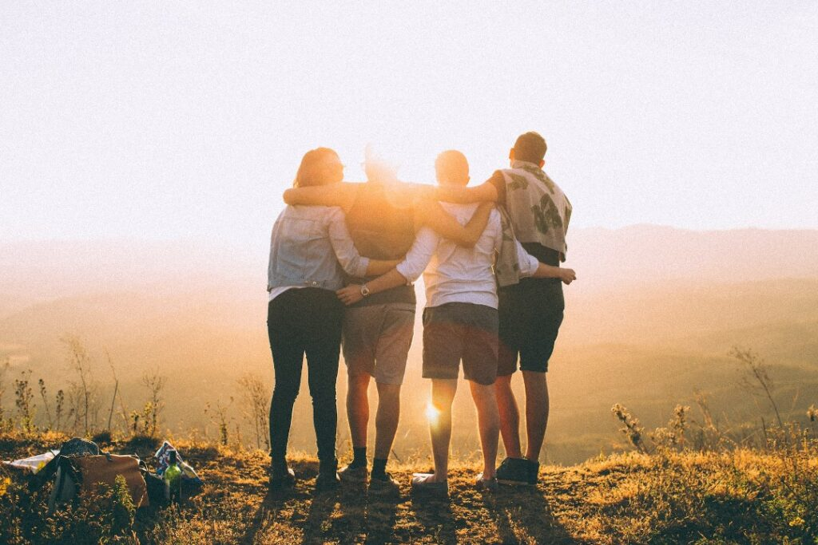
1- Motivations for Recreational Participation
    1.1- Social and Affiliation Drives in Leisure
    - The desire to belong to a group and form meaningful relationships.
    Key Needs Fulfilled:
    - Companionship - Support
    - Emotional intimacy

Slide 4
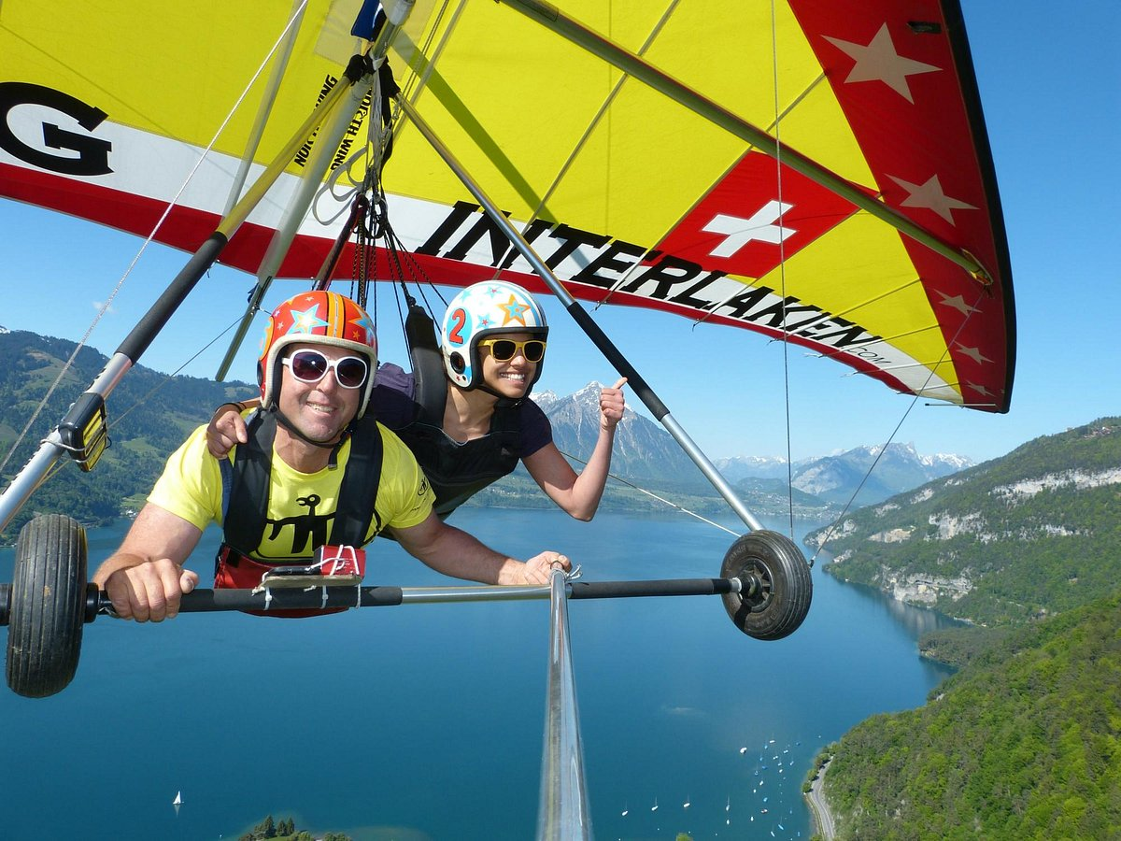
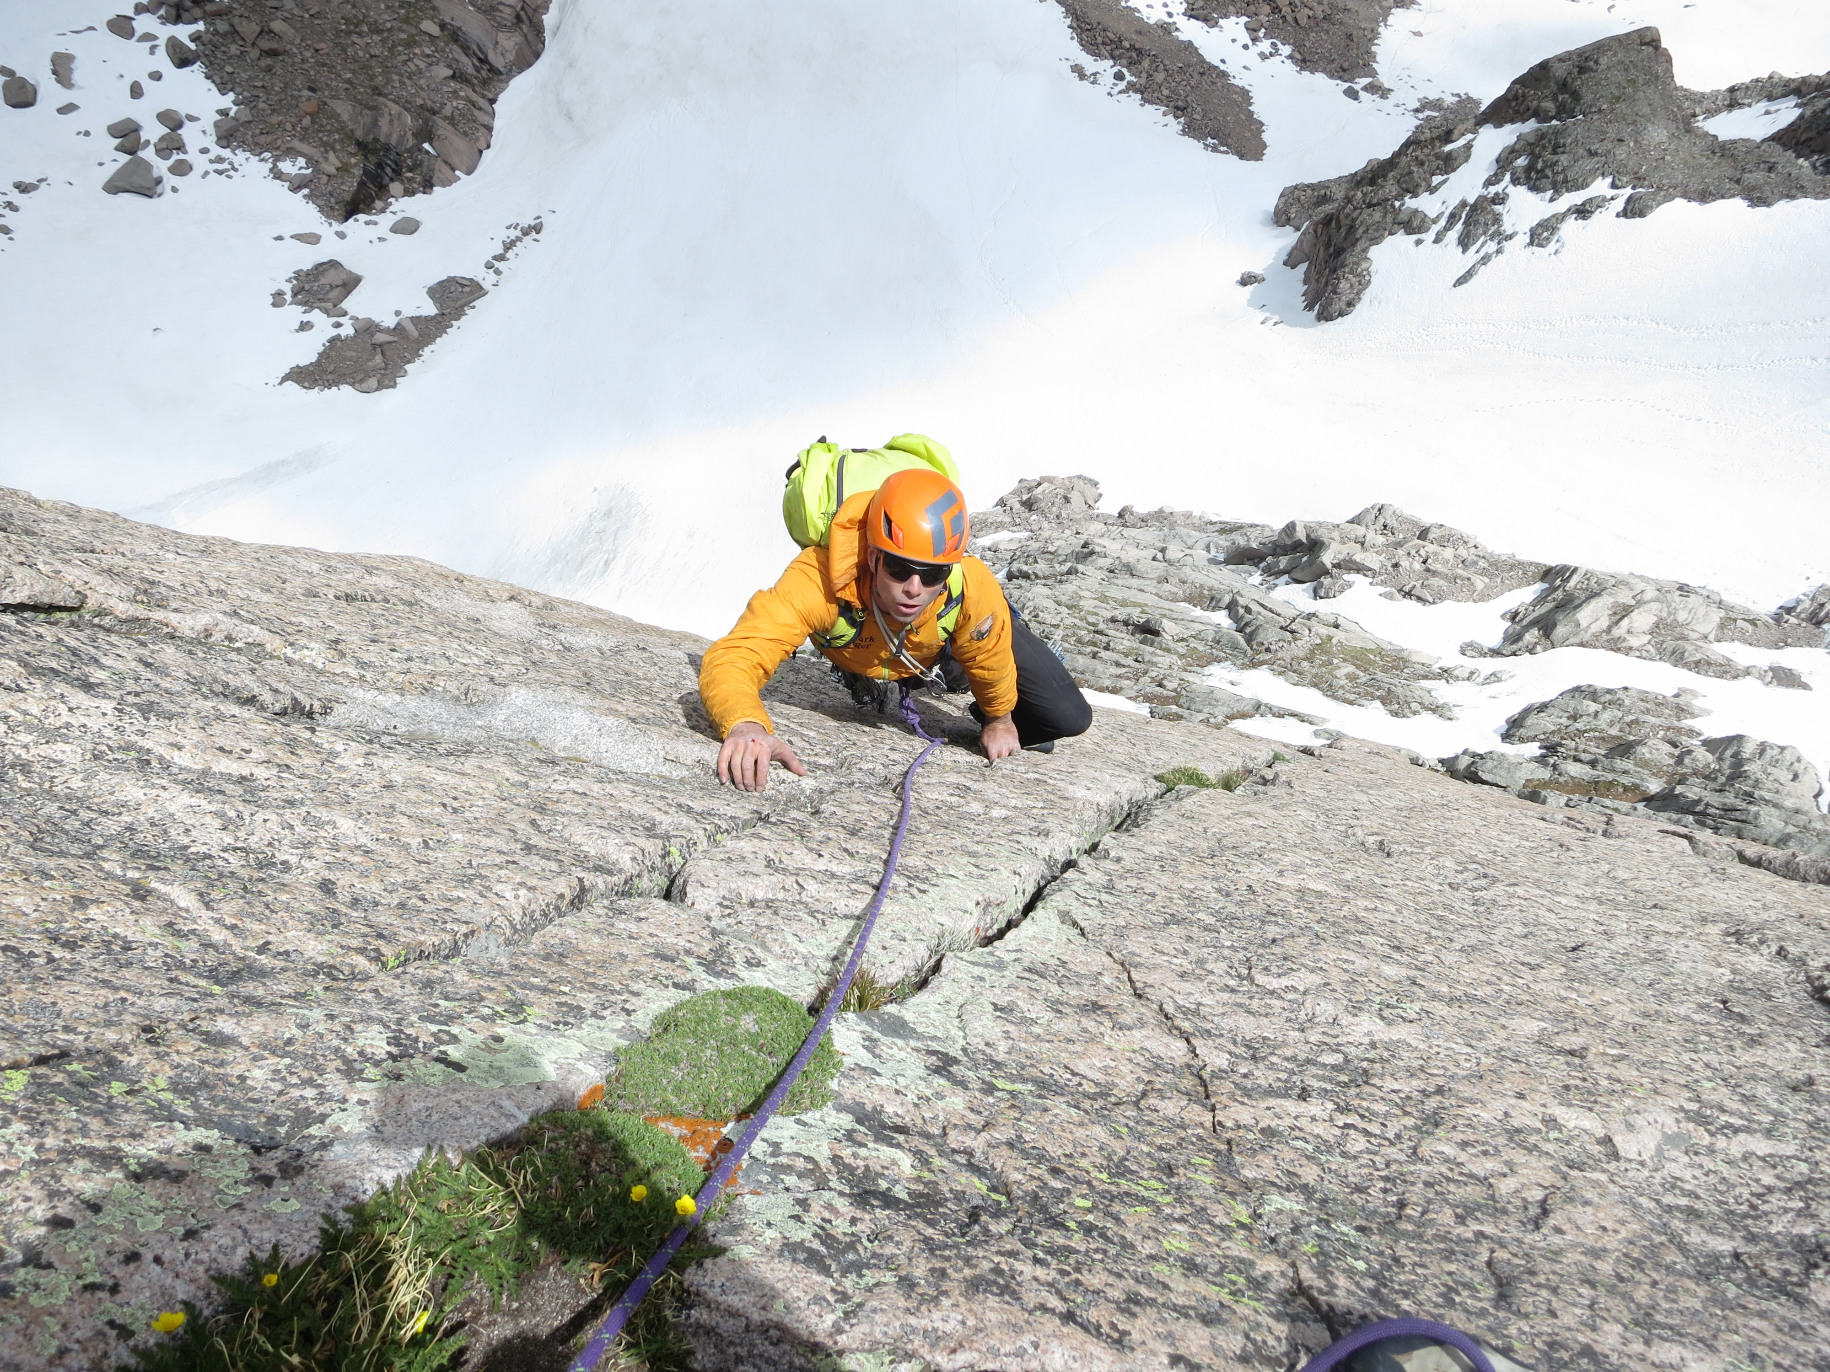
1- Motivations for Recreational Participation
    1.2- Excitement and Challenge Motivations
    Core Idea:
    - Thrill - Adventure
    - Testing personal limits.
    Risk recreation and outdoor adventure
    - Satisfy the sensation-seeking drive
    Examples:
    - Ballooning - Skydiving,
    - Para-sailing - Hang gliding
    - Amateur stock car racing

Slide 5
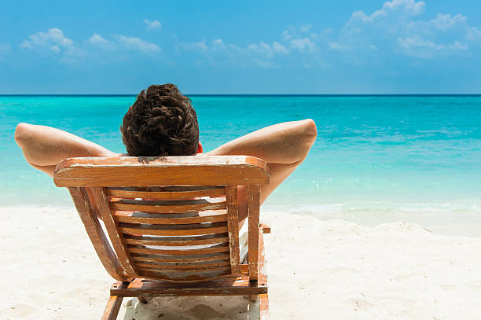
1- Motivations for Recreational Participation
    1.3- Hedonistic Motivations in Leisure
    - Pleasure, enjoyment, and sensual satisfaction.
    Examples:
- Dining at fine restaurants | - Spa treatments and massages
- Sunbathing or beach vacations | - Listening to music or dancing
- Romantic getaways | - Enjoying luxury experiences

Slide 6
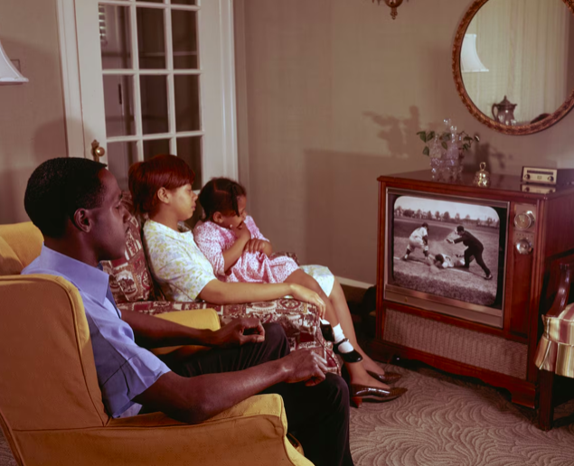
1- Motivations for Recreational Participation
    1.4- Nostalgia-Based Motivations
    - To relive or recapture the past
    - Reflects different memories
    - Reinforces personal or cultural identity
    - linked with people, places, or experiences from the past
    Examples:
    - Sports camps
    - Re-watching classic films or TV shows
    - Visiting childhood vacation spots or hometowns

Slide 7
1- Motivations for Recreational Participation
    1.5- Other Motivations
    Self-Expression
    – Using creative talents; gaining satisfaction and recognition.
    Companionship
    – Engaging in playful, supportive relationships with others.
    Power
    – Fulfilling the need to control or influence social situations.
    Compensation
    – Seeking new or unusual experiences beyond routine life.

Slide 8
1- Motivations for Recreational Participation
    Security
    – Enjoying safe, familiar, and predictable activities.
    Service
    – Helping others or volunteering for community benefit.
    Intellectual and Aesthetic Stimulation
    – Participating in cultural, artistic, or creative pastimes.
    Self-Sufficiency
    – Enjoying time alone and being comfortable in solitude.

Slide 9
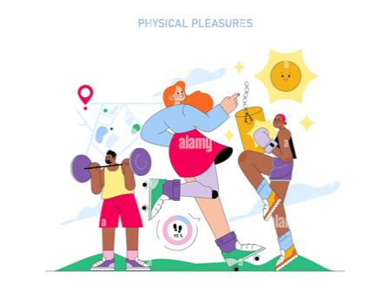
2- Personal Values of Recreational Involvement
    2.1- Physical Values
    - It leads to positive physical development and improved health.
    Types of Activities:
    - Sports and games -Fitness and aerobic exercises
    - Walking, hiking - Gardening
    Key Physical Benefits:
    - Improved cardiovascular health
    - Enhanced muscular strength and flexibility
    - Weight management and body composition
    - Reduction in risk of chronic diseases

Slide 10
2- Personal Values of Recreational Involvement
    2.2- Emotional Values and Outcomes of Recreation
    - Even people with "normal" lifestyles often experience:
Tension | Boredom
Stress | Frustration
Difficulty in finding satisfying leisure experiences

Slide 11
2- Personal Values of Recreational Involvement
    2.2.1- Key Emotional Benefits of Recreation:
    Relaxation and Escape
    - Physical activity, reading, or other mental pastimes
    Overcoming Loneliness
    - Social contact, friendship, or intimacy with others
    Stress Management
    - Stress reduction
    Play as Emotional Release
    - feelings of pleasure and satisfaction

Slide 12
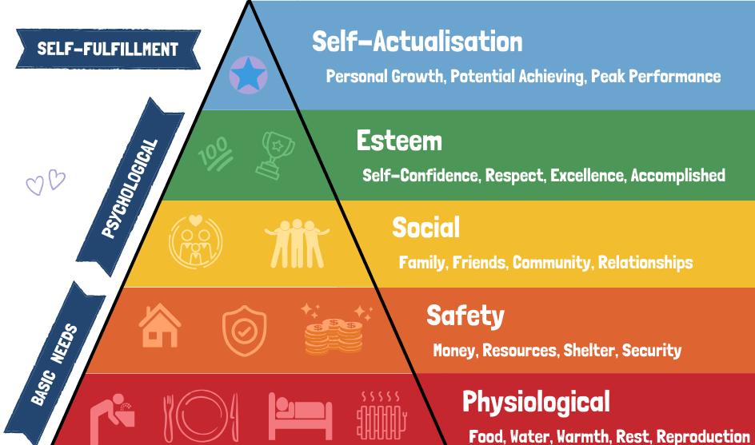
2- Personal Values of Recreational Involvement
    2.2.1- Key Emotional Benefits of Recreation:
    Self-Actualization
    Play and recreation can achieve at least the last three, highest levels of need in Maslow's hierarchy where,
    - Group games, clubs, team sports, and social events
    foster connection and companionship.
    Esteem:
    Achieving goals in recreation enhances self-respect
    and recognition.
    Self-Actualization:
    -Personal challenges, and meaningful leisure pursuits
    help individuals express their true selves.

Slide 13
2- Personal Values of Recreational Involvement
    2.3- Social Values of Recreation
    - Many adults today form their most meaningful social relationships during leisure time.
    - This happens through:
    Voluntary associations
    Recreational activities
    Cultural or religious events
    Volunteer work

Slide 14
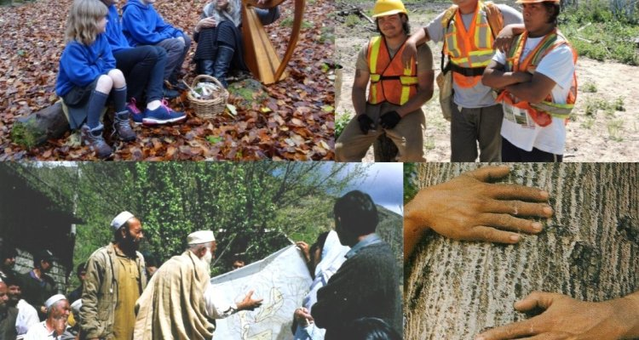
2- Personal Values of Recreational Involvement
2.4- Spiritual Values
    - Not limited to religion
    - Refers to humanity’s higher nature
    - A sense of moral values
    - Development of inner awareness
    - Respect for other humans

Slide 15
2- Personal Values of Recreational Involvement
2.4- Spiritual Values
    - How Recreation Contributes:
    Expression of the Best Self:
    In leisure, people can act authentically, without external pressures or obligations.
    Time for Reflection:
    Leisure allows for contemplation
    Disinterested Activity:
    Activities are done for their intrinsic joy and meaning.
    Human Connection:
    People come together simply as individuals, by shared interests.

Slide 16
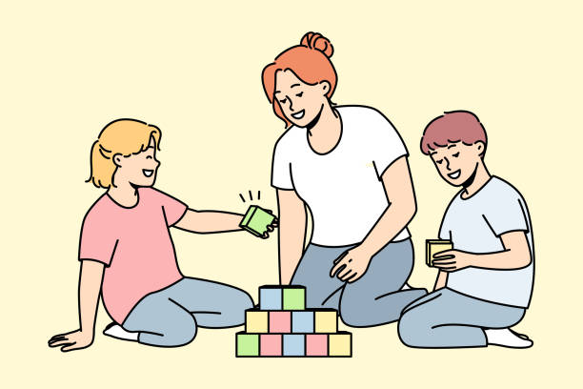
2- Personal Values of Recreational Involvement
2.5- Intellectual Values
- Recreation can stimulate the mind, encourage learning, and foster creativity
Mental Stimulation
- Strategy games, reading, or learning new skills keep the
brain active and engaged.
- Creative Expression
- Arts, crafts, writing, music, and performance allow
individuals to use imagination and develop originality.

Slide 17
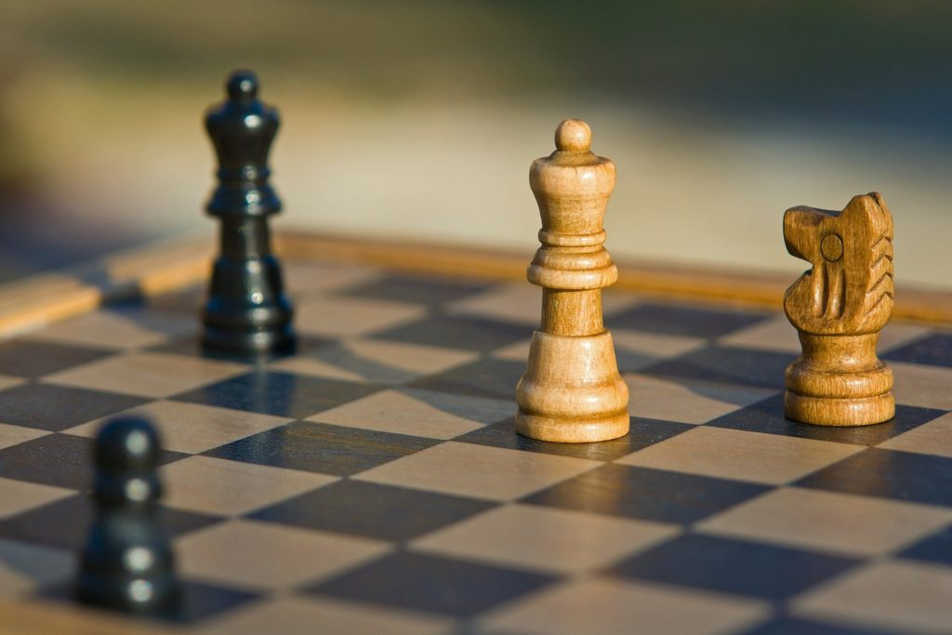
2- Personal Values of Recreational Involvement
2.5- Intellectual Values
Critical Thinking and Problem Solving
- Activities like chess or simulations promote analytical
thinking and decision-making.
Curiosity and Exploration
- Travel, cultural events, museums, and nature experiences
inspire a desire for knowledge and discovery.

Slide 18
Discussion
What are the other personal values and benefits of recreational activities?

Slide 19
3- Leisure Constraints: Barriers to Participation
Leisure barriers are varied and include:
Lack of Free Time
- Busy work schedules, family responsibilities, or academic commitments.
Lack of Interest
- Some individuals may not feel motivated by recreational opportunities.
Lack of Money
- Participation in some activities requires financial resources.

Slide 20
3- Leisure Constraints: Barriers to Participation
Lack of Facilities or Access
- Poor availability of recreational spaces or transportation can limit access.
Lack of Recreational Skills
- Individuals may avoid activities they feel unskilled or unprepared for, fearing failure or embarrassment.

Slide 21
4- Recreation Supply
    Definition:
    “Recreation supply includes the total set of opportunities, programs, and physical spaces provided by public, private, and nonprofit sectors to meet the recreational needs and preferences of a population”.

Slide 22
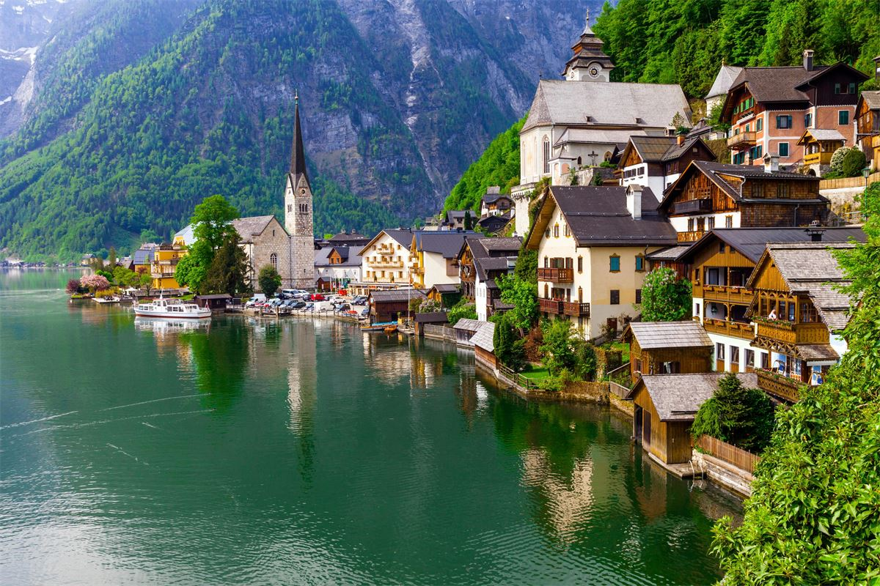

4- Recreation Supply
    4.1- Supply Components:
    Natural Attractions:
Climate | Beaches
Landscape | Fauna and flora
Waterfalls | Lakes
Mountains

Slide 23
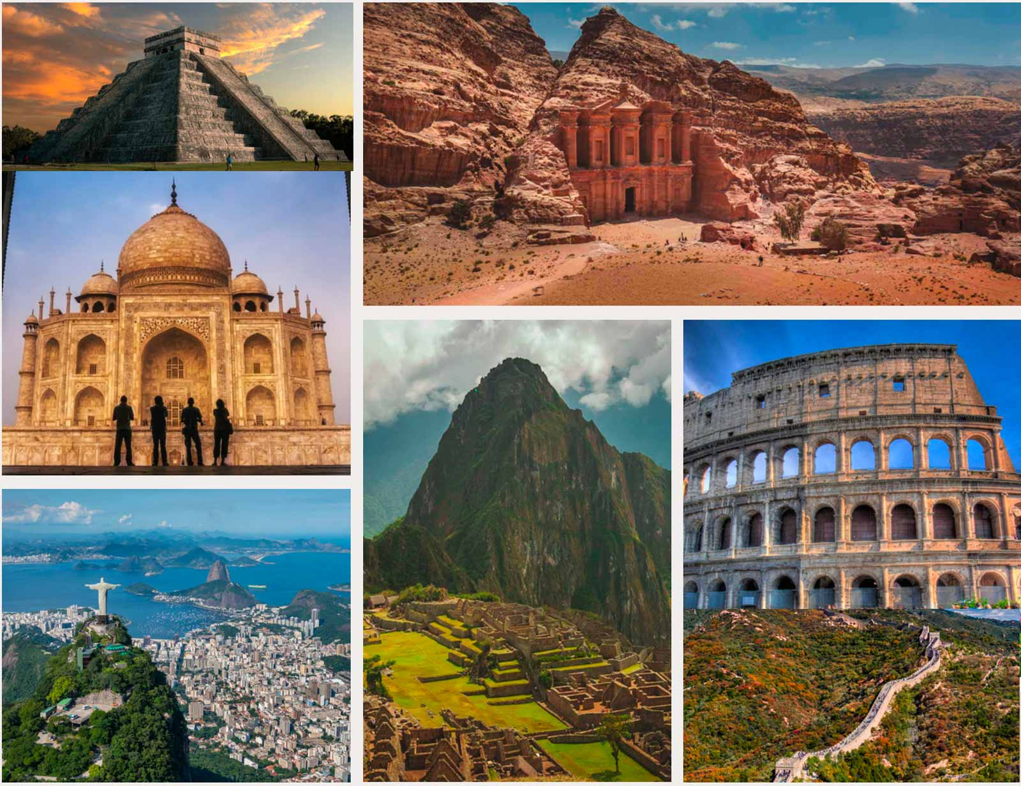
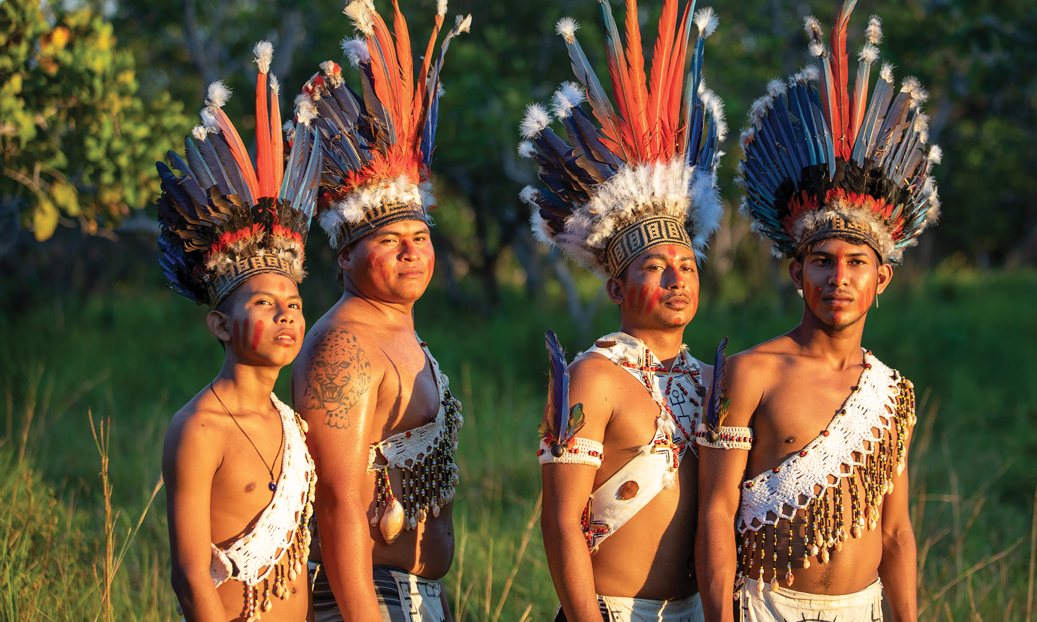
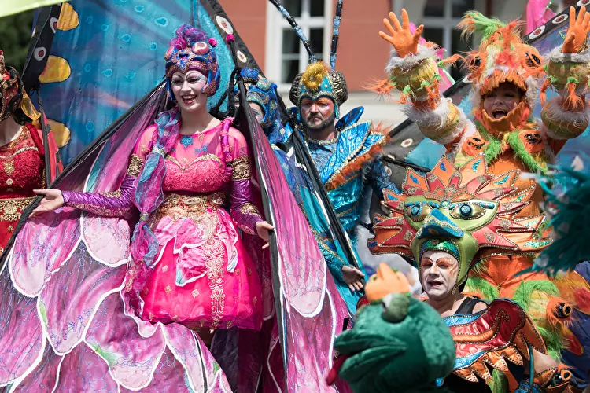
4- Recreation Supply
    4.1- Supply Components:
    Man-Made Attractions:
    Built Attractions
    Cultural Attractions
    Social Attractions

Slide 24
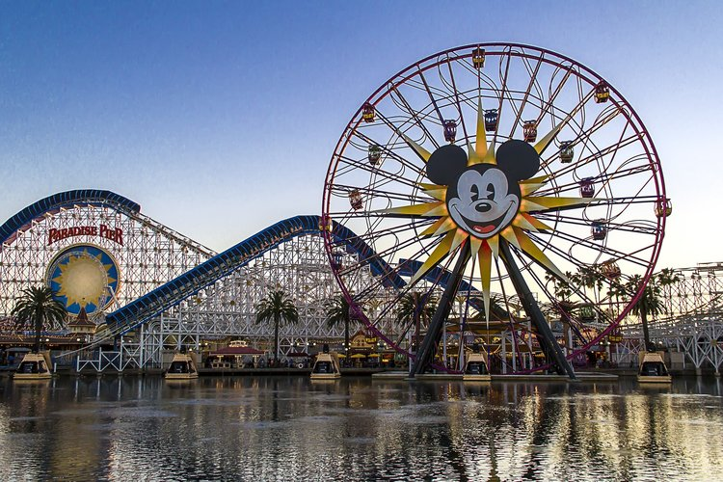
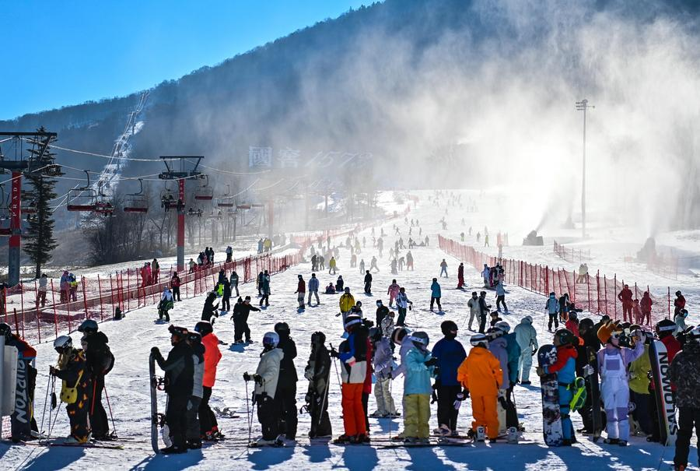
4- Recreation Supply
    4.1- Supply Components:
    Purpose-Built Attractions:
Theme parks | Ski tracks
Festivals | Events
Spas | Lakes

Slide 25
4- Recreation Supply
    4.2- Factors affecting Supply:
    A- Pricing
    - Prices are set based on demand, perceived value, and availability
    The Natural and Socio-Cultural Attractions:
    - Can be part of the leisure supply
    - Their inherent value can drive up prices

Slide 26
4- Recreation Supply
Free of charge Discounted
Discounted
Membership-based
    4.2- Factors affecting Supply:
    Varied Pricing Models:
    Some recreational activities are:
    Free of charge (public parks)
    Discounted (student or senior rates)
    Membership-based (gyms, clubs)

Slide 27
4- Recreation Supply
    4.2- Factors affecting Supply:
    B- Changes in Technology
    - Example: Development of jumbo jets
    Impact:
    - Increases the number of available seats per flight
    - Reduces cost per traveler, making package tours more affordable
    - Expands access to international leisure travel

Slide 28
5- Recreation and Leisure-Service Providers
      5.1- Government agencies:
      Federal agencies
      State and provincial agencies
      Local departments of recreation and parks

Slide 29
5- Recreation and Leisure-Service Providers
      5.2- Voluntary organizations:
      Nongovernmental agencies
      Nonprofit in nature
      They can be:
      Sectarian or Nonsectarian
      They serve:
      The public at large
      Or selected elements of the public

Slide 30
5- Recreation and Leisure-Service Providers
      5.3- Private membership organizations :
      Their main functions:
      Provide recreational and social activities
      support community recreation needs as well
Golf clubs | Tennis clubs
Yacht clubs | Athletic clubs
Country clubs

Slide 31
5- Recreation and Leisure-Service Providers
      5.5- Commercial recreation enterprises are:
      Privately owned
      Operated for profit
      They include a wide variety of businesses such as:
Bowling alleys | Ski centers
Nightclubs | Movie houses or theaters
Health spas or fitness centers | Amusement parks or theme parks

Slide 32
Discussion
What are the most popular recreational activities in your country and who are the main providers of these activities

Slide 33
Thank you
      European Institute of Innovation, Entrepreneurship and Technology
      Lessingstraße 79,
      13158 Berlin, Germany
      Phone: +49 176 55524449
      Email: info@eiiet.com
Discover the world of eiIET

