Slide 1
Tourism Law and Legislation
European Institute of Innovation, Entrepreneurship and Technology
Lessingstraße 79, 13158 Berlin, Germany
Mahmoud Abdou| Berlin
      Lessingstraße 79,
      13158 Berlin, Germany
      Phone: +49 30 233618555
      Fax: +49 30 233618556
      Email: info@eiiet.com

Slide 2
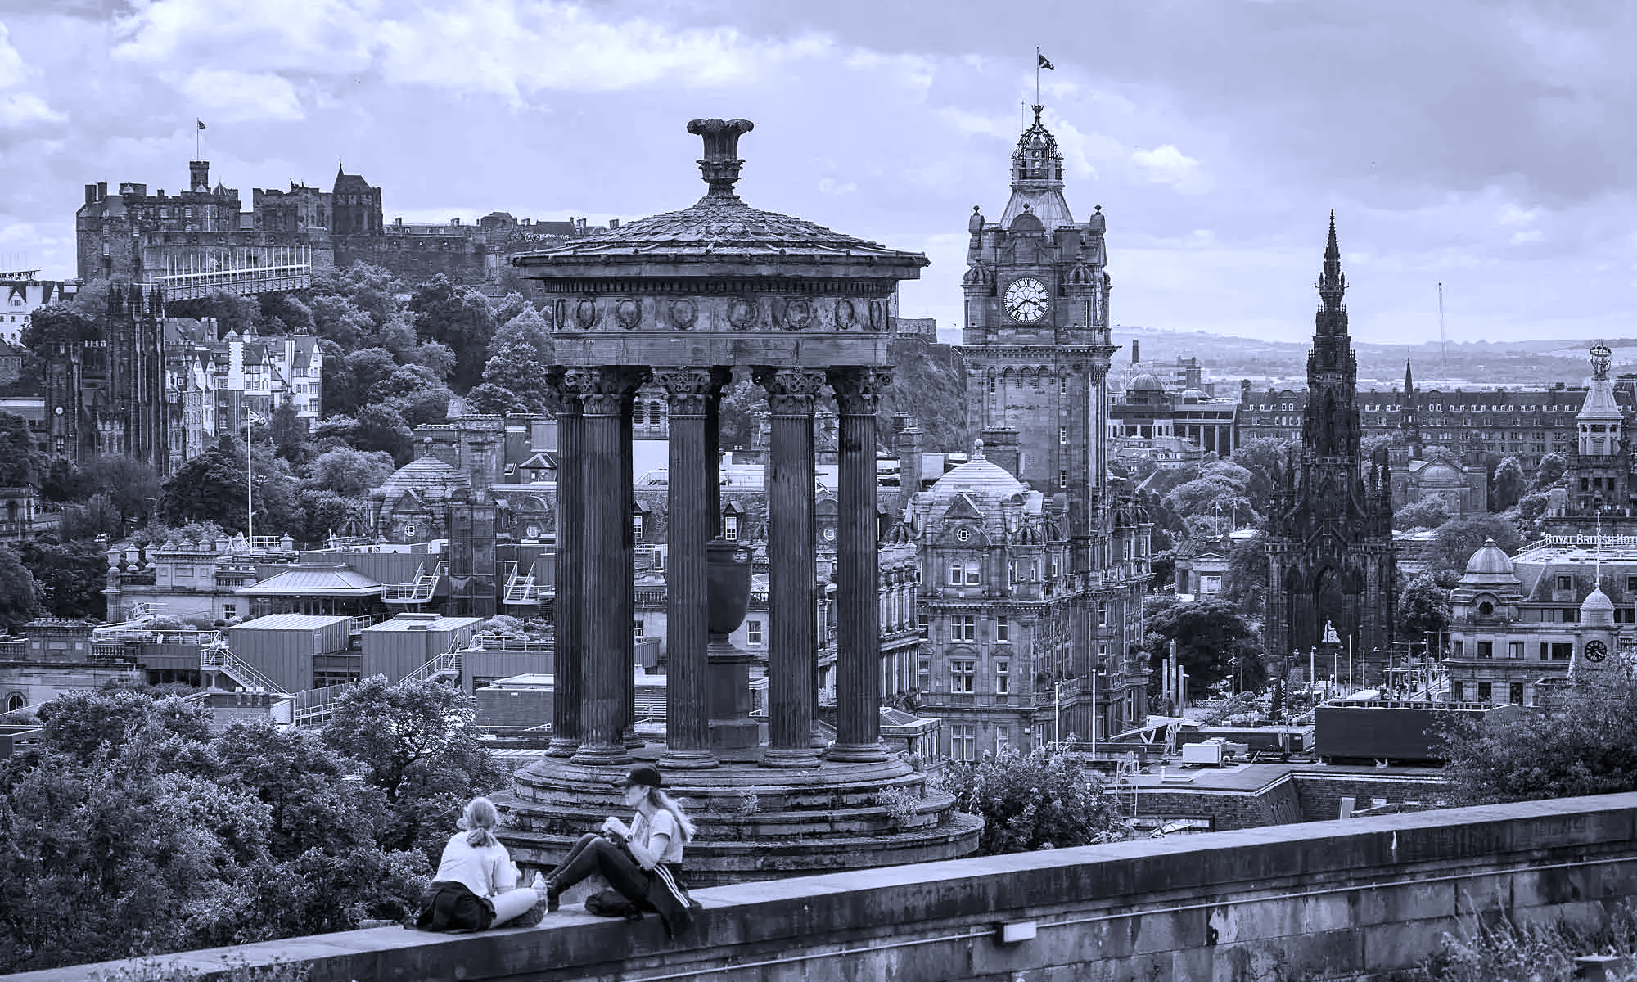
Outline:
1- Structure of UNWTO - Policy making
2- The Subsidiary Bodies of UNWTO
3- The Significance of the Manila Declaration
4- Key Themes of the Manila Declaration

Slide 3
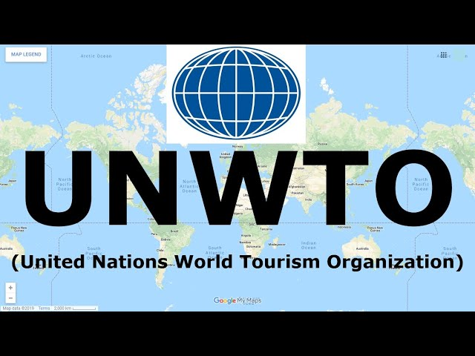
1- STRUCTURE OF UNWTO - POLICY MAKING

Slide 4
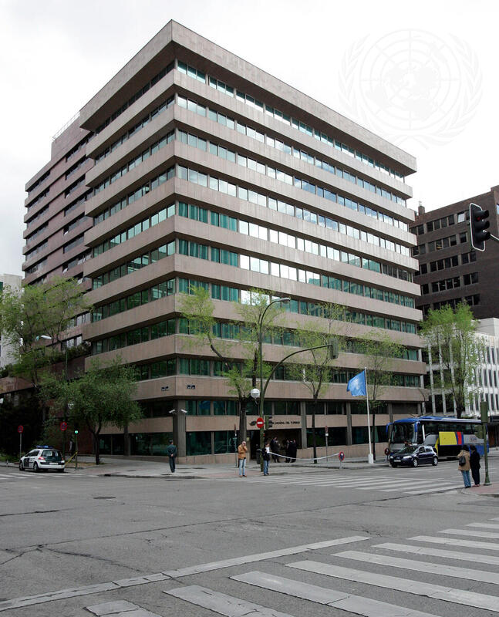
1- Structure of UNWTO - Policy making
A- The General Assembly
- It consists of all Member States
- Adopts decisions in the form of resolutions
- Throughout the years, it has adopted a series of recommendations and declarations.
- For instance, the Manila Declaration on World Tourism in 1980.
- And the Chengdu Declaration on Tourism and the Sustainable Development Goals in 2017.

Slide 5
1- Structure of UNWTO - Policy making
B- The Executive Council
- It can also adopt decisions with internal or external effects.

Slide 6
1- Structure of UNWTO - Policy making
- Both the General Assembly and the Executive Council, have established temporary and permanent subsidiary, intergovernmental bodies.
- The main functions of these subsidiary organs include:
To address specific topics.
To submit recommendations back to them.

Slide 7
2- The Subsidiary Bodies of UNWTO
1.1- The Subsidiary Bodies of the General Assembly:
A- Regional Commissions
B- World Committee on Tourism Ethics
Africa - CAF | The Americas - CAM
East Asia and the Pacific – CAP | South Asia - CSA
Europe – CEU | Middle East - CME

Slide 8
2- The Subsidiary Bodies of UNWTO
1.2- The Subsidiary Bodies of the Executive Council:
- They have a technical nature
- There are 4 technical committees:
Committee on Statistics
Committee on Sustainability
Committee on Tourism and Competitiveness
Committee on Online Education

Slide 9
2- The Subsidiary Bodies of UNWTO
The Key Functions of the Subsidiary Bodies:
- Advisory and consultative role
- First validation step
- Develop technical outputs
- Guidelines and standards
- Submit to governing bodies
- Final approval by authorities

Slide 10
2- The Subsidiary Bodies of UNWTO
A- The Roles of the Committee on Statistics:
- UN recognizes UNWTO as the authority for tourism statistics
- Collects tourism data from countries
- Analyzes data for insights
- Publishes statistics for global use
- Standardizes statistical methods
- Improves quality and scope of tourism data
- Integrates tourism stats into UN system

Slide 11
2- The Subsidiary Bodies of UNWTO
Consequently, the Executive Council requires the collaboration of the Committee in:
- Propose initiatives for international tourism statistics
- Promote international comparability of data
- Support integration into national systems
- Help member countries improve their statistics
- Coordinate with other international statistical bodies

Slide 12
2- The Subsidiary Bodies of UNWTO
B- The Roles of the Committee on Sustainability:
- Promote sustainable tourism development and management
- Generate social, economic, and cultural benefits for destinations
- Minimize negative impacts on natural and socio-cultural environments

Slide 13
2- The Subsidiary Bodies of UNWTO
C- The Roles of the Committee on Competitiveness:
- Reinforcing global competitiveness
- Enhancing visitor experience and value
- Providing reliable market intelligence
- Creating stakeholder synergies

Slide 14
2- The Subsidiary Bodies of UNWTO
D- The Roles of the Committee on Online Education:
- Advise the Executive Council and the Secretary-General
- Provide recommendations on tourism education

Slide 15
3- THE MANILA DECLARATION ON WORLD TOURISM

Slide 16
3- The Manila Declaration on World Tourism
- Adopted at the World Tourism Conference, Manila, in 1980.
Main aim:
- Clarify the true nature of tourism
- Redefines tourism as more than an economic activity
- Emphasizes tourism’s role in social, cultural, ethical, political, and human development

Slide 17
4- Key Themes of the Manila Declaration
Key Aspects Included in the Declaration:
- Tourism as a Human and Social Activity
- Tourism and Peace
- Tourism and Development
- Social Tourism and Inclusiveness
- Protection of Culture, Heritage, and the Environment
- Ethics, Education, and Human Values

Slide 18
4- Key Themes of the Manila Declaration
Tourism as a Human and Social Activity:
- Tourism is an essential activity for the life of nations
- It affects social, cultural, educational, and economic sectors
- Tourism is closely linked to the right to rest, leisure, holidays, and freedom of travel.

Slide 19
4- Key Themes of the Manila Declaration
Tourism and Peace:
- It highlights the connection between tourism and peace:
- Tourism can only develop in a climate of peace and security
- Tourism itself is seen as a force for world peace
- It promotes mutual understanding, respect, and confidence among peoples and nations

Slide 20
4- Key Themes of the Manila Declaration
Tourism and Development:
- It emphasizes tourism’s role in:
Economic and social development
Reducing the gap between developed and developing countries
Contributing to a new international economic order based on equity and cooperation

Slide 21
4- Key Themes of the Manila Declaration
Social Tourism and Inclusiveness:
- Strong support for social tourism
- Tourism should be accessible to all: youth, elderly, disabled, low-income groups
- Governments have a responsibility to support tourism access for less privileged citizens

Slide 22
4- Key Themes of the Manila Declaration
Protection of Culture, Heritage, and the Environment:
- Tourism resources are part of the heritage of mankind
- Uncontrolled tourism can lead to deterioration or destruction
- States have a fundamental responsibility to protect:
Natural resources
Historical, cultural, and religious sites
Local communities’ social and economic interests

Slide 23
4- Key Themes of the Manila Declaration
Ethics, Education, and Human Values:
- It emphasizes spiritual and ethical values
- Tourism should prioritize:
Human dignity
Cultural authenticity
Education
- Moral and spiritual development over purely technical or material considerations

Slide 24
DISCUSSION
- What are the main key themes covered in Part B of the Manila Declaration on World Tourism?

Slide 25
Thank you
      European Institute of Innovation, Entrepreneurship and Technology
      Lessingstraße 79,
      13158 Berlin, Germany
      Phone: +49 176 55524449
      Email: info@eiiet.com
Discover the world of eiIET

