Slide 1
Presentation Title
European Institute of Innovation, Entrepreneurship and Technology
Lessingstraße 79, 13158 Berlin, Germany
Presenter Name| Berlin
      Lessingstraße 79,
      13158 Berlin, Germany
      Phone: +49 30 233618555
      Fax: +49 30 233618556
      Email: info@eiiet.com

Slide 2
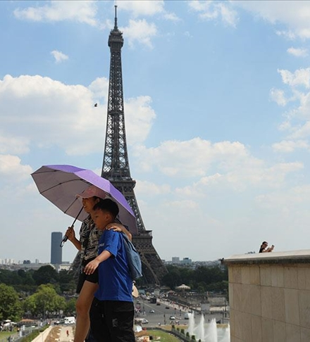
Index
- Climate Change and Heat Waves
Climate Change and Its Impact on Tourism
Air Pollution and Its Impact on Tourism
Air Pollution and Destination Image
UV Radiation and Travel Health Risks

Slide 3
1- Climate Change and Heat Waves
      Heat Wave and Its Risks
      Definition:
      - Heat waves are periods of hot weather lasting several days
      Heat waves amplify multiple risks, including:
      - Health risks: Increased human mortality and heat-related illnesses
      - Environmental risks: Drought, poor water quality, wildfires, and smoke
      - Economic risks: Power shortages, agricultural losses, and damage to tourism

Slide 4
1- Climate Change and Heat Waves
      Hot weather significantly increases the risk of:
      - Cardiopulmonary issues
      - Mental health disorders
      - Skin cancers (dermatological malignancies)
      - Allergies
      - Renal function loss
      - Tropical infections
      - Heat stroke and heat exhaustion
      - Adverse pregnancy outcomes

Slide 5
1- Climate Change and Heat Waves
      Regional Trends and Alarming Data
      Heat waves are increasing in:
      - Frequency
      - Relative and absolute intensity
      - Duration
      - Since 1950, a significant upward trend has been recorded across Europe.
      In South-Eastern Europe and Scandinavia:
      - Extra 10 hot days per decade since 1960

Slide 6
1- Climate Change and Heat Waves
      Wider Regional Findings (1951–2010):
      Study of 59 weather stations across:
      - Eastern Europe - The Caucasus
      - The Russian Federation - Central Asia
      - Found a clear rise in the frequency of extremely hot summers
      - While 1 extreme summer occurred in the first 30 years,
      - 5 occurred in the last 10 years of the study period

Slide 7
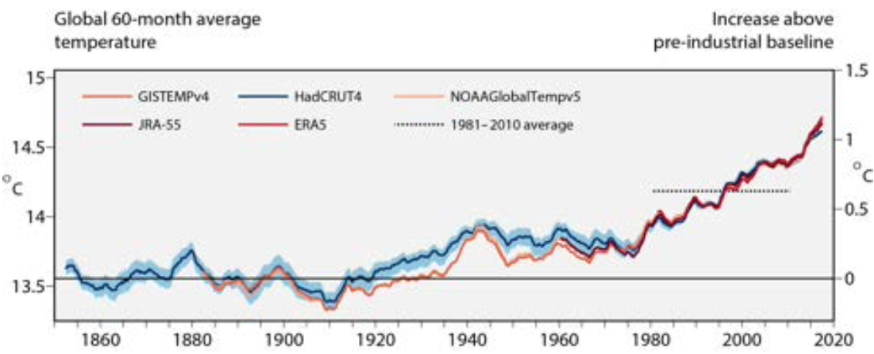
1- Climate Change and Heat Waves
      - Pre-1900 temperatures were fairly stable and low (near or just above 13.5°C).
      - After 1950, temperatures begin to rise more sharply.
      - Since around 1980,
      the temperature rise becomes
      rapid and consistent.
      - By 2020, global temperatures
      are about 1.2°C above the
      pre-industrial baseline.

Slide 8
1- Climate Change and Heat Waves
      Heat Waves and Human Health – Summer 2019
      - In June 2019, a heat wave affected south-western and central Europe, causing several deaths in Spain and France.
      - A more severe heat wave occurred in late July 2019, affecting much of central and western Europe.
      Health Impacts Reported:
      Netherlands:
      - 3,000 deaths
      England (UK):
      - 572 excess deaths in people aged 65
      France (June–Sept 2019):
      - 20,000 visits for heat-related illnesses
      - 5,700 home doctor visits

Slide 9
1- Climate Change and Heat Waves
      Heat-Related Health Impacts in Asia:
      - Significantly affect Thailand, India, Vietnam and Myanmar
      Thailand:
      - 2,500–3,000 cases of heat-related illness annually
      India (2017–2021):
      - 31,000 heat-related deaths

Slide 10
2- Climate Change and Its Impact on Tourism
      Climate change is causing several adverse environmental effects:
      - Increases in temperature
      - Changes in humidity
      - Flooding
      - Droughts
      - Unpredictable weather conditions

Slide 11
2- Climate Change and Its Impact on Tourism
      These environmental changes are leading to:
      - More frequent and intense extreme weather events
      - Disruption of tourism activities and destinations
      - Challenges in seasonal planning and tourist satisfaction
      - Reduced attractiveness of some destinations
      - Strain on infrastructure and local communities

Slide 12
2- Climate Change and Its Impact on Tourism
      Climate conditions are a critical resource for tourism:
      - Tourism activities depend heavily on nature and landscapes.
      - However, they are most vulnerable to climate change
      Suitable weather (sunshine, mild temperatures) is essential for:
      - Visitor comfort and satisfaction
      -Outdoor activities and sightseeing
      - Seasonal tourism patterns (beach or ski tourism)

Slide 13
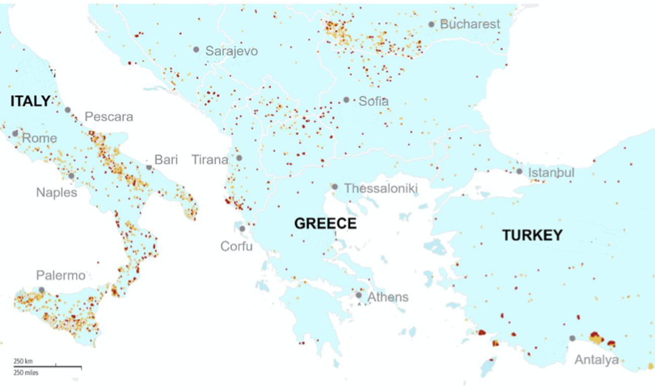
2- Heat Waves and Its Impact on Tourism
      A specific climate-related problem increasingly affecting tourism:
      Heat waves
      Heat waves in 2021 led to:
      - Very long dry periods across various regions
      - Widespread forest fires
      - Forest fires occurred not only in tropical
      countries, but also in:
      Europe
      North America
Source: Filho, (2021).

Slide 14
2- Heat Waves and Its Impact on Tourism
      Heat waves of increasing intensity have three major impacts on the tourism sector:
      Reduced Comfort for Tourists
      - Extremely high temperatures make coastal and inland destinations less enjoyable
      - Outdoor activities become difficult or even dangerous

Slide 15
2- Heat Waves and Its Impact on Tourism
      Heat waves of increasing intensity have three major impacts on the tourism sector:
      - Increased Risk of Wildfires
      - 2021 saw major fires in:
      California and British Columbia (North America)
      Greece and Turkey (Europe)
      - Fires threaten natural attractions and tourism infrastructure

Slide 16
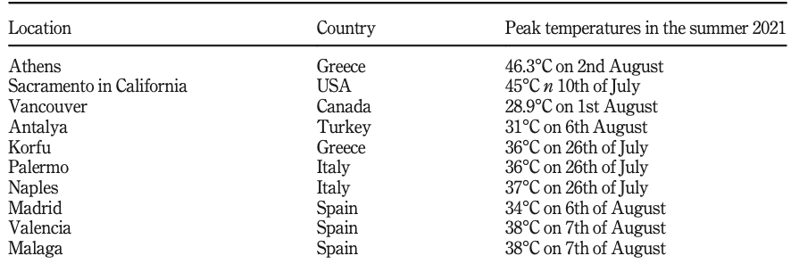
2- Heat Waves and Its Impact on Tourism
      Heat waves of increasing intensity have three major impacts on the tourism sector:
      Health Risks for Vulnerable Groups
      - Tourists who are elderly, very young,
      or with medical conditions face greater risks
      - Heat poses serious challenges to human
      health and safety.
Source: Filho, (2021).

Slide 17
2- Heat Waves and Its Impact on Tourism
      Heat-Related Illness (HRI) in Mass Gatherings
      HRIs are a major health threat during large events, including:
      - The Hajj pilgrimage
      - World Cup and Olympic Games
      Key contributing factors during these events:
      - Insufficient airflow
      - Limited access to drinking water
      - Body heat from large crowds
      - Heat emission from buildings, vehicles, and infrastructure
      -Lack of shade or cooling zones

Slide 18
2- Heat Waves and Its Impact on Tourism
      Understanding Heat-Related Illnesses (HRI)
      HRI includes a spectrum of conditions:
      Mild: Heat cramps
      Moderate: Heat exhaustion
      Severe: Heat stroke (life-threatening)

Slide 19
2- Heat Waves and Its Impact on Tourism
      Understanding Heat-Related Illnesses (HRI)
      Risk factors for HRI in travellers:
      - High temperatures and humidity
      - Very young or elderly individuals
      - Pre-existing health conditions
      - Strenuous physical activity
      - Inadequate hydration

Slide 20
2- Heat Waves and Its Impact on Tourism
      Heat waves and Tourism

Slide 21
3- Air Pollution and Its Impact on Tourism
      Air Pollution – A Global Health Threat
      - Air pollution causes 1 in 8 deaths worldwide each year
      - Most people are exposed to 3x the WHO's safe limit for particulate matter
      Health Effects of PM – Based on Particle Size:
      - Some PM Lodges in the lungs
      - Others penetrate alveoli, enters bloodstream
      - Triggers inflammation, oxidative damage, vascular dysfunction

Slide 22
3- Air Pollution and Its Impact on Tourism
      Air Pollution is defined as:
      - the presence of harmful and toxic solid, liquid, or gaseous substances, or their combinations, within a specific layer of the atmosphere at concentrations that are harmful or uncomfortable for humans, negatively affecting their health and overall quality of life.
      - the contamination of indoor or outdoor environments by chemical, physical, or biological agents that alter the natural properties of the atmosphere (WHO, 2016).

Slide 23
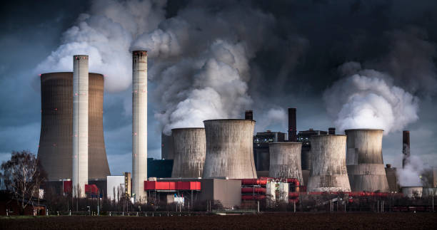
3- Air Pollution and Its Impact on Tourism
      The common features of these definitions of air pollution include
      - Presence of Harmful Substances
      - Alteration or Contamination
      - Environmental Scope
      - Impact on Health and Quality of Life
      - alters the atmosphere.

Slide 24
3- Air Pollution and Its Impact on Tourism
      Air pollution sources are classified as:
      Natural Sources
      - Originating from natural processes in the environment
      Anthropogenic Sources
      Resulting from human activities, such as:
      - Emissions from motor vehicles and fuels
      - Emissions from home heating in municipal and residential areas
      - Other industrial and urban activities

Slide 25
3- Air Pollution and Its Impact on Tourism
      Air Pollution Risks for Travellers
      - Traveling involves various health risks, including those from air pollution
      - Travellers arriving in urban areas during pollution episodes face high exposure to harmful pollutants
      - Visitors often lack adaptation to local air quality conditions
      - They may also miss precautionary advice to reduce health risks

Slide 26
3- Air Pollution and Its Impact on Tourism
      Short-Term Air Pollution Exposure and Traveller Health
      - Sudden exposure to high air pollution can harm travellers’ cardiopulmonary systems
      - Air pollution can cause diseases without long-term exposure
      Even short visits to polluted cities can trigger:
      - Respiratory symptoms
      - Cardiovascular events

Slide 27
3- Air Pollution and Its Impact on Tourism
      Environmental Quality, Tourism, and Health Risks
      Tourism depends heavily on the natural environment
      - A clean, pleasant environment is a key motivation for travel
      - Tourists seek destinations for relaxation and stress relief
      Environmental quality influences:
      - Tourist traffic and destination choice
      - Perceived well-being and health safety

Slide 28
3- Air Pollution and Its Impact on Tourism
      Environmental Quality, Tourism, and Health Risks
      Urban tourism challenges:
      - High levels of air pollution in many cities
      - Pose serious health risks to tourists, including:
      Respiratory diseases
      Circulatory disorders
      Cancer

Slide 29
3- Air Pollution and Its Impact on Tourism
      Air Pollution’s Impact on Tourism Competitiveness
      Air pollution is a major problem for the tourism industry
      - It decreases the quality of the tourist experience
      - Poor air quality can cause destinations to lose attractiveness
      - Tourists may avoid places where health risks are perceived
      Maintaining high environmental quality is crucial for:
      - Attracting visitors
      - Ensuring long-term tourism development
      - Enhancing destination competitiveness

Slide 30
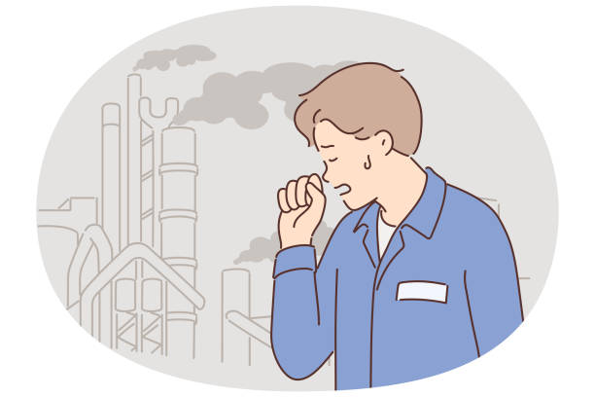
3- Air Pollution and Its Impact on Tourism
      Psychological and Behavioral Impacts of Air Pollution on Tourists
      Air pollution is a hazardous environmental condition that can trigger:
      - Negative emotions such as uncertainty, fear, and worry
      - Concerns over respiratory and cardiac health
      Examples of air pollution effects:
      - Smog and poor air quality may cause:
      Breathing difficulties
      Cardiovascular strain
      General discomfort and anxiety

Slide 31
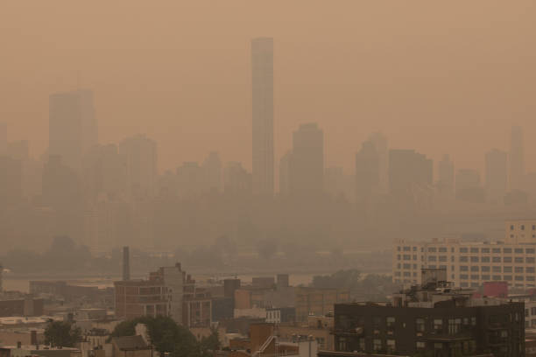
3- Air Pollution and Its Impact on Tourism
      Air Pollution, Smog, and Tourist Experience
      Smog and air pollution hinder tourism development:
      - Diminish the quality of the travel experience
      - Reduce visibility, which affects scenic enjoyment
      - Create health concerns, leading to uncertainty
      and worry.

Slide 32
3- Air Pollution and Its Impact on Tourism
      Air Pollution, Smog, and Tourist Experience
      Consequences for Tourism:
      Lower tourist satisfaction due to:
      Unrealized expectations
      Travel disruptions or changes
      - Reduced intention to revisit destinations

Slide 33
4- Air Pollution and Destination Image
      Destination Image and Revisit Intention
      Why Tourists Return:
      - A strong, positive image of the destination
      - High-quality previous experiences
      What Drives Revisit Intention:
      - Satisfaction with past trips
      - Memorable and enjoyable experiences
      - Emotional connection to the place
      - Met or exceeded expectations

Slide 34
4- Air Pollution and Destination Image
      Destination Image and Revisit Intention
      - Meteorological conditions shape destination image
      - Air pollution can harm travel experience
      - Poor air and water quality influence destination choice
      - Air pollution reduces international and domestic tourism
      - Environmental quality is critical to tourist appeal

Slide 35
5- UV Radiation and Travel Health Risks
      International travelers face increased UV exposure, especially in:
      - Sunnier climates
      - Lower latitudes
      - Higher altitudes
      - Snow-covered environments (skiing)
      Short-term risks:
      - Sunburn - Eye irritation
      - Long-term risks:
      - Premature skin aging - Cataracts
      - Skin cancers

Slide 36
5- UV Radiation and Travel Health Risks
      Environmental factors that determine the amount of UV that reaches the Earth’s surface include:
      - Time of year (stronger in summer)
      - Time of day (peak UV between 10 a.m. – 4 p.m.)
      - Latitude (stronger closer to the equator)
      - Altitude (higher elevation = more UV)
      - Geographic location and weather conditions

Slide 37
5- UV Radiation and Travel Health Risks
      Human behaviors determining how much UVR reaches a person’s body include:
      - Type of clothing and skin exposure
      - Outdoor activity type and duration
      - Time spent outside during peak UV hours
      - Use (or lack) of sun protection (sunscreen, hats, sunglasses)

Slide 38
5- UV Radiation and Travel Health Risks
      Sunburn
      - A common, preventable condition caused by UV exposure
      - Both UVA and UVB rays contribute to sunburn
      - Requires broad-spectrum sunscreen for protection

Slide 39
5- UV Radiation and Travel Health Risks
      Sunburn
      Clinical Features:
      - Mild: pink skin
      - Severe: red, painful skin with swelling or blisters
      - Exposed areas most affected
      Systemic Symptoms (Severe Cases):
      - Headache -Fever, chills
      - Nausea, vomiting. - Muscle aches

Slide 40
5- UV Radiation and Travel Health Risks
      Sun Exposure and Skin Cancer Risks
      Vacation Risks
      - Travel to sunny, warm destinations is a major risk factor for excessive UV exposure.
      - Resort holidays often lead to intentional suntanning and sunburns.
      Associated Findings
      - Studies in Europe, Australia, Canada, and the US show a strong link between vacationing and skin cancer risk.
      - Melanoma is associated with:
      - Lifetime recreational sun exposure
      - Beach and waterside activities
      - Holidays in sunny or mountainous areas

Slide 41
      Discussion
      Which groups are most vulnerable to heat-related illness while traveling?
      How can we protect ourselves from ultraviolet (UV)?

Slide 42
Thank you
      European Institute of Innovation, Entrepreneurship and Technology
      Lessingstraße 79,
      13158 Berlin, Germany
      Phone: +49 176 55524449
      Email: info@eiiet.com
Discover the world of eiIET

