Slide 1
Planning and Management of Sustainable Tourism Spaces
European Institute of Innovation, Entrepreneurship and Technology
Lessingstraße 79, 13158 Berlin, Germany
Mahmoud Abdou| Berlin
      Lessingstraße 79,
      13158 Berlin, Germany
      Phone: +49 30 233618555
      Fax: +49 30 233618556
      Email: info@eiiet.com

Slide 2
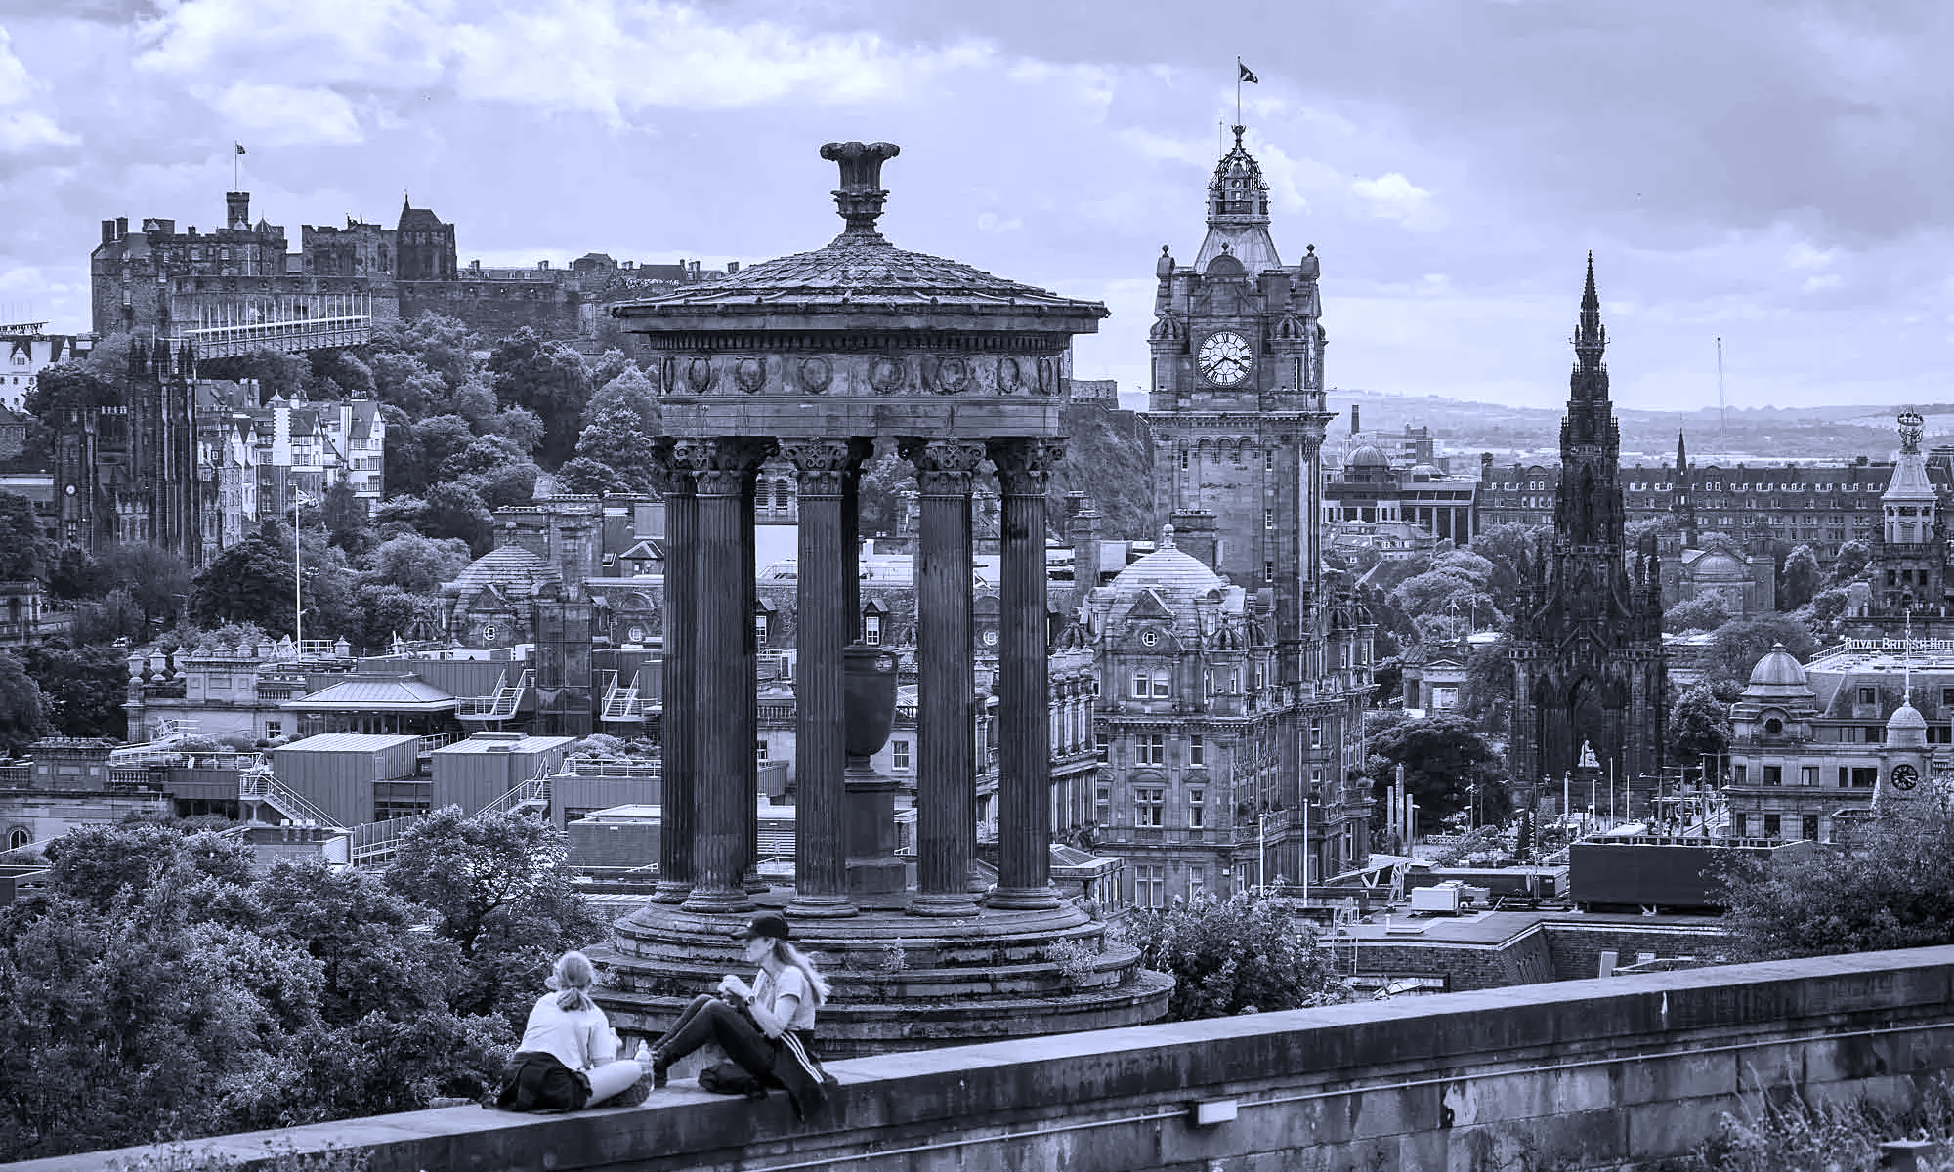
Outline:
1- Socio-Cultural Conflicts and Tourism
2- Environmental Crises and Tourism
3- Commercial Crises and Toursism

Slide 3
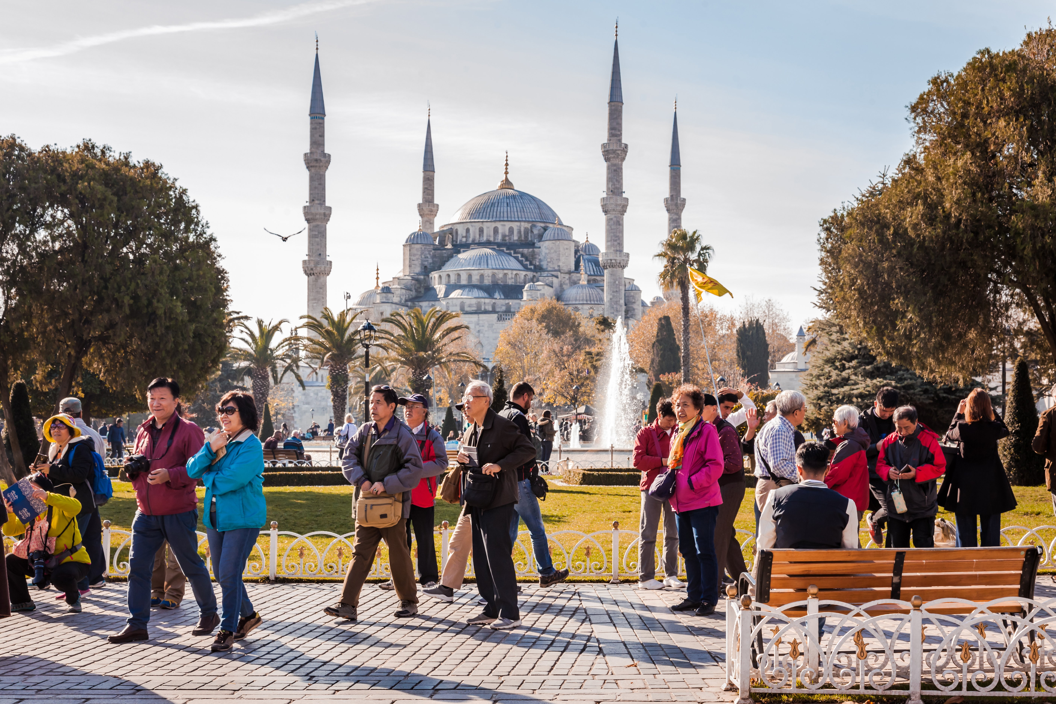
1- Socio-Cultural Conflicts and Tourism

Slide 4
1.1- Socio-Cultural Impacts of Tourism
It is defined as:
“Changes to societies and cultures at destinations as a result of tourism” (Henderson, 2007).

Slide 5
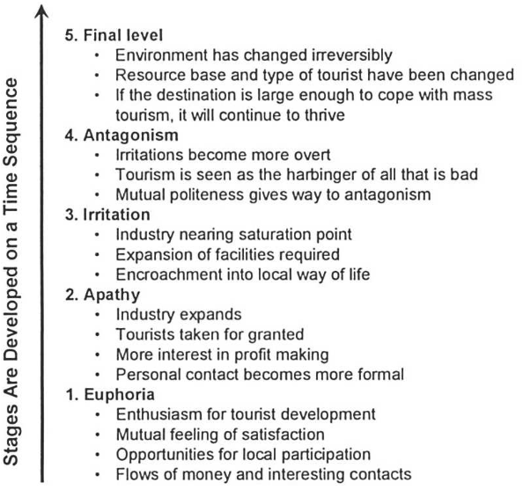
1.1- Socio-Cultural Impacts of Tourism
Doxey’s Irritation:
- Host–guest interactions can have positive
or negative effects.
- Doxey introduced an early model of these
interactions in 1975–1976.
- He developed a five-stage framework,
known as Doxey’s Irritation.

Slide 6
1.1- Socio-Cultural Impacts of Tourism
- The irritation stems from various factors:
The physical presence of tourists.
Their numbers and behavior matter.
Longer stays can increase irritation.
Cultural differences can create tension.
Foreign ownership can add to irritation.
Causes of Irritation

Slide 7
1.1- Socio-Cultural Impacts of Tourism
- At first, hosts usually feel positive about tourism.
- Over time, their attitudes can turn negative as pressure increases.
- Doxey’s model shows a one-way shift from euphoria to apathy, irritation, antagonism, and finally a last stage.
Causes of Irritation

Slide 8
1.1- Socio-Cultural Impacts of Tourism
- Euphoria:
Tourism creates excitement in the early stage.
Tourists are warmly welcomed because numbers are low.
Visitors respect locals and the place.
Interactions are lightly commercial and mutually satisfying.

Slide 9
1.1- Socio-Cultural Impacts of Tourism
Apathy:
Tourism grows and tourist numbers rise.
Locals start seeing tourists as part of daily life.
Tourists are viewed mainly as a source of income.
Interactions become formal and business-focused.

Slide 10
1.1- Socio-Cultural Impacts of Tourism
Irritation:
Hosts begin separating their private lives from tourists.
Local frustrations start to grow.
Irritation rises when tourism exceeds the destination’s capacity.

Slide 11
1.1- Socio-Cultural Impacts of Tourism
Antagonism:
Locals protest as resources strain and behavior issues appear.
Tension and conflict grow between hosts and tourists.
Tourists are blamed for negative changes.
Hosts become openly intolerant.

Slide 12
1.1- Socio-Cultural Impacts of Tourism
Final Level:
The destination loses appeal from overtourism.
Attractiveness declines.
Tourists move on to other places

Slide 13
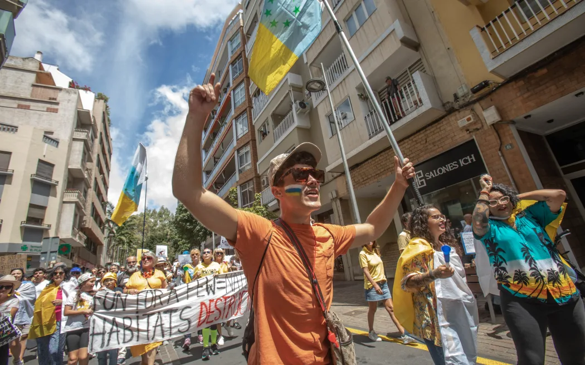
1.2- Socio-Cultural Tourism Crises
A- Mass Tourism
Barcelona, Mallorca, and Granada
The Canary Islands
Venice, Italy

Slide 14
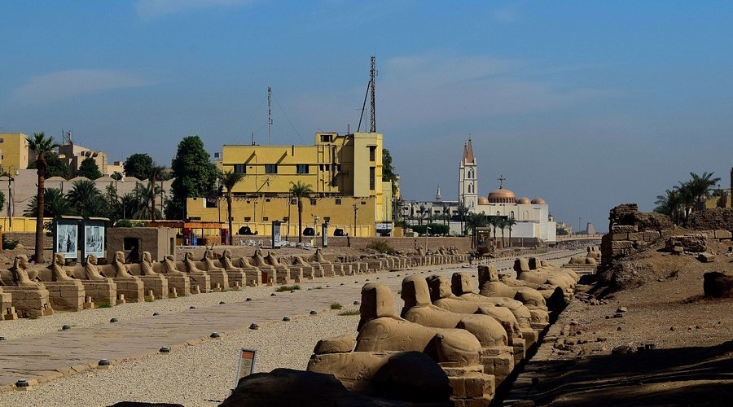
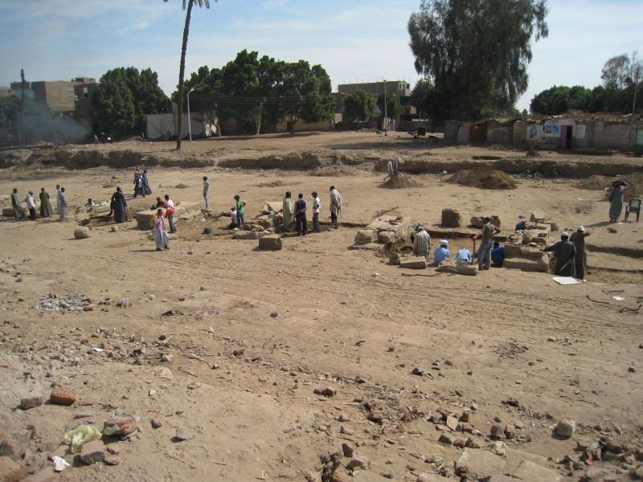
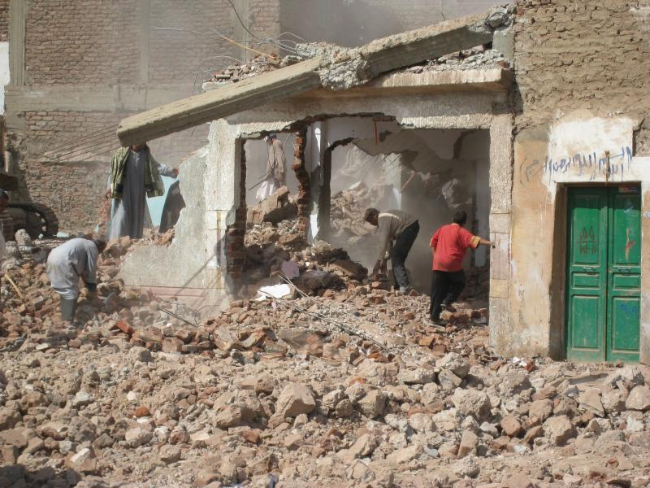
1.2- Socio-Cultural Tourism Crises
B- Tourism-Based Development
- Displacement of Local Community
- Inadequate Compensation

Slide 15
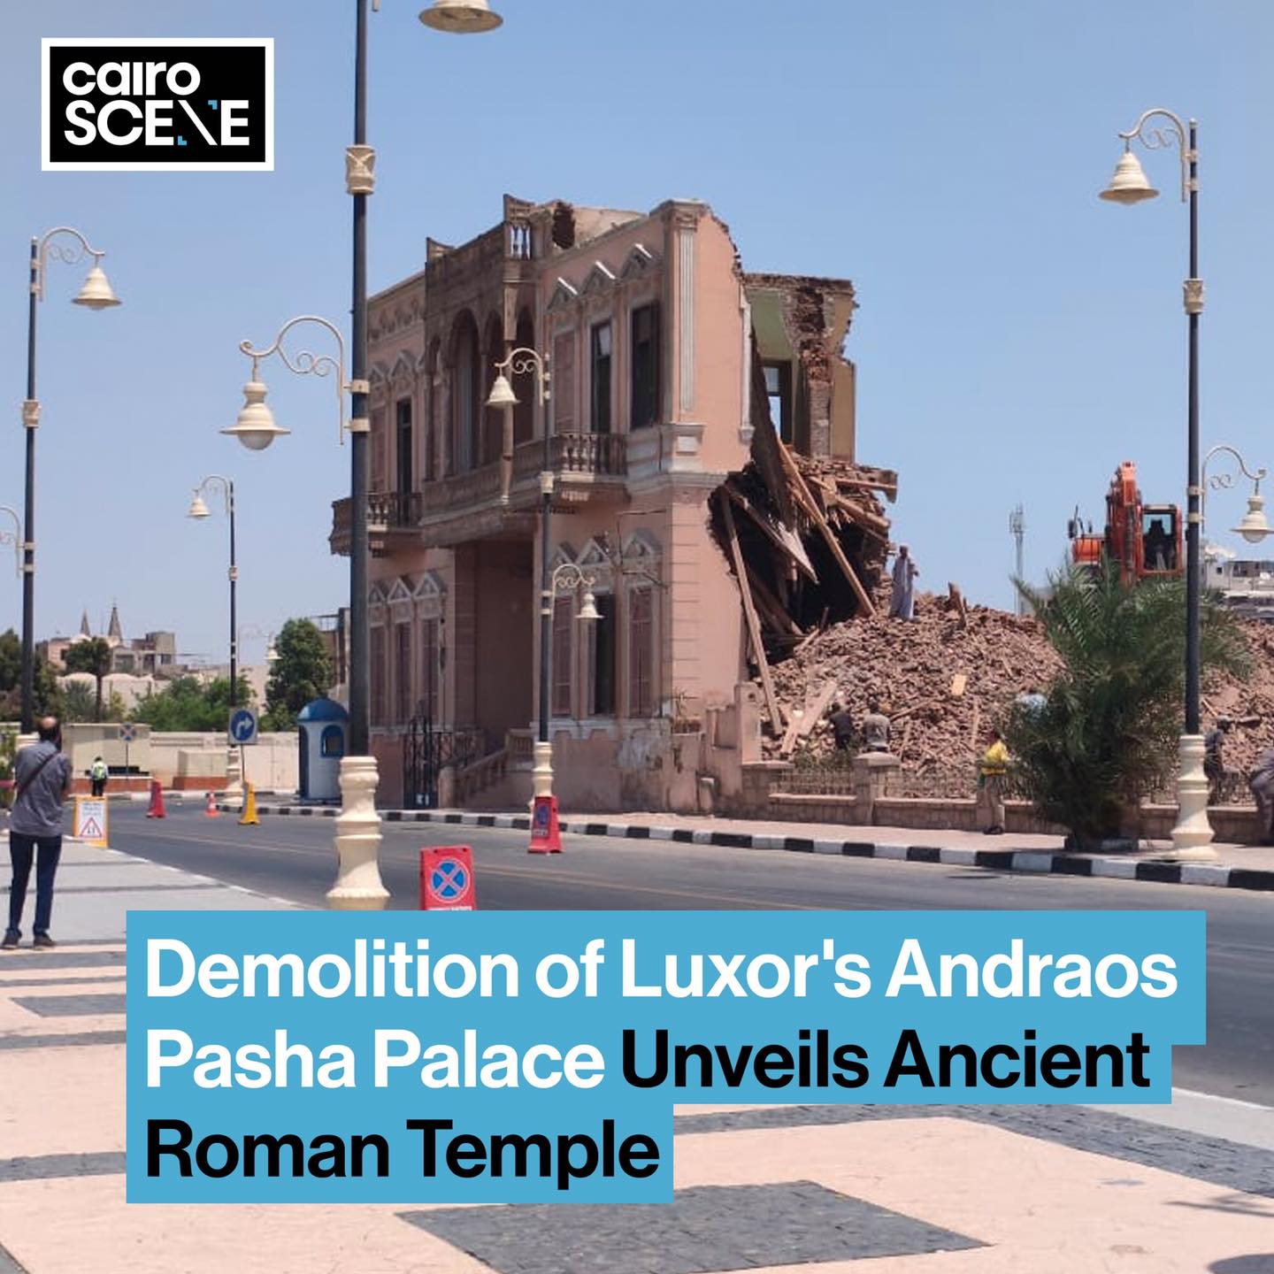
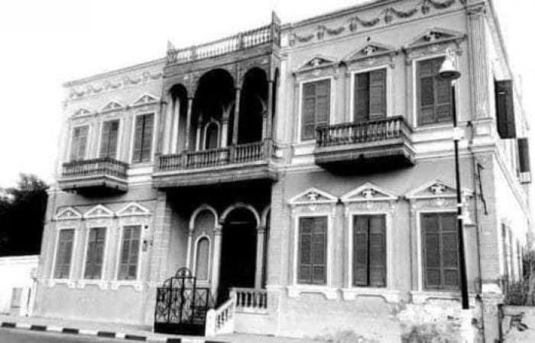
1.2- Socio-Cultural Tourism Crises
B- Tourism-Based Development
- The destruction of a 120-years old Andraos Palace in Luxor.

Slide 16
1.3- The Negative Socio-Cultural Impact of Tourism
- Tourism mainly affects the traditions and values of local communities.
- Locals face constant change, while tourists frequently move on.

Slide 17
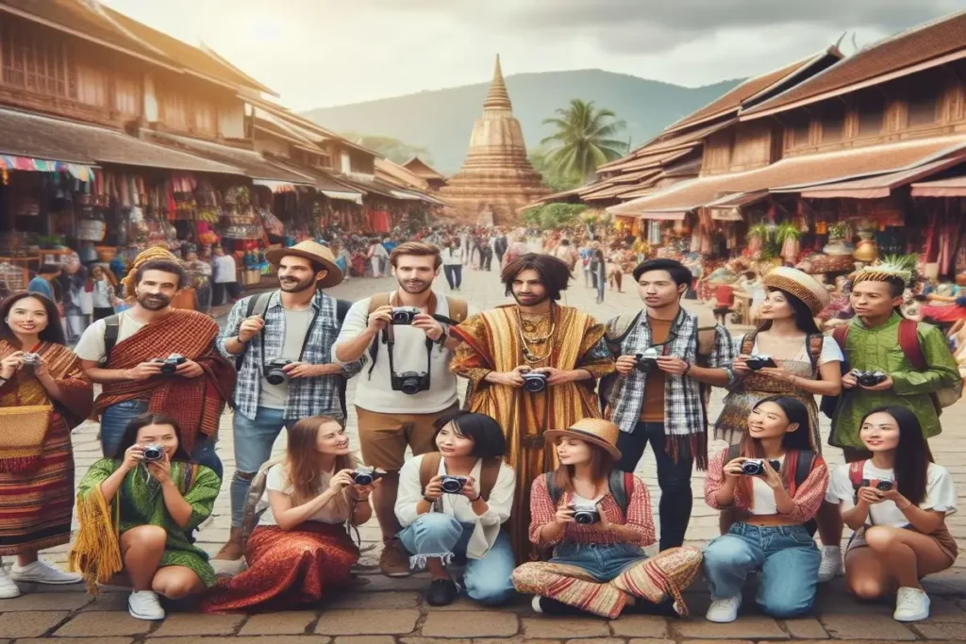
1.3- The Negative Socio-Cultural Impact of Tourism
A- Acculturation:
- One culture changes to fit another; sometimes both adapt, and changes may become permanent.
B- Cultural drift:
- Cultures adjust temporarily but return to their original state afterward.

Slide 18
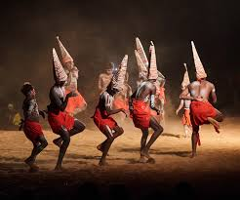
1.3- The Negative Socio-Cultural Impact of Tourism
C- Staged Authenticity:
- Tourists want to see or join traditional activities.
- This create tension between authenticity and commercialization.
- Some events are performed outside their original context for tourists, becoming “staged.”

Slide 19
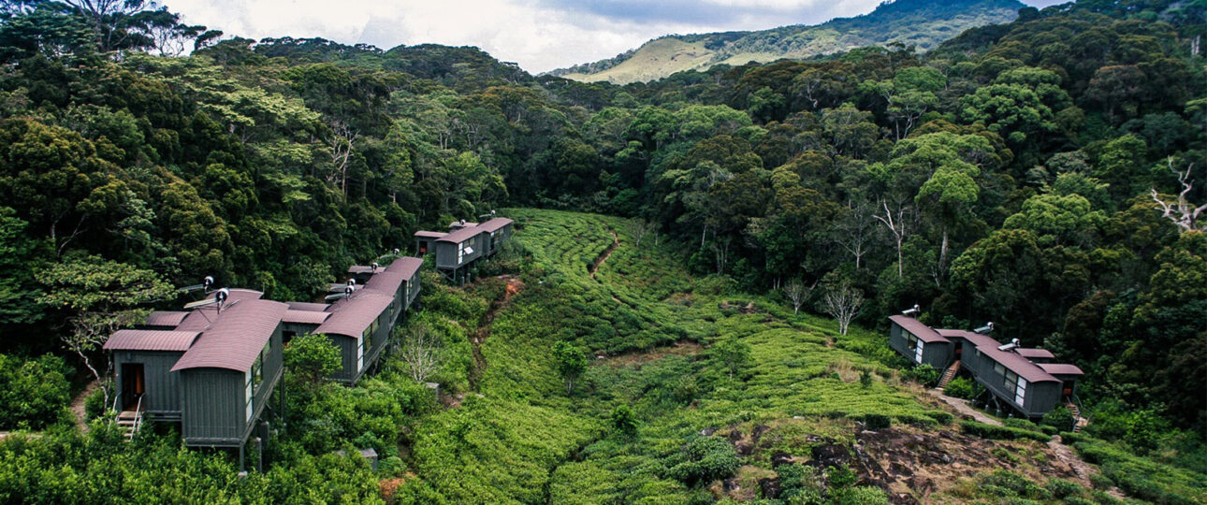
2- Environmental Crises and Tourism

Slide 20
2- Environmental Impacts of Tourism
- Tourism and the Environment:
Tourism infrastructure can cause erosion, flooding, and landslides.
Activities may harm ecosystems and threaten biodiversity.
Transport linked to tourism creates air, noise, and visual pollution

Slide 21
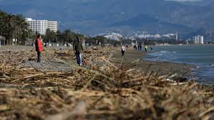
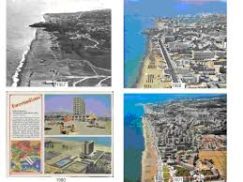
2.1- Uncontrolled Tourism Development and Environmental Hazards
The Case of Torremolinos, Spain:
- Torremolinos, a former fishing village, grew into a resort after WWII.
- Its crowded beaches and high-rise hotels attract budget tourists.

Slide 22
2.1- Uncontrolled Tourism Development and Environmental Hazards
The Case of Torremolinos, Spain:
- Limited Planning:
Congestion during peak seasons strained services and infrastructure.
- Environmental Degradation:
Beaches, sea, and inland areas were damaged.
- Symbol of Unplanned Tourism:
Torremolinos became an example of negative mass tourism.

Slide 23
2.1- Uncontrolled Tourism Development and Environmental Hazards
The Case of Torremolinos, Spain:
- Government Response:
Initiatives were launched to tackle environmental issues and prevent decline.
Supportive Reforms:
Reforms improved regional planning and coastal management in Spain.

Slide 24
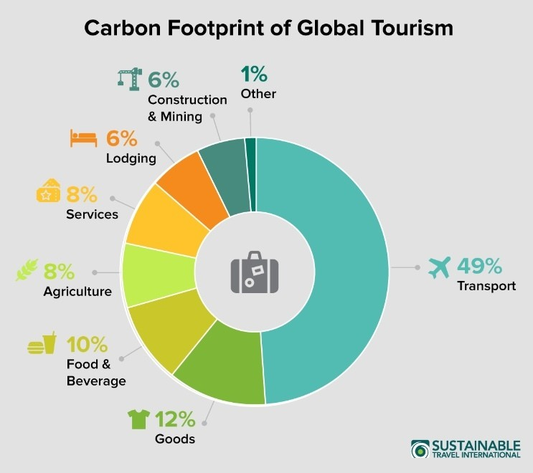
2.2- Global Warming and Tourism
- Tourism generates about 10% of global greenhouse gas emissions.
- Nearly half of transport emissions come from tourism.
- UNWTO forecasts tourism emissions will rise 25% from 2016 to 2030.
weforum.org

Slide 25
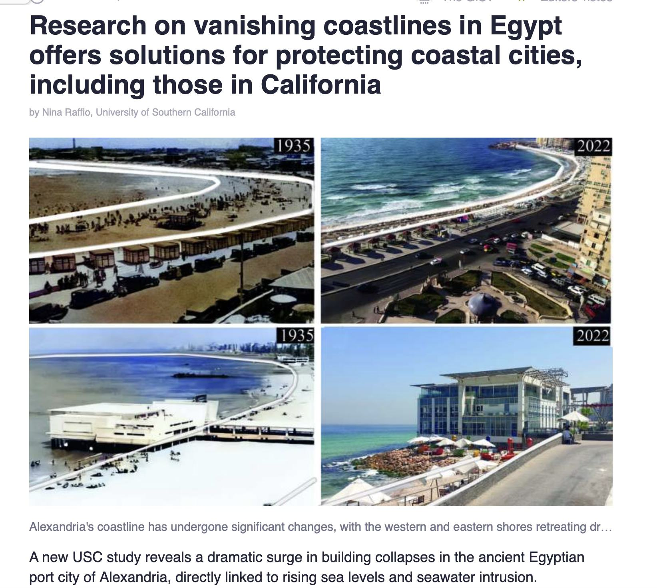
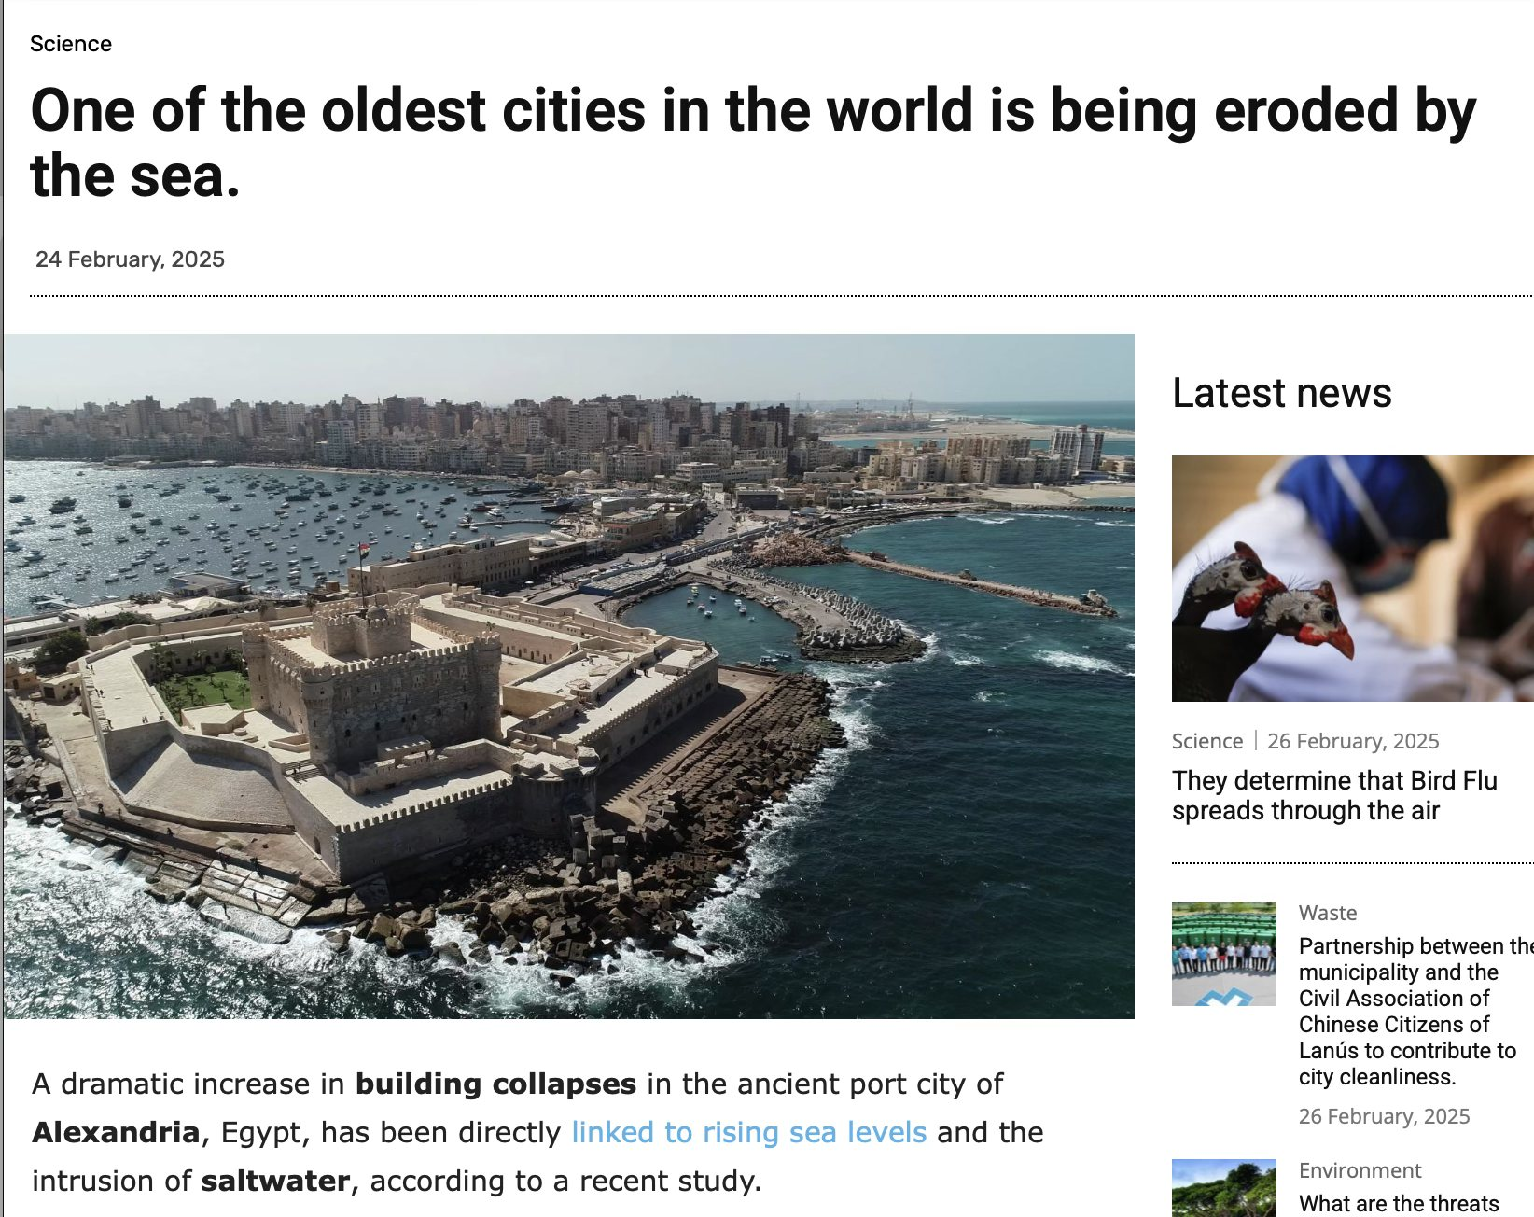
2.3- Global Warming, Tourism, and the Rise of Sea-Level
Alexandria, Egypt
weforum.org

Slide 26
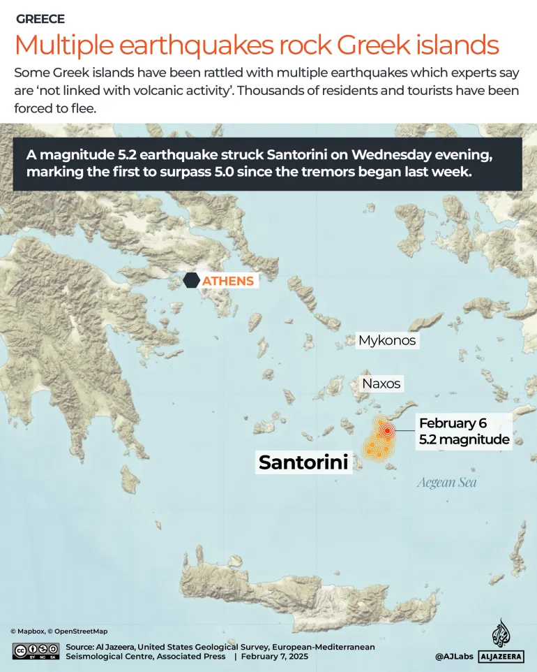
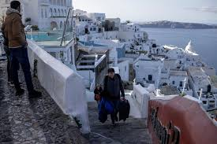
2.4- Natural Disasters and Tourism
Earthquakes in Santorini, Greece.

Slide 27
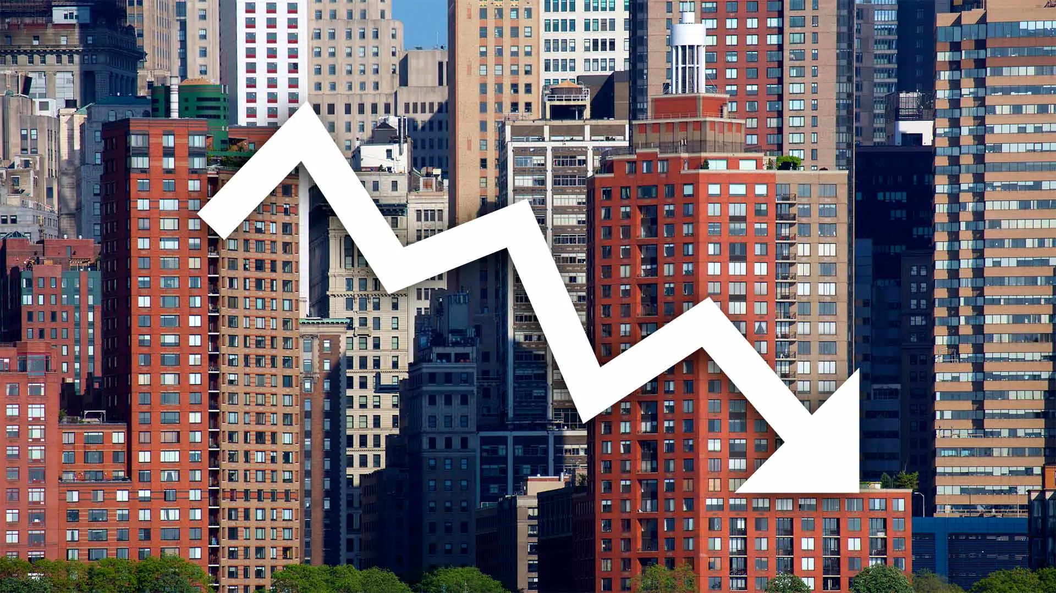
3- Commercial Toursism Crises

Slide 28
3- Commercial Toursism Crises
Commercial crisis is defined as:
“A crisis with its roots in the industry or a business organization or which is exacerbated by the prevailing culture, conditions and management” (Henderson, 2007).

Slide 29
3- Commercial Toursism Crises
Defective products | Sabotage
Boycotts | Finance-related crises
Human-resource-related crises | Regulatory-related crises
Demand-related crises | corruption and fraudulent practices
poor management decisions and policymaking | insufficient crisis-management planning
3.1- Forms of Commercial Crises

Slide 30
3.1- Forms of Commercial Crises
- Crisis is often a result of change.
- Tourism is highly sensitive to alterations.
- The tourism industry itself is constantly evolving, leading to:
New product development
Efforts to identify and enter untapped markets
A- Changing Demand

Slide 31
3.1- Forms of Commercial Crises
- Although companies can influence demand, they must also:
Stay alert to new developments
Anticipate emerging trends
Adapt to accommodate these trends
- Failure to respond to changing demand can lead to business decline.
A- Changing Demand

Slide 32
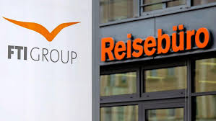
3.1- Forms of Commercial Crises
- Reasons Behind the FTI Bankruptcy:
State Aid and Repayment Issues
FTI received €595 million in state aid during the COVID-19 pandemic but managed to repay only a small portion.
- Funding Gap and Investor Refusal:
A major funding shortfall in the double-digit million range emerged.
The new investor declined to provide the additional funds needed.
The Bankruptcy of FTI Group

Slide 33
3.1- Forms of Commercial Crises
- Bankruptcy Filing:
Due to mounting financial challenges and insufficient capital, FTI was forced to file for bankruptcy.
- Decline in Bookings and Liquidity Crisis
Booking numbers fell short of expectations.
Suppliers demanded advance payments, significantly increasing liquidity pressure.
The Bankruptcy of FTI Group

Slide 34
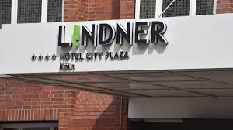
3.1- Forms of Commercial Crises
- Tourism faces strong competition.
- This benefits customers but can harm businesses.
- Competition alone or with other factors can trigger crises.
B- Competion

Slide 35
3.1- Forms of Commercial Crises
- Lindner Hotels AG Operations:
Operates over 30 hotels in Europe, mostly in Germany.
- Financial Struggles:
Unable to generate enough revenue to meet financial obligations.
- Impact of External Crises:
The COVID-19 pandemic and the war in Ukraine created economic pressures.
B- Competition

Slide 36
Thank you
      European Institute of Innovation, Entrepreneurship and Technology
      Lessingstraße 79,
      13158 Berlin, Germany
      Phone: +49 176 55524449
      Email: info@eiiet.com
Discover the world of eiIET

