Slide 1
Customer Service in Multicultural Tourism

Slide 2
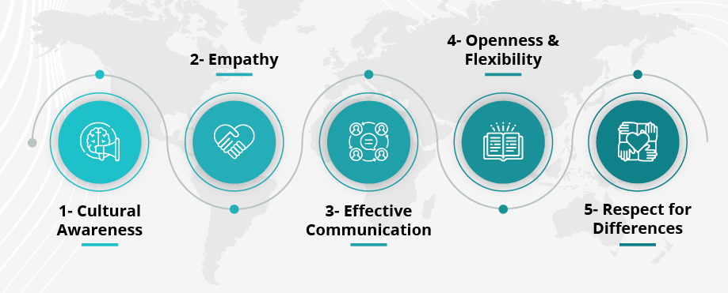
Introduction
Importance of customer service in tourism industry
Multicultural sensitivity as a key service component
Objective: Equip staff with communication and cultural skills (Santos et al., 2021).
The report provides overview information about its structure followed by the main training objectives.
Figure 1. Key Components for Cultural Sensitivity
Source (Santos et al., 2021)
Notes:
The slide emphasizes customer service operations as essential in tourism while stressing multicultural sensitivity as an essential component. The central goal consists of providing essential communication and cultural competence training to staff members. The training combines with a report to teach five main competencies including Cultural Awareness, Empathy, Effective Communication, Openness & Flexibility and Respect for Differences (Santos et al., 2021). The delivery of quality inclusive services in diverse global tourism requires these fundamental elements to help employees provide effective customer interaction across different cultural groups. A fundamental structure follows from the overview to develop training methods which will boost service quality and satisfaction levels.

Slide 3
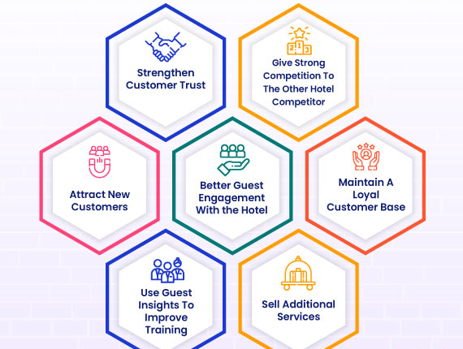
What is Cultural Sensitivity?
Awareness of cultural differences in communication and behavior (Safaeimanesh et al., 2021).
Avoiding assumptions and respecting diversity
Building inclusive and welcoming environments.
Service quality together with positive guest experiences require it as an essential element
Figure 2. Importance of Guest Experience
Source (Safaeimanesh et al., 2021)
Notes:
The slide presents cultural sensitivity as an ability to identify how cultures communicate and behave differently from each other. Hospitality development mandates a dual focus on neutrality as well as respect toward cultural diversity and environment creation for everyone. A service operation which displays cultural sensitivity results in better guest satisfaction rates together with improved service quality outcomes. The multiple advantages of cultural sensitivity become apparent to guests when they establish trust with customers through increased guest engagement which leads to loyalty improvement and new client acquisition (Safaeimanesh et al., 2021). The understanding of guests leads to improved staff education and builds enterprise advantages that boost sales of service operations. Strong relationships between the hospitality and tourism industries and their guests depend on cultural sensitivity as their basic necessity to ensure business success.

Slide 4
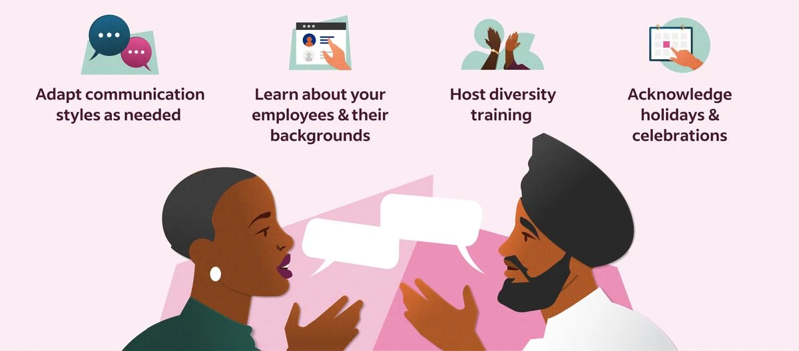
Examples of Cultural Misunderstandings
Gestures that have different meanings across cultures
Varied perceptions of personal space and eye contact
Differences in attitudes toward time and punctuality (Hsiao et al., 2023).
Language barriers and unintentional offense
Figure 3. Examples of Cultural Differences
Source (Hsiao et al., 2023)
Notes:
The slide demonstrates several typical cases of cultural misunderstandings which occur between employees and customers at work. Language barriers together with different cultural meanings of gestures and distinct opinions regarding eye contact and space perceptions and differing views on punctuality can result in unintentional offenses. The illustration includes adaptable communication methods as well as cultural background education while providing diversity training and acknowledging cultural observances. Enhanced workplace understanding alongside prevention of miscommunication and promotion of respect and inclusion create an environment needed for productive service delivery and harmonious relations in multicultural workplaces (Hsiao et al., 2023).

Slide 5
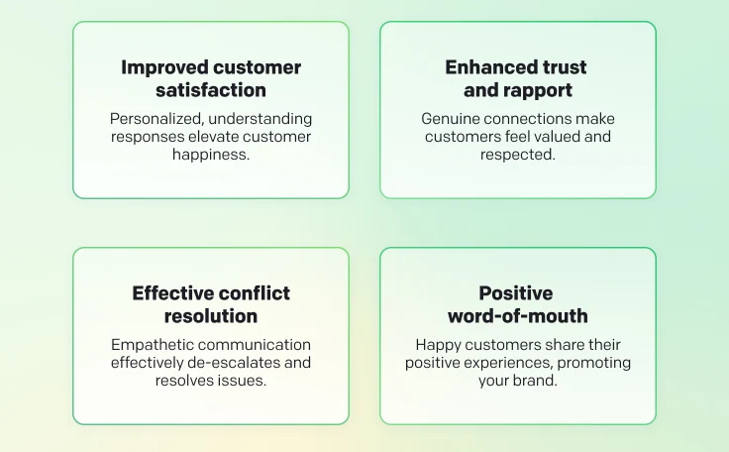
Importance of Respect and Empathy
Empathy enables understanding of guest needs and emotions (Helena Margarida Alves et al., 2022).
Respectful language promotes inclusivity
Avoiding stereotypes and cultural generalizations
Active listening as a tool for better service
Figure 4. Ways to Show Empathy in Customer Service
Source (Helena Margarida Alves et al., 2022)
Notes:
The slide demonstrates that respect combined with empathy stands vital for exceptional customer service. Guests experience better emotions recognition through empathy while a respectful communication style can establish an inclusive environment and setting. By eliminating stereotypes combined with active listening services achieve better quality and create a more comfortable environment for guests (Helena Margarida Alves et al., 2022). The image demonstrates four essential advantages namely personalized service delivery produces satisfied customers while staff establish trust through personalized care which leads to effective conflict resolution and results in positive word-of-mouth from content customers sharing their positive experiences. Culture-sensitive and exceptional tourism services require respect together with empathy to establish deep guest relationships within the hospitality sector.

Slide 6
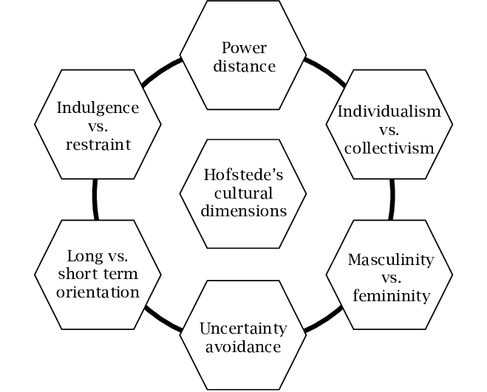
Hofstede’s Cultural Dimensions
Overview of six key cultural dimensions
Application to real-life tourism scenarios
Understanding guest expectations based on culture (Fan, Tsaur, et al., 2021).
Enhancing adaptability and personalized service
Figure 5. Hofstede’s Cultural Dimensions
Source (Fan, Tsaur, et al., 2021)
Notes:
The presentation shows Hofstede’s six cultural dimensions which serves as a model for interpreting cultural variations. The cultural framework consists of six dimensions that analyze power difference and the contrast between individualistic and collective societies in addition to masculine-feminine dynamics along with uncertainty avoidance and short-term and long-term strategic perspectives and restraint versus indulgence. The dimensional framework enables understanding between individuals who represent diverse cultures regarding their thinking patterns and communication styles and behavioral patterns (Fan, Tsaur, et al., 2021). Staff members increase their guest service effectiveness by applying these concepts in the tourism industry. Business success stems from employee ability to act with personalized service delivery methods which leads to better guest satisfaction and enhanced inclusivity. A better understanding of local customs enables staff members to connect with different visitors while increasing their ability to function in various hospitality settings.

Slide 7
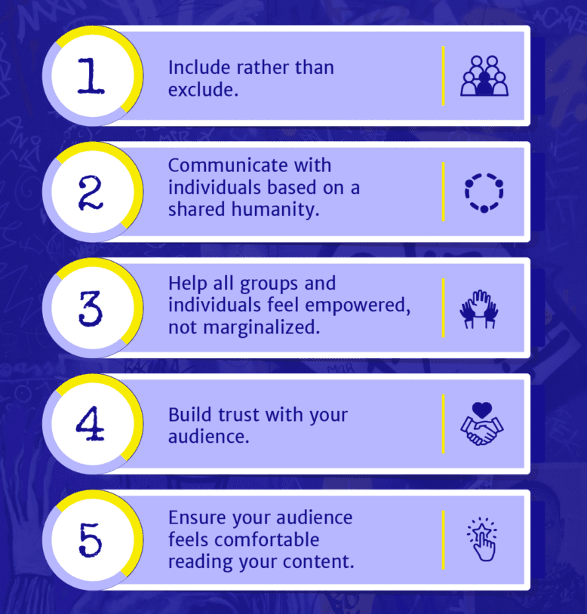
Professional Tone and Inclusive Language
Maintaining polite and formal tone with all guests
Using gender-neutral and culturally neutral terms
Importance of consistency in communication
Role of tone in conflict resolution and trust building (Fan, Van Hoof, et al., 2021).
Figure 6. Benefits of an Inclusive Language
Source (Fan, Van Hoof, et al., 2021)
Notes:
The presentation emphasizes how employees must adopt both a professional attitude and inclusive wording whenever they deal with visitors. Professional conduct along with formal and respectful service helps develop confidence between guests and employees while successfully managing conflicts. The purpose of both gender-neutral language and cultural non-bias terminology is to prevent any one group from feeling left out or discriminated against (Fan, Van Hoof, et al., 2021). The integration of consistent communication approaches creates both clear and professional dialogue and the implementation of inclusive language builds empowerment among all people and builds group unity. The visual display illustrates core service principles that involve both inclusion instead of exclusion and Trust development and Guest comfort and Respect throughout their experience. Service quality improvement along with a welcoming environment comes mainly from effective tone and language usage.

Slide 8
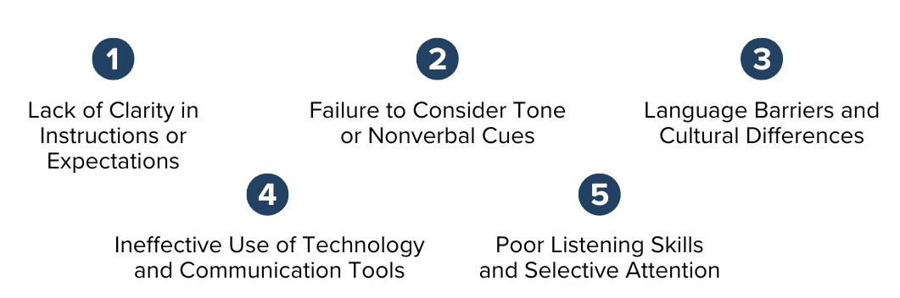
Avoiding Idioms and Slang
Common idioms that confuse non-native speakers
Clear alternatives for better understanding
Replacing slang with direct, literal phrases
Enhancing clarity and avoiding miscommunication (Erose Sthapit et al., 2023).
Figure 7. Examples of Workplace miscommunication
Source (Erose Sthapit et al., 2023)
Notes:
The use of idioms and slang must be avoided for precise communication because non-native speakers struggle to understand these expressions. The usage of common idioms combined with informal expressions produces confusion among guests who do not have familiarity with these expressions. The staff should employ basic language terms together with concrete explanations to improve comprehension while minimizing misunderstandings (Erose Sthapit et al., 2023). Guest satisfaction improves when slang disappears through literal phrase replacements which improves understanding and prevents frustration. The visual presents three main barriers which include confusing instructions and language differences together with listening difficulties but these issues become manageable through careful communication practices. Service quality enhancement and establishment of a welcoming professional environment stem from incorporating clear and inclusive language.

Slide 9
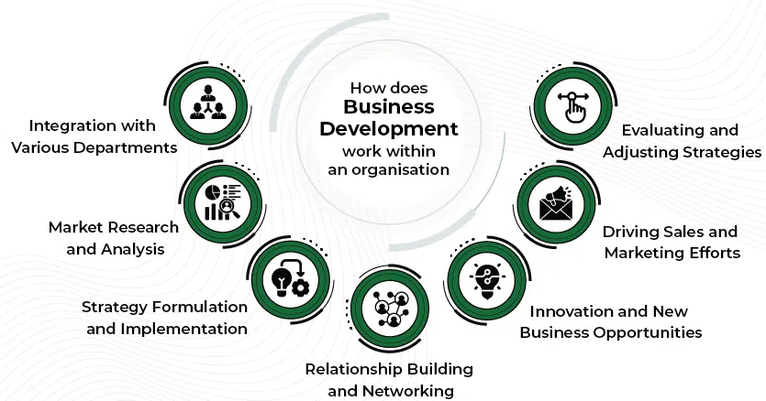
Clear vs. Confusing Expressions
Examples: 'You’re all set' vs. 'Your reservation is confirmed'
Idioms like 'piece of cake' can confuse guests
Using precise, universal terms
Helps build professionalism and global understanding (Chen & Yu, 2023)
Figure 8. Business Development process
Source (Chen & Yu, 2023)
Notes:
The use of straightforward instead of complex verbalization methods produces better communication results particularly in multicultural and international scenarios. Non-native speakers fail to understand expressions which include "piece of cake" when spoken with native speakers. The substitution of unclear phrases with specific language which functions universally helps create both professional and easy-to-understand messaging. The method minimizes communication failures while building global comprehension and trust among people (Chen & Yu, 2023). The illustration demonstrates why easy-to-understand communication becomes vital for strategic execution together with product development and company expansion since employees must relay information efficiently between departments and international teams. Transparency in verbal communication serves as the foundation for credible operations which also deliver efficient service.

Slide 10
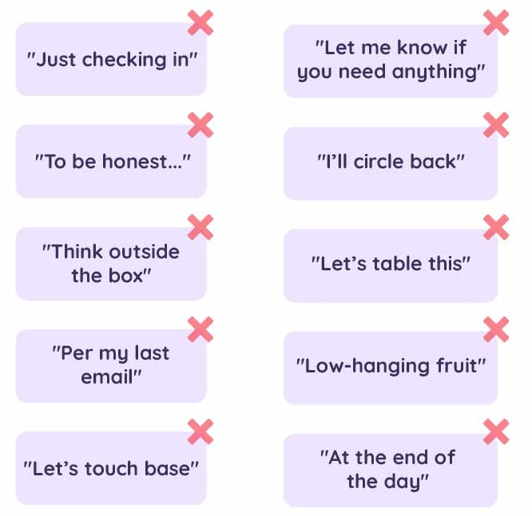
Positive Communication Phrasebook
'Let me check that for you' instead of 'I don’t know'
'Please wait a moment' instead of 'Hold on'
'How may I assist you today?' for polite interaction (Ayyildiz et al., 2023).
'I understand your concern' for empathy and support
Figure 9. Phrases to avoid at work
Source (Ayyildiz et al., 2023)
Notes:
The Positive Communication Phrasebook demonstrates how organizations should replace indecisive or laid-back verbalizations through specific supportive verbalization methods. The correct approach when facing uncertainty would be to say "Let me check that for you" which demonstrates your drive to resolve issues. Customers should wait for a moment while you say "Please wait a moment" for polite communication and "How may I assist you today?" initiates their involvement. Such alternatives create communication that stands out with respect and empathy (Ayyildiz et al., 2023). Modes of professional communication can enhance trust by helping staff members use appropriate language that replaces ambiguities like “To be honest” and “Per my last email” through the visual presentation of common phrases. Such language improvements help build better relationships with guests and customers in hospitality and service industries.

Slide 11
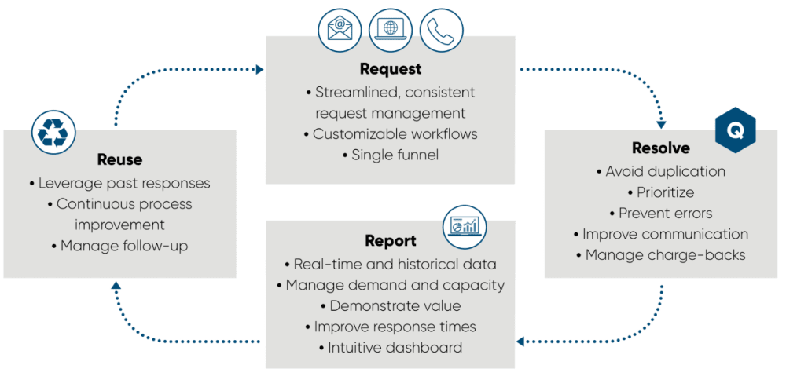
Handling Inquiries
Example scenario: guest asks for directions
Use of clear and polite language
Support with visual aids or written directions (Amr Saad, 2022).
Avoid assumptions about language fluency
Figure 10. Enquiry and Request Management System
Source (Amr Saad, 2022)
Notes:
The Handling Inquiries slide presents guidelines for assisting guests who require directions specifically through effective assistance strategies. The presentation stresses both the need for polite language and visual or written directional tools to help guests understand instructions better. Staff members who do not make assumptions about guests' language abilities deliver service more inclusively to their customers (Amr Saad, 2022). A communication framework called Request – Resolve - Report - Reuse guides staff to deliver standardized service through object-based operations that produce better data for service enhancement while meeting guest needs. Such organization enhances communication while decreasing service errors and helps build trust throughout staff and guest interactions in hospitality businesses serving diverse cultural backgrounds.

Slide 12
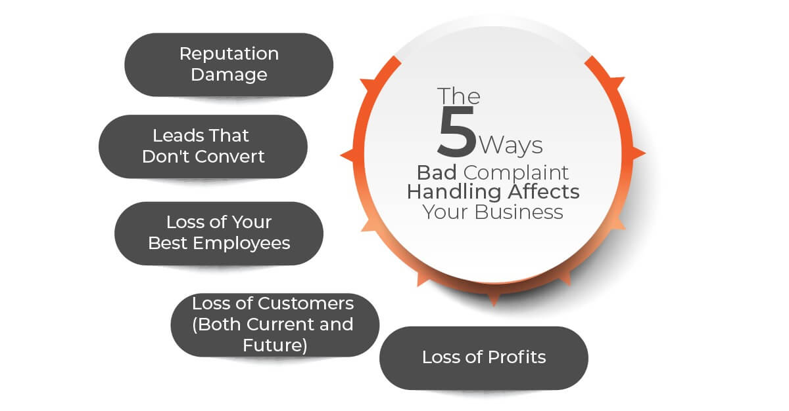
Handling Complaints
Scenario: delayed check-in or booking issue
Acknowledge concern and apologize sincerely
Offer immediate solutions or alternatives (Akram et al., 2024).
Be aware of direct vs. indirect complaint styles
Figure 11. Ways to Handle Customer Complaints
Source (Akram et al., 2024)
Notes:
The presentation shows essential strategies that serve customers for complaint resolution specifically when check-in delays or booking mistakes occur. The strategy stresses staff should first acknowledge concerns followed by sincere apologies together with immediate alternatives or solutions (Akram et al., 2024). Staff should identify direct complaints together with those that present themselves indirectly. Poor complaint handling generates multiple unfavorable effects on a hotel operation including degraded reputation and lead abandonment and employee departure whereas customers leave and profits decrease significantly. A business needs proficient complaint management to defend both customer contentment and its lasting economic success as well as reputation preservation.

Slide 13
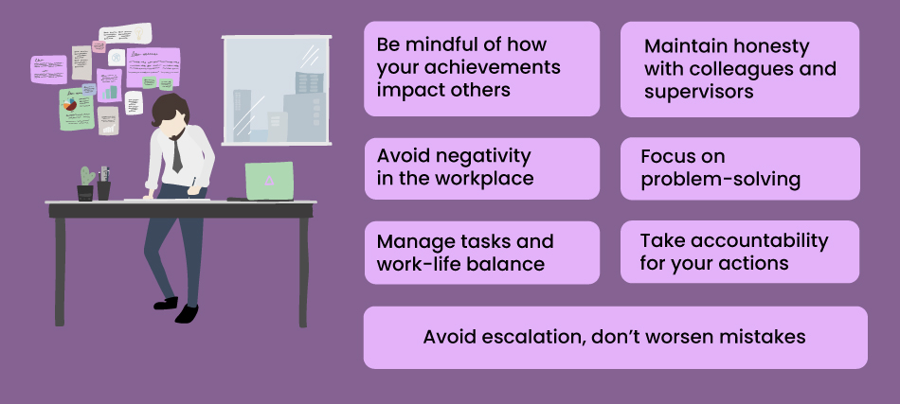
Dealing with Difficult Situations
Scenario: angry or frustrated guest
Preserve your communication with the guest through a composed discussion approach.
Use non-threatening body language
The staff should display empathy and offer confidence to guests (Pu et al., 2022).
Figure 12. Tips to Handle Challenging Situation at Work
Source (Pu et al., 2022)
Notes:
The presentation teaches essential techniques to handle guest incidents that stem from their frustration together with their upset state. To handle difficult situations people should maintain their composure by using respectful language and non-threatening body movements. Hospital personnel who provide guest care need to detect patient emotions so they can deliver the required assurance to patients (Pu et al., 2022). Hospital personnel learn effective strategies for workplace honesty through video presentations and understand systems for handling issues as well as absolute accountability structures. Partnership between communication methods allows task processes to detect risks which prevent the growth of problems. Hotels create better work environments that yield fewer guest complaints thanks to their defusion method deployment.

Slide 14
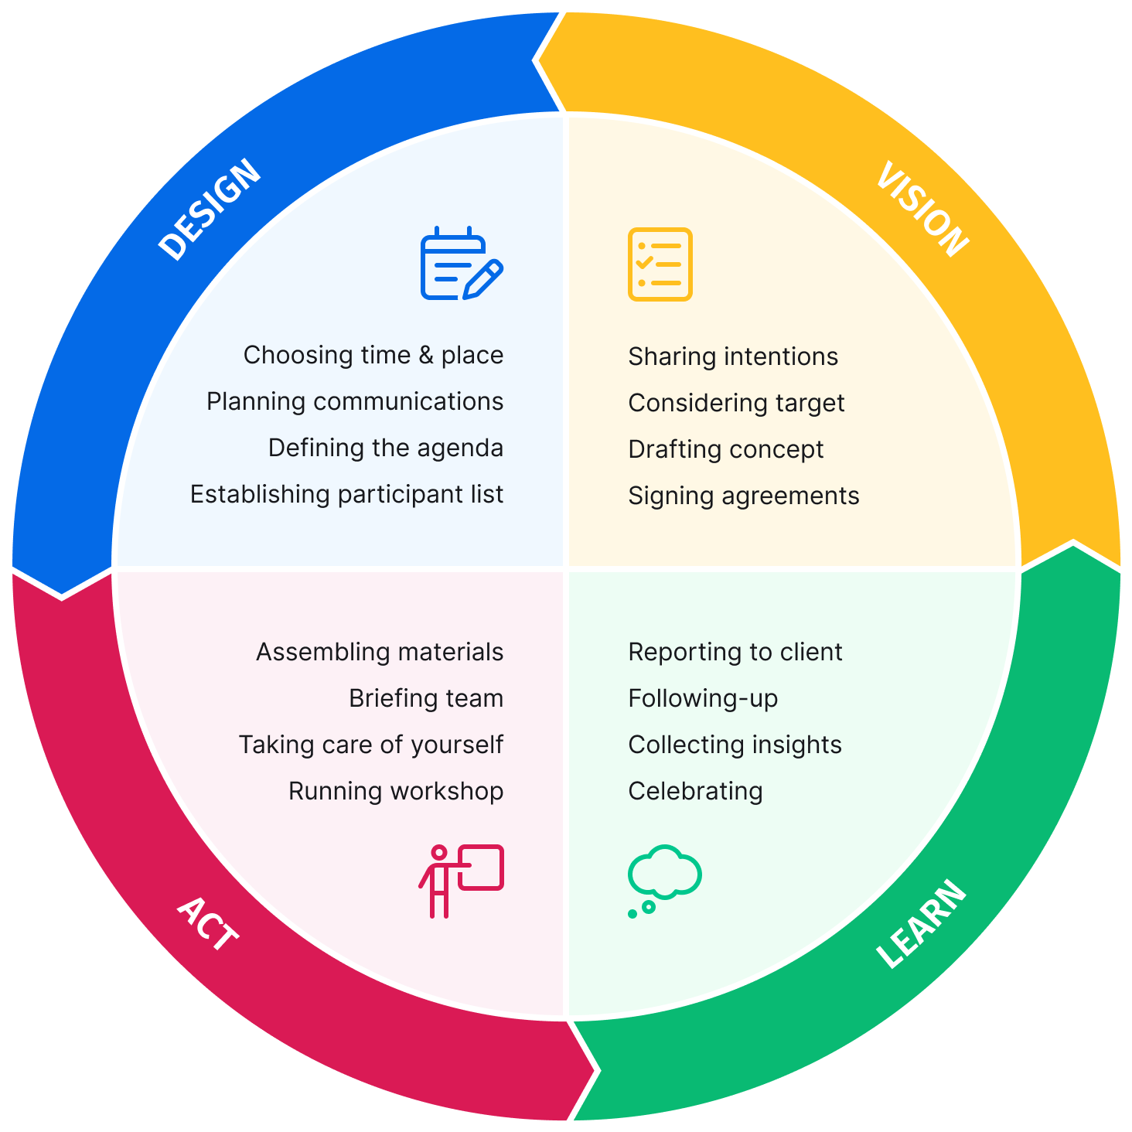
Training Methods
Allow learners to apply theoretical knowledge in a safe and controlled setting, improving problem-solving skills.
Promote peer learning and diverse perspectives by working together to examine and solve realistic business or operational cases.
Ensure uniform delivery of content while catering to various learning styles through videos, quizzes, and interactive content.
Keep knowledge current and relevant by delivering short, focused updates that align with ongoing developments (Rodríguez-López et al., 2023).
Figure 13. Gude to Planning a Workshop
Source (Rodríguez-López et al., 2023)
Notes:
The presentation explains professional methods that help employees manage painful interactions between customers which lead to angry or upset guests. The core components needed to face difficult situations involve staying composed along with using polite language and showing non-aggressive physical expressions. Staff members must understand guest emotions to lower tension during services through reassurance (Pu et al., 2022). The visual materials show integration techniques between honesty and negative prevention in order to fulfill complete responsibility. Using conscience both improves work success and stabilizes situations before they become worse than intended. The combined approaches utilize defusion methods to minimize both guest complaints and improve workplace environment at the same time.

Slide 15
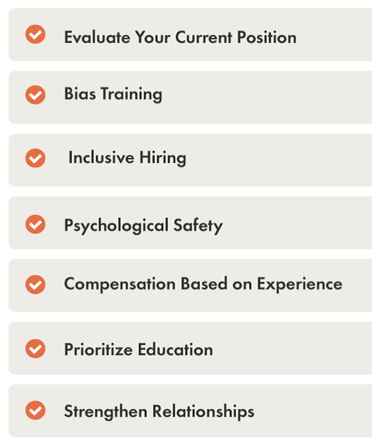
Core Skills to Develop
Help learners refine their pronunciation and boost clarity in professional conversations.
Encourage understanding of cultural norms and behaviors through immersive scenario-based activities.
Foster deeper emotional intelligence by encouraging learners to view situations from multiple viewpoints.
Build communication confidence and active listening through guided conversational exercises (Liu et al., 2022).
Figure 14. Cultural Competency in the Workplace
Source (Liu et al., 2022)
Notes:
The subsequent presentation enumerates essential competencies required for personal and professional advancement within customer service and hospitality work environments. The training curriculum teaches language abilities along with pronunciation methods together with emotional competence and active listening for building personal confidence and communication skills. These competencies establish minimum requirements needed to develop organizations that foster welcome and support (Liu et al., 2022). Practice evaluation with bias training and inclusive recruitment methods and psychological security programs and equal wage compensation make up activities in the right checklist section. Service quality and employee connection to both clients and colleagues from mixed backgrounds improve through educational investments and relationship-building strategies.

Slide 16
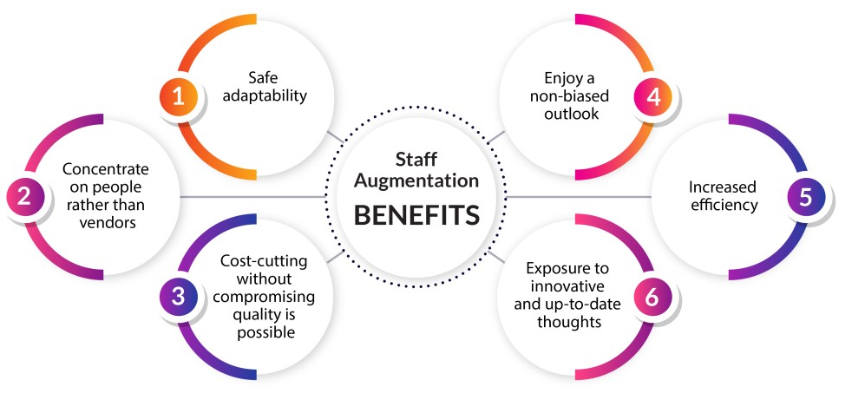
Conclusion
Boost in team morale and staff retention
Higher guest satisfaction and loyalty
Positive reviews and improved reputation
Competitive edge in the global tourism market (Riva & Agostino, 2022).
Figure 15. Staff Augmentation Model
Source (Riva & Agostino, 2022)
Notes:
The important advantages of successful hospitality training and staff development programs can be found on this presentation slide. This section details four essential outcomes which include superior staff engagement alongside employee retention rates as well as happier guests who remain loyal to the brand and improved review scores and organizational reputation which together deliver market dominance in international tourism (Riva & Agostino, 2022). Staff augmentation provides multiple advantages shown in visual graphics including the ability to adapt safely and pay special attention to employees instead of vendors as well as maintaining budget-friendly operations without quality compromise and promoting objective insights that generate operational excellence with new inventive perspectives. The service and tourism industry achieves lasting success and sustainability through investment in staff according to these important elements.

Slide 17
References
Pu, P., Cheng, L., Samarathunga, W., & Wall, G. (2022). Tour guides’ sustainable tourism practices in host-guest interactions: when Tibet meets the west. Tourism Review, 78(3). https://doi.org/10.1108/tr-04-2022-0182
Rodríguez-López, M. E., Alcántara-Pilar, J. M., & Del Barrio-García, S. (2023). Satisfaction or delight? A cross-cultural study of loyalty formation linked to two restaurant types. Journal of Hospitality and Tourism Insights. https://doi.org/10.1108/jhti-04-2022-0157
Liu, P., Tse, E. C.-Y., & He, Z. (2022). Influence of Customer Satisfaction, Trust, and Brand Awareness in Health-related Corporate Social Responsibility Aspects of Customers Revisit Intention: A Comparison between US and China. Journal of Quality Assurance in Hospitality & Tourism, 1–27. https://doi.org/10.1080/1528008x.2022.2135163
Riva, P., & Agostino, D. (2022). Latent dimensions of museum experience: assessing cross-cultural perspectives of visitors from tripadvisor reviews. Museum Management and Curatorship, 1–25. https://doi.org/10.1080/09647775.2022.2073560
Santos, V., Ramos, P., Sousa, B., & Valeri, M. (2021). Towards a framework for the global wine tourism system. Journal of Organizational Change Management. https://doi.org/10.1108/jocm-11-2020-0362
Safaeimanesh, F., Kılıç, H., Alipour, H., & Safaeimanesh, S. (2021). Self-Service Technologies (SSTs)—The Next Frontier in Service Excellence: Implications for Tourism Industry. Sustainability, 13(5), 2604. https://doi.org/10.3390/su13052604
Hsiao, A., Ma, E., Manfreda, A., Baker, M., & Xu, J. (2023). A social exchange perspective on boosting customer loyalty through culturally competent servers. Journal of Hospitality Marketing & Management, 32(4), 1–23. https://doi.org/10.1080/19368623.2023.2184439
Helena Margarida Alves, Sousa, B., Carvalho, A., Santos, V., Dias, Á., & Valeri, M. (2022). Encouraging Brand Attachment on Consumer behaviour: Pet-friendly Tourism Segment. Journal of Tourism, Heritage & Services Marketing, 8(2). https://doi.org/10.5281/zenodo.7357978
Fan, D. X. F., Tsaur, S.-H., Lin, J.-H., Chang, T.-Y., & Tsai, Y.-R. (2021). Tourist Intercultural Competence: A Multidimensional Measurement and Its Impact on Tourist Active Participation and Memorable Cultural Experiences. Journal of Travel Research, 61(2), 004728752098237. https://doi.org/10.1177/0047287520982372
Fan, A., Van Hoof, H. B., Dou, X., & Serrano, A. L. (2021). The impact of linguistic style on customer satisfaction: A cross-cultural empirical study in ecuador. International Hospitality Review, 37(1). https://doi.org/10.1108/ihr-04-2021-0028
Erose Sthapit, Garrod, B., Stone, M. J., Björk, P., & Song, H. (2023). Value co-destruction in tourism and hospitality: a systematic literature review and future research agenda. Journal of Travel & Tourism Marketing, 40(5), 363–382. https://doi.org/10.1080/10548408.2023.2255881
Chen, X., & Yu, S. (2023). Synergizing Culture and Tourism Talents: Empowering Tourism Enterprises for Success. Journal of the Knowledge Economy. https://doi.org/10.1007/s13132-023-01598-x
Ayyildiz, T., Ayyildiz, A. Y., & Koc, E. (2023). Illusion of control in service failure situations: customer satisfaction/dissatisfaction, complaints, and behavioural intentions. Current Psychology. https://doi.org/10.1007/s12144-023-04292-y
Amr Saad, D. E. (2022). Rural Tourism. International Journal of Modern Agriculture and Environment, 2(1), 45–56. https://doi.org/10.21608/ijmae.2023.214688.1001
Akram, U., Rambabu Lavuri, Bilal, M., Hameed, I., & Byun, J. (2024). Exploring the roles of green marketing tools and green motives on green purchase intention in sustainable tourism destinations: a cross-cultural study. Journal of Travel & Tourism Marketing, 41(4), 453–471. https://doi.org/10.1080/10548408.2023.2293022

