Slide 1
Health Threats in Tourism
European Institute of Innovation, Entrepreneurship and Technology
Lessingstraße 79, 13158 Berlin, Germany
Mahmoud Abdou| Berlin
      Lessingstraße 79,
      13158 Berlin, Germany
      Phone: +49 30 233618555
      Fax: +49 30 233618556
      Email: info@eiiet.com

Slide 2
Index
- An Introduction to the Health Risks of Tourism
- Tourism and the Spread of Disease and Infection
- Food, Water, and Risk
- Vector-Borne Risks

Slide 3
1- An Introduction to the Health Risks of Tourism
    There are several factors to consider when exploring the relationship between health and tourism including:
    Communicable Diseases
    - Risk of exposure to illnesses such as respiratory infections, gastrointestinal diseases, or mosquito-borne viruses.
    Behavioral Changes
    - Travelers may engage in riskier behaviors during trips, affecting their health and safety.

Slide 4
1- An Introduction to the Health Risks of Tourism
    Hygiene and Sanitation Differences
    - Variations in cleanliness standards can increase vulnerability to infection and illness.
    Social and Personal Factors
    - Stress, fatigue, and individual health conditions can influence tourists’ resilience.
    External Environmental Factors
    - Climate, altitude, and pollution in destination areas may pose additional health challenges.

Slide 5
1- An Introduction to the Health Risks of Tourism
    1.1. Health Risks in Tourism
    Multiple Stakeholders Affected
    - Health risks impact not only tourists but also local communities, hotel staff, restaurant workers, and residents.
    Exposure Through Various Settings
    - Tourists interact in public spaces, accommodations, and private homes—broadening the scope of health risk transmission.

Slide 6
1- An Introduction to the Health Risks of Tourism
    1.1- Health Risks in Tourism: Impact on Stakeholders
    International Tourism as a Vector
    - Cross-border movement through airports, seaports, and transit hubs facilitates the spread of diseases.
    Variation in Destination Preparedness
    - Some destinations have robust health and tourism infrastructure; others lack the resources to effectively manage health risks.
    Development Level Matters
    - Risk factors vary significantly between developed and developing destinations, influencing both tourist safety and public health.

Slide 7
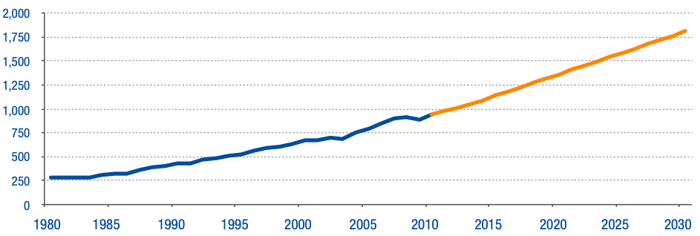
2- Tourism and the Spread of Disease and Infection
    Rapid Growth of Global Tourism
    - Projected to reach 1.8 billion travelers by 2030
    Tourism as a Disease Vector
    - Increases the spread of communicable diseases
    - Transmission can occur person-to-person or
    through animals, vectors, or environments
    Exposure to New Environments
    - Tourists encounter unfamiliar environmental factors
    - Increased interaction with new people, cultures, and ecosystems
International Tourist Arrivals, million
Source: World Tourism Organization (2011)

Slide 8
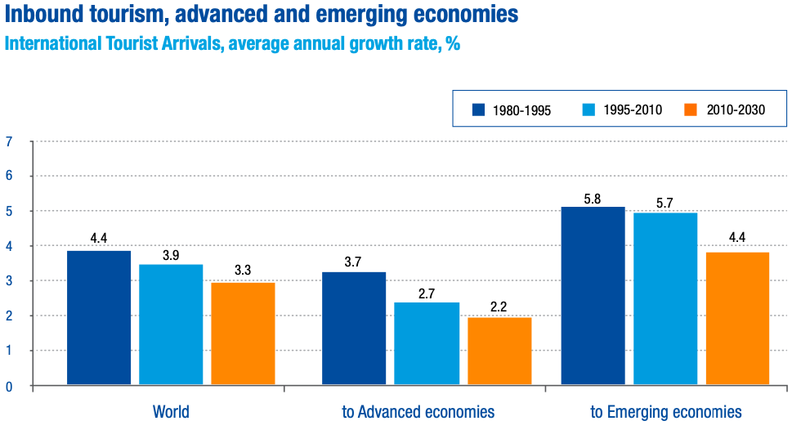
2- Tourism and the Spread of Disease and Infection
    Health Risks from Local Conditions
    - Potential threats include:
    - Air quality
    - Food and water safety
    - Exposure to native species
    - Local sanitation standards
    Dual Role of Tourists in Disease
    - Tourists often fall ill abroad
    - They may unknowingly contribute to disease transmission across borders
Source: World Tourism Organization (2011)

Slide 9
2- Tourism and the Spread of Disease and Infection
    2.1- Borders and Transportation: Health Challenges in Tourism
    Transportation as a Health Risk
    - Air, sea, and land travel facilitate movement and transmission of diseases
    - Increases exposure to airborne and contact-transmitted infections
    Influenza and Group Travel
    - Large tour groups (e.g., Hajj pilgrims) are at risk due to prolonged close contact
    - Influenza transmission is common in such dense gatherings

Slide 10
2- Tourism and the Spread of Disease and Infection
    2.2- Air Travel–Related Health Concerns
    Rising Air Traffic
    - Continuous growth in global air travel
    - Frequent flyers form a significant part of the traveling population
    - Increase in long-haul flights worldwide
    Health Impacts of Long-Distance Flights
    - Passengers face various health and well-being challenges
    - Prolonged sitting, cabin pressure, and dry air are common concerns

Slide 11
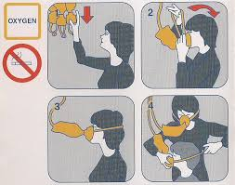

2- Tourism and the Spread of Disease and Infection
    2.2.1- Cabin Air Pressure
    Reduced Cabin Pressure
    - Cabin pressure at cruising altitude is lower than at sea level
    Impact on the Body
    - Less oxygen absorbed into the bloodstream (hypoxia)
    - Expansion of gases within the body (stomach, sinuses)
    consequences
    - Generally well tolerated by healthy individuals
    - May pose discomfort or risk for those with respiratory
    or cardiovascular conditions

Slide 12
2- Tourism and the Spread of Disease and Infection
    2.2.2- Cabin Humidity and Dehydration
    - Humidity levels in aircraft cabins are typically low—usually below 20%, compared to over 30% in most homes.
    - This low humidity can lead to skin dryness and discomfort in the eyes, mouth, and nasal passages
    However, it does not pose a direct health risk.
    To reduce discomfort:
    - Use moisturizing lotion for the skin.
    - Apply a saline nasal spray to keep nasal passages moist.
    - Consider wearing eyeglasses instead of contact lenses to reduce eye irritation.

Slide 13


2- Tourism and the Spread of Disease and Infection
    2.2.3- Motion Sickness in Air Travel
    - Motion sickness is uncommon during air travel, except in cases of severe turbulence.
    Passengers prone to motion sickness should:
    - Sit in the mid-section of the cabin where movement is less noticeable.
    - Keep the motion sickness bag (provided at each seat) easily accessible.
    - Avoid alcohol during the flight and for at least 24 hours before flying.
    - Consult a doctor or travel medicine specialist
    about preventive medication before the flight.

Slide 14
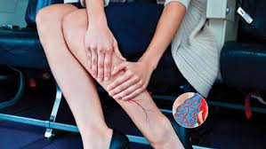
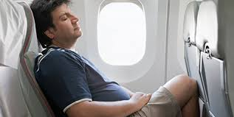
2- Tourism and the Spread of Disease and Infection
    2.2.4- Immobility, Circulatory Problems, and Deep Vein Thrombosis (DVT) in Travel
    - Muscle contraction helps maintain healthy blood flow, especially in the legs.
    Prolonged immobility, particularly when seated for long periods,
    can lead to:
    - Pooling of blood in the legs
    - Swelling, stiffness, and discomfort
    Deep vein thrombosis (DVT) may develop due to limited movement:
    - DVT is a blood clot that forms in a deep vein, usually in the legs.
    - Long-distance travel (by car, bus, train, or air) increases the risk of DVT.
    - Encouraging movement and leg exercises during travel can help reduce
    the risk.
Notes:
What measures or precautions can be taken to prevent deep vein thrombosis and alleviate discomfort and stiffness?

Slide 15


2- Tourism and the Spread of Disease and Infection
    2.2.5- Jet Lag
    - Definition: Jet lag refers to symptoms caused by disruption of the body’s internal clock.
    - Cause: Occurs after crossing multiple time zones (east–west or west–east).
    Common Symptoms:
    - Indigestion and bowel disturbances
    - General malaise and daytime sleepiness
    - Insomnia or difficulty sleeping at night
    - Reduced physical and mental performance
    - Additional Fatigue: Often combined with tiredness from the travel itself.
Notes:
What measures or precautions can be taken to alleviate consequences of Jet Lag?

Slide 16
2- Tourism and the Spread of Disease and Infection
    2.2.6- Transmission of Communicable Diseases on Aircraft
    - Research shows minimal risk of communicable disease transmission during air travel.
    Primary Transmission Methods:
    - Coughing and sneezing by an infected passenger.
    - Direct contact or touching contaminated surfaces within the cabin.
    - Proximity Factor: Risk increases among passengers seated close to an infected individual.
    - Comparable Settings: Similar to risks in trains, buses, or theatres.
    - Ventilation Systems: Poorly functioning ventilation increases the likelihood of spreading airborne illnesses like influenza.
Notes:
What measures or precautions can be taken to alleviate consequences of Jet Lag?

Slide 17
2- Tourism and the Spread of Disease and Infection
    2.2.6- Transmission of Communicable Diseases on Aircraft
    Transmission of TB and SARS on Aircraft
    Tuberculosis (TB):
    - Cases of TB transmission reported in the 1980s on long-haul flights.
    - No confirmed cases of active TB resulting from in-flight exposure since then.
    - Ongoing vigilance is essential due to:
    - Increased global air travel.
    - Emergence of drug-resistant TB.
Notes:
What measures or precautions can be taken to alleviate consequences of Jet Lag?

Slide 18
2- Tourism and the Spread of Disease and Infection
    2.2.6- Transmission of Communicable Diseases on Aircraft
    Severe Acute Respiratory Syndrome (SARS):
    - During the 2003 SARS outbreak, the risk
    - Transmission: Documented in-flight spread of infection.
    Geographic Spread within Weeks:
    - Spreading within weeks from China to Hong Kong, Vietnam, Singapore, and Canada.
Notes:
What measures or precautions can be taken to alleviate consequences of Jet Lag?

Slide 19

2- Tourism and the Spread of Disease and Infection
    2.2.7- Aircraft Disinsection
    - To eliminate insects on aircraft arriving from regions where insect-borne diseases (e.g., malaria, yellow fever) are present.
    Health Risk Example:
    - Documented malaria cases near airports in non-malaria regions suggest mosquitoes escaped from aircraft.
    Mandatory in Some Countries:
    - Australia and New Zealand routinely enforce disinsection.
    - Aimed at protecting public health and agriculture from invasive species.
Notes:
What measures or precautions can be taken to alleviate consequences of Jet Lag?

Slide 20
2- Tourism and the Spread of Disease and Infection
    2.2.7- Aircraft Disinsection
    - Meningococcal Disease and Border Health Control
    Serious Health Risk:
    Meningococcal disease is a potentially fatal infection spread through respiratory or throat secretions.
    Transmission Risk:
    - Can spread between travelers or from tourists to local residents through everyday interactions.
    Example – Saudi Arabia:
    - Requires mandatory meningococcal vaccination for incoming visitors, especially during events like Hajj.
Notes:
What measures or precautions can be taken to alleviate consequences of Jet Lag?

Slide 21
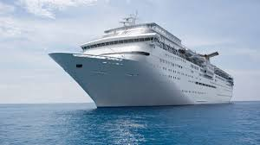
2- Tourism and the Spread of Disease and Infection
    2.3- Health Risks Associated with Sea Travel
    Rapid Port Transits:
    - Cruise ships visit multiple ports with varying sanitation standards
    and disease exposure risks.
    High Risk of Disease Spread:
    - Closed, crowded environments on ships facilitate transmission among passengers and crew.
    - Disembarking individuals can carry diseases back to their home communities.
Notes:
What measures or precautions can be taken to alleviate consequences of Jet Lag?

Slide 22
2- Tourism and the Spread of Disease and Infection
    2.3- Health Risks Associated with Sea Travel
    Documented Outbreaks (Past 30 Years):
    - Over 100 disease outbreaks linked to cruise ships (likely underreported), including:
    - Measles, rubella, varicella, meningococcal meningitis
    - Hepatitis A, legionellosis, respiratory and gastrointestinal illnesses
    Recent Public Health Concerns:
    - Notable outbreaks of influenza and norovirus pose ongoing challenges.
    - These outbreaks have serious health implications and economic consequences for the cruise industry.
Notes:
What measures or precautions can be taken to alleviate consequences of Jet Lag?

Slide 23

2- Tourism and the Spread of Disease and Infection
    2.3.1- Communicable Diseases
    A- Gastrointestinal Disease
    Most outbreaks are linked to food or water consumed on board, including:
    - Contaminated bunkered water
    - Inadequate disinfection of drinking water
    - Sewage contamination of potable water
    - Poor design/construction of water storage tanks
    - Deficiencies in food handling, preparation, and cooking
    - Use of seawater in the galley
Notes:
What measures or precautions can be taken to alleviate consequences of Jet Lag?

Slide 24
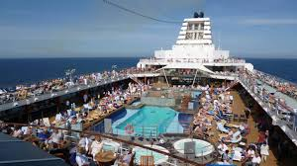
2- Tourism and the Spread of Disease and Infection
    2.3.1- Communicable Diseases
    A- Gastrointestinal Disease
    Norovirus on Cruise Ships
    Most Common Pathogen:
    - Leading cause of outbreaks on cruise ships
    Symptoms:
    - Sudden onset of vomiting and/or diarrhoea
    - May include fever, abdominal cramps, and malaise
Notes:
Noroviruses are a group of highly contagious viruses that cause acute gastroenteritis — which means inflammation of the stomach and intestines.
This leads to vomiting, diarrhea, stomach pain, and nausea.

Slide 25
2- Tourism and the Spread of Disease and Infection
    2.3.1- Communicable Diseases
    A- Gastrointestinal Disease
    Norovirus on Cruise Ships
    Transmission Routes:
    - Spread through contaminated food or water
    - Person-to-person contact
    - Highly contagious
Notes:
Noroviruses are a group of highly contagious viruses that cause acute gastroenteritis — which means inflammation of the stomach and intestines.
This leads to vomiting, diarrhea, stomach pain, and nausea.

Slide 26
2- Tourism and the Spread of Disease and Infection
    2.3.1- Communicable Diseases
    B- Influenza and Respiratory Infections
    - Respiratory infections are frequent among passengers on cruise ships.
    Global Transmission Risk:
    - Travelers can introduce influenza viruses to regions outside the seasonal cycle.
    Crew as Transmission Vectors:
    - Crew members may become reservoirs of infection, spreading viruses to passengers on subsequent cruises.
Notes:
What measures or precautions can be taken to alleviate consequences of Jet Lag?

Slide 27
2- Tourism and the Spread of Disease and Infection
    2.3.1- Communicable Diseases
    C- Legionellosis (Legionnaires’ Disease) on Cruise Ships
    Definition:
    - A potentially fatal form of pneumonia caused by inhaling Legionella bacteria
    Transmission:
    - Through tiny droplets from contaminated water
    - Not spread person-to-person
Notes:
What measures or precautions can be taken to alleviate consequences of Jet Lag?

Slide 28
2- Tourism and the Spread of Disease and Infection
    2.3.1- Communicable Diseases
    C- Legionellosis (Legionnaires’ Disease) on Cruise Ships
    Occurrence on Ships:
    - Over 50 incidents and 200+ cases reported in the past 30 years
    - Example: 1994 outbreak infected 50 passengers across nine cruises, causing one death
    The disease was linked to:
    - Whirlpool spas
    - Potable water systems
    - Exposure at ports during layovers
Notes:
What measures or precautions can be taken to alleviate consequences of Jet Lag?

Slide 29
2- Tourism and the Spread of Disease and Infection
    2.3.2- Non- communicable Diseases on Cruise Ships
    Health Risks from Travel Conditions:
    - Temperature and weather variations
    - Changes in diet and physical activity
    Vulnerable Groups:
    - Especially affects elderly passengers
    - Risk of worsening chronic conditions
Notes:
What measures or precautions can be taken to alleviate consequences of Jet Lag?

Slide 30
2- Tourism and the Spread of Disease and Infection
    2.3.2- Non-communicable Diseases on Cruise Ships
    Leading Cause of Mortality:
    - Cardiovascular events are the most common cause of death on cruise ships
    Other Health Issues:
    - Motion sickness, particularly on smaller vessels.
Notes:
What measures or precautions can be taken to alleviate consequences of Jet Lag?

Slide 31
3- Food, Water, and Health Risks in Tourism
    - Another risk factor for tourists' health is the food they consume.
    - Contaminated or unfamiliar water sources may increase the risk of illness or infection.
    Legionella Risk Beyond Cruise Ships:
    - Legionella outbreaks reported in both static (hotels) and mobile (transport) settings
Notes:
What measures or precautions can be taken to alleviate consequences of Jet Lag?

Slide 32
3- Food, Water, and Health Risks in Tourism
    Case Study: Dubai (2016–2017):
    - Legionella cases have been reported in both static and mobile tourism contexts.
    - A 2016–2017 outbreak could not be traced to a single accommodation.
    - Notable increase in Legionnaires’ disease among: British, Swedish, and Dutch travelers
    - Indicates the source of risk was destination-based, not travel-specific.
Notes:
What measures or precautions can be taken to alleviate consequences of Jet Lag?

Slide 33
3- Food, Water, and Health Risks in Tourism
    Case Study:
    Cozumel, Mexico (2008–2010):
    - Outbreak linked to potable water system at a resort
    - Nine travelers affected over a 2-year span
Notes:
What measures or precautions can be taken to alleviate consequences of Jet Lag?

Slide 34
3- Food, Water, and Health Risks in Tourism
    Case Study:
    Turkish Baths – Spa Facilities:
    - Hot water systems identified as a potential source of Legionnaires’ disease
    - Evidence reviewed following a UK spa pool outbreak
Notes:
What measures or precautions can be taken to alleviate consequences of Jet Lag?

Slide 35
3- Food, Water, and Health Risks in Tourism
    - Food and Hygiene Standards at the destination play a critical role in tourist health
    - Travelers’ Diarrhea ("Holiday Sickness"):
    Common during or shortly after travel
    Often caused by poor sanitation and food hygiene
    High-Risk Food Sources (perceived or actual):
    - Street food vendors often viewed as risky by tourists
    - Importance of food handling, water source, and cleanliness
Notes:
What measures or precautions can be taken to alleviate consequences of Jet Lag?

Slide 36
3- Food, Water, and Health Risks in Tourism
    - Case Study: 2007 Gastrointestinal Outbreak – Dominican Republic
    - Location: Resort in the Dominican Republic
    - Impact: Affected 600+ international travelers
    - 2 UK return flights (August 9) required disinfection before reuse
    It led to the outbreaks of:
    - Campylobacter - E. coli
    - Listeria - Salmonella
Notes:
What measures or precautions can be taken to alleviate consequences of Jet Lag?

Slide 37
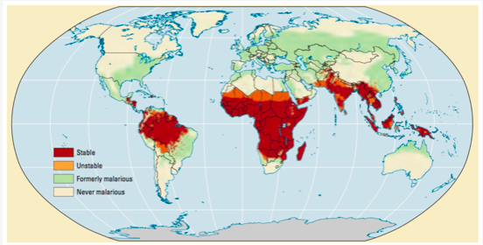
4- Vector-Borne Risks
    Transmitted by:
    - Arthropods (e.g., mosquitoes)
    Major Concern:
    - Malaria — affects 125 million travelers yearly
    Who is at risk?
    - Travelers to tropical & subtropical areas during
    transmission season.
    - Those without immunity are especially vulnerable
    Symptoms:
    - Headache -Vomiting
    - Organ failure & coma (severe cases)
    - Potentially fatal if untreated
Severity of malaria prevalence in 2009. Source, Obonyo et al. 2018
Notes:
What measures or precautions can be taken to alleviate consequences of Jet Lag?

Slide 38
4- Vector-Borne Risks
    Monkey Malaria: A Growing Risk for Adventure Travelers
    Adventure seekers, backpackers, wildlife watchers visiting rainforests and monkey habitats in:
    Singapore, Malaysia, Philippines, Thailand, Vietnam
    Cause:
    Parasite transmitted from monkeys to humans in natural habitats
    - Monkey Malaria: A Growing Risk for Adventure Travelers
Notes:
What measures or precautions can be taken to alleviate consequences of Jet Lag?

Slide 39
4- Vector-Borne Risks
    Tourist cases reported from:
    Malaysia → Finland
    Borneo → Sweden
    Thailand → Germany, France
    Other countries: USA, Netherlands, Spain, Australia, New Zealand
    Tourism practices increasing risk:
    - Wildlife conservation projects bringing tourists closer to monkey habitats
    - Feeding animals to attract them for viewing → increased proximity and infection risk
Notes:
What measures or precautions can be taken to alleviate consequences of Jet Lag?

Slide 40
Thank you
      European Institute of Innovation, Entrepreneurship and Technology
      Lessingstraße 79,
      13158 Berlin, Germany
      Phone: +49 176 55524449
      Email: info@eiiet.com
Discover the world of eiIET

