Slide 1
Quality and Sustainability in Tourism and Hospitality
European Institute of Innovation, Entrepreneurship and Technology
Lessingstraße 79, 13158 Berlin, Germany
Mahmoud Abdou| Berlin
      Lessingstraße 79,
      13158 Berlin, Germany
      Phone: +49 30 233618555
      Fax: +49 30 233618556
      Email: info@eiiet.com

Slide 2

Outline:
Resource Planning and Destination Development
Destination Development Elements
Carrying capacity and Limits of Acceptable Change

Slide 3
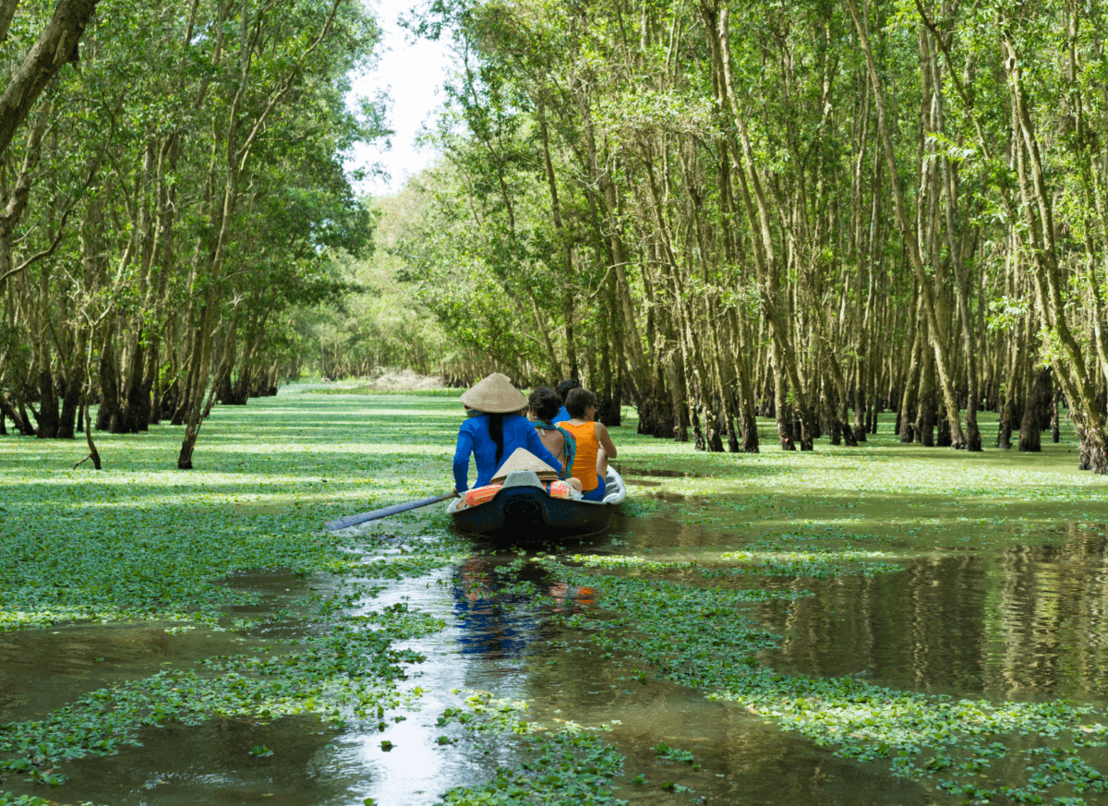
1- Resource Planning and Destination Development

Slide 4
1- Destination Management
      - It is the coordinated and strategic organization of all the elements that contribute to a tourist destination.
      - This includes:
Attractions | Amenities
Access | Marketing
Pricing

Slide 5
1- Destination Management
      - Destination Mangement helps:
      - Prevent duplication in:
      Promotion
      Visitor services
      Training and business support
      -Identify management gaps
      Unaddressed issues or underdeveloped areas
      - Encourage collaboration across sectors

Slide 6
1- Destination Management
      - The key Benefits of Destination Management
      Establishing a competitive edge
      Ensuring tourism sustainability
      Spreading the benefits of tourism
      Improving tourism yield
      Building a strong and vibrant brand identity

Slide 7
1- Destination Management
      Common Drivers Behind Destination Management:
      A- Improving Tourism Yield
      - Lengthen visitor stay
      - Increase visitor spending
      - Maximize capacity usage
      B- To protect communities and provide viable livelihoods.
      - Creates alternative income streams
      - Revitalizes local businesses
      - Underpins community stability and long-term viability

Slide 8
1- Destination Management
      C- To reduce seasonality.
      - Distribute visitor flow more evenly across the year
      - Improve employment stability and ROI for businesses
      - Maximize use of tourism infrastructure year-round
      - Promote off-season activities
      D- To spread the benefits of tourism more widely.
      - Encourage broader visitor dispersal across regions
      - Support under-visited areas to participate in tourism growth
      - Ease pressure on over-visited hotspots

Slide 9
1- Destination Management
      E- To increase awareness and enhance the image of the destination.
      - Develop unique and memorable visitor experiences
      - Promote creatively and strategically
      - Use travel influencers and social media
      F- To ensure long term sustainability.
      - Maintains destination quality over time
      - Supports local communities and culture
      - Can have a positive or regenerative effect on the destination

Slide 10
1- Destination Management
      G- To protect cultural or natural assets
      - Supports site preservation and funding
      - Stimulates tourism revenue to fund protection efforts
      - Helps balance visitor access with conservation

Slide 11
2- Destination Development Elements

Slide 12
2- Destination Development Elements
      2.1- Infrastructure and facility planning
      A- Roads and Signage
      - Ensure well-maintained, connected roads
      - Use clear, multilingual signage
      - Improve orientation and visitor safety
      B- Transportation Systems
      - Plan for efficient and accessible transport.
      - Create designated parking zones to reduce congestion.
      - Encourage low-impact transport options to support sustainability.

Slide 13
2- Destination Development Elements
      C- Visitor Centers
      - Offer maps, brochures and local info
      - Provide rest areas and visitor amenities
      - Support education and destination interpretation.
      D- Communication Networks
      - Provide internet and mobile access
      - Enable digital bookings and navigation
      - Support emergencies with reliable channels

Slide 14
2- Destination Development Elements
      2.2- Accessibility and Inclusivity
      A- Adapting Activities:
      - Offer inclusive programs for all ages and abilities.
      - Provide adaptive equipment and modifications.
      - Engage underserved and diverse groups.
      B- Inclusive Design:
      - Ensure wheelchair accessibility (ramps, paths, restrooms).
      - Address sensory needs (quiet spaces, visual cues, tactile signage).
      - Provide multilingual signs/materials to reduce language barriers.

Slide 15
2- Destination Development Elements
      2.3- Zoning and Land-Use Planning
      A- Designated Areas
      - Allocate land for tourism use
      - Prevent land-use conflicts
      - Support organized development
      B- Sustainable Development
      - Align tourism with conservation goals
      - Protect nature and heritage
      - Avoid overdevelopment

Slide 16
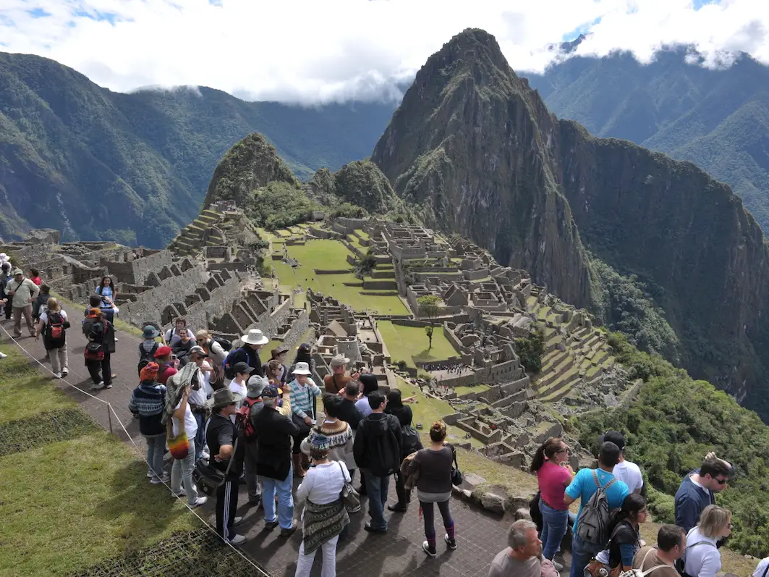
3- Carrying capacity and Limits of Acceptable Change

Slide 17
3- Carrying Capacity
      Defined by the UN World Tourism Organization (UNWTO):
      - “The maximum number of people that may visit a tourist destination at the same time without causing destruction to the physical, economic, and socio-cultural environment, and an unacceptable decline in visitor experience.”
      Modern Perspectives:
      - Shift focus from visitor numbers to the acceptability of impacts caused by visitation.
      - They prioritize factors such as:
      - Biophysical Characteristics
      Soil erosion, vegetation damage, landscape/topography sensitivity
      - Social Aspects
      Visitor behavior, group size, travel mode, seasonality, crowding perceptions
      - Management Policies
      Zoning, visitor use limits, regulations, infrastructure capacity

Slide 18
3- Carrying Capacity
      3.1- Types of Carrying Capacity:
      A- Physical Carrying Capacity
      - Maximum number of tourists a site can physically accommodate
      - Beyond this limit, environmental degradation may occur
      B- Ecological Carrying Capacity
      - Focuses on tourism’s impact on natural ecosystems
      - Ensures long-term sustainability of resources

Slide 19
3- Carrying Capacity
      C- Psychological Carrying Capacity
      - Concerns visitor satisfaction and perception
      - Varies depending on tourist type, destination, and crowd levels
      D- Social Carrying Capacity
      - Social and cultural effects on local communities
      - Includes residents’ attitudes toward tourism and changes in daily life

Slide 20
3- Carrying capacity
      E- Economic Carrying Capacity
      - Ability to support tourism without harming other local economic activities
      - Weighs profitability against opportunity costs and community well-being

Slide 21
3- Carrying capacity
      Select a cultural heritage/ natural heritage site that is opened to visitor and explain in the light of visitor management aspect:
      - the main challenges facing the site
      - How would you increase/decrease the number of the visitor
      - the different strategies would you select to overcome these challenges
      - the main strategies would you adopt to increase the number of visitors

Slide 22
3- Carrying capacity
      4.2- What are Visitor Limits?
      - Visitor limits help manage carrying capacity to ensure a sustainable, safe, and enjoyable experience for all.
      The Importance of Visitor Limits:
      Environmental Protection
      - Prevents damage to habitats, vegetation, and wildlife
      Visitor Experience
      - Reduces overcrowding, noise, and preserves enjoyment

Slide 23
3- Carrying capacity
      Resource Management
      - Ensures adequate capacity of trails, parking, and facilities
      Safety
      - Helps avoid accidents in high-use or sensitive areas
      Sustainability
      - Supports the long-term viability of the destination

Slide 24
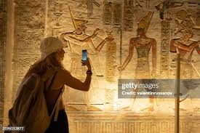
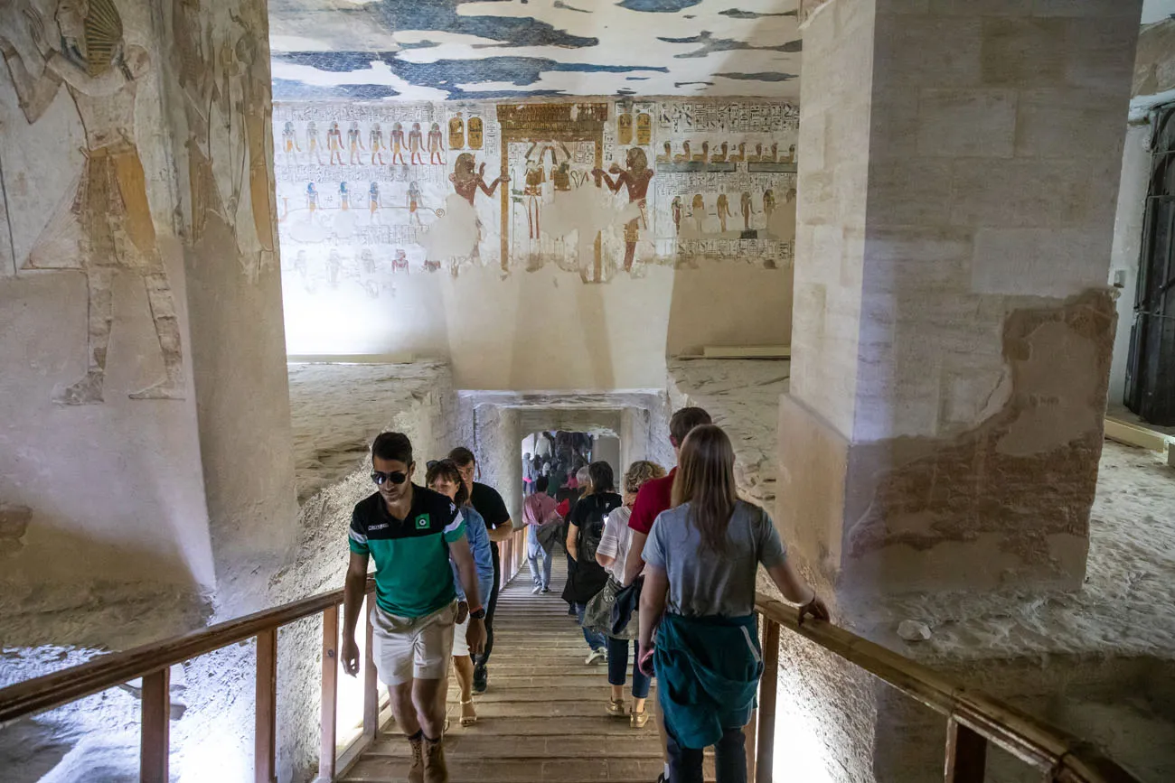
3- Carrying capacity
      3.3- Visitor Limit Strategies:
      Reservations and Permits:
      - Control access by requiring advance booking.
      Timed Entry:
      - Stagger arrivals to reduce crowding.

Slide 25
3- Carrying capacity
      3.3- Visitor Limit Strategies:
      Capacity Limits:
      - Set max visitor numbers per site/activity.
      Alternative Options:
      - Promote less-visited areas or activities.
      Education:
      - Inform visitors about low-impact behavior.

Slide 26
Thank you
      European Institute of Innovation, Entrepreneurship and Technology
      Lessingstraße 79,
      13158 Berlin, Germany
      Phone: +49 176 55524449
      Email: info@eiiet.com
Discover the world of eiIET

