Slide 1
Sociology of Tourism
European Institute of Innovation, Entrepreneurship and Technology
Lessingstraße 79, 13158 Berlin, Germany
Mahmoud Abdou| Berlin
      Lessingstraße 79,
      13158 Berlin, Germany
      Phone: +49 30 233618555
      Fax: +49 30 233618556
      Email: info@eiiet.com

Slide 2
Index
- Host-Guest Relationship
- Acculturation, Cultural Appropriation, and Commodification of Culture
- The Advantages and Disadvantages of the Tourism Movement

Slide 3
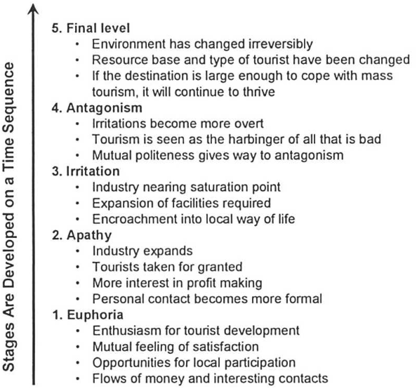
1- Host-Guest Relationship
      - The attempt to understand the nature, potential, and effects
      of interactions between hosts and guests is marked by
      a contrast between negative and positive perspectives.
      - One of the earliest concepts of interaction between guests
      and hosts was introduced by Doxey in 1975 and 1976.
      - He developed a five-stage framework, known as Doxey’s
      Irritation, which examines the progression of hosts' irritation
      caused by the presence of tourists at a destination.

Slide 4

1- Host-Guest Relationship
      The irritation stems from various factors:
    - including the physical presence of tourists,
    - their numbers and characteristics,
    - the duration of their stay,
    - cultural differences and distance between hosts and visitors,
    - and foreign ownership of local resources.

Slide 5
1- Host-Guest Relationship
      - At the initial stage of tourism development in a destination,
      hosts’ attitudes are generally positive. However, they
      gradually shift toward negativity as tourism places increasing
      pressure on the local community.
      - Doxey's irritation model suggests a one-direction
      progression in which hosts’ attitudes evolve through stages
      of euphoria, apathy, irritation, antagonism, and ultimately
      reach a final stage.

Slide 6
1- Host-Guest Relationship
      Euphoria:
      - Characterizes the initial excitement about tourism
      development.
      - Tourists are warmly welcomed as their numbers are small.
      - Tourists show respect for residents and the destination.
      - Interactions are slightly commercial but accompanied by
      mutual satisfaction

Slide 7
1- Host-Guest Relationship
      Apathy:
      - Emerges as tourism grows and the number of tourists
      increases.
      - Locals begin to naturally accept tourists as part of daily life.
      - Hosts view tourists primarily as a source of income.
      - Interactions become more formal and business-oriented.

Slide 8
1- Host-Guest Relationship
      Irritation:
      - Hosts start to separate their personal lives from tourists.
      - Concerns and frustrations among locals increase.
      - Irritation intensifies if tourism surpasses the destination’s
      capacity.

Slide 9
1- Host-Guest Relationship
      Antagonism:
      - Some hosts protest against tourism due to limited natural
      and cultural resources and tourists’ inappropriate behavior.
      - Tensions grow between locals and tourists, leading to
      confrontations and antagonism.
      - Tourists are blamed—fairly or unfairly—for negative
      changes to local lifestyles and society.
      - Hosts become openly intolerant of tourists, viewing them
      as exploiters.

Slide 10
1- Host-Guest Relationship
      Final Level:
      - The destination loses its appeal due to the accumulated
      negative consequences of overtourism.
      - Decline occurs as the area's attractiveness deteriorates.
      - Tourists look for and move on to different destinations.

Slide 11

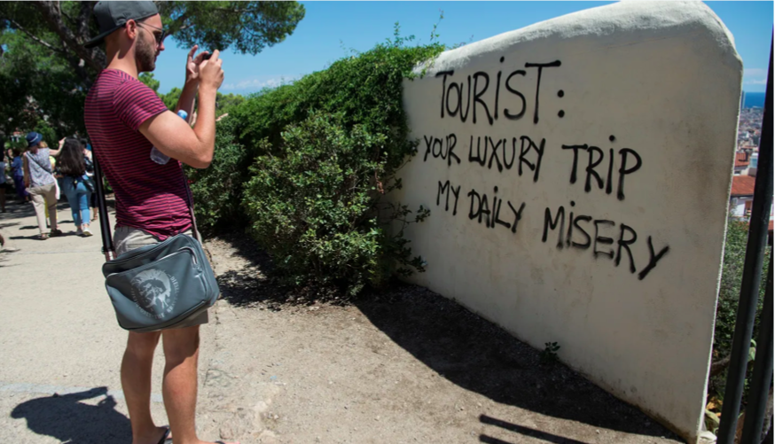
1- Host-Guest Relationship
      Protests in Spain in Barcelo, Mallorca, Canaries against over - tourism:
      - Non-sustainable tourism.
      - Negative economic impacts (prices and rents).
      Extensive pressure on infrastructure and environment.

Slide 12
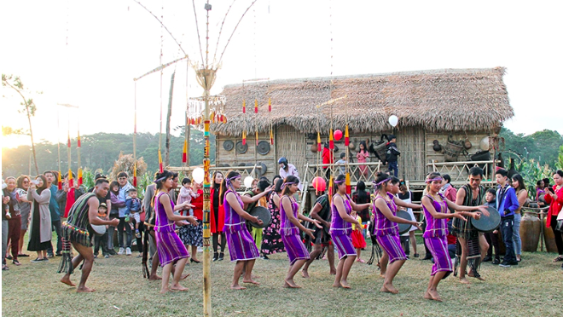
2- Acculturation, Cultural Appropriation, Commodification of Culture
      Acculturation:
      - The acculturation process refers to long-term changes and transformations in the host culture resulting from the presence of tourists.
      - Also, it can be understood as the process in
      which members of one culture respond to and
      interact with another culture with which they
      come into contact.

Slide 13
2- Acculturation, Cultural Appropriation, Commodification of Culture
      Acculturation :
      - One or more cultural elements, during the acculturation process, are adopted as a result of the interaction between hosts and guests.
      - This exchange process is both asymmetric and imbalanced, as the dominant culture of the guests shapes and alters the culture of the hosts
      - The form of interaction, varying levels of
      socio-cultural integration, socio-economic
      differences, and other factors often lead to an
      imbalanced cultural exchange

Slide 14
2- Acculturation, Cultural Appropriation, Commodification of Culture
      Acculturation :
      - Apparently, tourists are less likely to adopt elements of their hosts' culture than hosts are to adopt from them, thereby initiating an unprecedented chain of change in the host community.
      - Ethnic and cultural differences play a critical role in either increasing or decreasing misunderstandings and unwelcome behavior between the two cultures

Slide 15
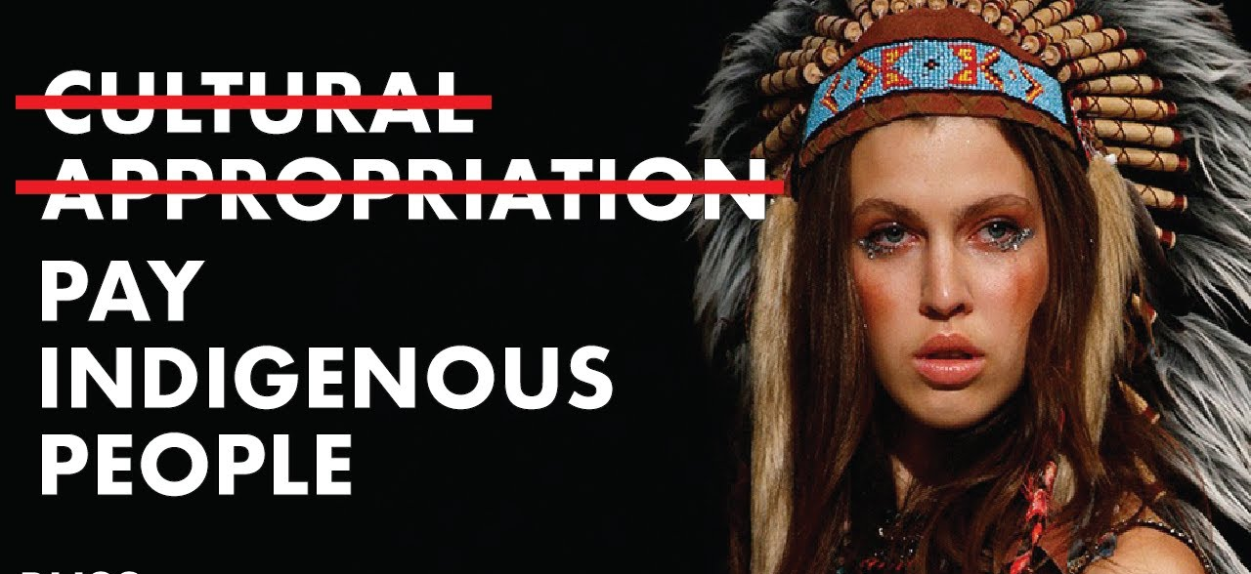
2- Acculturation, Cultural Appropriation, Commodification of Culture
      Cultural Appropriation:
      - Cultural appropriation is considered ethically problematic, as it often involves misrepresentation, misuse, or unauthorized use of the stories, traditions, and material heritage of historically oppressed and socially marginalized communities.

Slide 16


2- Acculturation, Cultural Appropriation, Commodification of Culture
      Cultural Appropriation:
      - An example of cultural appropriation is the sombrero, originally designed
      to provide shade for farmworkers and horse riders, which has become a
      significant symbol of Mexican culture.
      - Many Mexicans feel uncomfortable and disrespected when foreigners wear it,
      as it can be offensive when individuals from other cultures adopt a cultural element without making an effort to understand its significance to the people of that culture

Slide 17
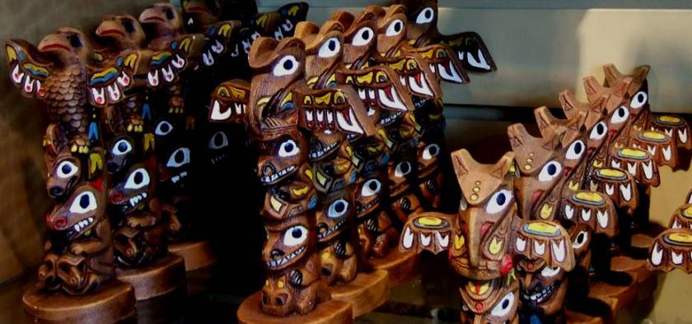
2- Acculturation, Cultural Appropriation, Commodification of Culture
      Commodification of Culture :
      - The commodification of culture indicates a process during which cultural aspects are transformed into goods.
      - Also, it was developed to explain how local rituals, celebrations,
      and artifacts are transformed into products tailored to meet the
      expectations of tourists.

Slide 18
2- Acculturation, Cultural Appropriation, Commodification of Culture
      Commodification of Culture :
      - Rituals and festivities, which once symbolized unity and shared identity among local communities, lose their original cultural significance under the influence of tourism, becoming mere tourist attractions.
      - The commodification of culture deprives people of the meanings that help them organize their social lives.
      - The loss of meaning resulting from commodification leads to a decline in authenticity and the erosion of social relationships.
      - Local cultures are often transformed, diminished, or even eradicated, leaving them meaningless.
      - In addition, rituals have been reduced to performances driven by financial motives, with their true essence entirely lost

Slide 19
2- Acculturation, Cultural Appropriation, Commodification of Culture
      Commodification of Culture :
      - However, the impact of commodification on the meaning and authenticity of the host culture can be seen as positive, as the performance of events for tourism provides an opportunity for the local community to reassess the value of these cultural practices.
      - The commodification of local culture does not necessarily lead to its destruction; on the contrary, the development of a cultural tourism market often helps preserve traditions that might otherwise disappear.
      - It allows communities to maintain a meaningful local or ethnic identity that could have been lost.
      - Therefore, the commodification of culture does not always have to diminish the authentic meaning of local culture, traditions, and artifacts.

Slide 20
2- Acculturation, Cultural Appropriation, Commodification of Culture
      Commodification of Culture :
      - Commodification of culture can also be seen as a way to maintain ethnic and cultural identity.
      - Local communities can use tourism to gain both local power and external recognition, as tourists' visits enhance pride and foster a self-conscious awareness of their traditional culture.
      - Commodification serves as a way to affirm one's identity, share one's story, and understand the significance and meaning of local experiences and heritage.

Slide 21

3- The Advantages and Disadvantages of the Tourism Movement
      The Positive Socio-Cultural Impact of Tourism:
      - Stimulus for Conservation and Heritage Preservation: Tourism can provide funding for preserving natural environments and cultural heritage.
      - Renewal of Cultural Pride: Tourism can help revive local traditions and foster pride in cultural identity.
      - Revitalization of Customs and Traditions: Tourism can encourage the continuation of cultural practices.
      - Cross-Cultural Exchange and Integration: Tourism facilitates interaction between different cultures, promoting understanding and integration.

Slide 22
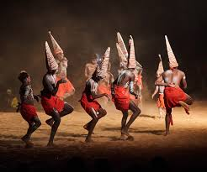
3- The Advantages and Disadvantages of the Tourism Movement
      The Negative Socio-Cultural Impact of Tourism
      Influence on Traditions and Customs:
      - Tourism predominantly affects the traditions, customs,
      and values of indigenous societies rather than tourists.
      - Local communities are constantly exposed to changing
      visitors, while tourists often shift destinations.
      - Even seasonal or intermittent tourism has long-term
      effects on the social and cultural fabric of host societies.

Slide 23
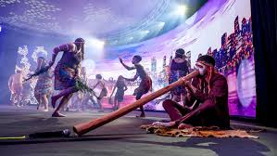
3- The Advantages and Disadvantages of the Tourism Movement
      The Negative Socio-Cultural Impact of Tourism
      Cultural Drift and Demonstration Effect:
      - Seasonal tourism in countries like Greece and Turkey leads to cultural drift, where locals temporarily adapt their behavior to tourists but revert after the season ends.
      - The demonstration effect encourages locals to adopt tourists' languages, foods, fashions, and entertainment preferences, contributing to cultural homogenization.

Slide 24
3- The Advantages and Disadvantages of the Tourism Movement
      The Negative Socio-Cultural Impact of Tourism
      Inter-Generational and Gender Conflicts:
      - Strictly religious, patriarchal, or close-knit societies face challenges like inter-generational conflicts, with younger generations embracing global lifestyles and older ones preserving traditions.
      - Women's roles may shift, empowering them in some cases but causing conflict in patriarchal societies, particularly when women become the primary breadwinners.

Slide 25
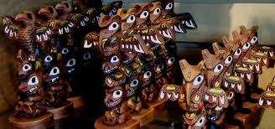
3- The Advantages and Disadvantages of the Tourism Movement
      The Negative Socio-Cultural Impact of Tourism
      The Commodification of Culture
      - Many tourists, including long-term backpackers, develop a preference for Western-style comforts such as fast food, alcohol, and brand-name products.
      - This demand forces destinations to cater to tourists’ tastes, often at the expense of local goods and services.
      - Excessive demand for local products may lead to mass production, which can commodify and commercialize local culture.

Slide 26
3- The Advantages and Disadvantages of the Tourism Movement
      The Negative Socio-Cultural Impact of Tourism:
      Tourist Demand for Traditional Events and 'Staged Authenticity':
      - Tourists often seek to participate in or spectate traditional activities and events, creating tension between preserving the authenticity of these practices and commercializing them for tourism.
      - Many traditional events and rituals are performed outside their original cultural context for tourists, leading to "staged authenticity."
      - While authenticity matters to tourists, it is more important that local communities are comfortable with their role as performers and entertainers.
      - Some religious or spiritual practices may not be suitable for tourist entertainment and should be respected for their cultural and spiritual significance.
      - The local community's willingness to commodify their culture for tourism purposes varies, and not all communities may feel comfortable with this process

Slide 27
3- The Advantages and Disadvantages of the Tourism Movement
      Mechanisms of Cultural Change
      - Permanent cultural changes are more likely to occur when tourism becomes a continuous and deeply integrated part of the local economy and society.
      - Tourism is just one of several factors that contribute to changes in the social and cultural fabric through:
      Cultural Drift:
      - Temporary changes in locals' behavior while interacting with tourists, disappearing once tourists leave.
      - Typically observed in seasonal tourism settings.
      Acculturation:
      - Permanent cultural shifts passed down generations, often occurring in non-seasonal tourism where the influence is pervasive and locals are receptive.

Slide 28
3- The Advantages and Disadvantages of the Tourism Movement
      The Economic Impacts of Tourism.
      The positive economic impacts of tourism can include direct and indirect impacts. The direct impacts are as follows:
      - Improved Standard of Living: Tourism offers populations better living standards by boosting local economies.
      - Creation of Employment: Tourism creates jobs in various sectors.
      - Foreign Exchange Earnings: Tourism brings in money from visitors, boosting the economy.

Slide 29
3- The Advantages and Disadvantages of the Tourism Movement
      The Economic Impacts of Tourism
      The indirect positive economic impacts of tourism are:
      - Expansion of Other Economic Sectors: Tourism can stimulate growth in other sectors, like agriculture, retail, and services.
      - Infrastructural Development: Tourism can lead to improved infrastructure such as roads, airports, and public facilities.
      -Enhancing Investment and Development: Tourism stimulates investment opportunities by encouraging both the government and private sector to allocate resources. The money spent by tourists is reinvested into various areas in the society.
      Revitalizing Economies in Underdeveloped Regions: Tourism plays a crucial role in fostering development and promoting non-industrialized regions.

Slide 30
3- The Advantages and Disadvantages of the Tourism Movement
      The Negative Economic Impacts of Tourism
      Economic Leakages and Imported Goods:
      - Catering to Western-style preferences can lead to economic leakages, as profits often flow to foreign companies instead of staying within the local economy.
      - Tourists tend to demand Western-style amenities, particularly in large hotel chains and all-inclusive resorts, increasing the reliance on imported goods and services.
      - In small island economies like the Caribbean or South Pacific, inter-island linkages can be strengthened, but there remains a significant need to import goods, contributing to economic leakages.

Slide 31
3- The Advantages and Disadvantages of the Tourism Movement
      The Negative Economic Impacts of Tourism
      Threat to Local Products and Commodification:
      - As locals adopt Western-style products, traditional goods may decline or disappear, weakening local industries.
      - Excessive tourist demand for local products can lead to mass production, which risks commodifying and commercializing local culture.
      Tourism as a 'Quick Fix' Solution and Neglect of Local Needs:
      - Governments often view tourism as a quick solution to economic challenges, aiming to elevate their global standing and attract foreign investment.
      - This emphasis on rapidly increasing visitor numbers can lead to the neglect of environmental, socio-cultural impacts, and local community needs, as national agendas take precedence.

Slide 32
3- The Advantages and Disadvantages of the Tourism Movement
      The Negative Economic Impacts of Tourism
      Loss of Control and External Investment:
      - Governments may hand over control of tourism development to international consultants and agencies, relying on their expertise.
      - In poverty-stricken areas, foreign investment becomes appealing, but local entrepreneurs may struggle to afford inflated land and property prices, increasing dependence on external capital.

Slide 33
3- The Advantages and Disadvantages of the Tourism Movement
      The Environmental Impacts of Tourism:
      The Positive Impacts include:
      Conservation of important natural areas:
      - Tourism supports the preservation and funding of vital natural areas and wildlife, including marine ecosystems, through the establishment of national and regional parks and reserves that attract visitors..
      - Without tourism, these areas might face alternative development or ecological degradation, leading to a loss of environmental heritage.

Slide 34
3- The Advantages and Disadvantages of the Tourism Movement
      The Environmental Impacts of Tourism:
      The Positive Impacts include:
      Enhancement of the Environment:
      - The development of well-designed tourist facilities, such as visually appealing hotels, can enhance and transform landscapes that might otherwise go unnoticed.
      Improvement of environmental quality:
      - Tourism incentivizes maintaining a clean environment by promoting the management and control of air, water, noise, and visual pollution

Slide 35
3- The Advantages and Disadvantages of the Tourism Movement
      The Environmental Impacts of Tourism:
      The Positive Impacts include:
      Increasing environmental awareness:
      - In areas where residents show limited interest in environmental conservation, witnessing tourists' enthusiasm for nature can inspire greater environmental awareness among the local population.
      Improvement of Infrastructure:
      - Tourism development improves local infrastructure like airports, roads, and waste systems, funding and utilizing them to reduce pollution and enhance environmental quality.

Slide 36
3- The Advantages and Disadvantages of the Tourism Movement
      The Environmental Impacts of Tourism:
      The Negative Impacts include:
      Ecological disruption and environmental hazards:
      - Uncontrolled tourism can cause ecological issues such as overuse of fragile environments, animal killings, deforestation, coral damage, and disturbance of wildlife by photography.
      Damage to historic / archaeological sites:
      - Overuse or misuse of fragile archaeological sites can result in damage through excessive wear, vibration, vandalism, and graffiti.

Slide 37
3- The Advantages and Disadvantages of the Tourism Movement
      The Environmental Impacts of Tourism:
      The Negative Impacts include:
      Land Use Problems:
      - Tourist facilities, such as hotels, resorts, and restaurants, may occupy land that could be more beneficial for other purposes, such as agriculture or mining.
      Congestion and Overcrowding:
      - Tourist destinations can become overly crowded, making movement difficult and causing negative environmental effects.

Slide 38
3- The Advantages and Disadvantages of the Tourism Movement
      The Environmental Impacts of Tourism:
      The Negative Impacts include:
      Waste Disposal Problems:
      - Improper disposal of litter and solid waste from resorts and hotels can lead to environmental and health problems, pollution, diseases, and make the destination unattractive.
      Visual Pollution:
      - Poorly designed hotels, tourist facilities, or buildings that do not match the local architecture,
      lack proper landscaping, or feature large, unattractive advertising signs can create an unpleasant
      environment for both locals and tourists

Slide 39
3- The Advantages and Disadvantages of the Tourism Movement
      The Environmental Impacts of Tourism:
      The Negative Impacts include:
      Water Pollution:
      - It occurs when proper sewage disposal systems are not installed in hotels, resorts, or other tourist facilities.
      - This can lead to contamination of groundwater from untreated sewage.
      Air Pollution:
      - Although tourism is often considered a "clean industry," air pollution can arise from tourist vehicles and the development of tourism areas, leading to significant air pollution issues.
      Noise Pollution:
      Noise from tourist vehicles, airplanes, attractions like amusement parks, or car and motorcycle races can reach disturbing levels for nearby residents.

Slide 40
      Activity
      Write about a destination you have visited or have heard about, covering the following points:
      - Destination Name and Location
      - Tourist Attractions
      - Positive Tourism Impacts (Socio-cultural, economic, environmental aspects).
      - Negative Tourism Impacts (Socio-cultural, economic, environmental aspects).

Slide 41
Thank you
      European Institute of Innovation, Entrepreneurship and Technology
      Lessingstraße 79,
      13158 Berlin, Germany
      Phone: +49 176 55524449
      Email: info@eiiet.com
Discover the world of eiIET

