Slide 1
Name – Jatinderpal kaur student number - DE240125

Slide 2
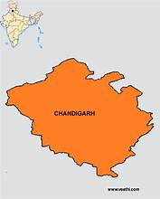
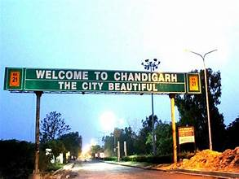
Chandigarh – THE Beautiful CITY
Prepared by :Jatinderpal kaur

Slide 3
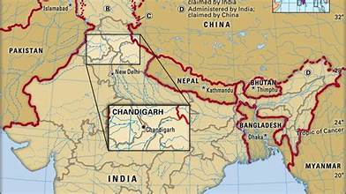
Introduction Of Chandigarh
A Union Territory and joint capital of Punjab and Haryana, nestled at the foot of the Shivalik Hills.
India’s first planned city post-independence, designed by architect Le Corbusier.
Known for its cleanliness, greenery, and high standard of living.
Name means “Fort of Goddess Chandi,” inspired by the nearby Chandi Mandir.
Acts as a gateway to the Himalayan hill stations and is a major cultural, educational, and administrative hub.

Slide 4
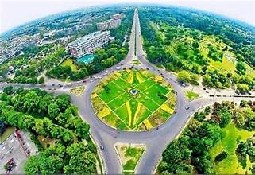
Historical Background
Conceived in 1947 after the partition of India to replace Lahore as Punjab’s capital.
Designed by Swiss-French architect Le Corbusier, with contributions from Pierre Jeanneret and others.
Built on ancient land once home to Harappan civilization and a prehistoric lake.

Slide 5
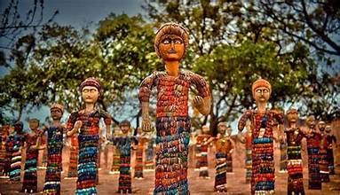
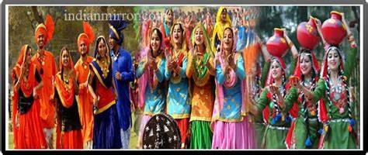
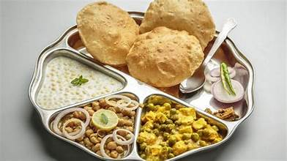
Cultural Features
Festivals: Diwali, Baisakhi, Lohri, Gurpurab, Holi, Eid, Christmas, and Navratri are celebrated with enthusiasm.
Signature Events:
  Rose Festival (Feb): Asia’s largest rose show.
  Chandigarh Carnival (Nov): Art, music, and dance extravaganza.
Customs & Habits: A blend of Punjabi warmth and cosmopolitan lifestyle; people enjoy folk dances like Bhangra and Gidda, and traditional foods like makki di roti and sarson da saag

Slide 6
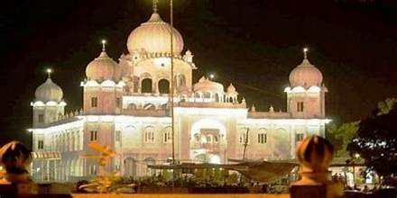
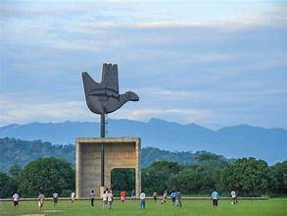
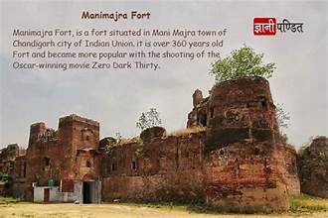
Historical & Archaeological Sites
Capitol Complex: UNESCO World Heritage Site with High Court, Secretariat, and Assembly.
Rock Garden: Created by Nek Chand using recycled materials.
Burail Fort & Manimajra Fort: Mughal-era remnants.
Le Corbusier Centre and Government Museum & Art Gallery: Architectural and cultural archives

Slide 7
Importance in Tourism Development
Serves as a gateway to Himachal Pradesh and Punjab.
Promoted as a short-stay destination for travelers heading to Shimla and Manali.
Government initiatives include guided tours, cultural performances, and infrastructure upgrades.
Economic Growth: Tourism generates revenue through hospitality, transport, shopping, and local services. In 2024 alone, Chandigarh welcomed over 10 lakh visitors, boosting local businesses and employment.
Job Creation: From tour guides and hotel staff to artisans and performers, tourism supports a wide range of jobs. The Chandigarh Tourism Department is actively promoting cultural performances and guided tours to expand these opportunities.
Cultural Preservation: By showcasing landmarks like the Rock Garden, Capitol Complex, and Sukhna Lake, tourism helps preserve and promote the city’s heritage and modernist legacy.
Urban Development: Tourism encourages better infrastructure—cleaner streets, improved public transport, and enhanced public spaces—all of which benefit residents too.
Regional Connectivity: Chandigarh acts as a gateway to Himachal Pradesh and Punjab. Tourism development strengthens its role as a hub for short-stay travelers heading to hill stations like Shimla and Manali.

Slide 8
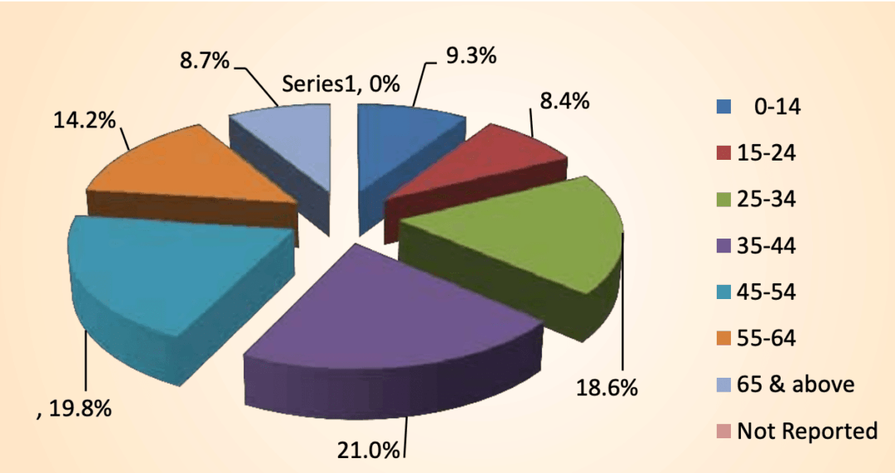
Tourist Footfall
2024: Over 1 million visitors.
Target for 2026: 1.5 million tourists annually.
Domestic tourist arrivals peaked at 3 million in 2022, though dipped in 2023 due to weather.
Collaborating with national travel agents to include Chandigarh in 1–2day stopovers.
Boosting cultural engagement, including live performances at iconic spots like the Rose Garden.
Expanding digital outreach, with a goal of reaching 40 lakh users across social media platforms by 2026.

Slide 9
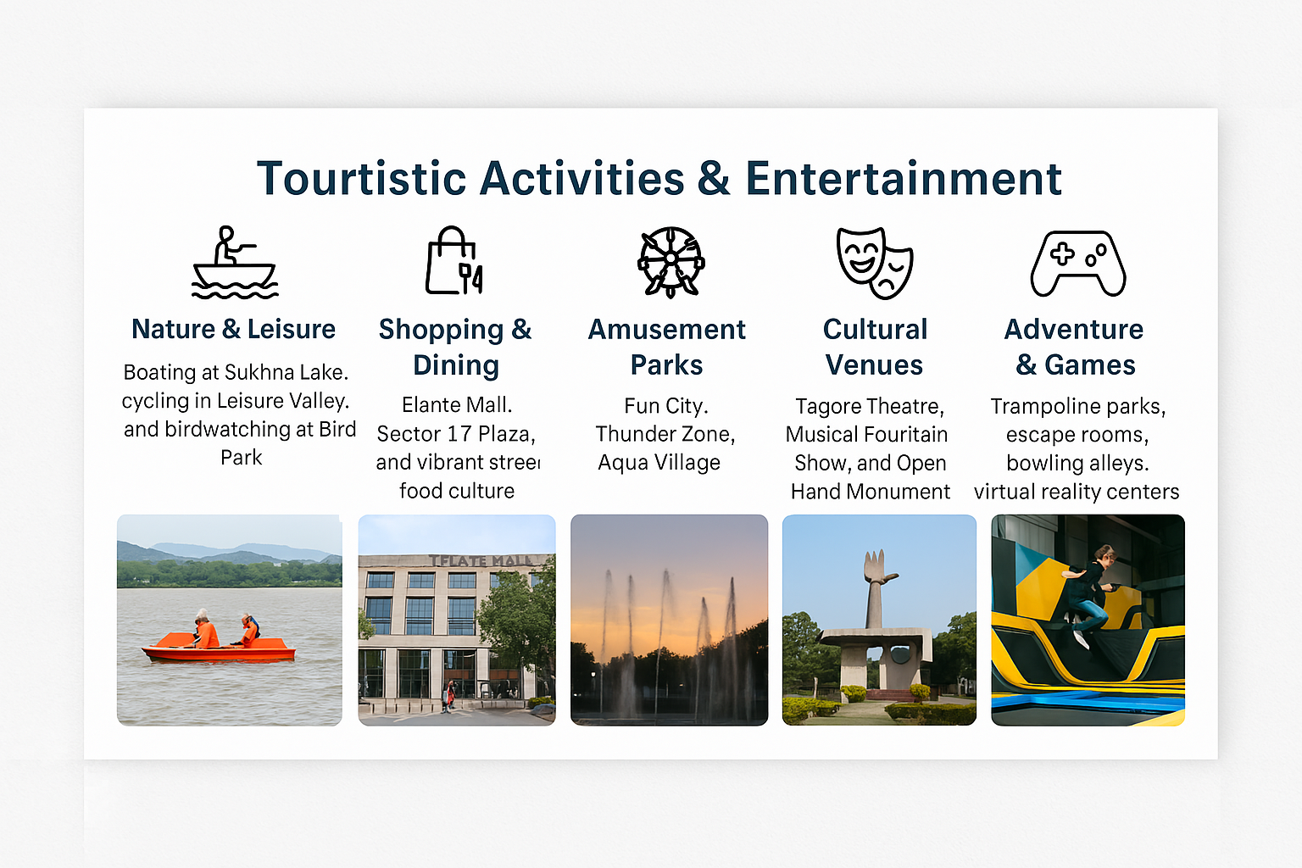
Touristic Activities & Entertainment
Nature & Leisure: Boating at Sukhna Lake, cycling in Leisure Valley, and birdwatching at Bird Park.
Shopping & Dining: Elante Mall, Sector 17 Plaza, and vibrant street food culture.
Amusement Parks: Fun City, Thunder Zone, Aqua Village.
Cultural Venues: Tagore Theatre, Musical Fountain Show, and Open Hand Monument.
Adventure & Games: Trampoline parks, escape rooms, bowling alleys, and virtual reality centers.

Slide 10
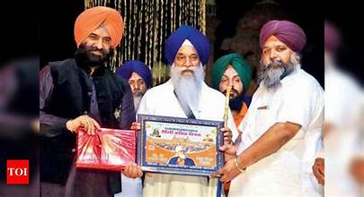
Conclusion
Chandigarh is a fusion of heritage and modernity, offering rich cultural experiences, architectural marvels, and diverse entertainment.
Its strategic location and government-backed tourism initiatives make it a rising star in India’s travel landscape

Slide 11
Thank you

