Slide 1
Tourism Law and Legislation
European Institute of Innovation, Entrepreneurship and Technology
Lessingstraße 79, 13158 Berlin, Germany
Mahmoud Abdou| Berlin
      Lessingstraße 79,
      13158 Berlin, Germany
      Phone: +49 30 233618555
      Fax: +49 30 233618556
      Email: info@eiiet.com

Slide 2
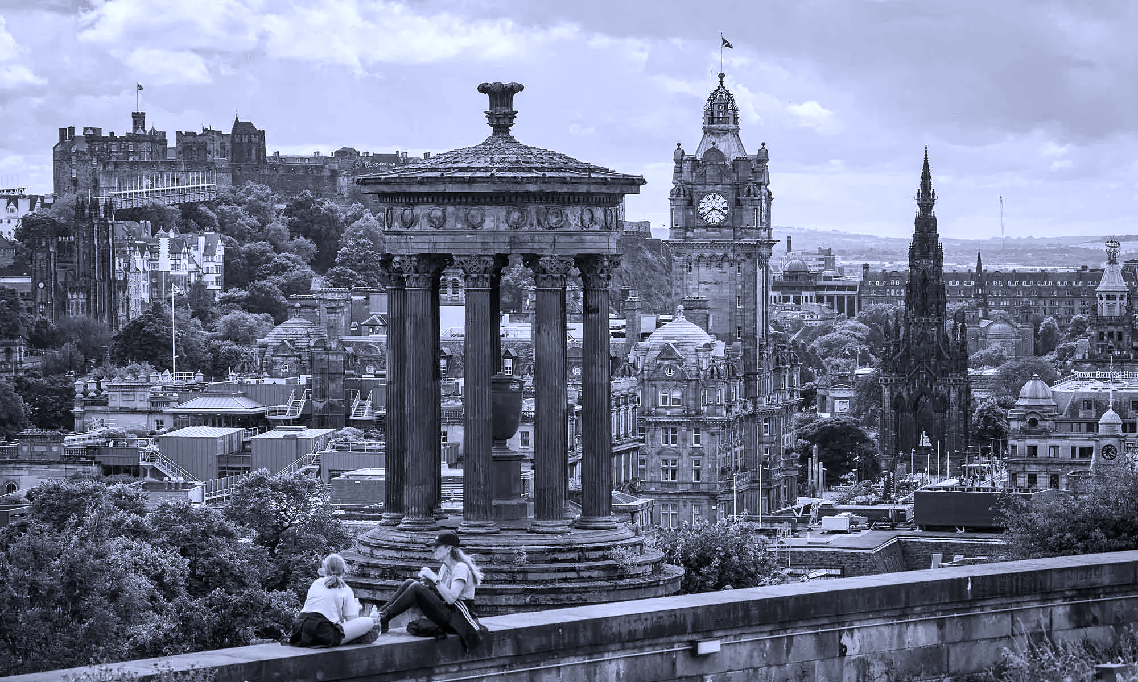
Outline:
1- International Institutions and Tourism law
2- Introduction to UNWTO
3- Role of UNWTO
4- Membership of UNWTO
5- Structure of UNWTO - Policy making

Slide 3
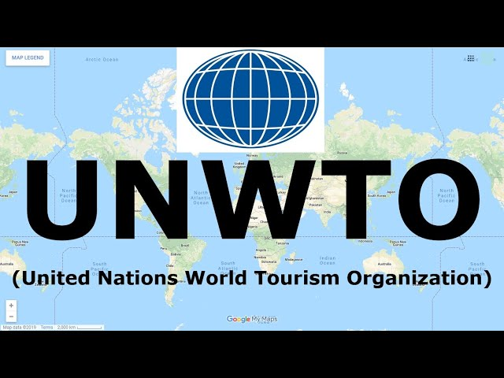
1- INTRODUCTION TO UNWTO

Slide 4
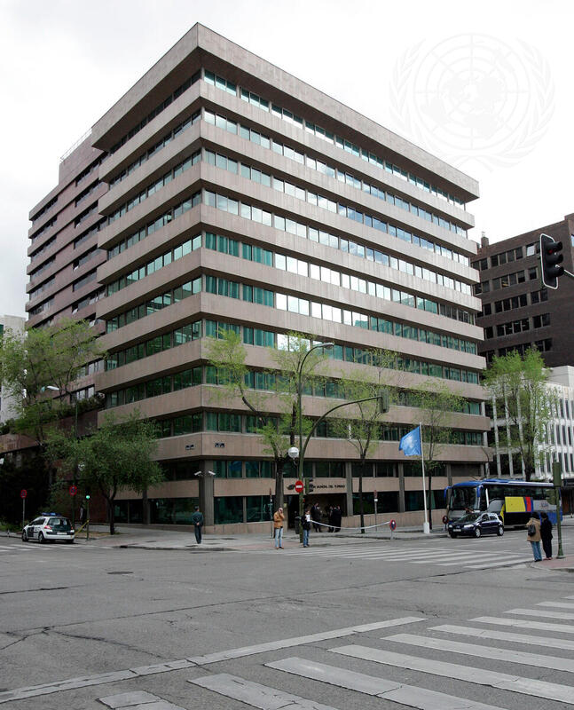
1- Introduction to UNWTO
- Specialized agency of the United Nations
- Responsible for development of tourism worldwide
- Promotes sustainable and responsible tourism
- Works at the global (world) level

Slide 5
1- Introduction to UNWTO
- Began as the International Congress of Official Tourist Traffic Associations (1925)
Established in The Hague
- In 1934, the International Union of Official Tourist Propaganda Organizations (IUOTOP) was created
- After World War II, it was renamed
- Became the International Union of Official Travel Organizations (IUOTO)
Headquarters in Geneva

Slide 6
1- Introduction to UNWTO
International Union of Official Travel Organizations (IUOTO):
- Functioned as a technical, non-governmental organization
- Membership at its peak included:
109 National Tourist Organizations (NTOs)
88 associate members
- Associate members comprised:
Public sector organizations
Private sector organizations

Slide 7
1- Introduction to UNWTO
- Tourism became an integral part of modern life
- International dimensions of tourism expanded
- National governments began to play a more significant and proactive role
- Government involvement included:
Tourism infrastructure development
Planning and policy support

Slide 8
1- Introduction to UNWTO
Developments During the 1960s:
- Recognition of the need for tourism development at:
International level
Regional level
National level
- Emphasis on maintaining peaceful and coordinated tourism development
- Need identified for specialized intergovernmental machinery

Slide 9
1- Introduction to UNWTO
- In 1967, IUOTO members called for:
Transformation into an intergovernmental organization
Authority to address global tourism issues
Cooperation with other international organizations

Slide 10
1- Introduction to UNWTO
Formation of the World Tourism Organization (UNWTO):
- 27 September 1970:
IUOTO’s Extraordinary General Assembly adopted the statutes of the World Tourism Organization
Meeting held in Mexico
- IUOTO was officially transformed into the World Tourism Organization
- First General Assembly held in Madrid in May 1975
- Secretariat established in Madrid
- Later, in 2003, it became a UN Specialized Agency (UNWTO

Slide 11
1- Introduction to UNWTO
World Tourism Day:
Established in 1979
Celebrated annually on 27 September
Marks the founding of the World Tourism Organization

Slide 12
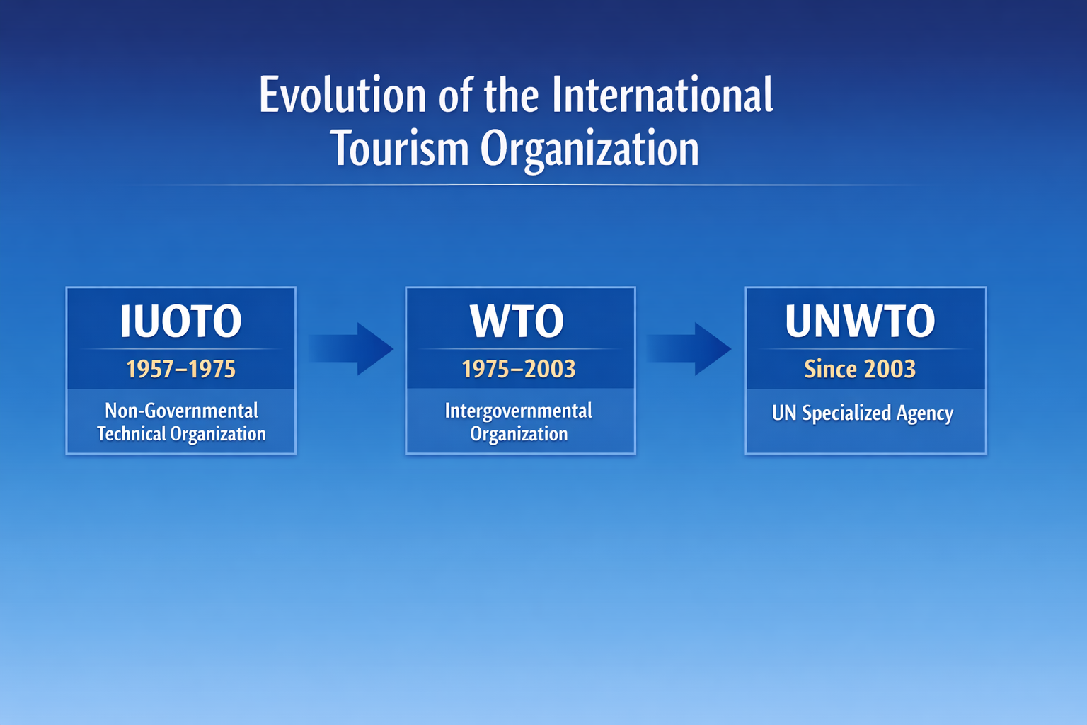
1- Introduction to UNWTO

Slide 13
1- Introduction to UNWTO
A- IUOTO was technical:
- It focused on expert work, such as:
Tourism statistics
Research and technical advice
Coordination between national tourism offices
Non-governmental:
- It was not an intergovernmental organization.
- It was not created by a treaty between states
- It was not part of the UN system
- It did not have international legal authority

Slide 14
1- Introduction to UNWTO
B- Intergovernmental Organization (IGO)
- Created by a treaty between sovereign states
Key Characteristics
- Members: only sovereign countries
- Has legal personality under international law
- Can enter agreements, set policies, and coordinate actions
- Decisions often need state approval to be binding

Slide 15
1- Introduction to UNWTO
C- UN Specialized Agency
-An autonomous UN organization
Key Characteristics:
- Members: mostly countries
- Operates under its own constitution but cooperates with the UN
- Can issue guidelines or codes of conduct influencing national laws
- Has higher international recognition and legitimacy

Slide 16
2- ROLE OF UNWTO

Slide 17
2- Role of UNWTO
- Promote international understanding and peace
- Build intercultural awareness and friendships
- Promote responsible and sustainable tourism
- Encourage universal access to tourism
- Strengthen public–private partnerships
- Implement the Global Code of Ethics for Tourism

Slide 18
3- MEMBERSHIP OF UNWTO

Slide 19
3- Membership of UNWTO
Membership of the organization shall be open to:
( a ) Full Members
( b ) Associate Members
( c ) Affiliate Members

Slide 20
3- Membership of UNWTO
( a ) Full Members:
- Full membership of the Organization shall be open to all sovereign States.
- At present, full members are 160 countries.

Slide 21
3- Membership of UNWTO
( b ) Associate Members:
- Open to territories not responsible for their external relations
- Requires prior approval from the government responsible for external relations
- Current number: associate members
- Includes: Aruba, Flanders, Hong Kong (China), Macao (China), Madeira, Portugal, Puerto Rico

Slide 22
3- Membership of UNWTO
( c ) Affiliate Members
- Open to international bodies with specialized tourism interests
- Open to commercial bodies and associations

Slide 23
4- ORGANIZATIONAL STRUCTURE OF UNWTO

Slide 24
4- Organizational Structure of UNWTO
( a ) The General Assembly:
- Supreme Organ of UN Tourism
- Meets in ordinary session every two years
- Debates topics of vital importance to tourism
- Approves the program of work and budget
- Elects the Secretary-General every four years

Slide 25
4- Organizational Structure of UNWTO
( a ) The General Assembly:
- Composition of the Governing Body:
Full Members and Associate Members
Affiliate Members and other international organizations participate as observers

Slide 26
4- Organizational Structure of UNWTO
( b ) The Executive Council
- Ensures the Organization carries out its work and adheres to its budget
- Meets at least twice a year
- Composed of Members elected by the General Assembly

Slide 27
4- Organizational Structure of UNWTO
( c ) The Secretariat
- Consists of the Secretary-General and required staff
Secretary-General
- Appointed by two-thirds majority of Full Members present and voting in the General Assembly
- Appointment is made on the recommendation of the Executive Council
- Term: 4 years, renewable

Slide 28
Thank you
      European Institute of Innovation, Entrepreneurship and Technology
      Lessingstraße 79,
      13158 Berlin, Germany
      Phone: +49 176 55524449
      Email: info@eiiet.com
Discover the world of eiIET

