Slide 1
The Fundamentals of Cost Accounting: Insights for Effective Business Management
European Institute of Innovation, Entrepreneurship and Technology
Lessingstraße 79, 13158 Berlin, Germany
RSS Vaibhav| Berlin
      Lessingstraße 79,
      13158 Berlin, Germany
      Phone: +49 30 233618555
      Fax: +49 30 233618556
      Email: info@eiiet.com

Slide 2
Index
- Introduction to Cost Accounting
Importance in Business
Components of Cost Accounting
Types of Costing Methods
Break-Even Analysis and Cost Control
Real-World Case Study
Applications of Cost Accounting in Different Industries
Conclusion

Slide 3
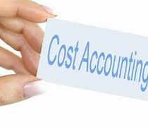
Introduction to Cost Accounting
Cost Accounting is essential for tracking, controlling, and planning the costs of producing goods or services.
Core Objectives:
- Cost Control
- Profitability Analysis
- Budgeting and Planning
- Pricing Decisions

Slide 4
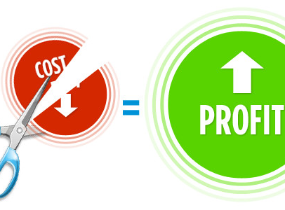
Importance in Business
For Small Businesses: Manage resources, set accurate prices.
For Large Corporations:
Optimize production,
Reduce waste,
Improve profitability.

Slide 5
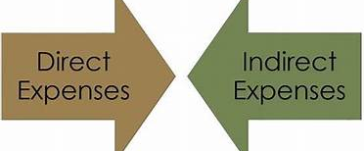
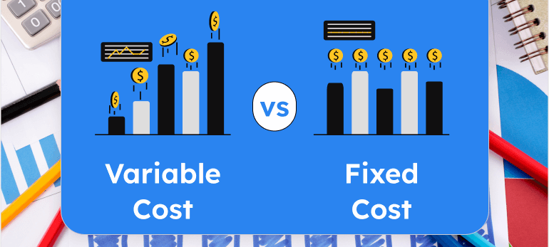
Components of Cost Accounting
Direct Costs: Costs that can be directly traced to the production of a specific product or service.
Indirect Costs (Overheads): Costs that cannot be directly traced to a specific product; they support the overall production.
Fixed Costs vs. Variable Costs
Fixed Costs: Unchanged by production volume
Variable Costs: Change with production

Slide 6
Types of Costing Methods
Job Costing: Tracks costs for individual jobs or projects, used when products are unique or customized.
Process Costing: Suitable for industries with homogeneous products; costs are averaged over all units.
Activity-Based Costing (ABC): Allocates indirect costs based on activities that drive costs, resulting in more accurate product costing.

Slide 7
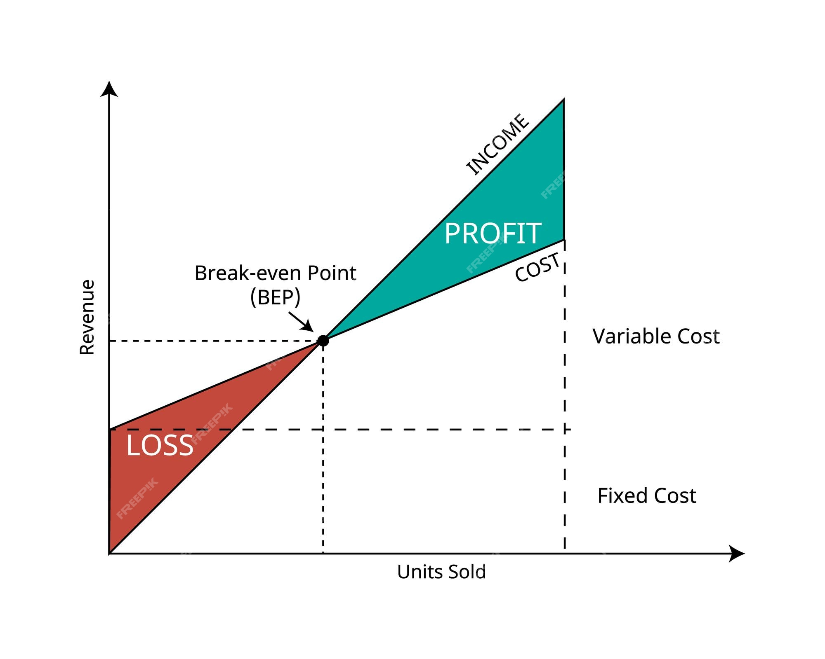
Break-Even Analysis and Cost Control
Break-Even Analysis: Calculates the production level at which total revenue equals total costs.
Formula: Break-even point = Fixed Costs / (Selling Price per Unit - Variable Cost per Unit).
Cost Control Strategies: Techniques for managing and reducing business expenses.
Strategies:
  Budgeting: Setting spending limits for various departments.
  Variance Analysis: Comparing actual costs with budgeted costs to spot discrepancies.

Slide 8
Real-World Case Study
Case Study - Bicycle Manufacturing Company
Scenario: A bicycle manufacturing company makes two types of bikes—road bikes and mountain bikes. Each bike type has different costs for materials, labor, and overhead.
Steps in Cost Accounting:
Direct Costs: Calculate materials and labor for each bike type (road bikes need less durable materials than mountain bikes).
Indirect Costs (Overheads): Allocate shared costs like factory rent across both bike types.
Fixed and Variable Costs: Identify costs that remain constant and those that fluctuate with production.
Break-even Analysis: Calculate how many bikes must be sold to cover all costs.

Slide 9
Applications of Cost Accounting in Different Industries
Applications in Different Industries:
Retail: Managing inventory and setting competitive prices.
Manufacturing: Tracking production costs to optimize efficiency.
Service Industry: Allocating labor and overhead to determine cost per service.

Slide 10

Conclusion
Cost accounting is essential in any business because it helps managers make informed decisions. By understanding costs, businesses can set profitable prices, control spending, and plan for the future more effectively.
Cost accounting helps businesses make informed decisions by understanding and managing costs.

Slide 11
Thank you
      European Institute of Innovation, Entrepreneurship and Technology
      Lessingstraße 79,
      13158 Berlin, Germany
      Phone: +49 176 55524449
      Email: info@eiiet.com
Discover the world of eiIET

