Slide 1
Research on Tourism Services
European Institute of Innovation, Entrepreneurship and Technology
Lessingstraße 79, 13158 Berlin, Germany
Mahmoud Abdou| Berlin
      Lessingstraße 79,
      13158 Berlin, Germany
      Phone: +49 30 233618555
      Fax: +49 30 233618556
      Email: info@eiiet.com

Slide 2
Index
- Marketing Collateral
- Marketing Mix: People, Product, and Physical Environment
- Marketing Mix: Partnership, Presentation, and Passion

Slide 3
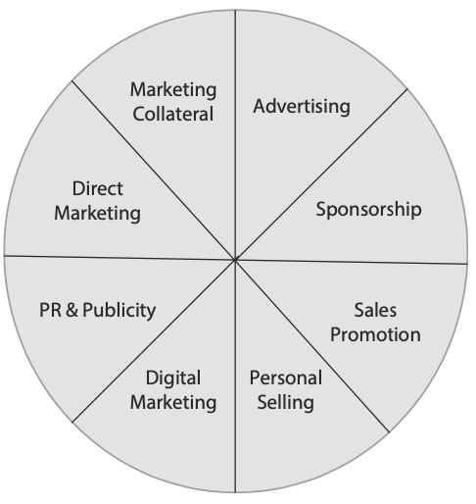
1- Marketing Collateral
    - Marketing collateral is a commonly utilized tool in the promotional mix for tourism organizations.
    - It encompasses printed materials that provide information
    about products or services, such as brochures, flyers, maps,
    business cards, leaflets, sales or fact sheets, postcards, posters,
    and even videos.

Slide 4
1- Marketing Collateral
    - A hotel requires a brochure featuring its tariff, a theme park or visitor
    attraction needs a guide or pamphlet, a tour operator promotes its
    services through a brochure showcasing various types of holidays and
    destinations, and a holiday resort utilizes a guide or pamphlet for
    its promotion.

Slide 5
1- Marketing Collateral
    - In the tourism and hospitality sector, marketing collateral serves as a mix of advertising, sales promotion, and distribution.
    - For instance, a theme park brochure may feature advertisements
    highlighting the park's attractions, include discount coupons for
    specific rides, and be handed out to visitors upon entry.

Slide 6

1- Marketing Collateral
    Types of Marketing Collateral
    - Various forms of marketing collateral can effectively promote and
    inform about services and offerings.
    - These include guidebooks, posters, holiday brochures, leaflets, flyers,
    in-house magazines, booklets, and tourist information packs.
    - The latter often comprises newsletters, discount leaflets,
    tariffs, and travel brochures.

Slide 7
1- Marketing Collateral
    Objectives of Marketing Collateral
    - Marketing collateral, including travel brochures, serves multiple purposes:
    raising awareness,
    providing education,
    making the offering more tangible,
    and actively promoting the offering.
raising awareness
providing education
Provide information
promoting the offering

Slide 8
1- Marketing Collateral
    Objectives of Marketing Collateral
    1- To Create Awareness
    - A primary function of a travel brochure is to generate awareness among potential customers.
    - Many first-time consumers learn about products through marketing collateral encountered at hotels, airports, tourism information centers, travel agencies, or shared by friends and family.
    - The brochure's design, especially its front cover, plays a vital
    role in capturing consumer attention, significantly increasing
    the likelihood of a booking.
raising awareness
providing education
Provide information
promoting the offering

Slide 9
1- Marketing Collateral
    Objectives of Marketing Collateral
    2- To Provide Information
    - Travel brochures play a crucial role in addressing the intangible nature of tourism offerings.
    - They deliver essential details about an organization's benefits, style, and strengths, allowing potential consumers to explore and understand what they are considering purchasing.
raising awareness
providing education
Provide information
promoting the offering

Slide 10
1- Marketing Collateral
    Objectives of Marketing Collateral
    3- To Provide Education
    - In addition to raising awareness and making offerings tangible, marketing collateral and travel brochures serve to educate consumers.
    - Recently responsible tourism marketers have a duty to inform consumers
    about tourism's environmental impacts,
    and brochures are an effective medium for this purpose.
raising awareness
providing information
Provide education
promoting the offering

Slide 11
1- Marketing Collateral
    Objectives of Marketing Collateral
    3- To Provide Education
    - Examples include brochures for national parks, game lodges, museum leaflets, destination guides, and maps, which often highlight environmental issues.
    For instance, the UNWTO, in collaboration with the World Committee
    on Tourism Ethics (WCTE) and various environmental
    and non-governmental organizations, developed the
    educational brochure Tips for a Responsible Traveller
    to promote responsible tourism guidelines.
raising awareness
providing information
Provide education
promoting the offering

Slide 12
1- Marketing Collateral
    Objectives of Marketing Collateral
    3- To Provide Education
    - Educating tourists is a powerful strategy for minimizing environmental damage.
    - Additionally, hotel marketers can leverage brochures to teach consumers about practices such as recycling, water conservation, and adhering to environmentally responsible behavior codes
raising awareness
providing information
Provide education
promoting the offering

Slide 13
1- Marketing Collateral
    Objectives of Marketing Collateral
    4- To Promote the Offering
    - Printed materials and brochures also serve the purpose of promoting an organization and its services.
    - Tour operators often depend on brochures as their primary tool for communication and promotion.
    - Potential customers frequently reach out to tour operators—
    via email, phone, or website links—to request brochures
    with detailed information about specific holidays and tours.
raising awareness
providing information
promoting the offering
Provide education

Slide 14
1- Marketing Collateral
    Objectives of Marketing Collateral
    4- To Promote the Offering
    - Brochures are crafted to attract consumers, inspire them to make purchases, and convey the organization’s image and market positioning through compelling visuals and text.
    - Some tour operators send brochures, both physically and electronically,
    to targeted audiences using data from client databases
raising awareness
providing information
promoting the offering
Provide education

Slide 15
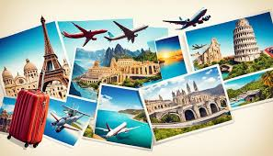
1- Marketing Collateral
    E-Brochures and Other Forms of Technology
    - Technological advancements are reshaping the role of traditional print materials.
    - Digital alternatives are now replacing printed maps, guidebooks, and brochures.
    - Tourists can download travel guide apps and digital maps on their smartphones, eliminating the need for physical guidebooks and audio guides.
    - Social media platforms, like Facebook, have taken
    over the role of traditional holiday postcards,
    allowing travelers to share their experiences with
    friends and family.

Slide 16
1- Marketing Collateral
    E-Brochures and Other Forms of Technology
    - Prospective consumers can visit websites to explore offerings from various tourism businesses, often accompanied by photos, maps, and company logos.
    - In many cases, they have the option to print the information themselves.
    - Additionally, the content traditionally found in printed brochures is now available through downloadable and printable e-brochures on websites, social media apps, and portable navigation devices.

Slide 17
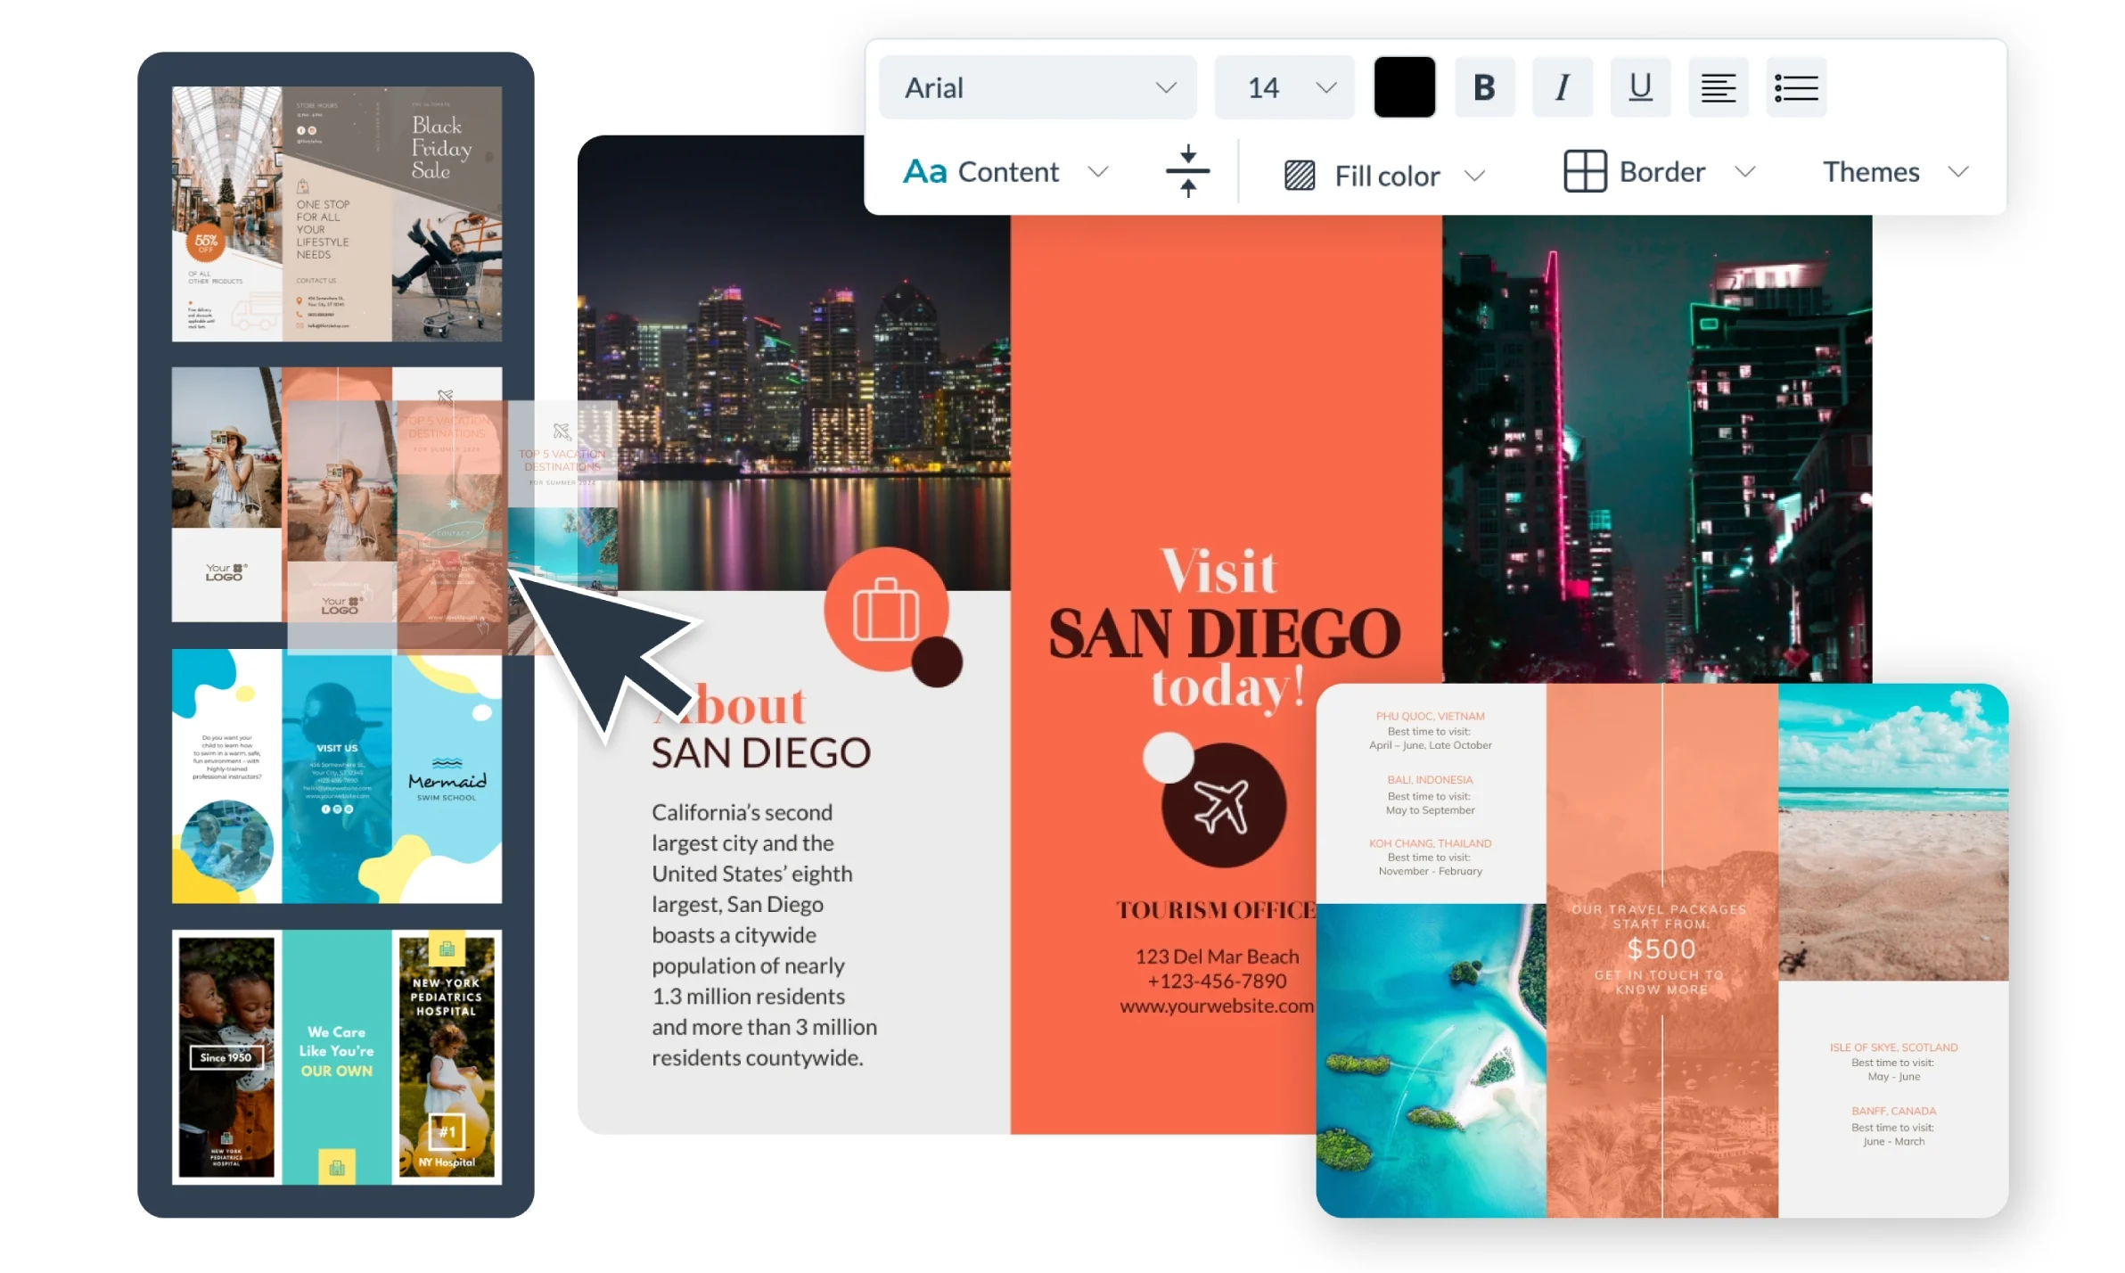
1- Marketing Collateral
    E-Brochures (Digital Brochures)
    - An e-brochure, also known as a digital or electronic brochure, is a brochure in digital format.
    - It can be easily downloaded and printed in color, offering a convenient alternative to traditional printed brochures.
    - E-brochures can be distributed via email and
    deliver rich multimedia content, combining
    text, images, sound, and video.
    - They are accessible whenever needed and
    can be easily translated into multiple
    languages.

Slide 18
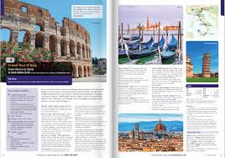
1- Marketing Collateral
    E-Brochures (Digital Brochures)
    - One of the key advantages of e-brochures is their measurability—companies can track how many people have viewed the brochure.
    - They can also easily incorporate special offers, photos, videos, virtual tours, photo galleries, 360-degree images, interactive maps, and electronic travel itineraries, providing an interactive experience for the reader.

Slide 19

1- Marketing Collateral
    E-Brochures (Digital Brochures)
    - In contrast to traditional paper brochures, e-brochures are cost-effective to produce and distribute, do not become outdated as quickly, and are easier to translate into different languages.
    - However, it’s important to ensure that
    e-brochures are printable for those who prefer
    physical copies.

Slide 20
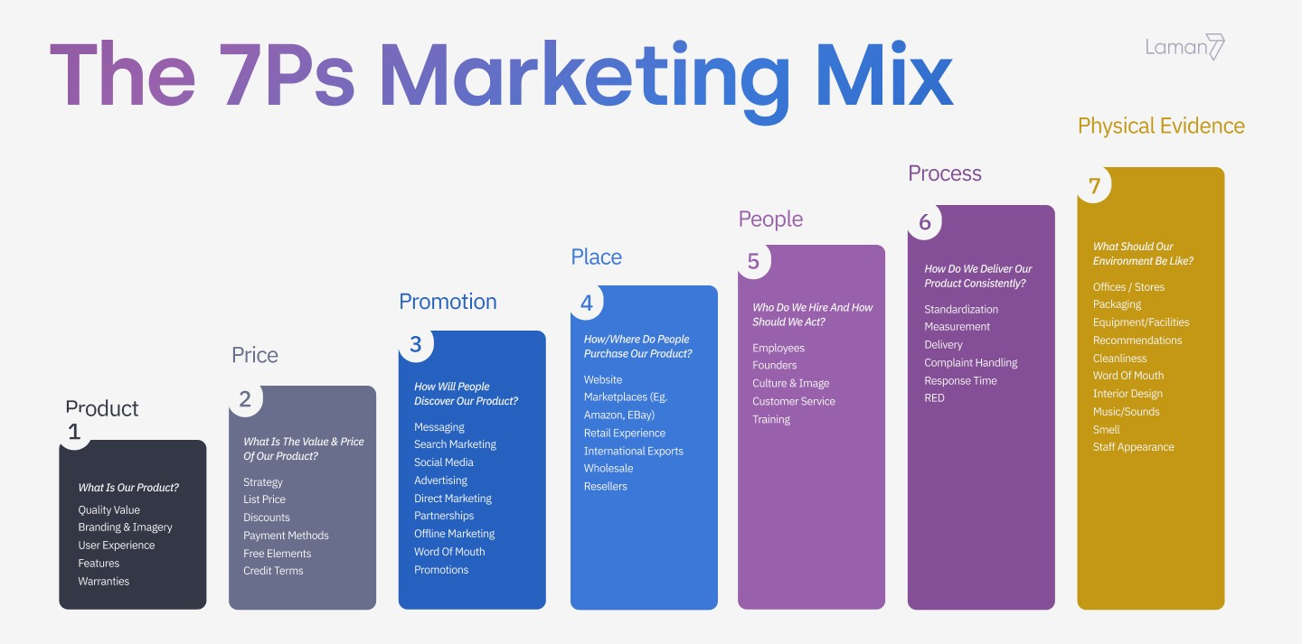
2- Marketing Mix: People
    - People are a fundamental component in the marketing of any product or service.
    - In the service sector, particularly in tourism, individuals are not just providers—they are the product itself.
    - Those delivering services, such as travel agents, tour guides, hotel staff, restaurant personnel, and transportation workers, represent the company and play a critical role in shaping the customer experience.
    - Organized events, like expositions or
    performances, rely on teams that include
    project managers, chefs, stewards, and other
    behind-the-scenes contributors.

Slide 21

2- Marketing Mix: People
    The appearance and attitude
    - The appearance, attire, attitude, behavior, knowledge, and skills of service personnel significantly influence customers' perceptions of a tourism offering.
    - Recognizing this, many companies prioritize training their staff in interpersonal skills and customer service, focusing on customer satisfaction and delight.

Slide 22

2- Marketing Mix: People
    Training the team
    - Training begins with induction, where new employees are introduced to the organization's culture, policies, and procedures.
    - High-quality customer service adds value by providing technical support, expertise, and advice.
    - How staff handle customer complaints is particularly impactful, as it can determine whether a customer is retained or lost, and whether the company’s reputation is strengthened or damaged—both of which directly affect business performance.

Slide 23
2- Marketing Mix: People
    Training the team
    - Training begins with induction, where new employees are introduced to the organization's culture, policies, and procedures.
    - High-quality customer service adds value by providing technical support, expertise, and advice.
    - How staff handle customer complaints is particularly impactful, as it can determine whether a customer is retained or lost, and whether the company’s reputation is strengthened or damaged—both of which directly affect business performance.

Slide 24
2- Marketing Mix: Process
    Process
    - The process refers to the methods and steps involved in delivering a service. It includes the procedures, mechanisms, and flow of activities that forge the service delivery and operating systems.
    - The process in tourism encompasses a combination of wellness actions, schedules, techniques, mechanisms, and routines delivered to tourists during their trips.
    - It also includes other aspects such as trip
    planning and anticipation, travel to the
    destination, on-site experiences, recollection,
    and the use of trip planning packages.

Slide 25
2- Marketing Mix: Process
    - These trip planning packages include maps, information about tourist attractions, destinations, accommodation, transportation, local cuisine, souvenirs, and the quality of services offered.
    - Additionally, the process involves providing essential details to travelers, such as the number of trips, journey times, destinations, and ticket prices.
    - This means that processes enable travel agencies and their staff to efficiently manage reservations, handle ticketing, and provide passengers with comprehensive and accurate information.

Slide 26
2- Marketing Mix: Process
    - Efficient management of service processes enhances customer satisfaction, encouraging repeat business and positive word-of-mouth recommendations.
    - In tourism, the service process is influenced by various industry characteristics.
    - For example, seasonality can place significant strain on the process during peak demand periods, potentially leading to failures and customer dissatisfaction.
    - Conversely, during low demand, a lack of atmosphere can result in customer disappointment.
    - Effective service process management must adapt to these conditions to maintain consistent service quality.

Slide 27
2- Marketing Mix: Process
    - It is crucial to identify key processes from the customer’s perspective and design them to enhance satisfaction and retention.
    - Unsatisfied customers often share negative feedback with family, friends, or acquaintances, which can create challenges for the tourism business.
    - To mitigate this, more companies now recognize the importance of addressing complaints effectively.
    - They encourage customer feedback and invest in employee training programs to refine service processes.
    -Engaging with dissatisfied customers proactively allows businesses to resolve issues before negative effects escalate

Slide 28
2- Marketing Mix: Physical Environment
    Physical environment
    - The physical environment encompasses the non-human elements of the service experience, such as equipment, furniture, and facilities.
    - It also includes abstract components like interior design, color schemes, and layout.
    - Certain elements, like souvenirs, invoices, or branded artifacts, serve as lasting evidence of the service encounter.

Slide 29

2- Marketing Mix: Physical environment
    Physical environment
    - This environment represents the space where customers interact with the service—such as a restaurant for a meal or a transport mode like an aircraft for a journey.
    - Key components of the physical environment include ambient conditions, spatial layout, functionality, and visual cues like signs and symbols.

Slide 30
2- Marketing Mix: Physical Environment
    Physical environment
    - A well-maintained physical environment is crucial for attracting customers and enhancing their experience during the service interaction.
    - Tourism businesses must regularly invest in renovations and updates to foster customer loyalty, encourage repeat visits, and generate positive recommendations.
    - Failing to maintain the premises can lead to a dated appearance, forcing businesses to rely on lower prices to attract customers, which ultimately reduces profitability

Slide 31

2- Marketing Mix: Partnership
    - Partnership involves collaborative promotions and marketing efforts among hospitality and travel organizations.
    - It plays a crucial role in the success of packaging and programming initiatives and supports a holistic approach to addressing tourism's ecological and sociocultural impacts.
    - Partnerships help ensure that sustainability principles are
    upheld throughout the entire tourism value chain.

Slide 32
2- Marketing Mix: Partnership
    - Key players in the tourism industry, including airlines, hotels, travel agents, and tour operators, are increasingly integrating in a sector where traditional boundaries are becoming less distinct.
    - In this evolving environment, collaborations and partnerships are essential rather than optional.
    - The 4 Cs—Compatibility, Capability, Commitment, and Control—are suggested as criteria for selecting suitable partners.

Slide 33
2- Marketing Mix: Partnership
    Successful relationships between hotels and travel agencies depend on factors such as:
    trust, commitment, effective coordination, high-quality communication, information exchange, active participation, the use of constructive conflict resolution techniques, and a balanced level of mutual dependence.

Slide 34
2- Marketing Mix: Partnership
    Types of Marketing Partnerships
    Small businesses can establish various types of marketing partnerships to enhance their reach and effectiveness. These include:
    Revenue Partners:
    - These are critical customers who may warrant customized packages or dedicated account managers.
    - They can also include key resellers, distribution channels, or sponsors essential for driving revenue.
    Product Partners:
    - Like crucial revenue partners, these suppliers are challenging to replace.
    - They might provide an exclusive product for distribution or a vital component, such as technology or packaging.

Slide 35
2- Marketing Mix: Partnership
    Types of Marketing Partnerships
    Alliances:
    - These partnerships enable businesses to collaborate and exchange value, creating and sharing a variety of smart marketing benefits.
    Promotional and PR Partnerships:
    - Such partnerships allow businesses to amplify their marketing efforts by aligning with another organization’s activities.
    - Value can be exchanged through cash, free products or services, or access to customer bases.
    - Even simple initiatives, such as reciprocal website links, can generate significant mutual benefits.

Slide 36
2- Marketing Mix: Presentation
    - Marketing is a process aimed at identifying, anticipating, and fulfilling consumer needs in a profitable way.
    - However, it cannot achieve these goals without effective presentation.
    - In today’s competitive market, saturated with paper, audio, and digital media, a strong message is essential to grab attention, build brand recognition, and drive sales.
    - The rise of the Internet, social media, and electronic platforms has significantly expanded marketing's reach and heightened the importance of impactful presentations.

Slide 37
2- Marketing Mix: Presentation
    - To ensure effective marketing presentations, it is essential to focus on creating relevance, building relationships, and delivering engaging experiences.
    - Presentations should be launched across multiple platforms to reach diverse audiences.
    - In an era where people face limited attention spans, tight schedules, and information overload, making a presentation memorable is critical to its success.

Slide 38

2- Marketing Mix: Passion
    - Passion plays a vital role in the field of marketing.
    - It drives entrepreneurs to remain dedicated to their ventures, persist in achieving their goals, and fully engage in their actions.
    - This enthusiasm is often infectious, influencing key players within the business, such as employees, and fostering a shared commitment.
    - Passion also impacts critical areas of entrepreneurship, including persistence, business survival, venture growth, and employee loyalty.

Slide 39

2- Marketing Mix: Passion
    - While an entrepreneur can create and execute an effective marketing plan without strong passion for their product or service, it is real enthusiasm that sustains them during challenging times.
    - Passion fuels a "we must win" mindset, motivating entrepreneurs to design marketing strategies that are both efficient and impactful.

Slide 40
DISCUSSION
What other aspects, from your point of view, can be included in the marketing mix?

Slide 41
Thank you
      European Institute of Innovation, Entrepreneurship and Technology
      Lessingstraße 79,
      13158 Berlin, Germany
      Phone: +49 176 55524449
      Email: info@eiiet.com
Discover the world of eiIET

