Slide 1
Quality and Sustainability in Tourism and Hospitality
European Institute of Innovation, Entrepreneurship and Technology
Lessingstraße 79, 13158 Berlin, Germany
Mahmoud Abdou| Berlin
      Lessingstraße 79,
      13158 Berlin, Germany
      Phone: +49 30 233618555
      Fax: +49 30 233618556
      Email: info@eiiet.com

Slide 2
Index
Sustainability Approaches in Hospitality
- Case Study: Hotel Co 51’s Sustainability Approach
Eco-Labels and Green Certifications
Types of Hotel Certifications

Slide 3
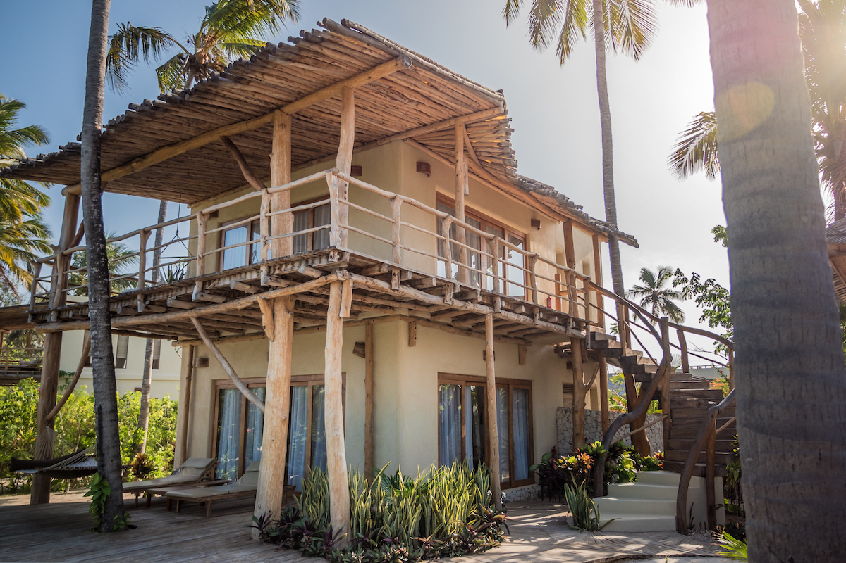
1- Sustainability Approaches in Hospitality

Slide 4
1.1- Energy Efficiency
      Planning and Design Phase
      - Address energy efficiency early
      - Building orientation, insulation, integrated energy systems
      Operational Phase
      - Purchase high-efficiency equipment
      - Optimize air conditioning parameters to balance comfort and energy use
      - Select renewable energy sources where possible
      Outcome
      - Combining construction strategies with operational practices maximizes sustainability
      - Reduces long-term costs and environmental impact

Slide 5
1.2- Waste Management
      Reduce
      - Minimize resource use and environmental impact
      - Use only what is necessary for hotel operations
      - Eliminate unnecessary expenses
      Reuse
      - Reuse items whenever possible before disposal
      - Extend product life and reduce waste volume

Slide 6
1.2- Waste Management
      Recycle
      - Separate waste types for proper recycling or disposal
      - Reuse materials or ensure correct waste handling
      Benefits
      - Enhances hotel’s environmental image
      - Generates economic advantages

Slide 7
1.3- Water Management
      Challenge
      - Must balance guest satisfaction with conserving a limited resource
      - Over 50% of hotel water use occurs in rooms; significant use also in kitchens, laundry, and common areas
      Key Principles
      - Water-saving measures must not reduce comfort, cleanliness, or hygiene.
      - Both conventional and innovative approaches are needed.

Slide 8
1.3- Water Management
      Conservation Measures
      - Towel and linen reuse programs (with guest awareness pamphlets)
      - Staff training and awareness to ensure responsible water use
      - Prompt leak detection and repair
      - Install low-flow fixtures and water-efficient equipment
      - Optimize kitchen, laundry, and irrigation practices

Slide 9
1.4- Hotels Eco Design
      Environmental Impact
      - Hotel construction and operations consume water, energy, and fossil fuels
      - Generate CO₂ emissions and other pollutants
      Sustainable Design Benefits
      - Use eco design to reduce emissions and environmental impact
      - Preserve surrounding natural and built environments
      - Integrate hotel architecture into the local context without harming existing styles
      - Potential to requalify degraded areas, support heritage conservation, and boost the local economy

Slide 10
1.4- Hotels Eco Design
      Key Practices
      - Choose materials from local and environmentally responsible suppliers
      - Apply energy- and water-saving technologies throughout the hotel’s life cycle
      Economic Advantages
      - Enhances hotel image and brand reputation
      - Higher initial investment offset by long-term profitability and reduced risk
      - Extends building life cycle and improves sustainability

Slide 11
1.5- Food and Beverage Management
      Role in Global Sustainability
      - Hotels serve large volumes of meals, making them key drivers of sustainable practices
      Definition of Sustainable Food and Drinks
      - The use of local products
      - Local sourcing reduces transport costs and supports the local economy
      - Energy-efficient production with low CO₂ emissions
      - Respect natural resource limits to ensure regeneration

Slide 12
1.5- Food and Beverage Management
      Key Characteristics
      - Healthy and nutritious for consumers
      - Provide a safe and hygienic environment for producers and retailers
      - Respect environmental limits and animal welfare
      - Support local economy and culture through community-based sourcing

Slide 13
1.6- Efficient Kitchen
      High Energy Use
      - Kitchens are among the biggest energy consumers in hotels
      - Inefficiencies often occur in food preparation and storage equipment
      Potential Savings
      - Energy consumption can be reduced by up to one-third
      - Achieved through efficient equipment and employee training

Slide 14
1.6- Efficient Kitchen
      Key Strategies
      Optimal Kitchen Layout:
      - Design to minimize energy waste
      Efficient Equipment:
      - Install high-performance, energy-saving appliances
      Staff Actions
      - Train employees in energy-conscious practices

Slide 15
1.7- Tourists’ Awareness
      Beyond Energy Efficiency
      - Hotels aim to educate tourists on adopting sustainable practices
      Initiatives to Raise Awareness
      - Guided tours of hotel surroundings to engage guests with local community and environment
      - Social events and charity initiatives to promote causes and attract media attention
      - Informational materials: pamphlets in rooms and hotel spaces detailing sustainable practices and benefits

Slide 16
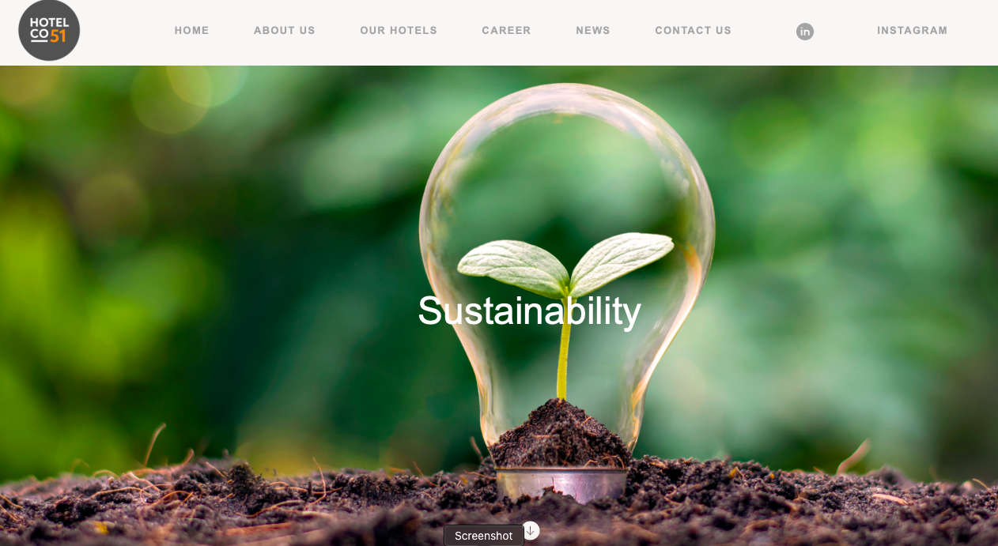
Tourists’ Awareness
2- The Case Study: Hotel CO51

Slide 17
Hotel Co 51’s Sustainability Approach
      The Approach:
      1- Environment: Sustainability is in our DNA
    2- Social: Putting people at the heart of the business

Slide 18
Hotel Co 51: Environmental Strategy
      Goal:
      - Reduce carbon footprint from the very beginning of every hotel project
      Sustainability Focus:
      - Built into every stage of design and operations
      Two Key Approaches:
      A- Designing Sustainability from the Start
      B- Embedding Sustainable Operations

Slide 19
2.1- Environmental Strategy
      A- Designing Sustainability from the Start:
      Carbon Footprint Challenge
      - Cement industry produces 8% of global CO₂ emissions
      - Buildings account for 42% of global energy-related CO₂—critical for hotels to address
      Hotel Co 51’s Approach
      - Use less carbon-intensive materials with energy-saving benefits
      - All properties are new-builds for better sustainability control and quality assurance

Slide 20
2.1- Environmental Strategy
      A- Designing Sustainability from the Start:
      Sustainable Construction Practices
      - Use energy-efficient, certified materials with low embodied carbon
      - Maximize prefabricated elements to:
Optimize energy performance | Improve indoor air quality
Ensure material quality and efficient usage | Minimize construction waste
Increase construction site safety and reduce accident risks

Slide 21
2.1- Environmental Strategy
      Achieving Green Building Certification
      - Ensures hotels are better for business, people, and the environment
      - Serves as a baseline for performance measurement and future improvement
      LEED Benefits and Achievements
      - 50% fewer GHG emissions from water use
      - 48% fewer GHG emissions from solid waste
      BREEAM Standards
      - Evaluates nine criteria: energy, ecology, waste, wellbeing, etc.

Slide 22
2.1- Environmental Strategy
      B- Embedding Sustainable Operations
      Regular Process and Systems Reviews
      - Annual evaluations of each hotel’s sustainability performance based on current and upcoming EU regulations
      - Use of effective technology to ensure buildings operate sustainably.
      Measuring and Reducing Energy Consumption
      - Identify opportunities for energy savings and optimisation.

Slide 23
2.1- Environmental Strategy
      B- Embedding Sustainable Operations
      Procuring Renewable Energy Across All Buildings
      - Ambition to procure 100% renewable electricity for all hotels.
      - install solar panels on hotel properties.
      - Improve insulation, reuse building heat, and upgrade in-hotel products to conserve energy.

Slide 24
2.2- Social Strategy
      Commitment to Meaningful and Decent Work
      - Providing meaningful and decent work is vital for a functional economy and a fair, inclusive society.
      - A diverse workforce brings varied skills, experiences, and perspectives, enhancing creativity and decision-making.
      - Diversity enriches both hotels and workplaces.
      Providing Opportunities to Grow
      - Attracting top talent and retaining employees through supportive systems.
      - A growing portfolio provides career progression opportunities within the business.

Slide 25
2.2- Social Strategy
      Equal Opportunities Employer
      - Creation of nurturing work environments that encourage growth, learning, togetherness, wellbeing, and work-life balance.
      -Hiring and engagement practices prioritise equal opportunities.
      - No discrimination based on:
Gender or appearance | Religion or age
Nationality or political opinion | Union affiliation, social, or ethnic origin

Slide 26

SOCIAL: Putting people at the heart of the business
3- Eco-Labels and Green Certifications

Slide 27
3- Eco-Labels and Green Certifications
      A- Early Beginnings: Standardization and Quality
      Early 20th Century:
      - Rise of international trade and tourism due to demand for standardization
      - Focused on product/service quality and safety
      Key Initiatives
      - British Standards Institute (BSI), 1901 foundation for quality standards
      - Ensured consistent service delivery in sectors like hospitality and manufacturing

Slide 28
3- Eco-Labels and Green Certifications
      A- Early Beginnings: Standardization and Quality
      Post-War Developments
      - WWI and industrial revolutions increased the need for global trade regulations
      - ISO established, 1947, which formalized quality standards
      Early Certification Focus
      - Operational efficiency and safety
      - Became benchmark for consistent service quality in hotels and other industries

Slide 29
3- Eco-Labels and Green Certifications
      B- Emergence of Environmental Awareness (1970s–1980s)
      Environmental Movement
      - 1970s: Growing concerns over pollution, resource depletion, and environmental degradation
      - Shifted focus toward sustainability in industries, including hospitality
      Government and NGO Involvement
      - Emphasized environmental responsibility in business operations
      Pioneering Certification
      - Blue Flag Program, 1985
      - Certified beaches and marinas
      - Focused on environmental management and water quality

Slide 30
3- Eco-Labels and Green Certifications
      C- Rise of Sustainable Tourism Certifications: 1990s
      - Global tourism boom, especially in environmentally sensitive areas
      - Need for sustainable tourism practices that balance profitability and responsibility
      Landmark Certification
      - Green Globe, 1998
      - First certification specifically for tourism industry
      Emphasized:
Sustainable resource use | Energy efficiency
Community engagement

Slide 31
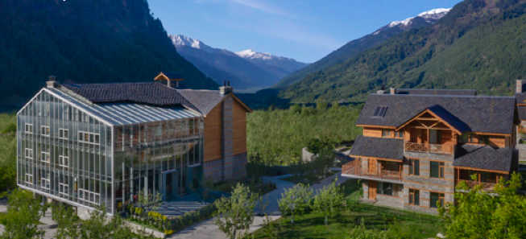
4- Types of Hotel Certifications

Slide 32
4- Types of Hotel Certifications
      Purpose of Certifications
      - Formal acknowledgment of compliance with specific standards
      Help hotels:
      - Enhance operational efficiency
      - Reduce environmental impact
      - Improve customer satisfaction
      - Demonstrate corporate social responsibility

Slide 33
4- Types of Hotel Certifications
      4.1- Environmental Certifications
      Purpose
      - Demonstrate commitment to environmental protection and sustainable resource management
      Industry Trend
      - Growing adoption due to increased consumer awareness of sustainability

Slide 34
4.1- Environmental Certifications
      A- ISO 14001: Environmental Management System (EMS)
      Purpose
      - Framework to establish, implement, maintain, and improve an EMS
      Hotel Application
      - Minimize environmental footprint through:
      - Ensure regulatory compliance
      - Position hotel as environmentally responsible
Efficient energy use | Waste management
Resource conservation

Slide 35
4.1- Environmental Certifications
      B- Green Key Certification
      Focus Areas
      Certification Requirements
      - Meet specific criteria across multiple environmental areas, including:
Energy efficiency | Waste reduction
Water conservation | Eco-friendly guest services
Water use | Energy management
Waste reduction

Slide 36
4.1- Environmental Certifications
      C- LEED (Leadership in Energy and Environmental Design)
      - Globally recognized green building certification
      - Evaluates environmental performance of buildings, including hotels
      Focus Areas
      - Sustainable design, construction, and operations
      - Assessment Criteria
Energy efficiency | Water conservation
Indoor air quality | Use of sustainable materials

Slide 37
4.1- Environmental Certifications
      D- EarthCheck Certification
      - Specifically designed for hotels and tourism operations
      Evaluation Criteria
      Requirements
      - Hotels must continuously improve their environmental performance
      - Must meet or exceed industry best practices for sustainability
Greenhouse gas emissions | Energy and water consumption
Waste management | Biodiversity conservation

Slide 38
4.1- Environmental Certifications
      E- EU Ecolabel Certification
      - Established by the European Commission
      - Promotes environmentally friendly products and services
      Criteria for Hotels
Energy consumption | Water use
Waste generation | Eco-friendly materials

Slide 39
4.2- Quality Management Certifications
      Aim to:
      - Improve hotel operations and service delivery
      - Ensure guest expectations are met or exceeded
      - Enhance operational efficiency and customer satisfaction

Slide 40
4.2- Quality Management Certifications
      A- ISO 9001 – Quality Management System
      - Most widely recognized quality management standard globally
      - Provides a framework for consistent and efficient processes
      Key Focus Areas
Enhancing customer satisfaction | Improving operational efficiency
Ensuring high service quality

Slide 41
4.2- Quality Management Certifications
      A- ISO 9001 – Quality Management System
      Application in Hotels
Systematic management of guest services | Comprehensive staff training programs
Ongoing process improvements for better performance

Slide 42
4.2- Quality Management Certifications
      B- The Five-Star Rating System
      - Provides travelers with a quick reference for hotel standards
      Usage
      - Globally recognized and widely applied across the hospitality industry
      - Evaluates hotels based on amenities, service quality, and overall guest experience
      Significance
      - Helps guests compare options and set expectations
      - Encourages hotels to maintain or improve standards for higher ratings

Slide 43
4.3- Health and Safety Certifications
      - Ensure hotels provide a safe environment for guests and staff
      - Maintain compliance with stringent health and safety protocols
      Relevance
      - Became especially critical during global health crises
      - Builds guest confidence and enhances hotel reputation
      Focus Areas
      - Hygiene and sanitation standards
      - Emergency preparedness and risk management
      - Staff training on health and safety procedures

Slide 44
4.3- Health and Safety Certifications
      A- Occupational Health and Safety (ISO 45001)
      - Ensures hotel operations comply with health and safety regulations
      - Minimizes the risk of accidents and workplace hazards
      Certification ISO 45001:
      - International standard for occupational health and safety management systems
      - Demonstrates commitment to protecting employees and guests
      Importance
      - Critical for maintaining safe working environments in hotels
      - Especially significant in the post-pandemic world for guest and staff confidence

Slide 45
4.3- Health and Safety Certifications
      B- Hazard Analysis and Critical Control Points (HACCP) and Food Safety Standards
      - Ensure food safety in hotel operations
      - Minimize risks of contamination and foodborne illnesses
      Importance
      - Critical for maintaining guest health and trust
      - Essential for hotels with restaurants, catering, or room service

Slide 46
4.4- Social Responsibility and Ethical Certifications
      - Promote ethical business practices in hotels
      -Highlight hotels’ role in supporting local communities and economies
      Industry Trend
      - Gaining momenum as guests become more aware of social issues
      - Focus areas include fair labor practices and community engagement

Slide 47
4.4- Social Responsibility and Ethical Certifications
      A- Travelife Certification
      - Leading international sustainability certification for hotels and accommodations
      - Focuses on both environmental and social sustainability
      Assessment Criteria
      - Fair labor practices
      - Community engagement
      - Support for local economies
      - Implementation of sustainable business practices

Slide 48
4.4-Social Responsibility and Ethical Certifications
      B- Fair Trade Tourism
      - Certification promoting ethical and sustainable tourism practices
      - Applies to hotels and tourism providers
      Key Criteria
      Fair labor standards:
      - Fair wages and safe working conditions
      Environmental sustainability:
      - Responsible use of resources and eco-friendly practices
      - Community support:
      - Initiatives that benefit local communities

Slide 49
Thank you
      European Institute of Innovation, Entrepreneurship and Technology
      Lessingstraße 79,
      13158 Berlin, Germany
      Phone: +49 176 55524449
      Email: info@eiiet.com
Discover the world of eiIET

