Slide 1
Operations Management in Hospitality
European Institute of Innovation, Entrepreneurship and Technology
Lessingstraße 79, 13158 Berlin, Germany
Mahmoud Abdou| Berlin
      Lessingstraße 79,
      13158 Berlin, Germany
      Phone: +49 30 233618555
      Fax: +49 30 233618556
      Email: info@eiiet.com

Slide 2
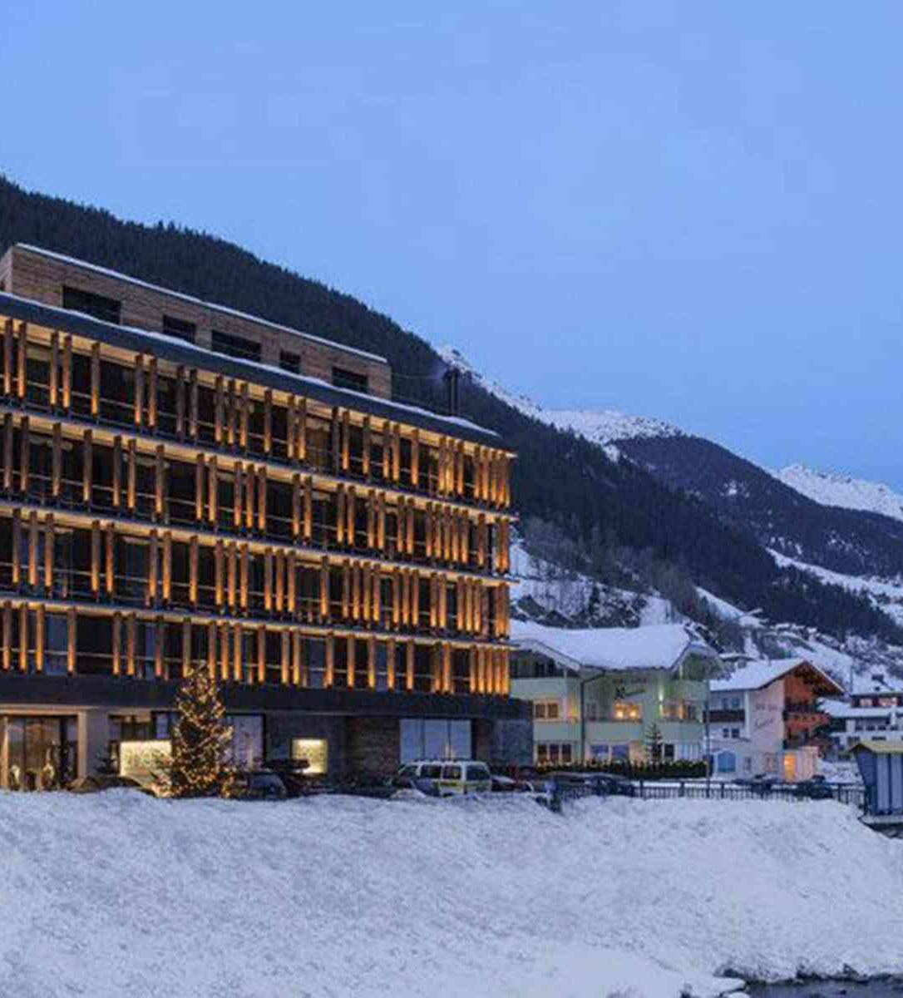
Outline
1- Data Requirements for Layout Decisions
2- Facility Layout
3- Ambience Design

Slide 3
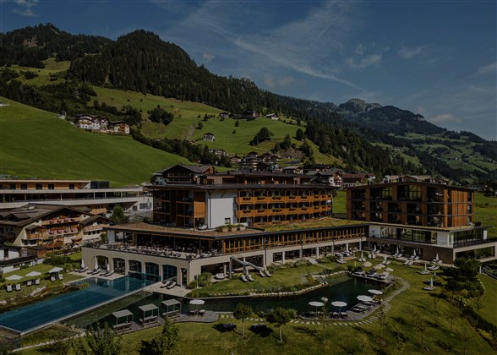
1- Data Requirements for Layout Decisions
Data Requirements for Layout Decisions

Slide 4
      1- Data Requirements for
      Layout Decisions
- Optimize space for operational efficiency
- Comfortably accommodate target customers and staff
- Event venue layout:
Smooth admissions and organized lines
Efficient coat check and beverage service
Easy access to main areas with enough seating/standing
Clear exits and well-designed restroom

Slide 5
      1- Data Requirements for
      Layout Decisions
- To support smooth operations and strong performance, layout planning must balance the following aspects:
Estimating capacity
Utilizing space efficiently
Optimizing flow

Slide 6
      1- Data Requirements for
      Layout Decisions
- To support smooth operations and strong performance, layout planning must balance the following aspects:
Ensuring convenience
Providing safety and comfort
Allowing flexibility
Maintaining attractive front-of-house areas

Slide 7
      1.1- Systematic Layout
      Planning
- It includes 6 main dimensions:
A- Objectives of the Business
- Define business concept
- Outlines service style, positioning, pricing, and operating hours.
- Consider future expansion plans.
- Layout depends on business goals

Slide 8
      1.1- Systematic Layout
      Planning
B- People / Services
- Identify customers, employees, and roles
- Determine the scope and complexity of services
- Single service vs. multi-service
- Degree of standardization vs. personalization

Slide 9
      1.1- Systematic Layout
      Planning
C- Quantity Demanded
- Volume of services or goods
- Customers/visitors per hour/day
- Guides space and workflow planning

Slide 10
      1.1- Systematic Layout
      Planning
D- Routing
- Flow of people, equipment, and customers
- Affects space capacity and traffic
Proper routing ensures:
- No congestion
- Efficiency
- Better customer experience

Slide 11
      1.1- Systematic Layout
      Planning
E- Space and Supporting Services
- Area, volume, and shape of spaces
- Core and supporting services

Slide 12
      1.1- Systematic Layout
      Planning
F- Timing
- Duration and frequency of services
- Overlaps between customer groups
- Continuous, scheduled, or seasonal tasks
- Flexible layout required

Slide 13
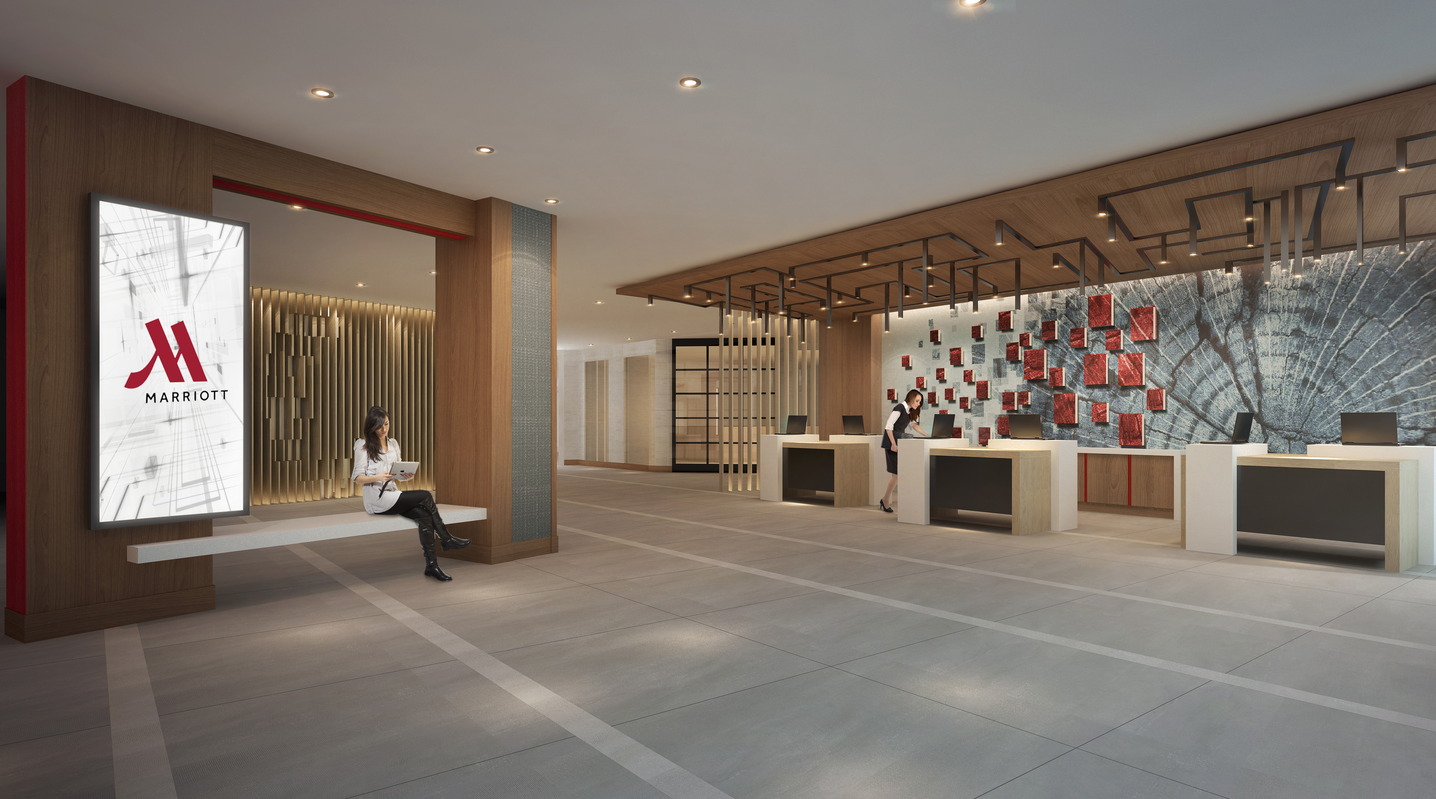
      2- Facility Layout

Slide 14
      2- Facility Layout
- Hospitality facilities must follow city building codes and allocate space based on the complexity of their operations.
- Space Allocation Strategies:
- Regulatory space requirements
Layout must comply with building codes and safety regulations.
- Operational complexity affects space needs
More complex service operations require more space.

Slide 15
      2.1- Space Allocation
      Strategies
- Full-service vs. select-service hotels
Full-service hotels need extra areas
Select-service hotels require less support space.
- Differences in restaurant space allocation
Quick-service restaurants
Table-service restaurants

Slide 16
- It is the systematic breakdown of a service into sequential steps to optimize operations and inform physical layout.
Key Aspects:
- Divides the service into a sequence of steps
- Identifies managerial challenges
- It shows dependencies between procedures.
- It guides efficient layout design.
2.2- Process Flow Analysis

Slide 17
Hotel Process Flow Analysis
- Pre-Arrival Phase
Activities: Reservation, room assignment, and housekeeping preparation.
Challenge: Seamless system integration (Reservations, PMS , Housekeeping).
Layout Implication: Efficient digital infrastructure connecting the Front Desk/Back Office to supporting departments.
2.2- Process Flow Analysis

Slide 18
Hotel Process Flow Analysis
- Arrival & Check-in Phase
Activities: Guest entry, luggage handling (Bell Desk), registration (Front Desk), key issuance.
Dependency: Links external arrival to internal movement.
High staff-guest interaction.
Layout Implications:
Lobby and Front Desk must be highly visible from the entrance.
Bell Desk adjacent to the Front Desk.
Direct, clear path from the Front Desk to the Elevator Core.
2.2- Process Flow Analysis

Slide 19
2.2- Process Flow Analysis
There are two layout strategies for hospitality organizations as follows:
A) Product-oriented; and
B) Process-oriented layouts.

Slide 20
- It arranges tasks in a fixed sequence to maximize efficiency for standardized, high-volume operations.
It aims to:
- Streamline labor and equalize time spent at each activity.
- Maintaining a steady flow to prevent bottlenecks
- Examples:
QSR (Quick Service Restaurant) kitchens, counter-service build-your-own meal concepts, and cafeterias.
A- Product-Oriented Layout

Slide 21
- It groups similar functions together to maximize flexibility and minimize travel distance between related tasks.
- No fixed sequence
- Tasks/resources are grouped by similarity of function
- It aims to place highly related functions close together
- Hospitality Use:
Ideal for large, complex services needing high flexibility.
Examples: Casinos, large conference hotels, resorts, and theme park
B- Process-Oriented Layout

Slide 22
Example 1: Fast-food restaurant
Service steps:
Order → Food preparation → Packaging → Payment → Pickup
- Analysis:
Food preparation depends on order-taking
Bottlenecks if payment/pickup areas are far apart
Layout decisions:
Place order and pickup areas near each other
Keep cooking and packaging areas closely connected to reduce delays
B- Process-Oriented Layout

Slide 23
Example 2: Hotel front desk
- Service steps:
Arrival → Check-in → Luggage handling → Room guidance → Check-out
- Analysis:
Check-in must handle peak arrivals efficiently
Luggage handling should be easily accessible
- Layout decisions:
Position front desk to allow smooth queuing
Keep luggage storage close to the front desk for efficiency
B- Process-Oriented Layout

Slide 24
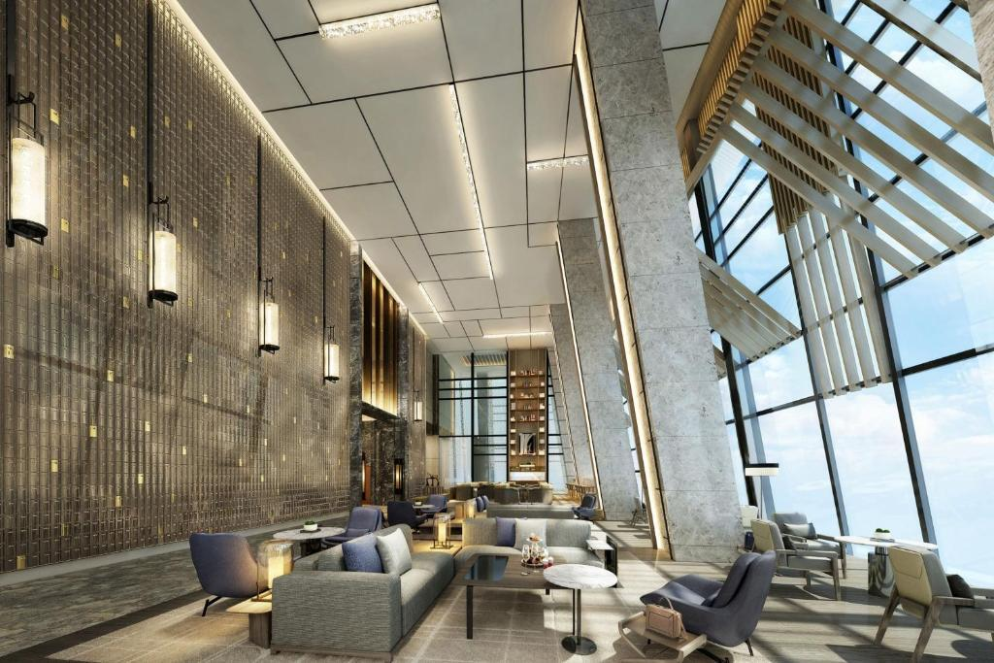
3- Ambience Design

Slide 25
Role of Physical Environment:
- In hospitality, production and consumption occur simultaneously
- Physical environment is crucial because guests experience it during service.
- Guests continuously notice environmental details.
- Longer stays make ambience even more influential.
3- Ambience Design

Slide 26
3- Ambience Design
Impact on Customer Psychology and Satisfaction:
- Physical environments strongly influence guests’ psychological states.
- Positive cues increase satisfaction and perceived service quality.
- Negative cues lower satisfaction and perceived quality.

Slide 27
Environmental Psychology & SOR Model
- Environmental psychology studies how physical surroundings affect human behavior.
The Stimulus–Organism–Response (SOR) model proposes:
- Stimuli (S): Human and physical environmental inputs
- Organism (O): Emotional states
- Response (R): Behavioral outcomes
3- Ambience Design

Slide 28
Types of Environmental Stimuli
- Social factors
- Design factors
- Ambient factors
Another classification identifies:
- Ambient cues
- Layout and functionality
- Signs, symbols, and artifacts
3- Ambience Design

Slide 29
Interior Design Features
- Considered less permanent elements of the physical environment.
Key visual cues include:
3- Ambience Design
Colors | Finishes
Lighting | Furniture
Fixtures | Equipment

Slide 30
- Importance:
Most noticeable visual cues in hospitality interiors.
Influence atmosphere, moods, and emotions of guests.
- Effects of Colors:
Warm colors:
Arousal, excitement, energy.
Cool colors:
Calmness, relaxation, peacefulness.
3.1- Colors and Finishes

Slide 31
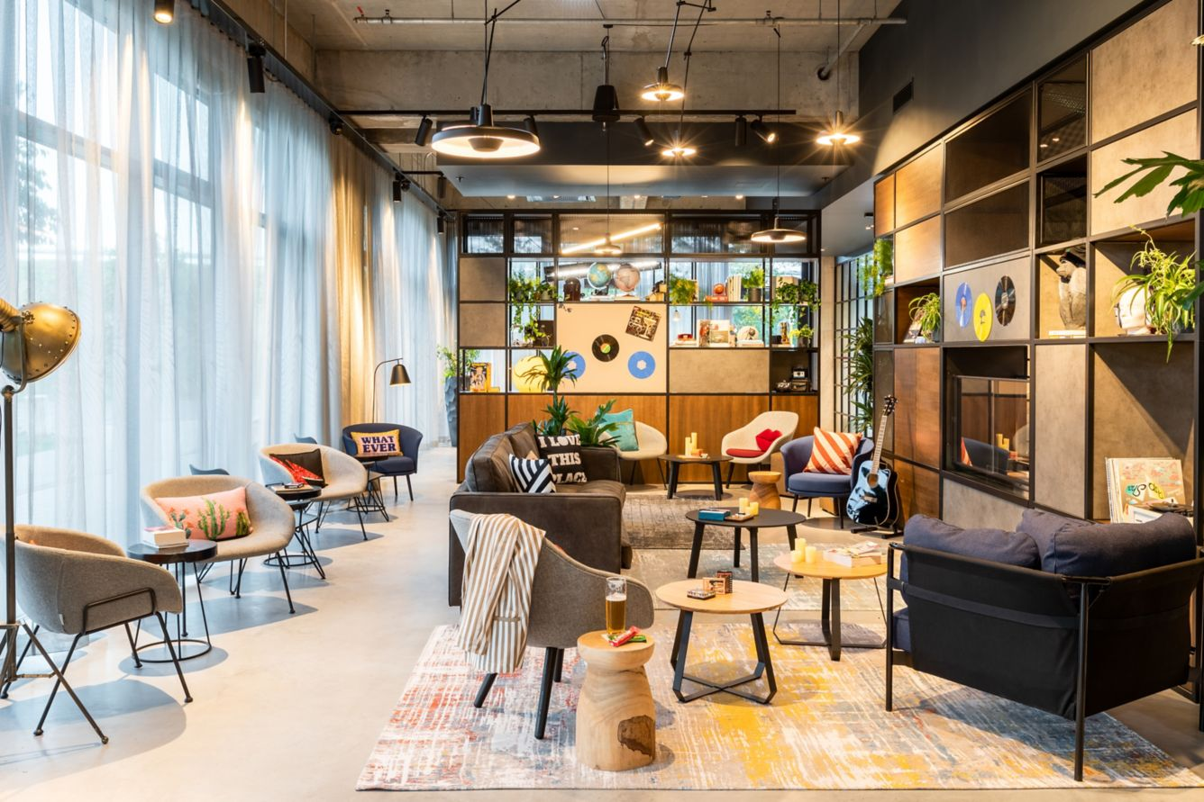
Example: Berlin Airport Hotel Design
A. Themed Decor
- Travel- and aviation-inspired design theme.
- Unique local art and installations integrated into public spaces.
3.1- Colors and Finishes

Slide 32
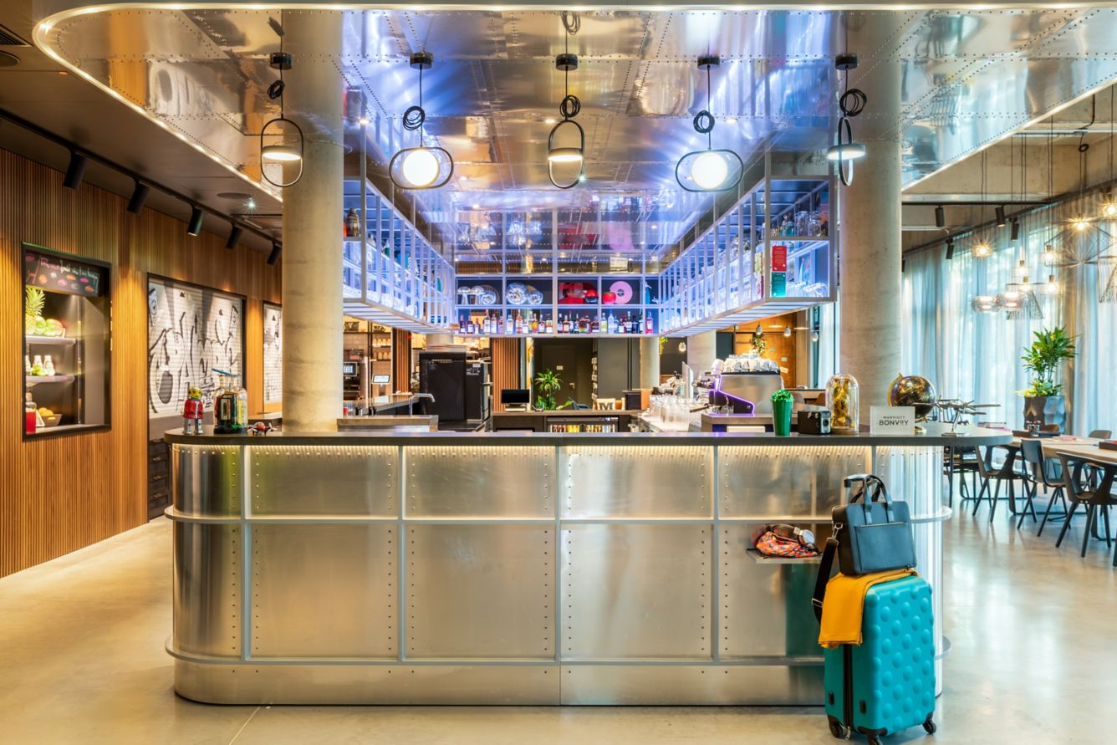
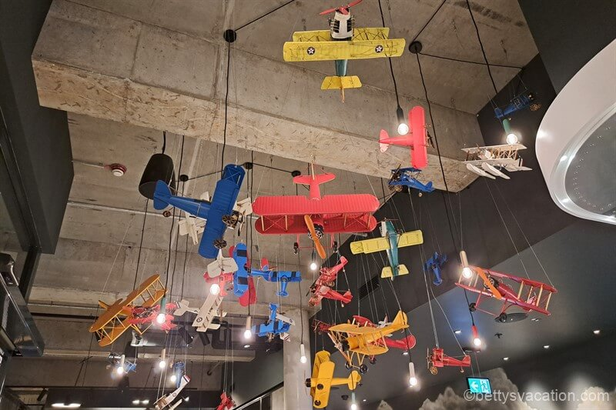
2. Lobby and Public Spaces
- Designed as a multi-functional social hub, not just for check-in.
Open and bright layout:
- High ceilings with modern, industrial style.
- Exposed elements: dark ceilings, metal pipes, concrete surfaces.
3.1- Colors and Finishes

Slide 33
Impact on Perception:
- Interior lighting shapes how customers perceive the environment.
- Can communicate both aesthetic and psychological meanings.
Lighting Types and Associations:
Bright fluorescent lighting
- Often perceived as low-cost or discounted.
Soft incandescent lighting
- Conveys higher quality and luxury.
3.2- Lighting

Slide 34
3.2- Lighting
Influence on Behavior:
- Affects interpersonal communication between guests and staff.
- Influences comfort and overall mood.
- Can modify arousal levels, impacting energy and engagement.

Slide 35
Importance of FF&E:
- Shapes the facility’s identity
- Shapes overall aesthetic impression.
- Improves guest comfort and supports functional needs.
Integration of Technology:
- Growing use of AI and smart devices in hotel design.
- Voice-controlled lighting
- Digital screens displaying customizable artwork
3.3- Furniture, Fixtures, and Equipment

Slide 36
Thank you
      European Institute of Innovation, Entrepreneurship and Technology
      Lessingstraße 79,
      13158 Berlin, Germany
      Phone: +49 176 55524449
      Email: info@eiiet.com
Discover the world of eiIET

