Slide 1
Advanced Cost Control Techniques and Strategic Costing
European Institute of Innovation, Entrepreneurship and Technology
Lessingstraße 79, 13158 Berlin, Germany
Presenter - Vaibhav Sai Sri| Berlin
      Lessingstraße 79,
      13158 Berlin, Germany
      Phone: +49 30 233618555
      Fax: +49 30 233618556
      Email: info@eiiet.com

Slide 2

Index
- Introduction to Strategic Costing
- Advanced Cost Control Techniques
- Value Engineering
- Lean Management
- Activity-Based Management (ABM)
- Case Study: ABC in Healthcare
- Zero-Based Budgeting (ZBB)
- Case Study: ZBB in FMCG
- Strategic Cost Control in Technology Sector
- Conclusion

Slide 3
Introduction to Strategic Costing
      Overview of Strategic Costing -
Focuses on optimizing cost structures for competitive advantage.
Essential for sustainable, long-term profitability.
      Why Advanced Cost Control Matters -
    Supports efficient resource allocation and waste reduction.
    Reference:
    Introduction to Strategic Costing | [You tube]

Slide 4

Advanced Cost Control Techniques
Key methods: value engineering, lean management, zero-based budgeting.
Selected based on industry needs and goals.
      Strategic Value -
Enhances resource efficiency, supporting growth and innovation.
Reference:
    Advanced Cost Control Techniques | [You tube]

Slide 5
Value Engineering
Optimizes products and processes to maintain value at reduced costs.
Widely applied in manufacturing.
      Real-Life Example -
Toyota employs value engineering to optimize vehicle production costs.
    Reference:
    Value Engineering in Business | [You tube]

Slide 6
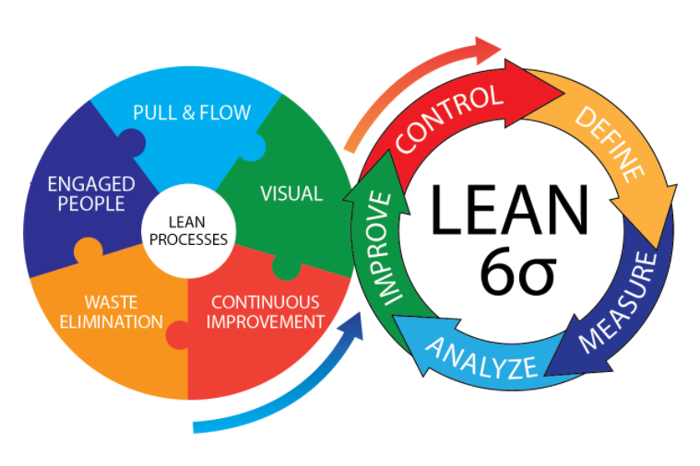
Lean Management
Principles of Lean Management -
Emphasizes reducing waste and continuous improvement.
Case Study -
Manufacturing Industry : Boeing’s lean practices resulted in reduced production time and cost savings.
Reference:
    Lean Management Explained | [You tube]

Slide 7
Activity-Based Management (ABM)
Uses activity-based data to optimize cost control.
    Helps organizations focus on cost drivers and identify inefficient activities that need improvement.
Benefits of ABM -
Increases cost transparency and resource allocation accuracy.
    Encourages resource allocation toward high-value activities, improving overall efficiency.
    Reference:
    Activity-Based Management Overview | [You tube]

Slide 8

Case Study: ABC in Healthcare
      Overview of Case Study -
Applied ABC to improve cost allocation in hospitals.
      Outcomes and Lessons -
Reduced indirect costs, leading to better budgeting insights.
Reference:
    ABC in Healthcare Industry | [You tube]

Slide 9
Zero-Based Budgeting (ZBB)
Concept of Zero-Based Budgeting -
Starts from a “zero base” to justify all expenses.
Aims to eliminate outdated expenses and ensure resources are allocated to essential activities.
Encourages departments to align spending closely with strategic goals.
Real-Life Example -
Used in FMCG to optimize resources and reduce overhead.
    Reference:
    Zero-Based Budgeting Explained | [You tube]

Slide 10
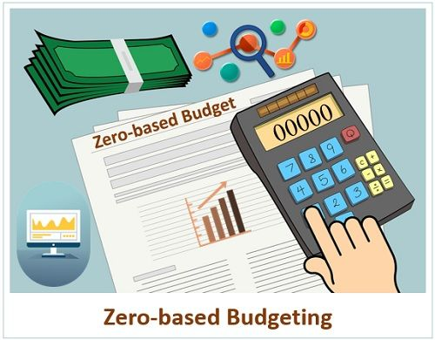
Case Study: ZBB in FMCG
Case Study Summary
Global FMCG firm reduced overhead by 20% with ZBB.
Key Takeaways
ZBB helped focus resources on high-impact activities.
Reference:
    ZBB in FMCG | [You tube]

Slide 11
Strategic Cost Control in Technology Sector
Tech Sector Overview –
Emphasis on cloud cost management and scaling.
Example: Cloud Services
AWS’s strategic cost management optimizes operations and scalability.
    Reference:
    Cost Control in Tech Industry | [You tube]

Slide 12
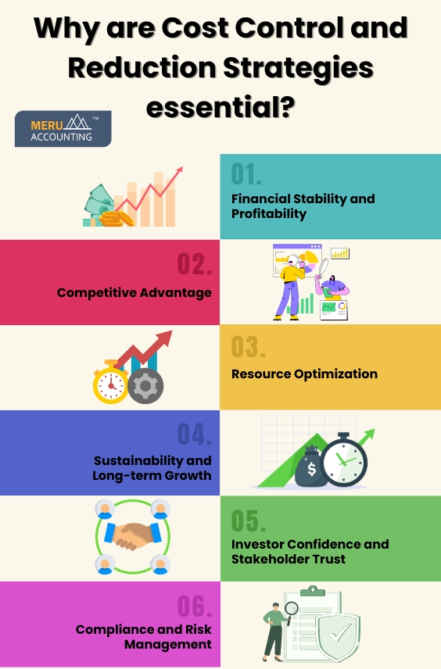
Conclusion
Strategic Importance: Advanced cost control techniques, like ZBB and lean management, empower businesses to reduce unnecessary costs and align spending with strategic priorities.
Real-World Applications: Techniques such as value engineering, activity-based management, and zero-based budgeting are widely applicable across industries, from manufacturing to technology.
Future Focus: With evolving cost control methods and technologies, companies can continuously improve efficiency and optimize resources, staying competitive in a dynamic market.

Slide 13
Thank you
      European Institute of Innovation, Entrepreneurship and Technology
      Lessingstraße 79,
      13158 Berlin, Germany
      Phone: +49 176 55524449
      Email: info@eiiet.com
Discover the world of eiIET

