Slide 1
Safety in Tourism and Crisis Management
European Institute of Innovation, Entrepreneurship and Technology
Lessingstraße 79, 13158 Berlin, Germany
Mahmoud Abdou| Berlin
      Lessingstraße 79,
      13158 Berlin, Germany
      Phone: +49 30 233618555
      Fax: +49 30 233618556
      Email: info@eiiet.com

Slide 2
Index
- Understanding safety and security
- Safety, security, and tourism
Socio-Cultural Conflicts and Tourism

Slide 3
2- Safety, Security,and Tourism
    Safety in Tourism:
    In recent years, discussions on the relationship between tourism and security have centered around three key conceptual groups:
    Group A:
    - Concepts focusing on the nature of tourism-related security incidents and crises, including their types, causes, methods, motives, and targets.
    Group B:
    - Concepts examining the impacts of security incidents and crises on the tourism industry, tourists, and host communities.
    Group C:
    - Concepts addressing the responses of tourism stakeholders—both short-term and long-term—to existing and potential security incidents and crises.

Slide 4
2- Safety, Security,and Tourism
    B.4- Impact on Host Governments
    Tourism is a key contributor to the economy in many communities often generating significant foreign currency earnings.
    Security incidents can severely affect these economies, making them a major concern for local, regional, and national governments.
    In response, governments typically:
    - Implement new or enhanced security measures to prevent or reduce future incidents in tourist areas.
    - Assist in damage control when security situations worsen.
    - Provide financial support to manage the negative consequences of security-related tourism crises.

Slide 5
2- Safety, Security,and Tourism
    B.4- Impact on Host Governments
    To evaluate the impact of security incidents on tourism from a governmental perspective, the following variables may be used:
    - Changes in security measures at affected destinations.
    - Adjustments in short-, medium-, and long-term government policies toward tourism.
    - Extent of governmental direct/indirect involvement in tourism operations.
    - Extent of governmental direct/indirect financial involvement in tourism.
    - Extent of governmental direct/indirect marketing involvement in tourism.

Slide 6
2- Safety, Security,and Tourism
    B.5- Impact on Governments of Generating Markets
    - Governments regularly issue bulletins that assess the risks associated with traveling to affected destination.
    - Many travelers rely on these assessments due to their lack of ability to independently evaluate risks.
    - Affected destinations have learned the importance of addressing the serious consequences of such warnings and strive to influence governments in generating markets to ensure these advisories are objective, unbiased, and updated regularly.

Slide 7
2- Safety, Security,and Tourism
    B.5- Impact on Governments of Generating Markets
    The most common perspectives used to evaluate the impact of government-issued travel warnings include:
    - Availability of travel advisories in generating markets
    - Level of exposure to travel advisories in generating markets
    - Position on the travel advisories' risk scale
    - Frequency of travel advisory updates

Slide 8
2- Safety, Security,and Tourism
    B.6- Media Behavior
    - The media often see security incidents as significant news events.
    - As a result, the media focuses on providing vivid and detailed information and analyses of these incidents.
    - This leads to the saturation of potential tourists in generating markets with real-time information.
    - This constant media coverage often shapes a perceived high-risk image of the affected destinations, which may influence travelers' decisions.
    - In some cases, the media’s portrayal of the severity of the incidents can be biased, exaggerating the real risks associated with travel to those areas

Slide 9
2- Safety, Security,and Tourism
    B.6- Media Behavior
    To assess media behavior and its potential bias during security-induced tourism crises, the following variables may be useful:
    - Extent of coverage of the incident
    - Types of media coverage
    - Forms of media coverage (informative vs interpretive)
    - Relative coverage of security situations across media platforms
    - Level of biased information
    - Level of biased interpretation of security situations
    - Impact of media warnings
    - Extent of media messages directly aimed at potential tourists

Slide 10
2- Safety, Security,and Tourism
    Group C: Reaction to Tourism Crises by All Tourism Stakeholders
    - It focuses on the efforts made by various stakeholders in the tourism industry in response to security incidents that may:
    - Affect tourist destinations in the future,
    - Be currently impacting destinations and causing a crisis, or
    - Have impacted destinations in the past.

Slide 11
2- Safety, Security,and Tourism
    Group C: Reaction to Tourism Crises by All Tourism Stakeholders
    - For many destinations, security incidents and crises are not just isolated events, but part of an ongoing cycle of crises and recovery.
    - Thus, the concepts and associated variables in this group are dynamic.
    - It is important to recognize the interconnectedness of these concepts and their cross-functional relationships

Slide 12
2- Safety, Security,and Tourism
    C.1- Destination Behaviour
    - In times of security-oriented tourism crises, affected destinations are crucial in their efforts to preserve both their economic and social stability.
    - When evaluating destinations' behavior during such crises, key questions to investigate include:
    - To what extent are destinations proactive or reactive as the crisis unfolds?
    - Are destinations involved in a coordinated, multistakeholder effort (involving the tourism industry, local community, and local/regional governments) to mitigate the consequences?

Slide 13
2- Safety, Security,and Tourism
    C.1- Destination Behaviour
    To assess the performance of destination stakeholders individually and as a unified effort in mitigating the damage caused by security crises, the following conceptions are frequently used:
    - Extent of publicity and public relations activities
    - Availability of contingency and crisis plans
    - Availability of marketing campaigns

Slide 14
2- Safety, Security,and Tourism
    C.1- Destination Behaviour
    In addition to,
    - Level of implementation of contingency and crisis plans
    - Level of cooperation among stakeholders in planning and implementing crisis management operations
    - Characteristics of marketing campaigns
    - Availability of tourist education programs
    - Availability of image enhancement programs
    - Availability of crisis management funding

Slide 15
2- Safety, Security,and Tourism
    C.2- Image and Perception Management
    - Security incidents in tourist destinations may not always lead to long-term damage to the local tourism industry.
    - However, global media coverage can create a strong negative image, influencing potential tourists' perceptions.
    - If the risk is deemed too high, tourists are likely to cancel bookings or opt for safer alternatives.
    - Therefore, tourism industries and governments must work to counter these negative images with accurate, balanced, and strategic messages.
    - To manage perceptions effectively, affected destinations must analyze how these images are perceived by potential markets.

Slide 16
2- Safety, Security,and Tourism
    C.2- Image and Perception Management
    The following variables are used to examine the characteristics, image, and risk perception of destinations affected by security incidents:
    - Nature of perceived destination image following security incidents
    - Levels of perceived risk.
    - Effect of mass media on destination image.
    - Effect of travel trade on destination image.
    - Effect of friends and relatives on destination image.
    - Effect of risk-taking tendency on destination image.
    - Effect of risk takers’ experience on destination image.

Slide 17
2- Safety, Security,and Tourism
C.3- Risk and Crisis Management (Prevention/Reduction/Mitigation) Techniques
- Destinations concerned about security incidents typically addressed the situation in two ways:
- Proactively, by developing contingency plans before an incident occurs.
- Reactively, by implementing crisis-management plans once an incident takes place.
- Proactive destinations tend to respond more effectively to security crises.
The success of both approaches depends on:
- The cooperation among all tourism stakeholders in the affected destination.
- The cooperation between stakeholders in the source markets.

Slide 18
2- Safety, Security,and Tourism
C.3- Risk and Crisis Management (Prevention/Reduction/Mitigation) Techniques
The following variables are used to evaluate the extent of operational cooperation and the success of crisis management plans:
- Availability of risk-related information to tourists and potential tourists.
- Availability of integrated contingency marketing plans for each crisis stage.
- Availability of media and image-management plans.
- Availability of attractive incentives for domestic tourists.

Slide 19
2- Safety, Security,and Tourism
C.3- Risk and Crisis Management (Prevention/Reduction/Mitigation) Techniques
In addition to,
- Level of labor cost reduction in private enterprises
- Level of dissemination of positive communication
- Development, operation, and updating of travel advisories among generating markets and host destinations
- Presence of law enforcement or military in tourist zones
- Level of technologically based means of protection in and around tourism installations
- Availability of dedicated tourist police units

Slide 20
2- Safety, Security,and Tourism
C.4- Recovery Methods
- Past experience indicates that destinations that implement well-coordinated efforts to regain tourists' trust after a crisis tend to see:
- An increase in tourist demand
- Recover relatively quickly.
- Successful recovery requires the involvement of various tourism stakeholders, and these efforts are most effective when supported by sufficient financial resources

Slide 21
2- Safety, Security,and Tourism
C.4- Recovery Methods
To evaluate the effectiveness of recovery strategies, the following aspects are commonly used:
- Effect of price reduction strategies
- Availability of funds for marketing recovery plans
- Ability to develop new market segments
- Availability of new and innovative promotional campaigns
Availability of destination-specific marketing strategies

Slide 22
2- Safety, Security,and Tourism
C.4- Recovery Methods
In addition to,
- Effectiveness of marketing campaigns by the private sector
- Availability of comprehensive marketing campaigns by Destination Management Organizations (DMOs), Non-Governmental Organizations (NGOs), and governments
- Scheduling of special events
- Availability of incentives to tourists

Slide 23
2- Safety, Security,and Tourism
C.4- Recovery Methods
In addition to,
- Availability of financial assistance from governmental agencies
- Level of local community involvement in recovery efforts
- Level of positive public relations campaigns to improve public opinion among the media, tourists, and locals
- Level of dissemination of positive information to existing and potential tourists

Slide 24
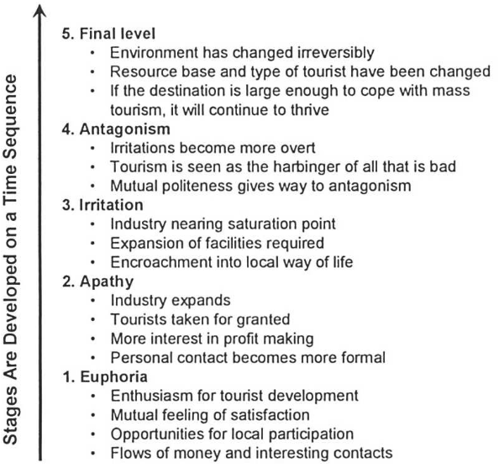
3- Socio-Cultural Conflicts and Tourism
      - The attempt to understand the nature, potential, and effects
      of interactions between hosts and guests is marked by
      a contrast between negative and positive perspectives.
      - One of the earliest concepts of interaction between guests
      and hosts was introduced by Doxey in 1975 and 1976.
      - He developed a five-stage framework, known as Doxey’s
      Irritation, which examines the progression of hosts' irritation
      caused by the presence of tourists at a destination.

Slide 25
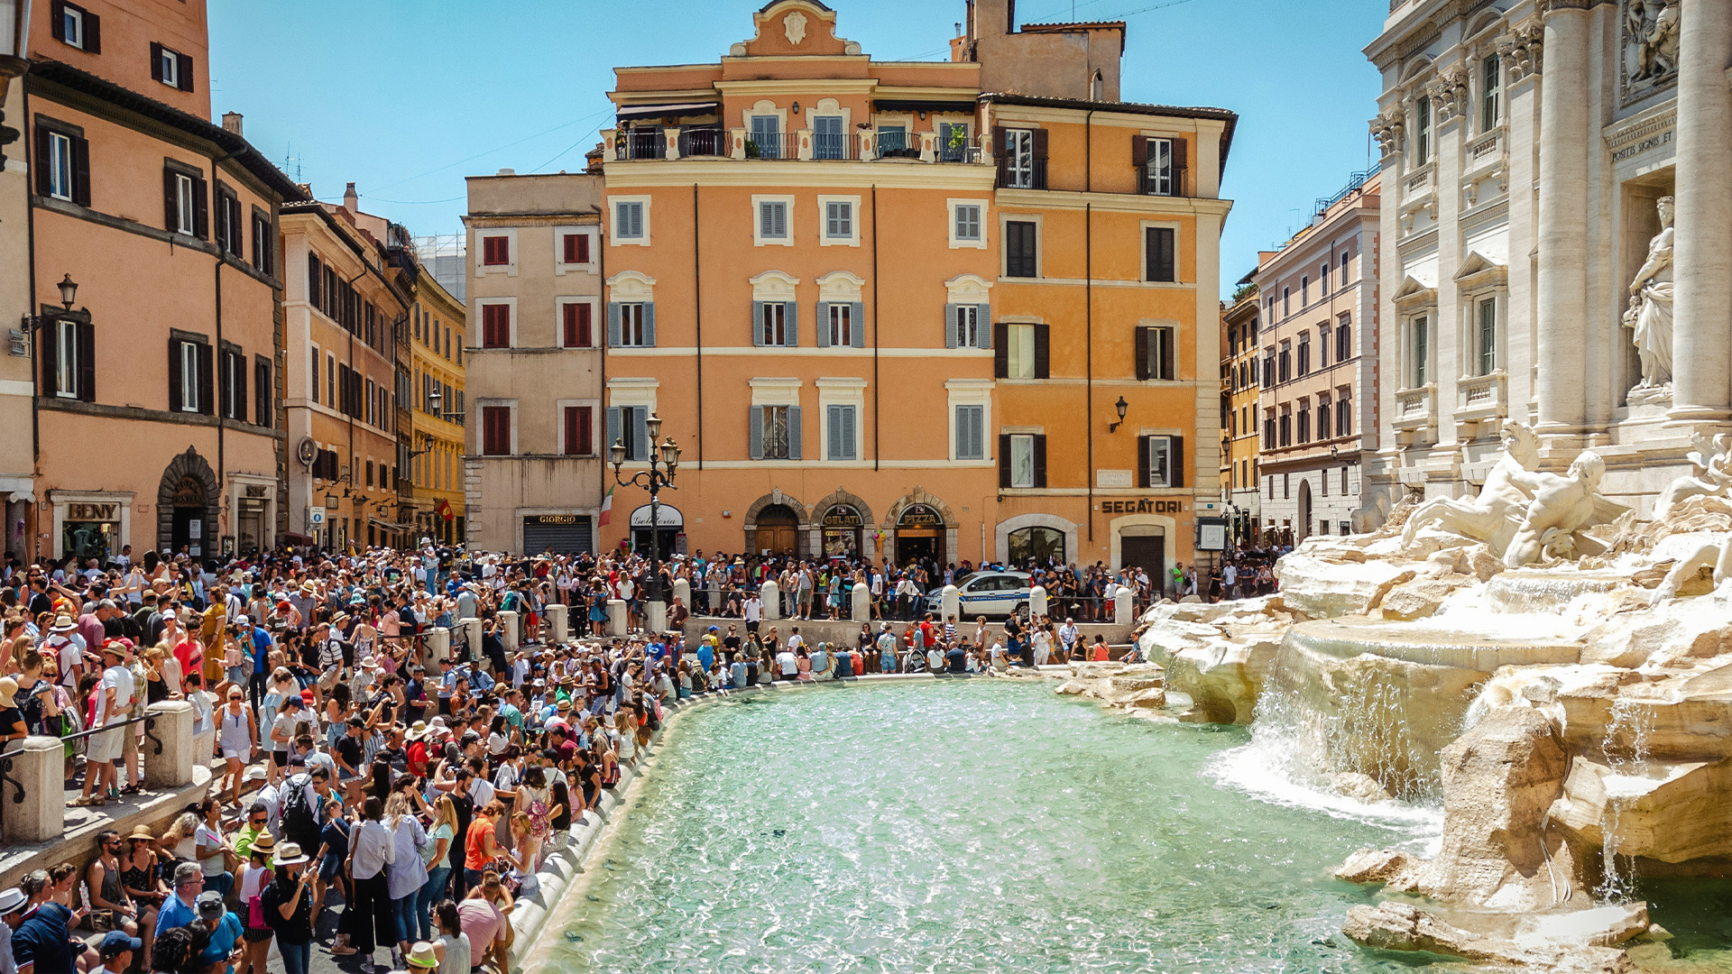
3- Socio-Cultural Conflicts and Tourism
      The irritation stems from various factors:
    - including the physical presence of tourists,
    - their numbers and characteristics,
    - the duration of their stay,
    - cultural differences and distance between hosts and visitors,
    - and foreign ownership of local resources.

Slide 26
3- Socio-Cultural Conflicts and Tourism
      - At the initial stage of tourism development in a destination,
      hosts’ attitudes are generally positive. However, they
      gradually shift toward negativity as tourism places increasing
      pressure on the local community.
      - Doxey's irritation model suggests a one-direction
      progression in which hosts’ attitudes evolve through stages
      of euphoria, apathy, irritation, antagonism, and ultimately
      reach a final stage.

Slide 27
3- Socio-Cultural Conflicts and Tourism
      Euphoria:
      - Characterizes the initial excitement about tourism
      development.
      - Tourists are warmly welcomed as their numbers are small.
      - Tourists show respect for residents and the destination.
      - Interactions are slightly commercial but accompanied by
      mutual satisfaction

Slide 28
3- Socio-Cultural Conflicts and Tourism
      Apathy:
      - Emerges as tourism grows and the number of tourists
      increases.
      - Locals begin to naturally accept tourists as part of daily life.
      - Hosts view tourists primarily as a source of income.
      - Interactions become more formal and business-oriented.

Slide 29
3- Socio-Cultural Conflicts and Tourism
      Irritation:
      - Hosts start to separate their personal lives from tourists.
      - Concerns and frustrations among locals increase.
      - Irritation intensifies if tourism surpasses the destination’s
      capacity.

Slide 30
3- Socio-Cultural Conflicts and Tourism
      Antagonism:
      - Some hosts protest against tourism due to limited natural
      and cultural resources and tourists’ inappropriate behavior.
      - Tensions grow between locals and tourists, leading to
      confrontations and antagonism.
      - Tourists are blamed—fairly or unfairly—for negative
      changes to local lifestyles and society.
      - Hosts become openly intolerant of tourists, viewing them
      as exploiters.

Slide 31
3- Socio-Cultural Conflicts and Tourism
      Final Level:
      - The destination loses its appeal due to the accumulated
      negative consequences of overtourism.
      - Decline occurs as the area's attractiveness deteriorates.
      - Tourists look for and move on to different destinations.

Slide 32
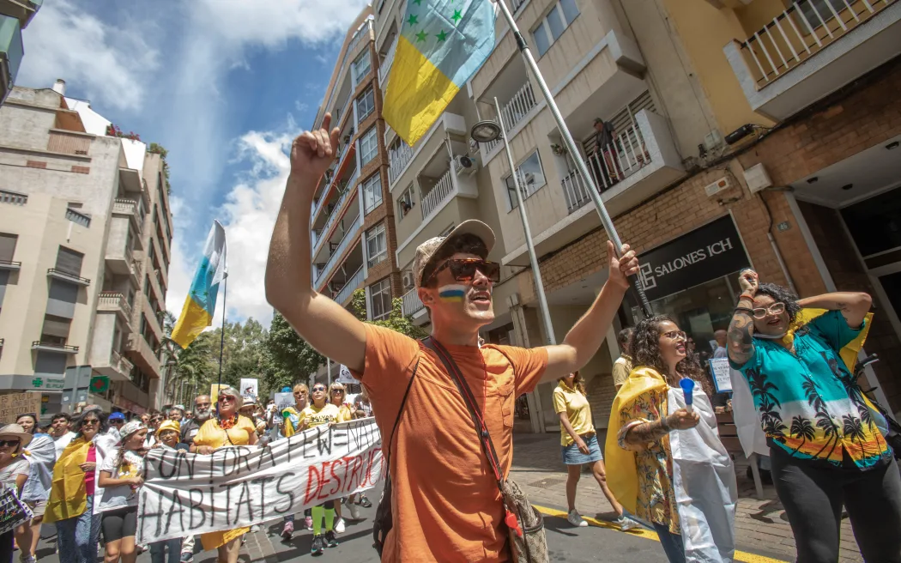
3- Socio-Cultural Conflicts and Tourism
      The Case of Canary Islands :
      The inappropriate tourist beavious:
      - The local community started
      demonstrations against the
      irresponsible tourist activities such
      as over drinking and violence

Slide 33
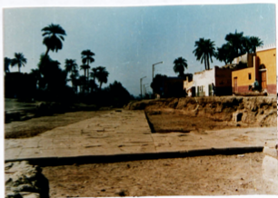
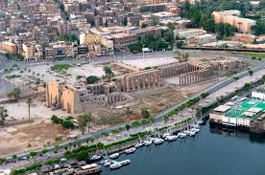
3- Socio-Cultural Conflicts and Tourism
      Grievances arise when local populations are displaced due to
      tourism-related development and forced to abandon traditional
      livelihoods like farming and fishing
      The case study of Luxor, Egypt:
      - The city witnessed different development plans since 1990.
      The development plans sought to improve the city's infrastructure
      by expanding roads and demolishing certain residential buildings,
      restaurants, cafes, bazaars, and etc.

Slide 34
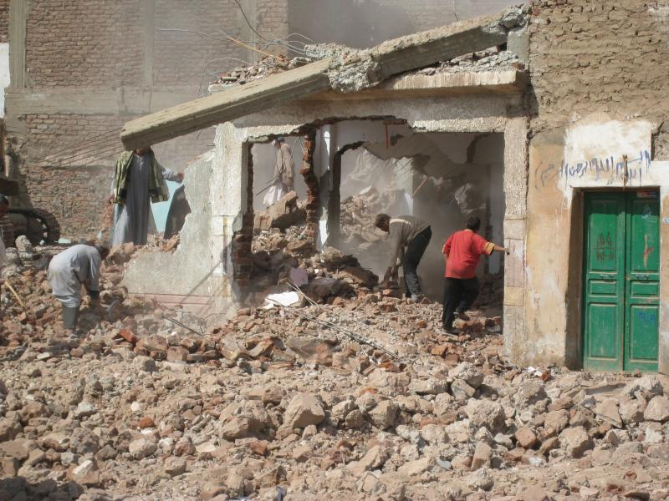
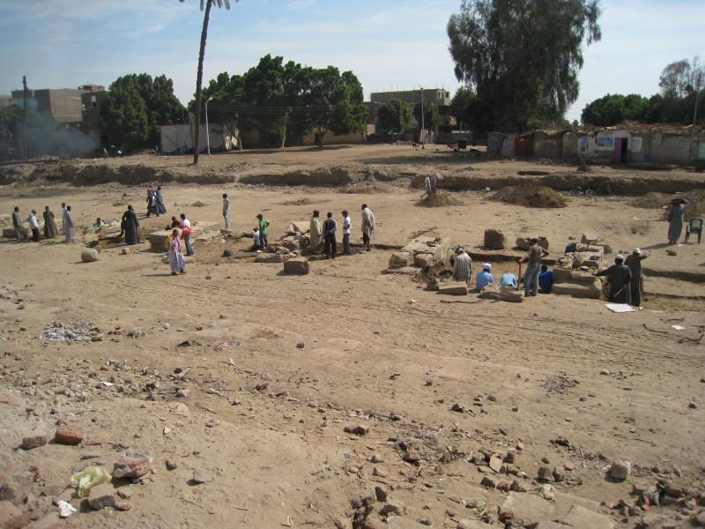
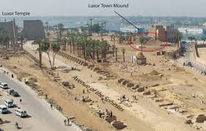
3- Socio-Cultural Conflicts and Tourism

Slide 35
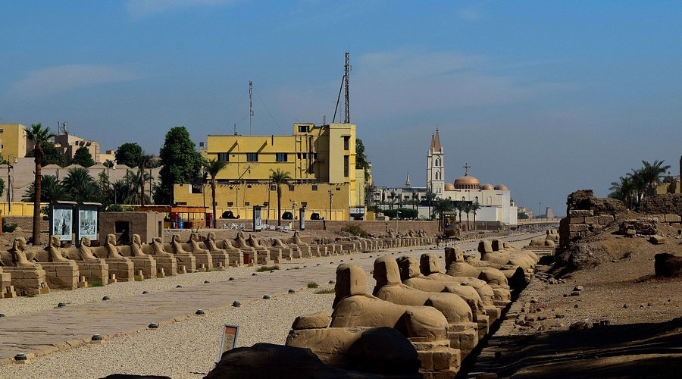
3- Socio-Cultural Conflicts and Tourism

Slide 36
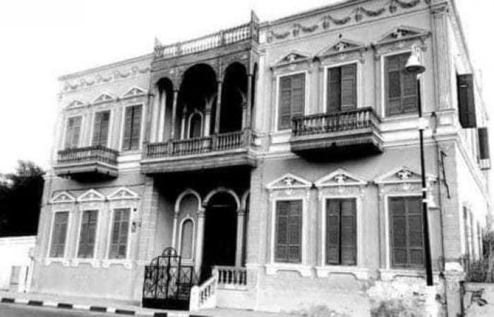
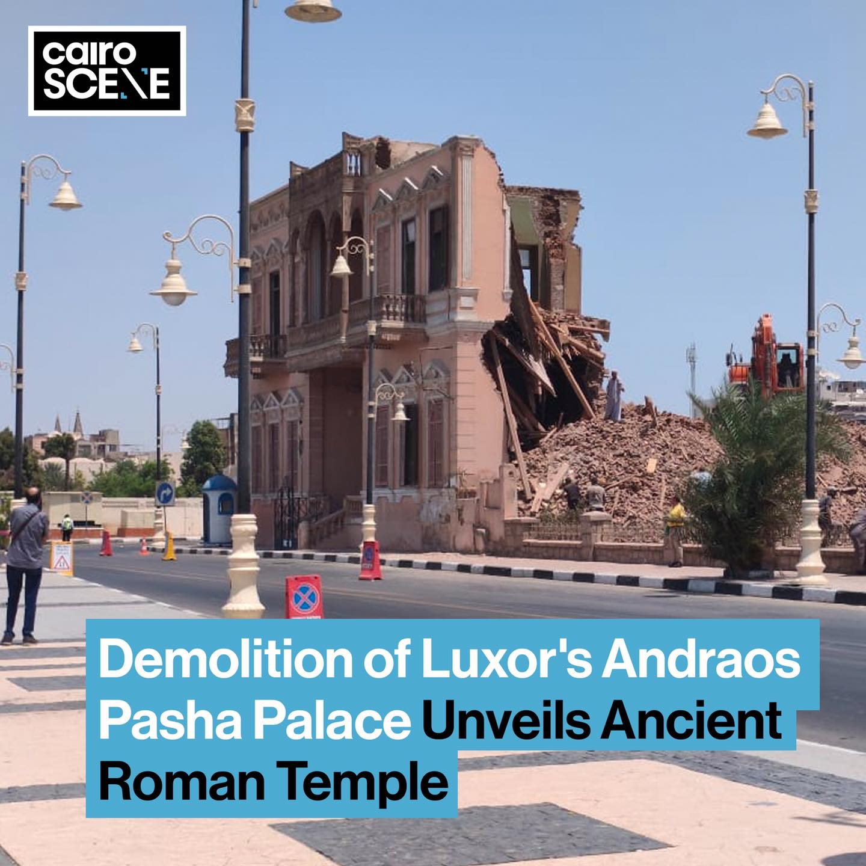
3- Socio-Cultural Conflicts and Tourism
- The destruction of a 120-years old Andraos Palace in Luxor.

Slide 37
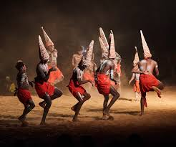
3- Socio-Cultural Conflicts and Tourism
      The Negative Socio-Cultural Impact of Tourism
      Influence on Traditions and Customs:
      - Tourism predominantly affects the traditions, customs,
      and values of indigenous societies rather than tourists.
      - Local communities are constantly exposed to changing
      visitors, while tourists often shift destinations.
      - Even seasonal or intermittent tourism has long-term
      effects on the social and cultural fabric of host societies.

Slide 38
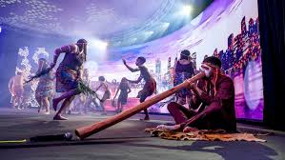
3- Socio-Cultural Conflicts and Tourism
      The Negative Socio-Cultural Impact of Tourism
      Cultural Drift and Demonstration Effect:
      - Seasonal tourism in countries like Greece and Turkey leads to cultural drift, where locals temporarily adapt their behavior to tourists but revert after the season ends.
      - The demonstration effect encourages locals to adopt tourists' languages, foods, fashions, and entertainment preferences, contributing to cultural homogenization.

Slide 39
3- Socio-Cultural Conflicts and Tourism
      The Negative Socio-Cultural Impact of Tourism
      Inter-Generational and Gender Conflicts:
      - Strictly religious, patriarchal, or close-knit societies face challenges like inter-generational conflicts, with younger generations embracing global lifestyles and older ones preserving traditions.
      - Women's roles may shift, empowering them in some cases but causing conflict in patriarchal societies, particularly when women become the primary breadwinners.

Slide 40
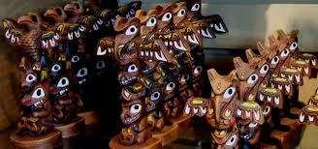
3- Socio-Cultural Conflicts and Tourism
      The Negative Socio-Cultural Impact of Tourism
      The Commodification of Culture
      - Many tourists, including long-term backpackers, develop a preference for Western-style comforts such as fast food, alcohol, and brand-name products.
      - This demand forces destinations to cater to tourists’ tastes, often at the expense of local goods and services.
      - Excessive demand for local products may lead to mass production, which can commodify and commercialize local culture.

Slide 41
3- Socio-Cultural Conflicts and Tourism
      The Negative Socio-Cultural Impact of Tourism:
      Tourist Demand for Traditional Events and 'Staged Authenticity':
      - Tourists often seek to participate in or spectate traditional activities and events, creating tension between preserving the authenticity of these practices and commercializing them for tourism.
      - Many traditional events and rituals are performed outside their original cultural context for tourists, leading to "staged authenticity."
      - While authenticity matters to tourists, it is more important that local communities are comfortable with their role as performers and entertainers.
      - Some religious or spiritual practices may not be suitable for tourist entertainment and should be respected for their cultural and spiritual significance.
      - The local community's willingness to commodify their culture for tourism purposes varies, and not all communities may feel comfortable with this process

Slide 42
3- Socio-Cultural Conflicts and Tourism
      Mechanisms of Cultural Change
      - Permanent cultural changes are more likely to occur when tourism becomes a continuous and deeply integrated part of the local economy and society.
      - Tourism is just one of several factors that contribute to changes in the social and cultural fabric through:
      Cultural Drift:
      - Temporary changes in locals' behavior while interacting with tourists, disappearing once tourists leave.
      - Typically observed in seasonal tourism settings.
      Acculturation:
      - Permanent cultural shifts passed down generations, often occurring in non-seasonal tourism where the influence is pervasive and locals are receptive.

Slide 43
      Discussion
      How can we manage socio-cultural tourism crises?

Slide 44
Thank you
      European Institute of Innovation, Entrepreneurship and Technology
      Lessingstraße 79,
      13158 Berlin, Germany
      Phone: +49 176 55524449
      Email: info@eiiet.com
Discover the world of eiIET

