Slide 1
Planning and Management of Sustainable Tourism
European Institute of Innovation, Entrepreneurship and Technology
Lessingstraße 79, 13158 Berlin, Germany
Mahmoud Abdou| Berlin
      Lessingstraße 79,
      13158 Berlin, Germany
      Phone: +49 30 233618555
      Fax: +49 30 233618556
      Email: info@eiiet.com

Slide 2
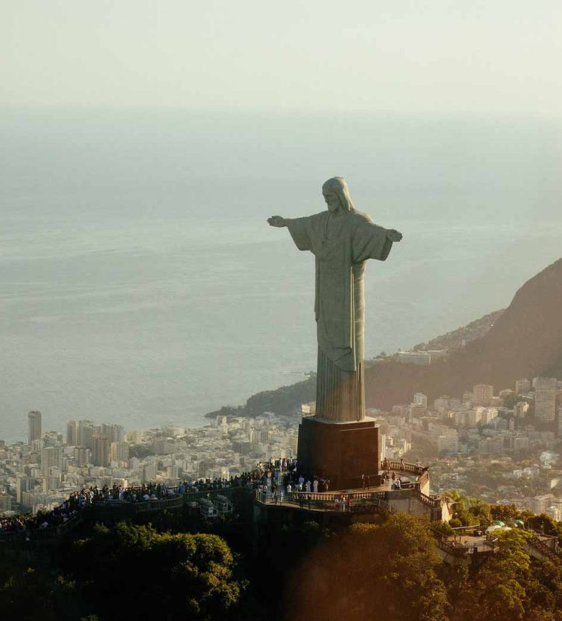
Outline
- Carrying capacity and Limits of Acceptable Change
- Stakeholder Involvement in Tourism Planning
- Destination Management Organizations
- Sustainable destination development

Slide 3
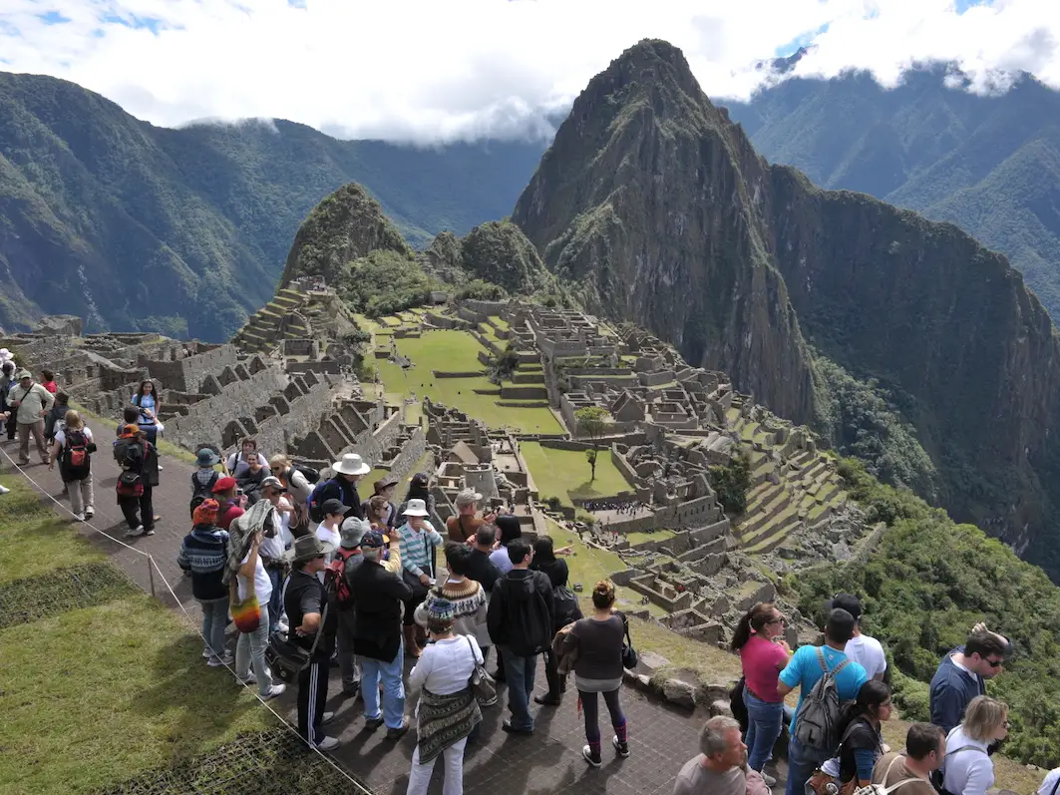
1- Carrying capacity and Limits of Acceptable Change

Slide 4
1- Carrying Capacity
      Defined by the UN World Tourism Organization (UNWTO):
      - “The maximum number of people that may visit a tourist destination at the same time without causing destruction to the physical, economic, and socio-cultural environment, and an unacceptable decline in visitor experience.”
      Modern Perspectives:
      - Shift focus from visitor numbers to the acceptability of impacts caused by visitation.
      - They prioritize factors such as:
      - Biophysical Characteristics
      Soil erosion, vegetation damage, landscape/topography sensitivity
      - Social Aspects
      Visitor behavior, group size, travel mode, seasonality, crowding perceptions
      - Management Policies
      Zoning, visitor use limits, regulations, infrastructure capacity

Slide 5
1- Carrying Capacity
      1.1- Types of Carrying Capacity:
      A- Physical Carrying Capacity
      - Maximum number of tourists a site can physically accommodate
      - Beyond this limit, environmental degradation may occur
      B- Ecological Carrying Capacity
      - Focuses on tourism’s impact on natural ecosystems
      - Ensures long-term sustainability of resources

Slide 6
1- Carrying Capacity
      C- Psychological Carrying Capacity
      - Concerns visitor satisfaction and perception
      - Varies depending on tourist type, destination, and crowd levels
      D- Social Carrying Capacity
      - Social and cultural effects on local communities
      - Includes residents’ attitudes toward tourism and changes in daily life

Slide 7
1- Carrying capacity
      E- Economic Carrying Capacity
      - Ability to support tourism without harming other local economic activities
      - Weighs profitability against opportunity costs and community well-being

Slide 8
1- Carrying capacity
      1.2- What are Visitor Limits?
      - Visitor limits help manage carrying capacity to ensure a sustainable, safe, and enjoyable experience for all.
      The Importance of Visitor Limits:
      Environmental Protection
      - Prevents damage to habitats, vegetation, and wildlife
      Visitor Experience
      - Reduces overcrowding, noise, and preserves enjoyment

Slide 9
1- Carrying capacity
      Resource Management
      - Ensures adequate capacity of trails, parking, and facilities
      Safety
      - Helps avoid accidents in high-use or sensitive areas
      Sustainability
      - Supports the long-term viability of the destination

Slide 10
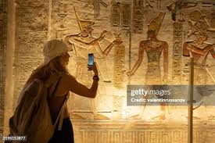
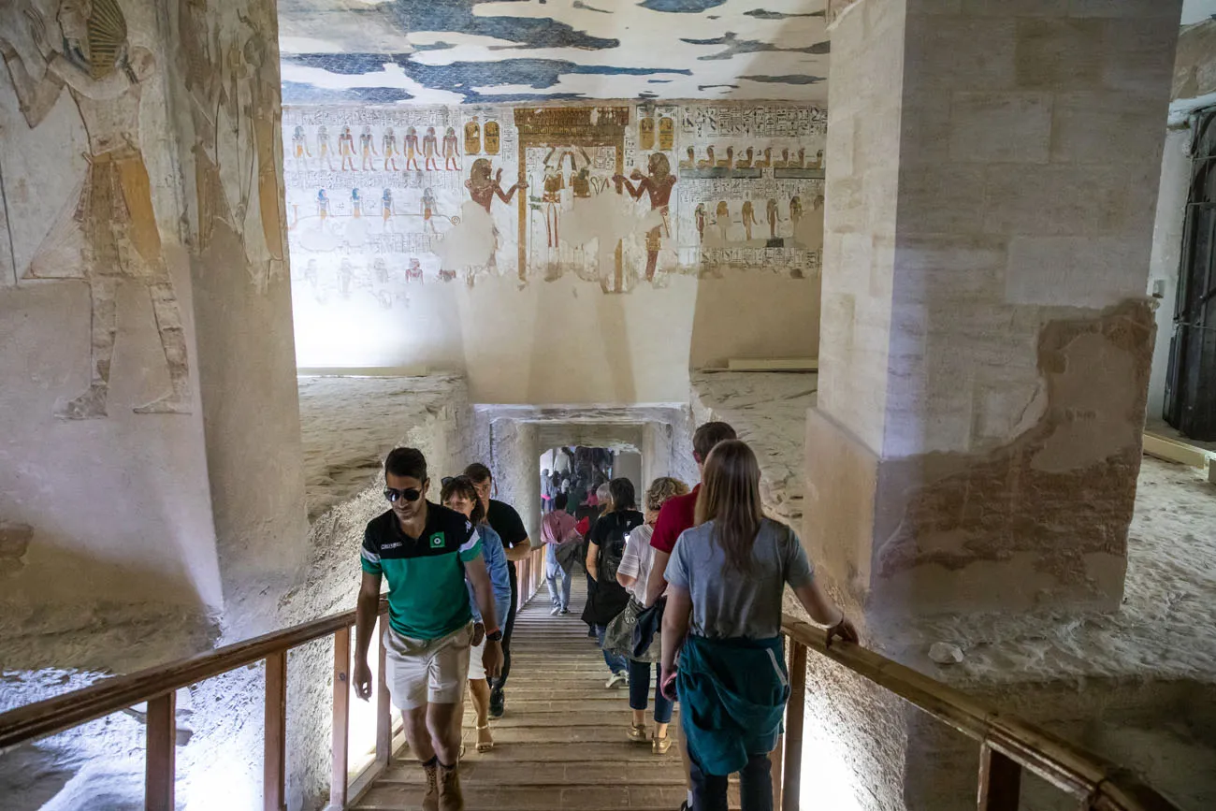
1- Carrying capacity
      1.3- Visitor Limit Strategies:
      Reservations and Permits:
      - Control access by requiring advance booking.
      Timed Entry:
      - Stagger arrivals to reduce crowding.

Slide 11
1- Carrying capacity
      1.3- Visitor Limit Strategies:
      Capacity Limits:
      - Set max visitor numbers per site/activity.
      Alternative Options:
      - Promote less-visited areas or activities.
      Education:
      - Inform visitors about low-impact behavior.

Slide 12

2- Stakeholder Involvement in Tourism Planning
      1.3- Visitor Limit Strategies:

Slide 13
2- Stakeholder Involvement in Tourism Planning
      - Stakeholders in tourism management include:
      Government Agencies and Regulatory Bodies
      Destination Management Organizations (DMOs)
      Tourism Businesses
      Local Communities
      Non-Governmental Organizations (NGOs)
      The Tourists
Key Actors
Government Agencies
Local Communities
NGOs
The Tourists
DMOs
Tourism Businesses

Slide 14
2- Stakeholder Involvement in Tourism Planning
      - Stakeholder Participation is defined as:
      “A process of involving all stakeholders in such way that decision-making is shared”.
      Stakeholder Participation is about:
      - Participation, consultation, and collaboration.
      - It ensures that different interests are represented when tourism strategies or policies are created.

Slide 15
2- Stakeholder Involvement in Tourism Planning
      2.1- Why Stakeholder Involvement Matters?
      - Effective tourism planning requires collaboration among stakeholders because tourism:
      Impacts the environment, economy, and society of destinations.
      Creates both benefits and costs.
      Involves multiple interdependent sectors

Slide 16
2- Stakeholder Involvement in Tourism Planning
      2.2-Key Benefits of stakeholder involvement:
      Better decision-making
      Legitimacy and transparency
      Conflict reduction
      Shared responsibility
      Long-term sustainability

Slide 17
2- Stakeholder Involvement in Tourism Planning
      2.3- Types of Local Stakeholder Participation in Tourism Development
      A- Coercive Participation
      - No real influence of local stakeholders in tourism planning or development
      - Top-down approach — decisions made entirely by external authorities
Types of Local Stakeholder
Coercive Participation
Induced Participation
Spontaneous Participation

Slide 18
2- Stakeholder Involvement in Tourism Planning
      B- Induced Participation
      - Consultation occurs, but locals are not involved throughout
      the decision-making process
      - Still a top-down approach with limited control for local stakeholders
Types of Local Stakeholder
Coercive Participation
Induced Participation
Spontaneous Participation

Slide 19
2- Stakeholder Involvement in Tourism Planning
      C- Spontaneous Participation
      - Local stakeholders actively participate in decision-making
      and manage the development process
      - Represents a bottom-up approach — strong local control and empowerment
Types of Local Stakeholder
Coercive Participation
Induced Participation
Spontaneous Participation

Slide 20
2- Stakeholder Involvement in Tourism Planning
      2.4- Tools and Methods for Stakeholder Involvement
      -Public Consultations and Hearings:
      Gather community opinions and feedback
      - Workshops and Focus Groups
      Promote discussion and idea sharing
      - Participatory Rural Appraisal
      Involve locals directly in planning and assessment

Slide 21
2- Stakeholder Involvement in Tourism Planning
      - Community Mapping and Visioning Exercises
      Identify resources and create shared development goals
      - Stakeholder Analysis and Power Mapping
      Determine key actors and their influence
      - Online Participation Platforms
      Expand engagement through digital tools
      - Collaborative Tourism Forums or Councils
      Build long-term cooperation among stakeholders

Slide 22

What are the Challenges of Stakeholder Involvement in Tourism?

Slide 23
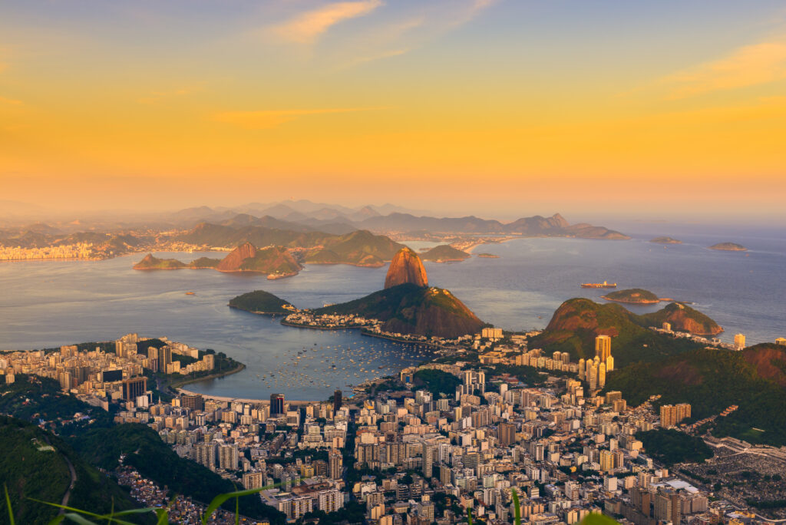
3- Destination Management Organizations

Slide 24
3- Destination Management Organizations
      3.1- Destination Management is defined as:
      - “A core entity responsible for coordinating tourism development and management”
      It includes:
      Aims to:
      - Facilitate partnerships and collaboration among key actors
      - Create a common vision for the tourism destination
      - Focuse on sustainable development, competitiveness, and visitor satisfaction
Public authorities | Tourism stakeholders
Professional associations

Slide 25
3- Destination Management Organizations
      3.2- Types of Destination Managemen Organizations:
      A- National DMO: Country-level
      - VisitBritain, Tourism Australia, Egyptian Tourism Authority
      B- Regional DMO: State or regional level
      - VisitScotland, Bavaria Tourism
      C- Local DMO: City or municipality level
      - VisitBerlin, Prague City Tourism

Slide 26
3- Destination Management Organizations
      Case Study 1: Egyptian Tourism Authority
      - Main Roles
Marketing and Promotion | Market Research
Coordination | International Representation
Event Organization

Slide 27
3- Destination Management Organizations
      Case Study 1: Focus Areas ETA
      Heritage Tourism
      Promote iconic sites: Pyramids, Luxor, Aswan
      Beach and Resort Tourism
      Develop popular destinations: Sharm El-Sheikh, Hurghada
      New Tourism Segments
      Expand eco-tourism and cultural routes
      Safety and Investment Confidence
      Highlight measures to ensure visitor safety
      Rebuild tourism post-crisis

Slide 28
3- Destination Management
      3.3- Roles and Functions of DMOs
      A. Strategic Planning and Policy
      - Develop and implement destination development strategies.
      - Conduct situation analyses to identify opportunities and challenges.
      - Guide sustainable tourism plans, including:
      Zoning and land use
      Carrying capacity management
      Heritage protection
      - Support infrastructure planning

Slide 29
3- Destination Management
      B. Marketing and Branding
      - Design and manage destination brands
      - Conduct market research to understand trends and target audiences
      - Promote tourism products to attract key market segments
      - Maintain online presence, digital platforms, and visitor information centers
      - Balance promotion with sustainability

Slide 30
3- Destination Management
      C- Coordination and Partnership Building
      - DMOs act as a bridge between stakeholders:
      - Coordinate between public institutions and private sector.
      - Support community-based tourism (CBT) projects.
      - Facilitate multi-stakeholder networks and cluster development.
      - Promote public-private partnerships (PPPs) in tourism infrastructure.

Slide 31
3- Destination Management
      D- Research, Monitoring, and Data Management
      - Collect and analyze visitor statistics
      - Monitor destination performance indicators
      - Conduct impact assessments and visitor surveys
      - Inform adaptive management strategies and policy adjustments

Slide 32
3- Destination Management
      E- Crisis and Risk Management
      - Develop and coordinate crisis response plans
      - Communicate accurate and timely information to tourists and partners
      - Support recovery campaigns

Slide 33
3- Destination Management
      F- Capacity Building and Education
      - Organize training workshops for local entrepreneurs, guides, and hospitality staff
      - Build community awareness about sustainability and visitor engagement
      - Support innovation and digital transformation in tourism SMEs

Slide 34
      Discussion
      Explain the role of the destination managment organization in your country, highlighting the main tasks, advantages, and the challenges

Slide 35
4- Sustainable destination development
      - Sustainable destination development requires balancing:
      Environmental limits, participatory processes, and institutional coordination
      A- Environmental Limits
      - Managed through Carrying Capacity and Limits of Acceptable Change (LAC)
      - Protect natural and cultural resources, maintain visitor experience quality
      - Expected Outcomes:
Resource conservation | Long-term ecological balance
Sustained visitor satisfaction

Slide 36
4- Sustainable destination development
      B- Participatory Processes
      - Achieved through Stakeholder Involvement
      - Inclusion, transparency, and shared decision-making
      - Expected Outcomes:
      Social acceptance and trust
      Empowered local communities
      Equitable benefit distribution

Slide 37
4- Sustainable destination development
      C- Institutional Coordination
      - Ensured through DMOs and Governance Systems
      - Policy alignment, coordination among institutions, and sustainable management
      Expected Outcomes:
      Effective policy implementation
      Improved destination competitiveness
      Resilience against crises and change

Slide 38
Thank you
      European Institute of Innovation, Entrepreneurship and Technology
      Lessingstraße 79,
      13158 Berlin, Germany
      Phone: +49 176 55524449
      Email: info@eiiet.com
Discover the world of eiIET

Slide 39
1- Carrying capacity
      Select a cultural heritage/ natural heritage site that is opened to visitor and explain in the light of visitor management aspect:
      - the main challenges facing the site
      - How would you increase/decrease the number of the visitor
      - the different strategies would you select to overcome these challenges
      - the main strategies would you adopt to increase the number of visitors

