Slide 1
Tourism Law and Legislation
European Institute of Innovation, Entrepreneurship and Technology
Lessingstraße 79, 13158 Berlin, Germany
Mahmoud Abdou| Berlin
      Lessingstraße 79,
      13158 Berlin, Germany
      Phone: +49 30 233618555
      Fax: +49 30 233618556
      Email: info@eiiet.com

Slide 2
Index
Transportation Contracts: Railway Routes
Convention concerning International Carriage by Rail
The Convention for the Unification of Certain Rules
for International Carriage by Air
4. Regulation (EU) No 181/2011 of the European Parliament

Slide 3
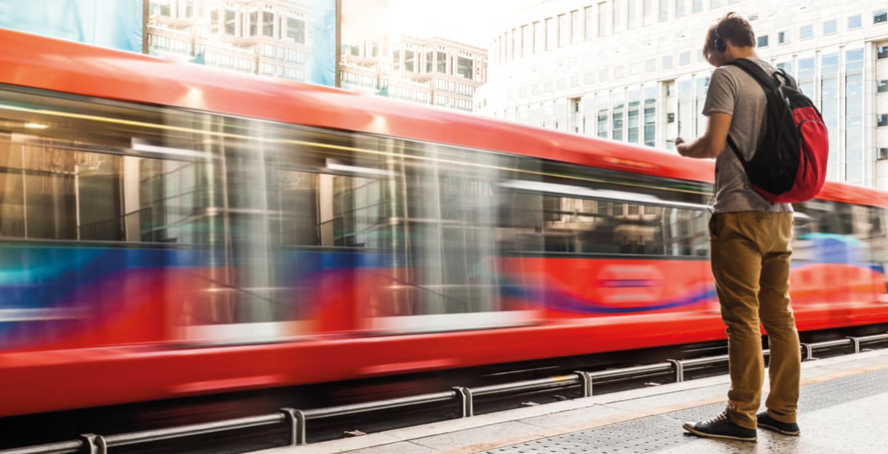
1- Transportation Contracts: Railway Routes
    - Transportation contracts in rail and road transport define the:
    Legal relationship
    Rights and obligations
    Liability framework
    Service standards
    -Between:
    Carrier (transport operator)
    Passenger or shipper (customer)

Slide 4
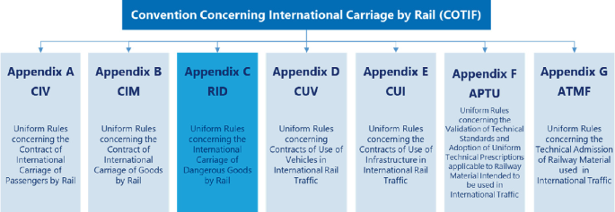
2- Convention concerning International Carriage by Rail
    - Article 1.1: Basic Rule: International Character
    - CIV Applies When:
    There is a rail passenger contract
    The journey is paid or free
    Departure and destination are in two different
    Member States
    The nationality of the passenger is irrelevant
    Domicile or business location is irrelevant

Slide 5

2- Convention concerning International Carriage by Rail
    - Article 1.2: Multimodal Transport
    - CIV Applies When:
    - There is a single international contract
    - The contract includes:
    A domestic road segment (e.g., bus), or
    A domestic inland waterway segment
    The segment supplements cross-border rail transport
    -Legal Effect:
    The entire journey remains governed by CIV.

Slide 6

2- Convention concerning International Carriage by Rail
    - Article 1.3: Cross-Border Waterway
    - CIV Applies If:
    - There is a single contract
    - The journey includes:
    A sea segment, or
    A cross-border inland waterway segment

Slide 7
2- Convention concerning International Carriage by Rail
    - Article 1.4: Persons Accompanying Goods
    - CIV Also Applies To:
    - Persons accompanying goods
    - When goods are transported under CIM Rules
    - Only regarding:
    Death
    Personal injury
    - Significance:
    Extends carrier liability protection beyond standard passengers.

Slide 8
2- Convention concerning International Carriage by Rail
    - Article 1.5: Exclusion: Border Infrastructure Rule
    - CIV Does NOT Apply When:
    Transport occurs between neighbouring States
    Infrastructure is managed under only one State’s authority
    - Reason:
    Prevents artificial classification of transport as international.

Slide 9
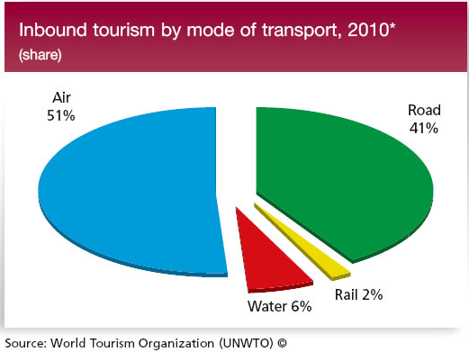
2- Convention concerning International Carriage by Rail
    - Article 1.6: Reservation by Acceding States
    - A State May:
    - Limit CIV application to a specific railway section
    - That section must:
    Be clearly defined
    Connect to a Member State
    - CIV Applies Only If:
    Departure/destination/route is on that section, OR
    It serves as a transit route between Member States

Slide 10
2- Convention concerning International Carriage by Rail
    Article 1.7: Withdrawal of Reservation
    - A State May:
    Withdraw its reservation at any time
    Notify the Depositary
    - Legal Effect:
    Takes effect one month after notification
    Ends automatically if the comparable convention ceases
    - Principle:
    Ensures adaptability of treaty obligations.

Slide 11
2- Convention concerning International Carriage by Rail
    Article 2: Withdrawal of Reservation
    - Right of a State to Make a Declaration
    - A State May Declare That:
    - It will not apply the full CIV liability provisions in cases of:
    Death of passengers Personal injury to passengers
    When:
    The accident occurs on its territory
    The passenger is:
    A national of that State Personal injury to passengers

Slide 12
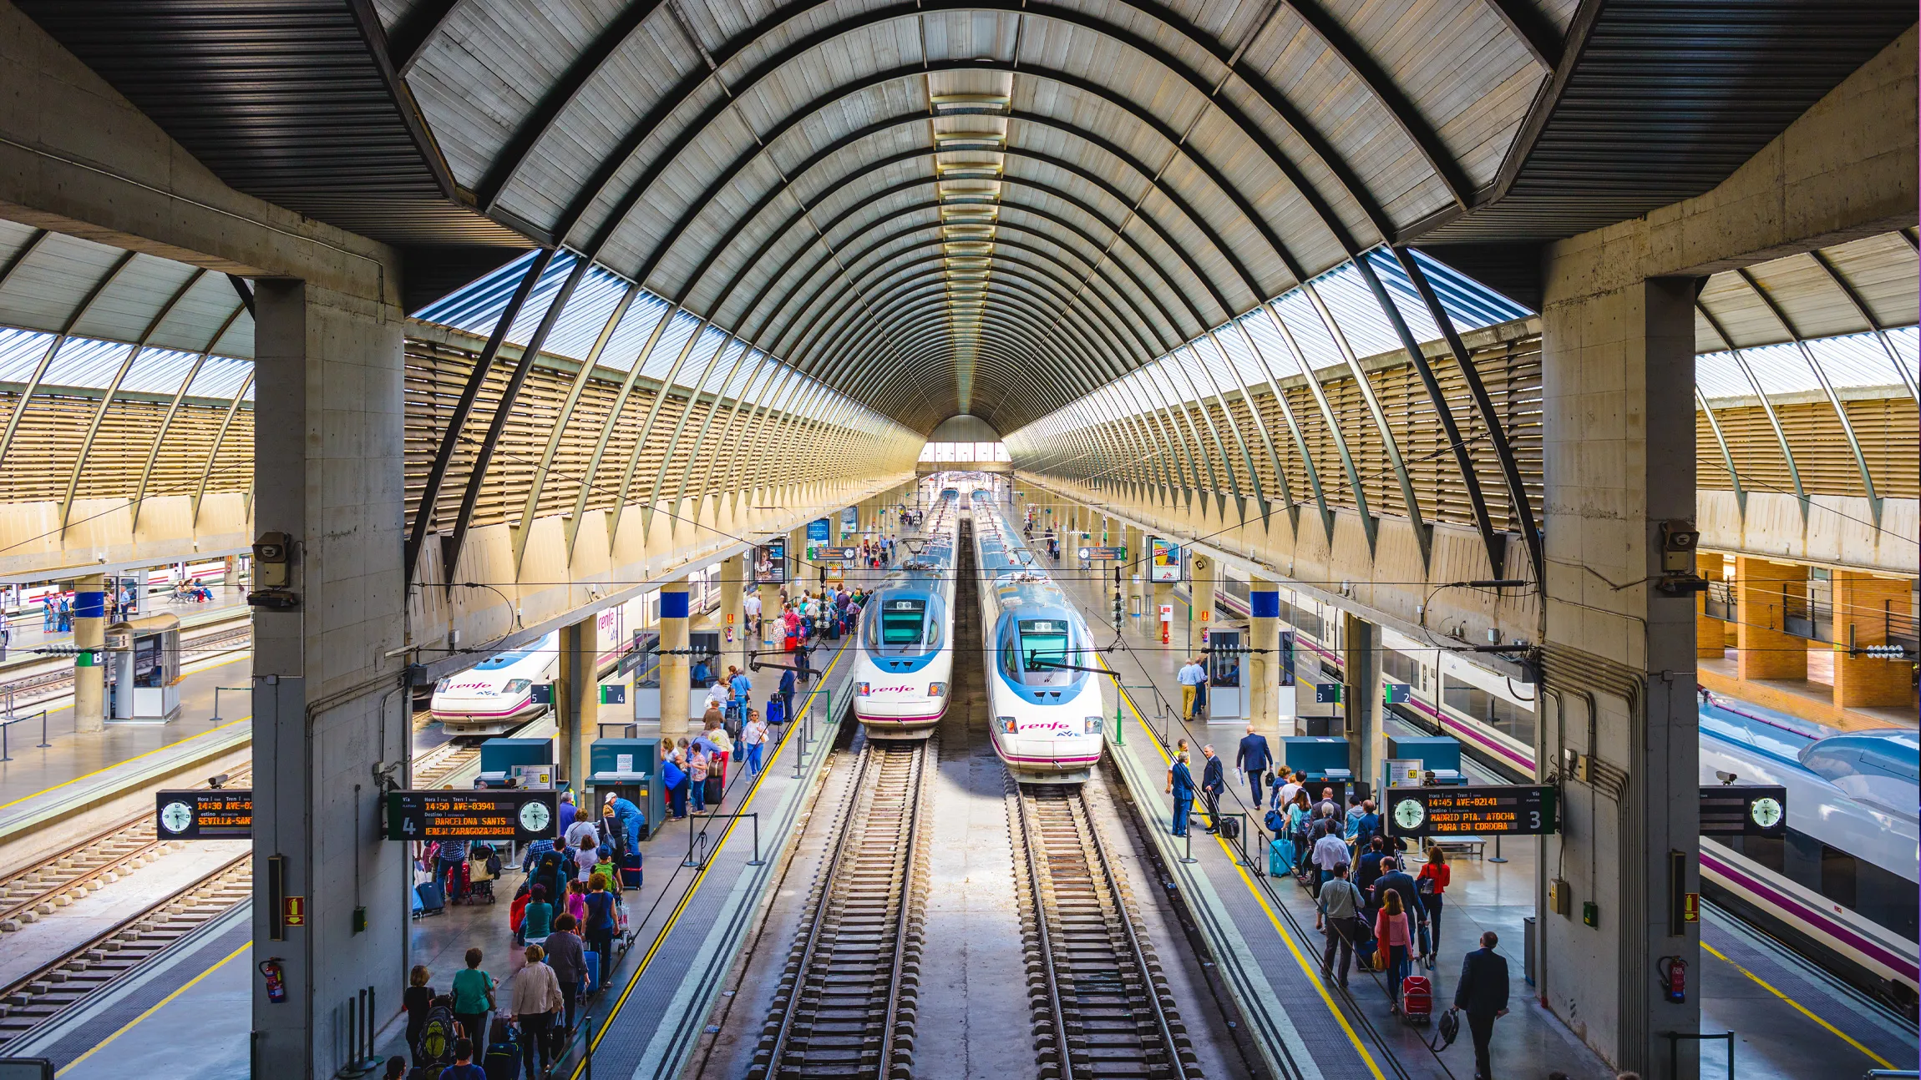
2- Convention concerning International Carriage by Rail
    Article 4: Derogations
    - A derogation is a legal exception or deviation from standard rules.
    - Exception from the Uniform Rules governing international rail carriage
    - Why allow derogations?
    Geographic realities
    Political situations
    Operational flexibility
    Cross-border cooperation

Slide 13
2- Convention concerning International Carriage by Rail
    Article 4: Derogations
    - The carrier is liable for:
    Death Personal injury
    Physical harm Mental harm
    - If caused by:
    An accident
    Arising out of railway operations

Slide 14
2- Convention concerning International Carriage by Rail
    Article 26: Liability
    - The carrier is relieved of liability (not responsible) if:
    A- External Circumstances (Force Majeure)
    An accident caused by events not connected with railway operation
    Carrier took all required care
    The accident could not be avoided
    Consequences could not be prevented

Slide 15
2- Convention concerning International Carriage by Rail
    Article 26: Liability
    - The carrier is relieved of liability (not responsible) if:
    B- Passenger’s Own Fault
    - Accident caused partly or fully by the passenger’s behaviour
    - Examples:
    Passenger jumps from moving train
    Ignores safety instructions
    Stands between carriages despite warnings

Slide 16
2- Convention concerning International Carriage by Rail
    Article 26: Liability
    - The carrier is relieved of liability (not responsible) if:
    D- Fault of a Third Party
    Accident caused by a third party
    Carrier exercised all required care
    Accident could not be avoided or prevented

Slide 17
2- Convention concerning International Carriage by Rail
    Article 26: Liability
    - If the carrier is not completely relieved, then:
    The carrier is fully liable
    Liability applies up to the limits set in the Uniform Rules
    The carrier keeps the right of recourse

Slide 18
2- Convention concerning International Carriage by Rail
    Article 26: Liability: Successive Carriers:
    - When one contract of carriage involves multiple railway carriers:
    - Who is liable?
    The carrier responsible for the part of the journey where the accident occurred
    - If a substitute carrier performed the service:
    Both carriers are jointly and severally liable
    - Joint and several liability means:
    The passenger can claim full compensation from either carrier
    The carriers settle responsibility between themselves later

Slide 19
2- Convention concerning International Carriage by Rail
    Article 27: Damages in Case of Death
    - What compensation includes:
    A- If a passenger dies as a result of an accident, damages cover:
    Necessary costs following death
    Transport of the body
    Funeral expenses
    B- If death is not immediate
    Medical expenses
    Financial loss during the period before death

Slide 20
2- Convention concerning International Carriage by Rail
    - Article 27: Compensation for Dependants
    - If the deceased passenger had a legal duty to support others, those persons are entitled to compensation.
    - Who can claim?
    Spouse
    Children
    Other legally dependent persons

Slide 21
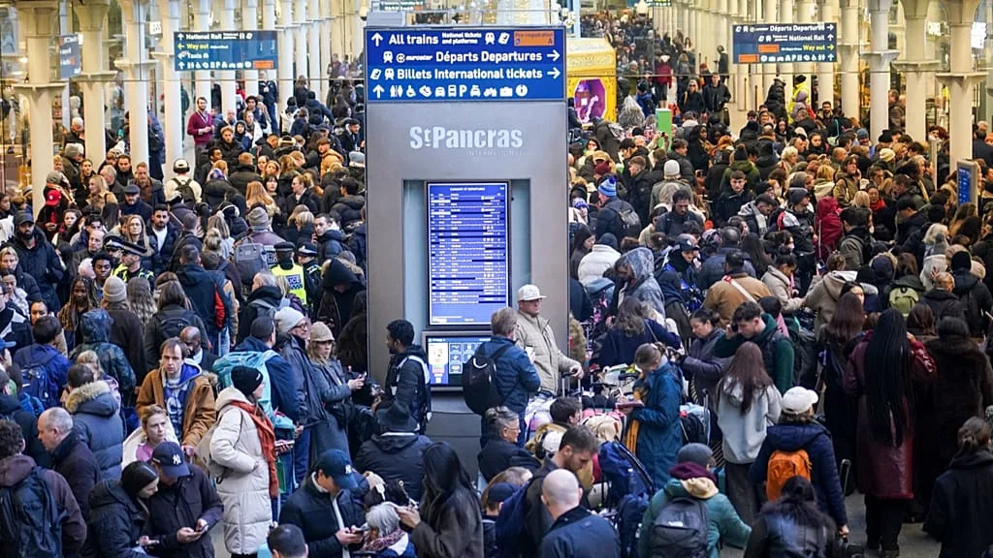
2- Convention concerning International Carriage by Rail
    Article 32: Liability for Cancellation, Late Trains and Missed Connections
    - When is the railway carrier liable?
    - The carrier is liable if, due to:
    Cancellation
    Late running
    Missed connection

Slide 22
2- Convention concerning International Carriage by Rail
    - Article 32: Liability for Cancellation, Late Trains and Missed Connections
    - The carrier is relieved of liability if the delay or cancellation is caused by:
    External circumstances
    The passenger’s fault
    Third-party behaviour

Slide 23
3- Regulation (EU) No 181/2011 of the European Parliament
    Article 1: Subject Matter
    - This regulation sets out the rules for bus and coach transport within the EU regarding passenger rights.
    - Key Areas Covered:
    A- Non-discrimination
    - Passengers must be treated equally regarding:
    Ticket prices
    Conditions of transport
    Access to services

Slide 24
3- Regulation (EU) No 181/2011 of the European Parliament
    Article 1: Subject Matter
    B- Rights in Case of Accidents:
    - Applies to accidents during bus or coach travel:
    Death or personal injury
    Loss or damage to luggage
    C- Disabled Persons and Reduced Mobility:
    - Mandatory assistance must be provided:
    Boarding and alighting
    Ticketing
    Onboard support

Slide 25
3- Regulation (EU) No 181/2011 of the European Parliament
    Article 1: Subject Matter
    D- Rights in Case of Delay or Cancellation:
    - Passengers are entitled to:
    - Rerouting or refund
    - Compensation for delays or missed connections
    E- Passenger Information:
    - Carriers must provide:
    - Information on delays and cancellations
    - Details of passenger rights
    - Instructions on complaint procedures

Slide 26
3- Regulation (EU) No 181/2011 of the European Parliament
    - Article 2: Scope
    - The regulation applies to passengers who:
    - Travel on regular bus or coach services
    Excludes chartered services for specific groups
    - Board or alight within an EU Member State
    - Are on services where the scheduled distance is 250 km or more

Slide 27
3- Regulation (EU) No 181/2011 of the European Parliament
    Article 7: Accident Liability in Bus and Coach Transport
    - This article regulates compensation in case of accidents arising out of the use of the bus or coach.
    - It covers:
    Death
    Personal injury
    Loss of or damage to luggage

Slide 28
3- Regulation (EU) No 181/2011 of the European Parliament
    Article 7: Accident Liability in Bus and Coach Transport
    - Compensation in Case of Personal Injury
    - Passengers are entitled to compensation for:
    Physical injuries
    Related financial consequences
    Medical costs

Slide 29
3- Regulation (EU) No 181/2011 of the European Parliament
    - Article 8: Immediate Practical Needs of Passengers
    - The carrier must provide reasonable and proportionate assistance to passengers.
    - The assistance may include:
    Accommodation
    Food
    Clothes
    Transport
    Facilitation of first aid

Slide 30
3- Regulation (EU) No 181/2011 of the European Parliament
    Article 19: Continuation, Re-routing and Reimbursement
    - This article applies when:
    - A regular service is
    Cancelled
    Delayed by more than 120 minutes
    Overbooked

Slide 31
3- Regulation (EU) No 181/2011 of the European Parliament
    - Article 19: Continuation, Re-routing and Reimbursement
    - The passenger must be immediately offered a choice between:
    A- Continuation / Re-routing
    To final destination
    No additional cost
    Comparable conditions
    At the earliest opportunity
    (b) Reimbursement
    - To final destination
    - Free return to first departure point
    -At the earliest opportunity

Slide 32
3- Regulation (EU) No 181/2011 of the European Parliament
    Article 19: Continuation, Re-routing and Reimbursement
    - If the carrier fails to offer the choice mentioned:
    - The passenger is entitled to:
    50% of the ticket price
    In addition to reimbursement
    Must be paid within 1 month after request.

Slide 33
3- Regulation (EU) No 181/2011 of the European Parliament
    Article 19: Continuation, Re-routing and Reimbursement
    - Bus Becomes Inoperable During Journey
    - Carrier must provide:
    Continuation with another vehicle
    OR
    Transport to a suitable terminal/waiting point

Slide 34
3- Regulation (EU) No 181/2011 of the European Parliament
    - Article 21: Assistance in Case of Cancellation or Delay
    - This article applies when:
    - The scheduled journey duration exceeds 3 hours, AND
    - Departure from a terminal is:
    Cancelled
    Delayed by more than 90 minutes

Slide 35
3- Regulation (EU) No 181/2011 of the European Parliament
    Article 21: Assistance in Case of Cancellation or Delay
    Passengers must be offered free of charge:
    A- Food and Refreshments
    Snacks, meals, drinks
    B- Right to Accommodation
    If delay requires an overnight stay:
    Carrier must provide:
    Hotel or other accommodation
    Transport between terminal and accommodation

Slide 36
Thank you
      European Institute of Innovation, Entrepreneurship and Technology
      Lessingstraße 79,
      13158 Berlin, Germany
      Phone: +49 176 55524449
      Email: info@eiiet.com
Discover the world of eiIET

