Slide 1
Research on Tourism Services
European Institute of Innovation, Entrepreneurship and Technology
Lessingstraße 79, 13158 Berlin, Germany
Mahmoud Abdou| Berlin
      Lessingstraße 79,
      13158 Berlin, Germany
      Phone: +49 30 233618555
      Fax: +49 30 233618556
      Email: info@eiiet.com

Slide 2
Index
- On the Meaning of Sustainable Development
- What is the Meaning of Development?
-What is the Meaning of Sustainability?
-Sustainable Tourism

Slide 3

1-On the Meaning of Sustainable Development
      What is meaning development?
    - Development is the act or process of developing; growth; and progress.
    - It is also defined as “an evolutionary process in which the human capacity increases in terms of initiating new structures, coping with problems, adapting to continuous change, and striving purposefully and creatively to attain new goals”.

Slide 4
1-On the Meaning of Sustainable Development
      What is the meaning development?
    - It is also understood as “a multi- dimensional process that involves major changes in social structures, attitudes, and institutions, as well as economic growth, reduction of inequality, and eradication of absolute poverty.”
    - So, development refers to the act or process of improving, evolving, or advancing something.
    - It encompasses growth, progress, and enhancement in different frameworks, from personal to societal, economic, technological, or organizational.

Slide 5
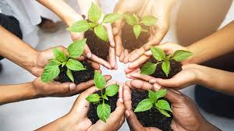
1- On the Meaning of Sustainable Development
      What is the meaning of sustainability?
    - Sustainability refers to the capability of maintaining or continuing an entity, outcome, or process over time.
    - The term can also signify enhancing and maintaining a balanced economic, ecological, and social system to support human development.
    - Sustainability emphasizes human activities a
    nd their capacity to meet needs and desires
    without depleting or exhausting available
    productive resources.

Slide 6
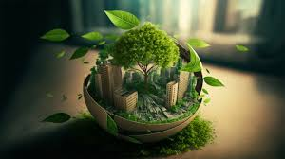
1- On the Meaning of Sustainable Development
      What is the meaning of sustainability?
    - Thus, sustainability can be defined as the fair and efficient allocation of resources within and between generations, ensuring that socio-economic activities function within the boundaries of a finite ecosystem.

Slide 7
1-On the Meaning of Sustainable Development
      What is the meaning of sustainability?
    - This perspective represents a reflection on how people should conduct their economic and social lives while utilizing ecological resources responsibly to support human development.
    This means:
    - Sustainability highlights the role of human actions in meeting their needs and desires.
    - It emphasizes using available productive resources without depleting or exhausting them.
    - Encourages consideration of how people live their economic and social lives.
    - Stresses the importance of drawing on ecological resources in a way that supports long-term human development.
    - Balances satisfying present human needs with the preservation of resources for future generations.

Slide 8
On the Meaning of Sustainable Development
      What is the meaning of sustainable development?
    - The concept of sustainable development began to gain wide recognition in the late 1980s, following its introduction in Our Common Future, also referred to as The Brundtland Report.
    - This report was the outcome of a UN-established commission tasked with proposing “a global agenda for change” in development approaches and practices.
    - It emphasized the need to rethink how we live and govern.
    - Achieving humanity's goals and aspirations responsibly would require innovative approaches to addressing old issues, along with international collaboration and coordination.

Slide 9
1- On the Meaning of Sustainable Development
      What is the meaning of sustainable development?
    - The report also sought to draw global attention to the unprecedented deterioration of the human environment and natural resources, as well as the impacts of this deterioration on economic and social development, stressing on two aspects:
    - The well-being of the environment, economies, and people is deeply interconnected.
    - Achieving sustainable development requires global collaboration.
    Therefore, sustainable development can be understood as the development that meets the needs of the present without compromising the ability of future generations to meet their own needs.

Slide 10
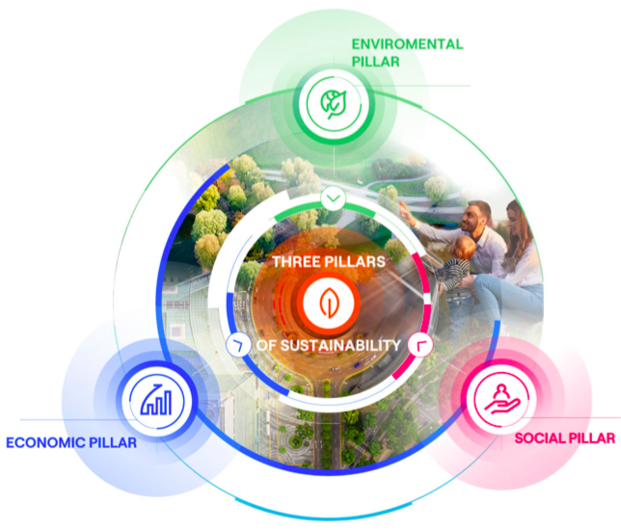
1-On the Meaning of Sustainable Development
      What is the meaning of sustainable development?
    - The three primary concerns of sustainable development are economic growth, environmental protection, and social equality.
    - From this perspective, it can be said that the concept of SD
    is built upon three key pillars: economic sustainability,
    social sustainability, and environmental sustainability.

Slide 11
1-On the Meaning of Sustainable Development
      Key Goals for Sustainable Development:
      - Eradicate poverty and hunger, ensuring a healthy life for all.
      - Ensure universal access to basic services like water, sanitation, and sustainable energy.
      - Support the creation of development opportunities through
      inclusive education and decent work.
      - Foster innovation and resilient infrastructure, building
      communities and cities capable of sustainable production and
      consumption.

Slide 12
On the Meaning of Sustainable Development
      Key Goals for Sustainable Development:
      - Reduce global inequalities, with a focus on gender equality.
      - Protect environmental integrity by combating climate change
      and safeguarding oceans and land ecosystems.
      - Promote collaboration among various social agents to foster
      peace and encourage responsible consumption and production.

Slide 13
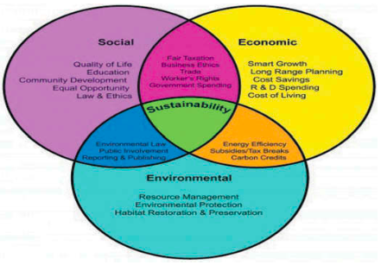
On the Meaning of Sustainable Development
      The Pillars of Sustainable Development
      The Social Sustainability:
      - Social sustainability involves concepts such as equity, empowerment, accessibility, participation, cultural identity, and institutional stability.
      - It emphasizes that development is centered around people, suggesting that the well-being of individuals and communities is crucial.
      - Essentially, social sustainability refers to a system of social
      organization that works to reduce poverty.
      - It addresses the relationship between social issues like
      poverty and environmental degradation.

Slide 14
On the Meaning of Sustainable Development
      The Pillars of Sustainable Development
      The Social Sustainability:
      - At the social level, sustainability involves promoting the development of individuals, communities, and cultures to enable a meaningful life.
      - This is achieved through access to proper healthcare, education, gender equality, and ensuring peace and stability worldwide.
      - Social sustainability focuses not on ensuring that all needs are met, but on establishing conditions that allow individuals to meet their needs if they wish.
      - Any hindrance to this capacity is considered a barrier and must be overcome for individuals, organizations, or communities to advance toward social sustainability.

Slide 15
On the Meaning of Sustainable Development
      The Pillars of Sustainable Development
      The Social Sustainability:
      Thus, to fulfill social sustainability, it is important to overcome:
      - Poverty and socio-economic inequality.
      - Discrimination, prejudice, and social exclusion.
      - Lack of access to resources.
      - Insecurity and conflict, locally, regionally and globally.
      - Poor governance, which includes phenomena such as corruption and institutional inefficiency.

Slide 16
On the Meaning of Sustainable Development
      The Pillars of Sustainable Development
      The Social Sustainability:
      The goals to be enhanced in terms of social sustainability include:
      - Promoting policies that respect fundamental human rights, such as the right to health and education.
      - Adopting practices that value and include individuals from diverse backgrounds, including gender, ethnicity, and ability.
      - Creating safer living environments with more effective justice administration.
      - Improving the health, mental, and physical well-being of individuals through access to quality healthcare services.

Slide 17
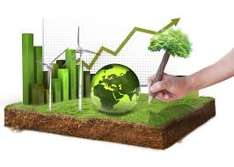
On the Meaning of Sustainable Development
      The Pillars of Sustainable Development
      The Economic sustainability:
      - Economic sustainability refers to a production system that meets current consumption needs without jeopardizing the ability to fulfill future needs.
      - It seeks to establish a balance between economic growth,
      efficient resource use, social equity, and financial stability.

Slide 18
On the Meaning of Sustainable Development
      The Pillars of Sustainable Development
      The Economic sustainability:
      Factors influencing economic sustainability include:
      - The responsible management of resources.
      - The capacity for efficiency and innovation of economic systems and enterprises.
      - Financial stability at the macro level.
      - International cooperation and partnerships between public administration and private enterprises.

Slide 19
On the Meaning of Sustainable Development
      The Pillars of Sustainable Development
      The Economic sustainability:
      Factors influencing economic sustainability include:
      - States' level of social innovation, that is, each country's commitment to promoting policies, programs and initiatives that address crucial social issues such as poverty, gender equality, access to education and health care, environmental sustainability, and other social issues.
      - The level of equity and social inclusion.
      - Corporate responsibility.

Slide 20
On the Meaning of Sustainable Development
      The Pillars of Sustainable Development
      The Economic sustainability:
      Aspects to make an economy sustainable include:
      - Promote Renewable Energy
      - Adopt Energy Efficiency Policies
      - Encourage the Circular Economy
      - Foster Social and Economic Inclusion
      - Invest in Technological Innovation
      - Promote Efficient and Transparent Governance
      - Raise Public Awareness and Education

Slide 21
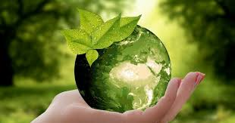
On the Meaning of Sustainable Development
      The Pillars of Sustainable Development
      Environmental sustainability
      - Environmental sustainability revolves around preserving the natural environment's capacity to stay productive and resilient in supporting human life.
      - It is closely connected to the integrity of ecosystems and the natural environment's carrying capacity.
      - However, the accelerated growth supported by technological
      advancement imposes greater pressure on the environmental
      resources and its sustainability.

Slide 22
On the Meaning of Sustainable Development
      The Pillars of Sustainable Development
      Environmental sustainability
      - The impacts of climate change, for example, strongly highlight the importance of environmental sustainability.
      - Climate change refers to significant and long-term shifts in the climate system, which may result from natural variations or human activities.
      - These shifts include atmospheric and oceanic warming, shrinking ice levels, rising sea levels, greater ocean acidification, and higher concentrations of greenhouse gases.
      - Also, Higher temperatures can influence the timing of reproduction in animal and plant species, alter migration patterns of animals, and affect species distributions and population sizes.

Slide 23
On the Meaning of Sustainable Development
      The Pillars of Sustainable Development
      Environmental sustainability
      - To achieve environmental sustainability, several key objectives must be met, including:
      - Reducing greenhouse gas emissions, particularly in critical sectors like power generation, industry, agriculture, and transportation.
      - Expanding the production and use of energy from renewable sources.
      - Implementing policies to protect biodiversity by addressing its underlying causes.
      - Adopting sustainable agricultural practices and improving the food supply chain.
      - Raising awareness and engaging communities in environmental sustainability efforts.

Slide 24

2- Sustainable Tourism
      There are various interpretations of sustainable tourism, such as:
      - “Tourism which is economically viable but does not destroy the resources on which the future of tourism will depend, notably the physical environment and the social fabric of the host community”.
      -“Tourism that takes full account of its current and future economic, social and environmental impacts, addressing the needs of visitors, the industry, the environment and host communities”.
      - “As a country, region, or town that has shown dedication
      to and success in tourism development that maximizes
      benefits to the natural environment and local
      communities and minimizes negative impact”.

Slide 25
2- Sustainable Tourism
      There are various interpretations of sustainable tourism, such as:
      Economic Viability:
      - They emphasize the importance of tourism being economically viable in the long term, ensuring that tourism can continue to provide economic benefits without causing harm to future generations.
      Environmental Protection:
      - They highlight the need for tourism to protect the natural environment, including the preservation of the physical resources and ecosystems essential to tourism's sustainability.
      Social Responsibility:
      - The social impact of tourism is a key theme. They underscore the need to consider the well-being of local communities, ensuring that tourism benefits host communities and preserves their cultural and social fabric.

Slide 26
2- Sustainable Tourism
      There are various interpretations of sustainable tourism, such as:
      Minimizing Negative Impact:
      - There is a focus on minimizing the negative effects of tourism on the environment, society, and economy. This includes preventing over-tourism and ensuring responsible tourism practices that don't degrade resources.
      Long-term Sustainability:
      - All three emphasize the idea that tourism should be developed and managed in a way that is sustainable over the long term, balancing current needs with future needs of tourists, the environment, and local communities

Slide 27
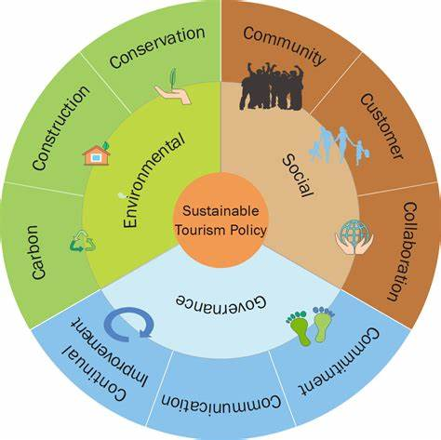
2- Sustainable Tourism
      The Pillars of Sustainable Tourism:
      Social sustainability
      - Emphasizes the protection of human rights and the provision of equal opportunities for everyone in society.
      - It advocates for a fair distribution of benefits, particularly aimed at reducing poverty.
      - The focus is on supporting local communities, preserving and enhancing
      their vital systems, honoring and respecting diverse cultures,
      and preventing any form of exploitation.

Slide 28
2- Sustainable Tourism
      The Pillars of Sustainable Tourism:
      Economic sustainability
      - Refers to creating prosperity across various levels of society while ensuring the cost-effectiveness of all economic activities.
      - It is primarily concerned with the long-term viability of businesses
      and operations, and their ability to be sustained over time.

Slide 29
2-Sustainable Tourism
      The Pillars of Sustainable Tourism:
      Environmental sustainability
      - Involves the conservation and management of resources, particularly those that are non-renewable or vital for sustaining life.
      - It calls for efforts to reduce pollution in the air, land, and water,
      as well as to protect biodiversity and preserve natural heritage.

Slide 30
2- Sustainable Tourism
      The Positive Socio-Cultural Impacts of Sustainable Tourism:
      Tourism represents a force for maintaining the peace:
      - Through travel, individuals connect with one another. Since sustainable tourism includes an educational aspect, it fosters mutual understanding between people and cultures while enabling cultural exchanges between hosts and visitors.
      - This enhances the likelihood of building empathy and mutual respect while reducing prejudices.
      Strengthening the communities:
      - Sustainable tourism can invigorate communities in various ways. For instance, events and festivals where locals serve as both participants and spectators are often revitalized and organized in response to the interest shown by tourists.

Slide 31
2- Sustainable Tourism
      The Positive Socio-Cultural Impacts of Sustainable Tourism:
      Development of facilities as a benefit for the local community:
      - In regions where the tourism industry drives the development of facilities and services that would otherwise be unattainable, it can significantly enhance local prosperity.
      - These benefits may include improved infrastructure, advancements in the healthcare system and transportation networks, the creation of new recreational and sports facilities, enhanced dining options and public spaces, as well as access to high-quality food and consumer goods.
      Revitalisation of culture and traditions:
      - Sustainable tourism holds the potential to enhance the preservation and transmission of cultural and historical traditions.
      - By supporting the sustainable conservation and management of natural resources, it can help safeguard local cultural heritage and revitalize traditional practices, including the regeneration of cultural arts and crafts

Slide 32
2- Sustainable Tourism
      The Positive Socio-Cultural Impacts of Sustainable Tourism:
      Tourism encourag es civic implication and a sense of pride:
      - Sustainable tourism can increase local awareness of the economic value of natural and cultural sites.
      - This awareness may foster a sense of pride in local and national heritage and encourage greater interest in its preservation.
      - As a result, involving local communities in developing and managing sustainable tourism becomes a crucial factor in promoting the sustainable use and conservation of biodiversity.
      Benefits of sustainable tourism for tourists:
      - Tourists benefit greatly from sustainable tourism, as it allows them to experience the unspoiled beauty of natural environments and landscapes, enjoy clean air and water, and visit healthy communities with low crime rates.
      - They also get to immerse themselves in the authenticity of thriving local traditions and cultures.

Slide 33
2- Sustainable Tourism
      The Positive Economic Impacts of Sustainable Tourism:
      Income realised from the exchange of foreign currency:
      - The spending of tourists, along with the import and export of goods and services, contributes to the income of the host economy.
      Contributions to the governmental income:
      - The income generated by the government from the tourism sector can be categorized into direct and indirect income.
      - Direct income comes from taxes on the income of tourism employees, commercial activities linked to tourism, and fees charged directly to tourists, such as ecological fees or output taxes.
      - Indirect contributions arise from taxes and fees levied on goods and services provided to tourists, such as taxes on souvenirs, alcohol, and restaurant services.

Slide 34
2- Sustainable Tourism
      The Positive Economic Impacts of Sustainable Tourism:
      Generation of work places:
      - The rapid growth of tourism has resulted in the creation of a significant number of jobs.
      - Tourism can directly generate employment through hotels, restaurants, taxis, souvenir sales, and indirectly by supporting the provision of goods and services required for commercial activities within the sector.
      Stimulation of investments in infrastructure:
      - Tourism can encourage local authorities to enhance infrastructure by developing better systems for water supply and sewage, roads, electricity, telecommunication, and public transportation networks.
      - These improvements not only raise the quality of life for local residents but also make it easier to support and promote tourism.

Slide 35
2- Sustainable Tourism
      The Positive Economic Impacts of Sustainable Tourism:
      Generation of work places:
      - The rapid growth of tourism has resulted in the creation of a significant number of jobs.
      - Tourism can directly generate employment through hotels, restaurants, taxis, souvenir sales, and indirectly by supporting the provision of goods and services required for commercial activities within the sector.
      Stimulation of investments in infrastructure
      - Tourism can encourage local authorities to enhance infrastructure by developing better systems for water supply and sewage, roads, electricity, telecommunication, and public transportation networks.
      - These improvements not only raise the quality of life for local residents but also make it easier to support and promote tourism.

Slide 36
2- Sustainable Tourism
      The Positive Environemntal Impacts of Sustainable Tourism:
      Biodiversity Preservation through Protected Areas
      - Tourism has played a key role in the establishment of national parks, marine reserves, and protected areas, many of which are now regarded as some of the world's most valuable natural assets.
      - The desire to experience pristine nature motivates people to travel great distances, prompting governments and communities to designate land or marine areas for conservation to safeguard these sites for future generations.
      Wildlife Rehabilitation and Rescue Programs
      - Countries recognize that their unique species serve as symbols of international visitors, who are often drawn to these destinations because of them.
      - Wild animals, untouched forests, and vibrant arrays of exotic plants are becoming increasingly rare sights in a world that is economically advanced.

Slide 37


2- Sustainable Tourism
      Non-Sustainable Tourism:
      Protests in Spain in Barcelo, Mallorca, Canaries against over - tourism:
      - Negative economic impacts (prices and rents).
      - Extensive pressure on infrastructure and environment.
      - Cultural Impact

Slide 38
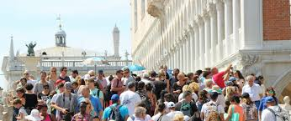
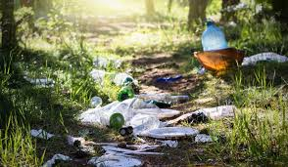
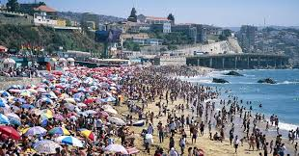
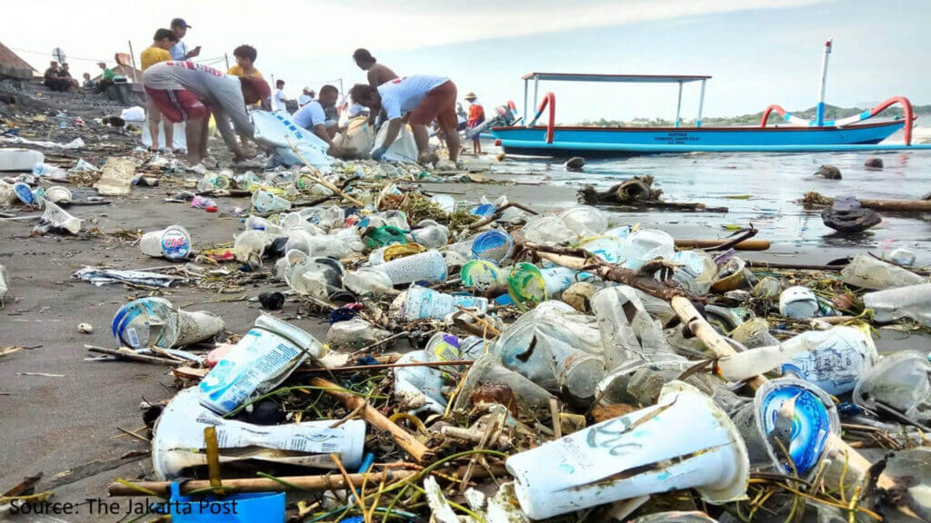

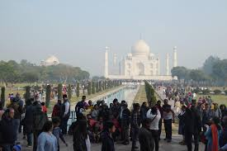
      Non-Sustainable Tourism:

Slide 39
      Activity
      - Explain, from your perspective, the main challenges of sustainable tourism—specifically the significant barriers that hinder its effective implementation.
      - Additionally, discuss how these barriers can be successfully addressed and managed to promote the development of sustainable tourism

Slide 40
Thank you
      European Institute of Innovation, Entrepreneurship and Technology
      Lessingstraße 79,
      13158 Berlin, Germany
      Phone: +49 176 55524449
      Email: info@eiiet.com
Discover the world of eiIET

