Slide 1
Operations Management in Hospitality
European Institute of Innovation, Entrepreneurship and Technology
Lessingstraße 79, 13158 Berlin, Germany
Mahmoud Abdou| Berlin
      Lessingstraße 79,
      13158 Berlin, Germany
      Phone: +49 30 233618555
      Fax: +49 30 233618556
      Email: info@eiiet.com

Slide 2

Outline:
1- Pricing Hotel Revenue Management Tools
2- Non-Pricing Hotel Revenue Management Tools

Slide 3
1- PRICING HOTEL REVENUE MANAGEMENT TOOLS

Slide 4
1- Pricing Hotel Revenue Management Tools
Pricing Revenue Management Tools
Price discrimination
Dynamic pricing
Lowest price guarantee
Price presentation
Price parity
- Pricing and price strategy are seen as a basis for creating sustainable competitive advantage.
- Pricing revenue management tools include:
Price discrimination
Dynamic pricing
Lowest price guarantee
Price presentation
Price parity

Slide 5
1- Pricing Hotel Revenue Management Tools
Pricing Revenue Management Tools
Price discrimination
Dynamic pricing
Lowest price guarantee
Price presentation
Price parity
A- Price Discrimination:
- Means different prices for the same room
- Segments have different price sensitivities
- Business travelers pay more than leisure travelers

Slide 6
1- Pricing Hotel Revenue Management Tools
Pricing Revenue Management Tools
Price discrimination
Dynamic pricing
Lowest price guarantee
Price presentation
Price parity
B- Dynamic Pricing:
- Adjust room rates in real time based on demand, occupancy, and market conditions
- It aims to maximize RevPAR and overall yield.
- How It Works:
Monitor demand and occupancy
Adjust rates
React to market changes

Slide 7
1- Pricing Hotel Revenue Management Tools
Pricing Revenue Management Tools
Price discrimination
Dynamic pricing
Lowest price guarantee
Price presentation
Price parity
C- Lowest Price Guarantee
- It is a commitment by a hotel to offer customers the lowest available rate.
- Purpose of Lowest Price Guarantee:
Builds customer trust
Encourages direct bookings
Protects brand value

Slide 8
1- Pricing Hotel Revenue Management Tools
Pricing Revenue Management Tools
Price discrimination
Dynamic pricing
Lowest price guarantee
Price presentation
Price parity
D- Price Presentation:
- The way a price is communicated to customers.
Forms:
Direct low price
Discounted price

Slide 9
1- Pricing Hotel Revenue Management Tools
Pricing Revenue Management Tools
Price discrimination
Dynamic pricing
Lowest price guarantee
Price presentation
Price parity
E- Price Parity:
- Price parity means maintaining the same room rate across all distribution channels
Purpose of Price Parity
Prevents channel conflict
Protects brand integrity
Maintains competitiveness

Slide 10

2- NON-PRICING HOTEL REVENUE MANAGEMENT TOOLS

Slide 11
2- Non-Pricing Hotel Revenue Management Tools
A- Capacity Management
- What is Capacity Management?
- Capacity management refers to activities related to controlling a hotel’s capacity
- Aim: match service capacity with demand.
- Objective: efficiency, service quality, and guest satisfaction.
Pricing Revenue Management Tools
Capacity Management
Overcontracting and Overbookings
Room Availability Guarantee
Length- of-Stay Control
100% Satisfaction Guarantee

Slide 12
2- Non-Pricing Hotel Revenue Management Tools
A- Capacity Management
- What is Capacity Management?
- Capacity management refers to activities related to controlling a hotel’s capacity
- Aim: match service capacity with demand.
- Objective: efficiency, service quality, and guest satisfaction.
Pricing Revenue Management Tools
Capacity Management
Overcontracting and Overbookings
Room Availability Guarantee
Length- of-Stay Control
100% Satisfaction Guarantee

Slide 13
2- Non-Pricing Hotel Revenue Management Tools
A- Capacity Management
- Concerned with how much capacity a hotel has
- How capacity is used
- How capacity is adjusted over time
It can be divided into:
- Strategic (long-term) decisions
- Tactical (short-term) decisions
Pricing Revenue Management Tools
Capacity Management
Overcontracting and Overbookings
Room Availability Guarantee
Length- of-Stay Control
100% Satisfaction Guarantee

Slide 14
2- Non-Pricing Hotel Revenue Management Tools
A- Capacity Management
- Strategic (long-term) decisions can include:
Capacity expansion
Carrying capacity
Capacity flexibility
Pricing Revenue Management Tools
Capacity Management
Overcontracting and Overbookings
Room Availability Guarantee
Length- of-Stay Control
100% Satisfaction Guarantee

Slide 15
2- Non-Pricing Hotel Revenue Management Tools
A- Capacity Management
- Tactical decisions
Refer to the set of activities related to managing capacity on a daily basis, including:
Work schedules
Guest arrival/departure times
Service interaction time
Customers’ participation in the service process
Pricing Revenue Management Tools
Capacity Management
Overcontracting and Overbookings
Room Availability Guarantee
Length- of-Stay Control
100% Satisfaction Guarantee

Slide 16
2- Non-Pricing Hotel Revenue Management Tools
Hotel Capacity
- Refers specifically to the Rooms Division capacity
- The total number of overnights a hotel can serve on a given date
Fluctuations in capacity:
- Not all rooms may be available every day due to:
Facility repairs or maintenance
Room damage
Employee accommodation needs
Pricing Revenue Management Tools
Capacity Management
Overcontracting and Overbookings
Room Availability Guarantee
Length- of-Stay Control
100% Satisfaction Guarantee

Slide 17
2- Non-Pricing Hotel Revenue Management Tools
B- Overcontracting and Overbooking
Overcontracting
- It refers to signing contracts with distributors for more rooms than the hotel’s physical capacity.
- Distributors rarely use their full room allotments.
Purpose:
-Maximize sales opportunities
- Reduce the risk of unsold inventory
- Ensure higher occupancy despite allotment underutilization.
Pricing Revenue Management Tools
Capacity Management
Overcontracting and Overbookings
Room Availability Guarantee
Length- of-Stay Control
100% Satisfaction Guarantee

Slide 18
2- Non-Pricing Hotel Revenue Management Tools
Overbooking
- It means accepting more bookings than the hotel’s available room capacity.
- Not all customers who book will actually stay.
Reasons for Overbooking:
- Some guests will not show up (no-shows).
- Others may cancel or amend reservations last minute.
- Some may leave earlier than planned.
Pricing Revenue Management Tools
Capacity Management
Overcontracting and Overbookings
Room Availability Guarantee
Length- of-Stay Control
100% Satisfaction Guarantee

Slide 19
2- Non-Pricing Hotel Revenue Management Tools
Overbooking
Purpose:
- Minimize lost revenue from unsold rooms.
- Maintain high occupancy despite cancellations or no-shows.
Pricing Revenue Management Tools
Capacity Management
Overcontracting and Overbookings
Room Availability Guarantee
Length- of-Stay Control
100% Satisfaction Guarantee

Slide 20
2- Non-Pricing Hotel Revenue Management Tools
The Effects of Overbooking:
1- Direct Financial Costs of Overbooking
These are immediate and measurable expenses, including:
Paying for accommodation in an alternative hotel
Transportation costs to the new hotel
Financial compensation
Pricing Revenue Management Tools
Capacity Management
Overcontracting and Overbookings
Room Availability Guarantee
Length- of-Stay Control
100% Satisfaction Guarantee

Slide 21
2- Non-Pricing Hotel Revenue Management Tools
The Effects of Overbooking:
2- Brand Image and Customer Goodwill Costs
Guest dissatisfaction and frustration
Negative online reviews and word-of-mouth
Loss of customer loyalty and repeat business
Damage to the hotel’s brand reputation
Pricing Revenue Management Tools
Capacity Management
Overcontracting and Overbookings
Room Availability Guarantee
Length- of-Stay Control
100% Satisfaction Guarantee

Slide 22
2- Non-Pricing Hotel Revenue Management Tools
Overbooking
- Who to be walked?
First come-first served
Length of Stay
Guest Loyalty
Room Rate Paid
- Where to walk guests?
- What compensation to provide?
Pricing Revenue Management Tools
Capacity Management
Overcontracting and Overbookings
Room Availability Guarantee
Length- of-Stay Control
100% Satisfaction Guarantee

Slide 23
2- Non-Pricing Hotel Revenue Management Tools
C- Room Availability Guarantee
- It is seen as a promise by hotels to selected guests that a room will always be available, regardless of occupancy.
Target Guests:
- Typically loyalty program members or other high-value customers.
Pricing Revenue Management Tools
Capacity Management
Overcontracting and Overbookings
Room Availability Guarantee
Length- of-Stay Control
100% Satisfaction Guarantee

Slide 24
2- Non-Pricing Hotel Revenue Management Tools
C- Room Availability Guarantee
Conditions:
- Booking must be made a minimum number of days before check-in.
Purpose:
- Reduces perceived risk of overbooking.
Benefit:
- Strengthens customer trust and loyalty.
Pricing Revenue Management Tools
Capacity Management
Overcontracting and Overbookings
Room Availability Guarantee
Length- of-Stay Control
100% Satisfaction Guarantee

Slide 25
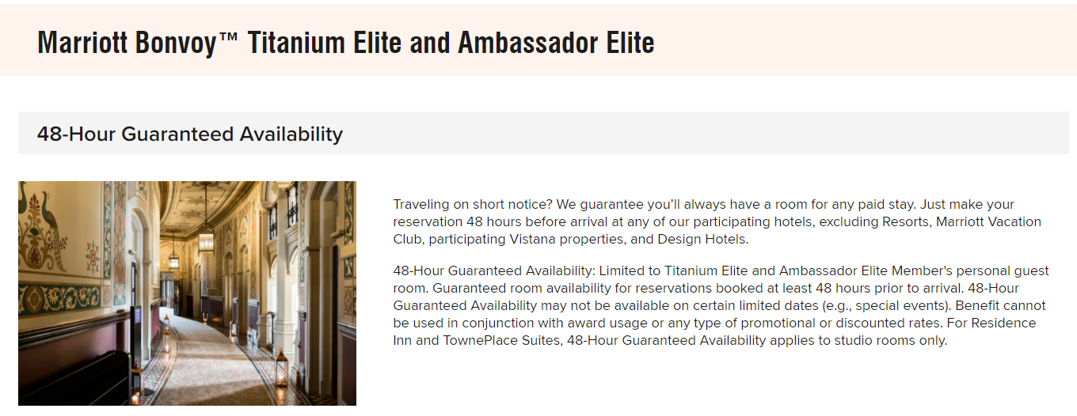
2- Non-Pricing Hotel Revenue Management Tools
C- Room Availability Guarantee

Slide 26
2- Non-Pricing Hotel Revenue Management Tools
D- Length-of-Stay (LOS) Control
Definition:
- A revenue management technique where hotels set minimum or maximum stay requirements on bookings.
Objective:
- Optimize room revenue by aligning guest stays with demand patterns
Pricing Revenue Management Tools
Capacity Management
Overcontracting and Overbookings
Room Availability Guarantee
Length- of-Stay Control
100% Satisfaction Guarantee

Slide 27
2- Non-Pricing Hotel Revenue Management Tools
D- Length-of-Stay (LOS) Control
Why It Matters
- Prevents revenue loss during peak demand periods.
- Shifts some bookings into low-demand days.
- Balances occupancy and revenue.
Pricing Revenue Management Tools
Capacity Management
Overcontracting and Overbookings
Room Availability Guarantee
Length- of-Stay Control
100% Satisfaction Guarantee

Slide 28
2- Non-Pricing Hotel Revenue Management Tools
E- 100% Satisfaction Guarantee
- A service guarantee where guests do not pay if they are not fully satisfied with their stay.
Advantages:
- Builds trust
- Competitive advantage
- Encourages trial
Pricing Revenue Management Tools
Capacity Management
Overcontracting and Overbookings
Room Availability Guarantee
Length- of-Stay Control
100% Satisfaction Guarantee

Slide 29
Thank you
      European Institute of Innovation, Entrepreneurship and Technology
      Lessingstraße 79,
      13158 Berlin, Germany
      Phone: +49 176 55524449
      Email: info@eiiet.com
Discover the world of eiIET

