Slide 1
Consumer Behaviour : Understanding Consumer Mindset
European Institute of Innovation, Entrepreneurship and Technology
Lessingstraße 79, 13158 Berlin, Germany
Presenter Vaibhav Sai Sri| Berlin
      Lessingstraße 79,
      13158 Berlin, Germany
      Phone: +49 30 233618555
      Fax: +49 30 233618556
      Email: info@eiiet.com

Slide 2
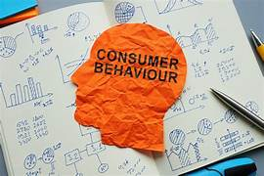
Index
1. Understanding Consumer Connections
2. Culture & Subculture
3. Social Class & Reference Groups
4. Personality & Buying Behaviour
5. Values & Ethical Consumption
6. In-Class Activity — “Decode the Consumer”
7. Task — “Spot the Bias”
8. Case Study 1 — Starbucks
9. Case Study 2 — Coca-Cola
10. Case Study 3 — Dove
11. Neuromarketing
12. Psychology of Impulse Buying
13. Conclusion

Slide 3
Understanding Consumer Connections (Recap)
Last class: motivation, perception, emotions, learning, and
digital behaviour.
We covered Maslow, conditioning, involvement, and the consumer
learning curve.
Examples: Maggi’s emotional bond; Starbucks’ cultural moves
in China; Spotify’s trial-to-loyalty path.

Slide 4
Culture & Subculture
Culture: shared values and norms that shape wants.
Subculture: niche groups with distinct behaviours (e.g., gamers, vegans).
Global brands succeed when they respect local habits.
Example: Menu adaptations (local flavours and customs).

Slide 5
Social Class & Reference Groups
Social class influences preferences, consumption style and risk appetite.
Reference groups (family, peers, influencers) shape norms and desirability.
Brand communities create belonging and loyalty.
Marketers tailor messaging for each class and segment.

Slide 6
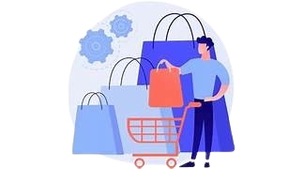
Personality & Buying Behaviour
Personality affects brand fit and consistency.
Extroverts prefer expressive, social brands.
Introverts prefer calm, functional brands.
Firms craft personas that align with these traits.

Slide 7
Values & Ethical Consumption
Consumers prioritise transparency, sustainability, and fairness.
Ethics can outweigh price in brand choice.
Examples: Patagonia (mindful consumption), The Body Shop (cruelty-free).
Authentic purpose builds emotional loyalty.

Slide 8

In-Class Activity — “Decode the Consumer”
Form groups of 3–4.
Select one brand you know well.
Identify: consumer profile, core motivation, cultural/value influences.
Each group presents for 2 minutes.

Slide 9

Task — “Spot the Bias”
Work individually or in pairs using only pen and paper.
Write down one advertisement or product you recently noticed.
Describe in 3 short points:
1. The emotional message it conveys.
2. Any cultural or stereotype element seen.
3. Whether it feels fair or misleading (one reason).

Slide 10
Case Study 1 – Starbucks Cultural Adaptation
Story:
Starbucks adapted to India by offering chai lattes, vegetarian snacks, and cozy
community spaces.
Respecting local culture helped build trust and emotional belonging.
Key Learning:
Global brands must localize to connect authentically.

Slide 11
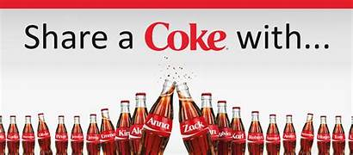
Case Study 2 – Coca-Cola’s Emotional Rebranding
Story:
“Share a Coke” campaign used personal names — made consumers feel seen.
Emotional personalization revived global sales.
Key Learning:
Emotion + identity = powerful marketing bond.

Slide 12

Case Study 3 – Dove’s Real Beauty Revolution
Story:
Dove challenged unrealistic beauty standards.
Real women, real stories → emotional authenticity.
Key Learning:
Social responsibility builds deeper and lasting consumer trust.

Slide 13
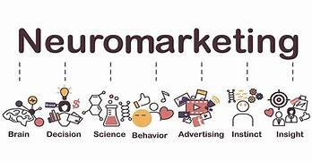
Neuromarketing (Emerging Concept)
- Studies subconscious responses (eye-tracking, biometrics, fMRI).
- Reveals emotional impact beyond self-reporting.
-Ethical consideration: influencing subconscious raises moral questions.

Slide 14
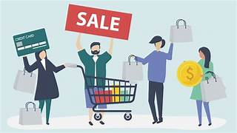

Psychology of Impulse Buying
Triggers: urgency cues, simple checkout, limited stock offers.
Examples: flash sales, one-click purchases, limited stock messages.
Marketers reduce friction and increase perceived urgency to boost spontaneous
purchases.

Slide 15
Conclusion
Consumer behaviour = culture + personality + emotion + context.
Authenticity and ethics define strong brand equity.
Effective marketing understands human feelings first.
Final thought: understand people before promoting products.

