Slide 1
Quality and Sustainability in Tourism and Hospitality
European Institute of Innovation, Entrepreneurship and Technology
Lessingstraße 79, 13158 Berlin, Germany
Mahmoud Abdou| Berlin
      Lessingstraße 79,
      13158 Berlin, Germany
      Phone: +49 30 233618555
      Fax: +49 30 233618556
      Email: info@eiiet.com

Slide 2
Index
What is Sustainability?
Pillars of Sustainable Tourism
The Positive aspects of Sustainable Tourism
Unsustainable Tourism
What is Quality and Service Quality?

Slide 3
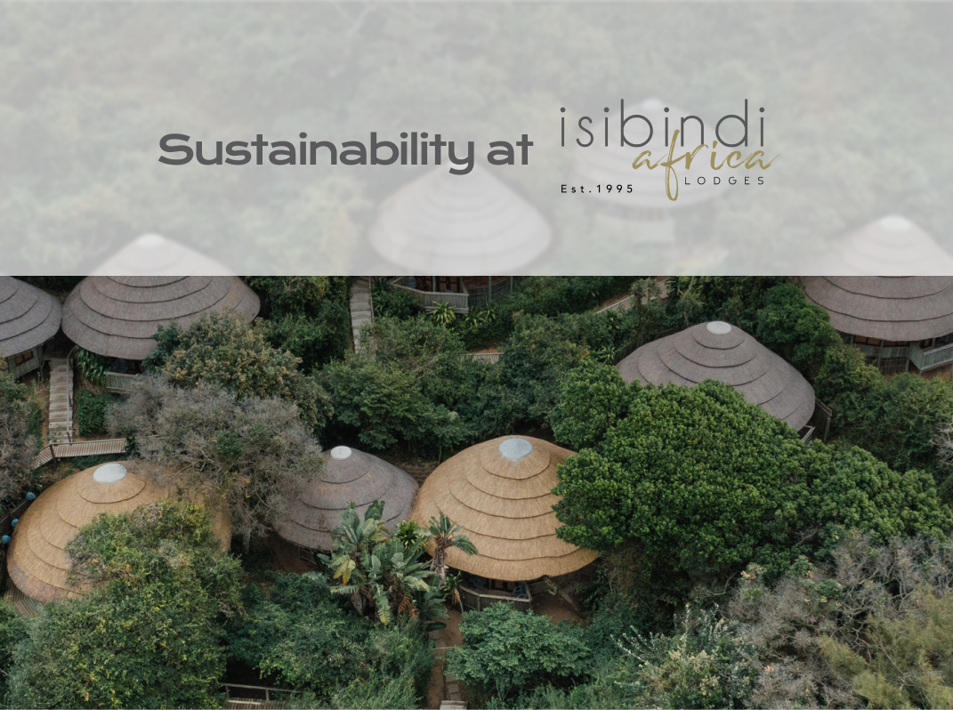
    1- What is Sustainability?

Slide 4
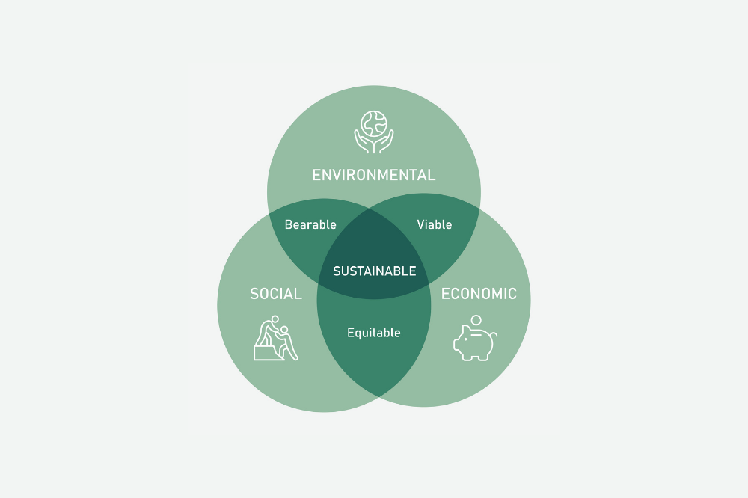
1- What is Sustainability?
      - Sustainability refers to the capability of maintaining or continuing an entity, outcome, or process over time.
      - It emphasizes human activities and their capacity to meet needs and desires without depleting or exhausting available productive resources.
      - Sustainable Development has 3 dimensions:
      Social Sustainability
      Economic Sustainability
      Environmental Sustainability

Slide 5
1- What is Sustainability?
    Social Sustainability:
    - Poverty and socio-economic inequality
    - Discrimination, prejudice, and social exclusion
    - Lack of access to resources
    - Insecurity and conflict
    - Poor governance

Slide 6
1- What is Sustainability?
    Economic Sustainability:
    - Promote Renewable Energy
    - Adopt Energy Efficiency Policies
    - Encourage the Circular Economy
    - Foster Social and Economic Inclusion
    - Invest in Technological Innovation

Slide 7
1- What is Sustainability?
    Environmental Sustainability:
    - Reducing greenhouse gas emissions
    - Expanding the production and use of energy from renewable sources.
    - Implementing policies to protect biodiversity
    - Adopting sustainable agricultural practices

Slide 8
    2- Pillars of Sustainable Tourism

Slide 9
2- Pillars of Sustainable Tourism
    Social Sustainability
    - Protects human rights and ensures equal opportunities
    - Promotes fair distribution of benefits, helping to reduce poverty
    - Supports local communities and preserves vital systems
    - Honors diverse cultures and prevents exploitation

Slide 10
2- Pillars of Sustainable Tourism
    Economic Sustainability
    - Ensures long-term economic viability
    - Creates jobs and supports local businesses
    - Generates benefits for the local economy
    - Avoids negative economic impacts on the community

Slide 11
2- Pillars of Sustainable Tourism
    Environmental Sustainability
    - Focuses on conservation and management of resources, especially non-renewable
    - Reduces pollution in air, land, and water
    - Protects biodiversity and preserves natural heritage

Slide 12

    3- The Positive aspects of Sustainable Tourism

Slide 13

3.1- The Positive Socio-Cultural Impacts of Sustainable Tourism
    Revitalisation of Culture and Traditions
    - Supports preservation and transmission of cultural and historical traditions
    - Encourages sustainable conservation of natural resources
    - Helps revitalize traditional practices, including arts and crafts
    Encourages Civic Engagement and Pride
    - Fosters pride in local and national heritage
    - Encourages active interest in preservation
    - Raises local awareness of the economic value of natural
    and cultural sites

Slide 14
3.1- The Positive Socio-Cultural Impacts of Sustainable Tourism
    Enhances Visitor Experience
    - Provides high-quality, well-managed recreational spaces
    - Reduces overcrowding and improves safety and accessibility
    Addresses Community Needs and Values
    - Involves local stakeholders in planning processes
    - Aligns tourism development with community goals and identity

Slide 15
3.2- The Positive Economic Impacts of Sustainable Tourism
    Fosters Economic Development
    - Attracts tourists and boosts local economies
    - Encourages investment in tourism infrastructure and services
    Supports Strategic Decision-Making
    - Provides data and guidelines for informed planning
    - Ensures balanced growth between conservation and development

Slide 16
3.2- The Positive Economic Impacts of Sustainable Tourism
    Generation of Workplaces
    - Tourism growth creates numerous jobs
    - Direct employment: hotels, restaurants, taxis, souvenir sales
    - Indirect employment: supports goods and services for the tourism sector
    Stimulation of Infrastructure Investments
    - Enhances quality of life for residents
    - Supports tourism development and promotion

Slide 17

3.3- The Positive Environmental Impacts of Sustainable Tourism
    Promotes Sustainable Use of Resources
    - Prevents overuse and degradation of natural and cultural assets
    - Ensures long-term viability of recreation and tourism areas
    Supports Environmental Conservation
    - Integrates ecological considerations into planning
    - Minimizes negative impacts on biodiversity and ecosystems

Slide 18
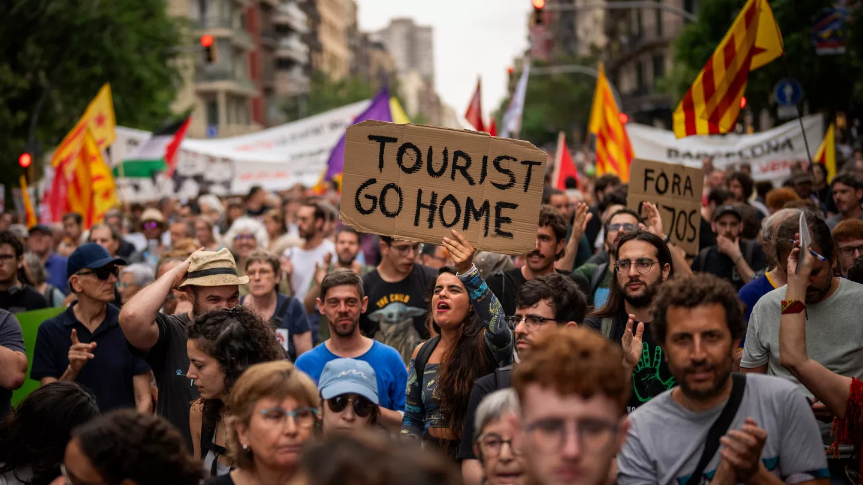
4- Unsustainable Tourism

Slide 19

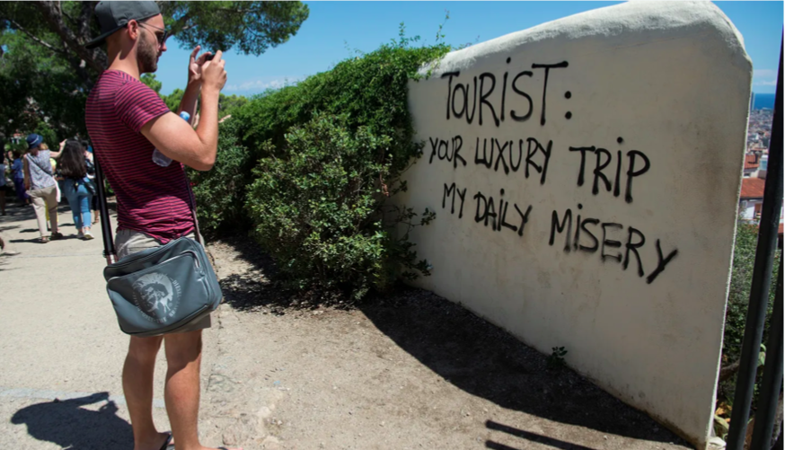
2- Sustainable Tourism
      Non-Sustainable Tourism:
      Protests in Spain in Barcelo, Mallorca, Canaries against over - tourism:
      - Negative economic impacts (prices and rents).
      - Extensive pressure on infrastructure and environment.
      - Cultural Impact

Slide 20
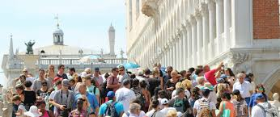
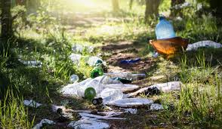
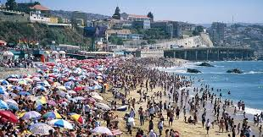
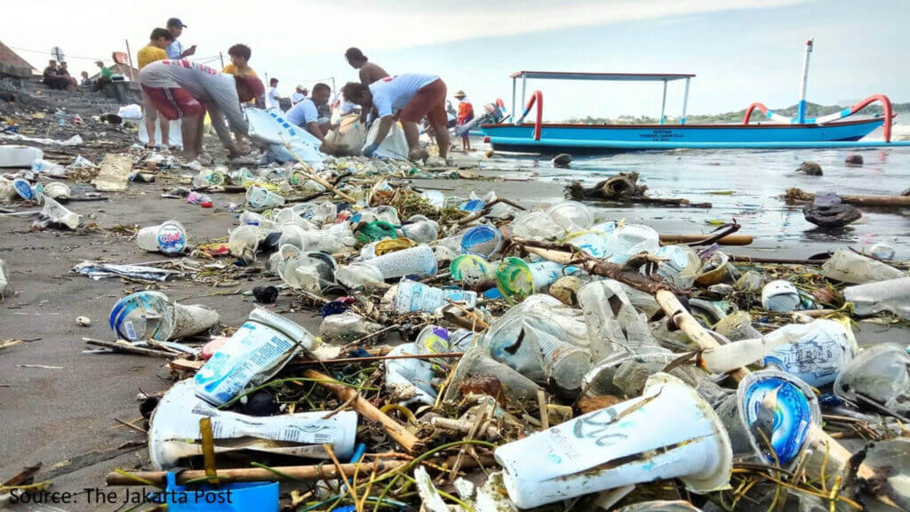
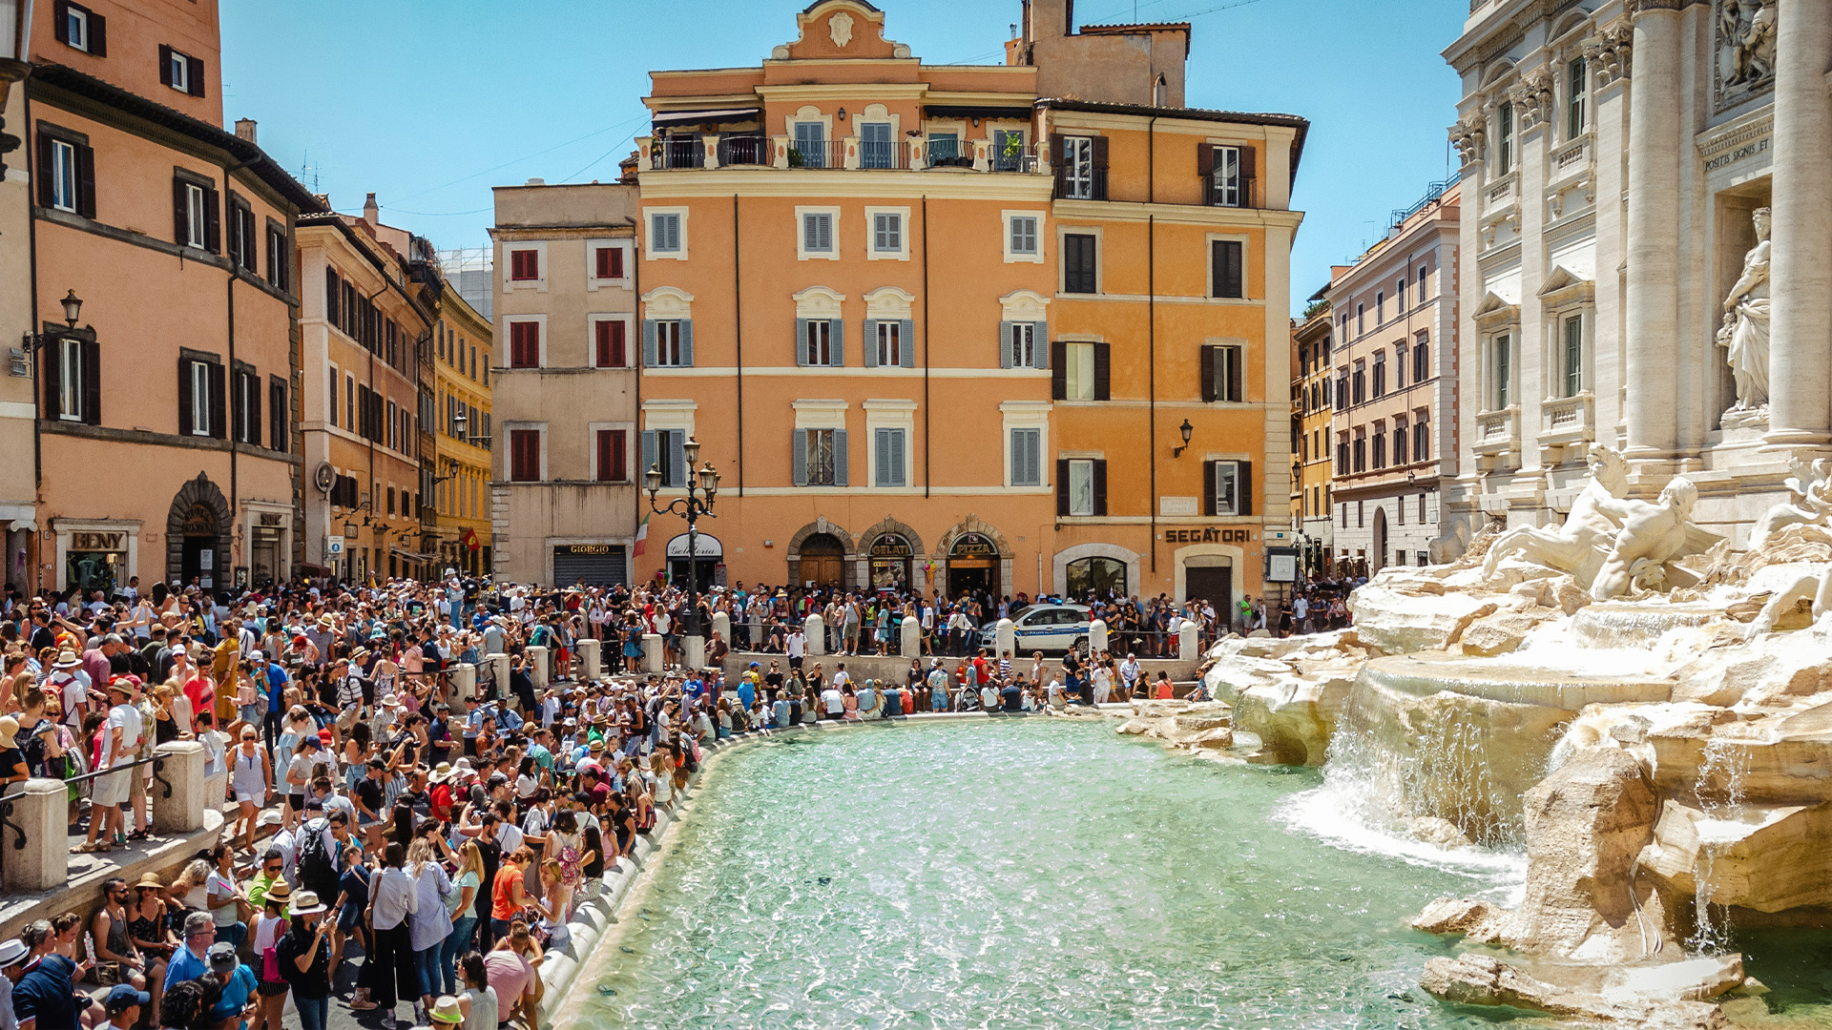
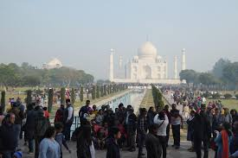
      Non-Sustainable Tourism:

Slide 21
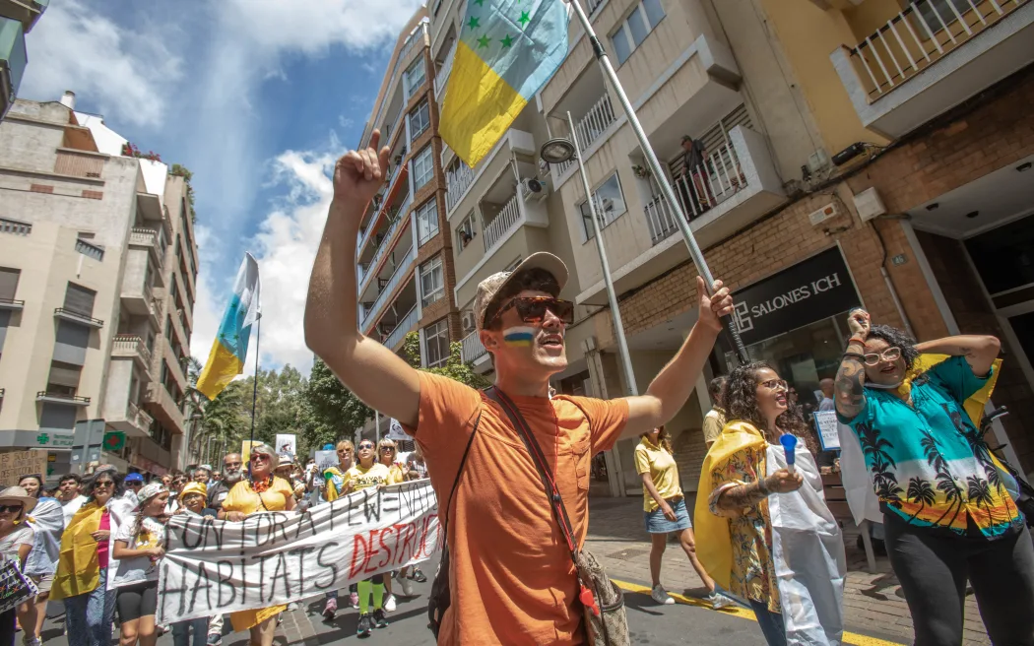
3- Socio-Cultural Conflicts and Tourism
      The Case of Canary Islands :
      The inappropriate tourist beavious:
      - The local community started
      demonstrations against the
      irresponsible tourist activities such
      as over drinking and violence

Slide 22
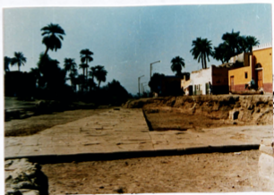
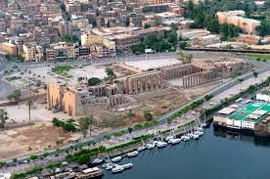
3- Socio-Cultural Conflicts and Tourism
      Grievances arise when local populations are displaced due to
      tourism-related development and forced to abandon traditional
      livelihoods like farming and fishing
      The case study of Luxor, Egypt:
      - The city witnessed different development plans since 1990.
      The development plans sought to improve the city's infrastructure
      by expanding roads and demolishing certain residential buildings,
      restaurants, cafes, bazaars, and etc.

Slide 23
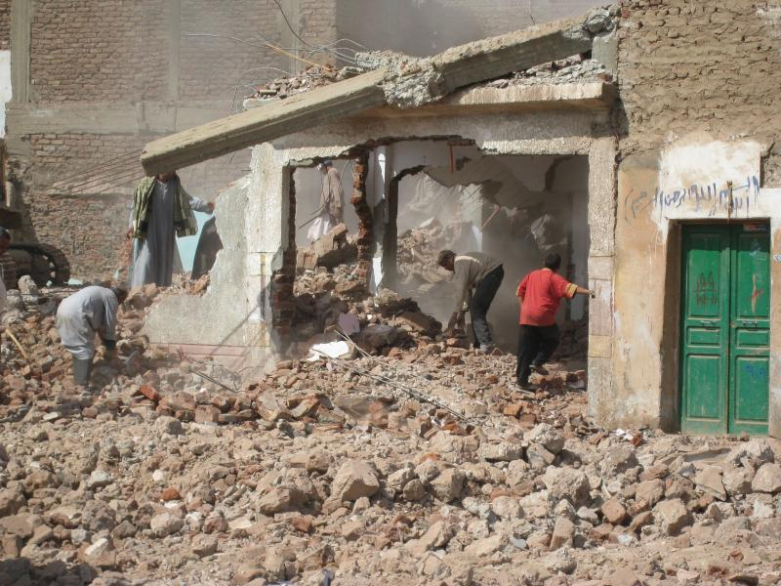
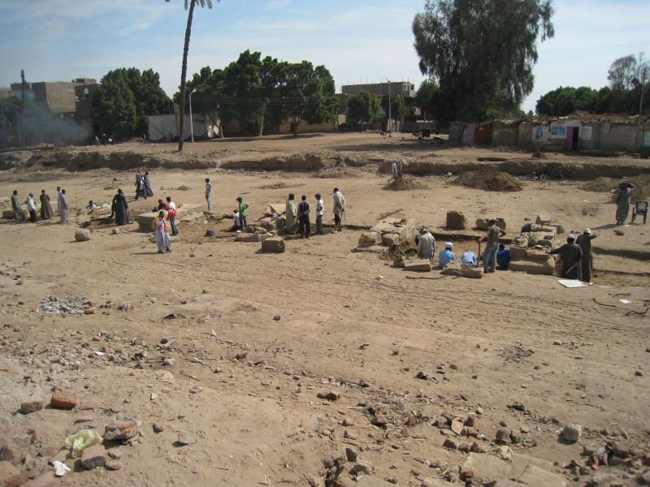
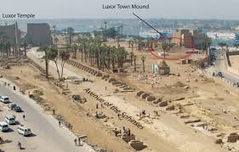
3- Socio-Cultural Conflicts and Tourism

Slide 24
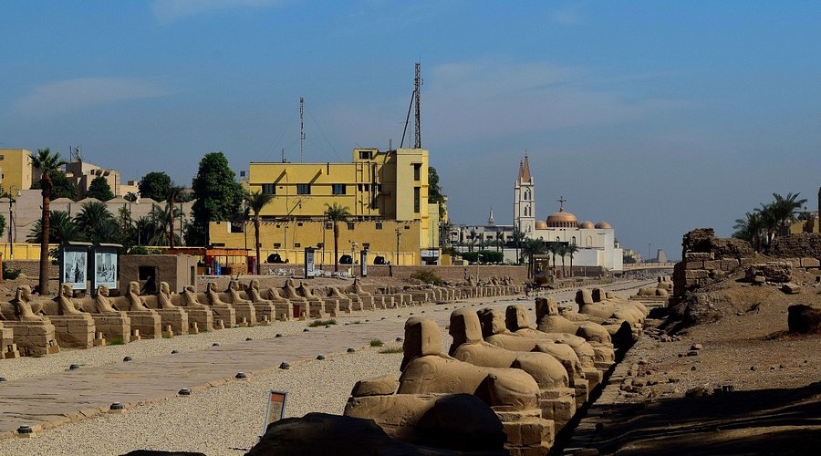
3- Socio-Cultural Conflicts and Tourism

Slide 25
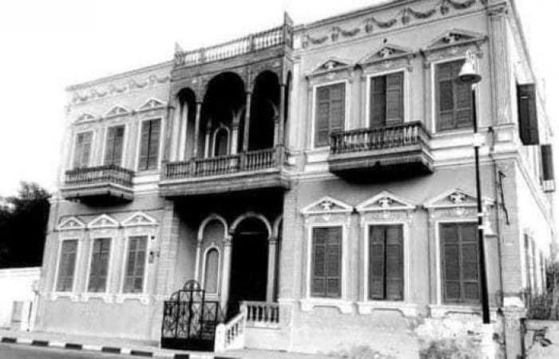
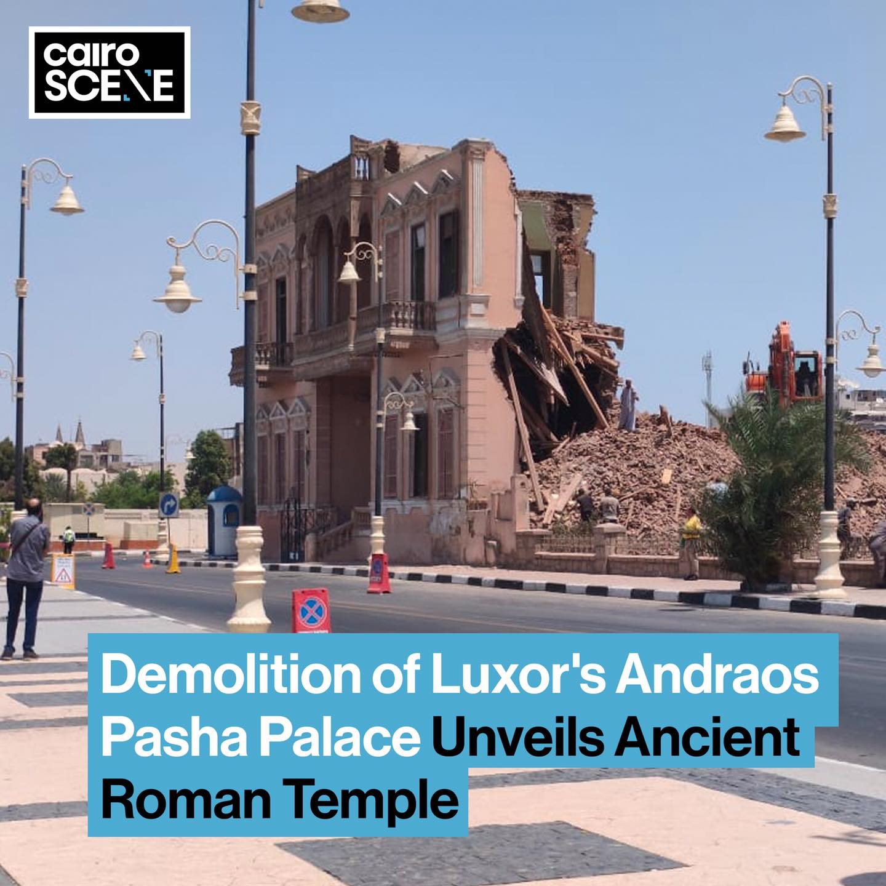
3- Socio-Cultural Conflicts and Tourism
- The destruction of a 120-years old Andraos Palace in Luxor.

Slide 26

5- What is Quality and Service Quality?
- The destruction of a 120-years old Andraos Palace in Luxor.

Slide 27
4- What is Quality and Service Quality?
4.1- What is quality:
- Quality is a key factor in achieving customer satisfaction and can be understood in two main ways:
      A- Technical Quality
      - Refers to the outcome of the service experience
      - It is about what the customer actually receives at the end.
      It’s more tangible and can often be measured or inspected.
      Examples:
      - Room in a hotel
      - Meal in a restaurant
      - Car from a rental agency

Slide 28
4- What is Quality and Service Quality?
      B- Functional Quality
      - This is the process of service delivery
      - It is about how the customer experiences the interactions.
      - It is about the manner and style in which the service is provided.
      Examples:
      - How the front desk staff welcomes you at check-in
      - The attentiveness of waiters at a restaurant.
      - How the car rental agent explains the terms and offers help

Slide 29
4- What is Quality and Service Quality?
      4.2- Definition of Service Quality
      - Understood as customers’ perceptions of the service component of an offering
      - More complex than in manufacturing, where products can be standardized
      - In tourism, customers expect tailor-made experiences matching their needs and desires
      Tourists’ Perceptions of Service Quality depend on:
      - Individual attitudes and expectations
      - Previous experiences
      - Benefits sought from the holiday

Slide 30
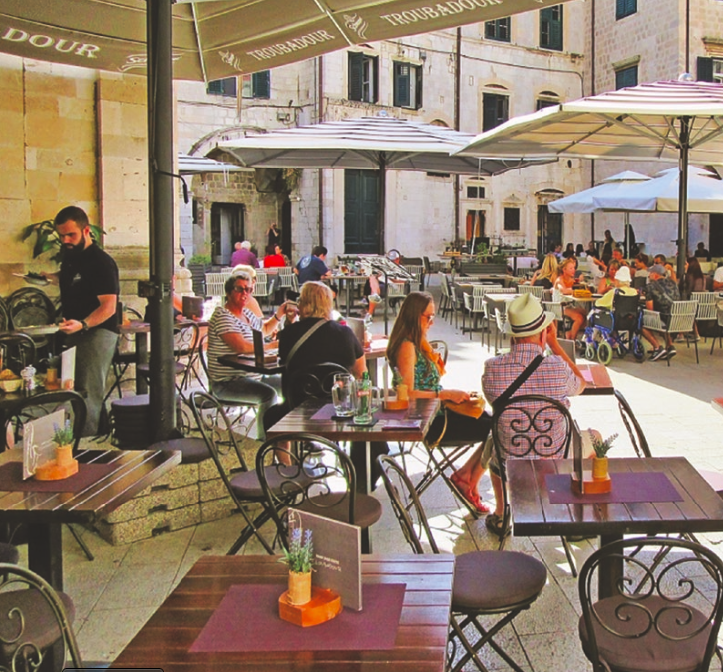
4- What is Quality and Service Quality?
4.3- Benefits of High-Quality Tourism Services
A- Increased Customer Loyalty
- Builds a loyal customer base
- Loyal visitors are more likely to return and recommend
- Generates repeat business and positive word-of-mouth
George, 2021.

Slide 31
4- What is Quality and Service Quality?
B- Avoidance of Price Competition
- Quality services reduce reliance on discounts or special offers
- Relies instead on repeat visitors and recommendations
C- Reducing Complaints
- Fewer complaints save time, money, and reputation
- Reduces need for compensations/freebies in hotels, restaurants, airlines, and attractions

Slide 32

4- What is Quality and Service Quality?
      4.4- Consequences of Poor Service Quality
      A- Dissatisfied Customers
      - Poor quality leads to negative experiences
      B- Customer Complaints
      - Dissatisfied customers are more likely to lodge complaints
      C- Adverse Word-of-Mouth (WOM)
      - Negative experiences are shared with others
      - Damages reputation and deters potential customers

Slide 33
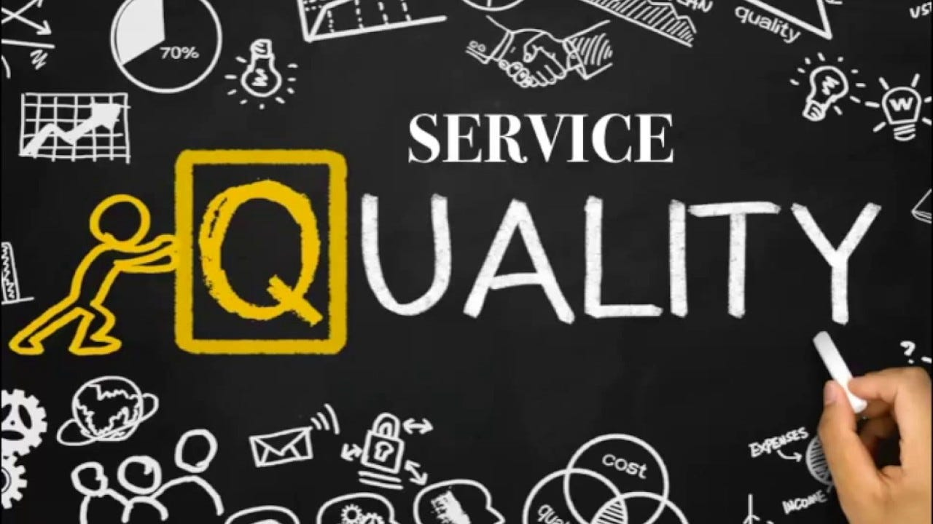
4- What is Quality and Service Quality?
      4.5- The Gaps Model of Service Quality
      - Identifies areas for improvement in tourism services
      - Compares customer expectations vs. perceptions
      - Provides a structured approach to evaluate satisfaction
      - Highlights where service delivery falls short
      - Supports better alignment with customer needs

Slide 34
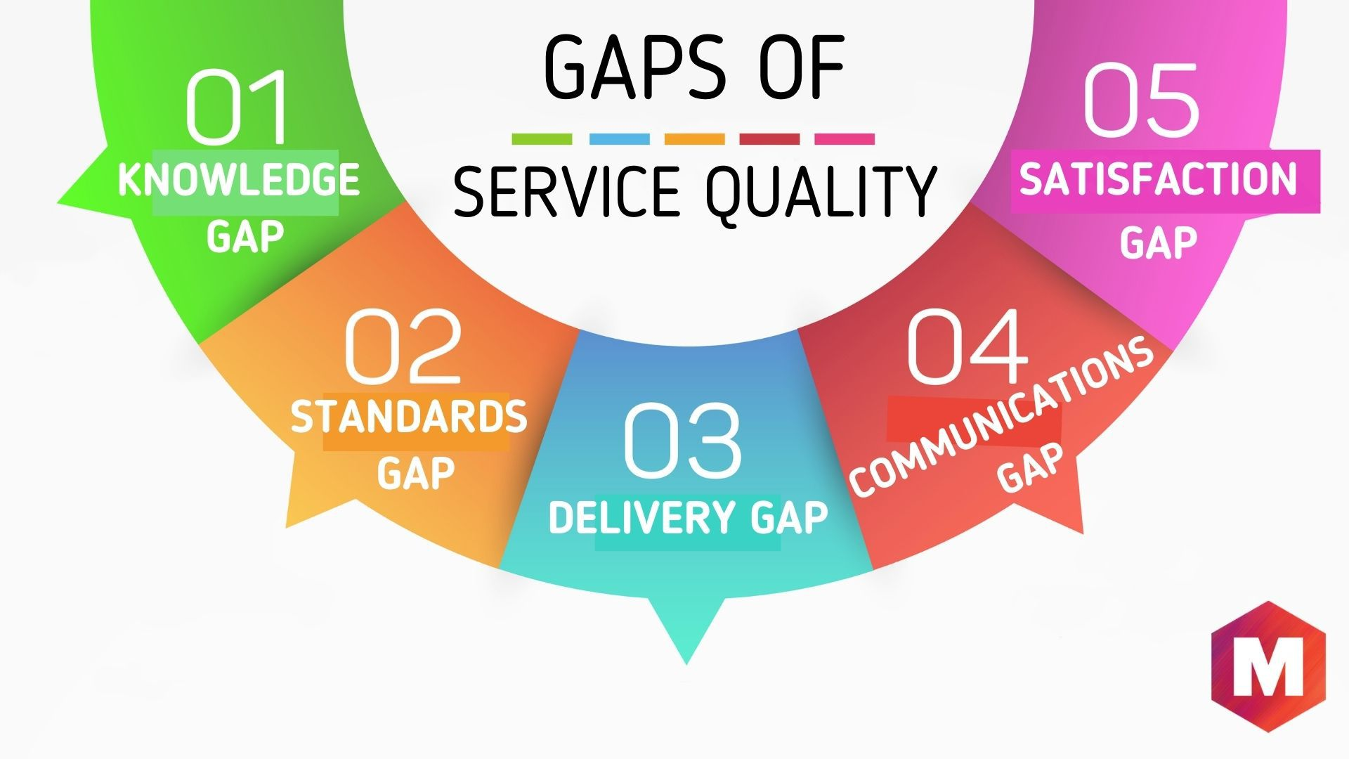
4- What is Quality and Service Quality?
      4.5- The Gaps Model of Service Quality
      A- Consumer Expectations vs. Management Perception
      - Difference between customer expectations and management’s perception
      - Often caused by a lack of understanding of customer priorities

Slide 35
4- What is Quality and Service Quality?
      B- Management Perceptions vs. Service Quality Specifications
      - Occurs when managers are unaware of consumer expectations
      - Service standards may be based on assumptions rather than actual needs
      - Standards can be unclear, unrealistic, or unenforced
      - Leads to inconsistent service delivery

Slide 36
4- What is Quality and Service Quality?
      C- Service Quality Specifications vs. Service Delivery
      - Service standards exist but are not properly delivered
      - Tourism relies heavily on employee–customer interactions
      - Challenge: ensuring staff meet quality specifications
      - Causes inconsistent service quality

Slide 37
4- What is Quality and Service Quality?
      D- Service Delivery vs. External Communications
      - Promised service does not match actual service
      - Marketing may set expectations that aren’t met

Slide 38
4- What is Quality and Service Quality?
      E- Perceived Service vs. Delivered Service
      - Difference between actual service and customer perception
      - Known as the “service gap”
      - Results from any of the previous gaps
      - Indicates overall service quality in the organization

Slide 39
5- What is Quality and Service Quality?
      - It ensures consistent product and service quality in tourism and hospitality
      Methods:
Customer surveys | Comment cards
Employee surveys | Focus group interviews
Mystery shopping | Observation

Slide 40
5- What is Quality and Service Quality?
      Common Tools for Assessing Service Quality and Satisfaction:
      A- SERVQUAL Method
      - Evaluates service quality
      - Measures the gap between customer expectations and perceptions of service delivery
      - Evaluates dimensions such as reliability, responsiveness, assurance, empathy, and tangibles
      B- Importance–Performance Analysis (IPA)
      - Compares performance of service elements with their importance to customers

Slide 41
5- What is Quality and Service Quality?
      A- SERVQUAL: Usage and Components
      Usage:
      - Applied across various service sectors:
      Banks, call centers, TV repair companies
      Airlines, hotels
      Components:
      - 22 service attributes measured in a survey
      - Grouped into five key service quality dimensions:
SERVQUAL Methods
Reliability
Assurance
Tangibles
Empathy
Responsiveness

Slide 42
5- What is Quality and Service Quality?
      Reliability:
      - Consistency and dependability of service delivery
      - Employees should perform the service correctly the first time
      - Organization must honor promises:
      Accurate billing
      Timely service delivery
      Meeting other service commitments
SERVQUAL Methods
Reliability
Assurance
Tangibles
Empathy
Responsiveness

Slide 43
5- What is Quality and Service Quality?
      Assurance
      - Employees’ knowledge and courtesy
      - Ability to convey trustworthiness and instill confidence in customers
      Tangibles
      - Physical aspects of the service
      - Examples:
      Hotel rooms and facilities
      Staff uniforms and presentation
      Organizational materials: brochures, frequent-guest cards
SERVQUAL Methods
Reliability
Assurance
Tangibles
Empathy
Responsiveness

Slide 44
5- What is Quality and Service Quality?
      Empathy
      - Providing caring, individual attention to customers
      - Treat consumers as individuals
      - Examples:
      Addressing customers by name
      Remembering preferences and interests
SERVQUAL Methods
Reliability
Assurance
Tangibles
Empathy
Responsiveness

Slide 45
5- What is Quality and Service Quality?
      Responsiveness
      - Prompt service delivery
      - Staff are willing and ready to assist customers
      - Examples:
      Responding to requests quickly
      Handling problems and queries efficiently
SERVQUAL Methods
Reliability
Assurance
Tangibles
Empathy
Responsiveness

Slide 46
5- What is Quality and Service Quality?
      SERVQUAL Survey and Gap Analysis
      - Customers rate two aspects for each service dimension:
      Expected Service:
      - What customers expect from an excellent company
      Perceived Service:
      - How they perceive the actual service delivered
      - Differences between expected and perceived service reveal service quality gaps

Slide 47
5- What is Quality and Service Quality?
      - Example in a Hotel Setting:
Attribute | Expectation (1–10) | Perception (1-10) | Gap
Clean and comfortable room | 10 | 7 | -3
Staff are polite and helpful | 9 | 8 | -1
Prompt check-in | 10 | 10 | 0

Slide 48
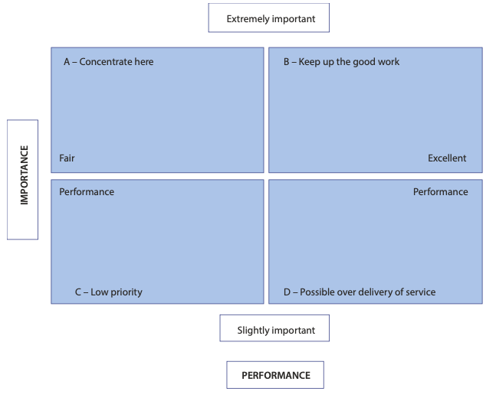
5- What is Quality and Service Quality?
      Importance–Performance Analysis (IPA)
      - Compares service performance with the
      importance of service elements to customers.
      - Helps identify areas needing improvement.

Slide 49
Thank you
      European Institute of Innovation, Entrepreneurship and Technology
      Lessingstraße 79,
      13158 Berlin, Germany
      Phone: +49 176 55524449
      Email: info@eiiet.com
Discover the world of eiIET

