Slide 1
Tourism Marketing for small businesses
Chapter 6
Designing Tourism Services and Experiences

Slide 2
Chapter learning aims
To enhance your understanding of:
service value as being co-created by the customer and the service provider
the challenges in transitioning to the experience economy
the key characteristics of memorable experiences

Slide 3
Key terms
Service
An interactive process of doing something for someone, which they value.
Service-dominant logic
A philosophy viewing service value as being co-created by the service provider together with the customer.
The experience economy
A paradigm shift recognising the need to evolve from providing a service to staging an experience. The challenge in the experience economy is to design an engaging experience that represents a memorable event for the customer, and commands a price premium for the business.

Slide 4
The importance of people
Frontline staff are the stars of the show
  But usually the lowest paid
A competitive edge can be gained by using operant resources (intangible skills and knowledge) to engage with consumers in a way that is superior to how competitors use their resources
  Empower staff to use their own best judgement
Culture eats strategy for breakfast
  (Peter Drucker)

Slide 5
Service-dominant logic
Tourism is mostly in the form of intangible services
Service can take place before, during and after purchase and consumption
Service is the act of doing something for someone, which they value
S-D logic is underpinned by the co-creation of value
  The business provides a value proposition (eg cheaper, faster, better)
  The customer decides if value proposition was delivered

Slide 6
Video link
Prof. Stephen Largo: Service-dominant logic. Basics, developments and state-of-the-art
  https://www.youtube.com/watch?v=J1h4JQ7bTmA

Slide 7
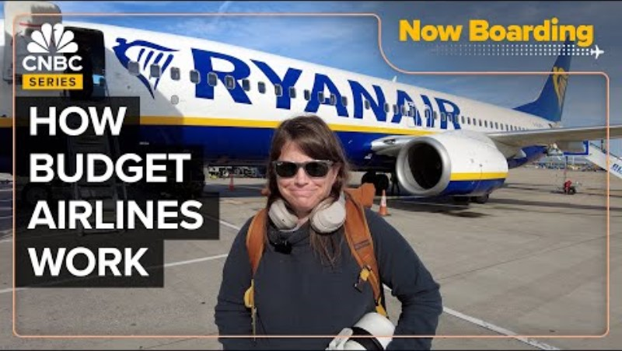
Examples of tourism service co-creation
The business model of low cost airlines relies on the customer self-booking their own flights via the internet and then benefitting from discounted fares (see Mintel, 2005).
Travel itinerary management platforms, such as TripIt.com, which enable the user to consolidate different bookings into one master itinerary (see Applegate, Piccoli & Brohman, 2008).

Slide 8
Examples of tourism service co-creation
Repeated trial and error product testing and experimentation with a new in-room entertainment system in a few guestrooms. Undertaken with regular guests who were briefed on the initiative on arrival, and then subsequently interviewed at checkout.
Development of a multi-sensory dining experience, where guests are seated ‘back stage’ to witness the skill involved in preparing their menu. Guest are also able to interact with the kitchen staff, and subsequently offer suggestions.
Customer survey feedback is scrutinised, and then used to structure focus group meetings with key clients. Clients are given two nights’ accommodation and wined and dined in return for four hours of focus group ‘work’.

Slide 9
Disruption
Disruption is not a new phenomenon
Throughout history, industries have been revolutionised through the advent of new technology
  Eg the steam engine, railroads, electricity, the telephone, jet aircraft
What is different in the digital age is the rapid speed at which new technologies can lead to disruption

Slide 10
Being non-customer centric is the threat
Amazon did not kill the retail industry. They did it to itself with bad customer service.
Netflix did not kill Blockbuster. They did it to itself with ridiculous late fees.
Uber did not kill the taxi business. They did it to itself with limited the number of taxis and fare control.
Apple did not kill the music industry. They did it to itself by forcing people to buy full-length albums.
Airbnb did not kill the hotel industry. They did it to itself with limited availability and pricing options.
Technology by itself is not the real disruptor.
Being non-customer centric is the biggest threat to any business.
Source: Alberto Brea, 2017
https://www.linkedin.com/pulse/amazon-did-kill-retail-industry-alberto-brea

Slide 11
Disruption (creative thinking) is harder than critical thinking
An ideal innovation is one that will cause minimal disruption to the firm, but maximum disruption in the market.
Creativity is a delicate process, so avoid any criticism during the brainstorming phase. Generate as many ideas at possible without judgement.
Take the most glaring flaw facing you and flip it. Zipcar.com identified the processing required at rental car offices as the defining negative characteristic in that market, so their business model was based on removing the office from the hire process.
Assume transformation is necessary, ask transformational questions (the hardest part of the process), and try to forget what you know (eg entrenched paradigms).
Address the how as well as the wow, by thinking money and magic. Money focuses on the business questions to generate profit, while magic focuses on the needs of the customer.

Slide 12
The experience economy
Increasingly competitive markets crowded with similar service offerings has led to recognition of the need to evolve from providing a service to delivering an experience
An experience takes place when a business uses its services as a theatrical stage
The challenge is to design an engaging experience that represents a memorable event for individual guests, and commands a price premium for the business.

Slide 13
Consumers don’t always know what they want to satisfy a need
Yes, services need to be designed based on consumer’s needs
But, consumers wants are limited by their imagination
Therefore, revolutionary product never emerge from only listening to consumers’ wants

Slide 14
Video link
Joseph Pine: What consumers want
  https://www.ted.com/talks/joseph_pine_on_what_consumers_want
Joseph Pine: The experience economy
  https://www.youtube.com/watch?v=pXv3cfvJ9F8

Slide 15
Designing memorable experiences
1. Theme the experience
A clear, focussed and compelling theme drives all the design elements and staged events
  Eg Cat poo coffee, Bali
  Eg Cat cafes
  Eg Jimmy Buffet’s Margaritaville
  Eg Theme parks

Slide 16
Designing memorable experiences
2. Harmonise impressions with positive cues
Impressions are what the guest takes away from the experience, and fulfil the theme
  Visual and cues, supporting the theme, need to be introduced to the guest to affirm the nature of the experience
  Eg staff in period costume
  First impressions are important

Slide 17
Designing memorable experiences
3. Eliminate negative cues
Eliminate anything that distracts the guest from the theme
  Clutter such as excessive signage or notices
  Unnecessary messages
  Poor service

Slide 18
Designing memorable experiences
4. Mix in memorabilia
A memento of an experience sells for a premium
The price point is related to the value the guest places on the experience, rather than the cost of the item
But…mementoes don’t have to be expensive

Slide 19
Designing memorable experiences
5. Engage the senses
The more senses that are engaged (related to the theme), the more memorable the experience
Create a sense of arrival
  Eg Pitch black restaurants
  Eg Hotel reception located in Casino gaming room

Slide 20
Discussion questions
Why is it important for a firm to not base all future service and experience designs on what consumers say in focus group research?
Why do many creative new product ideas fail commercially?
While Pine and Gilmore suggested the transition from the service economy to the experience economy would be difficult, why might small tourism businesses hold an advantage over the big travel brands in this regard?

