Slide 1
Research on Tourism Services
European Institute of Innovation, Entrepreneurship and Technology
Lessingstraße 79, 13158 Berlin, Germany
Mahmoud Abdou| Berlin
      Lessingstraße 79,
      13158 Berlin, Germany
      Phone: +49 30 233618555
      Fax: +49 30 233618556
      Email: info@eiiet.com

Slide 2
Index
-Promotion
-Personal Selling
- Public Relations
-Sponsorship
5- Digital Marketing

Slide 3

1- The Marketing Mix: Promotion
- Among all the elements of the marketing mix, promotion is the most emphasized in tourism and hospitality marketing.
- It serves to communicate details about offerings to target audiences while also playing a key role in informing, educating, persuading, and reminding consumers.
- The intangible nature of tourism products makes this function even more vital, as there is no physical product or packaging to capture the attention of potential customers.

Slide 4
1- The Marketing Mix: Promotion
- Among all the elements of the marketing mix, promotion is the most emphasized in tourism and hospitality marketing.
- It serves to communicate details about offerings to target audiences while also playing a key role in informing, educating, persuading, and reminding consumers.
- The intangible nature of tourism products makes this function even more vital, as there is no physical product or packaging to capture the attention of potential customers.

Slide 5
1- The Marketing Mix: Promotion
- The marketer can choose from a large number of tools to deliver the message including advertising, sales promotion, personal selling, and public relations, and digital marketing and social media.
- These techniques are also referred to as the promotions mix.

Slide 6
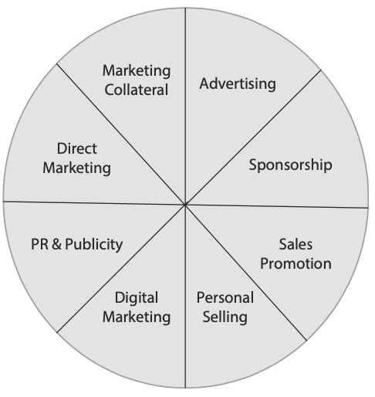
2- Personal Selling
- Personal selling is a process of direct, person-to-person
communication between a salesperson and a prospective customer.
- In this process, the salesperson learns about the customer’s needs
and aims to satisfy those needs by offering relevant products
or services.
- It is a key promotional tool in tourism and hospitality,
where offerings are inseparable, meaning both the service provider
and the consumer must be present.

Slide 7
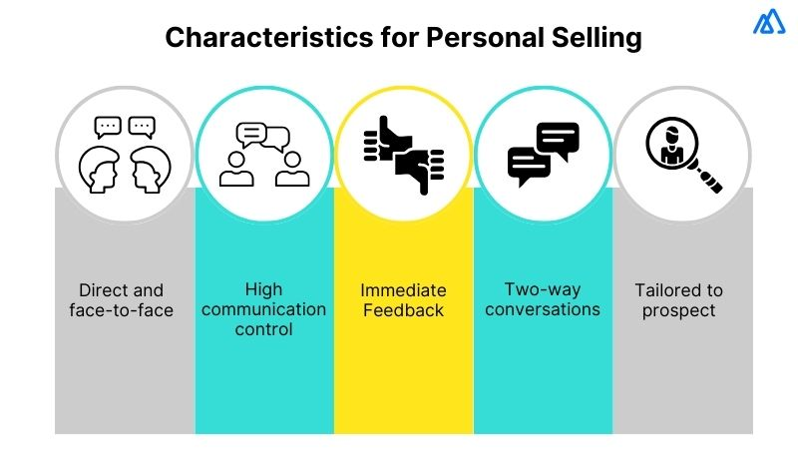
2- Personal Selling
- Personal selling involves face-to-face encounters, making it an effective method for persuading customers to make a purchase.
- This activity can be carried out by an individual salesperson or as part of a sales team.
- Personal selling involves direct interaction
between the buyer and seller, whether in person,
via mobile phone, or through video conferencing.

Slide 8
2- Personal Selling
-This approach facilitates a dialogue, allowing two-way communication where consumers can ask questions and sales representatives can respond to specific needs.
- This interactive exchange is often more effective than one-way methods like advertising.
- Unlike advertising, sales promotion, marketing collateral, and direct marketing, personal selling involves direct interaction between two or more individuals.
-However, this distinctive feature comes with a cost, as personal selling demands significant time and financial resources compared to other promotional methods.

Slide 9

2- Personal Selling
There are 4 methods of personal selling:
- Internal Selling: face-to-face efforts made within an
organization to secure a sale, often involving direct interactions
with existing customers.
- External Selling: External selling refers to face-to-face
presentations of a product or service to prospective consumers
outside the organization or in the field.

Slide 10

2- Personal Selling
There are 4 methods of personal selling:
- Telephone Sales: Telesales is a method of personal selling that involves using the telephone to promote offerings and generate sales.
- Personal Skills: the appearance, presentation, and hospitality of employees play a crucial role in creating a positive customer experience.

Slide 11
2- Personal Selling
The Advantages of Personal Selling
- Focused on specific target markets (external selling).
- Delivers more comprehensive information to consumers than advertising, making it highly persuasive.
- Involves an interactive approach, fostering engagement.
- Establishes strong consumer relationships, promoting repeat business.
- Passive sales are cost-efficient, as being friendly and polite comes at no financial cost.

Slide 12

2- Personal Selling
The Disadvantages of Personal Selling
- Restricted target audience, limiting reach.
- High costs for establishing and training a sales team, making it resource-intensive.
- Telephone selling often perceived as annoying and intrusive
by consumers.

Slide 13

3- Public Relations
- Public relations (PR) refers to the communication efforts that a tourism or hospitality organization uses to build and maintain favorable relationships with other organizations, individuals, and the public.
- It encompasses a broad range of activities, including managing consumer perceptions of the organization’s offerings, its corporate identity, and its promotional efforts.
- PR aims to enhance the overall image of the organization and influence how it is perceived by its target audience.

Slide 14

3- Public Relations
- Public relations can be defined as “the discipline which looks after reputation, with the aim of earning understanding and support and influencing opinion and behaviour.
- It is the planned and sustained effort to establish
and maintain goodwill and mutual understanding
between an organisation and its publics”.

Slide 15
3- Public Relations
Community relations
- Fostering good relationships and positive connections with the local community.
Corporate communications
- To build understanding and foster a positive image of the organization among both internal and external audiences.
Counselling
- Guiding management on issues, brand reputation, and public policies that impact the organization's image during crises.
Crisis management/ communications
- To manage adverse events as they arise.

Slide 16
3- Public Relations
Digital content and social media
- PR agencies are increasingly creating digital content, including videos and text, for their clients
Editorials (or feature stories)
- To highlight the key selling points of a product offering.
- Human interest articles designed to entertain, inform, or educate audiences across various media platforms.
Educational trips (familiarisation trip)
- A tour that allows travel agents, tour operators, travel writers, and other tourism industry professionals to experience facilities and services firsthand, enabling them to better advise clients on their holiday options.

Slide 17
3- Public Relations
- Lobbying
To engage with the government mainly to influence legislation and regulations.
- Media/Press relations
To promote a positive image of a company or event by crafting newsworthy stories for the press, radio, and television.
- Memberships
Obtaining memberships should also be considered an integral part of a tourism business's networking strategy (Association of British Travel Agents (ABTA), European Tour Operators Association (ETOA), World Youth Student and Educational Travel Confederation (WYSE).

Slide 18
3- Public Relations
Networking
- The skill of networking with potential customers and other tourism providers at an event.
- Obtaining information that can uncover opportunities and lead to the development of new marketing strategies.
Product placement
- A type of sponsorship that involves integrating branded products into movies and television shows.
Travel trade events
- Travel trade expos
- Travel exchanges involve a Destination Marketing Organization (DMO) inviting key international intermediaries to a 2–3-day exhibition, where they typically participate in meetings with tourism businesses that have paid for display space., such as such as Tourism Indaba (Africa), International Trade Bourse (ITB) in Berlin, World Travel Market (WTM) in London.

Slide 19
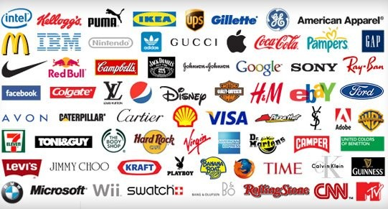
4- Sponsorship
- Sponsorship involves an organization providing financial support to another in order to gain prestige and status through their association.
- It is often part of an organization’s
public relations strategy as it indirectly
boosts customer perceptions of the
organization or its products.

Slide 20
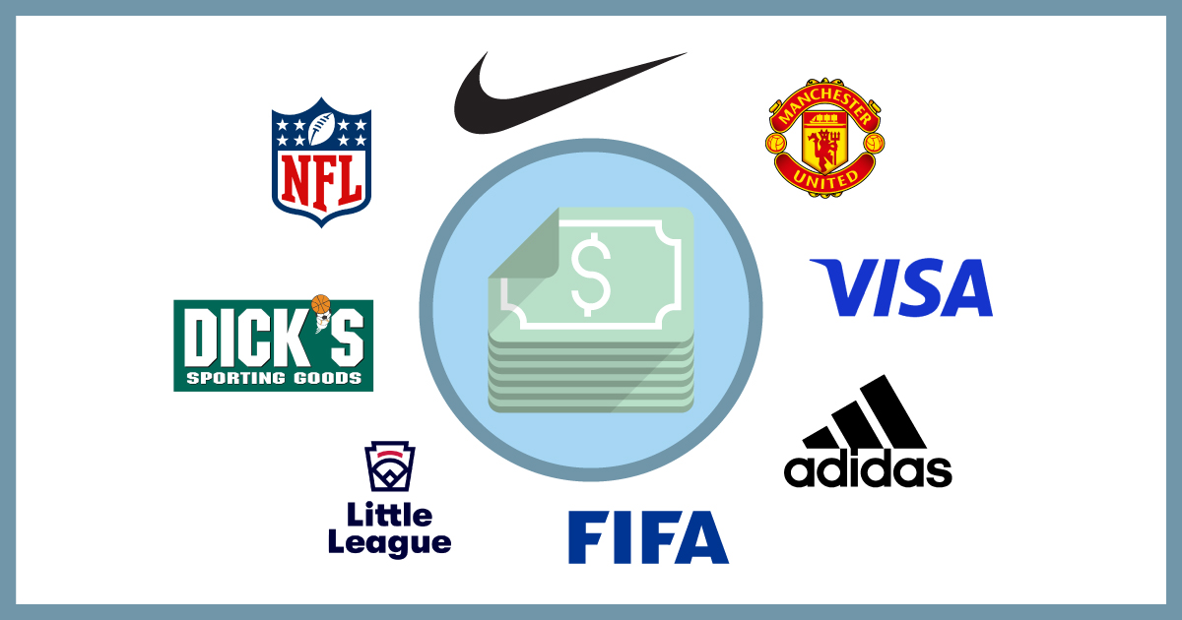
4- Sponsorship
- An organization might sponsor television programs, sporting events, major cultural events, or even individuals.
- Sponsorship is a prominent form of collaborative marketing between organizations that share a common market.

Slide 21
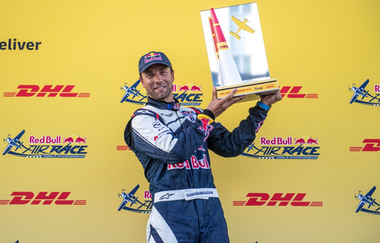
4- Sponsorship
The Role of Sponsorship in Tourism and Hospitality Marketing
1- Sponsorship of an Event or a Tourism Activity By a Non-tourism Organisation
- Examples of tourism events sponsored by non-tourism companies include logistics firm DHL, which sponsors the Red Bull Air Race and also provides transport services for the event.
- Another example is bungee-jumping at Storms River in
South Africa, sponsored by Hunter’s Gold cider.
- In both cases, the sponsors gain promotional exposure
while contributing to the event in other ways.

Slide 22


4- Sponsorship
The Role of Sponsorship in Tourism and Hospitality Marketing
2- Sponsorship of a Non-tourism Event By a Tourism Organisation
- Examples of non-tourism events sponsored by tourism and hospitality organizations include the city of Johannesburg sponsoring the annual South African Open golf championships and the ATP World Tour.
- Other forms of sponsorship include financial or material support for the arts, such as Emirates Airline sponsoring the Festival of Literature in Dubai, UAE.
- Sponsorship also extends to fine
arts, concerts, educational trips,
television programs, and various
sporting events.

Slide 23
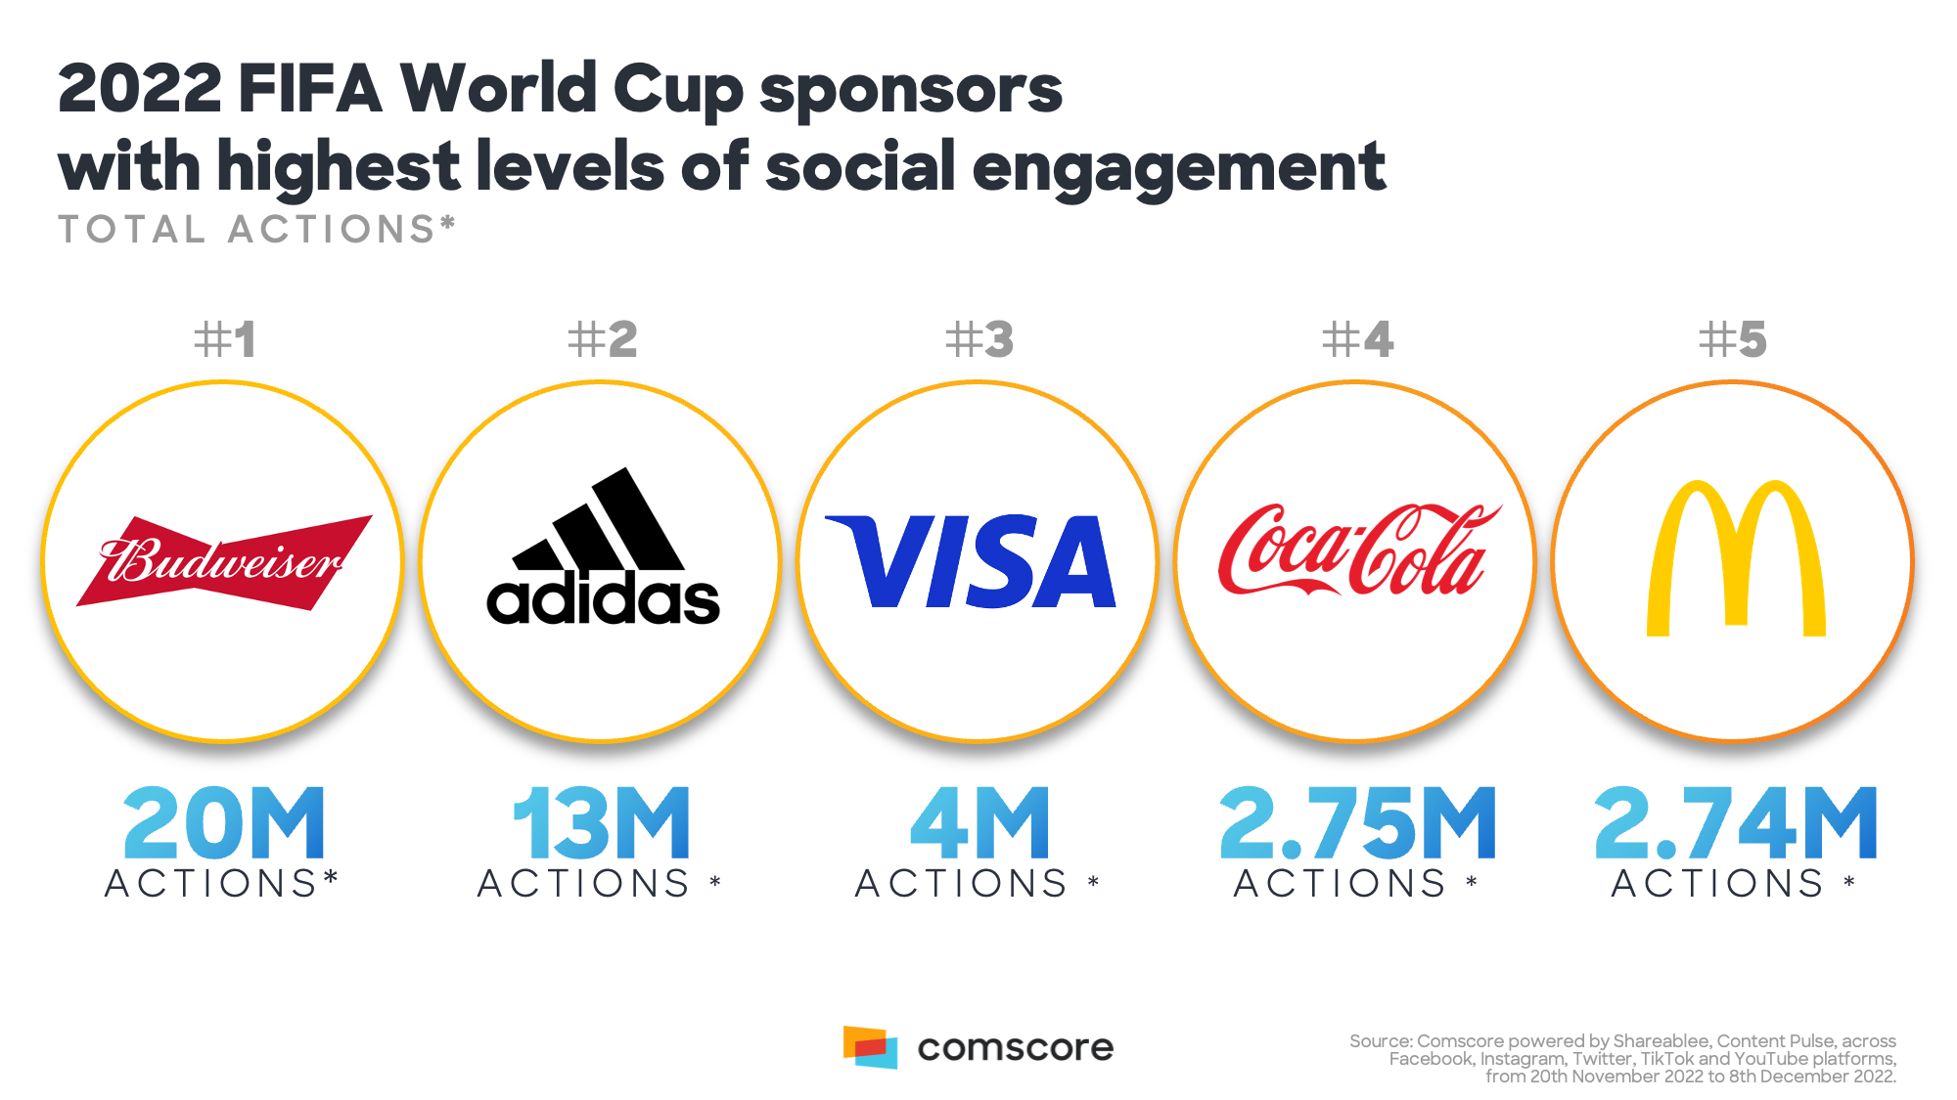
4- Sponsorship
The Role of Sponsorship in Tourism and Hospitality Marketing
2- Sponsorship of a Non-tourism Event By a Tourism Organisation
- Sports sponsorship is particularly prominent, with companies ranging from soft drink brands to newspapers supporting major events like football, rugby, cycling, and cricket.
Sporting events, like the FIFA 2018 World Cup in Russia and 2022 in Qatar, generated over US$1.65 & 1,795 billion, respectively in sponsorship revenue.

Slide 24
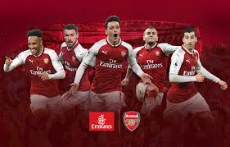

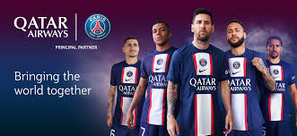
4- Sponsorship
The Role of Sponsorship in Tourism and Hospitality Marketing
2- Sponsorship of a Non-tourism Event By a Tourism Organisation
- Sponsorship of events serves as an effective publicity tool, allowing sponsors to engage with suppliers, journalists, and customers while attracting public attention.
- Event sponsorship involves providing financial support in exchange for advertising privileges, as seen with brands like Emirates Airline, which sponsors top European football clubs like Real Madrid, Arsenal, and PSG.
-Similarly, VisitFlorida sponsors Fulham FC, and Etihad Airways sponsors Manchester City FC and New York City FC.

Slide 25
4- Sponsorship
The Advantages of Sponsorship:
- Improves the company's image and reputation.
- Offers opportunities for sales and merchandising.
- Builds goodwill within the community or industry.
- Expenses can be deducted from taxes.
- Boosts brand awareness and generates publicity.

Slide 26
4- Sponsorship
The Disadvantages of Sponsorship:
- Can be costly and may not always yield the desired results.
- Challenging to assess the effectiveness of sponsorship activities.
- No assurance that the sponsored team or individual will meet expectations.

Slide 27
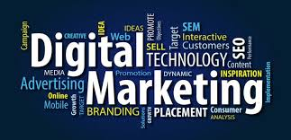
5- Digital Marketing
- Digital marketing is the practice of achieving marketing objectives by leveraging digital technologies and media.
- It involves promoting products or services using digital channels such as the internet, social media, email, digital television, search engines, and wireless media.
- Unlike traditional marketing, digital marketing allows organizations to track and analyze their marketing campaigns in real time, providing insights into what strategies are effective and which need adjustment.
- This enables more precise targeting and
optimization of marketing efforts.
- It can be defined as “the marketing of
products or services using digital electronic
technologies and channels such as the internet,
e-mail, digital TV, and wire- less media”.

Slide 28
5- Digital Marketing
Digital marketing offers several key advantages:
- Creating Equal Opportunities: It allows tourism organizations of all sizes to compete more equally for consumer attention, giving small businesses an edge they might lack with traditional marketing.
- Cost Efficiency: Digital marketing is often more affordable and efficient than traditional methods, making it accessible to smaller enterprises.
- Enhanced Consumer Experience: It provides opportunities to strengthen relationships with customers through personalized and interactive engagement.
- Instant Responses: Consumers can quickly book flights, reserve hotel rooms, or access promotional materials with just a few clicks.
- Accessibility: Digital platforms enable businesses to operate 24/7, providing constant access to products and services.

Slide 29
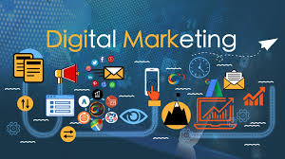
5- Digital Marketing
The 5Ds of digital marketing represent the key areas where consumers engage with brands and where tourism and hospitality businesses can connect with their audiences:
- Digital Devices – Consumers interact with brands through various connected devices, including smartphones, tablets, desktop computers, smart TVs, and gaming consoles, often via business websites and mobile apps.
- Digital Platforms – Interactions primarily occur on major platforms or services, such as Facebook, Instagram, Google, YouTube, TikTok, Twitter, Snapchat,
and LinkedIn, accessed through browsers or apps.

Slide 30
5- Digital Marketing
- Digital Media – These include paid, owned, and earned media channels like online advertising, e-mails, messaging services, search engines, and social networking sites.
- Digital Data – Insights gathered from consumer profiles and their interactions with businesses, which are increasingly regulated by data protection laws in many countries.
- Digital Technology – The tools businesses use to create interactive experiences, such as websites, mobile apps, in-store kiosks, and e-mail campaigns.

Slide 31
5- Digital Marketing
- There are four digital marketing domains:
Business to Consumer (B2C):
- Business to Consumer (B2C) e-commerce involves selling products and services directly to end consumers through online platforms.
- Virtually anything can be purchased online today, including cars, houses, books, food, music, and airline
e-tickets.
- In the travel and tourism sector, prominent examples of B2C e-commerce include online travel companies such as Travel Republic, Trivago, Booking.com, FlightSite, and Expedia.
- Most travel and tourism companies now maintain a strong online presence through dedicated websites where they sell their offerings directly to consumers.

Slide 32
5- Digital Marketing
Business to Business (B2B):
- Business to Business (B2B) e-commerce facilitates online transactions between businesses.
- Examples include interactions such as those between a tour operator and a travel agency or a professional conference organizer (PCO) and a conference center.
- This model also extends to various business-related services like printing services, outsourced marketing, hiring, and the buying or selling of office equipment.
- Similar to B2C, B2B e-commerce offers benefits such as reduced operational costs, improved efficiency, and streamlined processes for businesses.

Slide 33
5- Digital Marketing
Consumer to Consumer (C2C):
- Consumer to Consumer (C2C) e-commerce is one of the fastest-growing domains in digital marketing.
- The internet serves as an excellent platform for consumers to exchange or purchase products, services, or information directly from each other.
- Prominent examples of C2C e-commerce include Uber, which facilitates a platform where consumers offer ride services to others based on location and cost preferences, and Airbnb, an online marketplace that connects travelers seeking authentic experiences with hosts providing unique accommodations and local experiences worldwide.

Slide 34
5- Digital Marketing
Consumer to Business (C2B)
- Consumer to Business (C2B) e-commerce involves consumers actively engaging with businesses, often by submitting suggestions, questions, or feedback via company websites.
- In this model, consumers initiate transactions with businesses rather than the other way around, as seen in traditional B2C models.
- For example, platforms like Priceline.com enable buyers to bid for airline tickets, rental cars, hotel rooms, and holiday packages.
- Sellers then decide whether to accept the offers, putting consumers in the driver's seat for determining terms of transactions.

Slide 35
Activity
Will digital media kill traditional marketing methods?

Slide 36
Thank you
      European Institute of Innovation, Entrepreneurship and Technology
      Lessingstraße 79,
      13158 Berlin, Germany
      Phone: +49 176 55524449
      Email: info@eiiet.com
Discover the world of eiIET

