Slide 1


Sustainability Tourism in India
Presented by: SUNIL KUMAR DE240173

Slide 2
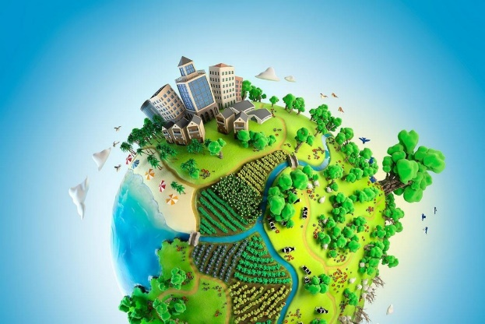
Introduction
India is one of the world’s top tourism destinations
The country has rich cultural heritage, biodiversity, and landscapes
There is a growing concern regarding balancing growth with sustainability
There are tourism arrivals growing steadily in the post COVID-19 phase
Sustainable tourism got the high international importance
Notes:
India is one of the world’s top tourism destinations. The country has rich cultural heritage, biodiversity, and landscapes. There is a growing concern regarding balancing growth with sustainability.
There are tourism arrivals growing steadily in the post COVID-19 phase. Sustainable tourism got the high international importance. The reason is that tourists along with entities now prefer to have sustainable services. This shift is due to the global warming that has become evident in countries.

Slide 3

What is Sustainable Tourism?
Tourism that focuses on meeting needs without compromising future generations
The focus is on environment, economy, and community
UNWTO principles include minimizing impact, protecting resources, and respecting culture
Encourages the long-term planning instead of short-term profit
Involves the active participation of stakeholders (tourists, locals, government)
Notes:
Tourism that focuses on meeting needs without compromising future generations. The focus is on environment, economy, and community. UNWTO principles include minimizing impact, protecting resources, and respecting culture. Encourages the long-term planning instead of short-term profit. It involves the active participation of all the important stakeholders. These include the tourists along with locals and government. Overall, sustainable tourism is getting popularity with each passing year. Tourists are becoming aware of negative environmental impact.

Slide 4

Importance for India
Supports more than 30 million jobs
Contributes around 6-7% to the GDP of India
It preserves the heritage sites (Taj Mahal, Hampi, Jaipur etc.)
Protects biodiversity in national parks and reserves
Provides income for rural and tribal communities
Helps India meet UN Sustainable Development Goals (SDGs)
Notes:
Tourism for India has high importance. The reason is that tourism in India supports more than 30 million jobs. Contributes around 6-7% to the GDP of India. It preserves the heritage sites (Taj Mahal, Hampi, Jaipur etc.). Protects biodiversity in national parks and reserves. It is beneficial for India since biodiversity is also a popular concept globally.
India’s tourism provides income for rural and tribal communities. Helps India meet UN Sustainable Development Goals (SDGs).

Slide 5
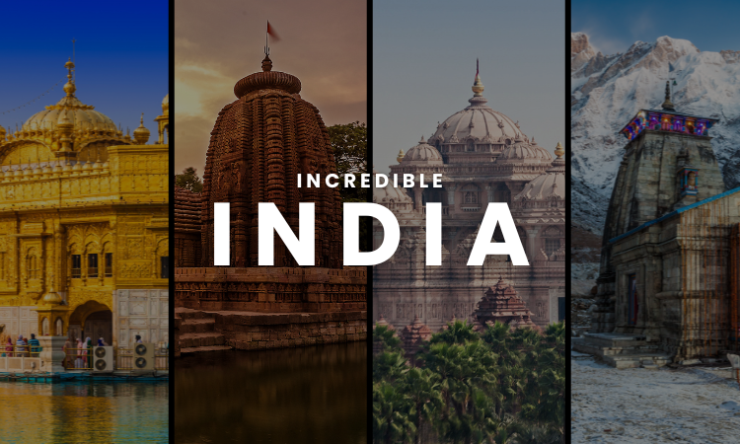
Key Sustainable Tourism Practices in India
Eco-friendly accommodations (solar, waste management)
Rural & village tourism initiatives
Wildlife and eco-parks (Kaziranga, Ranthambore)
Community-based tourism (homestays, crafts, local food)
Cultural preservation through festivals and handicrafts
Promotion of low-carbon transport options (Electric Vehicles)
Notes:
Eco-friendly accommodations (solar, waste management). Rural & village tourism initiatives are also important as the core sustainable practices in India. Wildlife and eco-parks (Kaziranga, Ranthambore) are also there that are operated sustainably. Community-based tourism (homestays, crafts, local food) is also a notable sustainable tourism practice.
In India, there is also cultural preservation through festivals and handicrafts. Promotion of low-carbon transport options (Electric Vehicles)

Slide 6
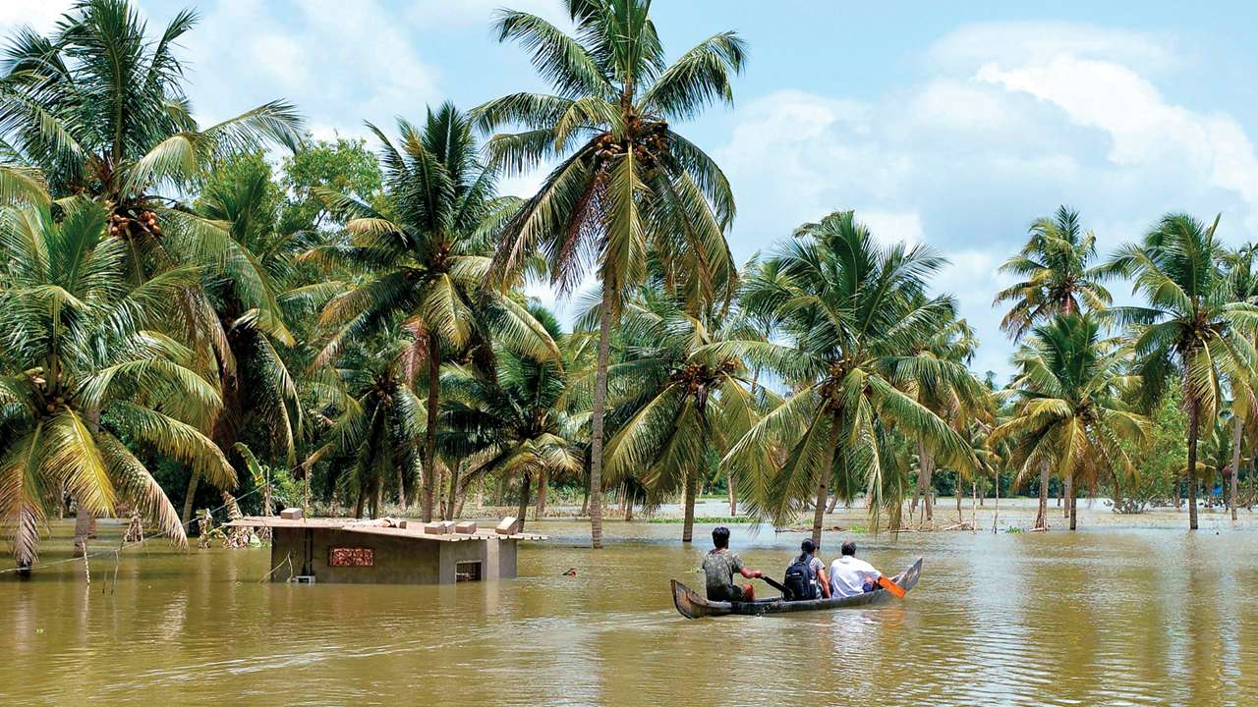
Case Study: Kerala
Kerala’s model is ‘God’s Own Country’
Promotes houseboats with solar energy
Ayurveda & wellness tourism
Community participation through Responsible Tourism Mission
Focus on clean beaches and water management
Recognized internationally as model for responsible tourism
Notes:
Kerala’s model is ‘God’s Own Country’ . Promotes houseboats with solar energy. Ayurveda & wellness tourism is also popular in the state of Kerala. Community participation through Responsible Tourism Mission is also highly popular. Focus on clean beaches and water management. Recognized internationally as model for responsible tourism

Slide 7
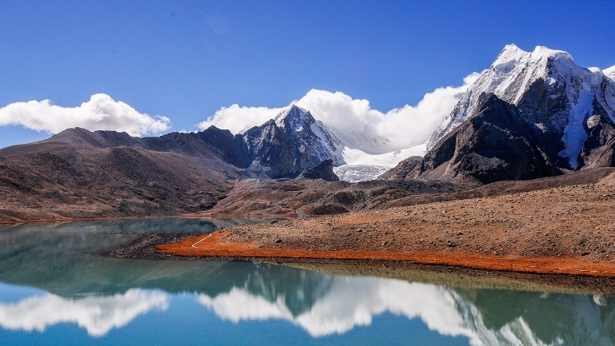
Case Study: Sikkim
First organically state in India
Promotes eco-tourism and conservation
Community-based trekking & cultural tourism
Recognition by UNWTO for sustainable practices
Strong waste management and plastic ban policies
Notes:
Sikkim is the first organically state in India. It promotes eco-tourism and conservation. Community-based trekking & cultural tourism is also a notable sustainable practice. Recognition by UNWTO for sustainable practices. Strong waste management and plastic ban policies are also effective sustainable practice integrated in the state’s tourism.

Slide 8
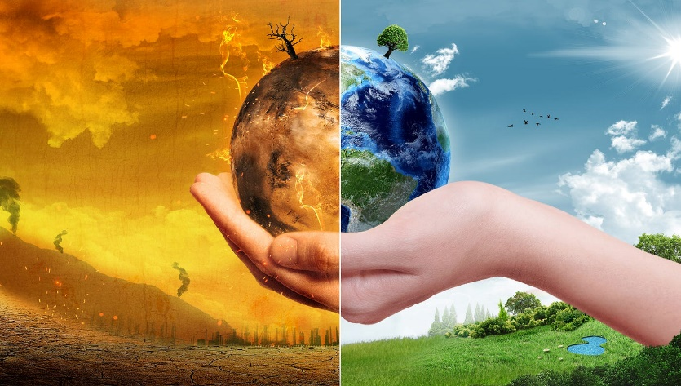
Environmental Challenges
Overcrowding at heritage sites (Taj Mahal, Shimla)
Deforestation and habitat loss from resorts
Pollution from transport and waste management
Climate change threats (floods, glacier melting in Himalayas)
Wildlife-human conflicts in eco-tourism areas
Notes:
Overcrowding at heritage sites (Taj Mahal, Shimla) are the core environmental challenges. Deforestation and habitat loss from resorts is also the notable environmental issue. Pollution from transport and waste management. Climate change threats (floods, glacier melting in Himalayas). Wildlife-human conflicts in eco-tourism areas

Slide 9

Social & Cultural Challenges
Loss of local traditions due to commercialization
Pressure on local communities from mass tourism
Unequal distribution of tourism advantages
Conflict between modern development and heritage preservation
Risk of cultural homogenization (loss of authenticity)
Rising cost of living in tourist hotspots
Notes:
Loss of local traditions due to commercialization. Pressure on local communities from mass tourism. Unequal distribution of tourism advantages. Conflict between modern development and heritage preservation. Risk of cultural homogenization (loss of authenticity). Also there is rising cost of living in tourist hotspots.

Slide 10

Economic Challenges
Lack of infrastructure in rural/eco-tourism areas
High cost of adoption of sustainable practices for small businesses
Dependence on seasonal tourism (e.g. Goa, hill stations)
Limited government funding for green projects
Revenue leakage when profits go to foreign operators
Unstable demand during the international crises (COVID, recessions)
Notes:
Lack of infrastructure in rural/eco-tourism areas. High cost of adoption of sustainable practices for small businesses. Dependence on seasonal tourism (e.g. Goa, hill stations). Limited government funding for green projects. Revenue leakage when profits go to foreign operators. Unstable demand during the international crises (COVID, recessions).

Slide 11

Future Directions
Green certification for hotel & tour operators
Promotion of slow travel, eco-friendly transport
Digital campaigns on responsible tourism
Stronger policies on waste, energy, and local involvement
Integrating sustainability into tourism education
Notes:
There are future directions to consider. Green certification for hotel & tour operators. It can further ensure high sustainability in the country’s tourism. Promotion of slow travel, eco-friendly transport. Digital campaigns on responsible tourism.
Stronger policies on waste, energy, and local involvement. Integrating sustainability into tourism education is also a notable future direction.

Slide 12

Conclusion
Sustainable tourism is essential for the future of India
It balances economic growth with cultural and environmental preservation
Requires the joint efforts: government, businesses, and tourists
‘Travel responsibly, preserve India for tomorrow’
India has strong ability to be the international leader in sustainable tourism
Notes:
Sustainable tourism is essential for the future of India. It balances economic growth with cultural and environmental preservation. Requires the joint efforts: government, businesses, and tourists.
‘Travel responsibly, preserve India for tomorrow’. India has strong ability to be the international leader in sustainable tourism.

Slide 13
References
Garg, P. and Pandey, A., 2021. Towards sustainable tourism: an empirical investigation. Foresight, 23(2), pp.188-200.
Jatav, S., 2023. Current trends in sustainable tourism in the Indian Context. In Handbook of Research on Sustainable Tourism and Hotel Operations in Global Hypercompetition (pp. 391-412). IGI Global Scientific Publishing.
Markose, N., Vazhakkatte Tazhathethil, B. and George, B., 2022. Sustainability initiatives for green tourism development: The case of Wayanad, India. Journal of Risk and Financial Management, 15(2), p.52.
Joseph, E.K., Varghese, B., Kallarakal, T.K. and Antony, J.K., 2021. Sustainable tourism practices: a perception of backwater tourism destinations in south Kerala, India. Geo Journal of Tourism and Geosites, 38(4), pp.1232-1238.
Dash, B. and Balamurugan, G., 2024. Sustainable tourism, livelihood and coastal governance: Chilika lake, India. Ocean & Coastal Management, 253, p.107128.

