Slide 1
Research on Tourism Services
European Institute of Innovation, Entrepreneurship and Technology
Lessingstraße 79, 13158 Berlin, Germany
Mahmoud Abdou| Berlin
      Lessingstraße 79,
      13158 Berlin, Germany
      Phone: +49 30 233618555
      Fax: +49 30 233618556
      Email: info@eiiet.com

Slide 2
Index
- The Marketing Mix: Promotion
-The Communication Theory
- The Promotional Campaign
- Advertising
Sales Promotion

Slide 3
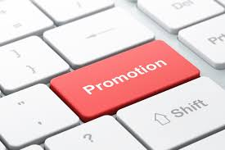
1- The Marketing Mix: Promotion
- Among all the elements of the marketing mix, promotion is the most emphasized in tourism and hospitality marketing.
- It serves to communicate details about offerings to target audiences while also playing a key role in informing, educating, persuading, and reminding consumers.
- The intangible nature of tourism products makes this function even more vital, as there is no physical product or packaging to capture the attention of potential customers.

Slide 4
1- The Marketing Mix: Promotion
- The goal of promotion is to drive demand and attract customers.
- Promotional activities encompass any actions aimed at boosting or increasing the sales of a tourism offering.
- These objectives are achieved by conveying a message about the product offering to the target audience.

Slide 5
1- The Marketing Mix: Promotion
- The marketer can choose from a large number of tools to deliver the message including advertising, sales promotion, personal selling, and public relations, and digital marketing and social media.
- These techniques are alsi referred to as the promotions mix.

Slide 6
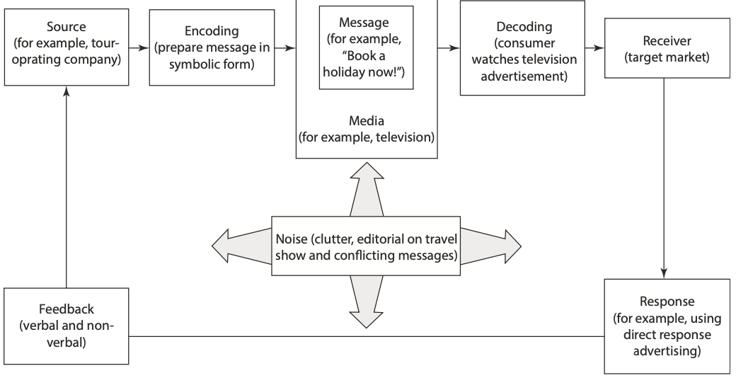
2- Communication Theory
- Communication theory helps explain the reasoning behind specific marketing communication strategies and actions.
The communication theory includes different elements for example:
Source, encoding, message, noise, media, decoding, receiver, response, and feedback

Slide 7
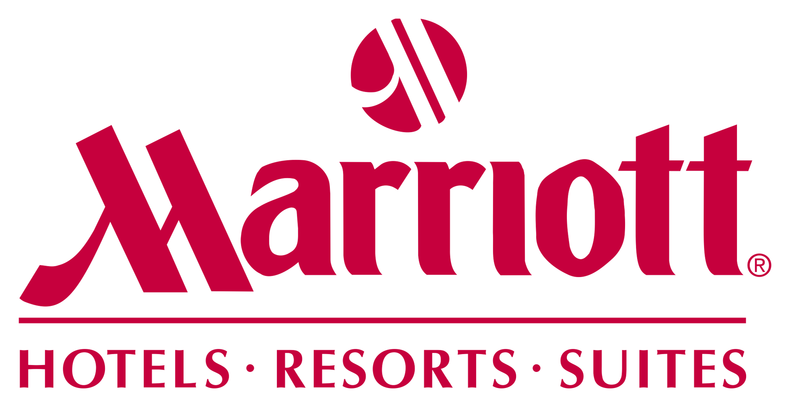
2- Communication Theory
Source:
It indicates the person or organization, aiming to deliver a message to consumers.
For instance, the Marriott hotel chain may introduce a new offer or service and aim to communicate it to its customers.

Slide 8
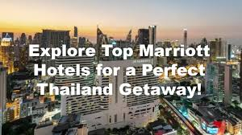
2- Communication Theory
Encoding
Encoding is the process of transforming a message into a symbolic format that the target market can easily understand by using suitable words, pictures,
use of celebrities, symbols, music, and sounds.

Slide 9
2- Communication Theory
Message:
- The message represents what the sender intends to communicate and hopes the recipient understands.
- It should be clear and straightforward,
ensuring it delivers the correct information to
the appropriate audience.

Slide 10
2- Communication Theory
Noise:
- For instance, a television advertisement for Marriott Hotels aired immediately after a news item covering a natural disaster, political instability, or a terrorist attack would fail to deliver the desired message.
- Additionally, the message can be distorted by clutter, meaning the audience may be exposed to a large number of advertisements that weaken the advertiser’s intended communication.

Slide 11
2- Communication Theory
Media
The media are the communication channels that transmit the message from the source to the receiver, such as television advertising, radio, and social media.
Decoding
Decoding a message means that receivers
interpret it in their own way.

Slide 12
2- Communication Theory
Receiver
- Receivers are the individuals who notice or hear the message from the source.
Response:
- The primary goal of all promotion is to influence consumers' purchasing behavior by stimulating demand to enhance sales.
- The receiver then responds and reacts, which can range from forming basic thoughts and feelings about the message to taking direct action
Feedback
- Feedback is the response that the receiver sends back to the source. Ultimately, feedback is reflected in the promotion's impact on the number of consumers who choose to use Marriott Hotels.

Slide 13
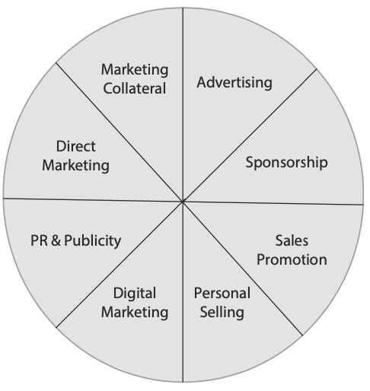
3- The Promotional Campaign
- It is important for the tourism marketer to select the right
combination of different promotional techniques to create an
effective promotional campaign.
- A marketer may choose to use just one of these techniques
or a blend of all of them, which is referred to as "integrated
marketing communication" (IMC).

Slide 14
3- The Promotional Campaign
Before designing the promotional campaign different aspects should
outlined such as,
determining the marketing objective or task,
identifying the target segment,
determining the desired response,
designing the message,
considering the promotional budget,
selecting the type of promotion,
and monitoring the impact.

Slide 15
3- The Promotional Campaign
The first step in creating a promotion is to identify the marketing objective it aims to achieve.
The four key objectives to consider are differentiation, reminder, information, and persuasion. This framework is called the DRIP model.
Differentiating
- In many markets, brands are often similar. The images crafted through marketing communications play a key role in distinguishing one brand from another.
Reminding
- Reminder promotions are primarily used when products or services have reached maturity, aiming to remind consumers of their availability.
- These promotions and advertisements also serve to inform consumers about where and when they can purchase the offering.

Slide 16
3- The Promotional Campaign
3.1- Determining the marketing objective or task:
Informing
- Informative promotions are designed to make potential consumers aware of the features and benefits of a tourism offering.
- The goal is to create new demand, attract new target markets, and build or improve the organization's image.
Persuading
- Persuasive promotions are crucial for enhancing consumer loyalty as competition intensifies, shifting consumer perceptions, and encouraging consumers who currently use a competitor’s offering to switch brands.
- This type of promotion often involves comparative advertising, where two organizations or offerings are contrasted in an advertisement.

Slide 17
3- The Promotional Campaign
3.2- Identifying the Target Segment
- The first factor to consider is the target audience and the benefits they are seeking.
- Most tourism businesses target multiple market segments.
- These segments may include current and potential users, category and brand users, as well as individuals and groups.
- The target audience has a significant impact on the marketer’s decisions regarding what the message will convey, how it will be delivered, where it will be delivered, and who will deliver it.

Slide 18
3- The Promotional Campaign
3.3- Determining the Desired Response
- Once the target audience is defined, the marketer must establish the desired response (also referred to as the "call to action").
- Various objectives within the AIDA (Attention, Interest, Desire, Action) process require different promotional techniques to generate Awareness, spark Interest, foster Desire, and prompt Action.
- Therefore, the desired response from any promotional activity is closely tied to the marketing objective.

Slide 19
3- The Promotional Campaign
3.4- Designing the Message
When crafting a message, marketers need to consider several factors:
- The source of the message
- The media channel to be used
The credibility of the message heavily depends on its source.
- For instance, a friend or relative would be perceived as a trustworthy source, whereas a stranger would need credentials or evidence to enhance the reliability of the information.

Slide 20
3- The Promotional Campaign
3.4- Designing the Message
- The marketer must select an appropriate media channel to communicate the message to the target audience. These channels can include:
Broadcast media: Such as television, radio, and cinema.
Print media: Including newspapers, posters, consumer magazines, and trade magazines.
Digital platforms: Such as email, websites, apps, social media, and digital billboards.
Out-of-Home (OOH) advertising: Like billboards and street furniture.

Slide 21
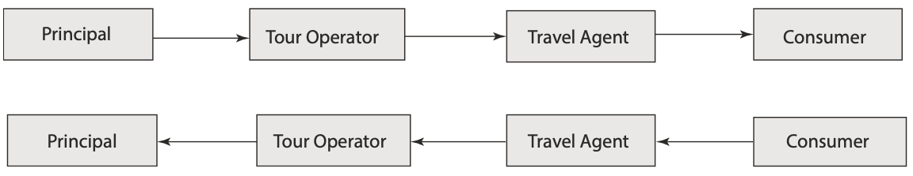
3- The Promotional Campaign
3.4- Designing the Message
- Another consideration in selecting promotional techniques is whether a tourism organization opts for a push or a pull strategy.
The Push Strategy
- A push strategy involves an organization driving sales by promoting its offerings directly to intermediaries, who then pass them along to their customers.
- The principal (such as a hotel, visitor attraction, or cruise line) employs promotional methods like personal selling and sales promotions to motivate intermediaries—such as tour operators or wholesalers—to order, stock, and market the offerings to retailers or travel agents, who ultimately promote them to consumers.

Slide 22
3- The Promotional Campaign
3.4- Designing the Message
The Pull Strategy
- In contrast, a tourism organization employing a pull strategy focuses its promotional efforts—primarily advertising and some sales promotions—directly on consumers to encourage them to purchase its offerings.
- This approach aims to create consumer demand, driving customers to visit travel agencies and intermediaries to stock the offering due to high demand.
- A pull strategy is a marketing approach where funds are allocated primarily to advertising and promotional efforts, aimed at creating consumer demand for a product or service.

Slide 23
3- The Promotional Campaign
3.5- Considering the Promotional Budget
- When selecting a promotional tool, the marketer must also consider the amount of money allocated for the campaign.
- Setting a budget for a new product can be challenging, as there are no established sales or profitability benchmarks.
- A promotional budget can be determined using one or more of the following methods:
Affordability or Ad Hoc Basis
- The simplest approach to setting a promotional budget is to base it on what the company can afford.

Slide 24
3- The Promotional Campaign
3.5- Considering the Promotional Budget
Industry Average
- This method involves analyzing the promotional budgets of competitors.
- Companies track competitors' advertising activities or conduct research on industry spending estimates from trade associations, and then set their own budgets in line with the industry average.
Percentage-of-Sales Method
- In this approach, the promotional budget is determined as a percentage of either past sales or foreseen sales.

Slide 25
3- The Promotional Campaign
3.5- Considering the Promotional Budget
Marketing Objectives
- This method involves setting the budget based on the tasks necessary to achieve specific marketing objectives. Each task is then assigned a cost.
- For instance, if the objective is to increase sales by 15%, the marketer develops a budget designed to accomplish that goal.
Share-of-Voice Method
- The Share-of-Voice method evaluates products and brands based on their presence in the marketplace.
- This is determined by calculating the value (based on cost) of the exposure they receive during monthly periods through various promotional materials.
- These include advertisements in print, cinemas, television, radio, out-of-home media (OOHM) such as transport, flyers, and online platforms.

Slide 26
3- The Promotional Campaign
3.6- Selecting the Type of Promotion
- The purpose of promotion is to convince potential consumers of the benefits of purchasing or using the tourism products or services provided by a specific organization.
- Tourism and hospitality marketers utilize various methods, collectively known as the promotions mix, to deliver their messages to the public.
- These methods include advertising, sales promotion, personal selling, public relations, and increasingly, digital marketing and social media.

Slide 27
3- The Promotional Campaign
3.6- Selecting the Type of Promotion
- A marketer may opt to use a single promotional tool or a combination of tools.
- With Integrated Marketing Communications (IMC), a marketer can achieve sales targets through various combinations of the promotions mix.
- IMC is often referred to as “platform convergence” because it integrates multiple communication channels to create a comprehensive strategy that enhances the customer experience.

Slide 28
3- The Promotional Campaign
3.7- Monitoring the Impact
- The final step in a promotional campaign is evaluating its effectiveness by quantifying its impact.
- Marketers should assess whether the marketing objectives have been achieved.

Slide 29
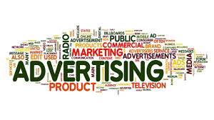
4- Advertising
- Advertising is the most widely recognized tool in the promotional mix, involving paid media placements designed to influence consumer behavior.
- It allows tourism and hospitality organizations, such as hotels, car hire companies, visitor attractions, airlines, and intermediaries like tour operators and travel agents, to reach target markets in various locations—whether at home, elsewhere, or on the move.
- Unlike other promotional tools, advertising is paid,
giving marketers control over the message, timing,
delivery method, and communication channels
used to reach their audience.

Slide 30
4- Advertising
The goals of advertising can vary, but typically include:
- Creating awareness of a new product or service.
- Describing the product's attributes and features.
- Suggesting usage situations for the product.
- Distinguishing the product from competitors' offerings.
- Directing buyers to the point-of-purchase.
- Creating or enhancing a brand image.

Slide 31
4- Advertising
- Advertising can de defined as “Advertising is a paid, mediated form of communication from an identifiable source, designed to persuade the receiver to take some action, now or in the future”.
The Advertising Campaign
- When designing an advertising campaign or media plan, the tourism marketer must address five key decisions:
4.1- Objective Setting
- As with any marketing plan, the first step in planning an advertising campaign is to establish clear objectives.
- There are four primary objectives to consider: differentiating, informing, persuading, or reminding the target market.

Slide 32
4- Advertising
4.2- Budget Decisions
- After defining the advertising objectives, the marketer must establish a budget for the campaign.
- As discussed earlier in this chapter on communications theory, several methods can be used to develop a promotional budget:
Affordability or ad hoc basis
Industry average
Percentage-of-sales method
Marketing objectives
Share-of-voice method

Slide 33
4- Advertising
4.3- Message Decisions
- The third step in creating an advertising campaign is to determine the message that the advertisement will convey.
- Regardless of the advertising budget, success is only achieved if the message captures attention and communicates effectively.
- The message should be innovative, engaging, and offer value to consumers.

Slide 34
4- Advertising
4.3- Message Decisions
- Marketers should follow three key steps to craft a creative advertising message:
Message Generation
- The first step is to generate an idea for the message.
- The intangible nature of tourism offerings, such as hotel stays, holidays, or dining experiences, can make selecting the right message challenging for marketers.
- The question is how to effectively illustrate these experiences.
Message Evaluation and Selection
- The tourism marketer must assess potential messages based on key criteria such as relevance, credibility, and uniqueness.
Message Execution

Slide 35
4- Advertising
4.3- Message Decisions
Message Execution
- The message must be presented in a format that captures the target market’s attention and interest.
- The marketer needs to choose the right style, tone, language, and format to effectively deliver the advertising message and engage the audience.

Slide 36
4- Advertising
4.3- Media Decisions
- The next step in the advertising campaign is to select the appropriate media to allocate the advertising budget.
- The tourism marketer has a wide range of media options available.
- There are three key stages in making media decisions:
Choosing among media types:
Print Advertising
Broadcast Advertising.
Digital or Mobile Advertising
Outdoor Advertising.

Slide 37
4- Advertising
4.3- Media Decisions
Deciding on reach, frequency, and impact:
- Reach refers to the total number of potential consumers who encounter the advertising campaign at least once.
- Frequency represents the average number of times these consumers come into contact with the advertising message.
- Impact assesses the effectiveness and credibility of the advertising message in influencing the target audience

Slide 38
4- Advertising
4.3- Media Decisions
Deciding on timing:
- The marketer must determine the optimal timing for placing advertisements, including when to run them and how frequently. There are three types of scheduling approaches: pulsing, concentrated, and continuity scheduling.
- Pulsing refers to the strategy of scheduling advertisements on an irregular basis over a specific period of time.
- A concentrated approach focuses advertisements in a particular part of the planning period, without spreading them out at other times.
- Continuity scheduling involves placing advertisements evenly and consistently throughout a specified time period.

Slide 39
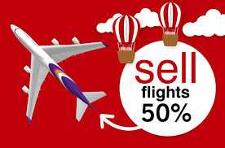
5- Sales Promotion
- Sales promotion is an activity designed to provide extra incentives for consumers, sales representatives, and intermediaries to make a purchase.
- It typically involves special offers, discounts, or other incentives to encourage immediate buying decisions.
- The primary aim of sales promotion is to stimulate
additional sales, often through short-term offers that
encourage consumers to act quickly and book or
purchase at the point of sale.

Slide 40
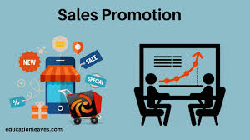
5- Sales Promotion
- Sales promotion should not be viewed merely as an alternative to advertising.
- Instead, it should complement advertising efforts.
-While advertising helps build awareness
and brand recognition over the long term,
sales promotion provides short-term
incentives that drive immediate action
and boost sales.

Slide 41
5- Sales Promotion
- Marketers may use sales promotion techniques when there's a need for a quick boost in sales, such as when launching a new product or when trying to sell excess capacity or stock.
- However, sales promotion is sometimes misused as a quick-fix solution for issues that require long-term strategies.
- For example, a restaurant facing serious problems
may see an immediate increase in visitors through
sales promotion, but this can mask underlying
management issues, creating the illusion of
efficiency.

Slide 42
5- Sales Promotion
The main objectives of sales promotion include:
- To gain consumer awareness or attract new users
- To increase off-peak sales
- To encourage repeat visits by loyal consumers
- To combat or pre-empt competition
- To encourage early bookings

Slide 43
5- Sales Promotion
There are also different techniques for sales promotion, such as
Merchandising and point-of-sale material:
- Wall displays, posters, brochure dispensers, menus, banners, signs and tent cards destination-branded souvenirs, t-shirts, and pens.
Samples:
- Free samples of items to push sales or arranging in
some way for people to experience part or all of
a tourism offering, encouraging potential customers
to engage and make a purchase at a low cost or free
as an incentive to purchase an offering.

Slide 44
5- Sales Promotion
Coupons (vouchers) and gift certificates:
- Coupons are vouchers or certificates that give target audience savings when they purchase specific offerings.
Discounts and special offers:
- Advertised reductions in price that does not involve a coupon or voucher.
Patronage awards (also known as loyalty incentives or club memberships)
- This technique focuses on rewarding and promoting loyalty by
encouraging frequent purchases from identified existing
consumers, often through loyalty programs or incentives
or free as an incentive to purchase an offering.

Slide 45
5- Sales Promotion
Competitions, sweepstakes, and prizes:
- Give individuals a chance to win money, a gift, or a holiday.
- They provide tourism companies with useful information to add to a consumer database
Free gifts, premiums, and incentives
- Items offered either at a low cost or free as an incentive to purchase an offering.

Slide 46
Activity
Imagine you are running a promotion process for an existing/new product, which promotion tool do you intend to use:
Advertising
- Specify your objective: differentiating, informing, persuading, or reminding
- Specify your budget decision
- Specify media decision
Sales promotion
- Specify your objective
- Specify your techniques

Slide 47
Thank you
      European Institute of Innovation, Entrepreneurship and Technology
      Lessingstraße 79,
      13158 Berlin, Germany
      Phone: +49 176 55524449
      Email: info@eiiet.com
Discover the world of eiIET

