Slide 1
Operations Management in Hospitality
European Institute of Innovation, Entrepreneurship and Technology
Lessingstraße 79, 13158 Berlin, Germany
Mahmoud Abdou| Berlin
      Lessingstraße 79,
      13158 Berlin, Germany
      Phone: +49 30 233618555
      Fax: +49 30 233618556
      Email: info@eiiet.com

Slide 2

Index
- Hospitality Operations Management: An Introduction
- The Definition and Nature of Services
- Hospitality Decisions and Processes
- The Strategic Service Vision

Slide 3
1- Hospitality Operations Management
      - Hospitality goes beyond hotels and restaurants
      - Includes:
Lodging | Food and beverage services
Meetings and events facilitation | Theme parks and amusements
Casino gaming | Clubs
Travel services

Slide 4
1- Hospitality Operations Management
      - Aims to coordinate profitably:
      The design, development, and delivery of service experiences
      -Encompasses all activities, decisions, and responsibilities for business success
      - Focuses on the effective use of company resources, including:
Employees | Equipment
Technology | Customers

Slide 5
1- Hospitality Operations Management
      1.1- Goals of Hospitality Operations Management:
      - Understand and meet customer needs
      - Design and deliver quality service
      - Manage efficient and effective service processes
      - Promote continuous service improvement
      - Achieve organizational objectives

Slide 6

2- The Definition and Nature of Services

Slide 7
2- The Definition and Nature of Services
      - Services are part of everyday life — diverse in style and outcome
      - Can be provided:
      Directly to the customer (spa treatments)
      For the customer (food deliveries)
      - Delivered through:
      Personnel (bellmen delivering luggage)
      Technology (online restaurant reservations)

Slide 8
2- The Definition and Nature of Services
      2.1- Defining a Service
      - A service is an action, performance, or process between customer and provider
      - Represents the intangible part of a transaction
      - A product, by contrast, is the tangible component

Slide 9
2- The Definition and Nature of Services
      2.2- Dimensions of Services
      - Service process
      - Service nature
      - Service delivery
      - Service availability
      - Service demand
Service process
Service nature
Service delivery
Dimens-ions of Services
Service availability
Service demand

Slide 10
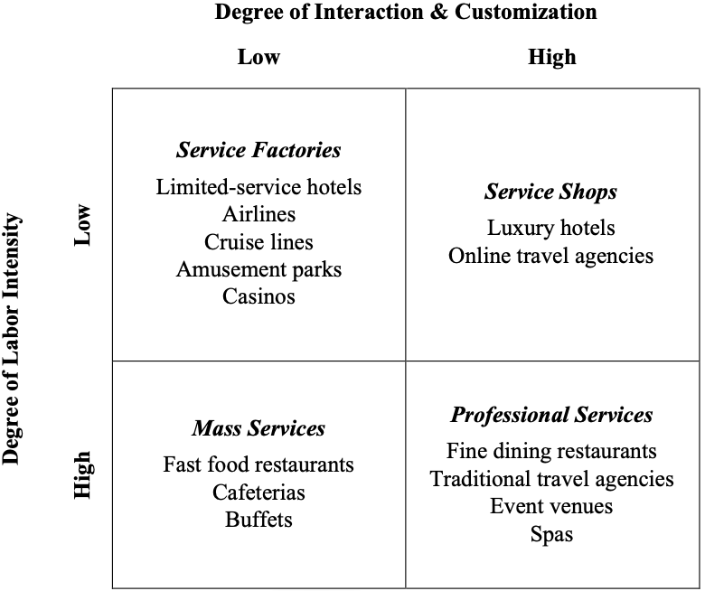
2- The Definition and Nature of Services
      A- Service Process:
      - This dimension explains how services differ based
      on two key factors:
      Labor Intensity
      Customization process

Slide 11
2- The Definition and Nature of Services
      Service Factory:
      - Low labor intensity, low customization.
      - Highly standardized and technology-driven.
      - Focus on efficiency, volume, and consistency
      rather than personal interaction.

Slide 12
2- The Definition and Nature of Services
      Service Shop:
      - Low labor intensity, high customization
      - Moderate human involvement, but still provides
      personalized service.
      - Combines some efficiency with customization.

Slide 13
2- The Definition and Nature of Services
      Mass Service:
      - High labor intensity, low customization
      - Many employees needed to serve large volumes of
      customers.
      - Service itself is standardized and repetitive.

Slide 14
2- The Definition and Nature of Services
      Professional Service:
      - High labor intensity, high customization
      - Services are highly personalized, time-consuming,
      and skill-intensive.
      - Employees are trained professionals who work closely
      with clients

Slide 15
2- The Definition and Nature of Services
      B- Service Nature:
      - This dimension looks at what the service does and
      what it acts upon to produce a result.
      - It helps classify services based on their effect and outcome.
      Service object:
      - The person or thing receiving the service
      Service result:
      - The tangible or intangible outcome of the service
Service process
Service nature
Service delivery
Dimens-ions of Services
Service availability
Service demand

Slide 16
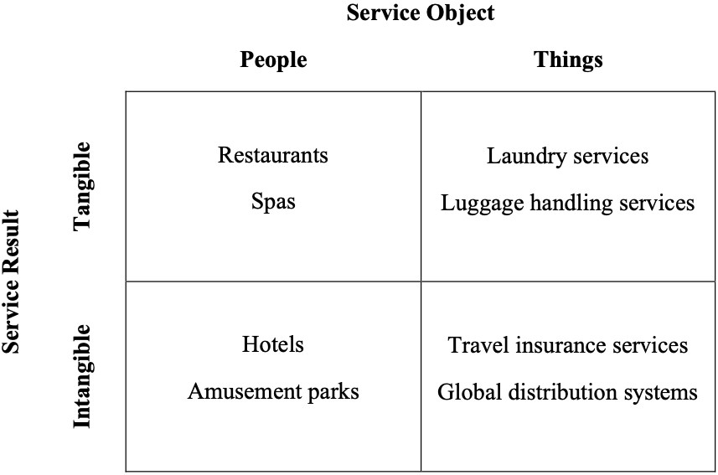
2- The Definition and Nature of Services
      Service Nature:
      - Application in Hospitality
      - Service objects are usually people
      - Service results can be:
      - Tangible or intangible

Slide 17
2- The Definition and Nature of Services
      C- Service Delivery:
      - Focuses on the timing and mode of service delivery.
      - Or, how and when a service is delivered to the customer.
      Timing of Service
      - Scheduled services:
      Require prior arrangement (fine dining reservations)
      - Unscheduled services:
      Available without prior notice (fast-food restaurants)
Service process
Service nature
Service delivery
Dimens-ions of Services
Service availability
Service demand

Slide 18
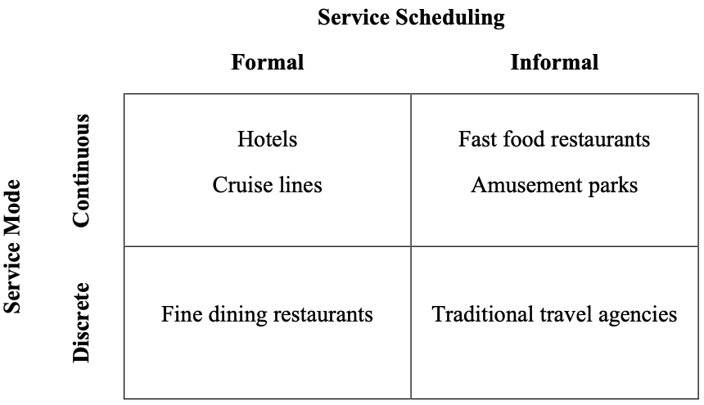
2- The Definition and Nature of Services
      - Mode of Service
      Fixed increments:
      -Continuous:
      Service occurs without interruption or
      ongoing throughout the experience.
      Service occurs in set portions or sessions.

Slide 19
2- The Definition and Nature of Services
      D- Service Availability:
      -Relates to the service setting.
      - Means where and how the service takes place
      Key Aspects
      Service site:
      - Occurs in one specific location or across multiple locations
      Service execution:
      - Effort required by guest, provider, or neither to access the service
Service process
Service nature
Service delivery
Dimens-ions of Services
Service availability
Service demand

Slide 20
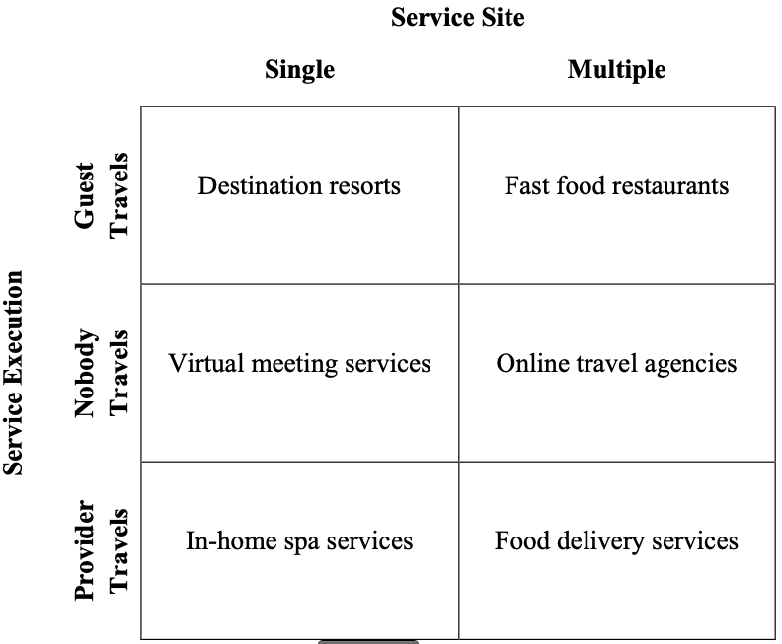
2- The Definition and Nature of Services
      Service Availability:
      - Service Setting
      Single-site service
      Multi-site service
      - Service Execution
      Guest-executed services
      Provider-executed services
      No travel required

Slide 21
2- The Definition and Nature of Services
      E- Service Demand:
      - Depends on two factors:
      Customer demand for the service
      Service capacity to accommodate that demand
Service process
Service nature
Service delivery
Dimens-ions of Services
Service availability
Service demand

Slide 22
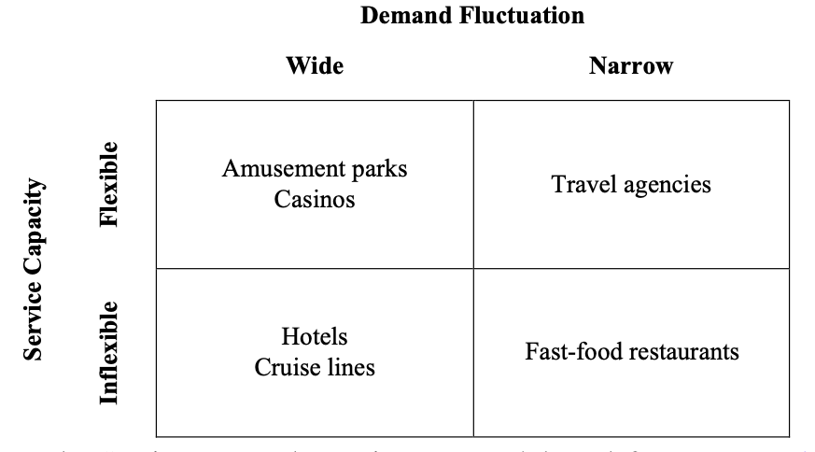
2- The Definition and Nature of Services
      Service Demand:
      Demand Fluctuation
      - This shows how much customer demand changes over time.
      - Wide fluctuation:
      Demand varies greatly depending on the season, day, or time.
      - Narrow fluctuation:
      Demand is steady throughout the year, with little variation.

Slide 23
2- The Definition and Nature of Services
      Service Capacity:
      - This refers to how easily a service can adjust its capacity to
      match fluctuations in demand.
      Flexible capacity:
      The service can adjust easily.
      For instance, by hiring temporary staff or extending hours.
      Inflexible capacity:
      The service has limited ability to adjust because of fixed
      resources or infrastructure.

Slide 24
2- The Definition and Nature of Services
      2.3- The Service Package:
      - Used to analyze the components that make up a delivered service
      - Represents the bundle of elements forming the guest experience
      - The service package consists of five components
Supportin facilities
Facilitatin goods
Service informat-ion
The Service Package
Explicit services
Implicit services

Slide 25
2- The Definition and Nature of Services
      A- Supporting Facilities
      - Services depend on a mix of location, equipment, and technology
      - These elements enable the performance and delivery of the service
      Example:
      - Hotel Requires:
      Physical structure (building and location)
      Interior design and aesthetic ambience (music, lighting, décor)
      Operational equipment (front office computers, restaurant dishware)
Suppor-tin facilities
Facilitatin goods
Service informat-ion
The Service Package
Explicit services
Implicit services

Slide 26
2- The Definition and Nature of Services
      B- Facilitating Goods
      - Tangible items that are transformed or consumed during the service process
      Examples
      - Restaurant experience: Food and beverages served to guests
      Distinction
      - Facilitating goods: used or consumed in the service
      - Supporting facilities: part of infrastructure
Suppor-tin facilities
Facilitatin goods
Service informat-ion
The Service Package
Explicit services
Implicit services

Slide 27
2- The Definition and Nature of Services
      C- Service Information
      - Knowledge from and about the customer used to enhance service delivery
      Examples in Hospitality and Services:
      - Ritz-Carlton Hotels:
      Captures guest preferences to personalize stays
      -Uber:
      Uses customer location data to optimize pickups and drop-offs
      - Hence, service information enables tailored, efficient,
      and responsive service experiences.
Suppor-tin facilities
Facilitatin goods
Service informat-ion
The Service Package
Explicit services
Implicit services

Slide 28
2- The Definition and Nature of Services
      D- Explicit Services
      - Obvious characteristics of the service process or outcome, directly perceived by the guest
      - What the customer gets
      Examples
      - Spa treatment:
      Guest feels muscle relaxation after a massage
      - Restaurant:
      Guest appreciates the aroma or presentation of food
      - Hence explicit services are direct consequences of the service,
      shaping the guest’s perception
Suppor-tin facilities
Facilitatin goods
Service informat-ion
The Service Package
Explicit services
Implicit services

Slide 29
2- The Definition and Nature of Services
      E- Implicit Services
      - Services that produce indirect emotional effects for the guest.
      - Enhance the overall guest experience and satisfaction.
      - Refers to how the customer feels
      Examples
Suppor-tin facilities
Facilitatin goods
Service informat-ion
The Service Package
Explicit services
Implicit services
Luxury atmosphere and design | Convenience features
Server attitude | Ambience and atmosphere
Waiting times | Guest status and sense of well-being
Privacy and security | Convenience

Slide 30
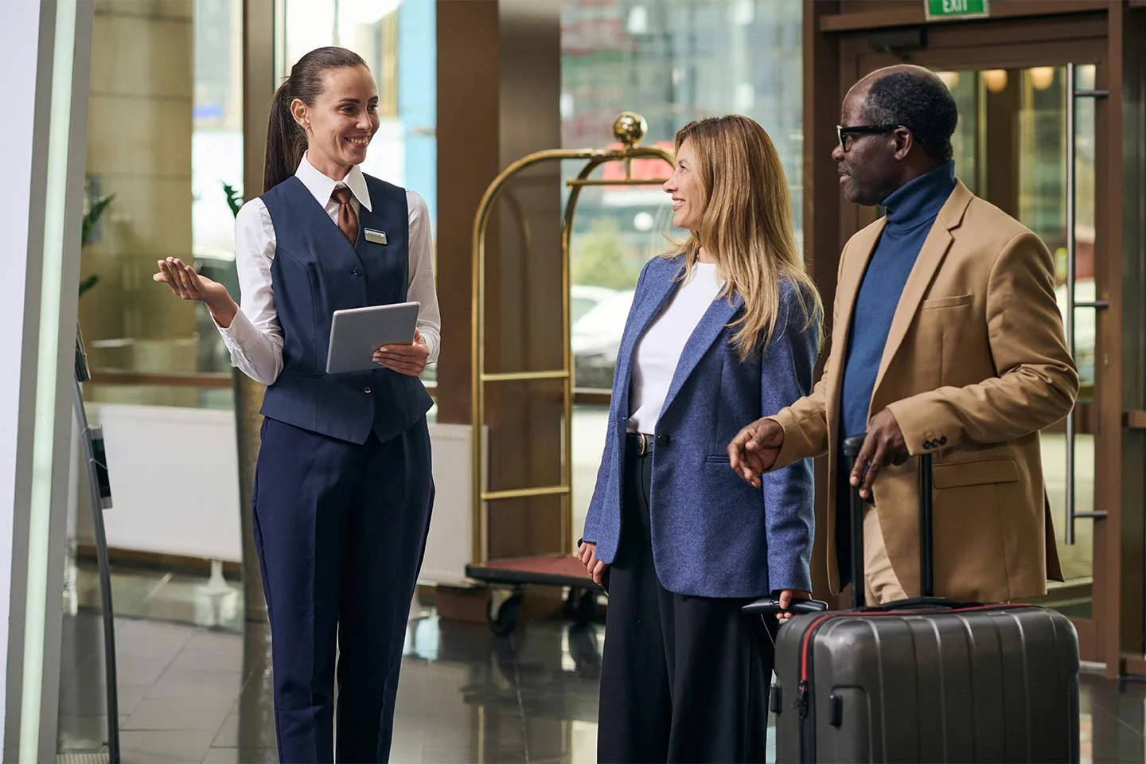
3- Hospitality Decisions and Processes

Slide 31
3- Hospitality Decisions and Processes
      3.1- Service Concepting
      - Identifies the “what” and “how” of a service
      - Reflects how customers, staff, and shareholders should perceive the service
      Importance in Hospitality
      - Ensures customers understand what they are buying or receiving
      - Helps staff know what they are selling and how to deliver it
      - Serves as the foundation for operations strategies

Slide 32
3- Hospitality Decisions and Processes
      - Helps firms strategically manage operations
      - Supports the development of competitive advantages
      - Service Concept includes:
      The organizing idea
      The Service Provided
      The Service Received
The organizing idea
The Service Provided
The Service Received
The Service Concept

Slide 33
3- Hospitality Decisions and Processes
      A- The Organizing Idea
      - Represents the core service that customers are purchasing
      - Guides resource allocation and service design decisions
      Example
      - Hotel organizing idea: “Providing a home-like environment”
      - Focus on creating rooms and spaces that make guests feel at home
The organizing idea
The Service Provided
The Service Received
The Service Concept

Slide 34
3- Hospitality Decisions and Processes
      B- The Service Provided
      - Represents the complete service process and outcomes
      - Reflects how the service concept is brought to life for the guest
      Example: “Home-like Environment” Hotel
      - Pleasant check-in experience supported by helpful staff
      - Beyond basic amenities:
      In-room kitchenettes
      On-site laundry facilities for guest use
The organizing idea
The Service Provided
The Service Received
The Service Concept

Slide 35
3- Hospitality Decisions and Processes
      C- The Service Received
      - Encompasses the customer experience and the service outcomes
      Customer Experience
      - Reflects the customer’s positive or negative response
      Service Outcomes
      - Represent what the customer gains from the service, such as:
The organizing idea
The Service Provided
The Service Received
The Service Concept
Products | Benefits
Emotions | Intentions

Slide 36
3- Hospitality Decisions and Processes
      3.2- Service-Profit Chain
      - Explains the link between customer satisfaction, loyalty, and profitability
      - Customer loyalty is a key source of competitive advantage and improved performance
      Core Principles:
      - Retaining existing customers is as crucial as attracting new ones
      - Customer satisfaction drives customer loyalty
      - Satisfied customers are more likely to return and recommend

Slide 37
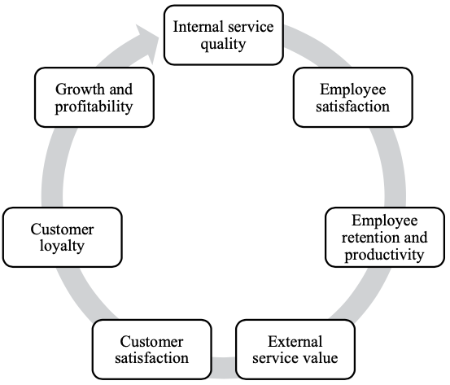
3- Hospitality Decisions and Processes
      3.2- Service-Profit Chain
      - Logic of the Service-Profit Chain is as follows:

Slide 38
3- Hospitality Decisions and Processes
      A- Internal Service Quality
      - Drives overall employee satisfaction
      - Influenced by the quality of the working environment
      - Key aspects of internal service quality:
      Equipping employees with skills and authority to serve customers
      Positive internal interactions among staff

Slide 39
3- Hospitality Decisions and Processes
      B- Employee Satisfaction
      Drives retention:
      - Satisfied employees are less likely to leave the company
      Boosts productivity:
      - Higher satisfaction leads to better performance and efficiency
      Reduces turnover costs:
      - Turnover rates can be up to three times lower for satisfied employees

Slide 40
3- Hospitality Decisions and Processes
      C- Employee Retention
      - High productivity enhances customer value perception
      - External service value includes:
      Timely service delivery
      Friendly and helpful employees
      Impact on customers:
      - Customers value not only physical attributes but
      also quality of service interactions

Slide 41
3- Hospitality Decisions and Processes
      D- External Service Value
      - External service value drives customer satisfaction
      - Customers are increasingly value-oriented as services/products
      become commoditized
      - Value is created at the point of consumption
      - Customers judge the experience and outcomes themselves

Slide 42
3- Hospitality Decisions and Processes
      E- Customer Satisfaction → Customer Loyalty
      - Satisfaction is key to loyalty
      - Satisfied customers:
      Visit more often
      Recommend the service to friends and family

Slide 43
3- Hospitality Decisions and Processes
      F- Customer Loyalty, Growth and Profitability
      - Drives revenue growth
      - Boosts profitability even with a small increase in loyal customers
      - Reduces marketing costs through positive word of mouth
      - Encourages repeat business and long-term relationships
      - Strengthens brand reputation

Slide 44

4- The Strategic Service Vision
4- The Strategic Service Vision

Slide 45
4- The Strategic Service Vision
      4- The Strategic Service Vision
      - A framework for strategic planning in service firms
      - Systematically guides a set of ideas and actions to maximize performance
      - Elements of the Strategic Service Vision
Target Market Segment | Service Concept
Operating Strategy | Service Delivery System

Slide 46
4- The Strategic Service Vision
      A- Target Market Segment:
      - Who is the business serving?
      - Hospitality operations cannot satisfy everyone
      Key Considerations for Targeting
      - Market Segmentation Dimensions
      - Primary Market Segment Characteristics
      - Customer Needs Priorities
Target Market Segment
Service Concept
Operation Strategy
Strategic Service Vision Elements
Service Delivery System

Slide 47
4- The Strategic Service Vision
      B- Service Concept
      - What is the business providing to customers?
      - Describes the nature of the service for customers, employees, and stakeholders
      Key Questions for Developing a Service Concept
      - Customer Expectations and Needs
      - Important Service Elements
      - Perceptions of the Service Concept
Target Market Segment
Service Concept
Operation Strategy
Strategic Service Vision Elements
Service Delivery System

Slide 48
4- The Strategic Service Vision
      C- Operations Strategy
      - What needs to change for us to advance?
      - It is a set of strategies, plans, and policies that guide how an organization manages its:
      Key Considerations
      - Role of Business Functions
      - Focus of Efforts and Investments
      - Quality and Cost Control
Target Market Segment
Service Concept
Operation Strategy
Strategic Service Vision Elements
Service Delivery System
Operations | Financing
Marketing | Human resources
Control systems

Slide 49
4- The Strategic Service Vision
      D- Service Delivery System
      - Does the process support our strategy?
      - It is designed to execute successful service offerings and
      ensure smooth, consistent service encounters.
      Key Considerations
      - Features of the Service Delivery System
      - Capacity Management
      - Quality, Differentiation, and Barriers to Entry
Target Market Segment
Service Concept
Operation Strategy
Strategic Service Vision Elements
Service Delivery System

Slide 50
Thank you
      European Institute of Innovation, Entrepreneurship and Technology
      Lessingstraße 79,
      13158 Berlin, Germany
      Phone: +49 176 55524449
      Email: info@eiiet.com
Discover the world of eiIET

