Slide 1
Reseacrh on Tourism Services
European Institute of Innovation, Entrepreneurship and Technology
Lessingstraße 79, 13158 Berlin, Germany
Mahmoud Abdou| Berlin
      Lessingstraße 79,
      13158 Berlin, Germany
      Phone: +49 30 233618555
      Fax: +49 30 233618556
      Email: info@eiiet.com

Slide 2
Index
- Special Features of Tourism Services
-Factors Influencing Consumer Behavior
- The Market Research and Customer Satisfaction
- Customer satisfaction and service quality
Measuring and Controlling Service Quality in Tourism

Slide 3
1- Special Features of Tourism Services
    - In addition to the four generic characteristics shared by all services (Intangibility, inseparability, perishability, variability, the tourism and hospitality industry has several unique features: non-ownership, seasonality, fixed location, customer loyalty, high costs, distribution channels, interdependence among tourism offerings, and vulnerability to external shocks and events.
    Non-ownership
    - Unlike tangible goods, such as cars, which are owned permanently after purchase, tourism offerings provide only temporary access or use.
    - Consumers do not retain physical products from their tourism experiences.
    - Ownership of tourism services or products (e.g., hotel rooms, rental cars) is not transferred to the consumer.
    - Customers pay for the right to use these services temporarily.
    - All that consumers take home are souvenirs and intangible memories of the experience

Slide 4
1- Special Features of Tourism Services
    Seasonality
    - According to scholar “tourism has one of the most highly seasonal patterns of demand for any product”.
    - Tourism demand varies significantly across different times of the year, often influenced by factors such as weather, holidays, and school schedules.
    - Seasonality heavily influences when tourism companies and Destination Marketing Organizations (DMOs) launch marketing campaigns.
    - Businesses, like holiday resorts, may tailor marketing strategies to specific seasonal periods.
    - A resort, for instance, could offer special promotions and direct marketing campaigns targeting repeat visitors during quieter months, such as September to November, after school holidays.

Slide 5
1- Special Features of Tourism Services
    Fixed Location
    - Tourist destinations and tourism/hospitality businesses (e.g., hotels, resorts, attractions) operate from specific, immovable locations.
    - Since the services cannot move to the consumer, effective communication and promotional strategies are critical to attract visitors.

Slide 6
1- Special Features of Tourism Services
    Fixed Location
    - Tourist destinations and tourism/hospitality businesses (e.g., hotels, resorts, attractions) operate from specific, immovable locations.
    High Costs
    • Tourism and hospitality businesses typically have high fixed costs and relatively low variable costs. Fixed costs refer to expenses that must be paid to keep the business operational, regardless of the level of activity. These include permanent staff wages, rent, utilities, and marketing expenditures.
    • However, variable costs are expenses that fluctuate based on the number of consumers served by the organization, including additional staff for peak periods, maintenance costs, and meals and other services provided to guests.
    Since the services cannot move to the consumer, effective communication and promotional strategies are critical to attract visitors.
    Customer Loyalty
    Brand Loyalty
    - Consumer loyalty in tourism is highly variable. Some travelers are loyal to specific products, while others may only visit a destination or use a service once.
    - Consumers may show loyalty to specific tourism brands, such as hotel chains, restaurant chains, or airlines.
    - This loyalty is often based on consistent satisfaction and the ability to meet their needs.

Slide 7
1- Special Features of Tourism Services
    Destination and Hotel Loyalty
    - Some consumers prefer variety, visiting different destinations or hotels on each trip.
    - Others exhibit destination or hotel loyalty, returning to the same resort or hotel year after year.
    Professional Loyalty
    - Professional Conference Organizers (PCOs) often remain loyal to hotels or venues that consistently deliver quality service for events.
    Influencing Factors
    - Availability: Ease of access and booking can influence loyalty.
    - Affordability: Disposable income plays a significant role in determining repeat patronage

Slide 8
1- Special Features of Tourism Services
    High Costs
    - Tourism and hospitality businesses typically have high fixed costs and relatively low variable costs.
    - Fixed costs refer to expenses that must be paid to keep the business operational, regardless of the level of activity. These include permanent staff wages, rent, utilities, and marketing expenditures.
    - However, variable costs are expenses that fluctuate based on the number of consumers served by the organization, including additional staff for peak periods, maintenance costs, and meals and other services provided to guests.

Slide 9
1- Special Features of Tourism Services
    Distribution Channels
    - Unlike other industries, where products are delivered to consumers, tourism customers must travel to the destination to experience the service.
    - The travel component itself (e.g., flight, train, etc.) is part of the overall tourism offering.
    - The tourism industry relies heavily on intermediaries to connect consumers with tourism offerings.
    - These intermediaries play a key role in facilitating the purchase and delivery of tourism services.
    - There is a wide range of distribution channels in tourism, each serving different customer needs and preferences.
    - These intermediaries have a significant role in the tourism industry.
    - Travel agents e.g., play a crucial role in shaping the satisfaction or dissatisfaction of tourists. Their services directly impact the overall travel experience, such as providing advice, offering accommodation recommendations, and handling bookings

Slide 10
1- Special Features of Tourism Services
    Interdependence of Tourism Offerings
    - The tourism and hospitality industry is highly interdependent, with consumers typically using a variety of services and products from different providers.
    - Tourists often engage with multiple businesses, each offering a part of the overall experience. Even a simple decision, such as booking a holiday to a destination, involves several complex choices, including:
    - The mode of transportation
    - The available attractions and which ones to visit
    - The various ways to organize the holiday
    - The processes involved in tourism are unique because they often depend on coordination between multiple service providers, which can create challenges.
    - Any disruption in one aspect of the journey can significantly affect the overall experience. For example, a delayed flight can impact the entire holiday

Slide 11
1- Special Features of Tourism Services
    External Shocks and Events
    - The tourism and hospitality industry is highly vulnerable to a wide range of external shocks that can disrupt operations and impact demand.
    - Many external factors are beyond the control of marketers and managers, making it difficult to accurately predict sales volumes and demand.
    Types of External Shocks
    - Natural Disasters:
    - Events like cyclones, hurricanes, earthquakes, and volcanic eruptions can severely affect tourism.
    Health Crises:
    - Diseases and pandemics can lead to travel restrictions and a decline in tourist numbers.

Slide 12
1- Special Features of Tourism Services
    Political Factors:
    - Elections, political instability, and terrorist attacks can discourage travel.
    - Transport Disruptions: Airline strikes, transport accidents, or disruptions in transport infrastructure can impact tourism operations.
    Adverse Publicity: Negative media coverage.
    - Economic Factors: Recessions, fluctuations in exchange rates, and economic conditions can reduce consumer spending on travel.
    - Environmental Conditions: Small changes in weather, such as unseasonal rain or lack of snow, can directly affect tourist demand

Slide 13
1- Special Features of Tourism Services
    Political Factors:
    - Elections, political instability, and terrorist attacks can discourage travel.
    - Transport Disruptions: Airline strikes, transport accidents, or disruptions in transport infrastructure can impact tourism operations.
    Adverse Publicity: Negative media coverage.
    - Economic Factors: Recessions, fluctuations in exchange rates, and economic conditions can reduce consumer spending on travel.
    - Environmental Conditions: Small changes in weather, such as unseasonal rain or lack of snow, can directly affect tourist demand

Slide 14
2-Factors Influencing Consumer Behavior
      Studies on travel behavior and tourism motivation focus on the tourists and the decision-making process they undergo when planning and booking a holiday.
      Travel Behavior:
    - This refers to the patterns and habits of tourists, including how, when, and why they travel.
    - It encompasses various factors such as destination choice, mode of transportation, travel frequency, and spending patterns
    Tourism Motivation:
    - This examines the underlying reasons and psychological drivers that influence individuals to travel.
    - It includes intrinsic factors like the desire for adventure, relaxation, or cultural exploration, as well as extrinsic factors such as social status or work obligations

Slide 15
2-Factors Influencing Consumer Behavior
      Travel Behavior Theories:
    - they focus on understanding how tourists act and the types of activities they engage in during their holidays.
    - They try to comprehend and explain how individuals behave while traveling, including their choices, activities, and interactions with the environment during a trip.
    - Key theories encompass, planned behavior theory, push-pull theory, destinations choice model, and time-space geography
    Tourism Motivation Theories:
    - aim to uncover why tourists travel and explore the psychological processes driving their choices
    - These theories investigate the internal and external factors that influence travel behavior, helping to understand what inspires individuals to leave their usual environment and seek experiences elsewhere

Slide 16
2-Factors Influencing Consumer Behavior
      These motivations can be classified according to:
      Intrinsic Motivations:
    - These are internal desires, such as the need for relaxation, adventure, self-discovery, or cultural enrichment.
    - Example: A person might travel to escape daily stress or to fulfill a personal quest for knowledge
    Extrinsic Motivations:
    - External factors like social recognition, prestige, or obligations.
    - Example: Traveling for business, family gatherings, or to showcase status through luxury vacations.

Slide 17
2-Factors Influencing Consumer Behavior
      - Consumer travel behavior is influenced by a complex set of factors, which can be broadly categorized into internal and external factors.
      - The internal factors can be further divided into four main types: personal factors, psychological factors, cultural factors, and social factors.
      Personal factors:
    - Age and lifestage
    - Lifestyle
    - personality
    - Self-Image

Slide 18
2-Factors Influencing Consumer Behavior
      Personal factors
      Age and lifestage:
    - Consumers in their early 20s tend to prefer different types of holidays, modes of travel, and accommodation compared to those over 55 years old
    - The stage of the family life cycle significantly affects travel behavior
    - Family-focused resorts cater to families with entertainment and facilities such as baby gyms and teen lounges
    - Airlines have introduced designated seating areas for parents traveling with children, enhancing the travel experience for families
    - In the early stages of the life cycle, consumers face busier lives and limited time
    - As a result, they prioritize convenience, flexibility, and accessibility
    - Marketers can assist these consumers by providing: easily accessible information to aid decision-making, online services for convenience, faster transaction options to save time

Slide 19
2-Factors Influencing Consumer Behavior
      Personal factors
      Age and lifestage:
    - As consumers progress towards the later stages of the life cycle, they typically have:
    - More disposable income.
    - Greater discretionary time, enabling them to travel.
    - This segment, also known as "senior tourism," includes travelers aged 60 and above.
    - Often referred to as "grey gappers" or "silver tourists," they tend to:
    - Visit multiple destinations.
    - Spend significant amounts of money, often called "silver dollars”.

Slide 20
2-Factors Influencing Consumer Behavior
      Personal factors
      Lifestyle:
    - Lifestyle refers to a person's pattern of living, reflected in their activities, interests, and opinions (AIOs).
    - Even people who share the same culture, social class, or reference group can have different lifestyles.
    - A method used to study lifestyles by measuring individuals' AIOs (activities, interests, and opinions).
    - Key Components of Lifestyle:
    - Activities: work, hobbies, holidays, shopping, sports, recreational activities, entertainment, and social events.
    - Interests: home, job, community, food, and media.
    - Opinions: beliefs about various topics, such as politics, religion, economics, future events, education, products, and culture

Slide 21
2-Factors Influencing Consumer Behavior
      Personal factors
      Personality and self-image:
    - An individual’s personality significantly impacts their travel and tourism purchasing decisions.
    - Traits such as being adventurous or cautious, sociable or introverted, confident or shy influence the type of holiday chosen.
    - Sociable individuals, such as backpackers, often prefer social environments like hostels.
    - Personality is closely tied to self-image or self-concept, which reflects how individuals see.
    - Shy or introverted individuals may avoid highly social trips.
    - However, this relationship is debatable; introverts might choose such trips to challenge themselves and become more outgoing

Slide 22
2-Factors Influencing Consumer Behavior
      Psychological Factors
    - Psychological factors play a crucial role in determining an individual’s decisions to purchase tourism products. They include behavior, perceptions, attitudes, and motivation.
    Behavior:
    - Tourist buying behavior is significantly influenced by perception, which refers to how consumers interpret and process information through their senses.
    - Perception is shaped by motivation, learning, and attitudes, with a strong connection to prior travel experiences.
    - Perception involves how individuals interpret sensory inputs (sight, hearing, taste, touch, smell) to make decisions about tourism offerings
    - Since tourism products are intangible (they cannot be seen or physically tested before purchase), consumers rely on their perceptions to guide their decisions.

Slide 23
2-Factors Influencing Consumer Behavior
      Psychological Factors
    Learning:
    - Learning refers to the process by which individuals acquire knowledge and experience related to purchasing and consuming tourism products, which they then apply to future decisions.
    - People gain knowledge through direct consumption (experiencing tourism offerings), as well as indirect sources, such as listening to others' experiences or reading reviews.
    - Over time, consumers accumulate a mental inventory of tourism products, including both positive and negative experiences, which influences their future choices

Slide 24
2-Factors Influencing Consumer Behavior
      Psychological Factors
    Attitudes:
    - An attitude is an evaluative judgment or level of liking towards an object, person, or event. People develop attitudes based on their feelings and thoughts about various subjects, including travel and tourism.
    - Attitudes play a crucial role in shaping purchasing behavior, influencing how consumers view and react to brands, products, or services.
    - In tourism, attitudes extend to knowledge of destinations, as well as experiences with people and events
    - Negative experiences, such as poor service at a hotel or an overcrowded, polluted destination, can lead to negative attitudes that prevent future purchases or visits
    - Consumers are increasingly concerned about ethical consumption, avoiding destinations or services that are environmentally irresponsible, unethical, or detrimental to local communities
    - A bad experience in the tourism or hospitality industry (e.g., at a hotel or restaurant) can result in a negative attitude, making the consumer less likely to return or recommend the service.

Slide 25
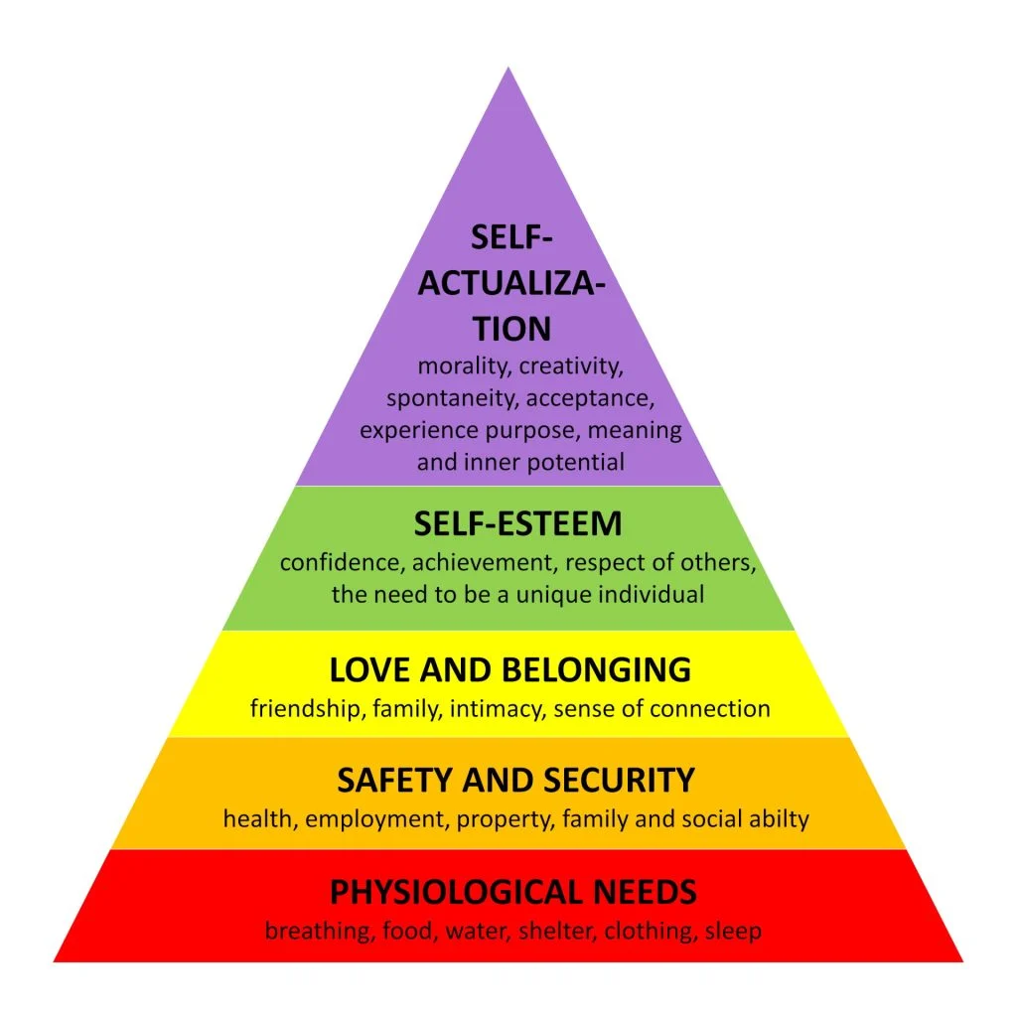
2-Factors Influencing Consumer Behavior
      - Psychological Factors
    Motivation:
    - One of the most widely used theories of motivation in
    marketing is Maslow’s Hierarchy of Needs,
    which proposes a pyramid structure of human needs.
    - The theory suggests that when an individual's goals
    are achieved, their needs subside,
    and they return to a state of normality until new needs emerge.

Slide 26
2-Factors Influencing Consumer Behavior
      Psychological Factors
    Motivation:
    - Maslow suggested that basic needs (such as physiological needs and safety) must be regularly met before individuals focus on higher-level needs like social needs or esteem needs.
    - In the tourism industry, if consumers perceive that a hotel chain effectively satisfies their basic needs (e.g., food, shelter, and security), these foundational needs become less significant to them
    - Once these lower-level needs are satisfied, marketers should focus on appealing to higher-level needs, such as status or self-esteem, in order to attract and retain consumers. For instance, a luxury hotel or a branded resort can position itself as a status symbol, offering premium services or exclusivity to appeal to consumers seeking higher-level satisfaction.

Slide 27
2-Factors Influencing Consumer Behavior
      Cultural Factors
    - Culture is the sum total of learned beliefs, values, and customs that influence the consumer behavior of members of a particular society.
    - Culture is made up of what a group has in common and what distinguishes it from other groups.
    - These elements, including language, food, clothing, art, religion, and architecture, are often passed down from one generation to another, shaping societal norms and individual behaviors.
    - Culture plays a significant role in the tourism industry as it shapes the preferences and behaviors of tourists.
    - People tend to choose destinations that align with their cultural values or interests.
    - From food preferences to the types of experiences sought (e.g., religious or historical sites, festivals), culture shapes demand in the tourism sector.

Slide 28
2-Factors Influencing Consumer Behavior
      Cultural Factors
      Culture and Ethnic Groups:
    - Culture is the sum total of learned beliefs, values, and customs that influence the consumer behavior of members of a particular society.
    - Culture is made up of what a group has in common and what distinguishes it from other groups.
    - These elements, including language, food, clothing, art, religion, and architecture, are often passed down from one generation to another, shaping societal norms and individual behaviors.
    - Culture plays a significant role in the tourism industry as it shapes the preferences and behaviors of tourists.
    - People tend to choose destinations that align with their cultural values or interests.
    - From food preferences to the types of experiences sought (e.g., religious or historical sites, festivals), culture shapes demand in the tourism sector.

Slide 29
2-Factors Influencing Consumer Behavior
      Cultural Factors
      Social grade:
    - Social grade (or class) refers to the classification of individuals based on factors such as occupation, education, income, and lifestyle. A typical class structure entails an upper, middle, and lower class. Social class is usually identified by occuption level, education, lifestyle and income
    - Consumers' social class determines their disposable income, which in turn influences their spending behavior.
    - Higher-income individuals tend to spend more on luxury or premium travel experiences, while lower-income individuals might prioritize more affordable options.
    - A typical class structure entails an upper, middle, and lower class. Social class is usually identified by occuption level, education, lifestyle and income.

Slide 30
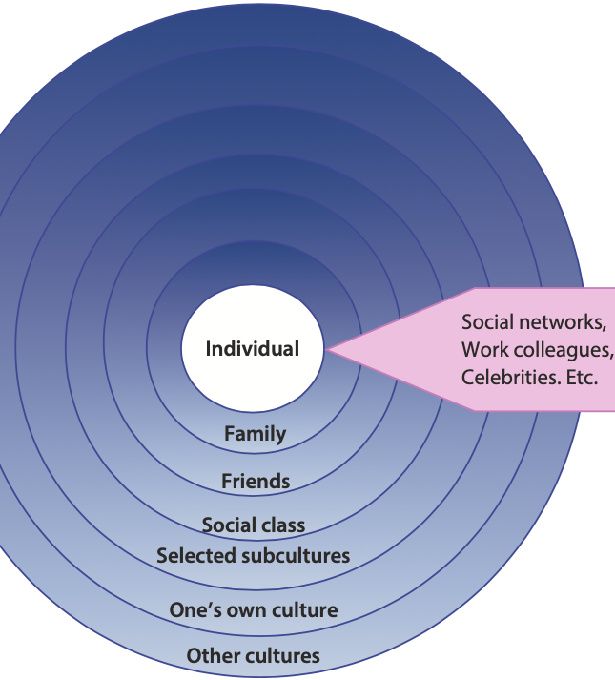
2-Factors Influencing Consumer Behavior
      -Social factors
      - Consumers’ decisions are heavily influenced by the people they
      interact with, either directly or through observation.
      - These social factors encompass reference groups and family –
      Consumers' social class determines their disposable income,
      which in turn influences their spending behavior.

Slide 31
2-Factors Influencing Consumer Behavior
      Reference groups:
    - A reference group is a group of people that influences an individual’s buying behavior.
    - Consumers often base decisions, such as choosing a holiday destination, on the preferences and behaviors of these groups.
    - Reference groups influencing consumer behavior can be diverse, including family and friends, celebrities, social clubs, workplace and colleagues, social networking sites, educational institutions, religious organizations.

Slide 32
3-The Market Research and Customer Satisfaction
      The ultimate aim of any business is to create a satisfied customer. This principle underscores the idea that customer satisfaction is not merely a byproduct of business operations but its central purpose.
      Marketing is the management process of:
      - Identifying: Understanding what customers need and want.
      - Anticipating: Predicting future customer desires and market trends.
      - Satisfying: Delivering products or services that meet or exceed expectations.
      - Profitability: Ensuring that these efforts result in sustainable profits.
      Example of a Need in Business Travel
      For business travelers, punctuality is a key need. For instance, an airline that fails to meet punctuality standards may lose business to competitors

Slide 33
3-The Market Research and Customer Satisfaction
      - Example of a Need in Business Travel
      For business travelers, punctuality is a key need. For instance, an airline that fails to meet punctuality standards may lose business to competitors.
      Example of Customer Expectations in Hotel Booking
      Travel search engines analyze customer preferences and profile hotels to refine offerings.
      Customers often search for specific requirements such as:
      - Location (e.g., city center)
      - Amenities like breakfast, wifi, fitness centers, and parking
      - Accessible rooms for those with reduced mobility
      Online booking platforms match these preferences with appropriate hotel options

Slide 34
3-The Market Research and Customer Satisfaction
      Distinguishing Wants from Needs
      - Not all customer requirements are needs.
      - For example, a warm and friendly attitude from cabin staff is a want rather than a need, as it doesn’t significantly impact a traveler’s choice of airline.
      Importance of Wants in Marketing
      - Wants are highly significant in marketing because, in many markets, airlines can meet customer needs similarly, making the choice of airline often based on less crucial wants.
      - On many routes, passengers fly similar aircraft, with comparable timetables and punctuality records.

Slide 35
3-The Market Research and Customer Satisfaction
      Definition of Wants
      - A want is a need that has been influenced by culture, society, and an individual's personality.
      Types of Wants
      - Tangible Wants: Physical, measurable desires. For example, business travelers may prefer dedicated cabins for privacy and comfort.
      - Psychological Wants: Emotional or personal desires that enhance the travel experience.
      Example of a Tangible Want
      Business travelers often appreciate separate service classes on an aircraft, providing a peaceful environment away from distractions like crying children. This enhances their ability to rest or work during the flight.

Slide 36
4-Customer satisfaction and service quality
      - Customer satisfaction is a psychological state resulting from customers' subjective evaluation of how well products or services meet their needs and expectations.
      - In the tourism industry, customer satisfaction serves as a crucial benchmark for assessing service quality due to the unique characteristics of tourism services:
      - Tourism services are inherently experiential, with quality largely determined by the personal experiences and emotions of tourists.
      - Unlike standardized products, service quality in tourism is difficult to assess using uniform testing criteria.
      - Tourists are actively involved in and experience the entire service process, giving them a direct and tangible perception of the service's strengths and weaknesses.
      - High levels of customer satisfaction strongly influence tourists' likelihood to recommend the service to others.
      - Enhancing customer satisfaction is therefore a key driver of economic growth for tourism businesses.

Slide 37
4-Customer satisfaction and service quality
What is quality:
- Quality is a key factor in achieving customer satisfaction and can be understood in two main ways:
Technical Quality
- This refers to the tangible outcome or product that the consumer receives after the service interaction is completed.
Examples of technical quality include:
- The room in a hotel
- The meal at a restaurant
- The car from a car rental agency

Slide 38
4-Customer satisfaction and service quality
Functional Quality
- This refers to the process of delivering the product or service, focusing on the interactions between consumers and employees.
- Functional quality emphasizes how the service is provided, including aspects like customer service, communication, and the overall experience during service delivery.
- The tourism industry recognizes the critical role that customer satisfaction and service quality play in ensuring long-term success. High-quality service is essential not only for attracting tourists but also for retaining them and fostering loyalty.

Slide 39
4-Customer satisfaction and service quality
Definition of Service Quality
- Service quality is defined as customers' perceptions of the service component of an offering.
- Service quality in tourism is more complex than in manufacturing, where products can be standardized.
- In tourism, customers desire tailor-made experiences that align with their unique needs and desires.
Tourists’ perceptions of quality depend on various factors, including:
• Individual Attitudes and Expectations
• Previous Experiences
• The Benefits Sought from the Holiday Unlike standardized products, quality in tourism cannot be guaranteed as it varies based on individual customer expectations.
- Quality is perceived differently by customers and is often considered "in the eye of the beholder."
- It is not always about charging a premium price. For example, a backpacker hostel might be perceived as high-quality for a young traveler on a budget holiday, even though it might not be considered premium

Slide 40
4-Customer satisfaction and service quality
Tourists’ perceptions of quality depend on various factors, including:
- Individual Attitudes and Expectations.
- Previous Experiences.
- The Benefits Sought from the Holiday.
Consequences of Poor Quality
Dissatisfied Customers:
- Poor service quality leads to negative experiences.
Customer Complaints:
- Dissatisfied customers are more likely to lodge complaints.
- Adverse Word-of-Mouth (WOM):
- Negative experiences are often shared with others, damaging the business's reputation and deterring potential customers.

Slide 41
4-Customer satisfaction and service quality
Benefits of Providing High-Quality Tourism Services
Increased Customer Loyalty:
- Consistently delivering high-quality services helps to build a loyal customer base.
- Loyal visitors are more likely to return and recommend the destination or service.
Enhanced Customer Satisfaction:
- Efforts to improve service quality have a direct impact on satisfaction levels.
- Satisfied customers are key to generating repeat business and positive WOM.
Positive Perception of Quality:
- A tourist's perception of the quality of services significantly influences their level of satisfaction.
- High perceived quality enhances the overall experience and increases the likelihood of repeat visits

Slide 42
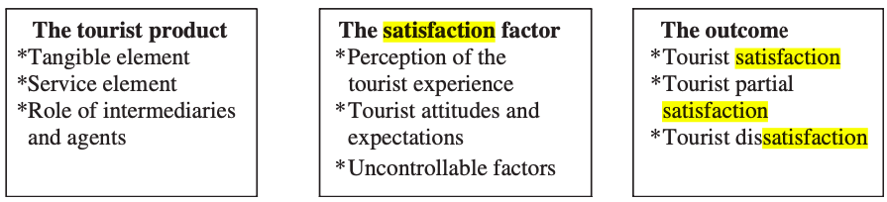
4-Customer satisfaction and service quality
It is believed that tourist satisfaction process has three stages including:
- The tourism product
- The tourism factor
- The outcome

Slide 43
5- Measuring and Controlling Service Quality in Tourism
      - It is crucial to measure and control the quality of product and service delivery in tourism and hospitality. This can be done using various quantitative and qualitative research techniques, such as: customer surveys, comment cards, employee surveys, focus group interviews, mystery shopping, and observation.
      - Two commonly used research tools to assess quality and consumer satisfaction in the service industry, including tourism and hospitality, are:
      SERVQUAL
      - A model used to evaluate service quality by measuring the gap between customer expectations and their perceptions of service delivery.
      Importance–Performance Analysis Model
      A tool used to assess the importance of different service attributes to customers and how well the service is performing in each area.

Slide 44
5- Measuring and Controlling Service Quality in Tourism
Usage of SERVQUAL
SERVQUAL has been widely applied across a range of service sectors such as banks, call centers, television repair companies, airlines, and hotels.
Components of SERVQUAL
- The SERVQUAL scale includes a survey with 22 service attributes that are grouped into five key service quality dimensions, known as RATER:
- Reliability
- Assurance
- Tangibles
- Empathy
- Responsiveness.

Slide 45
5- Measuring and Controlling Service Quality in Tourism
Reliability
- Reliability refers to the consistency and dependability of the service provided by an organization.
Key Aspects
- Employees should deliver the desired service correctly the first time, without errors or delays.
- The organization should honor its promises, including:
- Accuracy in billing and charges.
- Performing the service at designated times (e.g., on time, as scheduled).

Slide 46
5- Measuring and Controlling Service Quality in Tourism
Assurance
Assurance refers to the knowledge and courtesy of employees and their ability to instill trust and confidence in customers.
Key Aspects
Employees should demonstrate competence and professionalism in their interactions.
Customers must feel assured that employees have the ability to provide the service reliably and address their concerns effectively.
For example, hotel staff handling a guest’s financial and personal security must be trusted to maintain confidentiality and ensure the safety of the guest

Slide 47
5- Measuring and Controlling Service Quality in Tourism
Tangibles
Tangibles refer to the physical aspects of the service, which help shape the customer’s perception of quality.
Key Aspects
Includes hotel bedrooms and facilities, such as cleanliness, furniture, and amenities.
The presentation of staff uniforms and their overall appearance.
The physical representation of the organization in items like brochures, signage, and frequent-guest cards.

Slide 48
5- Measuring and Controlling Service Quality in Tourism
Empathy
Empathy refers to the individualized, caring attention that employees provide to customers, making them feel valued and understood.
Key Aspects
Employees should treat customers as individuals by offering personalized service.
This can include addressing customers by their names, remembering their preferences and interests, and tailoring the service to meet their specific needs.

Slide 49
5- Measuring and Controlling Service Quality in Tourism
Responsiveness
Responsiveness refers to the promptness and willingness of staff to provide service and assist customers.
Key Aspects
Services should be delivered quickly and efficiently.
Employees must be ready and eager to help, addressing customer needs without delay.
Examples include responding promptly to customer requests and resolving issues or queries in a timely manner.

Slide 50
5- Measuring and Controlling Service Quality in Tourism
      SERVQUAL Survey and Gap Analysis
      The SERVQUAL survey asks customers to rate two aspects for each service dimension:
      Expected service: What customers expect from an excellent company in the sector.
      Perceived service: How customers perceive the actual service delivered by a specific company.
      Gap scores are calculated by comparing these two ratings for each of the five service quality dimensions.
      The results highlight areas for improvement and help companies understand where they are meeting or falling short of customer expectations.

Slide 51
5- Measuring and Controlling Service Quality in Tourism
      Data collected through a SERVQUAL survey can serve multiple purposes:
      • To Determine the Average Gap Score
      • To Assess a Company’s Service Quality Along Each SERVQUAL Dimension
      • To Track Customers’ Expectations and Perceptions Over Time
      • To Compare a Company’s SERVQUAL Scores Against Competitors
      • To Identify and Examine Customer Segments with Differing Assessments of Service Quality.

Slide 52
5- Measuring and Controlling Service Quality in Tourism
      The Importance–Performance Analysis (IPA)
      The Importance–Performance Analysis (IPA) is a method that compares service performance with the importance of various service elements to the consumer.
      Purpose
      The IPA model helps managers identify areas for improvement in service delivery by analyzing the relationship between how well a company performs on certain attributes and how important those attributes are to consumers.
      Quadrants in the IPA Model
      The IPA results are typically plotted on a two-dimensional grid with importance on the vertical axis and performance on the horizontal axis.

Slide 53
5- Measuring and Controlling Service Quality in Tourism
      The grid is divided into four quadrants, each offering different management suggestions:
      Quadrant 1: "Concentrate Here"
      Attributes: Perceived as important by customers but showing low performance.
      Action: The company needs to focus on improving performance in these areas to meet customer expectations.
      Quadrant 2: "Keep Up the Good Work"
      Attributes: Highly important to customers and showing good performance.
      Action: The company is performing well in these areas and should maintain this level of service.

Slide 54
5- Measuring and Controlling Service Quality in Tourism
      Quadrant 3: "Low Priority"
      Attributes: Both importance and performance ratings are lower than average.
      Action: These attributes may receive low priority in resource allocation decisions since they don’t significantly impact customer satisfaction.
      Quadrant 4: "Possible Overkill"
      Attributes: Low in importance but showing high performance.
      Action: The company is performing well on attributes that are of relatively low importance to customers. It may not be necessary to invest additional resources to improve these areas further.

Slide 55
Thank you
      European Institute of Innovation, Entrepreneurship and Technology
      Lessingstraße 79,
      13158 Berlin, Germany
      Phone: +49 176 55524449
      Email: info@eiiet.com
Discover the world of eiIET

