Slide 1
GLOBAL TALENT STRATEGY FOR A TOURISM ENTERPRISE
Student Name-
Student ID-

Slide 2
Introduction
A global talent management strategy is essential for the businesses since it aids them in effectively attracting, improving and retaining knowledgeable employees.
Such practices allow the hotel businesses to improve their performance and initiate productive creativity.
It is found that the hotel industry globally experienced several problems including labour shortages and others (Schwarz, 2025).
Such practices hamper the service delivery to the guests and lower their reputation.
Notes:
Thus, it can be stated that with the help of a robust talent management strategy, hotels can lower their turnover rates and leverage customer service. This presentation is shaped from the perspective of the talent strategy consultant of Four Seasons Hotels & Resorts situated in Canada and highlights their global talent management strategy emphasised hiring, worker development and retention. The aim of the business is to expand in the new markets of Southeast Asia and Eastern Europe. The objective of the work is to exhibit the detailed press release and internal training mail along with the EVP campaign cultivated for the culturally diversified team. It showcases the utilisation of AI within the recruitment, and internal mobility and ways it can contribute towards the digital employee engagement.

Slide 3
Global Talent Management Strategy focused on recruitment, employee development, and retention
Recruitment plays an important role during digital transformation because companies in many industries need to hire employees with a global talent management strategy, who oppose IT-related skills, ability and knowledge.
“Digitalisation strategy” is one of the most revolutionary developments in the perspective of business in the last few decades.
It becomes clear that recruitment plays an important role in digital transformation in pre-digital companies (Gilch & Sieweke, 2021).
In Four Season Hotel & Resort, a place of luxury, hospitality vans generosity can implement this technique which will provide a dynamic and rapid environment, attract talents ensure employee commitment, increase the implementations in the department autonomy and introduce new roles in the job management (Martínez-Morán, 2021).
Notes:
By implementing Digitalisation, Four Season Hotel & Resorts can develop and expand their luxurious hotel and introduce many new roles with developed skills through the process of recruitment. This is one of the finest Global talent management Strategies to enhance growth in a long-term road and expand and develop for the upcoming challenges.

Slide 4
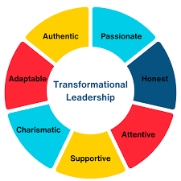
Employee development
“The transformational Leadership strategy” is crucial for the development of organisation as well as skills in employees for the long-term growth.
It aims to provide strategic HR strategies and plans such as long-time planning, resource optimization, and the integration of cost-cutting with impactful results.
For Four Season Hotel & Resort, it is a bridge which fills the gap between organizational aspirations and resource reality, providing theoretically grounded and practical relevant insights (BBristol-Alagbariya, Ayanponle & Ogedengbe, 2024).
(Source: Explorepsychology.com, 2024)
Notes:
The main objective is to provide practical and innovative approaches to leadership development and adapt new approaches for availing advanced management. Effective leadership contribution is not just a matter of organisational success, it is a matter of equity and sustainability. It contributes to introducing new approaches to the implant for the development of the employees to attain new skills to enhance and attract new talents to perform globally. Another key objective is to adopt the system approach to HR management, which is embedded with an organisational framework that aligns leadership practices with strategic goals.

Slide 5
Retention
Employee retention strategy integrates some necessary steps and practices that make the employee stay for a longer period of time (Greenhouse.com, 2024).
Employee retention in this case primarily aims to create a positive work environment for the diverse team of this designated company.
The need for robust employee retention is vital, as maintaining a highly skilled and talented workforce is important for the emerging highly competitive scenario of the hospitality industry.
Notes:
A “talent retention strategy” incorporates the practices as well as the policies of a company that mostly adopts to reduce and prevent employees from resigning from the office or organisation. A retention strategy here aims to foster an engaging as well as a positive work environment that motivates employees to stay with the employer in the long term. For the “Four Seasons and Hotels & Resorts”. A strategic and robust retention strategy is utterly crucial for maintaining a skilled workforce within this competitive industry of hospitality.

Slide 6

Retention (contd.)
For the "Four Seasons and Hotels & Resorts" an ideal retention plan could be investing in employee development.
. Investing in employee development includes making them aware of multiculturalism and also empowering them with effective communication tools and skills so that they will be connected to each and maintain transparency.
Transparent communication within a crisis situation can help them stay motivated and increase their morale, which can eventually affect employees (Erickson, 2021).
In this case, another plan in this regard could be offering enough compensation and recognition, which can eventually help them to stay encouraged and motivated even in the high-pressure workload.
Additionally, by making them recognise and fulfil their individual needs, the employer here can make them realise not to lead the employer and contribute their skills for the best outcome.
Notes:
This retention strategy mostly focuses on improving employee morale for bith new and old hires. In order to secure robust retention practices by the designated company, the company is suggested to prioritise crisis support. Besides this, the approach towards ethical leaders while maintaining emotional intelligence is also suggested here. Apart from this, a good investment in employee development is also suggested here. Offering several opportunities for training, internal mobility, and growth can help them feel supported and empowered, which eventually makes them realise that they should stay for a longer period of time.

Slide 7
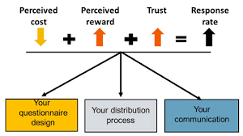
Retention (contd.)
The retention plan for Four Seasons and Hotels & Resorts aligns with the "Social Exchange theory"
According to the theory, employees are likely to stay within an organisation by finding that their contributions are recognised and rewarded(Ahmad et al. 2023)
By offering perks, rewards and enough compensation to the diverse team according to their contribution can increase their long term commitment towards their organisations.
(Source: News.nnlm.gov, 2024)
Notes:
The mentioned retention plan is directly aligned to the social exchange theory, which suggests that the commitment of employees towards their organisation is grounded on the perception or understanding of the balance between contribution and recognition. It means that by offering enough rewards and recognitions, the employee finds enough reward for what they contribute, and thus their commitment towards the organisation will be increased gradually.

Slide 8
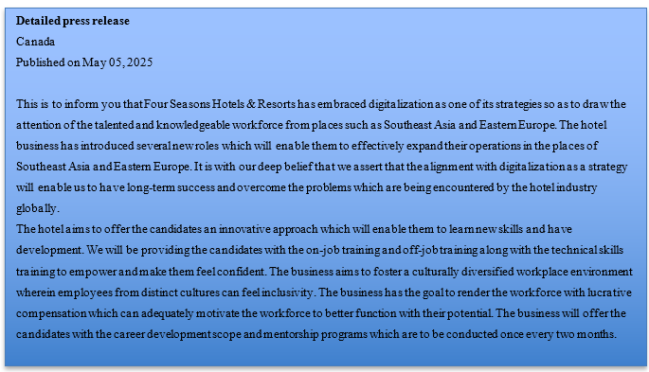
Detailed press release, internal training emails, and EVP campaign copy tailored for culturally diverse teams

Slide 9
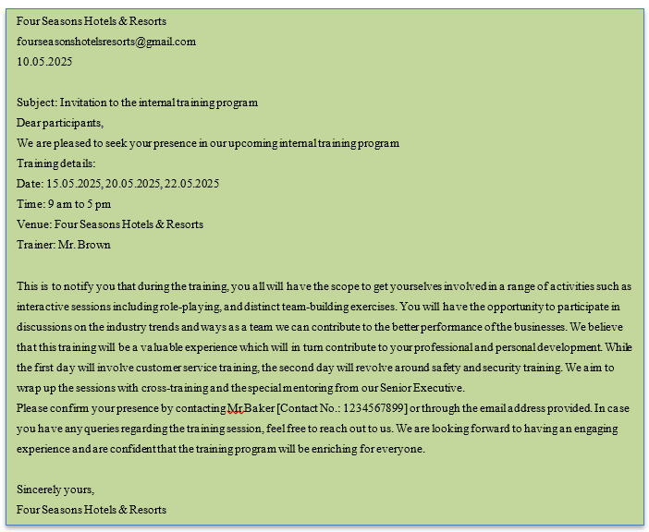
Internal training email

Slide 10
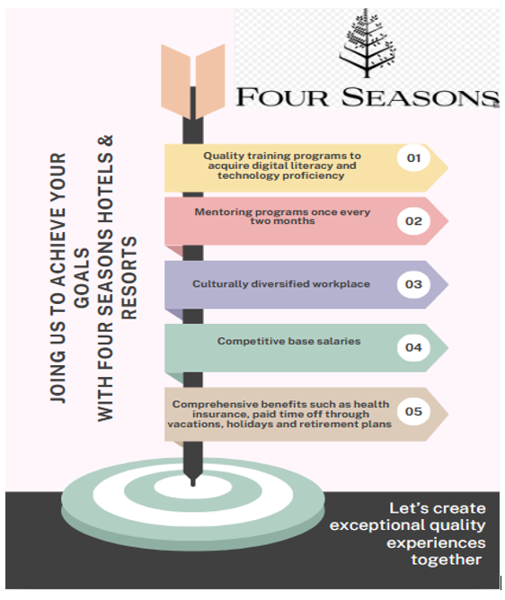
EVP campaign copy tailored for culturally diverse teams

Slide 11
The use of AI in recruitment, internal mobility, and digital employee
Using artificial intelligence to recruit new employees in tourism helps human resource management to hire employees according to their roles
This reduces the chances of turnover among the employees and boosts the performance of the organisation because of hiring eligible employees for their assigned roles. .
In the traditional way of recruiting tourism companies in Southeast Asia or Eastern Europe, employees often go through step-by-step processes like managing the submission of applications, selecting eligible applicants, and looking if they are suitable for their assigned role.
Using artificial intelligence tools makes the work easier by automatically checking the resumes applied by the candidates, and higher them according to their talent and experience (Abaza & Eltobgy, 2025).
Notes:
Using different forms of recruitment using Artificial intelligence in recruiting also makes the process more engaging, for example hiring candidates through gaming that helps analyse the performance of the candidate. It is a form of engaging the hiring process as well as a form of distraction for the player. Using tools supported by artificial intelligence makes it easier to identification of talent, recruit efficient employees and retain them. AI tools like chatbots, humanly, fetcher, higher value, hired scores, and Jobsite can analyse data, reduce biases, exclude using any external source while hiring and help make informed decisions using these tools the tourism companies first attract new candidates to apply for the job through any advertisement on social or job sites.

Slide 12
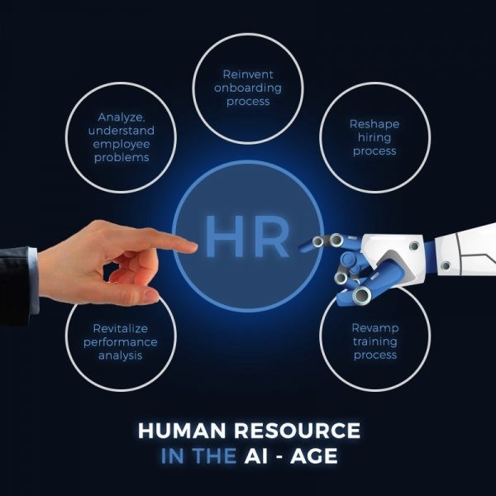
The use of AI in recruitment, internal mobility, and digital employee
Further, the AI tools guide the candidate to follow the steps of applying for a job in tourism companies in Southeast Asia or Eastern Europe.
Finally, the employer can make a decision after seeing the resumes of the applicants using machine learning tools.
There is an option of a CV test for the employer through which the employer can understand how much ethnicity of the applicant and the hiring process fairer.
By using AI tools, the internal mobility of the company increases. It not only makes the process of applying for the job easier, but the process of hiring adopted by the Human Resource Management becomes easier as well. (Peña et al. 2023).
(Source: Linkedin.com, 2024)
Notes:
The AI tools extract data from the applicant's resume and match it with the applicant's experience or work history. With this, each candidate receives work recommendations according to their skills or needed coaching path for the career of the applicant. This opens new opportunities for applicants to enhance their skills. Often it is difficult for the leader or employer of the company to identify the skills of the applicant through traditional ways of recruiting. The employer by using these tools can understand the skills of the applicant and suggest how learning new things will enhance their capability.
The use of AI enhances digital employee management by providing the employees of tourism companies in Southeast Asia and Eastern European countries with fact-based information, by automatically responding to the employees to their queries, and helps with strategic ideas in decision-making. Artificial intelligence also analyses the performance of the employees and suggests areas for improvement. This improves the efficiency of the employee and increases their productivity as well. All this helps the tourism companies of Southeast Asia and Eastern Europe to stay connected digitally and helps to outperform in the competitive market.

Slide 13
Conclusion and recommendations
It can be concluded that with the aid of digitalisation and technologies the hotel businesses such as Four-Season Hotel & Resorts can acquire a skilled workforce. Such practices will enable them to effectively expand in many new markets.
It is through the practice of transformational leadership that the hotel can initiate better approaches to improve the knowledge and competencies of the workforce.
It can be suggested that Four Seasons Hotel & Resorts can provide the workers with competitive wages along with distinct unique perks.
The hotel business can offer employees discounts on dining experiences which can leverage the compensation package.
Notes:
Conclusion:
Retaining of the employees becomes essential for the businesses so as to thrive in the competitive business landscape. It is by providing beneficial and attractive compensation and rewards the hotel business can effectively retain their skilled workforce. Such practices can motivate the workers to better contribute towards the performance of the organization.
Recommendations:
To improve the skills of the workers, the hotel can empower the staff to take ownership of their respective work. They can offer regular feedback to the staff which can assist them to identify areas in which they need to improve. As per the view of Batool et al., (2021) for management positions distinct technology training tends to positively contribute towards worker development. The author asserts that technology training ensures that staff can improve their decision-making skills and acknowledge ways to better run the operations. Therefore, Four Seasons Hotel & Resorts can also offer regular technology training that can enable the workers to stay proficient with the modern hotel management system and better perform their roles.

Slide 14
References
Abaza, W. A., & Eltobgy, A. E. (2025). Examining the Intention to use Artificial Intelligence in Recruitment and Selection within Human Resource Management: A Case Study of Egyptian Tourism and Travel Agencies. Journal of Association of Arab Universities for Tourism and Hospitality, 28(1), 83-105. Retrieved from: https://jaauth.journals.ekb.eg/article_394785.html
Ahmad, R., Nawaz, M. R., Ishaq, M. I., Khan, M. M., & Ashraf, H. A. (2023). Social exchange theory: Systematic review and future directions. Frontiers in Psychology, 13, 1015921. Retrieved From: https://doi.org/10.3389/fpsyg.2022.1015921
Batool, N., Hussain, S., Baqir, M., Islam, K. A., & Hanif, M. (2021). Role of HR technology and training for the development of employees. International Journal of Business and Management, 5(1). Retrieved from: https://www.researchgate.net/profile/K-M-Anwarul-Islam/publication/350545257_ROLE_OF_HR_TECHNOLOGY_AND_TRAINING_FOR_THE_DEVELOPMENT_OF_EMPLOYEES/links/606582cb458515614d27a848/ROLE-OF-HR-TECHNOLOGY-AND-TRAINING-FOR-THE-DEVELOPMENT-OF-EMPLOYEES.pdf
Bristol-Alagbariya, B., Ayanponle, O. L., & Ogedengbe, D. E. (2024). Leadership development and talent management in constrained resource settings: A strategic HR perspective. Comprehensive Research and Reviews Journal, 2(2), 13-22. Retrieved From: https://doi.org/10.3390/su13042264
Erickson, S. (2021). Communication in a crisis and the importance of authenticity and transparency. Journal of Library Administration, 61(4), 476-483. Retrieved From: https://doi.org/10.1080/01930826.2021.1906556
Gilch, P. M., & Sieweke, J. (2021). Recruiting digital talent: The strategic role of recruitment in organisations’ digital transformation. German Journal of Human Resource Management, 35(1), 53-82. Retrieved From: https://doi.org/10.1177/2397002220952734
Greenhouse.com, (2024) What is talent retention strategy? Retrieved From: https://www.greenhouse.com/resources/glossary/what-is-talent-retention-strategy#:~:text=Talent%20retention%20strategies%20identify%2C%20develop,%E2%80%8D Accessed on 03.05.2025
Martínez-Morán, P. C., Urgoiti, J. M. F. R., Díez, F., & Solabarrieta, J. (2021). The digital transformation of the talent management process: A Spanish business case. Sustainability, 13(4), 2264. Retrieved From: https://doi.org/10.57219/crrj.2024.2.2.0031
Peña, A., Serna, I., Morales, A., Fierrez, J., Ortega, A., Herrarte, A., ... & Ortega-Garcia, J. (2023). Human-centric multimodal machine learning: Recent advances and testbed on AI-based recruitment. SN Computer Science, 4(5), 434. Retrieved from: https://doi.org/10.1007/s42979-023-01733-0
Schwarz, L., (2025) 13 Common Challenges in the Hospitality Industry in 2025 Retrieved from: https://www.netsuite.com/portal/resource/articles/erp/hospitality-industry-challenges.shtml

