Slide 1
Tourist Regions and Attractions
European Institute of Innovation, Entrepreneurship and Technology
Lessingstraße 79, 13158 Berlin, Germany
Mahmoud Abdou| Berlin
      Lessingstraße 79,
      13158 Berlin, Germany
      Phone: +49 30 233618555
      Fax: +49 30 233618556
      Email: info@eiiet.com

Slide 2
Index
- The Demand for Tourism: Definitions and Concepts
- Determinants of Travel Propensity
- Forms of Tourism

Slide 3

1- The Demand for Tourism: Definitions and Concepts
    Tourist demand can be described as:
    - “The total number of persons who travel, or wish to travel, to use tourist facilities and services at places away from their places of work and residence” (Boniface & Cooper, 2009: p. 22).
    - The definition implies a wide range of influences as determinants of demand:
    - Tourism demand is shaped by multiple factors beyond price
    and income-
    Tourism demand includes both actual and potential travelers.
    - Therefore, the concept of demand encompasses both actual
    and potential tourists.

Slide 4
1- The Demand for Tourism: Definitions and Concepts
    The “effective” and “suppressed” demand for tourism:
    - Effective (or actual) demand refers to people who are currently traveling.
    - It is the most measurable aspect of tourism demand.
    - Most tourism statistics are based on effective demand.

Slide 5
1- The Demand for Tourism: Definitions and Concepts
    The “effective” and “suppressed” demand for tourism:
    - Suppressed demand includes people who are not currently traveling for various reasons.
    It consists of two elements:
    Potential demand:
    - Individuals who may travel in the future if their personal circumstances (e.g., income) improve.
    Deferred demand:
    - Travel postponed due to external factors (e.g., natural disasters).
    -Both potential and deferred demand can become effective demand in the future.
    -There is also a group with no demand, made up of those who have no desire to travel at all.

Slide 6
2- Determinants of Travel Propensity
    Travel propensity is influenced by a range of factors, grouped into two main categories:
    A- National-level factors:
    - These include broad, large-scale influences such as economic development, population traits, and political systems.
    B- Individual-level factors (the personal aspect)
    - These involve personal aspects like lifestyle, life cycle stage, and personality.

Slide 7
2- Determinants of Travel Propensity
    A. 1- National-level factors: Economic Factors
    - A country's level of economic development significantly affects tourist demand.
    - As societies develop into advanced economies, several key transformations occur:
    - Employment shifts from primary sectors (agriculture, fishing) to secondary (manufacturing) and tertiary sectors (services like tourism).
    - Affluent societies emerge as the economically active population grows from 30% to over 50%.

Slide 8
2- Determinants of Travel Propensity
    A. 1- National-level factors: Economic Factors
    - The emerging market stage leads to growing demand for consumer goods and leisure activities, including tourism (e.g., China’s example).
    - Economic growth improves health, education, mobility, and leisure time—fostering tourism demand.
    - Industrialization and development increase both leisure and business travel, as seen in countries like India.

Slide 9
2- Determinants of Travel Propensity
    A. 2- National-level factors: Population Factors
    - Population growth, distribution, and density influence travel propensity.
    - These demographic factors affect how likely people are to travel.
    - Population growth is tied to economic development stages.
    - This is explained through the demographic transition model, which has four phases of population change

Slide 10
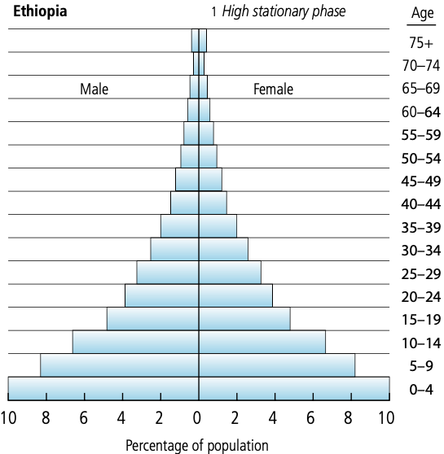
2- Determinants of Travel Propensity
    A. 2- National-level factors: Population Factors
    The demographic transition:
    A- The High Stationary Phase
    - It is typical of least developed countries (LDCs).
    - These countries have high birth rates and high death rates.
    - As a result, population growth remains low and unstable.
(Boniface & Cooper, 2009)

Slide 11
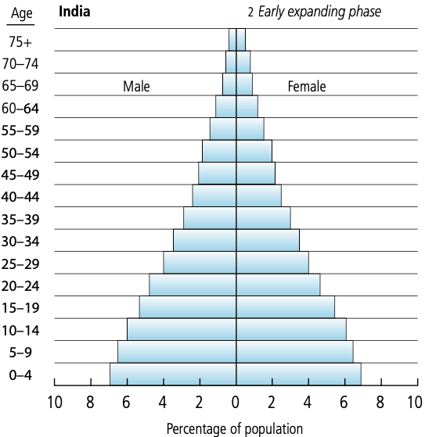
2- Determinants of Travel Propensity
    A. 2- National-level factors: Population Factors
    The demographic transition:
    B- The Early Expanding Phase
    - Birth rates remain high
    - Death rates decline due to improved health care, sanitation,
    and social stability
    - Results in rapid population growth, especially among young,
    large families
    - Hence, some governments invest in attracting foreign tourists.
(Boniface & Cooper, 2009)

Slide 12
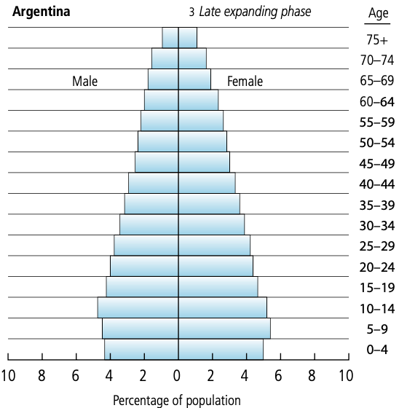
2- Determinants of Travel Propensity
    A. 2- National-level factors: Population Factors
    The demographic transition:
    C- The Late Expanding Phase
    - Birth rates begin to decline due to:
    Industrialization
    Improved access to birth control
    Changing social values

Slide 13
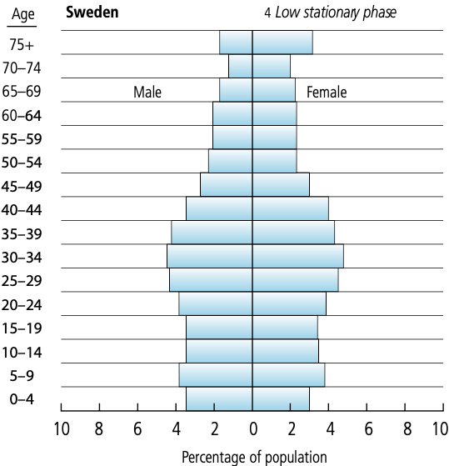
2- Determinants of Travel Propensity
    A. 2- National-level factors: Population Factors
    The demographic transition:
    D- The Low Stationary Phase
    - Low, stable birth/death rates.
    - Ageing, affluent population boosts demand.
    - Baby boomers and new household trends
    reshape travel markets.

Slide 14
2- Determinants of Travel Propensity
    A. 3- National-level factors: Political Factors
    Democratic nations vary in their approach to tourism based on political ideology:
    Conservative / Neo-liberal governments:
    - Favor free-market principles
    - Focus on enabling tourism growth through regulation and environment creation
    - Limited direct involvement in tourism services

Slide 15
2- Determinants of Travel Propensity
    A. 3- National-level factors: Political Factors
    Socialist governments:
    - Promote government involvement in tourism
    - Aim to increase access for disadvantaged groups
    - States may restrict outbound travel by limiting foreign currency allowances especially when:
    The currency is weak.
    The economy is unstable.

Slide 16
2- Determinants of Travel Propensity
    A. 3- National-level factors: Political Factors
    Socialist governments:
    - Promote government involvement in tourism
    - Aim to increase access for disadvantaged groups
    - States may restrict outbound travel by limiting foreign currency allowances especially when:
    The currency is weak.
    The economy is unstable.

Slide 17
2- Determinants of Travel Propensity
    B- The Personal Aspect:
    Travel propensity is influenced by both lifestyle and life cycle factors.
    Lifestyle Factors
    - Income - Employment status
    - Holiday entitlement - Education level
    - Physical mobility
    Life Cycle Factors
    - Age
    - Family and domestic circumstances

Slide 18
2- Determinants of Travel Propensity
    B. 1- The Personal Aspect: Income
    Tourism is a luxury: It requires a minimum income level to afford.
    Key Income Types:
    Gross Income
    - Total earnings
    - Doesn't reflect actual spending power

Slide 19
2- Determinants of Travel Propensity
    B. 1- The Personal Aspect: Income
    Key Income Types:
    Disposable Income:
    -Income after taxes
    - Still used for essentials (e.g. housing, food)
    Discretionary Income:
    - Income left after all essential expenses
    - Best indicator of ability to spend on tourism
    - Two people with the same gross income may have very different discretionary income

Slide 20
2- Determinants of Travel Propensity
    B. 1- The Personal Aspect: Employment
    -Employment and unemployment affect travel propensity differently.
    Employment Status Influences:
    - Income level
    - Holiday entitlement
    - Type of holiday chosen

Slide 21
2- Determinants of Travel Propensity
    B. 1- The Personal Aspect: Employment
    Unemployment Effects:
    - Lower overall demand for tourism
    - Shifts in travel behavior:
    Later bookings
    Preference for domestic and visiting friends and relatives(VFR) trips
    Shorter stays
    Reduced spending

Slide 22
2- Determinants of Travel Propensity
    B. 1- The Personal Aspect: Paid-Holiday Entitlement
    - National holidays and paid leave vary globally
    - Entitlement may arise from law or employer- trade union agreements
    - Low holiday entitlement = travel constraint
    - Fewer days off limits opportunity to travel
    -High entitlement encourages travel, but:
    Other factors (job status, income, mobility) also play a role
    Some may opt for leisure at home due to tourism costs

Slide 23
2- Determinants of Travel Propensity
    B. 1- The Personal Aspect: The Life Cycle Aspect
    B.1.1- Age
    - Travel habits are shaped more by life stage than actual age
    - Chronological age (actual age) is commonly used but limited in predicting travel behavior.
    - Domestic age (life cycle stage) is more effective for understanding tourism demand.
    - This approach is known as life course analysis
    The different life stages (e.g. single, married, with children, retired) show:
    Varying travel propensities
    Distinct holiday preferences and needs

Slide 24
2- Determinants of Travel Propensity
    B. 3- The Personal Aspect: The Personality Aspect
    - People vary in attitudes, perceptions, and motivations
    - These differences strongly shape travel decisions
    Travel Motivators:
    - Intrinsic motivators: Personal needs or desires (relaxation, adventure, cultural enrichment)
    - Extrinsic motivators: social recognition, prestige, or obligations
    (Traveling for business, family gatherings, or to showcase status through luxury vacations).

Slide 25
2- Determinants of Travel Propensity
    B. 3- The Personal Aspect: The Personality Aspect
    - Gray’s (1971) Classification:
    Wanderlust: Desire for the unknown and cultural exploration
    Sunlust: Desire for better climate and recreational amenities

Slide 26
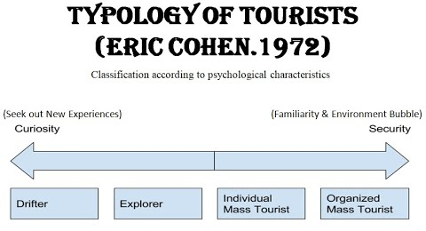
2- Determinants of Travel Propensity
    B. 3- The Personal Aspect: The Personality Aspect
    - Cohen’s (1972) Tourist Typology:
    - Based on balance between novelty and familiarity
    - Tourists range across a spectrum from:
    - Risk-seeking adventurers to
    - Comfort-seeking traditionalists

Slide 27
2- Determinants of Travel Propensity
    B. 3- The Personal Aspect: The Personality Aspect
    - The Organized Mass Tourist
    - Least adventurous traveler type
    - Seeks maximum comfort and convenience
    - Relies on prearranged package holidays with fixed itineraries
    - Stays within the “tourist bubble” (controlled, familiar environment)

Slide 28
2- Determinants of Travel Propensity
    B. 3- The Personal Aspect: The Personality Aspect
    Key Characteristics
    Preference for Familiarity
    - Chooses Western-style hotels, food, and attractions
    Dependence on the Industry
    - Prefers all-inclusive packages; avoids independent planning
    Controlled Experiences
    - Any "unique" activities are carefully curated to minimize risk
    Destination Choices
    - Favors popular, well-developed tourist areas, domestic or international
    - Selects locations with established mass tourism infrastructure

Slide 29
2- Determinants of Travel Propensity
    B. 3- The Personal Aspect: The Personality Aspect
    The Individual Mass Tourist
    - Relies on institutionalized services (flights, bookings, transfers)
    - More freedom and flexibility than organized mass tourists
    - Balances structure with independence

Slide 30
2- Determinants of Travel Propensity
    B. 3- The Personal Aspect: The Personality Aspect
    The Individual Mass Tourist
    Key Characteristics
    Greater Independence
    - Does not follow a rigid package
    - Chooses own destinations and activities
    Prearranged Travel
    - Flights, hotels, and transfers are booked in advance
    - Flexibility in planning day-to-day itinerary
    Familiar Destinations
    - Visits popular attractions but on their own schedule

Slide 31
2- Determinants of Travel Propensity
    B. 3- The Personal Aspect: The Personality Aspect
    The Explorer
    - Independent traveler seeking autonomy and authentic experiences.
    - Often avoids heavily touristed areas
    - Immerses in local culture and seeks off-the-beaten-path
    Destinations.

Slide 32
2- Determinants of Travel Propensity
    B. 3- The Personal Aspect: The Personality Aspect
    The Explorer
    Key Characteristics
    Independence in Travel
    - Plans own itinerary based on personal research
    - Customizes travel for authenticity
    Off the Beaten Track
    - Seeks remote and less-known destinations
    - Prioritizes local culture and genuine interactions

Slide 33
2- Determinants of Travel Propensity
    B. 3- The Personal Aspect: The Personality Aspect
    The Explorer
    Key Characteristics
    Escaping the Tourist Bubble
    - Avoids traditional tourist spaces but flexible if necessary
    - Uses tourist infrastructure only when logistically essential
    Temporary Return to the Bubble
    - Returns to familiar spaces only when needed due to
    challenging conditions.

Slide 34
2- Determinants of Travel Propensity
    B. 3- The Personal Aspect: The Personality Aspect
    The Drifter
    - The most independent and immersive type of tourist
    - Rejects structured tourism; seeks authentic, off-grid experiences
    Key Characteristics
    Complete Independence
    - No fixed itinerary; travels spontaneously
    - Avoids prearranged plans or schedules

Slide 35
2- Determinants of Travel Propensity
    B. 3- The Personal Aspect: The Personality Aspect
    The Drifter
    Key Characteristics
    Strong Local Interaction
    - Lives like a local: works, stays, and eats within communities
    - Deep cultural immersion
    Avoidance of Tourism Hotspots
    - Actively avoids popular destinations
    - Rejects mainstream tourism infrastructure
    Motivated by Novelty
    - Seeks unique, challenging, and unfamiliar experiences
    - Welcomes discomfort and unpredictability as part of the journey

Slide 36
2- Determinants of Travel Propensity
    B. 3- Suppressed Demand
    Potential Demand
    Tourism as a Luxury
    - For much of the global population, tourism remains an unattainable luxury
    - Affects individuals in both developing and developed countries
    - Highlights inequalities in access to tourism
    Potential Demand
    - Refers to those who would like to travel but are unable to do so
    - Barriers often linked to personal and socio-economic circumstances

Slide 37
2- Determinants of Travel Propensity
    B. 3- Suppressed Demand
    Potential Demand
    Barriers to Travel
    - Expense of travel
    - Lack of time
    - Physical limitations (e.g. ill health)
    - Family responsibilities
    - Lack of interest

Slide 38
2- Determinants of Travel Propensity
    B. 3- Suppressed Demand
    Potential Demand
    - Often, people experience more than one barrier simultaneously
    - A single parent or caregiver may face time, income, and family-related constraints
    Social Tourism Movement
    - Aims to enable travel for disadvantaged or handicapped individuals
    - Seeks to remove barriers and promote inclusion in tourism
    - Actors Supporting Social Tourism
    - In state-led systems: government and public agencies
    - In other contexts: labor unions, church groups, and voluntary organizations

Slide 39
2- Determinants of Travel Propensity
    B. 3- Suppressed Demand
    Deferred Demand in Tourism
    - Barriers in the supply environment can delay or discourage travel decisions.
    - These lead to deferred demand, where potential tourists postpone or alter travel plans.
    Major Global Events Influencing Deferred Demand
    - 2004 Asian tsunami
    - Terrorist attacks at destinations and events
    - Ongoing conflicts (e.g. Syria, Afghanistan)
    - Global pandemics (e.g. COVID-19)
    - Rising awareness of tourism's role in climate change

Slide 40
2- Determinants of Travel Propensity
    B. 3- Suppressed Demand
    Deferred Demand in Tourism
    Tourist Behavior Changes
    - Postpone travel or adjust plans in response to risk and uncertainty
    - Opt for destinations perceived as safer and closer to home
    - Choose surface transport (e.g. rail) over air travel for environmental reasons
    - Book trips later and use flexible, online booking platforms
    - Take shorter, lower-cost, lower-emission trips
    - Avoid long-haul travel or stop traveling entirely

Slide 41
3- Forms of Tourism
    - The geographical components of tourism, combined with concepts like spatial scale and tourist flows, result in a diverse range of tourism forms.
    These can be categorized based on the following criteria:
    - Type of Destination
    - The characteristics of the tourism system
    - The market
    - The distance travelled.

Slide 42
3- Forms of Tourism
    3.1. Type of Destination
    - Distinction Between International and Domestic Tourism
    Domestic Tourism
    Involves individuals travelling within their own country.
    Tourists do not cross national borders.
    Often more accessible and cost-effective.
    International Tourism
    Involves travel to a country other than the one in which the tourist normally resides.

Slide 43
3- Forms of Tourism
    3.1. Type of Destination
    International Tourism can be further divided into:
    Inbound Tourism
    Non-residents traveling into a specific country.
    Example: A French tourist visiting Germany contributes to Germany’s inbound tourism.
    Outbound Tourism
    Residents of a country traveling abroad to other countries.
    Example: A German tourist visiting Thailand contributes to Germany’s outbound tourism.

Slide 44
3- Forms of Tourism
    3.1. Type of Destination
    - Factors Affecting International vs. Domestic Tourism
    - International Tourism
    Involves crossing national borders.
    May require:
    Use of different currencies
    Navigating language barriers
    Complying with immigration and visa requirements

Slide 45
3- Forms of Tourism
    3.1. Type of Destination
    - Factors Affecting International vs. Domestic Tourism
    - Domestic Tourism
    Easier to undertake due to:
    Familiarity with language and customs
    No border crossings or currency exchange
    Greater convenience and lower cost

Slide 46
3- Forms of Tourism
    3.1. Type of Destination
    Factors Affecting International vs. Domestic Tourism
    - Influence of Country Size
    Larger countries (e.g., United States):
    Tend to have a greater variety of attractions
    Offer extensive domestic tourism opportunities
    High percentage of tourism is domestic (e.g., 90% in the U.S.)
    Smaller countries (e.g., the Netherlands):
    Easier access to neighboring nations
    Higher proportion of international travel (e.g., around 50% domestic tourism)

Slide 47
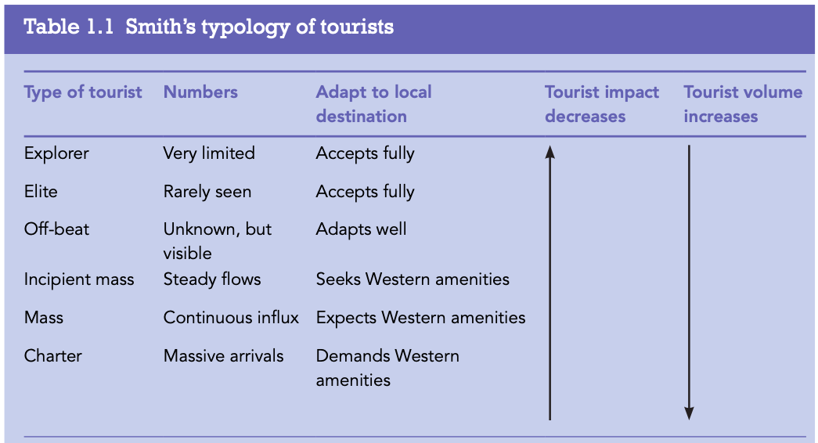
3- Forms of Tourism
    Classification of Tourists:
    Explorer:
    Travel in small numbers
    Fully accept and adapt to local conditions.
    Self-sufficient and well-prepared.
    Typically engage in non-mainstream,
    niche tourism activities.
    Often motivated by research, adventure,
    or exploration rather than leisure or
    Comfort.
Boniface, Cooper And Cooper, 2021

Slide 48
3- Forms of Tourism
    Classification of Tourists:
    Elite:
    Travel off the beaten track for pleasure.
    Have extensive travel experience – "they have done it all"
    Now seek something different or unique.
    Use tourist facilities (e.g., accommodation, transport).
    Adapt easily to local conditions.
    Often motivated by a desire for:
    Authentic cultural experiences
    Personal enrichment
    Escaping mass tourism
Boniface, Cooper And Cooper, 2021

Slide 49
3- Forms of Tourism
    Classification of Tourists:
    Off-beat:
    Not as wealthy as elite tourists.
    Seek an "added extra" or unique experience within a standard tour.
    Interested in going slightly beyond mainstream tourism
    Adapt well to local conditions.
    Can cope with local environments for a few days.
    Likely motivated by:
    A desire for novelty
    A taste of authenticity without full immersion
Boniface, Cooper And Cooper, 2021

Slide 50
3- Forms of Tourism
    Classification of Tourists:
    Incipient mass:
    Travel in a steady flow, typically as small groups or individuals
    Prefer comfort and amenities such as:
    Central heating, air conditioning, and modern facilities.
    Willing to tolerate the absence of amenities for a short
    time.
    View discomfort as part of the travel experience
    Seek a balance between comfort and authentic
    experiences.
Boniface, Cooper And Cooper, 2021

Slide 51
3- Forms of Tourism
    Classification of Tourists:
    Mass:
    Consists of large numbers of tourists
    Often from Europe, North America, or Asia.
    Typically have middle-class values and relatively
    high incomes.
    Highly seasonal travel patterns
    (e.g. summer or holiday periods).
Boniface, Cooper And Cooper, 2021

Slide 52
3- Forms of Tourism
    Classification of Tourists:
    Mass:
    Expect:
    Western-style amenities (e.g., modern hotels, familiar food)
    Multi-lingual guides
    Organized, structured experiences
    Motivated by:
    Comfort and convenience
    Leisure and relaxation
    Safe, predictable environments
Boniface, Cooper And Cooper, 2021

Slide 53
3- Forms of Tourism
    Classification of Tourists:
    Charter:
    Represents full-blown, mass-market tourism
    Involves high volumes of tourists
    Totally dependent on the travel trade (e.g., package tours, tour operators)
Boniface, Cooper And Cooper, 2021

Slide 54
3- Forms of Tourism
    Classification of Tourists:
    Charter:
    Tourists have:
    Standardised tastes and expectations
    Little to no interest in the uniqueness of the destination
    The country of destination is largely irrelevant to the tourist experience
    Focus is on:
    Low cost
    Convenience
    All-inclusive, familiar offerings
Boniface, Cooper And Cooper, 2021

Slide 55
3- Forms of Tourism
    3.2. The Characteristics of the Tourism System
    - Tourism types are shaped by the destination, which in turn affects:
    The market (types of tourists and their motivations)
    The transportation modes used
    The overall tourism product and experience

Slide 56
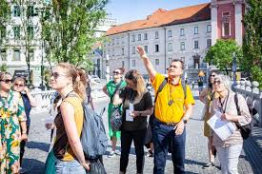
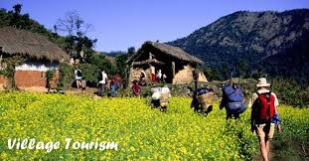
3- Forms of Tourism
    Forms of Tourism by Destination Type
    Rural Tourism:
    - Tourism focused on the countryside, often involving farm stays, nature walks, and village life.
    Urban Tourism:
    - Tourism centered in towns and cities, featuring shopping, cultural sites, events, and nightlife.

Slide 57
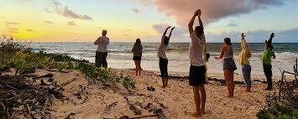
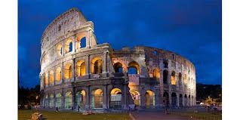
3- Forms of Tourism
    Forms of Tourism by Destination Type
    Health and Wellness Tourism:
    - Travel aimed at improving physical, mental, and spiritual well-being.
    - Includes spas, beauty treatments, fitness retreats, and mindfulness practices.
    - Traditionally centered on thermal resorts and spa towns.
    Heritage Tourism:
    - Focuses on experiencing tangible historical elements (e.g. monuments, architecture, ruins).
    and travel to sacred places.

Slide 58

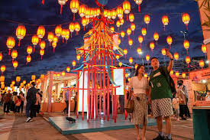
3- Forms of Tourism
    Forms of Tourism by Destination Type
    Cultural Tourism:
    - Involves discovering and engaging with a different way of life, customs, arts, festivals, and local traditions.
    Sport Tourism:
    - Can involve spectators attending events (like the Olympics or football matches) or participants in sporting activities.

Slide 59
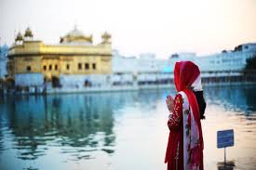

3- Forms of Tourism
    Forms of Tourism by Destination Type
    Dark Tourism:
    - Visits to sites associated with tragedy, death, or disaster, such as battlefields, genocide memorials, or former prisons.
    Faith-Based Tourism:
    - Motivated by religious beliefs, involving pilgrimages and travel to sacred places.

Slide 60
3- Forms of Tourism
    3.3. The Market
    - The tourism market can be defined as a segment of the population expressing a demand for specific tourism products or experiences.
    - This demand is often linked to the purpose of the visit:
    Holiday Tourism:
    This is the most common form of tourism, primarily driven by leisure and recreation.
    Sun, Sand, and Sea Tourism:
    - Focuses on destinations with beaches and good weather.
    - Tourists are drawn to beach-related activities like swimming, sunbathing, and water sports.
    Touring, Sightseeing, and Culture Tourism:
    - Focuses on exploring new destinations.
    - Tourists are interested in experiencing different cultures, lifestyles, and historical or cultural attractions.

Slide 61
3- Forms of Tourism
    3.3. The Market
    B- Common-Interest Tourism
    - This type of tourism involves travelers who visit destinations with a specific purpose that they share with the people or places at the destination.
    - It includes various categories, such as:
    Visiting Friends and Relatives (VFR):
    - Tourists travel to reconnect with family or friends, often resulting in less demand for serviced accommodation or standard tourist services.
    Religious Tourism:
    - Travel motivated by religious practices, pilgrimages, or visits to sacred sites.

Slide 62
3- Forms of Tourism
    3.3. The Market
    Health Tourism:
    - Travel for medical treatment, wellness, or holistic health experiences.
    - Educational Tourism:
    Travel motivated by learning or study, including academic exchanges, conferences, or specialized courses.
    Key Characteristics:
    Limited Demand:
    - Common-interest tourists, especially VFR visitors, may not require traditional tourist services such as hotels, restaurants, or guided tours, as their focus is more personal or purpose-driven.
    Cultural or Emotional Connection:
    - It often relies on deep personal connections to the destination, whether family ties, religious beliefs, or shared interests in health or education.

Slide 63
3- Forms of Tourism
    3.3. The Market
    Business and Professional Tourism
    - This category of tourism is primarily driven by work-related or professional purposes
    - It includes activities such as:
    A- MICE Tourism:
    MICE stands for Meetings, Incentives, Conferences, and Exhibitions.

Slide 64
3- Forms of Tourism
    3.3. The Market
    Business and Professional Tourism
    B- Corporate Travel:
    -Employees or executives traveling for business-related purposes
    Key Characteristics:
    Work-Oriented:
    - Business tourism is focused on professional activities, meaning there is often limited leisure time for tourists during their stay.
    Demand for Specific Services:
    - Business tourists typically require conferencing facilities, event management services, and high-quality business amenities like Wi-Fi, meeting rooms, and transportation.
    Economic Impact:
    - Business tourism, especially MICE, often brings higher spending due to the nature of the industry (luxury hotels, high-end services, etc.).

Slide 65
3- Forms of Tourism
    3.3. The Market
    - Tourism can also be analyzed based on the type of travel arrangements purchased.
    A- Inclusive Tours:
    An inclusive tour bundles two or more components of the trip together, such as transport, accommodation, and activities at a single price.
    Characteristics:
    - Typically offered by tour operators.
    - Provides a set itinerary with pre-arranged accommodations and activities.
    - Popular for group tours or packaged vacations.
    - Convenient and cost-effective for travelers who prefer a hassle-free experience.

Slide 66
3- Forms of Tourism
    3.3. The Market
    B- Independent Travel:
    - Independent travelers purchase various elements of their trip separately, such as flights, hotel bookings, and activities.
    Characteristics:
    - Offers greater flexibility and personalization.
    - Travelers make their own arrangements for transportation, accommodation, and other trip details.
    - Often preferred by individuals or couples who enjoy exploring destinations on their own schedule.
    - Can be more time-consuming and require more effort in planning.

Slide 67
3- Forms of Tourism
    3.3. The Market
    C- Tailor-Made Travel:
    - A combination of both inclusive tours and independent travel, where elements are customized to the traveler’s preferences.
    Characteristics:
    - Travelers can select individual components (like accommodation, activities, or transportation) but have the flexibility of customized itineraries.
    - Common in luxury travel or for those who want a personalized experience without the full complexity of independent travel.
    - The Internet has made it easier for travelers to mix and match services (e.g., booking flights, hotels, and activities online).

Slide 68
3- Forms of Tourism
    3.3. Distance Traveled
    The distance traveled is a key factor in defining types of tourism.
    - It is often categorized into long-haul, medium-haul, and short-haul tourism.
    - This distinction is important for various aspects, such as aircraft operations, marketing strategies, and understanding tourist behaviors.

Slide 69
3- Forms of Tourism
    3.3. Distance Traveled
    A- Long-Haul Tourism:
    - Travel that typically covers a distance of at least 3,000 kilometers.
    Characteristics:
    - Often involves international travel, usually between continents (e.g., Europe to Asia, North America to Australia).
    - Requires longer flights, often intercontinental.
    - More expensive due to the length of travel and higher airfares.
    - Tourists are often seeking unique or exotic destinations far from home, such as tropical islands, historical landmarks, or large cultural cities.

Slide 70
3- Forms of Tourism
    3.3. Distance Traveled
    Medium-Haul Tourism:
    - Travel distances between 1,000 km (620 miles) and 3,000 km (2,000 miles).
    Characteristics:
    - Typically involves regional international travel.
    - Flights are generally moderate in duration, neither too short nor extremely long.
    - The destination is likely within the same continent or neighboring continents, such as Europe to the Middle East or Europe to North Africa.
    - Culturally rich destinations or well-known tourist regions are popular for medium-haul travelers.

Slide 71
3- Forms of Tourism
    3.3. Distance Traveled
    Short-Haul Tourism:
    Travel covering distances of less than 1,000 kilometers (620 miles), typically considered domestic or regional travel.
    Characteristics:
    - Often involves easy and quick access, such as weekend trips or short vacations.
    - Cost-effective due to the short flight durations.
    - Low-cost carriers and regional transport (e.g., trains, buses) are often used for this type of travel.
    - Destinations are usually within a country or a neighboring country, appealing to people seeking quick getaways or short-term vacations.

Slide 72
Thank you
      European Institute of Innovation, Entrepreneurship and Technology
      Lessingstraße 79,
      13158 Berlin, Germany
      Phone: +49 176 55524449
      Email: info@eiiet.com
Discover the world of eiIET

