Slide 1
Tourism Law and Legislation
European Institute of Innovation, Entrepreneurship and Technology
Lessingstraße 79, 13158 Berlin, Germany
Mahmoud Abdou| Berlin
      Lessingstraße 79,
      13158 Berlin, Germany
      Phone: +49 30 233618555
      Fax: +49 30 233618556
      Email: info@eiiet.com

Slide 2
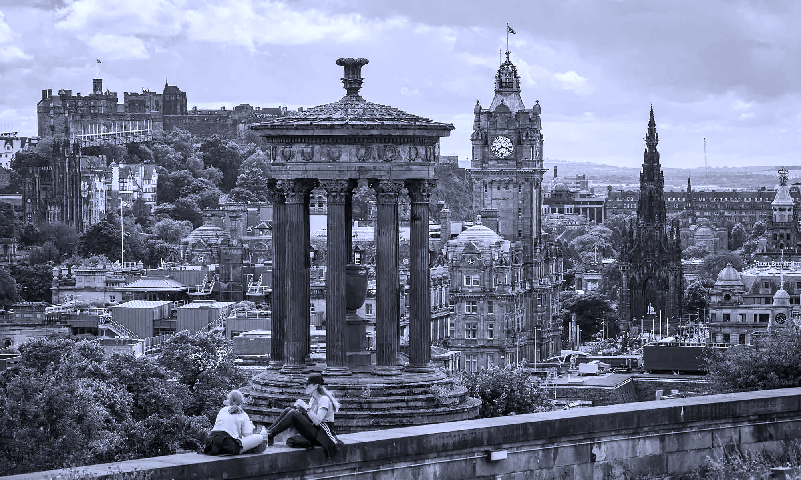
Outline:
1- The Rules of the Market: Transport and Tourism
2- Markets and Competition
3- Tourism and Infrastructure

Slide 3

1- THE RULES OF THE MARKET: TRANSPORT AND TOURISM

Slide 4
1- The Rules of the Market: Transport and Tourism
- In this part, we will focus on two main themes:
1- The legal rules applicable to tourism markets and transportation
2- The analysis of international contracts of carriage of passengers by sea, air, railway, and roads

Slide 5
1- The Rules of the Market: Transport and Tourism
- The legal rules applicable to tourism markets and transportation will include:
A- The Basic Legal Rules
An exploration and understanding of the basic legal rules
Applicable to those who want to join these two markets
B- Analysis:
Focusing on explaining how to make these two markets a competitive dimension for business activities.

Slide 6
1- The Rules of the Market: Transport and Tourism
- The legal rules applicable to tourism markets and transportation will include:
C- review
review specific issues affecting their respective infrastructure

Slide 7
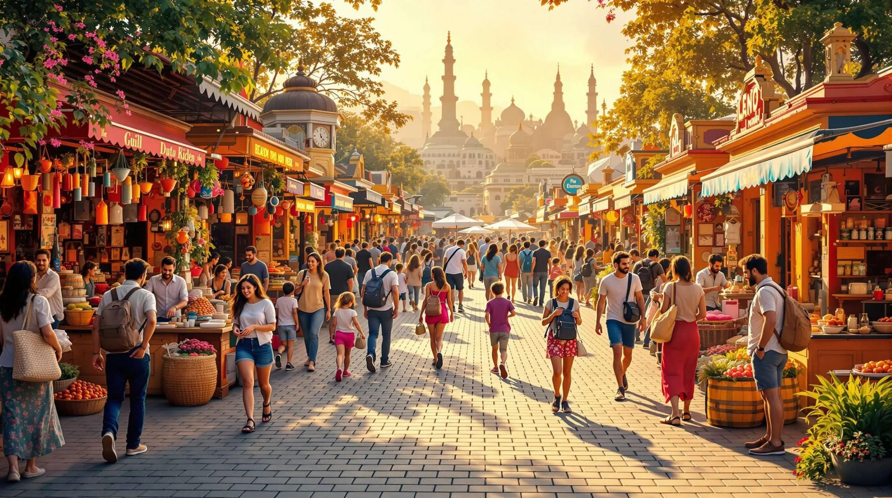
2- MARKETS AND COMPETITION

Slide 8
2- Markets and Competition
- Competition is a fundamental principle of free-market economies
- Protected by competition laws worldwide
- Applies to all sectors, including tourism and transport

Slide 9
2- Markets and Competition
Why Competition Matters
- Ensures free access to markets for businesses
- Prevents illegal restraints on offering goods and services
- Benefits consumers through:
Lower prices
Better quality
Greater choice

Slide 10
2- Markets and Competition
Competition Law and Tourism & Transport
- Tourism and transport are not exempt from competition law
- These sectors may face specific anti-competitive risks
- Same legal principles apply regardless of the market

Slide 11
2- Markets and Competition
Two Main Branches of Competition Law:
Competition law is divided into:
1- Illicit Anti-competitive / Antitrust Practices
2- Unfair Competition Practices
-Both aim to protect competition but use different legal tools

Slide 12
2- Markets and Competition
1- Illicit Competition
Illicit competition rules prohibit:
A- Collusive agreements between businesses
B- Abuse of dominant market positions

Slide 13
2- Markets and Competition
A- Collusive Agreements:
- Illegal agreements that restrict competition, such as:
Price-fixing airlines agreeing on fares)
Limiting production or investment
Sharing markets or customers
Discriminatory trading conditions
Tying contracts to unrelated obligations

Slide 14
2- Markets and Competition
B- Abuse of Dominant Position
- Holding a dominant market position is not illegal
- Abusing that position is illegal
- Examples:
Imposing unfair prices
Imposing unfair trading conditions
Discriminating between business partners

Slide 15
2- Markets and Competition
Legal Consequences of Illicit Competition:
- Illegal agreements and conduct are null and void
- Heavy administrative fines may be imposed
- Possible civil liability and compensation claims

Slide 16
2- Markets and Competition
Mergers and Cooperation Control:
- Mergers and major cooperation projects may require:
- Notification to competition authorities
- Failure to notify may result in:
Fines
Serious legal and business consequences

Slide 17
2- Markets and Competition
2- Unfair Competition Law:
- Focuses on unethical or dishonest market behavior
- Examples include:
Deceptive or misleading practices
Imitation and confusion
Aggressive or denigratory conduct
Unfair advertising and dumping

Slide 18
2- Markets and Competition
Legal Nature of Unfair Competition:
- Governed mainly by private law
- Enforced through courts
- Can lead to damages and compensation

Slide 19
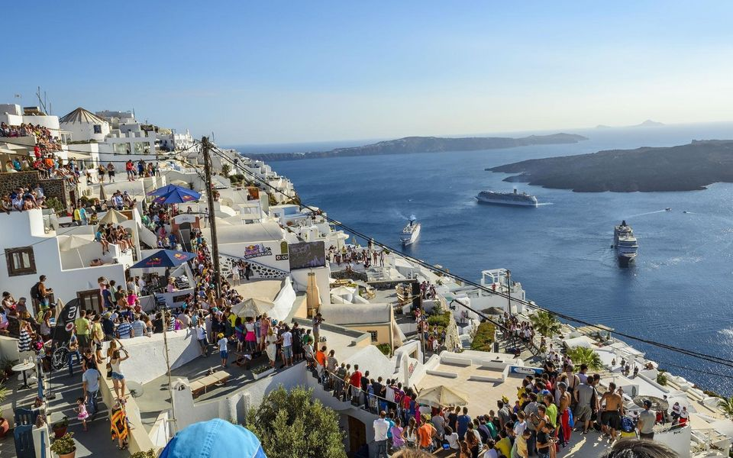
3- TOURISM AND INFRASTRUCTURE

Slide 20
3- Tourism and Infrastructure
Introduction
- Tourism and transport are infrastructure-dependent sectors
- Services cannot be provided without physical facilities and systems
- Infrastructure is essential for mobility and service delivery

Slide 21
3- Tourism and Infrastructure
Infrastructure in Transportation
Transportation infrastructure includes:
Physical networks:
Support facilities:
Roads | Railways
Airports | Ports
Railway stations | Bus terminals

Slide 22
3- Tourism and Infrastructure
Role of Transport Infrastructure:
- Allows vehicles to operate
- Connects destinations and markets
- Essential for economic and tourism development

Slide 23
3- Tourism and Infrastructure
Infrastructure in Tourism:
- Broader and more diverse than transport infrastructure
- Depends on type of tourism activity
- Includes:
Accommodation facilities (hotels, resorts)
Tourism sites and attractions
Facilities where tourism activities take place

Slide 24
3- Tourism and Infrastructure
Legal Approach to Infrastructure:
- No special legal regime only for tourism or transport
- Regulation focuses on:
Safety standards
Health protection
Environmental protection

Slide 25
3- Tourism and Infrastructure
Legal Approach to Infrastructure:
- No special legal regime only for tourism or transport
- Regulation focuses on:
Safety standards
Health protection
Environmental protection

Slide 26
3- Tourism and Infrastructure
Key Challenges in Infrastructure Management:
- Rapid changes in technology and markets
- Growing environmental and health concerns
- Need for efficient and sustainable management

Slide 27
3- Tourism and Infrastructure
A- Digitalization
- Increasing use of digital tools in infrastructure management
- Examples:
Benefits:
Online contracting | Digital documentation and registration
Online service provision | Artificial intelligence and blockchain
Lower costs | Greater efficiency

Slide 28
3- Tourism and Infrastructure
B- Technological Innovation
- Technology is a key driver of change
- Examples in transport:
Autonomous vehicles
High-speed transport systems

Slide 29
3- Tourism and Infrastructure
C- Environmental Sustainability
- Sustainability is now a central concern
- Focus on reducing environmental impact
- Examples:
Promotion of rail transport over short-haul flights
Sustainable tourism practices

Slide 30
3- Tourism and Infrastructure
D- Health as a Key Challenge
- Health strongly affects tourism and transport
- COVID-19 demonstrated sector vulnerability
- Need for:
New legal frameworks
Health and safety measures for tourists and passengers

Slide 31
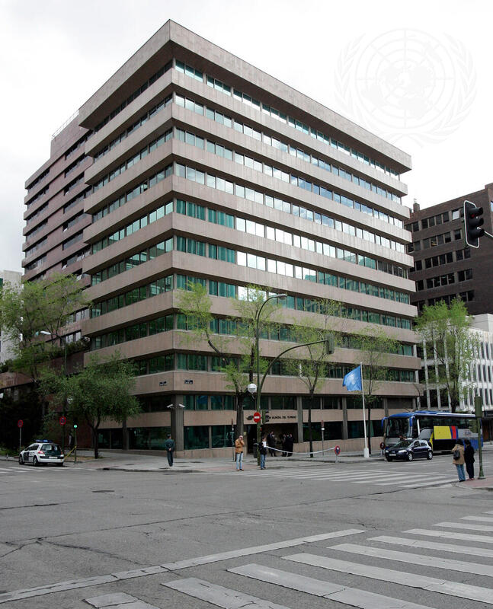
DISCUSSION

Slide 32
Thank you
      European Institute of Innovation, Entrepreneurship and Technology
      Lessingstraße 79,
      13158 Berlin, Germany
      Phone: +49 176 55524449
      Email: info@eiiet.com
Discover the world of eiIET

