Slide 1
Recreation
European Institute of Innovation, Entrepreneurship and Technology
Lessingstraße 79, 13158 Berlin, Germany
Mahmoud| Berlin
      Lessingstraße 79,
      13158 Berlin, Germany
      Phone: +49 30 233618555
      Fax: +49 30 233618556
      Email: info@eiiet.com

Slide 2
Outline:
Urban and Rural Recreation
Urbanization and Recreation
Rural Recreation
Active and Passive recreation
Push/Pull Theory and Recreation Activities

Slide 3
1- Urban and Rural Recreation
      1.1- What is Urban Recreation?
      - Leisure activities enjoyed in city environments
      -Includes:
      Parks and green spaces
      Sports facilities and gyms
      - Cultural attractions (museums, theaters, galleries)

Slide 4
1- Urban and Rural Recreation
      1.2- Benefits of Urban Recreation
      Improved Physical Health
      - Encourages exercise, reduces obesity, and lowers stress levels
      Enhanced Mental Health
      - Time in green spaces helps reduce anxiety and boost mood

Slide 5
1- Urban and Rural Recreation
      1.2- Benefits of Urban Recreation
      Stronger Social Connections
      Community centers and local events promote interaction and friendship
      Sense of Belonging
      - Public spaces create community identity and inclusiveness
      Economic Benefits
      - Attracts visitors and supports local businesses and jobs

Slide 6
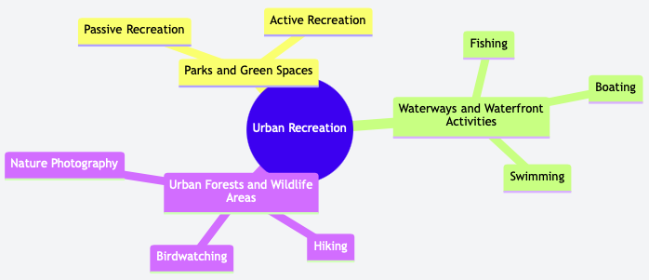
1- Urban and Rural Recreation
      1.3- Types of Urban Recreation
      A- Parks and Green Spaces
      - Core spaces for urban recreation
      - Support passive activities (picnicking, walking)
      - Support active activities (sports, playground use)
      - Encourage healthy lifestyles and relaxation
      - Accessible to all age groups and backgrounds
      - Good design and management improve:
      Usability
      Safety
      Community appeal

Slide 7
1- Urban and Rural Recreation
      B- Waterwys and Waterfront Activites
      - Include rivers, lakes, canals, and coastlines
      - Offer diverse recreation:
Boating | Fishing
Swimming | Kayaking and paddleboarding

Slide 8
1- Urban and Rural Recreation
      B- Waterwys and Waterfront Activites
      Waterfront development can add:
      - Promenades and walking paths
      - Parks and green zones
      - Enhance the scenic and recreational value
      -Promote relaxation, tourism, and community use

Slide 9
1- Urban and Rural Recreation
      C- Urban Forests and Wildlife Areas
      - Provide natural habitats for diverse plant and animal species
      - Offer peaceful spaces for:
      Hiking and nature walks
      Birdwatching
      Nature photography

Slide 10
1- Urban and Rural Recreation
      C- Urban Forests and Wildlife Areas
      - Help urban residents connect with nature
      - Support biodiversity and ecological balance
      - Require careful preservation and management
      Ensures sustainability
      Enhances educational and recreational value

Slide 11
2- Urbanization and Recreation
      Industrialization:
      - Shift from farming to manufacturing economies
      - Leads to job creation in urban centers
      Urbanization:
      - Movement of people to cities in search of work
      - Results in high population density and changing lifestyles
      Impact on Recreation:
      - Urban populations seek leisure and relaxation
      - Increases demand for parks, sports facilities, and cultural spaces

Slide 12
2- Urbanization and Recreation
      Increased Demand for Recreation in Urban Areas
      - Urbanization = More people in cities
      - Higher demand for recreational spaces and programs
      - Cities offer diverse recreation options:
      Parks and playgrounds
      Sports and fitness centers
      Cultural events and entertainment venues

Slide 13
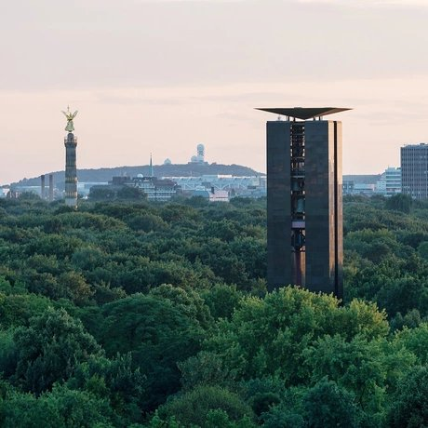
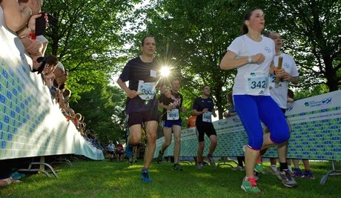
2- Urbanization and Recreation
      A Case Study: Berlin
      The Rise of Public Parks in Berlin
      - Concept of public parks emerged in the late 19th and early 20th centuries
      - Aimed to provide green spaces for relaxation, recreation, and public health
      Key historical parks include:
      - Großer Tiergarten
      - Schlosspark Charlottenburg
      - Treptower Park

Slide 14
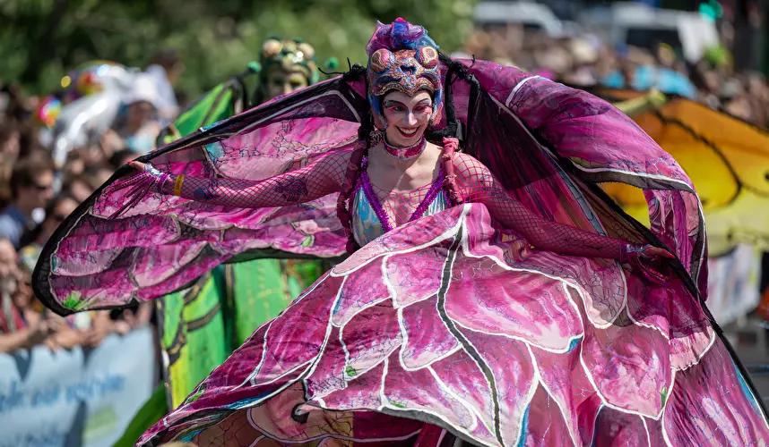
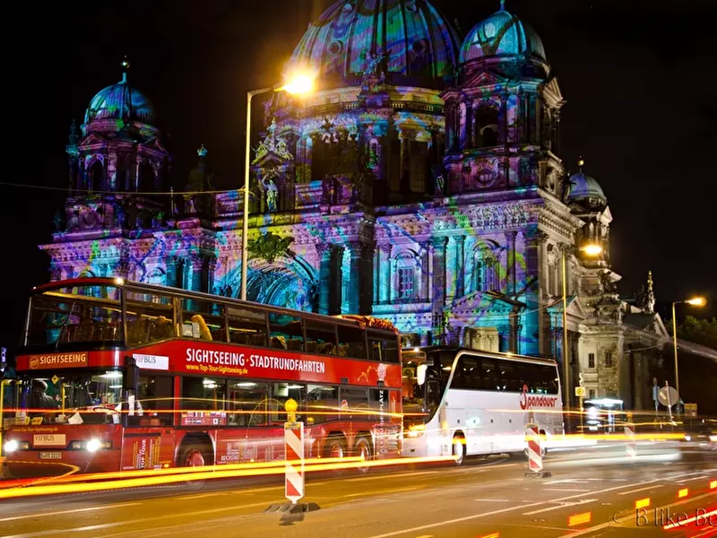
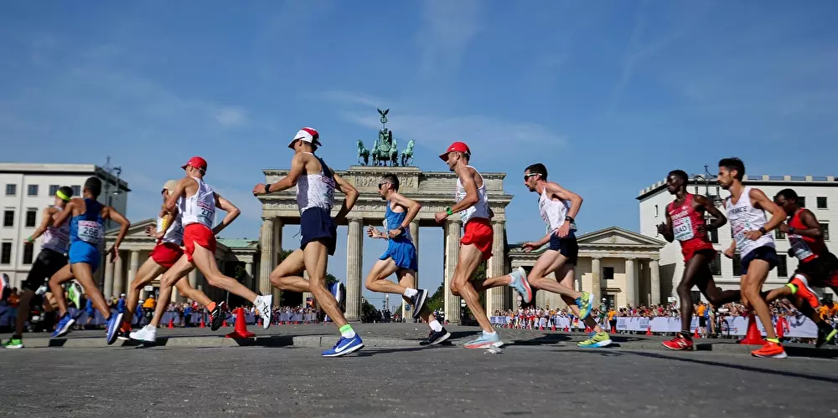
2- Urbanization and Recreation
      A Case Study: Berlin
      - Berlin offers a wide range of cultural festivals and recreational activities.
      - The city is known for its diverse festivals, including:
      Berlin Art Week
      Carnival of Cultures
      Festival of Lights
      BMW Berlin Marathon

Slide 15
3- Rural Recreation
      The term “rural recreation” has two meanings, depending on perspective:
      Urban/Suburban View
      - Rural areas seen as destinations
      - Recreation is associated with visiting
      - Examples: camping, hiking, farm stays
      Rural Resident View
      - Recreation is part of everyday community life
      - Focus on local opportunities for leisure and relaxation
      - Examples: local parks, community fairs, fishing, nature walks

Slide 16
3- Rural Recreation
      3.1- The Appeal of Rural Recreation
      - Many city dwellers seek escape from urban stress and crowding
      - The countryside offers:
      Peace and quiet
      Open spaces and nature
      A slower, more relaxed pace of life

Slide 17
3- Rural Recreation
      Driven by a nostalgic view of rural life – the “rural idyll”
      Simpler times
      Close-knit communities
      Natural beauty
      This appeal fuels interest in:
      Heritage tourism
      Rural villages
      Traditional lifestyles and crafts

Slide 18
3- Rural Recreation
      3.2- Types of Rural Recreation
      A- Outdoor Activities
      - Hiking, biking, horseback riding
      - Camping, fishing, hunting
      - Water sports: kayaking, swimming
      - Wildlife viewing and nature photography

Slide 19
3- Rural Recreation
      B- Community-Based Recreation
      - Local festivals and fairs
      - Farm visits and agri-tourism
      - Participation in rural traditions and events

Slide 20
3- Rural Recreation
      C- Passive Recreation vs Active Recreation
      - Passive Recreation
      - Low-impact, relaxing activities:
Walking and sightseeing | Visiting historical and cultural sites
Attending local festivals | Viewing nature
Farm-based visits

Slide 21
3- Rural Recreation
      C- Passive Recreation vs Active Recreation
      - Active Recreation
      - High-energy, physically demanding activities:
Off-road motor vehicle riding | Wind-surfings
Hang-gliding | Parasailing
Snow skiing

Slide 22
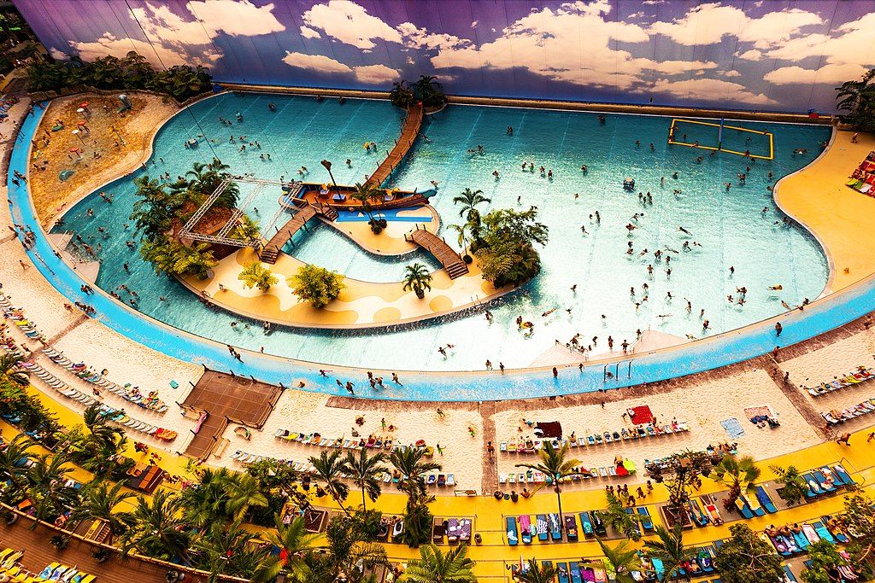
3- Rural Recreation
      Tropical Island Resort
      - A tropical-themed indoor water park
      - Located in Dahme-Spreewald, Brandenburg, about 50 km south of Berlin
      - World’s largest indoor water park

Slide 23
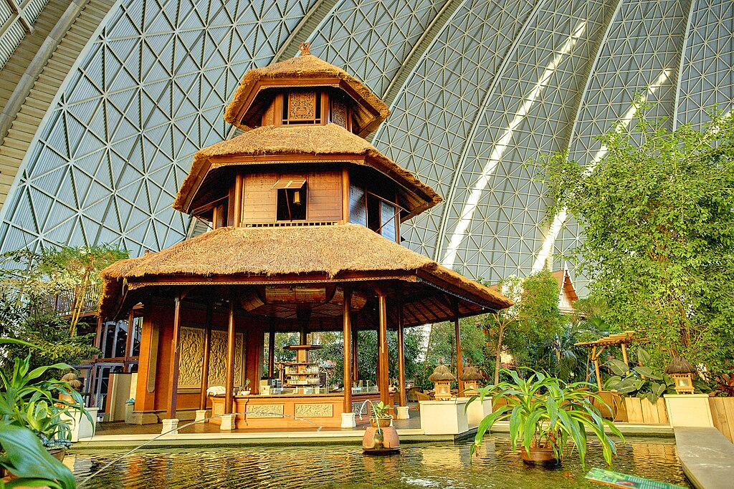
3- Rural Recreation
      Themed Areas of Tropical Islands
      Tropical Village
      -Replicas of traditional buildings from Thailand, Samoa, and Bali
      Rainforest
      - Home to 50,000 plants
      - Over 600 species, including rare plants
      Tropical Sea
      - pool with a sandy beach
      - resembles a coral island lagoon

Slide 24
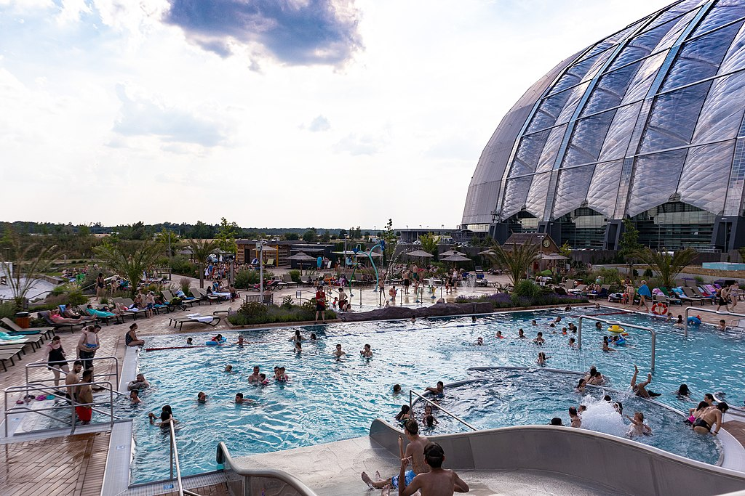
3- Rural Recreation
      Themed Areas of Tropical Islands
      Bali Lagoon
      - Includes fountains, whirlpools, current canal
      - Includes 2 water slides
      Amazonia (Outdoor Area)
      - Features 2 pools, sunbathing area,
      - beach volleyball and soccer courts, and a kiosk

Slide 25
4- Active and Passive recreation
      4.1- What is Active Recreation?
      - Involves physical activity during free time
      - Can be structured or unstructured
      - Not part of competitive sports
      - Includes a wide range of physical activities
      - Active living
      Physical movement
      Sport (non-competitive)
      - Can be individual or team-based
      - Often requires special facilities, courses, fields, or equipment

Slide 26
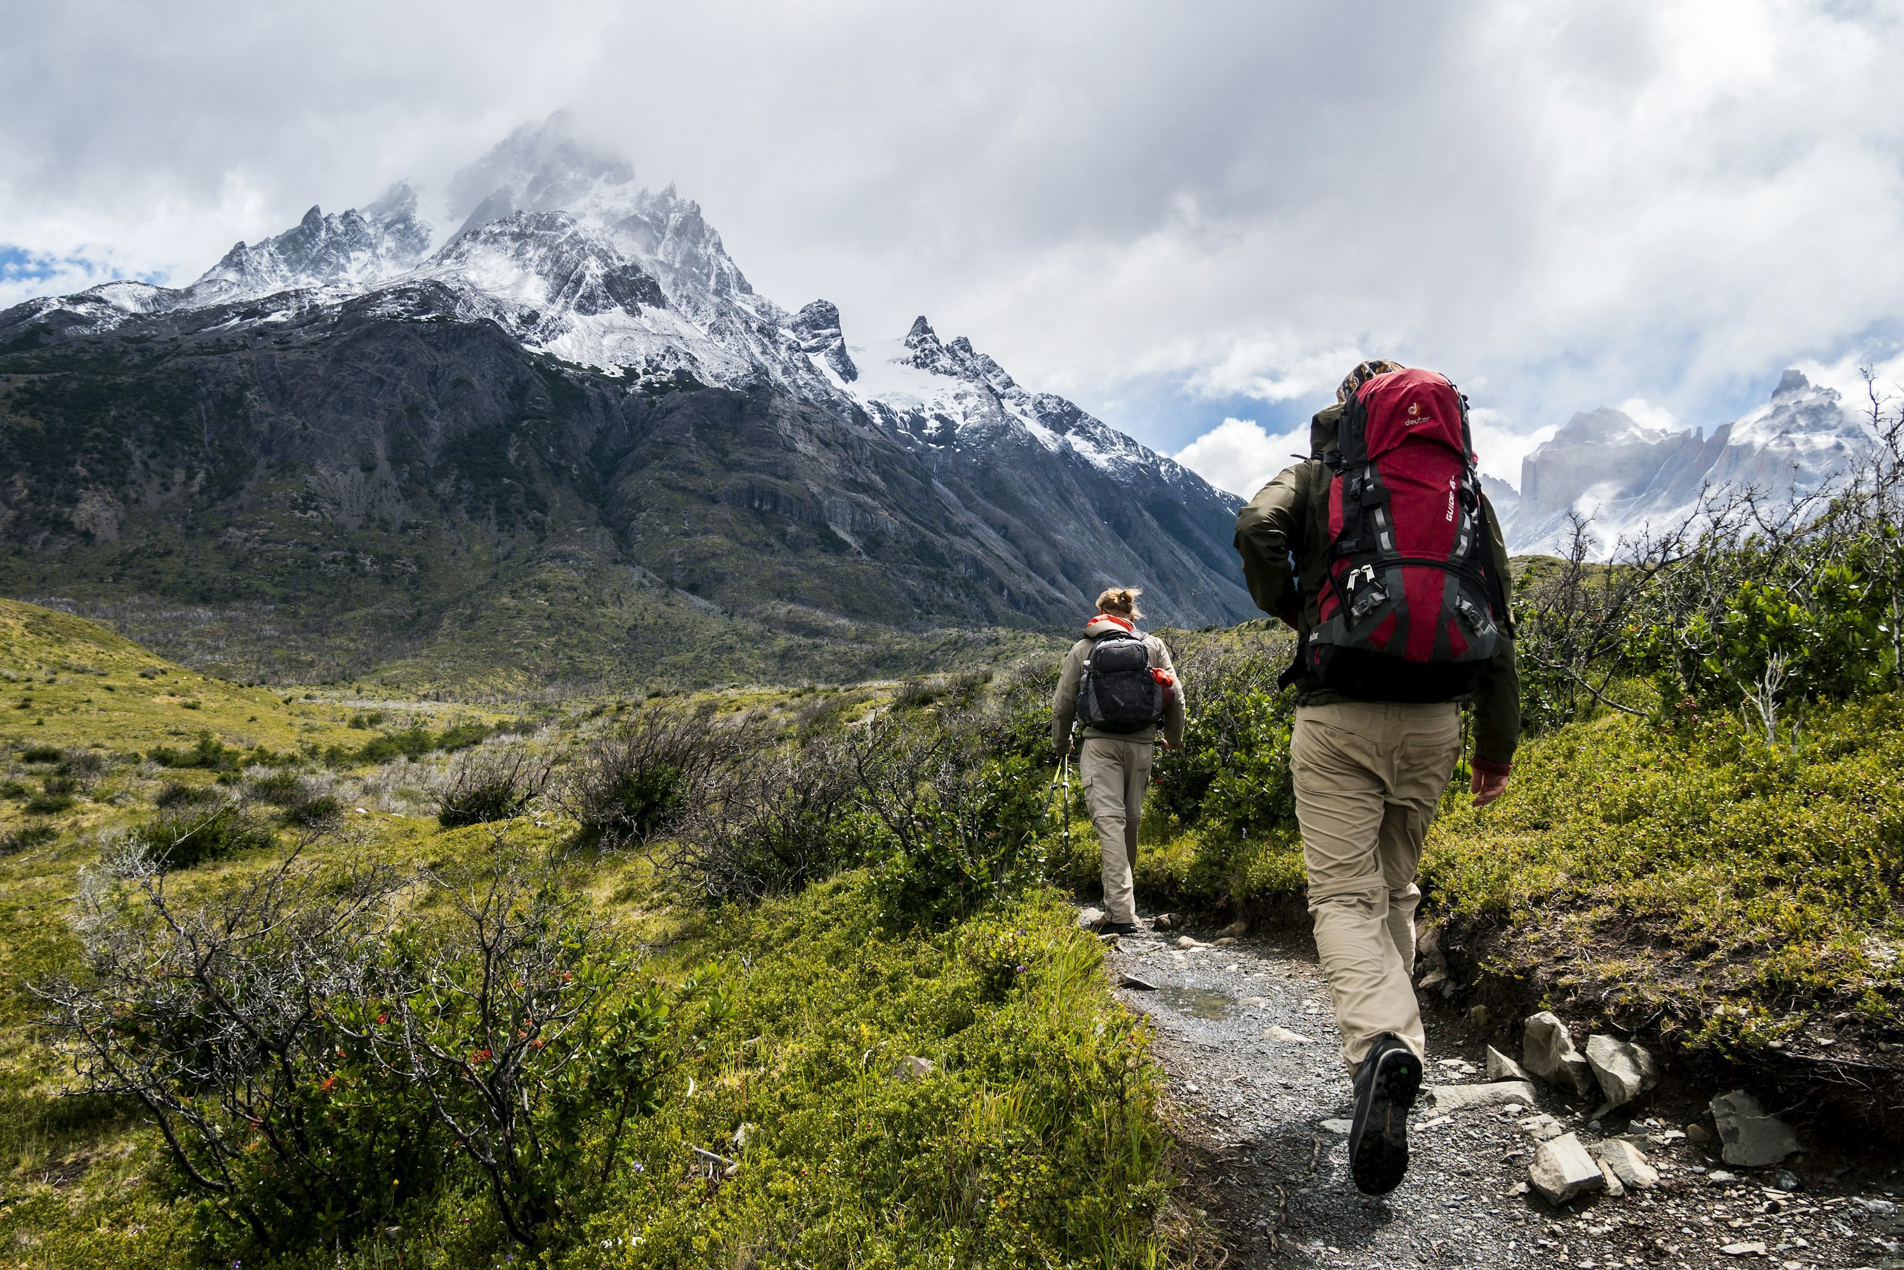
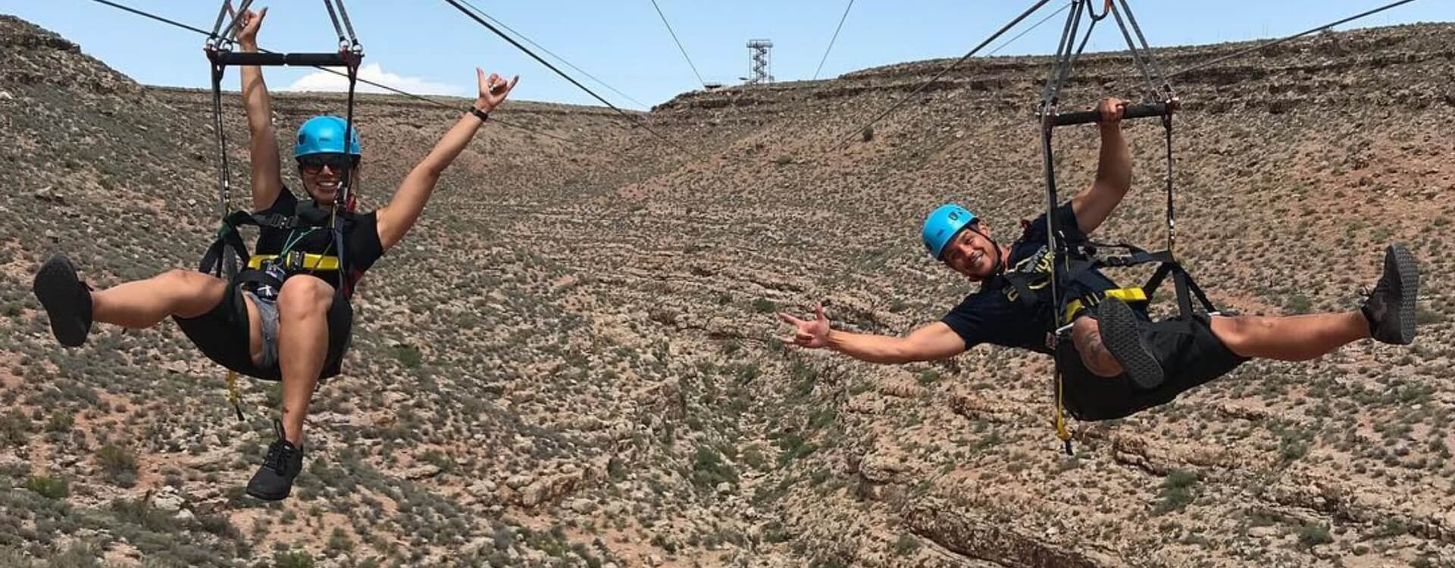
4- Active and Passive recreation
      Examples:
      - Hiking, swimming, kayaking
      Sports (tennis, football, skiing)
      Adventure tourism (ziplining, rock climbing)

Slide 27
4- Active and Passive recreation
      4.2- What is Paassive Recreation?
      - Involves low-impact, non-intrusive activities
      - Does not require built facilities (like sports fields or pavilions)
      - Places minimal stress on natural areas
      - Supports ecosystem protection and sustainability

Slide 28
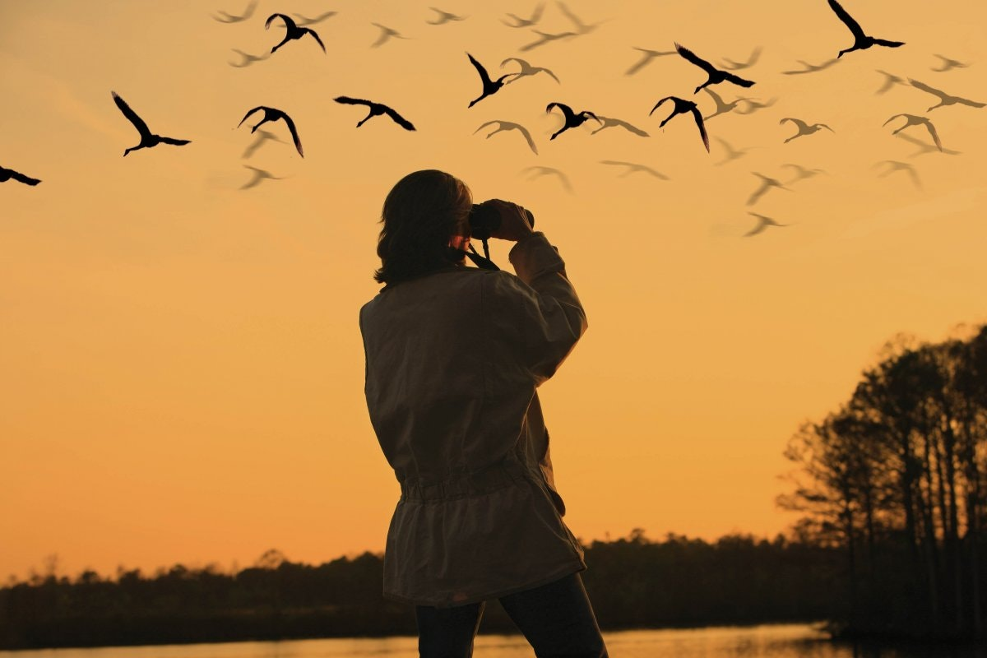
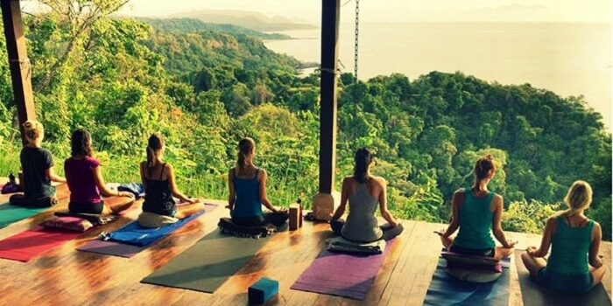
4- Active and Passive recreation
      Examples include:
      - Birdwatching, reading in parks
      - Scenic train rides, sunbathing
      - Museum visits, meditation retreats

Slide 29
4- Active and Passive recreation
      Key Differences Between Active and Passive Recreation
Feature | Active Recreation | Passive Recreation
Physical Intensity | High | Low
Equipment/Space | Highly required | Low need
Health Benefits | Physical and mental | Mostly mental/relaxation

Slide 30
5- Push/Pull Theory and Recreation Activities
      - It explains why tourists choose one destination over another
      Push Factors (internal motivations):
      - Desire to escape routine
      - Need for relaxation or adventure
      - Personal or psychological needs (e.g., self-fulfillment, socialization)
      Pull Factors (external attractions of a destination):
      - Natural beauty, culture, or climate
      - Events, attractions, or activities available
      - Safety, affordability, and accessibility

Slide 31
5- Push/Pull Theory and Recreation Activities
      The relation between Push/Pull Theory and Recreation Activities:
      - It explains why individuals choose certain types of activities based on:
      Their internal motivations (push factors)
      Destination features (pull factors)

Slide 32
5- Push/Pull Theory and Recreation Activities
      Other activities can be based on push factors:
      - Desire for adventure or excitement
      - Need for relaxation or escape
      - Health and fitness goals
      - Desire for peace or reflection

Slide 33
4- Push/Pull Theory and Recreation Activities
      These activities can be based on bull factors:
      - Mountain landscapes
      - Tranquil natural settings
      - Cultural or heritage attractions
      - Adventure parks or water sports

Slide 34
      Discussion
      1- What are the challenges facing urban and rural recreational activities?
      2- What kinds of conflicts can arise between residents and recreationalists due to rural recreational activities, and how can they be resolved?

Slide 35
Thank you
      European Institute of Innovation, Entrepreneurship and Technology
      Lessingstraße 79,
      13158 Berlin, Germany
      Phone: +49 176 55524449
      Email: info@eiiet.com
Discover the world of eiIET

