Slide 1
Health Threats in Tourism
European Institute of Innovation, Entrepreneurship and Technology
Lessingstraße 79, 13158 Berlin, Germany
Presenter Name| Berlin
      Lessingstraße 79,
      13158 Berlin, Germany
      Phone: +49 30 233618555
      Fax: +49 30 233618556
      Email: info@eiiet.com

Slide 2
Index
Psychoactive Substance Use-related- Disorders
Other Concerns
Health Threats and Crisis Management
Tourism Crisis Management Framework

Slide 3
1- Psychoactive Substance Use-related- Disorders
      1.1- Disorders due to psychoactive substance use
      - Psychoactive substance use can lead to a wide range of mental and behavioral disorders
      - Disorders vary in severity — from mild impairment to serious psychiatric emergencies
      - Substance misuse is commonly observed among international travellers:
      Alcohol
      Cannabis
      Stimulants
      Hallucinogens
      Prescription medications

Slide 4
1- Psychoactive Substance Use-related- Disorders
      1.1- Disorders due to psychoactive substance use
      Key features of substance dependence:
      - Craving – strong desire or compulsion to use the substance
      - Loss of control over substance use (onset, duration, quantity)
      - Withdrawal symptoms when stopping or reducing use
      - Tolerance – need for increasing doses to achieve the same effect
      - Neglect of other interests in favor of substance use
      - Continued use despite harm

Slide 5
1- Psychoactive Substance Use-related- Disorders
      1.1- Disorders due to psychoactive substance use
      Travel considerations:
      -Travel does not cause substance dependence
      - However, travel can trigger relapse due to:
      Lack of social restraints (family, work, community)
      Easy access to substances in new environments
      A sense of freedom or detachment from home routines

Slide 6
1- Psychoactive Substance Use-related- Disorders
      1.2- Acute intoxication:
      - A transient, dose-related condition caused by alcohol or psychoactive substances
      - Affects consciousness, thinking, perception, mood, behavior, and body functions
      Alcohol intoxication (drunkenness):
      - Typically not a psychiatric emergency
      - Becomes an emergency if violent or suicidal behavior occurs
      Higher risk substances for psychiatric emergencies:
      - Stimulants -Hallucinogens
      - Inhalants - Cannabis

Slide 7
1- Psychoactive Substance Use-related- Disorders
      1.2- Acute intoxication:
      - Travel and Intoxication
      Travel as a Risk Environment:
      - International/leisure travel can increase exposure to alcohol and drugs
      - Environments may be more permissive or unregulated

Slide 8
1- Psychoactive Substance Use-related- Disorders
      6.2- Acute intoxication:
      Travel and Intoxication
      Increased Exposure and Opportunity:
      - Alcohol is widely available and socially encouraged
      - Common in beach resorts, festivals, nightlife zones
      - Travellers may experiment with local or unfamiliar substances
      - Especially in regions with cultural tolerance for recreational drug use
      High-Risk Groups:
      - Young, adventurous, or uninformed travellers at higher risk
      - Greater chance of acute intoxication and psychiatric/medical emergencies

Slide 9
1- Psychoactive Substance Use-related- Disorders
      1.3- Withdrawal
      - Withdrawal states can become psychiatric emergencies, especially with:
      Alcohol
      Sedatives/Hypnotics
      Typical withdrawal symptoms:
      - Autonomic hyperactivity (sweating, increased heart rate)
      - Tremors
      - Insomnia
      - Anxiety and agitation

Slide 10
1- Psychoactive Substance Use-related- Disorders
      1.3- Withdrawal
      Severe withdrawal complications:
      - Seizures
      - Delirium tremens (DTs):
      Delirium
      Severe autonomic hyperactivity
      Vivid hallucinations and delusions
      Extreme tremors and agitation
      High mortality risk

Slide 11
1- Psychoactive Substance Use-related- Disorders
      1.3- Withdrawal
      Travel and Withdrawal
      - Travel can trigger or worsen withdrawal symptoms, especially in those dependent on:
      Alcohol
      Sedative-hypnotics
      Risk of Psychiatric Emergencies:
      - Withdrawal during travel may lead to life-threatening complications

Slide 12
1- Psychoactive Substance Use-related- Disorders
      1.3- Withdrawal
      Travel and Withdrawal
      Travel Triggers Withdrawal Risks thorugh:
      - Unintentional Interruption of Substance Use
      - Limited access due to:
      Legal restrictions
      Customs/airline rules
      Cultural/religious bans

Slide 13
1- Psychoactive Substance Use-related- Disorders
      1.3- Withdrawal
      Travel and Withdrawal
      - Travellers may:
      Forget to bring enough medication
      Assume availability at destination
      -Disrupted Routine and Environment
      Time zone changes, altered schedules
      Medication adherence issues (missed doses, planning errors)
      Abrupt cessation of use due to logistical challenges

Slide 14
1- Psychoactive Substance Use-related- Disorders
      1.3- Withdrawal
      Travel and Withdrawal
      - Travel-Related Stress
      Jet lag, fatigue, dehydration
      Emotional stress (anxiety, culture shock)
      These can intensify withdrawal symptoms or cause a crisis

Slide 15
2- Other Concerns
      2.1- Air Rage and Travel
      What is Air Rage?
      - Aggressive passenger behavior during air travel
      - Can range from verbal threats to physical assault
      - Serious injuries are rare, but disruptions are concerning

Slide 16
2- Other Concerns
      2.1- Air Rage and Travel
      Common Characteristics
      - Often involves young males
      May be fueled by:
      - Alcohol or substance misuse
      - Intoxication or withdrawal
      - Arguments with airline staff
      - Crowding, flight delays, and lack of communication

Slide 17
2- Other Concerns
      2.2- Culture Shock
      - Emotional and psychological reaction to sudden exposure to a different culture
      - Common during long-term travel, migration, or expatriation
      Triggered by:
      - New customs, lifestyles, and languages
      - Loss of familiar routines and social cues
      - Feeling of being completely alien in the new environment

Slide 18
2- Other Concerns
      2.2- Culture Shock?
      Identity and Lifestyle Conflicts
      - Travellers may feel torn between:
      Keeping aspects of their original lifestyle
      Adopting new cultural habits
      - Leads to internal conflict and identity stress

Slide 19
2- Other Concerns
      1.5- Culture Shock
      Age Matters
      - Children and young adults adjust more easily:
      Learn new language faster
      Mature into the new cultural norms
      - Middle-aged and elderly may struggle more:
      Harder to adapt to change
      Language acquisition takes longer

Slide 20
2- Other Concerns
      1.5- Culture Shock
      Family and Group Support
      - Adjustment is easier if:
      The move was planned and positive
      One is part of a family or social group
      -Shared experience can lower emotional stress
      Cultural Continuity
      - Maintaining some familiar cultural practices can ease transition
      - Safe integration without full cultural loss = reduced culture shock

Slide 21
2- Other Concerns
      What strategies can help relieve culture shock?

Slide 22
2- Other Concerns
      1.5- What is Culture Shock?
      Natural Emotional Reactions
      - Anxiety, depression, isolation, fear
      - Sense of identity loss during adjustment
      - These symptoms are normal and understandable
      What Helps?
      - Self-awareness: Recognizing these feelings as part of the process
      - Time: Emotional adjustment improves gradually
      - Support systems: Family, friends, and colleagues can ease distress

Slide 23
2- Other Concerns
      1.5- What is Culture Shock?
      Positive Coping Strategies
      Seek community involvement:
      Join local groups or activities
      Connect with locals:
      Engage with neighbours and coworkers
      Stay socially active:
      Reduces feelings of isolation and boosts adaptation

Slide 24
2- Other Concerns
      1.5- Reverse Culture Shock
      Emotional Challenges
      - Returning home after long travel can be stressful
      - Harder if you loved your time abroad
      - Home life may feel less exciting
      - Younger or long-term travelers may want to stay longer
      - Feeling anxious or worried is common

Slide 25
2- Other Concerns
      1.5- Reverse Culture Shock
      - Some travelers feel a sense of loss or bereavement after returning home.
      - This happens because:
      Both sides have changed
      Home environment has changed
      - This gap between the traveller’s new identity and their home environment can cause:
      Surprise and frustration
      Confusion and anxiety
      Sadness and emotional pain

Slide 26
3- Health Threats and Crisis Managment
      What is a Crisis in Tourism?
      - Crises = Times of High Uncertainty
      - Things become unpredictable
      - We may lose control over important systems and operations
      In Tourism:
      A crisis can be one major event or a series of problems
      It can harm a destination’s image or a business’s market potential
      The reputation of a region or company may suffer

Slide 27
3- Health Threats and Crisis Managment
      The Difference between Crisis and Disaster
      Crisis
      - More predictable
      - Often caused by human actions (anthropogenic)
      - Shows warning signs or build-up
      - Typically longer in duration
      - May escalate slowly over time

Slide 28
3- Health Threats and Crisis Managment
      The Difference between Crisis and Disaster
      Disaster
      - Often sudden and unexpected
      - Usually caused by natural forces
      - Little or no warning signs
      - Generally shorter in duration
      - Can cause emergencies needing quick action

Slide 29
3- Health Threats and Crisis Managment
      Understanding Risk Management
      - Good risk management can prevent problems from becoming a crisis
      - Poor risk understanding or planning can trigger a crisis
      What Is Risk Management?
      - Identifying potential negative events
      - Assessing how likely they are to happen
      - Understanding the impact on tourism operations
      - Taking steps to reduce the risk or prepare for it

Slide 30
3- Health Threats and Crisis Management
Six Functions of Risk Management:
Identify
Analyse
Plan
Track
Control
Communicat

Slide 31
4- Tourism Crisis Management Framework
      What is a Tourism Crisis?
      - “An event, in whatever form it occurs, that creates a shock to the tourism industry, resulting in the sudden emergence of an adverse situation.”
      Why It Matters:
      - Tourism is highly vulnerable to external shocks such as:
      pandemics, political unrest, natural disasters
      Crises can impact:
      - Visitor numbers
      - Reputation and safety
      - Revenue and jobs

Slide 32
4- Tourism Crisis Management Framework
      Types of Crisis in Tourism:
      - Environmental crises
      Geological, extreme weather
      Human-induced events
      - Societal and political events
      Crime
      Politically-motivated disturbances
      Human rights abuses
      External threats

Slide 33
4- Tourism Crisis Management Framework
      Types of Crisis in Tourism:
      - Health-related crises
      Macro-level epidemics
      Micro-level events
      - Technological incidents or failures
      - Economic events

Slide 34
4- Tourism Crisis Management Framework
      What is Crisis Management?
      - “Strategies, processes, and measures which are planned and put into force to *prevent and cope with crisis.”
      - What Does It Involve?
      - Understanding how tourism businesses react to a crisis
      - Identifying what actions are needed
      - Assessing the impacts of those actions
      - Ensuring preparedness, response, and recovery are well-coordinated

Slide 35
4- Tourism Crisis Management Framework
Pre-event
Prodromal
Emergency
Post-crisis
Recovery
Resolution
- Crisis Management Framework

Slide 36
4- Tourism Crisis Management Framework
- Crisis Management Framework
1- Pre-event Phase
- Risk identification and scenario forecasting
- Response strategies for different types of crises
- Crisis communication plans to avoid reputational harm
Pre-event
Prodromal
Emergency
Post-crisis
Recovery
Resolution

Slide 37
4- Tourism Crisis Management Framework
- Crisis Management Framework
2- Prodromal Phase
- The early signs of a crisis appear
- A quick and coordinated response can prevent escalation.
Key Actions to Take:
- Increase communication
- Prepare public messaging
- Set up a communication centre
Pre-event
Prodromal
Emergency
Post-crisis
Recovery
Resolution

Slide 38
4- Tourism Crisis Management Framework
- Crisis Management Framework
3- Emergency Phase
- Customer Safety First
Staff Safety
- Repair Critical Infrastructure
- Transparent Communication
- Clear Messaging to Customers
Pre-event
Prodromal
Emergency
Post-crisis
Recovery
Resolution

Slide 39
4- Tourism Crisis Management Framework
- Crisis Management Framework
4- Post-crisis Phase
- Accelerate recovery efforts
- Government leadership matters
- Focus on unaffected areas
Pre-event
Prodromal
Emergency
Post-crisis
Recovery
Resolution

Slide 40
4- Tourism Crisis Management Framework
- Crisis Management Framework
4- Post-crisis Phase (Intermediate Recovery)
Communication Strategy:
- Share accurate, timely, and transparent information
- Target both the trade and individual tourists
- Help prospective visitors make informed travel decisions
- Focus on limiting physical damage and reputation loss
Pre-event
Prodromal
Emergency
Post-crisis
Recovery
Resolution

Slide 41
4- Tourism Crisis Management Framework
- Crisis Management Framework
5- Recovery (Long Term)
- Infrastructural Improvements
- Investment Incentives
- Professional Development
Pre-event
Prodromal
Emergency
Post-crisis
Recovery
Resolution

Slide 42
4- Tourism Crisis Management Framework
- Crisis Management Framework
5- Recovery (Long Term)
- Rebuilding Destination Image
- Seize New Opportunities
- Develop New Products
Pre-event
Prodromal
Emergency
Post-crisis
Recovery
Resolution

Slide 43
4- Tourism Crisis Management Framework
- Crisis Management Framework
6- Resolution Phase
- Monitor Short and Medium Term Measures
- Evaluate Long-Term Strategies
- Modify future contingency plans
Pre-event
Prodromal
Emergency
Post-crisis
Recovery
Resolution

Slide 44
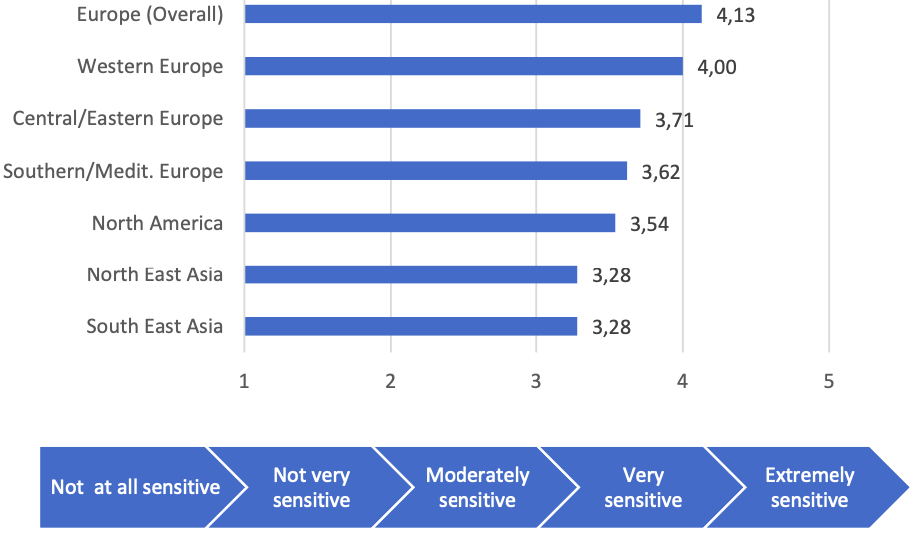
4- Tourism Crisis Management Framework
- Sensitivity of Tourism Markets to Crisis
Sensitivity to disruption varies by:
- Tourist market
- Segment
- Type of disruption

Slide 45
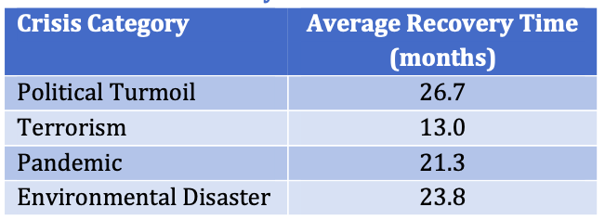
4- Tourism Crisis Management Framework
Quick Recovery Possible:
- Isolated terrorist attack
- Minimal infrastructure damage
- Clear communication and rapid response
Slow Recovery Likely:
- Ongoing political instability
- Large-scale natural disasters
- Environmental damage
Destinations Crisis Recovery Time

Slide 46
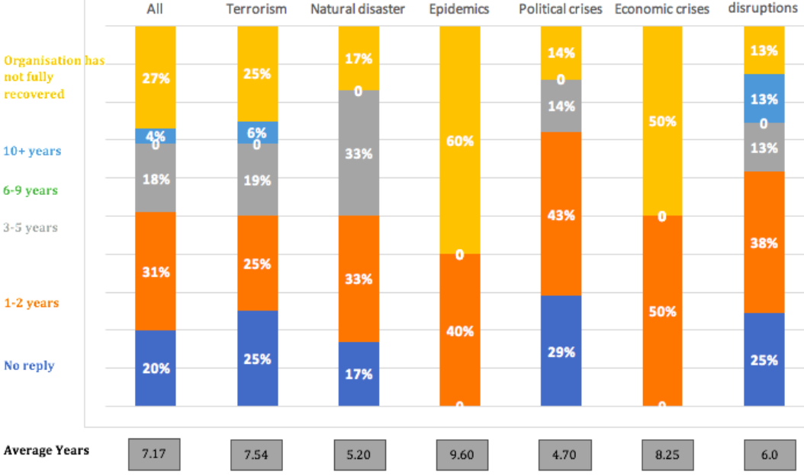
4- Tourism Crisis Management Framework
Destinations Crisis Recovery Time

Slide 47
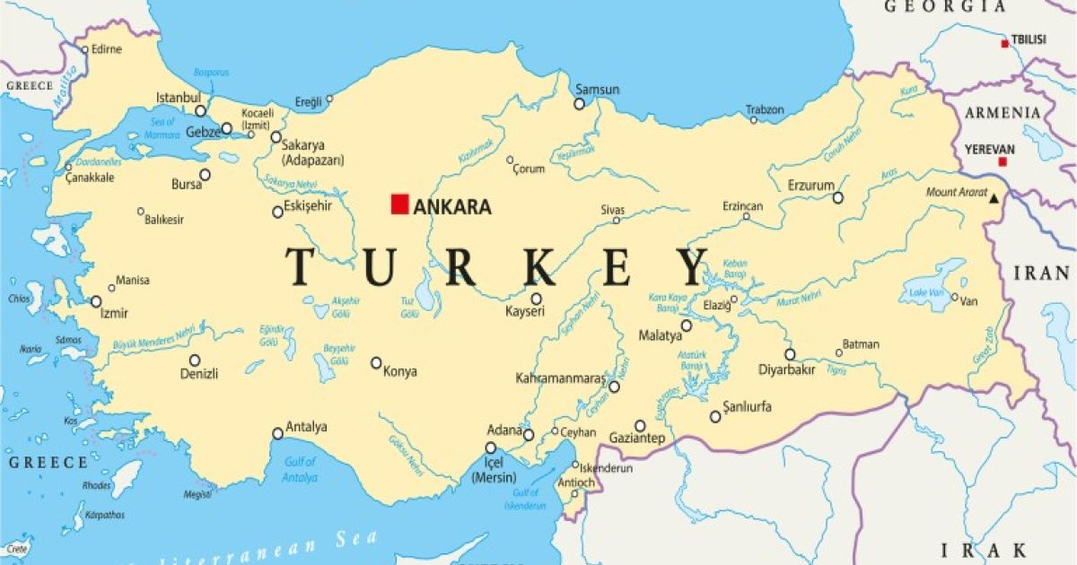
4- Tourism Crisis Management: Case Studies
Case Study: Turkey
Tourism development in Turkey:
- Rich historical heritage
- Stunning natural beauty
Unique location bridging Europe and Asia
- Organized tourism in Turkey dates back
To 1923, with the foundation of “
Travellers Associations”

Slide 48
4- Tourism Crisis Management: Case Studies
Case Study: Turkey
Tourism development in Turkey:
- By 1934, the Turkish government took its first formal step in supporting tourism:
Established a tourism administrative department
Housed within the Ministry of Economy
- In the following years,
The public sector developed the basic tourist infrastructure
Supporting the private investment in hospitality

Slide 49
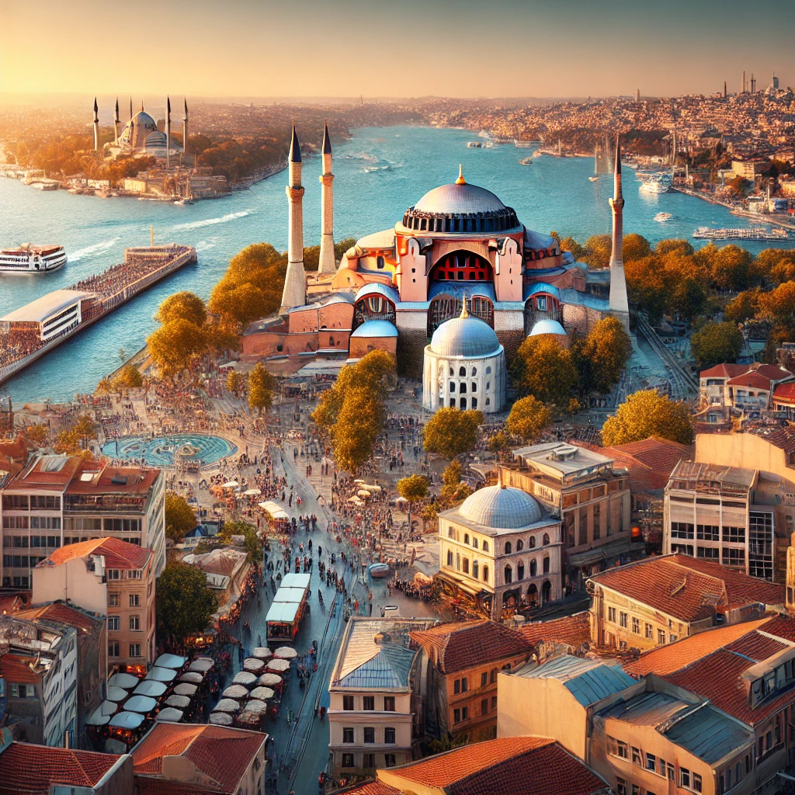
4- Tourism Crisis Management: Case Studies
Tourism development in Turkey:
- The 1990s showed a clear emphasis on
- Environmental sustainability,
- Cultural protection
- Human resource development.
- The new millennium has experienced:
Quality Improvements
Intensified Marketing
Product Diversification
Improved Accessibility

Slide 50
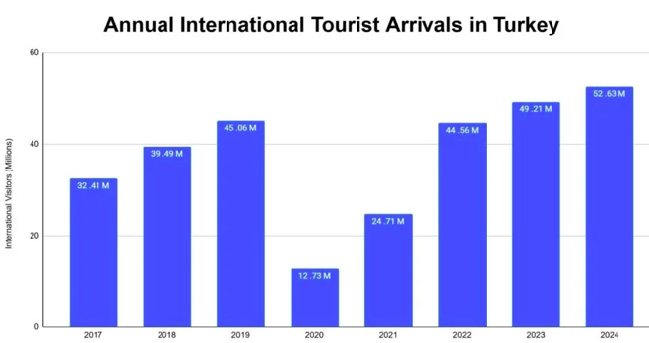
4- Tourism Crisis Management: Case Studies
Tourism development in Turkey:
- Crises Affecting Turkish Tourism
1999: Izmit Earthquake
2006: Avian Flu
2011 : Syrian Civil War
2015: Various Terrorist Attacks
2016: Coup Attempt
2019: COVID 19 Pandemic

Slide 51
4- Tourism Crisis Management: Case Studies
- Turkey’s Crisis Management Strategies:
- Cooperative Marketing Plan
- Pricing
- Image Building
- 2016 Action Plan
Cooperative Marketing Plan
Pricing
Image Building
2016 Action Plan

Slide 52
4- Tourism Crisis Management: Case Studies
- Turkey’s Crisis Management Strategies:
1- Cooperative Marketing Plan
- Advertising Campaigns
- Public Relations Campaigns
- Incentive Tours
Cooperative Marketing Plan
Pricing
Image Building
2016 Action Plan

Slide 53
4- Tourism Crisis Management: Case Studies
- Turkey’s Crisis Management Strategies:
2- Pricing
- Hotel room rates and holiday packages were lowered
- Applied after crises such as:
Avian Flu epidemic
Other major disruptions impacting tourist arrivals
Cooperative Marketing Plan
Pricing
Image Building
2016 Action Plan

Slide 54
4- Tourism Crisis Management: Case Studies
- Turkey’s Crisis Management Strategies:
3- Image Building
- Social Media Campaigns
- Familiarisation (FAM) Trips
Cooperative Marketing Plan
Pricing
Image Building
2016 Action Plan

Slide 55
4- Tourism Crisis Management: Case Studies
- Turkey’s Crisis Management Strategies:
4- 2016 Action Plan
- the government of Turkey announced an Action Plan to counter
the crisis impacting on the country’s tourism sector including:
Direct Subsidies
Indirect Subsidies
Employment Initiative
Business Development Strategies
Risk and Crisis Plans
Cooperative Marketing Plan
Pricing
Image Building
2016 Action Plan

Slide 56
Discussion
Based on the crisis management framework, what health threat management strategies were adopted in your country at each stage to mitigate the impacts of COVID-19?

Slide 57
Thank you
      European Institute of Innovation, Entrepreneurship and Technology
      Lessingstraße 79,
      13158 Berlin, Germany
      Phone: +49 176 55524449
      Email: info@eiiet.com
Discover the world of eiIET

