Slide 1
Research on Tourism Services
European Institute of Innovation, Entrepreneurship and Technology
Lessingstraße 79, 13158 Berlin, Germany
Mahmoud Abdou| Berlin
      Lessingstraße 79,
      13158 Berlin, Germany
      Phone: +49 30 233618555
      Fax: +49 30 233618556
      Email: info@eiiet.com

Slide 2
Index
- The Marketing Mix
- The Marketing Mix: Place
- The Marketing Mix: Product
- The Marketing Mix: Price
The Marketing Mix: Promotion

Slide 3
1- The Marketing Mix: Place
    The Tourism Marketing Mix:
    - The marketing mix is crucial to an organization’s success, serving as a collection of tools that marketers use to achieve strategic positioning.
    - It is defined as “a set of tools used by marketers to achieve a strategic position or positions”
    - For tourism organizations, the marketing mix encompasses all controllable elements used to meet consumer needs and communicate effectively.
    - The core components of the marketing mix include product, price, place, promotion, people, physical evidence, and process.

Slide 4
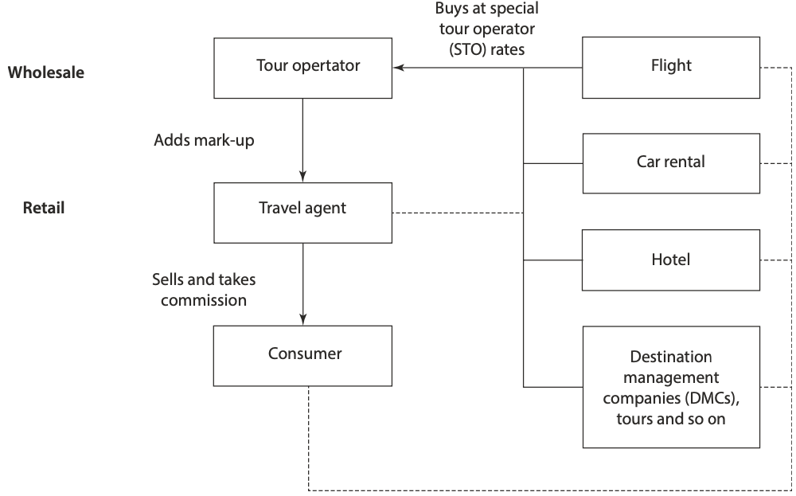
1- The Marketing Mix: Place
    - Tourism products are intangible, meaning they cannot be physically transported like physical goods”.
    - Instead, tourism organizations must attract consumers through direct or indirect sales, utilizing various distribution channels.
    - These channels are unique because they
    influence travelers' itineraries, and
    consumers actively participate in
    the distribution process.

Slide 5
1- The Marketing Mix: Place
    - Additionally, tourism providers typically pay commissions to intermediaries, such as travel agents,
    who connect them with customers.
    - This relationship can impact pricing,
    competitiveness, and profitability for
    tourism businesses
    - Intermediaries also play an important
    role in providing information and services
    to tourism consumers, often referred to
    as part of the "travel industry.

Slide 6
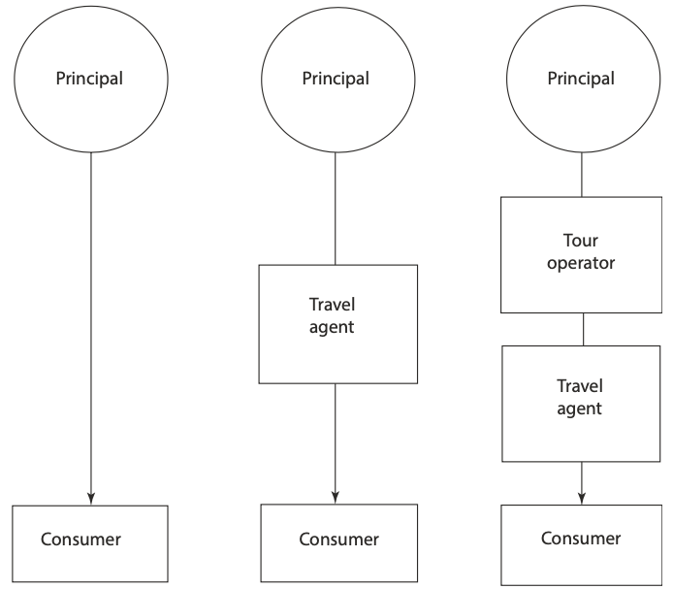
1- The Marketing Mix: Place
    1.1- Levels of Distribution in Tourism and Hospitality
    - The simplest form of distribution is direct sales to the consumer, where there is a single-level channel. For example, a hotel might sell a room directly to the person who
    will stay in it.
    - Similarly, a tour operator or principal might sell directly to
    the consumer. However, this approach requires staff to
    process and manage the bookings.

Slide 7
1- The Marketing Mix: Place
    1.1- Levels of Distribution in Tourism and Hospitality
    - The second form of distribution is indirect, involving longer, multi-level channels, known as a “multi-channel distribution system.”
    - In this system, a tourism organization sets up two or more
    marketing channels to reach one or more consumer segments.
    - For instance, a tourism provider, such as a hotel, resort,
    airline, or cruise company, may choose to sell through
    intermediaries like travel agents or tour operators.
    Tour operators sometimes use travel agents as intermediaries.

Slide 8
1- The Marketing Mix: Place
    2.1- Indirect Intermediaries
    2.1.1. Tour Operators
    - In the distribution chain, tour operators act as
    wholesalers (or middlemen) in the tourism industry.
    - They purchase tourism products in bulk from
    principals, such as airlines, hotels, and car rental
    companies, and then resell these products through
    retail travel agencies.
Tour Operators
outbound tour operators
specialist tour operators
retail travel agents
online travel agents
domestic tour operators
destination management companies
franchises

Slide 9
1- The Marketing Mix: Place
    2.2- direct Intermediaries
    - Direct booking systems are rapidly expanding due to advancements in digital technology, allowing consumers to book tourism products from the comfort of their homes, workplaces, or while on the move.
    - Additionally, technology provides consumers with all the necessary information to make informed travel decisions.
    - Over the past decade, there has been a significant increase in the availability of information and booking options through online communication systems.
    - The same technology that revitalized the role of travel agencies is now accessible directly to consumers.
    - Digital technology—especially the internet and call centers—has played a key role in disintermediation, a term that refers to consumers bypassing traditional intermediaries to deal directly with tourism principals and suppliers.

Slide 10
2- The Marketing Mix: Product
      2.1- What is a Tourism Product?
      - A tourism product, often referred to as a tourism offering, includes anything provided for use or consumption in exchange for money or value.
      - It is a composite entity that encompasses products, services, and experiences.
      - This highlights the inclusion of both tangible and intangible elements in a tourism product:
    Tangible elements: Examples include a hotel’s décor, furniture, staff uniforms, and promotional merchandise from travel agencies.
    Intangible elements: Examples include service quality, the ambiance of a restaurant, holiday packages curated by tour operators, and the overall holiday experience.

Slide 11
2- The Marketing Mix: Product
      2.2- Product Levels in Tourism:
      -Tourism marketers need a clear understanding of what they are truly marketing.
      -Every product has distinct features, which can be categorized into three levels: the core level, the expected level, and the augmented level.
      -In tourism, the product is not limited to the primary purchase, such as a holiday, dining experience, or museum visit.
      -Instead, it encompasses all tangible and intangible elements that contribute to the overall experience enjoyed by the consumer.
      -This concept emphasizes that marketers must focus on all aspects of the product to meet consumer expectations effectively, ensuring satisfaction and encouraging repeat purchases.
      -The product levels include: the core product, the expected product, and the augmented product.

Slide 12
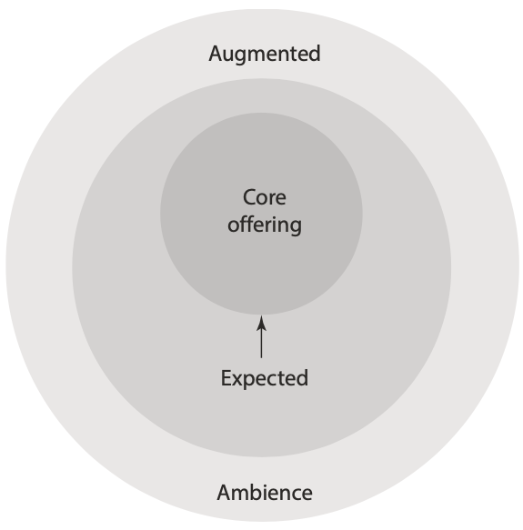
2- The Marketing Mix: Product
      2.2 Product Levels in Tourism:
      -The product levels include: the core product, the expected product, and the augmented product.
      The core product
      - At the most fundamental level, the core product represents the
      primary benefit or service being offered.
      - It is intangible and focuses on what the consumer is truly purchasing,
      addressing the main benefits sought to satisfy their needs.

Slide 13
2- The Marketing Mix: Product
      2.2- Product Levels in Tourism:
      -The product levels include: the core product, the expected product, and the augmented product.
      The core product
      - For example, the core benefit of staying in a luxurious hotel could be
      defined as rest and relaxation, while for a theme park like Disneyland
      Resort in Paris, France, the core product is excitement.

Slide 14
2- The Marketing Mix: Product
      The Expected Product in Tourism
      - The expected product refers to the combination of the physical goods or delivered services that support the core offering and meet consumer expectations.
      - It encompasses the specific features and benefits that customers anticipate as standard when purchasing an offering, along with their perceptions of service quality.

Slide 15
2- The Marketing Mix: Product
      The Expected Product in Tourism
      - For instance, when staying at a five-star hotel like The Radisson Blu Hotel,
      guests typically expect features such as valet service, internet access, room service,
      satellite television, in-room security safes, and privacy.
      - These elements collectively define the expected product and play a critical
      role in ensuring customer satisfaction by meeting or exceeding their
      baseline expectations.

Slide 16
2- The Marketing Mix: Product
      The Augmented Product in Tourism
      - The augmented product includes both tangible and intangible elements that go beyond the core and expected product.
      - It represents the additional features or services that are not essential to the
      product itself but enhance the overall offering and may influence the
      consumer’s purchasing decision.

Slide 17
2- The Marketing Mix: Product
      The Augmented Product in Tourism
      - This is where most competition occurs, as organizations seek to differentiate their products and create a competitive advantage.
      - For instance, The Radisson Blu Hotel may offer a business centre and
      a health spa as part of its augmented product, which appeal to specific
      customer needs and contribute to making the hotel more attractive
      compared to other competitors.

Slide 18
2- The Marketing Mix: Product
2.3- The Product Life Cycle Concept
- Tourism and hospitality products, as well as businesses, are often described as having life cycles.
- This concept suggests that, like people, all products have a life span, and understanding their development is essential for marketers to plan effectively at each stage.
- The traditional product life cycle theory proposes that tourism products go through four distinct stages: introduction, growth, maturity, and decline.
- Initially, a product is introduced, and sales grow as consumers become more aware of it.
- This success often attracts competitors, causing sales to level off.
- If new alternatives are introduced, the original product may be viewed as outdated, leading to a decline in sales.

Slide 19
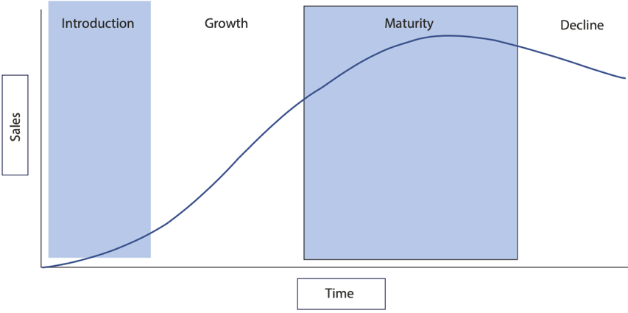
2- The Marketing Mix: Product
2.3.1- The introduction stage
- At the introduction stage, the tourism product is new to the market and typically purchased by innovators—a small subset of the target audience.
- The marketer's primary goal is to create awareness through extensive advertising and public relations efforts, leading to high costs for launch and promotion.

Slide 20
2- The Marketing Mix: Product
2.3.1- The introduction stage
- Profits are usually low at this stage as the product is still being tested in the marketplace.
- Pioneer organizations, being the first to offer a particular product, often use promotions to encourage consumer trials.
- Pricing strategies need careful consideration, and this stage is high-risk since the product’s success has not yet been proven.
- However, this risk is balanced by the potential
for gaining market share quickly, ahead of
competitors who enter the market later.

Slide 21
2- The Marketing Mix: Product
2.3.2- The Growth Stage
- During the growth stage, sales increase, and profits begin to rise as the product gains market penetration.
- The long-term success of the product becomes more predictable.
- However, as the product becomes profitable, competitors are likely to enter the market with similar offerings.
- This is a crucial time to capture market share,
as it is easier to attract new consumers than to
persuade them to switch brands later.
- The focus of promotions shifts to attracting both
new consumers and repeat buyers.
- The organization may also invest in enhancing
the product and expanding its distribution network.

Slide 22
2- The Marketing Mix: Product
2.3.3- The Maturity Stage
- At the maturity stage, sales and profit growth begin to slow down.
- This phase is often the longest, lasting anywhere from a few weeks to many decades or even centuries.
- Competition is typically well established, and success depends on the ability to maintain market share.
- Tourism organizations must focus on retaining their position or dominating a niche market.
- To protect their place in a mature market,
marketers should adjust target markets,
the product, and the marketing mix to ensure
continued profitability.
- The organization should also be ready to
reposition the product if necessary.

Slide 23
2- The Marketing Mix: Product
2.3.4- The Decline Stage
- During the decline stage, a product's popularity decreases, leading to a steady drop in sales and profits.
- The decline may be gradual or rapid, depending on the product.
- This stage can result from factors like technological advancements, increased competition, changing consumer preferences, or external events such as natural disasters or health crises (e.g., COVID-19).
- For example, a travel agency may struggle as
consumers opt to book directly with airlines due to
new technologies.

Slide 24
2- The Marketing Mix: Product
2.4- Innovation and New Tourism and Hospitality Products
- Changes in society, markets, and economies have led to shorter product life cycles, increasing the need for organizations to innovate continually.
- New products can range from small modifications, such as updating a restaurant menu or brochure, to more significant developments like creating a new hotel or resort, or repositioning a destination for the international tourism market.
- Marketers must replace products that have reached the end of their life cycle with innovative new offerings to stay competitive and meet evolving consumer demands.

Slide 25
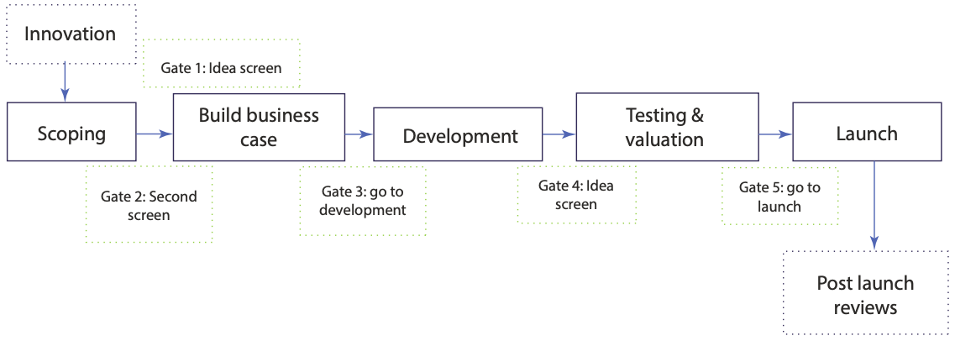
2- The Marketing Mix: Product
2.5-Stages in New-Product Development (NPD)
- The stage-gate process, which emphasizes risk management at each development stage, is now the primary approach in NPD.
- It consists of five stages, with decision points ("gates") that help determine whether to proceed to the next stage or revisit previous stages for product improvement.

Slide 26
2- The Marketing Mix: Product
2.5-Stages in New-Product Development (NPD)
- Stage 1: Preliminary (Idea Stage)
- In the preliminary stage, the marketer seeks ideas for developing a new product.
Ideas can come from various sources, including consumers, competitors, internal teams, intermediaries, suppliers, and others.
- The more diverse the sources, the greater the likelihood of generating a wide range of ideas.
- During this stage, the NPD team assesses the viability of the ideas and determines if they present a potential market opportunity.

Slide 27
2- The Marketing Mix: Product
2.5-Stages in New-Product Development (NPD)
- Stage 2: Detail (Building a Business Case):
- In this stage, the NPD team evaluates the commercial viability of the product idea through a business analysis.
- This involves defining the product, creating a business case, planning the project, and assessing feasibility by comparing market potential with development costs.
- The team then decides whether to proceed with development.

Slide 28
2- The Marketing Mix: Product
2.5-Stages in New-Product Development (NPD)
- Stage 3: Development
- In this stage, the product is brought to life by creating a prototype.
- This could include building a model or designing key elements, such as a hotel room replica or a staff uniform logo, to test and refine the product.

Slide 29
2- The Marketing Mix: Product
2.5-Stages in New-Product Development (NPD)
- Stage 4: Test and Validation
- In this stage, the product or idea is test-marketed by launching it in the marketplace for a limited time to gauge consumer demand.
If the product is not well received, the NPD team can decide not to invest further resources in the next stage of development.

Slide 30
2- The Marketing Mix: Product
2.5-Stages in New-Product Development (NPD)
Stage 5: Launch
- The final stage involves the official market introduction of the product, which requires significant investment.
The marketer must spend heavily on promotions to generate consumer awareness and drive initial sales.

Slide 31
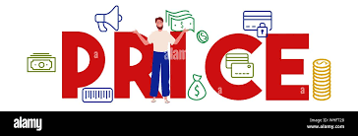
2- The Marketing Mix: Price
3.1- Price as a Strategic Marketing Tool
- Price is a crucial element of the marketing mix and can be used to defend a market, increase market share, or enter new markets.
- The price must be acceptable to consumers, who evaluate the value for money based on their expectations and satisfaction with the product.
- Many tourism and hospitality organizations offer products at various price levels to cater to different consumer segments, such as airlines offering business-class and economy seats, or hotels charging different rates for rooms based on location

Slide 32
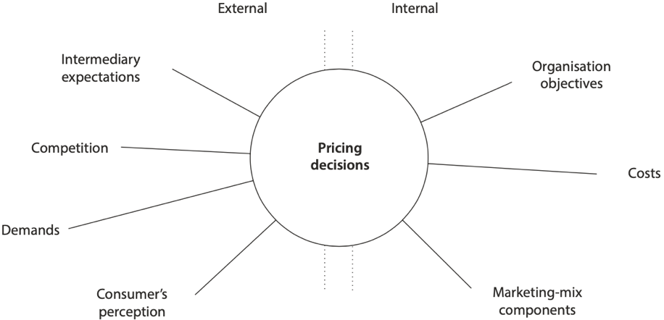
3- The Marketing Mix: Price
3.2- Factors That Affect Pricing Decisions
- In tourism and hospitality, pricing decisions are influenced by both internal factors and external forces.
Internal Factors Influencing Pricing Decisions
- Internal factors that influence pricing decisions include the organization's objectives, such as profit goals or market positioning, as well as the other components of the marketing mix (product, promotion, and place).
- Additionally, the overall costs associated with providing
and promoting the offering, such as production,
distribution, and marketing expenses, play a significant role
in determining the price.

Slide 33
3- The Marketing Mix: Price
3.2- Factors That Affect Pricing Decisions
- External Forces Influencing Pricing Decisions
- External forces that affect pricing decisions include the nature of demand for the offering, price elasticity, competition, and consumer perceptions.
- Marketers must assess how sensitive consumers are to price changes (price elasticity) and consider market demand levels.
- They must also evaluate competitors' pricing strategies
and how consumers perceive the value of the product

Slide 34
3- The Marketing Mix: Price
3.3.Approaches to Pricing
- Revenue management is a key pricing strategy that involves selling the right product to the right customer at the right time for the right price.
This strategy includes adjusting prices—lowering them to stimulate demand when sales are low and increasing them to maximize income when demand is high.
- Tourism marketers have various pricing approaches to choose from, some of which may be more relevant to tourism and hospitality than others.
These approaches can often be combined for optimal results.
The four main pricing techniques considered most effective for organizations are: cost-Plus pricing, demand-based pricing, going-rate pricing, and value-based pricing.

Slide 35
3- The Marketing Mix: Price
3.3.Approaches to Pricing
Cost-Plus Pricing
- Cost-plus pricing, also known as cost-based pricing, is a straightforward method used by many tourism and hospitality organizations.
- It involves calculating the total costs of providing the offering, such as overhead costs (e.g., staffing, food), and then adding a required margin or mark-up to determine the price.
- This method is commonly used for retail outlets at tourist attractions and restaurants, as it provides flexibility in pricing.

Slide 36
3- The Marketing Mix: Price
3.3.Approaches to Pricing
Demand-based Pricing
- Demand-based pricing adjusts prices according to demand, independent of production costs.
- For example, a seaside B&B charges higher rates in summer and lower rates in winter based on demand fluctuations.
- This approach can increase profits if consumers see value in the offering.
- Its success depends on the marketer's ability to analyze demand, with airlines commonly using this strategy by offering different seat prices for first class, business class, and economy class.

Slide 37
3- The Marketing Mix: Price
3.3.Approaches to Pricing
Going-Rate Pricing
- In going-rate pricing, marketers set the price of their offerings based on competitors’ prices, often referred to as "the going rate."
- This approach allows organizations to increase sales or market share by aligning with competitor pricing rather than focusing on costs or demand.
- Also known as "me-too pricing," it is commonly used in price-sensitive markets where the core benefits of products or services are similar.

Slide 38
3- The Marketing Mix: Price
3.3.Approaches to Pricing
Value-Based Pricing
- Value-based pricing sets the price based on what consumers perceive a product or service to be worth, rather than the cost of providing it.
- Unlike cost-plus pricing, which is product-driven, value-based pricing focuses on customer perceptions of the product's value.
- This approach ensures that the price reflects the benefits and value that the consumer expects from the offering.

Slide 39
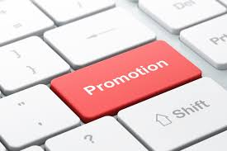
4- The Marketing Mix: Promotion
- The promotional mix is a combination of various promotional tools used to achieve marketing objectives.
- It includes: advertising, sales promotion, personal selling, and public relations, In addition, digital marketing and social media.
- The goal of promotion is to stimulate demand and attract customers.
- Promotional activities encompass any actions taken to encourage or increase sales of a tourism offering.

Slide 40
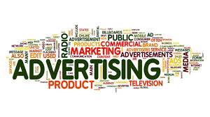
4- The Marketing Mix: Promotion
4.1- Advertising
- Advertising is the most widely recognized tool in the promotional mix, involving paid media placements designed to influence consumer behavior.
- It allows tourism and hospitality organizations, such as hotels, car hire companies, visitor attractions, airlines, and intermediaries like tour operators and travel agents, to reach target markets in various locations—whether at home, elsewhere, or on the move.
- Unlike other promotional tools, advertising is paid,
giving marketers control over the message, timing,
delivery method, and communication channels
used to reach their audience.

Slide 41
4- The Marketing Mix: Promotion
4.1- Advertising
The goals of advertising can vary, but typically include:
- Creating awareness of a new product or service.
- Describing the product's attributes and features.
- Suggesting usage situations for the product.
- Distinguishing the product from competitors' offerings.
- Directing buyers to the point-of-purchase.
- Creating or enhancing a brand image.

Slide 42
4- The Marketing Mix: Promotion
4.1- Advertising
There are various advertising media options that tourism and hospitality marketers can use to reach their target audience:
- Print Advertising: Includes newspapers, magazines, inflight magazines, printed flyers, brochures, posters, backs of tickets, and supermarket receipts.
- Broadcast Advertising: Covers radio, television, and cinema ads.
- Digital or Mobile Advertising: Includes online streaming channels, online banners, web pop-ups, and ads in the opening sections of streaming audio and video.
- Outdoor Advertising: Includes wall paintings, billboards, and street furniture, roof mounts and passenger screens, musical stage shows, subway platforms and trains.

Slide 43
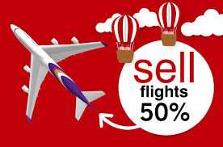
4- The Marketing Mix: Promotion
4.2- Sales Promotion
- Sales promotion is an activity designed to provide extra incentives for consumers, sales representatives, and intermediaries to make a purchase.
- It typically involves special offers, discounts, or other incentives to encourage immediate buying decisions.
- The primary aim of sales promotion is to stimulate
additional sales, often through short-term offers that
encourage consumers to act quickly and book or
purchase at the point of sale.

Slide 44
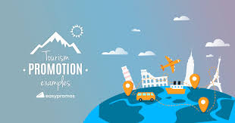
4- The Marketing Mix: Promotion
4.2- Sales Promotion
- Sales promotion should not be viewed merely as an alternative to advertising.
- Instead, it should complement advertising efforts.
-While advertising helps build awareness
and brand recognition over the long term,
sales promotion provides short-term
incentives that drive immediate action
and boost sales.

Slide 45
4- The Marketing Mix: Promotion
4.3- Personal Selling
- Personal selling is a process of direct, person-to-person communication between a salesperson and a prospective customer.
- In this process, the salesperson learns about the customer’s needs and aims to satisfy those needs by offering relevant products or services.
- It is a key promotional tool in tourism and hospitality, where offerings are inseparable, meaning both the service provider and the consumer must be present.
- Personal selling involves face-to-face encounters, making it an effective method for persuading customers to make a purchase.
- This activity can be carried out by an individual salesperson or as part of a sales team.

Slide 46
4- The Marketing Mix: Promotion
4.3- Personal Selling
There are 4 methods of personal selling:
- Internal Selling: face-to-face efforts made within an organization to secure a sale, often involving direct interactions with existing customers.
- External Selling: External selling refers to face-to-face presentations of a product or service to prospective consumers outside the organization or in the field.
- Telephone Sales: Telesales is a method of personal selling that involves using the telephone to promote offerings and generate sales.
- Personal Skills: the appearance, presentation, and hospitality of employees play a crucial role in creating a positive customer experience

Slide 47
4- The Marketing Mix: Promotion
4.4- Public Relations (PR)
- Public relations (PR) refers to the communication efforts that a tourism or hospitality organization uses to build and maintain favorable relationships with other organizations, individuals, and the public.
- It encompasses a broad range of activities, including managing consumer perceptions of the organization’s offerings, its corporate identity, and its promotional efforts.
- PR aims to enhance the overall image of the organization and influence how it is perceived by its target audience.

Slide 48
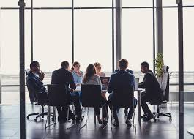
4- The Marketing Mix: Promotion
4.4- Public Relations (PR)
- Public relations can be defined as “the discipline which looks after reputation, with the aim of earning understanding and support and influencing opinion and behaviour.
- It is the planned and sustained effort to establish
and maintain goodwill and mutual understanding
between an organisation and its publics”.

Slide 49
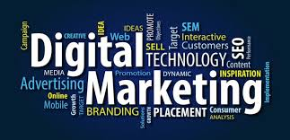
4- The Marketing Mix: Promotion
4.5-Digital Marketing
- Digital marketing is the practice of achieving marketing objectives by leveraging digital technologies and media.
- It involves promoting products or services using digital channels such as the internet, social media, email, digital television, search engines, and wireless media.
- Unlike traditional marketing, digital marketing allows organizations to track and analyze their marketing campaigns in real time, providing insights into what strategies are effective and which need adjustment.
- This enables more precise targeting and
optimization of marketing efforts.
- It can be defined as “the marketing of
products or services using digital electronic
technologies and channels such as the internet,
e-mail, digital TV, and wire- less media”.

Slide 50
4- The Marketing Mix: Promotion
4.5-Digital Marketing
Digital marketing offers several key advantages:
- Creating Equal Opportunities: It allows tourism organizations of all sizes to compete more equally for consumer attention, giving small businesses an edge they might lack with traditional marketing.
- Cost Efficiency: Digital marketing is often more affordable and efficient than traditional methods, making it accessible to smaller enterprises.
- Enhanced Consumer Experience: It provides opportunities to strengthen relationships with customers through personalized and interactive engagement.
- Instant Responses: Consumers can quickly book flights, reserve hotel rooms, or access promotional materials with just a few clicks.
- Accessibility: Digital platforms enable businesses to operate 24/7, providing constant access to products and services.

Slide 51
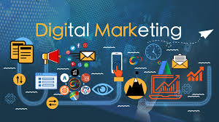
4- The Marketing Mix: Digital Marketing
4.5-Digital Marketing
The 5Ds of digital marketing represent the key areas where consumers engage with brands and where tourism and hospitality businesses can connect with their audiences:
- Digital Devices – Consumers interact with brands through various connected devices, including smartphones, tablets, desktop computers, smart TVs, and gaming consoles, often via business websites and mobile apps.
- Digital Platforms – Interactions primarily occur on major platforms or services, such as Facebook, Instagram, Google, YouTube, TikTok, Twitter, Snapchat,
and LinkedIn, accessed through browsers or apps.

Slide 52
4- The Marketing Mix: Promotion
4.5-Digital Marketing
- Digital Media – These include paid, owned, and earned media channels like online advertising, e-mails, messaging services, search engines, and social networking sites.
- Digital Data – Insights gathered from consumer profiles and their interactions with businesses, which are increasingly regulated by data protection laws in many countries.
- Digital Technology – The tools businesses use to create interactive experiences, such as websites, mobile apps, in-store kiosks, and e-mail campaigns.

Slide 53
4- The Marketing Mix: Promotion
4.5-Digital Marketing
- There are four digital marketing domains:
Business to Consumer (B2C):
- Business to Consumer (B2C) e-commerce involves selling products and services directly to end consumers through online platforms.
- Virtually anything can be purchased online today, including cars, houses, books, food, music, and airline
e-tickets.
- In the travel and tourism sector, prominent examples of B2C e-commerce include online travel companies such as Travel Republic, Trivago, Booking.com, FlightSite, and Expedia.
- Most travel and tourism companies now maintain a strong online presence through dedicated websites where they sell their offerings directly to consumers.

Slide 54
4- The Marketing Mix: Promotion
4.5-Digital Marketing
Business to Business (B2B):
- Business to Business (B2B) e-commerce facilitates online transactions between businesses.
- Examples include interactions such as those between a tour operator and a travel agency or a professional conference organizer (PCO) and a conference center.
- This model also extends to various business-related services like printing services, outsourced marketing, hiring, and the buying or selling of office equipment.
- Similar to B2C, B2B e-commerce offers benefits such as reduced operational costs, improved efficiency, and streamlined processes for businesses.

Slide 55
4- The Marketing Mix: Promotion
4.5-Digital Marketing
Consumer to Consumer (C2C):
- Consumer to Consumer (C2C) e-commerce is one of the fastest-growing domains in digital marketing.
- The internet serves as an excellent platform for consumers to exchange or purchase products, services, or information directly from each other.
- Prominent examples of C2C e-commerce include Uber, which facilitates a platform where consumers offer ride services to others based on location and cost preferences, and Airbnb, an online marketplace that connects travelers seeking authentic experiences with hosts providing unique accommodations and local experiences worldwide.

Slide 56
4- The Marketing Mix: Promotion
4.5-Digital Marketing
Consumer to Business (C2B)
- Consumer to Business (C2B) e-commerce involves consumers actively engaging with businesses, often by submitting suggestions, questions, or feedback via company websites.
- In this model, consumers initiate transactions with businesses rather than the other way around, as seen in traditional B2C models.
- For example, platforms like Priceline.com enable buyers to bid for airline tickets, rental cars, hotel rooms, and holiday packages.
- Sellers then decide whether to accept the offers, putting consumers in the driver's seat for determining terms of transactions.

Slide 57
Thank you
      European Institute of Innovation, Entrepreneurship and Technology
      Lessingstraße 79,
      13158 Berlin, Germany
      Phone: +49 176 55524449
      Email: info@eiiet.com
Discover the world of eiIET

