Slide 1
Availability Management in Tourism
European Institute of Innovation, Entrepreneurship and Technology
Lessingstraße 79, 13158 Berlin, Germany
Mahmoud Abdou| Berlin
      Lessingstraße 79,
      13158 Berlin, Germany
      Phone: +49 30 233618555
      Fax: +49 30 233618556
      Email: info@eiiet.com

Slide 2

Index
- Quality and the Accommodation Sector
Air Transport and Tourism
Types of Airlines
Airline Agencies
Quality and Air Transport

Slide 3
1- Quality and the Accommodation Sector
      1.1- The Role of Quality and Tourism Accommodation
      A- Quality Linked to Long-Term Success
      - Directly impacts return on investment
      - Influences market share and competitiveness
      - Quality as an Essential Ingredient
      Drives customer satisfaction and loyalty
      Supports sustainable business growth

Slide 4
1- Quality and the Accommodation Sector
      B- Accommodation’s Role in the Tourist Experience
      Tourist Experience is Multifaceted
      Comprised of tangible and intangible elements
      Some factors are uncontrollable
      Accommodation is Central
      Often a key part of holiday experiences
      Its quality and service are controllable and manageable

Slide 5
1- Quality and the Accommodation Sector
      C- Service Inseparability in Tourism Accommodation
      Inseparability Defined
      Production and consumption of services happen simultaneously
      Services are contact-dependent
      “Moment of Truth”
      The quality of service delivery at the point of interaction shapes the tourist experience
      Crucial to manage frontline staff and guest interactions

Slide 6
1- Quality and the Accommodation Sector
      1.2- Human Resources and Quality Management
      - Service Quality Culture
      Essential to build a culture focused on service quality
      Achieved through effective HR policies
      - Key HR Policies to Support Quality
Selection | Training and development
Empowerment Rewards | Teamworking

Slide 7
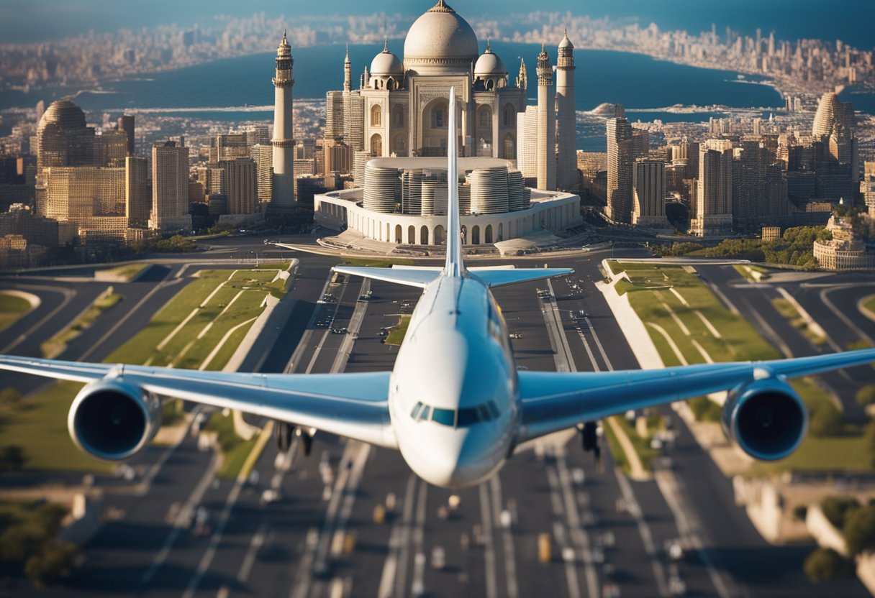
2- Air Transport and Tourism
      Why Air Travel Matters for Tourism
      - Crucial for International Travel
      - Time-Saving
      - Cost and Accessibility Matter
      - Destination Choices Shaped by Access
      - Supports Tourism Growth

Slide 8
2- Why Air Travel Matters for Tourism
      A Historical Perspective
      19th Century: The Age of Railroads
      - Development of the UK rail network
      - Rise of coastal resorts
      The 20th Century: Automobile Revolution
      - Greater spatial freedom for tourists
      - More destinations accessible
      - Rise of road trips, countryside tourism, and suburban leisure

Slide 9
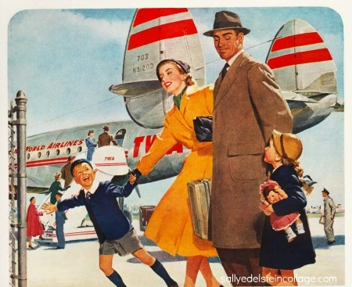
2- Why Air Travel Matters for Tourism
      A Historical Perspective
      1970s: The Jet Age Takes Off
      - Enabled mass intercontinental tourism
      - Civilian aviation industry matured
      - Marked the start of global travel for the masses

Slide 10

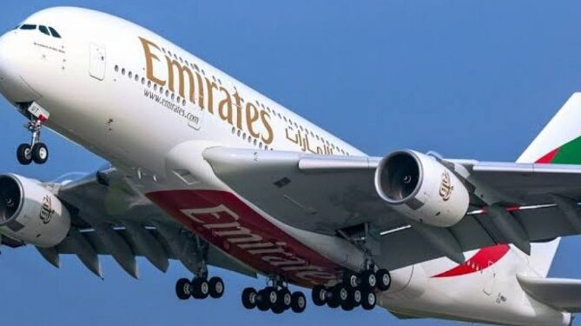
3- Types of Airlines
      Drawn on their business models and operational scope, airlines can be categorized into:
      3.1- Full-Service Airlines (FSAs)
      Also known as legacy carriers.
      Characteristics:
      - Offer a range of services: in-flight meals, checked baggage, and entertainment.
      - Operate short-, medium-, and long-haul routes.
      - Higher ticket prices but more amenities.
      Examples:
Lufthansa (Germany) | British Airways (UK)
Emirates (UAE) | Singapore Airlines

Slide 11
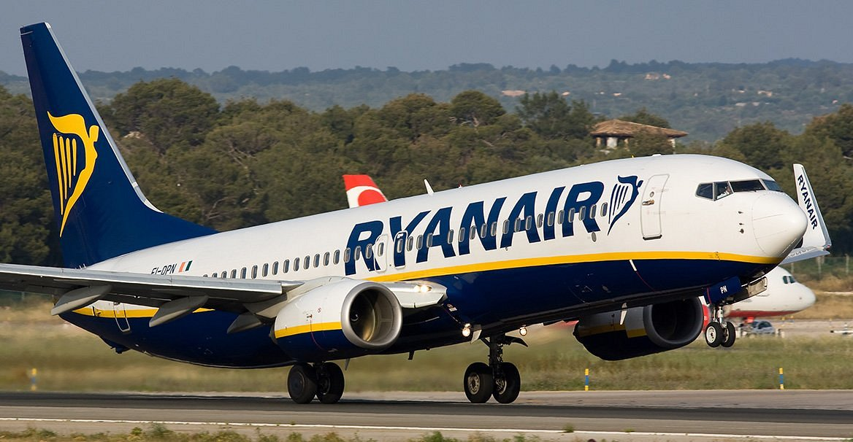
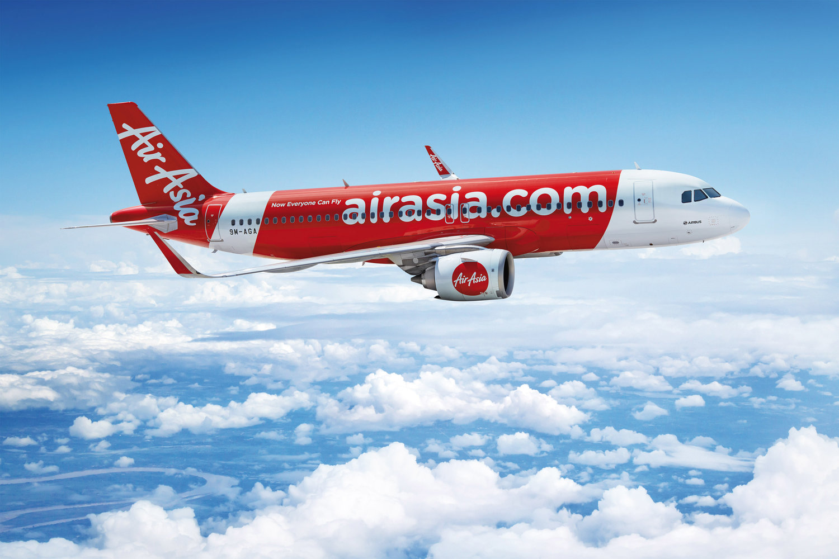
3- Types of Airlines
      3.2- Low-Cost Carriers (LCCs)
      Also known as budget airlines.
      Characteristics:
      - Focus on no-frills, cost-efficient service.
      - Point-to-point routes, often between secondary airports.
      Extra fees for luggage, food, seat selection.
      Examples:
Ryanair (Ireland) | easyJet (UK)
AirAsia (Malaysia) | Southwest Airlines (USA)

Slide 12
3- Types of Airlines
      3.2- Low-Cost Carriers (LCCs)
      Relevance to Tourism:
      - Encourage short-haul, frequent travel, including weekend
      tourism and domestic tourism.
      - Open up new tourist markets through affordability.
      - Boost regional tourism in lesser-known areas.

Slide 13
3- Types of Airlines
      3.3- Charter Airlines
      - Operate non-scheduled flights, usually booked by tour operators.
      Characteristics:
      - Flights arranged by travel agencies or tourism companies.
      - Often seasonal and connected to package holidays.
      - Lower prices negotiated for bulk bookings.

Slide 14
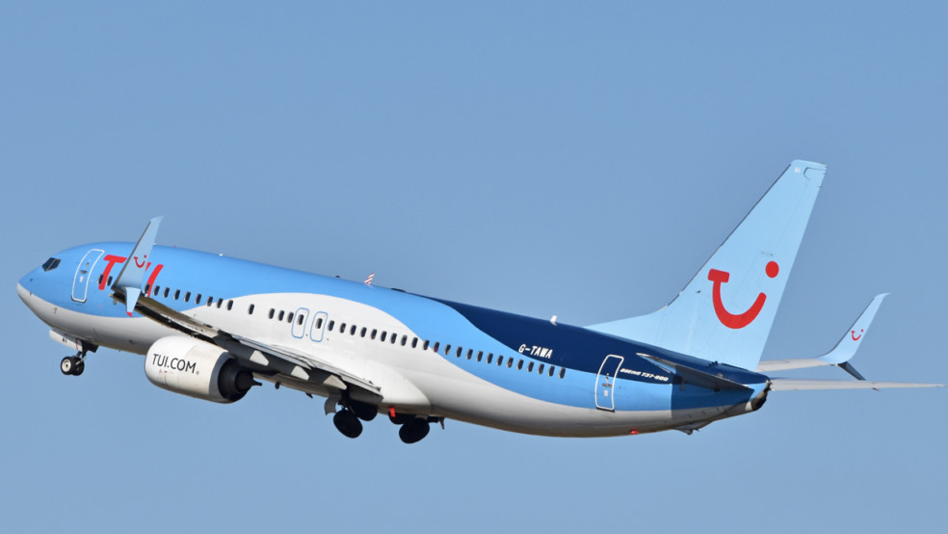
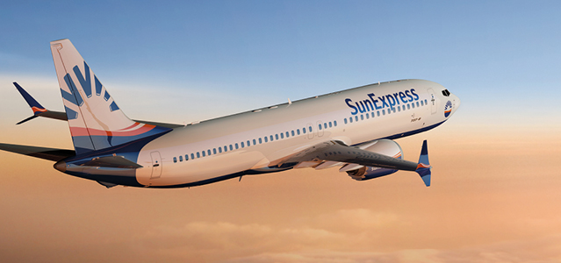
3- Types of Airlines
      3.3- Charter Airlines
      Examples:
TUI Airways (UK) | SunExpress (Germany/Turkey)
Condor (Germany) | Southwest Airlines (USA)
Relevance to Tourism:
- Popular in mass tourism and leisure travel.
- Common for holiday destinations with seasonal demand

Slide 15
3- Types of Airlines
      3.4- Regional Airlines
      - Operate short-distance routes.
      - Often connect smaller cities or remote regions.
      Characteristics:
      - Short-haul flights using smaller aircraft.
      - Feed passengers into hubs operated by full-service airlines.
      - May operate under codeshare agreements.

Slide 16
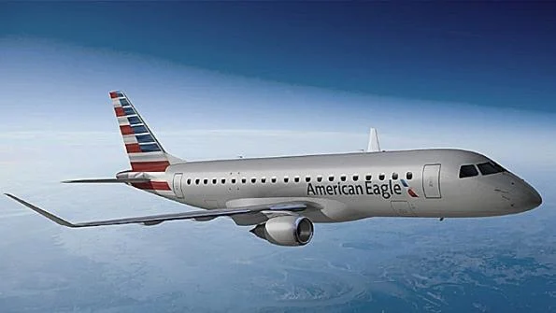
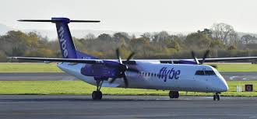
3- Types of Airlines
      3.4- Regional Airlines
      Examples:
      Lufthansa Regional (Germany)
      American Eagle (USA)
      Flybe (UK)
      Relevance to Tourism:
      - Important for rural or less accessible destinations.
      - Enhance domestic tourism networks.

Slide 17
3- Types of Airlines
      3.5- Flag Carriers
      - Often government-owned or historically national airlines.
      Characteristics:
      - Represent national identity.
      - Often started as state-owned, now may be privatized.
      - Typically full-service carriers.

Slide 18
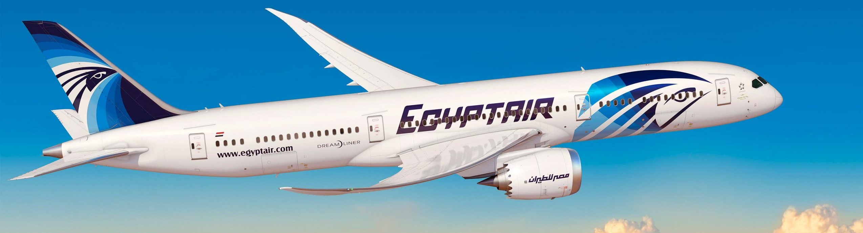
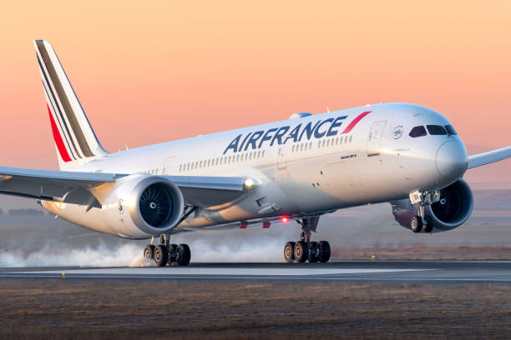
3- Types of Airlines
      3.5- Flag Carriers
      Examples:
      Air France
      EgyptAir
      Kenya Airways
      Relevance to Tourism:
      - Promote country branding and national tourism.
      - Sometimes subsidized to maintain key international routes.

Slide 19
3- Types of Airlines
      What are the commonalities and differences between full-service airlines and flag carriers?

Slide 20
4- Airline Agencies
      Airline organizations can be broadly categorized into:
      - Airline alliances
      - Industry trade groups,
      - Regulatory bodies.
      Their Roles include:
      - Setting standards
      - Promoting safety
      - Advocating for the industry
      - fFacilitating cooperation among airlines

Slide 21
4- Airline Agencies
      4.1- Airline Alliances
      Functions:
      - Facilitate cooperation among airlines
      - Enable code-sharing, shared lounges, joint marketing
      - Improve customer connectivity and loyalty programs
      Examples:
      - Star Alliance, SkyTeam, oneworld

Slide 22
4- Airline Agencies
      4.2- Industry Trade Groups
      Functions:
      - Set industry standards (ticketing, safety protocols)
      - Promote efficiency and safety
      - Advocate for airline interests globally
      Examples:
      - IATA (International Air Transport Association)
      - A4A (Airlines for America)
      - A4E (Airlines for Europe)
      - AACO (Arab Air Carriers Organization)

Slide 23
4- Airline Agencies
      4.2.1- IATA (International Air Transport Association)
      Headquarters:
      - Montreal, Canada
      Founded:
      - 19 April 1945, in Havana, Cuba
      - Successor to the International Air Traffic Association (founded in 1919 in The Hague)
      Membership:
      - Original: 57 airlines from 31 countries (mainly Europe and North America)
      - Today: 230 member airlines from over 140 countries worldwide

Slide 24

4- Airline Agencies
      4.2.1- IATA (International Air Transport Association)
      Objectives of IATA:
      - Promote Safe, Regular and Economical Air Transport
      For the benefit of people worldwide
      Encourage and foster air commerce
      Study challenges related to international air transport

Slide 25
4- Airline Agencies
      4.2.1- IATA (International Air Transport Association)
      Objectives of IATA:
      Encourage Collaboration Among Airlines
      Support cooperation between enterprises
      Both direct and indirect air transport stakeholders
      - Cooperate with Global Organizations
      Work closely with ICAO and other international aviation bodies
      Align on global standards, regulations, and development goals

Slide 26
4- Airline Agencies
      4.3- Regulatory Bodies
      Functions:
      - Set legal and safety regulations
      - Monitor air traffic standards and pilot licensing
      - Ensure international compliance and oversight
      Examples:
      - ICAO (International Civil Aviation Organization),
      - FAA (Federal Aviation Administration),
      - EASA (European Union Aviation Safety Agency)

Slide 27

4- Airline Agencies
      4.3.1 - ICAO (International Civil Aviation Organization)
      Established:
      - 7 December 1944
      Purpose:
      - Codifies the principles and techniques of international air navigation
      - Fosters planning and development of international air transport
      - Ensures the safe and orderly growth of civil aviation worldwide
      Headquarters:
      - Montreal, Canada

Slide 28
4- Airline Agencies
      4.3.1 - ICAO (International Civil Aviation Organization)
      Objectives:
      - Ensure the safe and orderly growth of international civil aviation
      - Promote safety of flight in international air navigation through:
      Standardisation
      Facilitation
      Economics
      Technical co-operation for development
      Law

Slide 29
5- Quality and Air Transport
      It refers to the overall standard of service and experience that passengers receive from booking to arrival.
      It includes:
      - Service quality (onboard and ground services)
      - Operational efficiency (on-time performance, baggage handling)
      - Safety and security
      - Comfort and amenities
      - Customer care and responsiveness

Slide 30
5- Quality and Air Transport
      5.1- Dimensions of Air Travel Quality
      5.1.1- Tangibles
      - Refers to the physical appearance of facilities, equipment, personnel, and communication materials.
      - Passengers judge service quality partly by how clean, modern, and well-maintained everything looks.
      Example:
      - Clean aircraft cabins
      - Up-to-date check-in kiosks
      - Well-dressed staff in uniform
      - Comfortable airport lounges

Slide 31
5- Quality and Air Transport
      5.1.2- Reliability
      -The ability to perform the promised service consistently and accurately.
      Example:
      - Flights departing and arriving on time
      - Accurate ticketing and reservations
      - Baggage delivered to the correct destination
      - Confirmed meal preferences honored

Slide 32
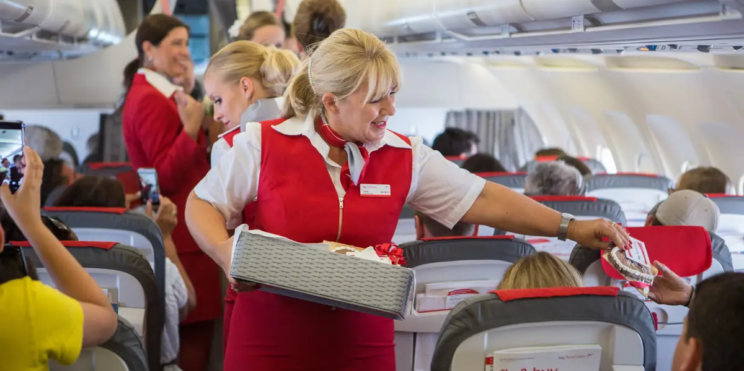
5- Quality and Air Transport
      5.1.3- Responsiveness
      - The willingness to help customers and provide prompt service.
      Example:
      - Ground staff assisting with last-minute gate changes
      - Cabin crew promptly responding to a passenger call button
      - Fast check-in and security processing
      - Clear updates during delays

Slide 33
5- Quality and Air Transport
      5.1.4- Assurance
      - The knowledge and confidence shown by employees.
      Example:
      - Pilots and crew projecting confidence and competence
      - Knowledgeable staff answering travel queries accurately
      - Staff communicating clearly during emergencies

Slide 34
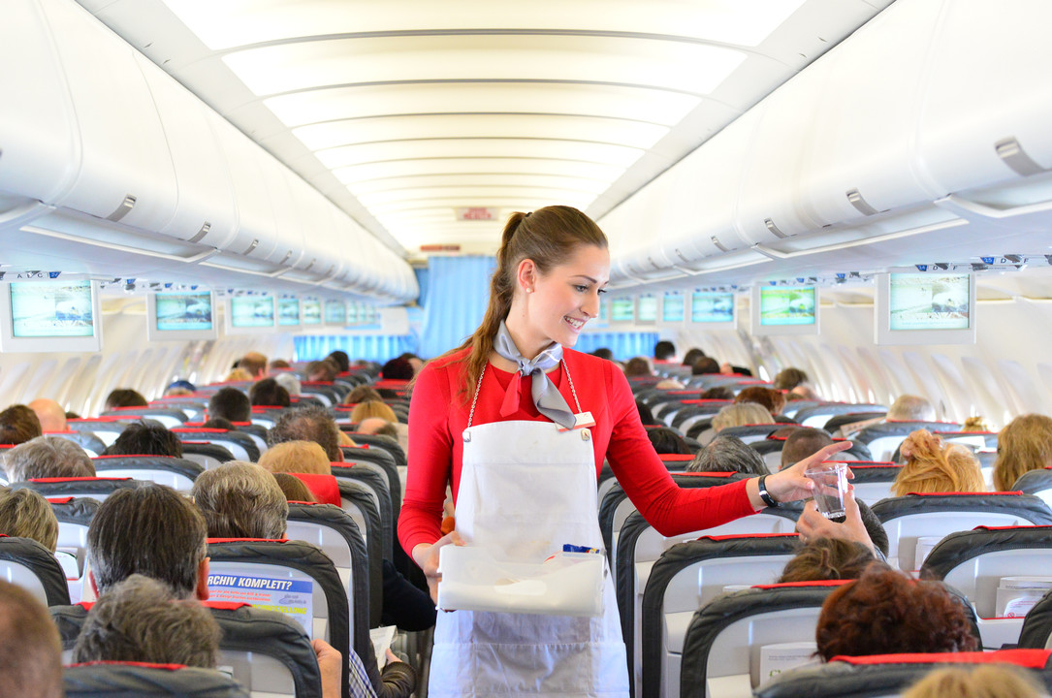
5- Quality and Air Transport
      5.1.5- Empathy
      - The ability to provide caring and personalized attention.
      Example:
      - Special assistance for elderly, disabled, or first-time flyers
      - Extra care for unaccompanied minors
      - Helping stressed passengers during flight cancellations

Slide 35
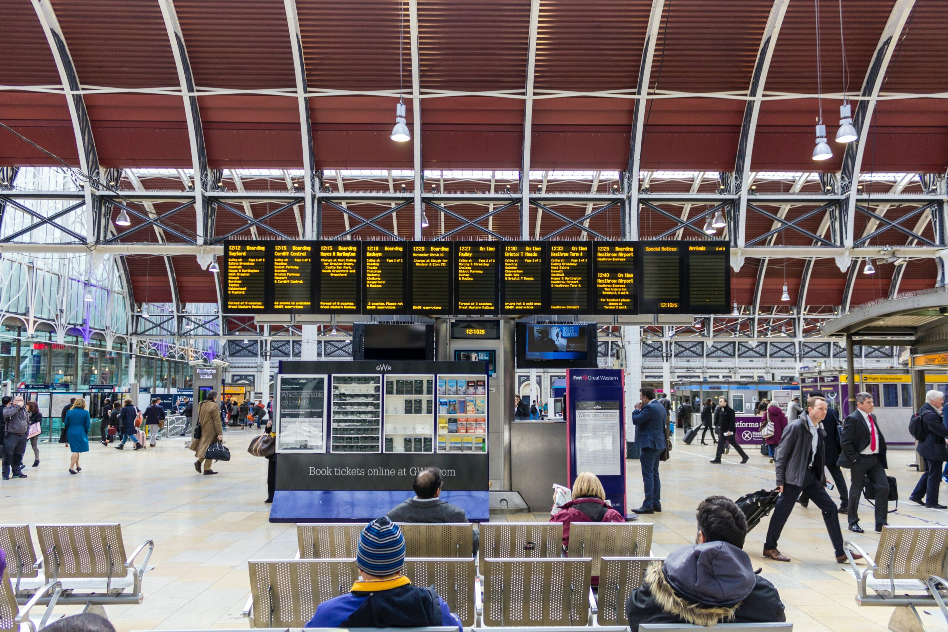
5- Quality and Air Transport
      5.2- Factors Influencing Perceived Quality
      - Ticket pricing vs. expectations (low-cost vs. full-service)
      - Brand reputation
      - In-flight services (meals, entertainment, seat comfort)
      - Airport experience (check-in, security, boarding)
      - Communication and crisis handling (delays, cancellations)

Slide 36
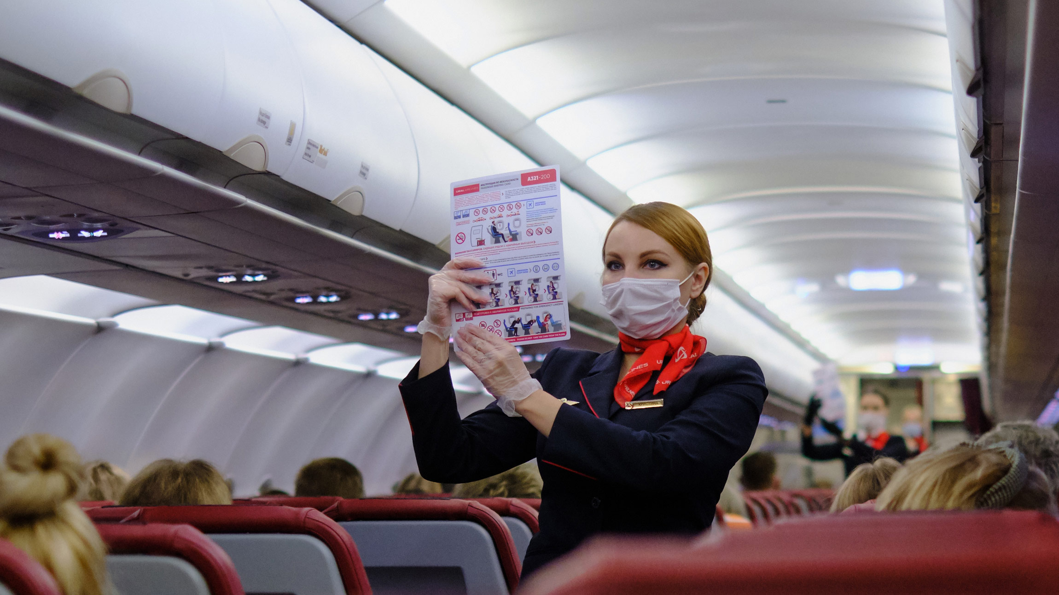
5- Quality and Air Transport
      5.3- Current Trends in Air Travel Quality
      - Digital innovation (self check-in, biometric boarding)
      - Personalization (custom meals, entertainment options)
      - Sustainability efforts
      - Post-COVID hygiene standards

Slide 37
      Discussion
      Using real-world data, choose an airline that is currently experiencing service quality issues, and analyze the following key areas:
      1. Quality Management Failures
      What are the airline's primary weaknesses in terms of service quality?
      Consider areas such as:
      Service design and delivery
      Staff performance and behavior
      Communication with passengers
      Operational reliability
      2- Identify strategies to overcome these weaknesses

Slide 38
Thank you
      European Institute of Innovation, Entrepreneurship and Technology
      Lessingstraße 79,
      13158 Berlin, Germany
      Phone: +49 176 55524449
      Email: info@eiiet.com
Discover the world of eiIET

