Slide 1
Sustainable Tourism in Australia
Quality and Sustainability in Tourism and Hospitality
Assignment 1 - 15.09.2025

Slide 2
Introduction
• Tourism is one of Australia’s largest industries
• Sustainable tourism balances economic growth, environmental protection, and cultural preservation
• Aim: To ensure long-term benefits for both communities and visitors

Slide 3
Concept of Sustainable Tourism
• Focus on minimizing environmental impact
• Promoting conservation of natural and cultural resources
• Engaging local communities in tourism planning
• Enhancing visitor experiences while protecting heritage

Slide 4
Importance in Australia
• Australia is home to unique ecosystems (Great Barrier Reef, Outback, rainforests)
• Indigenous cultural heritage is globally significant
• Tourism contributes significantly to GDP and jobs
• Sustainability is essential to protect fragile environments

Slide 5
Key Practices in Australia
• Eco-certification programs for operators
• Wildlife conservation and responsible tours
• Renewable energy use in hotels/resorts
• Promotion of eco-friendly transport options
• Collaboration with Indigenous communities

Slide 6
Challenges of Implementation
• Climate change impacts (e.g., coral bleaching)
• Balancing mass tourism with sustainability
• High operational costs for eco-practices
• Limited awareness among tourists
• Pressure on local infrastructure and resources

Slide 7
Case Study: Great Barrier Reef
• One of the world’s most visited natural attractions
• Threatened by climate change and mass tourism
• Sustainable practices: reef-safe tourism, visitor education, conservation funding
• Example of balancing tourism revenue and environmental protection

Slide 8
Strategies for the Future
• Stronger eco-certification enforcement
• Greater investment in green infrastructure
• Expanding Indigenous-led tourism initiatives
• Promoting slow tourism and regional dispersal
• Raising awareness through education campaigns

Slide 9
Conclusion
• Sustainable tourism is vital for Australia’s future
• Protects natural and cultural assets
• Supports communities and economy
• Requires collaboration between government, industry, and travelers

Slide 10
Questions & Discussion
Thank you!

Slide 11
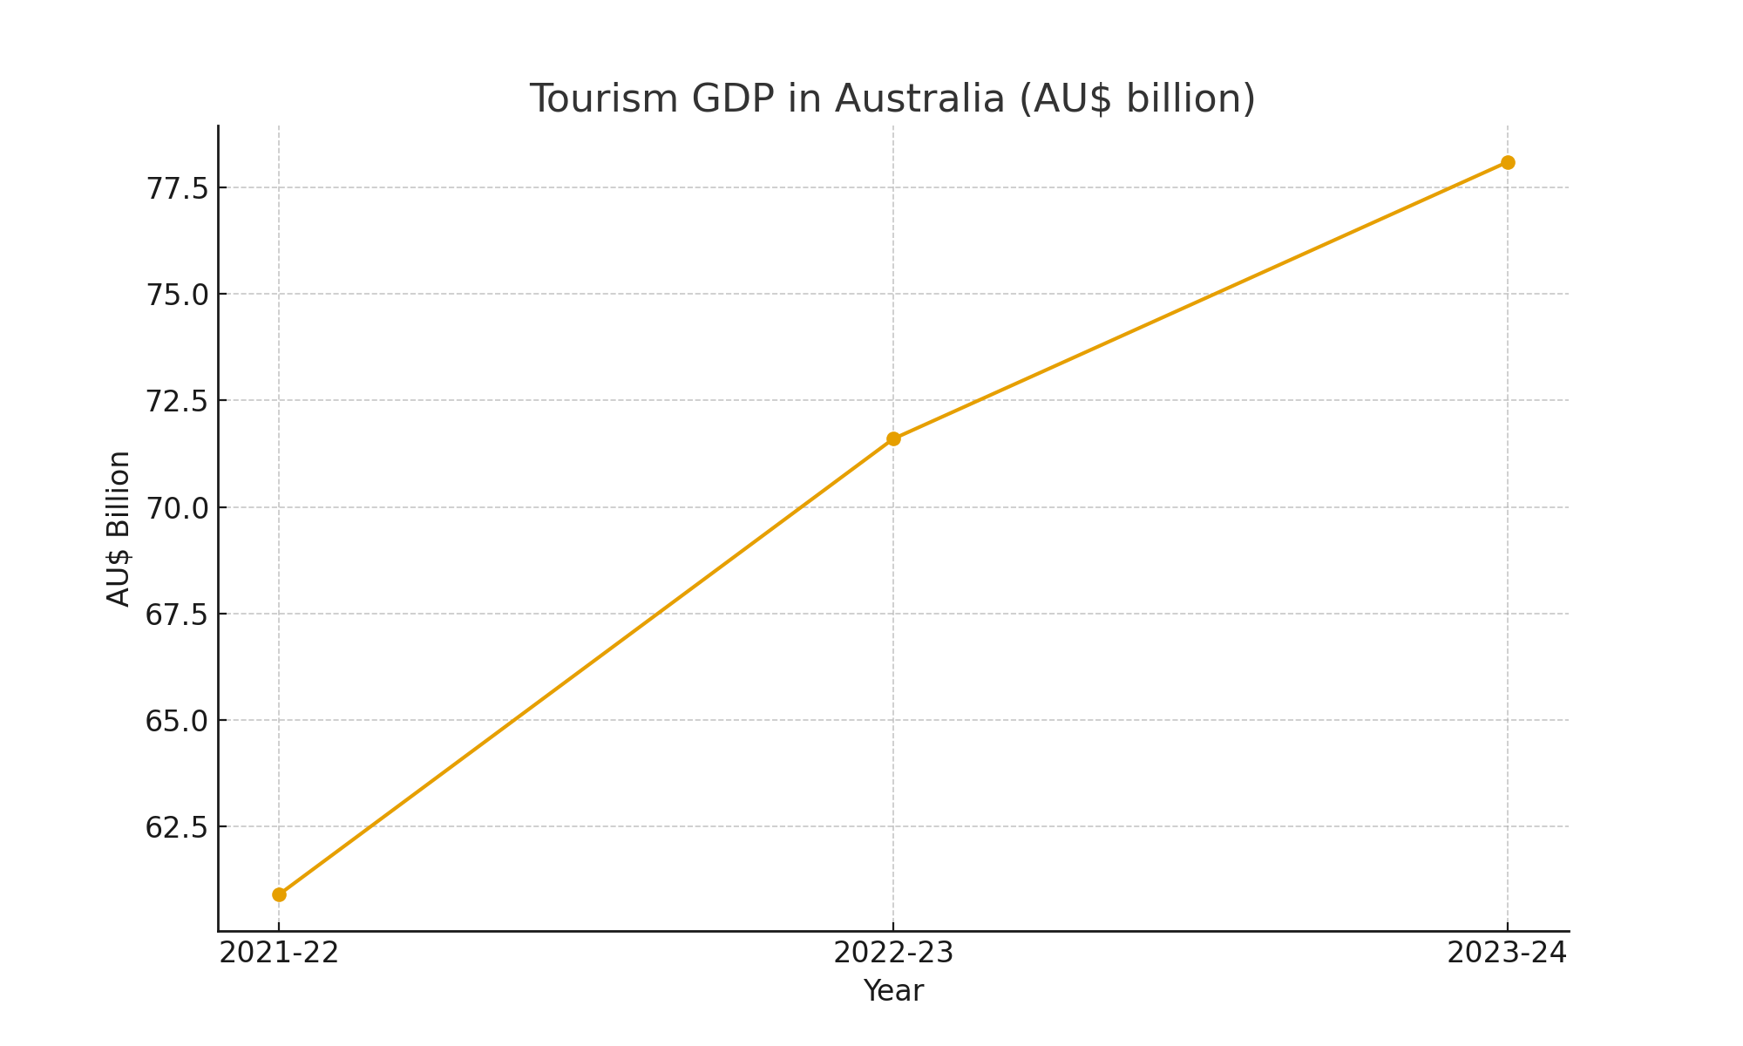
Tourism GDP Over Time

Slide 12
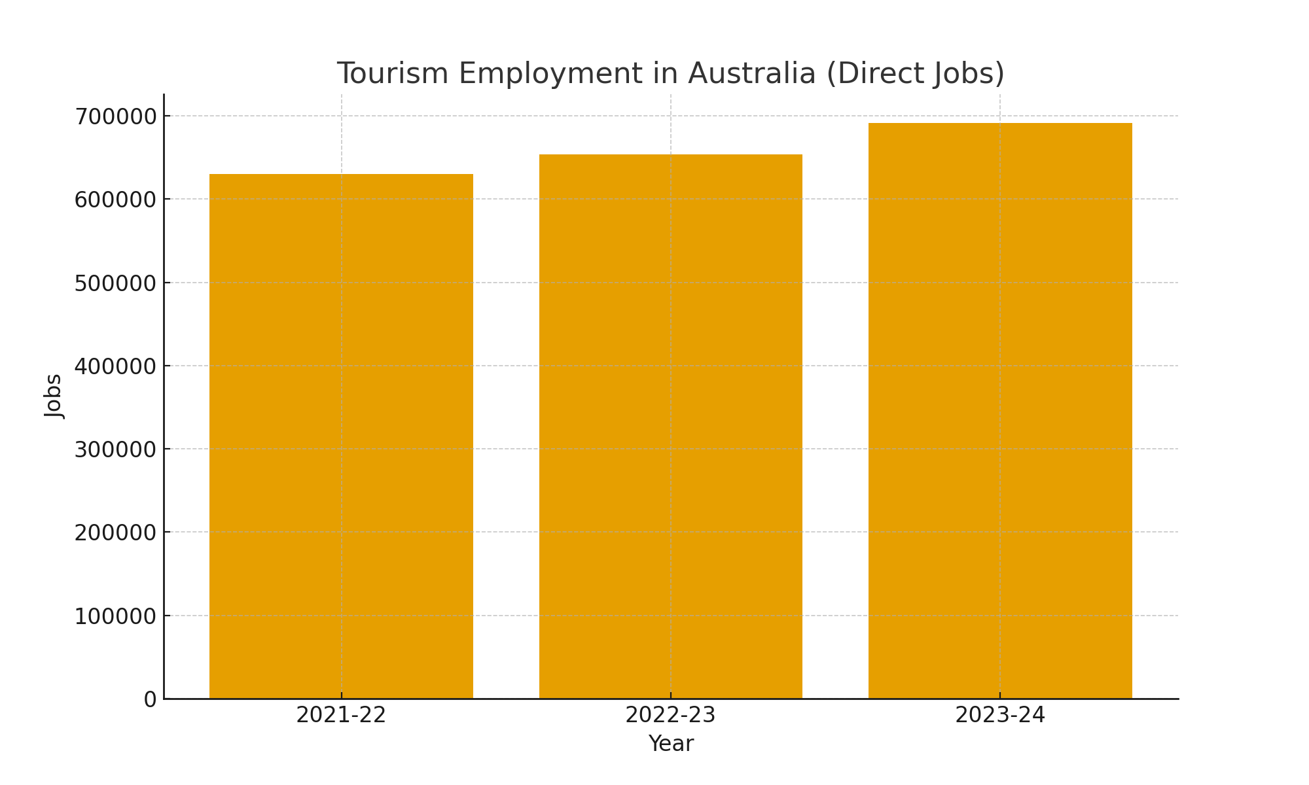
Tourism Employment

Slide 13
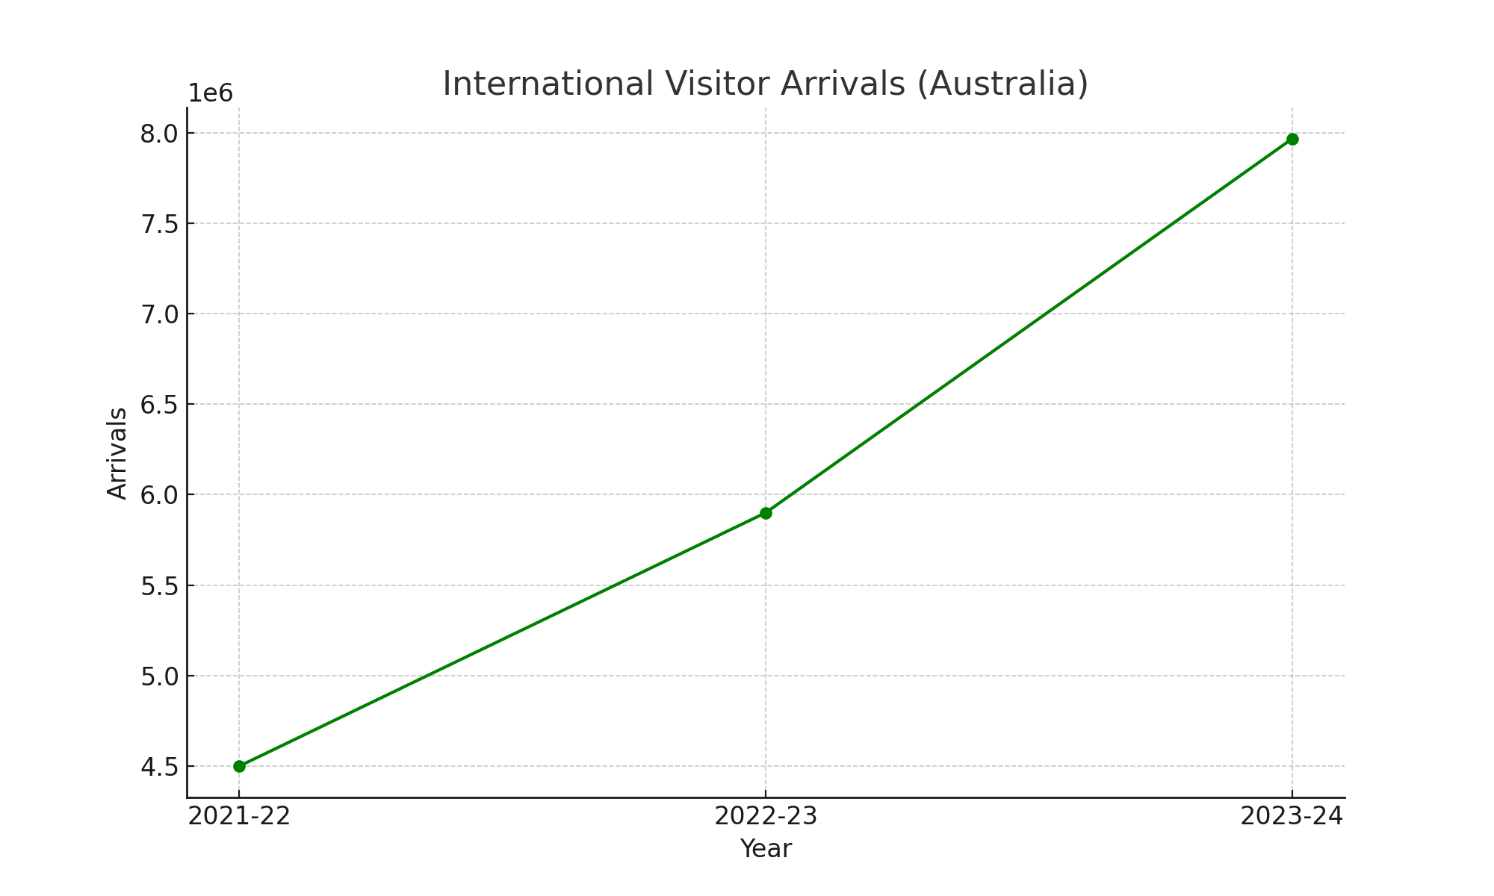
International Visitor Arrivals

