Slide 1
Structure of Tourism Markets
European Institute of Innovation, Entrepreneurship and Technology
Lessingstraße 79, 13158 Berlin, Germany
Mahmoud Abdou| Berlin
      Lessingstraße 79,
      13158 Berlin, Germany
      Phone: +49 30 233618555
      Fax: +49 30 233618556
      Email: info@eiiet.com

Slide 2
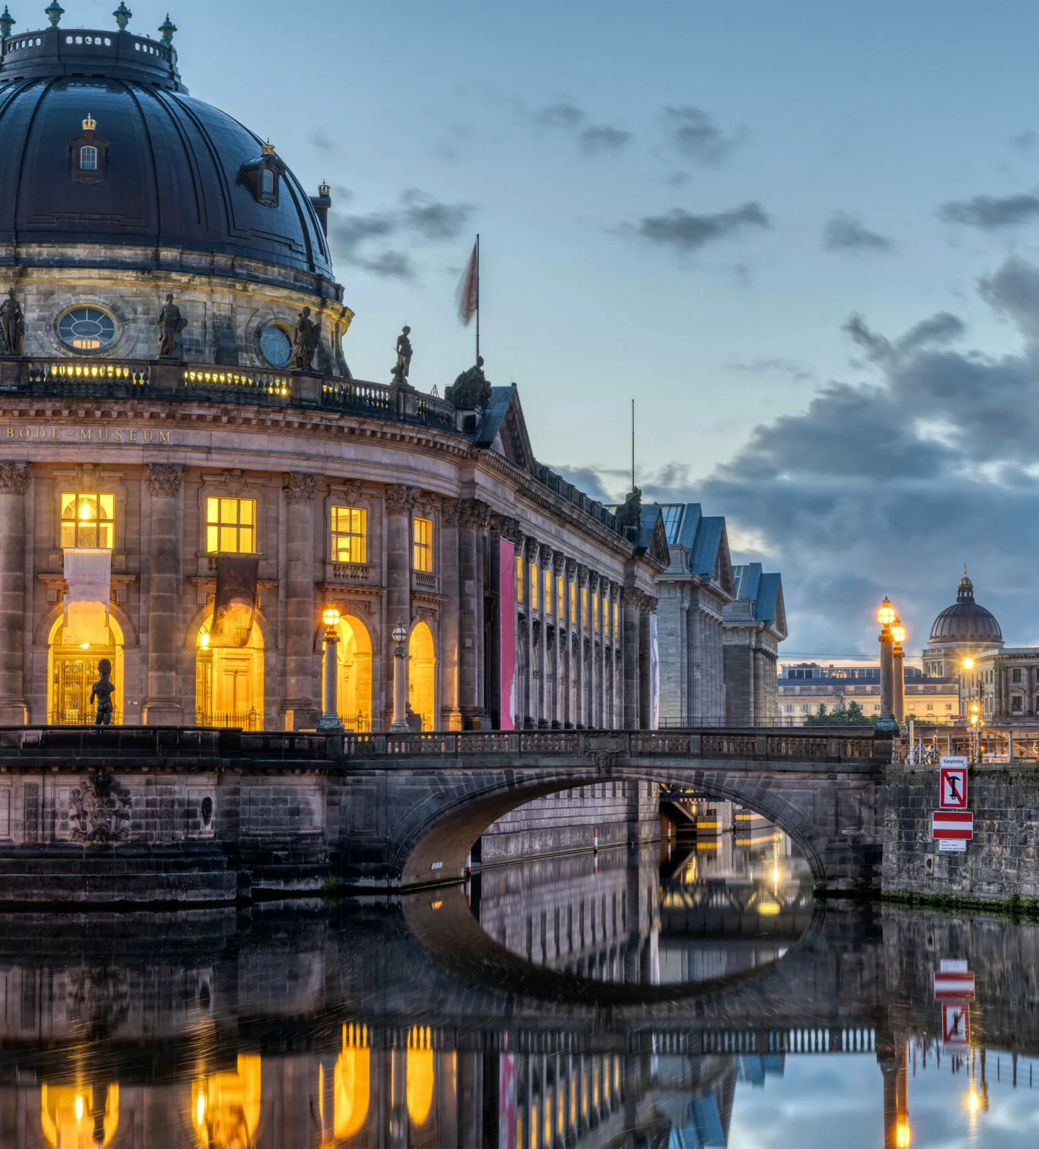
Outline
- Distribution Channels in Tourism
Intermediaries in Tourism
The Tour Packaging Process

Slide 3
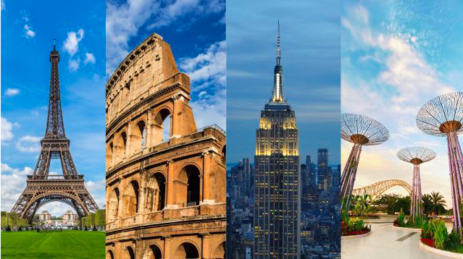
1- DISTRIBUTION CHANNELS IN TOURISM

Slide 4
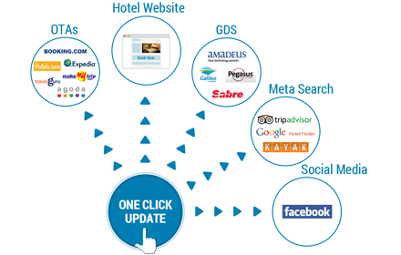
1- Distribution Channels in Tourism
- They refer to the pathways through which tourism products and services are offered, delivered, and sold to consumers. Also Known As: - "The Chain of Distribution" - A system linking tourism providers to end consumers through various intermediaries.

Slide 5
1- Distribution Channels in Tourism
What It Describes: - The location and availability of the tourism offering - The methods and platforms used to reach consumers - The intermediaries involved in connecting supply to demand
The location
The methods
The intermediaries
Distribution Channels

Slide 6
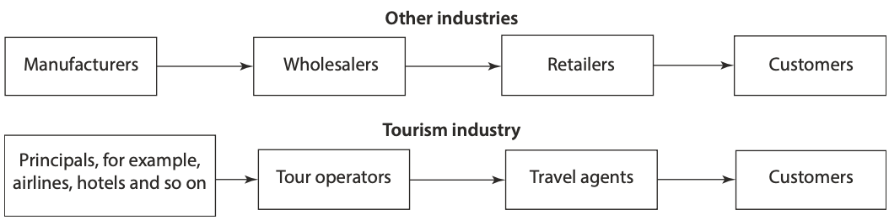
1- Distribution Channels in Tourism
In the manufacturing Industry - Distribution channels move tangible goods from the manufacturer to the consumer In the tourism industry - They move the consumer to the supplier

Slide 7
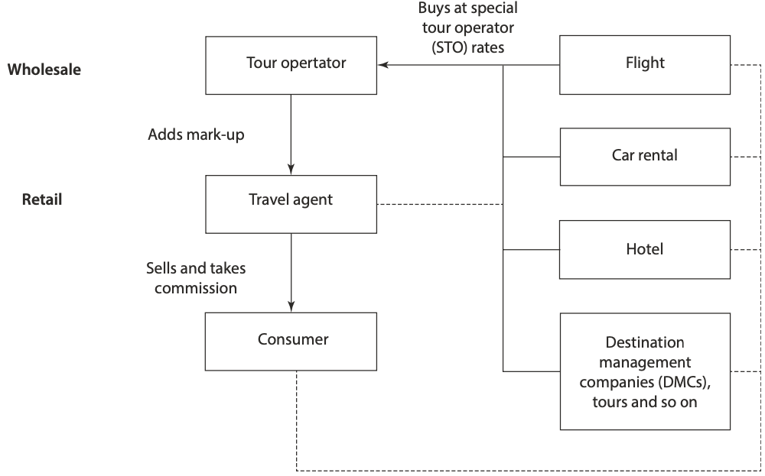
1- Distribution Channels in Tourism
1.1. Traditional Distribution of Tourism Products
- Tourism products are often not sold directly by suppliers. - Instead, they move through intermediaries - Main Types of Intermediaries A- Wholesalers (Tour Operators): - Consolidate different tourism products - Create packages tailored for specific markets B- Retailers (Travel Agents): - Sell packages or individual services to end-consumers

Slide 8
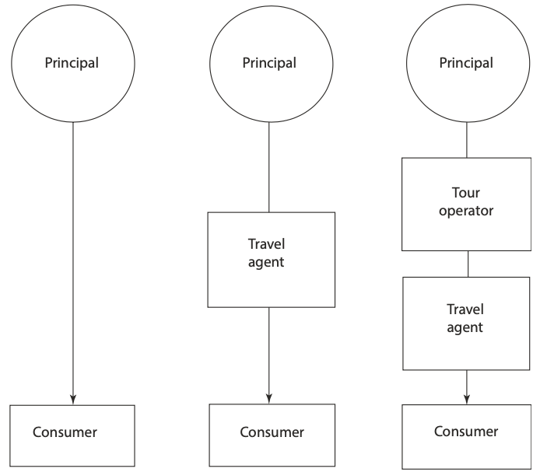
1- Distribution Channels in Tourism
1.2- Level of Distribution Channels
One-Level Channel: - Direct connection between the supplier and the customer Two-Level Channel: - Involves one intermediary Three-Level Channel: - Involves multiple intermediaries

Slide 9
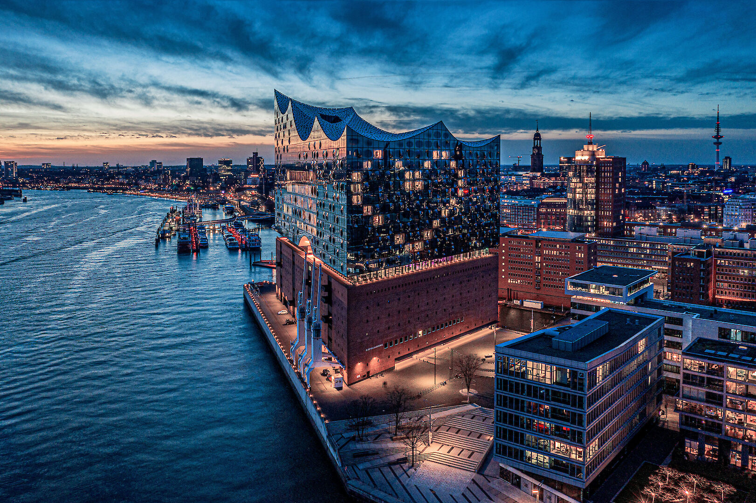
2- INTERMEDIARIES IN TOURISM

Slide 10
2- Intermediaries in Tourism
1.2- Level of Distribution Channels
- There is a wide range of intermediaries between tourism suppliers and consumers. - They can be classified into: A- Direct Channels - No intermediaries; supplier sells directly to the consumer - Often technology-driven A- Indirect Channels - Use of intermediaries to reach consumers - Often more personal interactions
Intermediaries in tourism
Indirect Channels
Direct Channels

Slide 11
2- Intermediaries in Tourism
2.1 Indirect Channels
A- Tour Operator - Combines core elements of a holiday into one package: Transport Accommodation Additional services (meals, guided tours, tickets) - Creates all-inclusive travel products tailored to customer needs - Sells packages through various channels: Travel agents Online platforms or other intermediaries
Indirect Channels
Tour Operators
Destination Management Companies
Retail Travel Agents
Online Travel Agents

Slide 12
2- Intermediaries in Tourism
A- Tour Operator
1- Domestic Tour Operators - Organize tours and holiday packages within one country - Focus on local destinations for residents of that country Key Roles: - Highlight lesser-known local attractions - Support regional tourism development - Provide convenience for those who prefer organized travel experiences at home
tour operator types
domestic tour operators
inbound tour operators
outbound tour operators
specialist tour operators
mass market operators

Slide 13
2- Intermediaries in Tourism
A- Tour Operator
2- Inbound Tour Operators (ITOs) - Specializing in handling incoming foreign tourists - Serve travelers arriving from other countries in the host country Key Roles: - Act as ground-handling agents for outbound tour operators - Range from basic hotel booking agents to full-service providers
tour operator types
domestic tour operators
inbound tour operators
outbound tour operators
specialist tour operators
mass market operators

Slide 14
2- Intermediaries in Tourism
A- Tour Operator
3-Outbound Tour Operators (OTOs) - Offer holiday packages abroad to individuals or groups - Sell tours from a traveler’s home country to foreign destinations Key Responsibilities: Arrange travel documents (visas, passports) Organize transportation to the tour starting point - Coordinate with: Inbound Tour Operators Destination Management Companies (DMCs)
tour operator types
domestic tour operators
inbound tour operators
outbound tour operators
specialist tour operators
mass market operators

Slide 15
2- Intermediaries in Tourism
A- Tour Operator
4- Specialist Tour Operators - Also known as independent or niche operators - Can operate in domestic, inbound, or outbound markets They Specialize in: Activities offered (adventure, culinary, wellness) Specific destinations Target markets Modes of transport
tour operator types
domestic tour operators
inbound tour operators
outbound tour operators
specialist tour operators
mass market operators

Slide 16
2- Intermediaries in Tourism
A- Tour Operator
5- Mass Market Tour Operators - Large tour operators offering a wide variety of holiday packages - Examples: Thomas Cook, TUI Key Characteristics: Cater to the general public Offer standardized packages to popular destinations Aim to meet the needs of a wide customer base
tour operator types
domestic tour operators
inbound tour operators
outbound tour operators
specialist tour operators
mass market operators

Slide 17
2- Intermediaries in Tourism
2.1 Indirect Channels
B- Destination Management Companies (DMC) - A DMC is a “service professional company with a wide range of knowledge and experience of the conditions and touristic resources of a region”. - They manage all tourists travel arrangements upon arrival.
Indirect Channels
Tour Operators
Destination Management Companies
Retail Travel Agents
Online Travel Agents

Slide 18
2- Intermediaries in Tourism
C- Retail Travel Agents - They function as convenient outlets where holidays and other travel-related offerings they supply the public with travel services - They act as a source of information Advice on visa applications Reservations for visitor attractions and entertainment venues Planning itineraries - Examples include: Thomas Cook - DERTOUR FTI Touristik - Tui
2.1 Indirect Channels
Indirect Channels
Tour Operators
Destination Management Companies
Retail Travel Agents
Online Travel Agents

Slide 19
2- Intermediaries in Tourism
D- Online Travel Agent - Electronic retailers that operate entirely online - No physical presence - Provide a convenient booking platform for consumers - Serve as a key part of the tourism distribution system Examples: - Booking.com -Expedia - Agoda - C.Trip
2.1 Indirect Channels
Indirect Channels
Tour Operators
Destination Management Companies
Retail Travel Agents
Online Travel Agents

Slide 20
2- Intermediaries in Tourism
- The Advantages of Indirect Channels Wider Market Reach Reduced Marketing Costs Sales Expertise and Brand Trust Convenience for the Consumer
2.1 Indirect Channels
Indirect Channels
Tour Operators
Destination Management Companies
Retail Travel Agents
Online Travel Agents

Slide 21
2- Intermediaries in Tourism
- The Disadvantages of Indirect Channels Reduced Profit Margins Loss of Control Dependence on Intermediaries Potential for Conflicts
2.1 Indirect Channels
Indirect Channels
Tour Operators
Destination Management Companies
Retail Travel Agents
Online Travel Agents

Slide 22
2- Intermediaries in Tourism
- European hotels are intensifying a legal challenge against Booking.com - They seek compensation for alleged overcharges The Core Issue: “Rate Parity” Clauses - Booking.com requires hotels to offer the same or lower prices on its platform. - Hotels cannot offer better rates on their own websites or other channels. - This practice allegedly led to: Inflated commission rates Restricted price competition
Conflicts between Europe’s hotels and Booking.com:
Indirect Channels
Tour Operators
Destination Management Companies
Retail Travel Agents
Online Travel Agents

Slide 23
2- Intermediaries in Tourism
- Selling tourism products and services directly to consumers - Noo intermediaries involved A- Company Website These websites allow customers to: Browse travel options Customize their trips and services Book directly with real-time availability Use secure payment processing
- Direct Channels:
Direct Channels
Company Websites
Social Media
Physical Locations
Call Centres

Slide 24
2- Intermediaries in Tourism
B- Social Media -Platforms like Facebook and Instagram enable tourism businesses to: Engage directly with potential customers Showcase tours, activities, and destinations Facilitate bookings through integrated tools or links
- Direct Channels:
Direct Channels
Company Websites
Social Media
Physical Locations
Call Centres

Slide 25
2- Intermediaries in Tourism
C- Physical Locations Companies can sell directly to customers at: - Offices - Tour starting points - Visitor information centers - It enhances: Personal interaction and trust Opportunity to answer questions face-to-face Useful for last-minute or walk-in bookings
- Direct Channels:
Direct Channels
Company Websites
Social Media
Physical Locations
Call Centres

Slide 26
2- Intermediaries in Tourism
D- Call Centres - To provide a single point of contact - Key Functions: Handle inquiries, bookings, and support via phone Ensure efficient call processing Often used by large tourism businesses
- Direct Channels:
Direct Channels
Company Websites
Social Media
Physical Locations
Call Centres

Slide 27
2- Intermediaries in Tourism
- The Advantages of Direct Channels Increased Control Higher Profit Margins Stronger Customer Relationships - The Disadvantages of Direct Channels High Initial Costs Limited Market Reach Potential for Increased Risk
- Direct Channels:
Direct Channels
Company Websites
Social Media
Physical Locations
Call Centres

Slide 28
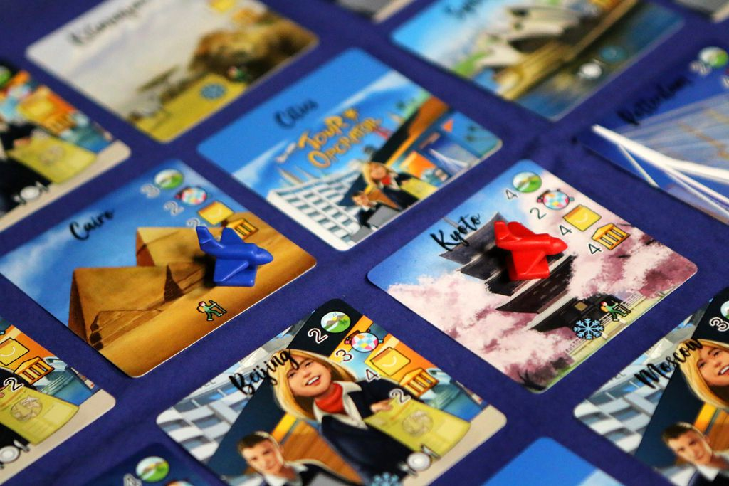
3- The Tour Packaging Process

Slide 29
3- The Tour Packaging Process
A- Market Research and Destination Selection - Identify target market segments (adventure, seniors, families) - Analyze demand trends and preferences - Evaluate potential destinations (safety, appeal, infrastructure) - Select destinations aligned with target market and brand
The Tour Packaging Process
Market Research
Supplier Contracting
Itinerary Planning
Costing and Pricing
Marketing and Sales

Slide 30
3- The Tour Packaging Process
B- Supplier Contracting - Partner with: Accommodation providers Transport services (airlines, buses, transfers) Local guides and activity providers - Negotiate rates, availability, and service standards - Build reliable relationships
The Tour Packaging Process
Market Research
Supplier Contracting
Itinerary Planning
Costing and Pricing
Marketing and Sales

Slide 31
3- The Tour Packaging Process
C- Itinerary Planning - Design engaging, realistic daily schedules - Balance sightseeing, travel time, meals, and rest - Consider flow, logistics, and timing - Adapt for special interests (culture, nature, adventure)
The Tour Packaging Process
Market Research
Supplier Contracting
Itinerary Planning
Costing and Pricing
Marketing and Sales

Slide 32
3- The Tour Packaging Process
D- Costing and Pricing - Calculate total cost: transport, lodging, entrance fees, meals, staffing - Add markup/profit margin - Offer competitive pricing - Ensure value for money
The Tour Packaging Process
Market Research
Supplier Contracting
Itinerary Planning
Costing and Pricing
Marketing and Sales

Slide 33
3- The Tour Packaging Process
E- Marketing and Sales - Promote through websites, travel agents, social media - Highlight unique selling points - Offer early bird discounts or group deals - Use distribution channels (OTAs, DMCs, direct bookings)
The Tour Packaging Process
Market Research
Supplier Contracting
Itinerary Planning
Costing and Pricing
Marketing and Sales

Slide 34
3- The Tour Packaging Process
4- Calculate the Package Cost and Selling Price: Transportation, accommodation, meals, activities, transfers. Then decide: - Profit/markup: - Final selling price per person: 5- Choose a Distribution Channel - Direct Channel: - Indirect Channel:
Design a Tour Package 1- Identify the Target Market - Families, young travelers 2. Select a Destination and consider: - Safety, attractions, infrastructure, accessibility, customer preferences 3. Create Your Tour Package - Transportation, accommodation, meals, activities/Excursions, transfers

Slide 35
Thank you
      European Institute of Innovation, Entrepreneurship and Technology
      Lessingstraße 79,
      13158 Berlin, Germany
      Phone: +49 176 55524449
      Email: info@eiiet.com
Discover the world of eiIET

