Slide 1
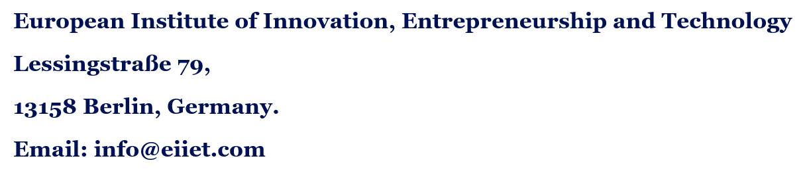
Management of Non Health Care Areas
Ms. Ana Lucia

Slide 2
Index
1
Module overview and roadmap
Slide 3
2
Part 1: Foundations of support services
Slide 6
3
Part 2: Logistics and procurement
Slide 12
4
Part 3: Hotel services
Slide 18
5
Part 4: A safe environment
Slide 24
6
Part 5: Outsourcing, contracts and performance
Slide 32
7
Capstone, discussion and review
Slide 42
Notes:
Use the index to show how the module fits together: foundations first, then supply, hotel services, safety and finally performance and contracts. Each line is clickable in slideshow mode and jumps to the start of that part, which is useful when you revisit a topic in a later session.

Slide 3
About This Module
Credits
Mode
Approach
4 ECTS, roughly 100 hours of total student workload
Onsite or blended, with materials and group work on the virtual campus
Lectures, role-play, service audits and hospital case studies
Clinicians treat patients, but they cannot do it without clean wards, sterile linen, working lifts, safe water, reliable supplies and meals that actually get eaten. This module is about managing that invisible half of the hospital.
Notes:
The 100-hour figure assumes 25 hours per ECTS credit; adjust if your institution uses a different convention. Ask students about their own background: many MAMPHS students have clinical experience and have never seen these services from the management side.

Slide 4
What You Will Be Able to Do ?
1
Explain why non-clinical services are critical to safe, effective care
2
Manage logistics, procurement, maintenance and hotel services
3
Apply safety rules for security, waste and infection prevention
4
Design and manage outsourcing contracts and KPIs
5
Coordinate support services with clinical operations
Notes:
These map directly onto the three competences in the module descriptor: understanding the role of non-clinical services, acquiring management skills across each service line, and coordinating them with clinical operations for continuity, safety and cost-efficiency.

Slide 5
Our Roadmap
Part 1: Foundations
Part 2: Supply
Part 3: Hospitality
What support services are and why they matter
Logistics, inventory and procurement
Catering, laundry and cleaning
Part 4: Safety
Part 5: Performance
Capstone
Maintenance, security, emergencies and waste
Outsourcing, contracts, KPIs and integration
A real service audit and contract role-play
Notes:
Each part closes with a case study. Several are cautionary tales on purpose: in support services, failure is usually far more visible than success.

Slide 6
Part 1
Foundations of Support Services
What counts as a non health care areas, how it is organised and why it shapes society , cost and patient experience

Slide 7
What Are Non-Healthcare Areas?
Definition: all services that support care without being clinical treatment
Hard services: buildings, engineering, maintenance, utilities
Soft services: cleaning, catering, laundry, portering, security, waste
Business support: logistics, procurement, helpdesk, car parking
Also called: facilities management (FM) or “hotel services”
Notes:
Ask students to list every non-clinical role they can think of in a hospital. A typical group reaches 15 to 20 within minutes: porters, chefs, electricians, security guards, storekeepers, receptionists, gardeners. The point is scale: these teams are often a large part of the total workforce.

Slide 8
Why They Matter ?
1
Patient safety
2
Infection control
Dirty surfaces, unsafe water or failed power put lives at risk directly.
Cleaning, linen and waste are front-line defences against infection.
3
Patient experience
4
Cost and continuity
Food, noise, comfort and cleanliness shape how care is judged.
Support services absorb a large share of the budget and must never stop.
Notes:
Patients often cannot judge clinical quality, so they judge what they can see. A stained pillow or a cold meal quietly lowers trust in the doctors too. This is why patient surveys and inspections pay so much attention to the environment.

Slide 9
Facility Management as a Discipline
ISO 41001:2018
Demand side
The international standard for a facility management system.
The hospital defines what its clinical areas need.
Supply side
The FM manager
In-house teams or contractors deliver those services.
Translates clinical needs into service specifications.
Core idea: buildings and services exist to serve the organisation’s core purpose, which is patient care.
Notes:
Recommend Atkin & Brooks, Total Facility Management, and Barrett & Baldry, Facilities Management: Towards Best Practice. Emphasise the demand/supply split: the biggest mistakes happen when support services are designed around their own convenience rather than around clinical need.

Slide 10
Service Quality: The SERVQUAL Lens
Tangibles
Reliability
Responsiveness
Clean, tidy, well-kept spaces
Meals and linen on time, every time
Fast reaction to a spill or fault
Assurance
Empathy
The gap
Competent, trusted staff
Respect for patients’ dignity and needs
Quality = what is perceived minus what was expected
Notes:
Parasuraman, Zeithaml and Berry (1988) developed SERVQUAL in retail services, but it transfers well to hospital hotel services. Exercise: ask groups to write one support-service example for each dimension from their own workplace.

Slide 11
How Support Services Are Organised ?
In-house
Outsourced
Mixed model
Hospital employs and manages the staff directly
A contractor delivers one service under contract
Some services in-house, others contracted out
Total FM
Shared services
PPP / PFI
One provider delivers most or all support services
Several hospitals pool one support function
Private partner builds, finances and runs services long-term
Notes:
No model is right everywhere. We will come back to the make-or-buy decision in Part 5. For now, ask students which model their own hospital or health system uses, and why they think it was chosen.

Slide 12
Part 2
Logistics and Procurement
Getting the right item to the right ward at the right time, and buying it at the right value

Slide 13

The Hospital Supply Chain
Plan: forecast demand from clinical activity
Source: select suppliers and agree terms
Receive and store: check, record, store safely
Distribute: deliver to wards, theatres, pharmacy
Use and replenish: track consumption, reorder in time
Notes:
Point out that nurses in many hospitals still spend real time hunting for supplies. Every minute a nurse spends looking for gloves or dressings is a minute taken from patients. Good logistics gives clinical time back.

Slide 14
Managing Inventory
ABC analysis
VED analysis
Rank items by annual spend; control the costly “A” items most tightly.
Vital, essential, desirable: rank items by clinical criticality.
Par levels
Two-bin kanban
Agreed stock for each ward, topped up by the logistics team.
When the first bin empties, it signals a reorder while the second is used.
Notes:
Combine ABC and VED in a matrix: a cheap item can still be vital (an airway device), and it must never run out. Discuss the tension between low inventory (saves money) and resilience (saves lives). The next case shows what happens when that balance is wrong.

Slide 15

The Procurement Process
Need: clinical and technical users define requirements
Specification: describe outputs, standards and volumes
Tender: invite competitive bids, transparently
Evaluation: weigh quality, cost and risk, not just price
Award and contract: agree terms, then manage the relationship
Notes:
In the EU, public hospitals follow Directive 2014/24/EU, which allows awards on the “most economically advantageous tender” (MEAT), combining price and quality. Stress that the cheapest bid often becomes the most expensive contract once failures and variations are counted.

Slide 16
Smarter Buying
Group purchasing
Value-based procurement
Hospitals combine volumes through a purchasing organisation to secure better prices and terms.
Judge suppliers on total cost of ownership and outcomes, not only the unit price.
Think about it: a cheaper mattress that causes more pressure ulcers is not a saving.
Notes:
Total cost of ownership includes purchase price, delivery, training, maintenance, consumables, energy, disposal and the clinical consequences of failure. Ask students to estimate total cost of ownership for a hospital bed over ten years.

Slide 17
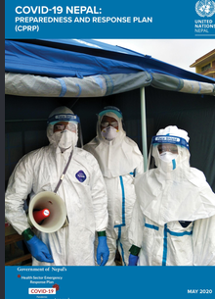
Case Study : The 2020 PPE Crisis
What happened ?
Early in the COVID-19 pandemic, hospitals worldwide ran short of masks, gowns and gloves. Many relied on lean, just-in-time stock and a few overseas suppliers. When demand surged and exports were restricted, prices soared and staff were left exposed.
Key management lessons
Lean stock needs a resilience buffer
Supplier concentration is a hidden risk
Emergency plans must cover supply chains
Discussion: how much should a hospital pay each year for resilience it may never use?

Slide 18

Part 3
Hotel Services
Catering, laundry and cleaning : the services patients notice most, and the ones that matter most for infection control

Slide 19

Hospital Catering
Nutrition is treatment: malnourished patients heal more slowly
Food safety: HACCP controls from delivery to bedside
Special diets: allergies, texture-modified, religious, clinical
Protected mealtimes: no routine ward activity during meals
Waste: uneaten food is a quality signal, not just a cost
Notes:
Protected mealtimes were promoted widely in the UK NHS so that patients are not interrupted while eating and staff can help those who need it. Ask: who is responsible when a frail patient’s tray is taken away untouched? Catering, nursing, or both?

Slide 20
Choosing a Catering Model
Cook-fresh
Cook-chill
Prepared on site and served soon after. Best taste, needs skilled kitchen staff.
Cooked, rapidly chilled, stored for a few days and reheated. Flexible and efficient.
Cook-freeze
Service style
Cooked and frozen for longer storage. Lower cost, less menu freshness.
Plated trays or bulk trolleys with choice at the bedside.
Notes:
Bulk trolley service lets patients choose portions at the bedside, which often reduces waste. Plated service gives tighter portion and diet control. Role-play idea: a catering manager and a ward sister negotiate a new service style.

Slide 21
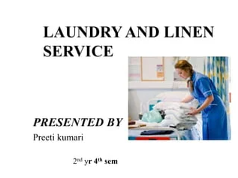
Laundry and Linen Services
Separate flows: soiled and clean linen never cross
Thermal disinfection: 65°C for 10 minutes or 71°C for 3 minutes
Infectious linen: sealed in water-soluble bags
Stock control: par levels, RFID tagging, loss tracking
Options: on-site laundry, central laundry or rental
Notes:
The temperature figures come from the UK guidance HTM 01-04 (Decontamination of linen for health and social care). Linen loss is a surprisingly large hidden cost; RFID tags let hospitals see where linen goes and how many wash cycles each item has done.

Slide 22

Cleaning and Environmental Hygiene
Risk-based: frequency set by the area’s risk to patients
Colour coding: separate equipment for each area type
Standards: NHS England cleanliness standards (2021) use risk categories FR1–FR6
Auditing: visual checks, ATP swabs, patient feedback
People: training and respect for cleaning staff
Notes:
Under the 2021 NHS standards, functional risk 1 covers the highest-risk areas such as operating theatres and intensive care, with the most frequent cleaning and auditing. Emphasise the last point: cleaning staff are often the lowest paid and least recognised, yet they are central to infection prevention.

Slide 23

Case Study: C. Difficile at Maidstone
What happened ?
Key management lessons
Between 2004 and 2006 this English NHS trust suffered outbreaks of Clostridium difficile. A 2007 Healthcare Commission investigation linked around 90 deaths to the infection. It found poor cleaning, shortages of staff and a board focused on finance and targets over safety.
Cleaning is a patient safety issue
Boards must monitor hygiene data
Cutting support staff has clinical costs
Discussion: which early warning signs could managers have acted on?
Notes:
Source: Healthcare Commission (2007), Investigation into outbreaks of Clostridium difficile at Maidstone and Tunbridge Wells NHS Trust. The chief executive resigned. Use the case to show that support-service decisions are governance decisions.

Slide 24

Part 4
A Safe Environment
Maintenance ,engineering ,security ,emergency, preparedness and healthcare waste

Slide 25

Maintenance Strategies
Reactive: fix it when it breaks. Cheap to plan, costly to live with.
Planned preventive (PPM): scheduled servicing to prevent failure
Predictive: sensors and data flag problems early
CMMS: software that logs assets, jobs and history
Medical equipment: often managed by clinical engineering
Notes:
A useful KPI here is PPM compliance: the percentage of scheduled maintenance tasks completed on time. Ask students what a realistic target would be and what happens to reactive workload when PPM compliance slips.

Slide 26
Critical Engineering Systems
Medical gases
Power
Water
Oxygen, air, vacuum
Backup generators, UPS
Legionella control
Ventilation
Lifts
Fire systems
Theatre and isolation air
Patient transfer routes
Detection, doors, alarms
Notes:
These are systems where failure can kill within minutes. Discuss testing regimes: generators should be tested under load regularly, water systems need temperature monitoring and flushing, and medical gas work usually needs a formal permit-to-work system.

Slide 27

Security Management
Access control: zones, ID badges, controlled entry
Staff safety: preventing violence and aggression
Vulnerable patients: maternity, paediatrics, dementia
Assets and drugs: theft prevention, controlled stores
Balance: security without a hostile atmosphere
Notes:
Violence against health workers is a serious and widely reported problem. Discuss de-escalation training, lone-working procedures and incident reporting. Ask: how do you secure a building that must stay open to the public 24 hours a day?

Slide 28
Emergency Preparedness
Business continuity
Fire safety
Plans to keep critical services running when systems fail (see ISO 22301).
Hospitals often use progressive horizontal evacuation to move patients to safe zones.
Major incidents
Drills
Surge plans, lockdown procedures and extra supplies.
Plans that are never practised usually fail on the day.
Notes:
Many patients cannot walk out of a building, which is why hospitals plan to move them sideways through fire compartments rather than straight outside. Tabletop exercise idea: the main power supply and one generator fail at 2 a.m. Who does what, in what order?

Slide 29

Healthcare Waste
General waste: about 85% of the total, similar to household waste
Hazardous waste: about 15%, which may be infectious, toxic or radioactive
Sharps: needles and blades, the main injury risk
Pharmaceutical and chemical: expired drugs, solvents
Radioactive: from diagnostics and therapy
Notes:
The 85/15 split comes from WHO. The management message: if general waste is mixed with hazardous waste, the whole bag must be treated as hazardous, which multiplies disposal costs. Good segregation is both safer and cheaper.

Slide 30
The Waste Management Chain
1
Segregate
2
Collect
3
Store
At source, in colour-coded bins
Sealed, labelled containers
Secure, time-limited holding area
4
Transport
5
Treat
6
Dispose
Licensed carriers with documents
Autoclave, incineration or other
Final disposal and audit trail
Notes:
Reference: WHO (2014), Safe management of wastes from health-care activities, 2nd edition. Duty of care usually stays with the hospital even after a contractor takes the waste away, so documentation (consignment notes) matters.

Slide 31
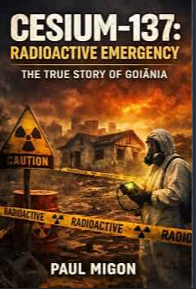
Case Study : Goiânia, Brazil (1987)
What happened ?
A radiotherapy unit was left behind in an abandoned clinic. Scavengers removed it and sold the parts. The capsule held caesium-137, which spread through the community. Four people died and around 249 were contaminated.
Key management lessons
Decommissioning is part of waste management
Responsibility continues after a service closes
Hazardous assets need tracked custody
Discussion: who should have been accountable for the equipment, and how?

Slide 32

Part 5
Outsourcing, Contracts and Performance
Deciding what to buy in ,writing contracts that work ,measuring performance and joining it all up with clinical care

Slide 33

To Outsource or Not?
Possible gains: specialist expertise, scale, cost control, flexibility
Possible risks: loss of control, weaker teamwork, contractor failure
Hidden costs: tendering, monitoring, disputes, exit
Staff impact: transfer of employees, morale, pay and conditions
Key question: can we specify and monitor this service well?
Notes:
Frame the decision with transaction cost thinking: services that are easy to specify and measure (laundry) are easier to outsource than those needing close integration with clinical teams (portering in a busy emergency department). Within the EU, staff transfers are governed by the Acquired Rights Directive (2001/23/EC).

Slide 34
Types of Service Contract
Input-based
Output-based
Specifies resources: “six cleaners per shift”.
Specifies results: “ward meets the cleanliness standard”.
Pricing
Performance-based
Fixed price, cost-plus, or unit price per item or bed-day.
Payments linked to KPIs, with deductions for failure.
Notes:
Output specifications give contractors room to innovate, but they only work if outcomes can be measured fairly. Discuss what goes wrong with each: input contracts reward presence, not quality; badly designed output contracts reward gaming the audit.

Slide 35
SLAs and Contract Management
The SLA
Response times
Governance
Defines what, when, how well and how it is measured
Urgent spills, lift failures, helpdesk calls
Regular review meetings and shared data
Deductions
Relationship
Exit plan
Fair, proportionate and clearly defined
Partnership works better than constant penalty
Handover and continuity if the contract ends
Notes:
Role-play preparation: one group plays the hospital contract manager, another the contractor’s account manager. Scenario: cleaning audit scores fell for two months after the contractor cut hours. Negotiate a recovery plan. This is the capstone role-play.

Slide 36
KPIs for Support Services
Service | Example KPI
Cleaning | Audit score by risk category
Catering | Meals served at correct temperature; plate waste
Laundry | Linen availability; loss rate
Maintenance | PPM compliance; time to fix urgent faults
Waste | Segregation errors per audit
All services | Cost per bed-day; patient satisfaction
Notes:
Good KPIs are few, meaningful and hard to game. Ask students to critique one KPI: for example, “response time to a call” can be met by arriving quickly and doing nothing. Pair each speed measure with a quality measure.

Slide 37
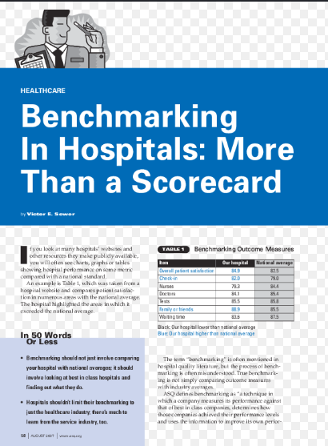
Benchmarking and Scorecards
Benchmarking : compare cost and quality with peer pressure
Balanced scorecard : finance, patients, processes and learning
Dashboards: monthly trends ,not one off snapshots
Caution: compare like with like , size ,case mix, building .age

Slide 38

Case Study: The Collapse of Carillion
What happened ?
Carillion, a major UK contractor, went into liquidation in January 2018. It provided facilities services to many public bodies, including NHS hospitals, and was building two new hospitals. Services had to be kept running and both building projects were badly delayed.
Key management lessons
Contractor failure is a real risk
Check financial health, not just price
Every contract needs an exit plan
Discussion: what would your contingency plan look like if your FM contractor failed tomorrow?

Slide 39
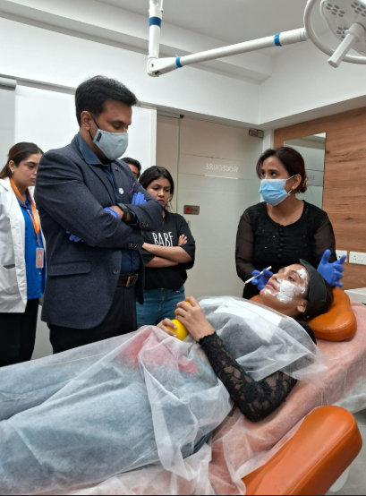
Integrating with Clinical Operations
Shared goals: patient flow, safety and experience
Communication: daily bed meetings and safety huddles
Joint planning: support services involved in service changes early
Escalation: clear routes when things go wrong
Culture: one team, not “clinical” versus “support”
Notes:
Ask students with clinical backgrounds whether they have ever attended a meeting with the head of cleaning or catering. Often the answer is no. Integration starts with simply being in the same room.

Slide 40
Example: Bed Turnaround
1
2
3
4
5
Discharge
Notify
Clean
Prepare
Ready
Patient leaves the ward
Bed status updated instantly
Standard or deep clean
Linen, equipment checked
Next patient admitted
Every delay between these steps keeps a patient waiting in the emergency department.
Notes:
This one process involves nursing, cleaning, portering, linen and often IT. Exercise: ask groups to map a real bed turnaround, time each step, and identify where handoffs fail. Electronic bed management systems can shorten the notify step dramatically.

Slide 41
Technology and Sustainability
Digital tools
Automation
CMMS, helpdesks, RFID tracking, electronic bed boards
Pneumatic tubes and autonomous delivery robots
Energy
Circular use
Efficient HVAC, LED lighting, smart building controls
Less single-use plastic, reprocessing, food waste reduction
Notes:
Hospitals are energy-intensive buildings that run around the clock, so support services are central to any net-zero strategy. Mention initiatives such as Health Care Without Harm’s global green and healthy hospitals network as a resource.

Slide 42
Capstone and Assessment
Service audit
Role-play
Suggested weighting
Audit one support service in a real facility and write a report with an action plan.
Negotiate a contract recovery plan as hospital manager or contractor.
Audit report 50%, role-play 20%, case analysis 30%.
Adjust the weighting to match the official module handbook. Submissions go through the virtual campus.
Notes:
Where site access is difficult, students can audit a service in any large public building or use a detailed case. Remind them to obtain permission and to respect patient confidentiality: no photos of patients.

Slide 43
Questions for Discussion
1
Visibility
2
Supply chains
3
Hygiene
Why do patients judge the doctors by the state of the ward?
What would you have done differently in the 2020 PPE crisis?
Who should own cleaning standards: estates, nursing or infection control?
4
Safety
5
Outsourcing
6
One team
What lessons from Goiânia apply to waste handling where you work?
Which support services would you never outsource, and why?
How could support teams take part in daily bed-flow decisions?
Notes:
Allow 20 to 30 minutes. Give each pair one question and five minutes to prepare, then take one answer per pair. Push students to use evidence from the module cases (the 2020 PPE crisis, Maidstone, Goiânia and Carillion) or from a hospital they know. In the blended format, post the six questions as forum threads on the virtual campus.

Slide 44
Key Takeaways
1
Critical services
2
Value over price
3
Hygiene matters
Support services directly shape safety, infection control and patient trust.
Buy on total cost of ownership and resilience, not the cheapest bid.
Cleaning, linen and waste data belong on the board’s agenda.
4
Plan for failure
5
Contracts
6
One team
Maintenance, continuity plans and drills keep critical systems running.
Clear SLAs, fair KPIs, partnership and an exit plan.
Integrate support and clinical teams around patient flow.
Notes:
Ask each student to pick the one takeaway most relevant to their own workplace and explain in two sentences what they would change on Monday morning. This works well as a closing round or a short written reflection on the virtual campus.

Slide 45
Key References and Resources
WHO (2014). Safe Management of Wastes from Health-Care Activities (2nd ed.).
ISO 41001:2018. Facility Management: Management Systems.
Atkin, B. & Brooks, A. (2015). Total Facility Management (4th ed.). Wiley.
Barrett, P. & Baldry, D. (2003). Facilities Management: Towards Best Practice.
NHS England (2021). National Standards of Healthcare Cleanliness.
Healthcare Commission (2007). Investigation: Maidstone and Tunbridge Wells.
IAEA (1988). The Radiological Accident in Goiânia.
Online: who.int · iso.org · england.nhs.uk · ifma.org
Notes:
Further reading: Parasuraman, Zeithaml & Berry (1988), SERVQUAL, Journal of Retailing 64(1); Department of Health (2016), HTM 01-04 Decontamination of linen; Directive 2014/24/EU on public procurement; Kaplan & Norton (1992), The Balanced Scorecard, HBR; Kenney (2011), Transforming Health Care; UK Parliament (2018) joint committee report on Carillion.

Slide 46
Thank you
      European Institute of Innovation, Entrepreneurship and Technology
      Lessingstraße 79,
      13158 Berlin, Germany
      Phone: +49 176 55524449
      Email: info@eiiet.com
Discover the world of EIIET

