Slide 1
Quality and Sustainability in Tourism and Hospitality
European Institute of Innovation, Entrepreneurship and Technology
Lessingstraße 79, 13158 Berlin, Germany
Mahmoud Abdou| Berlin
      Lessingstraße 79,
      13158 Berlin, Germany
      Phone: +49 30 233618555
      Fax: +49 30 233618556
      Email: info@eiiet.com

Slide 2
Index
Quality and Service Quality
Benefits of High-Quality Tourism Services
The Implications of Poor Service Quality
The Gaps Model of Service Quality
Tools for Assessing Service Quality and Satisfaction

Slide 3

1 Quality and Service Quality
- The destruction of a 120-years old Andraos Palace in Luxor.

Slide 4
1- What is Quality and Service Quality?
1.1- What is quality:
- Quality is a key factor in achieving customer satisfaction and can be understood in two main ways:
      A- Technical Quality
      - Refers to the outcome of the service experience
      - It is about what the customer actually receives at the end.
      It’s more tangible and can often be measured or inspected.
      Examples:
      - Room in a hotel
      - Meal in a restaurant
      - Car from a rental agency

Slide 5
1- What is Quality and Service Quality?
      B- Functional Quality
      - This is the process of service delivery
      - It is about how the customer experiences the interactions.
      - It is about the manner and style in which the service is provided.
      Examples:
      - How the front desk staff welcomes you at check-in
      - The attentiveness of waiters at a restaurant.
      - How the car rental agent explains the terms and offers help

Slide 6
1- What is Quality and Service Quality?
      1.2- Definition of Service Quality
      - Understood as customers’ perceptions of the service component of an offering
      - More complex than in manufacturing, where products can be standardized
      - In tourism, customers expect tailor-made experiences matching their needs and desires
      Tourists’ Perceptions of Service Quality depend on:
      - Individual attitudes and expectations
      - Previous experiences
      - Benefits sought from the holiday

Slide 7
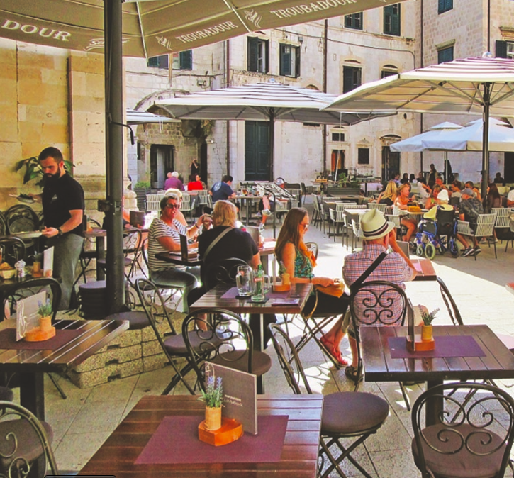
2- Benefits of High-Quality Tourism Services
A- Increased Customer Loyalty
- Builds a loyal customer base
- Loyal visitors are more likely to return and recommend
- Generates repeat business and positive word-of-mouth
George, 2021.

Slide 8
2- Benefits of High-Quality Tourism Services
B- Avoidance of Price Competition
- Quality services reduce reliance on discounts or special offers
- Relies instead on repeat visitors and recommendations
C- Reducing Complaints
- Fewer complaints save time, money, and reputation
- Reduces need for compensations/freebies in hotels, restaurants, airlines, and attractions

Slide 9

3- The Implications of Poor Service Quality
      A- Dissatisfied Customers
      - Poor quality leads to negative experiences
      B- Customer Complaints
      - Dissatisfied customers are more likely to lodge complaints
      C- Adverse Word-of-Mouth (WOM)
      - Negative experiences are shared with others
      - Damages reputation and deters potential customers

Slide 10
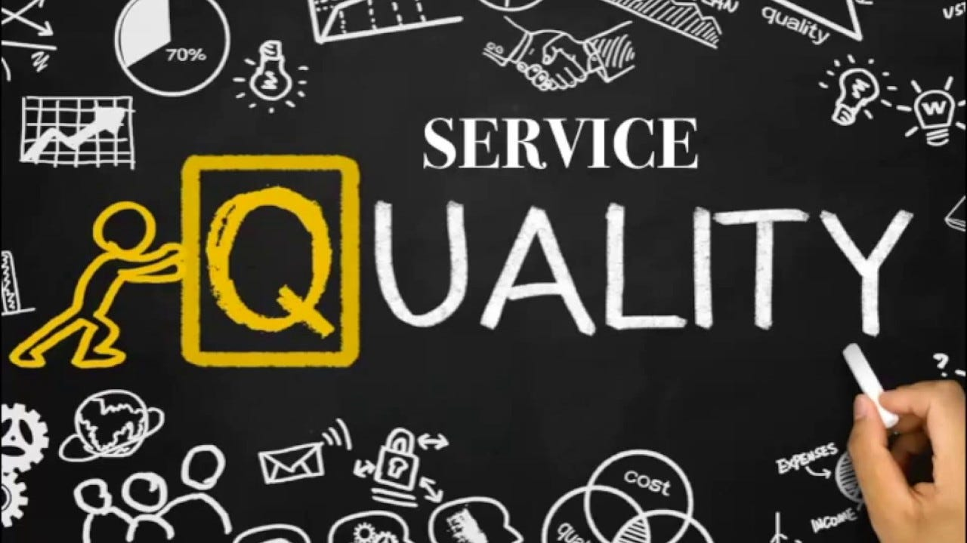
4- The Gaps Model of Service Quality
      - Identifies areas for improvement in tourism services
      - Compares customer expectations vs. perceptions
      - Provides a structured approach to evaluate satisfaction
      - Highlights where service delivery falls short
      - Supports better alignment with customer needs

Slide 11
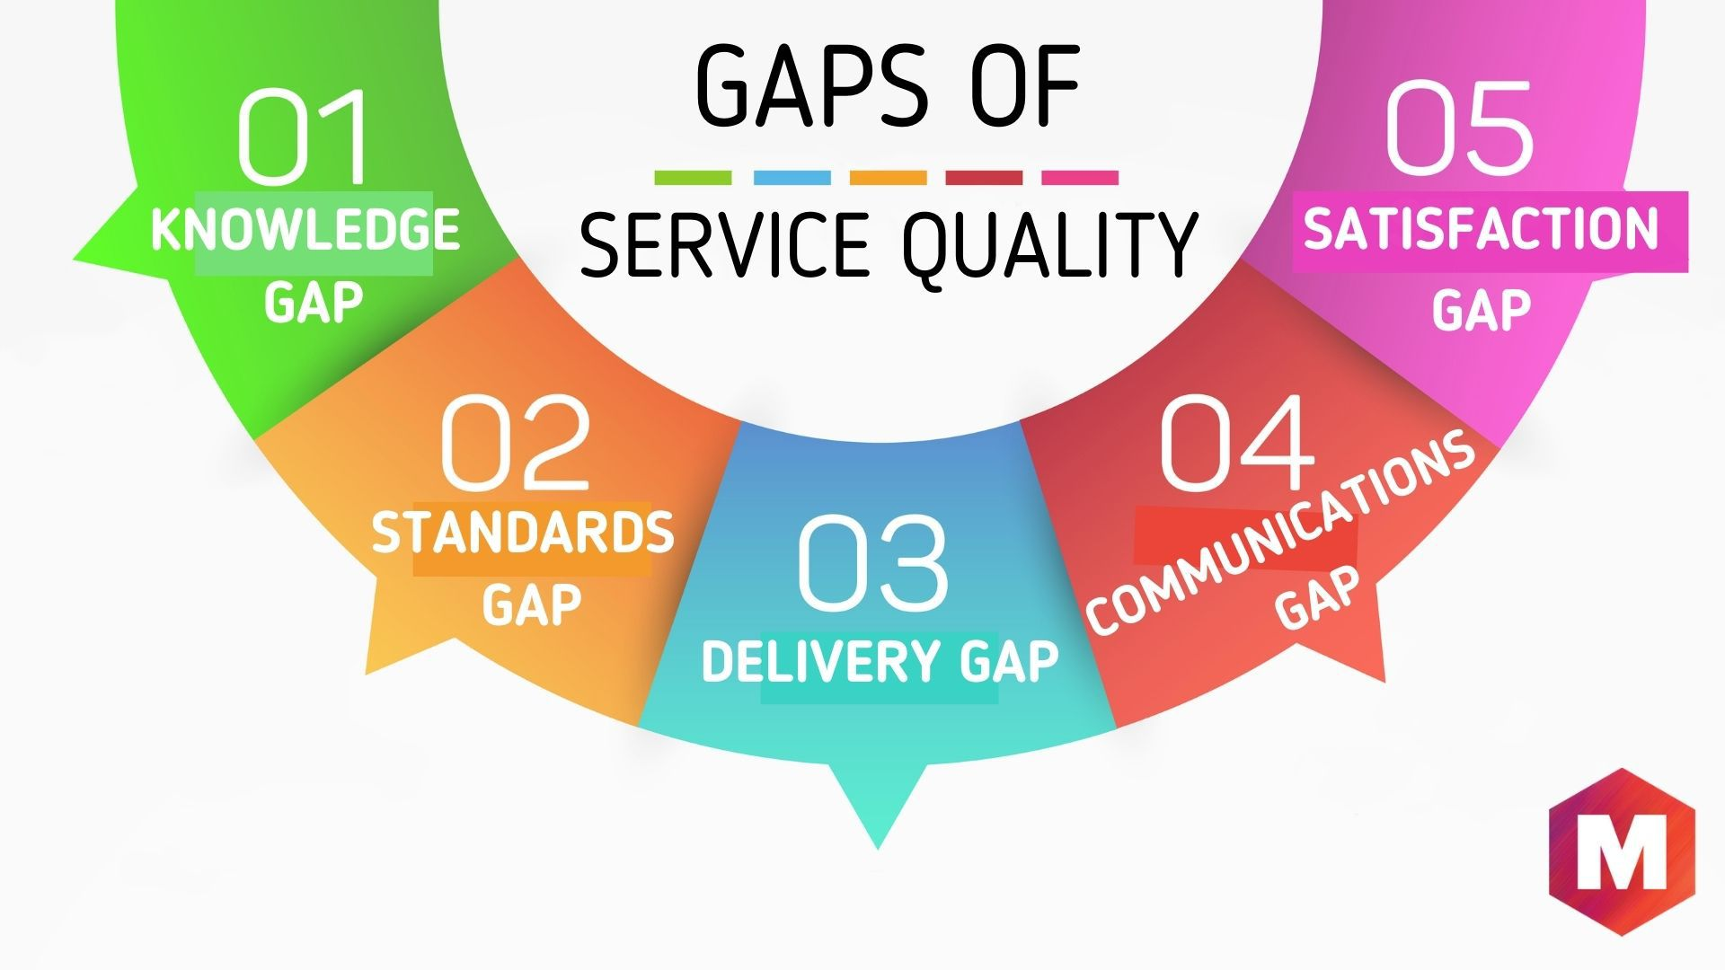
4- The Gaps Model of Service Quality
      A- Consumer Expectations vs. Management Perception
      - Difference between customer expectations and management’s perception
      - Often caused by a lack of understanding of customer priorities

Slide 12
4- The Gaps Model of Service Quality
      B- Management Perceptions vs. Service Quality Specifications
      - Occurs when managers are unaware of consumer expectations
      - Service standards may be based on assumptions rather than actual needs
      - Standards can be unclear, unrealistic, or unenforced
      - Leads to inconsistent service delivery

Slide 13
4- The Gaps Model of Service Quality
      C- Service Quality Specifications vs. Service Delivery
      - Service standards exist but are not properly delivered
      - Tourism relies heavily on employee–customer interactions
      - Challenge: ensuring staff meet quality specifications
      - Causes inconsistent service quality

Slide 14
4- The Gaps Model of Service Quality
      D- Service Delivery vs. External Communications
      - Promised service does not match actual service
      - Marketing may set expectations that aren’t met

Slide 15
4- The Gaps Model of Service Quality
      E- Perceived Service vs. Delivered Service
      - Difference between actual service and customer perception
      - Known as the “service gap”
      - Results from any of the previous gaps
      - Indicates overall service quality in the organization

Slide 16
4- The Gaps Model of Service Quality
      - It ensures consistent product and service quality in tourism and hospitality
      Methods:
Customer surveys | Comment cards
Employee surveys | Focus group interviews
Mystery shopping | Observation

Slide 17
5- Tools for Assessing Service Quality and Satisfaction
      A- SERVQUAL Method
      - Evaluates service quality
      - Measures the gap between customer expectations and perceptions of service delivery
      - Evaluates dimensions such as reliability, responsiveness, assurance, empathy, and tangibles
      B- Importance–Performance Analysis (IPA)
      - Compares performance of service elements with their importance to customers

Slide 18
5- Tools for Assessing Service Quality and Satisfaction
      A- SERVQUAL: Usage and Components
      Usage:
      - Applied across various service sectors:
      Banks, call centers, TV repair companies
      Airlines, hotels
      Components:
      - 22 service attributes measured in a survey
      - Grouped into five key service quality dimensions:
SERVQUAL Methods
Reliability
Assurance
Tangibles
Empathy
Responsiveness

Slide 19
5- Tools for Assessing Service Quality and Satisfaction
      Reliability:
      - Consistency and dependability of service delivery
      - Employees should perform the service correctly the first time
      - Organization must honor promises:
      Accurate billing
      Timely service delivery
      Meeting other service commitments
SERVQUAL Methods
Reliability
Assurance
Tangibles
Empathy
Responsiveness

Slide 20
5- Tools for Assessing Service Quality and Satisfaction
      Assurance
      - Employees’ knowledge and courtesy
      - Ability to convey trustworthiness and instill confidence in customers
      Tangibles
      - Physical aspects of the service
      - Examples:
      Hotel rooms and facilities
      Staff uniforms and presentation
      Organizational materials: brochures, frequent-guest cards
SERVQUAL Methods
Reliability
Assurance
Tangibles
Empathy
Responsiveness

Slide 21
5- Tools for Assessing Service Quality and Satisfaction
      Empathy
      - Providing caring, individual attention to customers
      - Treat consumers as individuals
      - Examples:
      Addressing customers by name
      Remembering preferences and interests
SERVQUAL Methods
Reliability
Assurance
Tangibles
Empathy
Responsiveness

Slide 22
5- Tools for Assessing Service Quality and Satisfaction
      Responsiveness
      - Prompt service delivery
      - Staff are willing and ready to assist customers
      - Examples:
      Responding to requests quickly
      Handling problems and queries efficiently
SERVQUAL Methods
Reliability
Assurance
Tangibles
Empathy
Responsiveness

Slide 23
5- Tools for Assessing Service Quality and Satisfaction
      SERVQUAL Survey and Gap Analysis
      - Customers rate two aspects for each service dimension:
      Expected Service:
      - What customers expect from an excellent company
      Perceived Service:
      - How they perceive the actual service delivered
      - Differences between expected and perceived service reveal service quality gaps

Slide 24
5- Tools for Assessing Service Quality and Satisfaction
      - Example in a Hotel Setting:
Attribute | Expectation (1–10) | Perception (1-10) | Gap
Clean and comfortable room | 10 | 7 | -3
Staff are polite and helpful | 9 | 8 | -1
Prompt check-in | 10 | 10 | 0

Slide 25
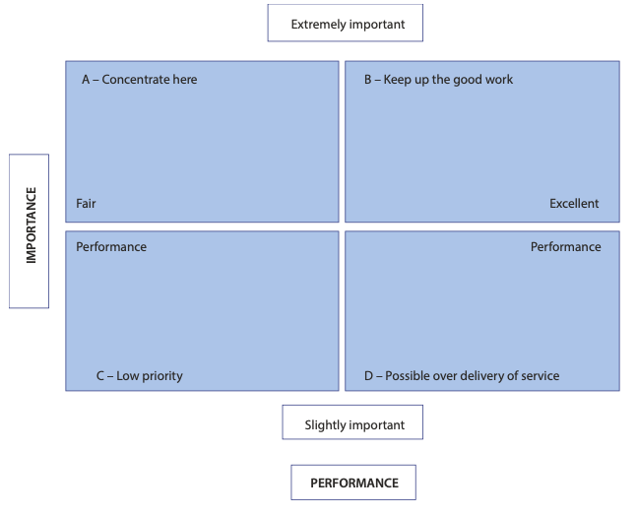
5- Tools for Assessing Service Quality and Satisfaction
      Importance–Performance Analysis (IPA)
      - Compares service performance with the
      importance of service elements to customers.
      - Helps identify areas needing improvement.

Slide 26
Thank you
      European Institute of Innovation, Entrepreneurship and Technology
      Lessingstraße 79,
      13158 Berlin, Germany
      Phone: +49 176 55524449
      Email: info@eiiet.com
Discover the world of eiIET

