Slide 1
Forms of Business Organizations
European Institute of Innovation, Entrepreneurship and Technology
Lessingstraße 79, 13158 Berlin, Germany
Presenter Name| Dr. Naresh Seetharam
      Lessingstraße 79,
      13158 Berlin, Germany
      Phone: +49 30 233618555
      Fax: +49 30 233618556
      Email: info@eiiet.com

Slide 2
Topics in-depth
- Sole Propretiorship
- Partnership
- Joint Stock Company
- Coperative Society
Factors affecting Business Organizations
Sole Proprietorship – Strategic Analysis
Partnership – Governance & Risk Sharing
Conclusion: Managerial Takeaways

Slide 3

Sole Proprietorship – Case Study (India)
Case: Amul Milk Retailer (India)
A single-owner milk retail outlet operated by an individual.
Features: Full control, easy formation, direct profit.
Limitations: Unlimited liability, limited capital, high risk.

Slide 4
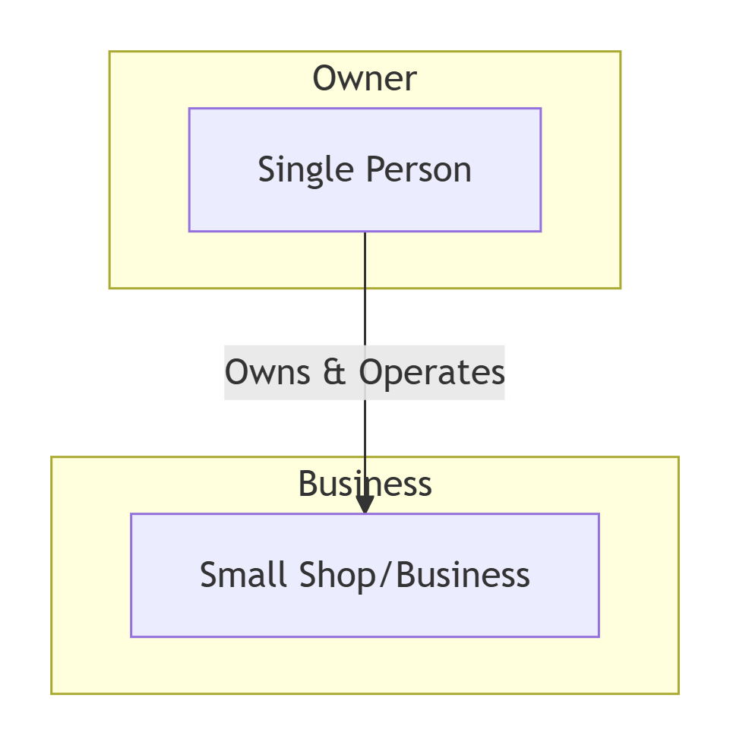

Slide 5

Partnership – Case Study (UK)
Case: PwC (PricewaterhouseCoopers), UK
A professional partnership owned by partners.
Features: Shared risk, pooled skills, better decision-making.
Limitations: Unlimited liability, possibility of conflicts.

Slide 6
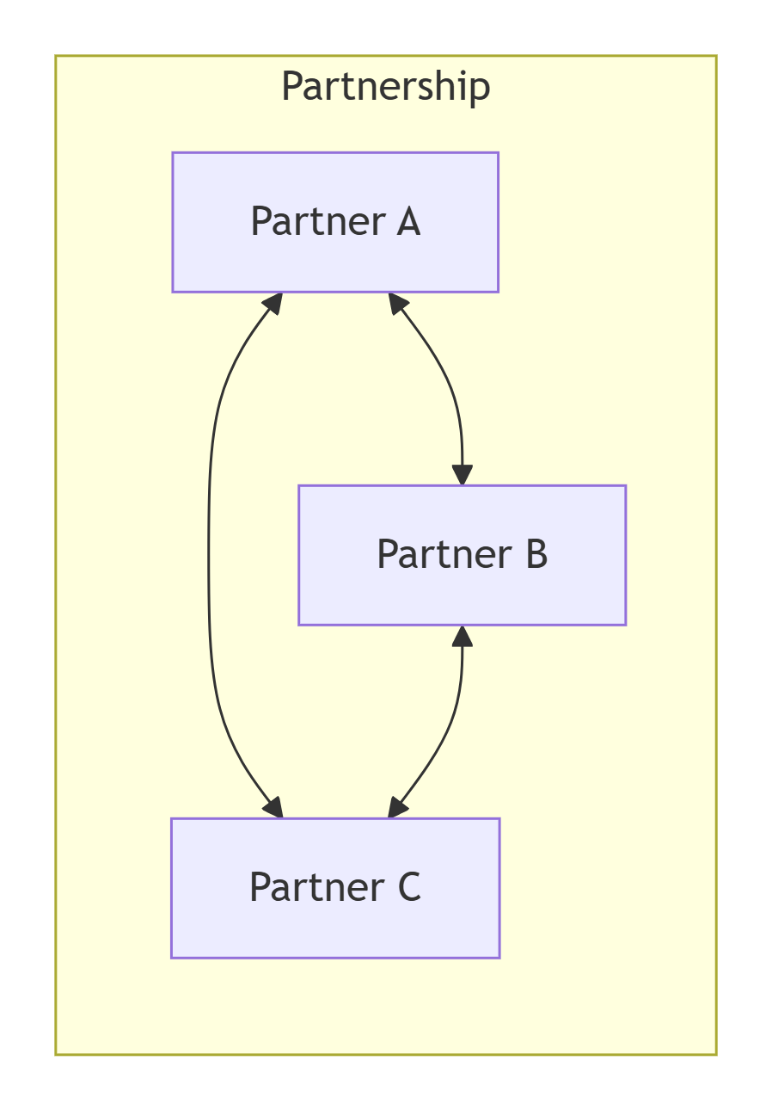

Slide 7

Joint Stock Company – Case Study (USA)
Case: Apple Inc. (USA)
A public limited company with millions of shareholders.
Features: Limited liability, large capital, continuity.
Limitations: Complex formation, separation of ownership and control.

Slide 8
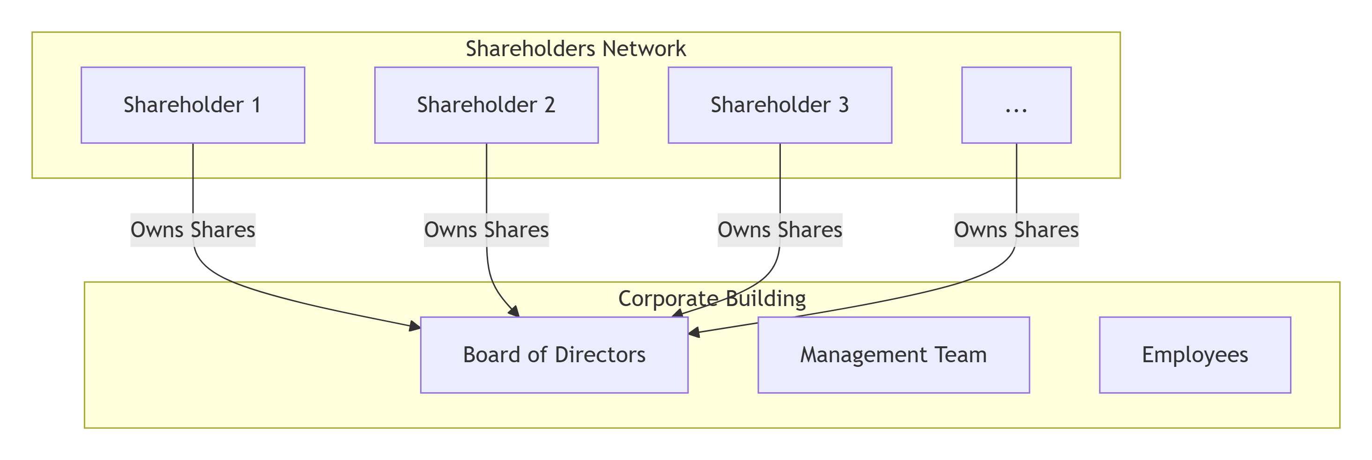

Slide 9

Cooperative Society – Case Study (India)
Case: Amul Cooperative (India)
Owned and managed by milk producers.
Features: Democratic management, service motive.
Limitations: Limited capital, slower decision-making.

Slide 10
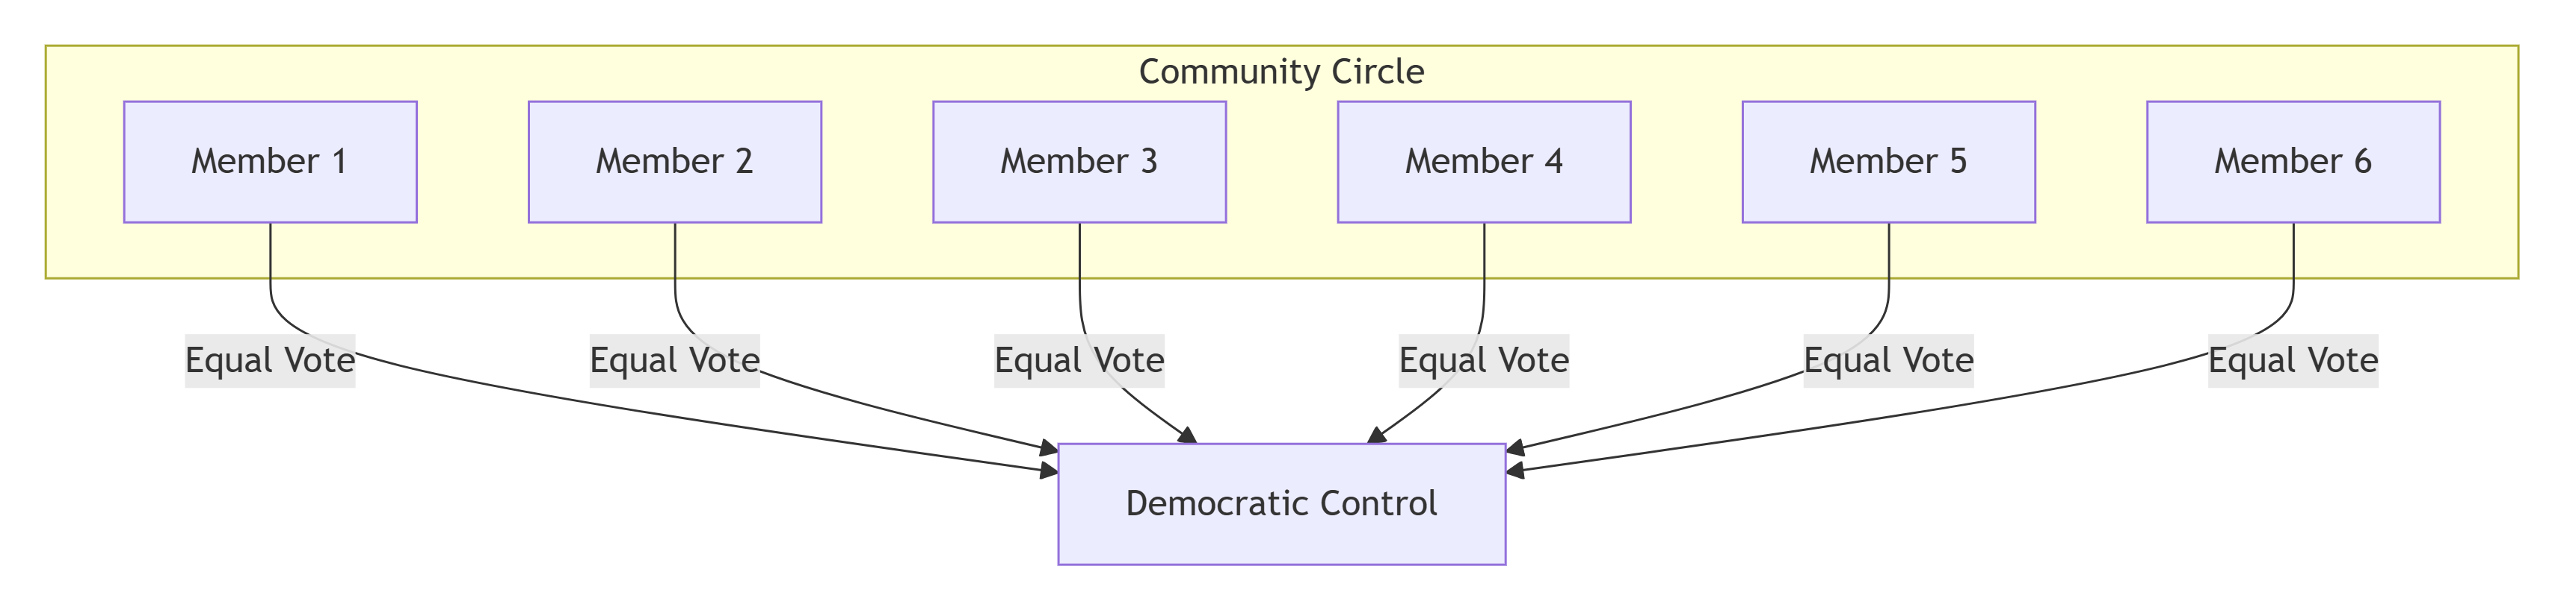

Slide 11
Limited Liability Partnership – Case Study (Singapore)
Case: RSM Singapore LLP
Professional services firm with LLP structure.
Features: Limited liability, operational flexibility.
Limitations: Legal compliance, limited public trust compared to companies.

Slide 12
Factors Affecting Choice of Business Organisation
Nature of business
Scale of operations
Capital requirements
Risk and liability
Control and management
Legal requirements

Slide 13
Sole Proprietorship – Strategic Analysis
Insight:
• Suitable for niche markets and entrepreneurial experimentation
• Low entry barriers encourage innovation
• Strategic limitation: scalability and funding constraints
• Often used as a precursor to formal corporate structures

Slide 14
Partnership – Governance & Risk Sharing
Insight:
• Effective for knowledge-intensive industries (law, consulting, audit)
• Shared ownership aligns incentives
• Governance risk due to joint liability
• Partnership agreements are critical strategic documents

Slide 15
Joint Stock Company – Corporate Strategy
Insight:
• Enables large-scale capital mobilization
• Separation of ownership and control introduces agency problems
• Requires strong corporate governance mechanisms
• Ideal for multinational expansion and public listing

Slide 16
Cooperative Society – Socio-Economic Model
Insight:
• Balances economic and social objectives
• Strong stakeholder engagement
• Limited managerial autonomy may affect competitiveness
• Relevant in sustainable and inclusive business models

Slide 17
LLP – Hybrid Organisational Advantage
Insight:
• Combines flexibility of partnership with limited liability
• Preferred in professional and advisory services
• Strategic advantage in risk containment
• Regulatory clarity varies across countries

Slide 18
Comparative Strategic Evaluation
Criteria:
• Capital access
• Risk exposure
• Control & decision-making
• Regulatory complexity
• Growth & scalability
Analysis focuses on trade-offs rather than best choice.

Slide 19
Choosing the Right Form: Decision Framework
Decision Factors:
• Business life cycle stage
• Industry dynamics
• Competitive strategy
• Investor expectations
• Exit strategy (IPO, acquisition, succession)

Slide 20
Conclusion: Managerial Takeaways
• No single form fits all businesses
• Organisational form must evolve with strategy
• Governance and risk management are central concerns
• Strategic flexibility is a key determinant of success

Slide 21
Thank you
      European Institute of Innovation, Entrepreneurship and Technology
      Lessingstraße 79,
      13158 Berlin, Germany
      Phone: +49 176 55524449
      Email: info@eiiet.com
Discover the world of eiIET

