Slide 1




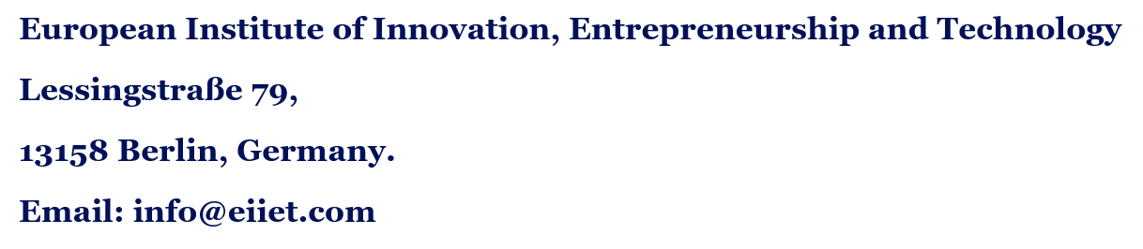
Discover the world of EIIET

Slide 2
What this module is about ?
By the end of the module you can:
6 ECTS
Explain how tourism can act as a strategic tool for local development and social progress, especially in rural and emerging areas.
Analyse, plan and promote tourism initiatives that support sustainable development, equity and community empowerment.
Use practical tools: stakeholder maps, project proposals and assessments of community-based tourism.
credits
Onsite
plus Virtual Campus
7 cases
from four continents
Tourism and Local Development Cooperation | 2
Discover the world of EIIET
Notes:
Walk through the two core competences from the curriculum. Stress that this is an applied module: students will not only discuss theory but produce a stakeholder map, an assessment of a real community-based tourism initiative and a project proposal. Readings, submissions and group collaboration run through the Virtual Campus, so remind them they need a laptop with internet access.

Slide 3
Our Route through the Course
1
Foundations
2
Cooperation
3
Planning
Tourism and local development
Models for development
Sustainable tourism planning
4
People
5
Identity
6
Practice
Participation, stakeholders, partnerships
Heritage and local products
Equity, assessment, proposals
Tourism and Local Development Cooperation | 3
Discover the world of EIIET
Notes:
A quick map of the journey. Parts 1 to 3 build the conceptual base. Part 4 is about people and power, which is where most tourism projects succeed or fail. Part 5 turns to what visitors actually experience: local identity and heritage. Part 6 gives the tools students will use in their coursework.

Slide 4
PART 1
Why tourism matters for local development ?
Definitions, the scale of tourism, how development thinking has changed, and the benefits and risks at community level.
Tourism and Local Development Cooperation | 4
Discover the world of EIIET
Notes:
Part 1 sets the foundation. We need a shared vocabulary before we talk about cooperation and planning.

Slide 5

What do we mean by local development?
Development that starts from a place: its people, resources, institutions and history.
Often called endogenous or bottom-up, because local actors set the priorities.
It is broader than income: skills, health, voice, cultural vitality and a liveable environment all count.
Tourism fits naturally, because visitors travel to the place and spend where the product is.
Tourism and Local Development Cooperation | 5
Discover the world of EIIET
Notes:
Contrast top-down development, such as a national government deciding to build a large resort, with bottom-up development, where a village decides to open homestays. Neither is automatically good or bad, but the question of who decides is central to this module. Ask students for an example from their home region.

Slide 6
Tourism at Global Scale
1.52 bn
+4%
1 in 10
international tourist arrivals in 2025
growth on 2024, back to pre-pandemic trends
jobs worldwide linked to travel and tourism
The headline numbers hide the question this module keeps asking: when a visitor arrives, who in the destination actually gains, and who carries the costs?
Sources: UN Tourism, World Tourism Barometer (January 2026); WTTC Economic Impact Research.
Tourism and Local Development Cooperation | 6
Discover the world of EIIET
Notes:
UN Tourism estimated 1.52 billion international arrivals in 2025, around 60 million more than in 2024. Europe alone received 793 million. The first quarter of 2026 showed growth of about 2 per cent despite disruption linked to the Middle East conflict. Point out that aggregate growth tells us nothing about distribution. A country can post record arrivals while rural areas see almost none of the benefit.

Slide 7
How development thinking evolved ?
1950s–60s
1970s
1980s–90s
1999–2002
2015 onward
Growth first
Dependency critique
Community & sustainable
Pro-poor tourism
SDGs & responsible
Big resorts and foreign capital.
Leakage and unequal power; de Kadt (1979).
Murphy (1985); Brundtland (1987).
Net benefits for the poor; ST-EP launched.
Tourism framed within the 2030 Agenda.
Tourism and Local Development Cooperation | 7
Discover the world of EIIET
Notes:
Each wave did not replace the previous one; they coexist today. Governments still build mega-resorts in the modernisation spirit, while NGOs run pro-poor programmes next door. De Kadt's 1979 World Bank and UNESCO volume "Tourism: Passport to Development?" was an early turning point, because it asked whether tourism really helped poor countries. ST-EP (Sustainable Tourism – Eliminating Poverty) was launched by the UN World Tourism Organization at the 2002 Johannesburg summit.

Slide 8



What tourism can bring to a community ?
Economic
Socio-cultural
Environmental
Jobs and small business
Demand for local farms and crafts
Income in places with few options
Pride and revived traditions
Cultural exchange
Infrastructure residents also use
Income that pays for conservation
A reason to protect landscapes
Awareness among visitors
Tourism and Local Development Cooperation | 8
Discover the world of EIIET
Notes:
These are potentials, not guarantees. Emphasise the word "can" in the title. Every benefit on this slide has a mirror-image risk that we look at next. A useful exercise: ask students to rank the three columns by importance for a remote mountain village, then for a coastal town near a capital city. The rankings usually differ, which shows why context matters.

Slide 9




The Other Side: Costs and Risks
Leakage
Dependency
Much of the money leaves the destination through imports, foreign ownership and overseas operators.
Seasonality and shocks such as pandemics or conflict hit single-sector economies hardest.
Commodification
Elite capture
Culture is simplified and staged for sale; daily life becomes a performance.
Benefits go to those already holding land, capital or connections.
Tourism and Local Development Cooperation | 9
Discover the world of EIIET
Notes:
Elite capture deserves particular attention. In many community projects the village committee is dominated by a few families, and the poorest households, often landless or from minority groups, are left out. Commodification links to Greenwood's classic 1977 study "Culture by the pound" about a Basque festival repackaged for tourists. We return to it in Part 5.

Slide 10
Leakage and Linkages: Follow the Money
Leaks out
Stays local
€100 spent by a visitor
Foreign-owned hotel profits
Imported food and drink
International tour operators
Airline and booking fees
Wages for local staff
Farmers and fishers as suppliers
Guides, crafts and transport
Local taxes and fees
Development cooperation aims to strengthen linkages: local sourcing, local ownership and skills.
Tourism and Local Development Cooperation | 10
Discover the world of EIIET
Notes:
UNEP has long estimated that in most all-inclusive package tours about 80 per cent of what travellers spend goes to airlines, hotels and other international companies rather than to local businesses or workers. Treat the figure as indicative, not universal. Then flip the perspective: leakage is the problem, linkages are the solution. Ask: what could a mid-sized hotel do tomorrow to buy more locally?

Slide 11
Tourism in the SDGs
8.9
12.b
14.7
Decent work
Responsible consumption
Life below water
Policies for sustainable tourism that create jobs and promote local culture and products.
Tools to monitor the development impacts of sustainable tourism.
More economic benefit for small island and least developed states, including from tourism.
Tourism is named in only three targets, yet it can contribute to all 17 goals.
Source: UNWTO & UNDP (2017), Tourism and the Sustainable Development Goals – Journey to 2030.
Tourism and Local Development Cooperation | 11
Discover the world of EIIET
Notes:
Paraphrase the three targets rather than reading them out. The point of the slide: tourism is explicitly on the development agenda, which is why donors, development banks and UN agencies fund tourism projects. Small group task, five minutes: pick one other SDG, for example gender equality or clean water, and find a way tourism could help or harm it.

Slide 12
PART 2
Models of Cooperation for Development
Who the actors are, how pro-poor and community-based models differ, and what partnerships look like on the ground.
Tourism and Local Development Cooperation | 12
Discover the world of EIIET
Notes:
Part 2 moves from why to how. Development cooperation is about actors working together, often across countries and sectors.

Slide 13





Who cooperates? The Main Actors
Multilateral
Bilateral agencies
NGOs & foundations
UN Tourism, UNDP, UNESCO, World Bank
GIZ, AFD, JICA, Swiss SECO
SNV, WWF, local NGOs
Government
Private sector
Communities
Ministries, regions, municipalities
Operators, hotels, investors
Cooperatives, village committees
Tourism and Local Development Cooperation | 13
Discover the world of EIIET
Notes:
Each actor brings different resources and different interests. Multilaterals bring money and frameworks; bilateral agencies such as Germany's GIZ bring technical assistance; the private sector brings market access; communities bring land, culture and labour. Tension arises when the actor with the money is not the actor who lives with the consequences. Ask students which actor they think is most often missing from the planning table.

Slide 14
Development Models Compared
Model | Core idea | Typical example
Community-based | Community owns, manages and shares | Village homestay networks
Pro-poor | Net benefits for the poor, any scale | Hotels buying from local farms
Ecotourism | Nature, conservation and local welfare | Conservancy lodges
Responsible | Every actor takes responsibility | Operator codes of conduct
Fair trade | Certified fair wages and terms | Fair Trade Tourism, South Africa
Tourism and Local Development Cooperation | 14
Discover the world of EIIET
Notes:
The models overlap heavily and the labels are often used loosely in marketing. The key distinctions: community-based tourism is about ownership and control; pro-poor tourism is about outcomes for the poor, regardless of who owns the business; responsible tourism comes from the 2002 Cape Town Declaration and puts the emphasis on all actors taking responsibility. Ask students to place a project they know in the table.

Slide 15


Pro-poor Tourism: Three Strategies
Increase economic benefits
Improve non-economic impacts
Reform policy & process
Jobs and wages
Small enterprise
Collective income
Skills and training
Less cultural harm
Access to water and roads
A say in planning
Business partners
Supportive rules
Pro-poor tourism is an approach, not a product: it can apply to a hostel or a luxury resort.
Tourism and Local Development Cooperation | 15
Discover the world of EIIET
Notes:
Based on Ashley, Roe and Goodwin (2001), a report by ODI, IIED and the Centre for Responsible Tourism. The important insight is that pro-poor tourism does not require a special niche product. A large resort that trains and promotes local staff and buys vegetables from smallholders may do more for poverty than a tiny eco-lodge. Mitchell and Ashley (2010) developed this into value chain analysis.

Slide 16
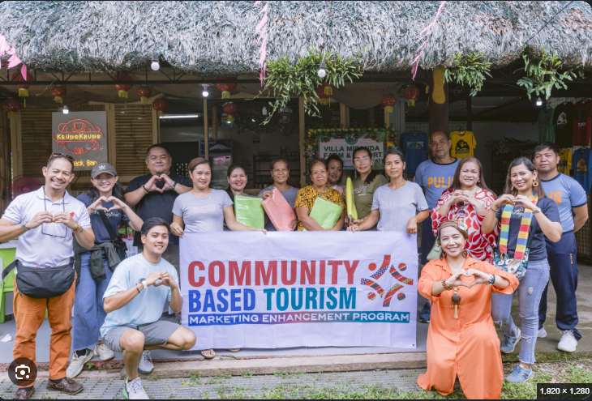
Community-based Tourism
Ownership: the community controls key assets and decisions.
Shared benefits: part of the income goes into a community fund.
Respect: culture and nature are protected, not just displayed.
Pace: hosts decide how much tourism is enough.
Partners: links to operators and NGOs for marketing and training.
Tourism and Local Development Cooperation | 16
Discover the world of EIIET
Notes:
Community-based tourism grew in the 1990s as a reaction to enclave resorts. In practice "the community" is never a single voice. Communities contain men and women, old and young, landowners and landless, majority and minority groups. The question is always: who in the community? Giampiccoli and Saayman, and Dangi and Jamal (2016), give good overviews of how the concept has developed.

Slide 17
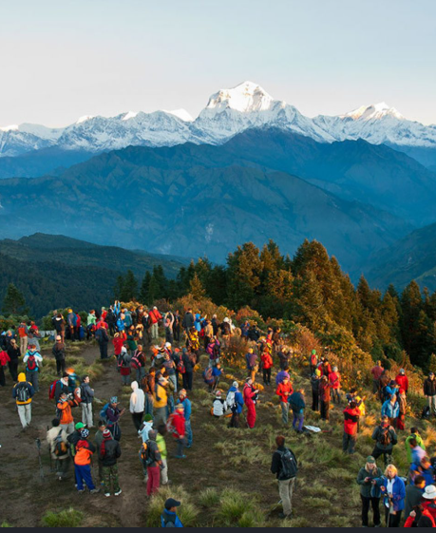
CASE STUDY 1
Annapurna Conservation Area
Nepal, 1986: launched by what is now the National Trust for Nature Conservation.
Scale: Nepal's first and largest conservation area, around 7,600 km².
Model: people live inside the area; conservation and development are managed together.
Money: trekking permit fees are reinvested in the region.
Tourism and Local Development Cooperation | 17
Discover the world of EIIET
Notes:
ACAP is one of the best-known examples of integrating conservation, tourism and community development. Unlike classic national parks that exclude residents, ACAP works through local Conservation Area Management Committees that help manage forests, lodges and trails. Permit fees paid by trekkers fund schools, micro-hydro, trail maintenance and conservation work.

Slide 18
Annapurna: Lessons for Practice
What worked
Ongoing challenges
Fees stay in the region and are visible to residents
Lodge standards and training raised quality
Conservation and livelihoods planned together
Benefits concentrated along main trekking routes
New roads changing the classic trekking product
Debate over handing control to local bodies
Discuss: should the fees go to a local body or the national treasury?
Tourism and Local Development Cooperation | 18
Discover the world of EIIET
Notes:
Use the discussion question for a short debate. Arguments for local control: accountability, motivation, visible benefits. Arguments for national control: redistribution to poorer regions without tourism, and oversight. There is no single right answer, which is exactly why cooperation models matter. Road construction is a good example of how a development benefit for residents can reduce the appeal of the tourism product.

Slide 19
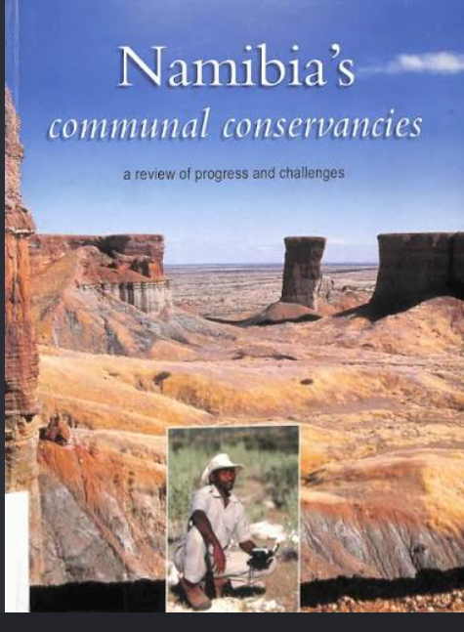
CASE STUDY 2
Namibia’s Communal Conservancies
Law, 1996: communities gained rights over wildlife and tourism on communal land.
Growth: more than 80 conservancies now cover a large part of the country.
Torra Conservancy: partnered with Wilderness Safaris on Damaraland Camp.
Result: lodge income, jobs and recovering wildlife in Kunene.
Tourism and Local Development Cooperation | 19
Discover the world of EIIET
Notes:
Namibia's community-based natural resource management programme is widely studied because it changed the incentives: once communities could earn from wildlife, poaching fell and wildlife numbers recovered in many areas. Torra, registered in 1998 in the Kunene region, is a classic example of a joint venture between a community and a private operator. Be honest about the limits: some conservancies earn very little, and income depends heavily on international demand, as COVID-19 showed.

Slide 20
The joint-venture model
Community brings
Agreement
Operator brings
Land and wildlife rights
Culture and local knowledge
Labour
Lease fees, share of revenue, local jobs, training, path to ownership
Capital and investment
Marketing and bookings
Management skills
Government and NGOs set the legal frame, broker deals and build community capacity to negotiate.
Tourism and Local Development Cooperation | 20
Discover the world of EIIET
Notes:
This model has been used in southern and eastern Africa and beyond. The weak point is almost always the negotiating capacity of the community. An experienced operator with lawyers can easily agree a contract that looks fair but is not. That is where NGOs and development agencies play a crucial brokering role. Ask: what clause would you insist on if you were advising the community?

Slide 21
PART 3
Sustainable Tourism Planning
Principles, the planning cycle, carrying capacity, destination life cycles, resident attitudes and livelihoods.
Tourism and Local Development Cooperation | 21
Discover the world of EIIET
Notes:
Part 3 gives the planning toolbox. Good intentions without planning often produce the very problems we saw in Part 1.

Slide 22


Four Pillars of Sustainability
Sustainable management
Socio-economic
A responsible organisation, a strategy, monitoring and stakeholder involvement.
Local jobs and enterprise, fair work, community wellbeing.
Cultural
Environmental
Protecting heritage, respecting traditions and intellectual property.
Conserving nature, managing resources, reducing pollution.
Source: Global Sustainable Tourism Council (2019), GSTC Destination Criteria v2.0, www.gstcouncil.org.
Tourism and Local Development Cooperation | 22
Discover the world of EIIET
Notes:
The GSTC Destination Criteria are the global baseline for sustainable destinations and are organised around these four pillars. Note that "sustainable management" comes first: without an organisation responsible for coordinating tourism, the other three rarely happen. Students can download the criteria and performance indicators for free from the GSTC website; they are useful for the assessment assignment.

Slide 23
The Tourism Planning Cycle
1
Situation analysis
2
Shared vision
3
Strategy
Resources, markets, community readiness
Goals agreed with stakeholders
Options, products, target markets
6
Monitor & adapt
5
Implement
4
Action plan
Indicators, feedback, revision
Partners, roles, capacity building
Budget, funding, timeline
Tourism and Local Development Cooperation | 23
Discover the world of EIIET
Notes:
Walk around the cycle clockwise. Stress that step 6 feeds back into step 1: planning is continuous, not a document that sits on a shelf. In development projects, step 1 should always include an honest assessment of community readiness: is there interest, leadership and capacity, or is the idea coming from outside? C. Michael Hall's "Tourism Planning" (2008) is the standard text here.

Slide 24
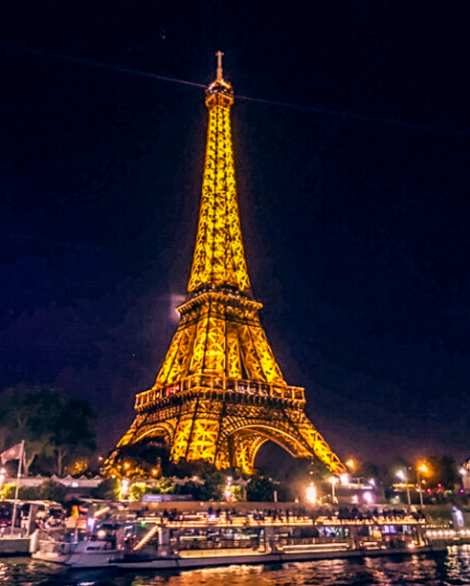
How much tourism is too much?
Carrying capacity: the level of use a place can take before the environment or the experience declines.
The catch: there is rarely one magic number.
Limits of Acceptable Change: decide which changes are acceptable, then monitor them.
Tools: caps, timed entry, zoning, pricing, spreading visitors.
Tourism and Local Development Cooperation | 24
Discover the world of EIIET
Notes:
Carrying capacity has physical, ecological, social and psychological dimensions. The Limits of Acceptable Change framework was developed by Stankey and colleagues for the US Forest Service in 1985. It shifts the question from "how many?" to "what condition do we want, and what will we do when we approach the limit?". That makes it far more practical for community planning, because residents can help define what is acceptable.

Slide 25
Butler’s Tourism Area Life Cycle
Why it matters locally?
Local control is often strongest early on
Outside capital arrives in the development stage
Planning early can shape the curve
Tourism and Local Development Cooperation | 25
Discover the world of EIIET
Notes:
Butler (1980) is one of the most cited models in tourism studies. The curve is illustrative, not a law. For local development, the most interesting moment is the shift from involvement to development, when external investors arrive and local residents may lose control of the product. Ask students where they would place a destination they know, and what the community could have done differently at that stage.

Slide 26
How Residents Feel: Doxey's Irridex
Attitudes also depend on who benefits: people who earn from tourism usually view it more positively.
Antagonism
Visitors blamed openly
Annoyance
Crowding and costs felt
Apathy
Visitors taken for granted
Euphoria
Visitors welcome, little planning
Tourism and Local Development Cooperation | 26
Discover the world of EIIET
Notes:
Doxey proposed the Irridex in 1975. Its limitation is that it treats a community as a single mood. Later research using social exchange theory, for example Ap (1992), shows that residents weigh perceived costs and benefits, so a guide and a retired neighbour in the same street may feel very differently. This is exactly why benefit-sharing is a planning issue and not only a fairness issue.

Slide 27


Tourism and Sustainable Livelihoods
Human
Social
Natural
Physical
Financial
Skills, languages, health
Networks, trust, groups
Land, water, wildlife
Roads, energy, housing
Savings, credit, income
Ask: does this tourism project strengthen households' assets, or erode them?
Tourism and Local Development Cooperation | 27
Discover the world of EIIET
Notes:
The Sustainable Livelihoods Framework comes from the UK Department for International Development (1999). Tao and Wall (2009) applied it to tourism in Taiwan and argued that tourism should be one strategy among several, not a replacement for farming or fishing. Example of erosion: a village sells its best land for a hotel, gains wages for a few years, but loses natural capital permanently.

Slide 28

CASE STUDY 3
Bhutan: High value, Low volume
Policy: tourism managed for value, not mass arrivals, since the 1970s.
Fee: Sustainable Development Fee of US$200 a night from 2022, cut to US$100 in 2023.
Use: fee revenue supports health, education and conservation.
Tension: fewer visitors strained small local businesses.
Tourism and Local Development Cooperation | 28
Discover the world of EIIET
Notes:
Bhutan opened to international tourism in 1974. When it reopened after COVID in September 2022 it raised the Sustainable Development Fee to US$200 per person per night; in 2023 it halved the fee to US$100, running to 2027, to support recovery. This is a live example of a national policy trade-off between limiting impacts and supporting livelihoods. Discussion: who wins and who loses under a high-fee model? Ask students to consider guides, small guesthouses and farmers separately.

Slide 29
PART 4
People, Participation and Partnerships
Levels of participation, stakeholder mapping, and public–private collaboration, with cases from Kenya and Italy.
Tourism and Local Development Cooperation | 29
Discover the world of EIIET
Notes:
Part 4 is about people and power. This part links directly to the stakeholder mapping assignment.

Slide 30
How real is participation?
Citizen control
Tosun's view of tourism (2006)
Delegated power
Coercive: residents are told; tourism is imposed.
Induced: residents are heard, but others decide.
Spontaneous: residents hold real decision-making power.
Partnership
Placation
Consultation
Informing
Therapy
Manipulation
Arnstein (1969)
Tourism and Local Development Cooperation | 30
Discover the world of EIIET
Notes:
Arnstein's ladder groups the rungs into non-participation (grey), tokenism (amber) and citizen power (green). Tosun adapted the idea for tourism in developing countries and found that most real-world "participation" is induced at best. Ask students to think of a public consultation they have seen: where on the ladder was it really? Tosun (2000) also identified operational, structural and cultural limits to participation.

Slide 31
Who has a stake in local tourism?
Residents & households
Local businesses
Tourism project
Community groups
Tour operators & OTAs
Local government
NGOs & donors
National authority
Visitors
Often forgotten: women, youth, minorities and people without land title.
Tourism and Local Development Cooperation | 31
Discover the world of EIIET
Notes:
Freeman's stakeholder theory (1984) defines a stakeholder as anyone who can affect or is affected by an organisation's objectives. In tourism development the affected groups are often the least visible. Ask students to add at least two stakeholders to this diagram for a destination of their choice. Common additions: religious leaders, landowners, transport unions, conservation authorities.

Slide 32
Power–Interest Mapping
Keep satisfied
Manage closely
Ministry, airline, bank
Municipality, lead investor, village committee
POWER
Monitor
Keep informed, and empower
Distant interest groups
Residents, small vendors, women's groups
INTEREST →
Tourism and Local Development Cooperation | 32
Discover the world of EIIET
Notes:
This is Mendelow's power–interest grid as presented in Johnson, Scholes and Whittington's strategy textbook. In a commercial setting the bottom-right quadrant is simply "keep informed". In development cooperation we deliberately add "and empower", because the goal is to move residents upwards in power. That is the ethical twist that distinguishes development work from ordinary project management. Students will use this grid in their first assignment.

Slide 33

Public–Private Collaboration
DMOs with mixed boards
Conditions for collaboration
Public and private members share strategy and marketing.
Partners see they depend on each other
Each expects real benefits
A trusted convenor leads
Decisions are genuinely shared
Concessions and leases
Private operators run services in protected areas for a fee.
Clusters and routes
Small firms group together, for example on a wine or craft route.
Jamal & Getz (1995), Collaboration theory and community tourism planning.
Tourism and Local Development Cooperation | 33
Discover the world of EIIET
Notes:
Jamal and Getz adapted collaboration theory from organisational studies to tourism planning. Their conditions are a useful checklist when students write their project proposals: if partners do not see their interdependence, the partnership will collapse once donor funding ends. Bramwell and Lane (2000) is a good edited volume for further reading on tourism partnerships.

Slide 34
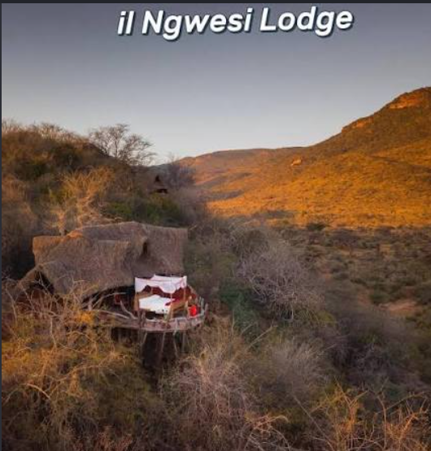
CASE STUDY 4
Il Ngwesi Lodge, Kenya
Who: Maasai community group ranch in Laikipia, northern Kenya.
What: community-owned eco-lodge opened in 1996 with support from neighbouring Lewa Conservancy.
Benefits: income for schools, water, health and wildlife protection.
Recognition: UNDP Equator Prize winner in 2002.
Tourism and Local Development Cooperation | 34
Discover the world of EIIET
Notes:
Il Ngwesi is frequently cited as one of the first community-owned lodges in Kenya. The partnership with Lewa shows the role of a private conservation neighbour as convenor and mentor. Lessons: conservation succeeds when it pays; a small lodge is vulnerable to droughts, security concerns and global shocks; and external partners remain important for marketing. Discussion: at what point should the external partner step back?

Slide 35
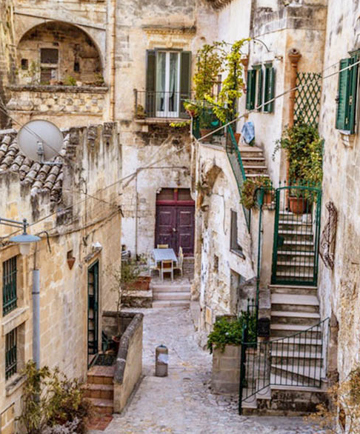
CASE STUDY 5
Europe: LEADER and the Scattered Hotel
LEADER: EU rural method since 1991, run by Local Action Groups.
Bottom-up: public, private and civil society partners write local strategies.
Albergo diffuso: rooms in restored houses across a village, with one reception.
Example: Santo Stefano di Sessanio, Abruzzo, revived through heritage.
Tourism and Local Development Cooperation | 35
Discover the world of EIIET
Notes:
Development cooperation is not only a Global South topic. LEADER has funded thousands of rural tourism projects in Europe, and tourism is one of its most common themes. The albergo diffuso concept is associated with Giancarlo Dall'Ara and grew out of reconstruction thinking after the 1976 Friuli earthquake. In Santo Stefano di Sessanio, the Sextantio project restored medieval houses using traditional materials. Discussion: what are the risks when an outside investor buys much of a village?

Slide 36
PART 5
Local Identity, Heritage and Tourism Products
Turning culture and heritage into experiences without selling out, with cases from Peru and Nepal.
Tourism and Local Development Cooperation | 36
Discover the world of EIIET
Notes:
Part 5 focuses on the product side. What makes a local tourism product distinctive is usually its identity, and that identity belongs to the community.

Slide 37
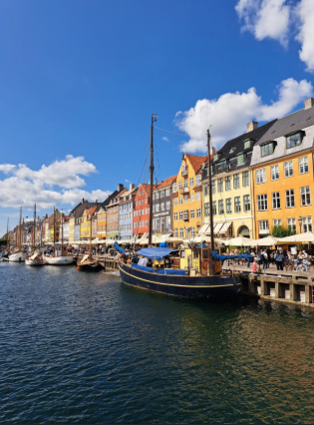
From Heritage to Experience
Tangible: buildings, landscapes, crafts, food.
Intangible: festivals, music, skills, stories.
Products: guided walks, craft workshops, food trails, festivals, community museums.
Control: the community decides what is shared and what stays private.
Beware commodification: culture reshaped only to sell.
Tourism and Local Development Cooperation | 37
Discover the world of EIIET
Notes:
The UNESCO 2003 Convention for the Safeguarding of the Intangible Cultural Heritage is a key reference. MacCannell's idea of "staged authenticity" (1973) distinguishes a front stage shown to visitors from a back stage kept for residents; healthy community tourism respects that boundary. Greenwood's 1977 study of the Alarde festival in Fuenterrabía shows how a ritual can lose its meaning when it is scheduled for tourists. Ask: who should decide what counts as authentic?

Slide 38
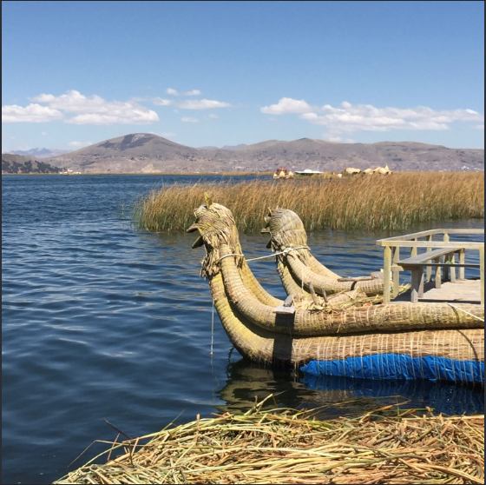
CASE STUDY 6
Taquile Island, Lake Titicaca, Peru
Community control: islanders organised boats, homestays and a cooperative craft shop.
Heritage: textile art recognised by UNESCO as intangible heritage.
Challenge: mainland operators took over much of the boat trade.
Effect: more day trips, fewer overnight stays.
Tourism and Local Development Cooperation | 38
Discover the world of EIIET
Notes:
Taquile is a classic case in the literature, analysed by Mitchell and Reid (2001) in Annals of Tourism Research. From the late 1970s the Quechua-speaking islanders ran tourism collectively, with rotating homestays and community-owned boats. "Taquile and its Textile Art" was proclaimed a Masterpiece of the Oral and Intangible Heritage of Humanity in 2005. The lesson: a community can control the product on the island but lose control of access to it. Discussion: how could Taquile regain control of transport?

Slide 39
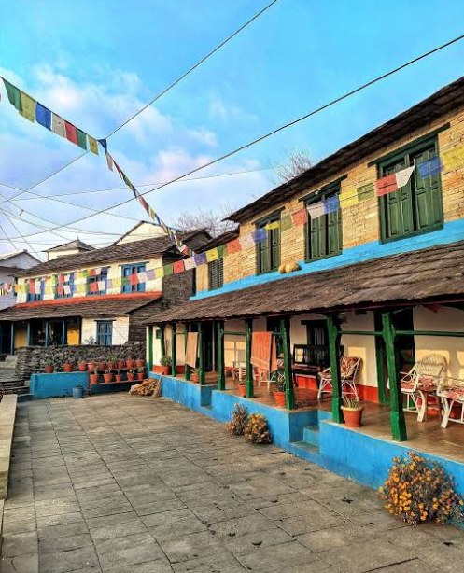
CASE STUDY 7
Sirubari, Nepal: Village homestays
Start: Nepal's pioneer village tourism programme, launched in 1997.
Model: guests rotate among households; a committee sets prices and rules.
Culture: local groups perform songs and dances; guests share family meals.
Legacy: inspired Nepal's wider community homestay movement.
Tourism and Local Development Cooperation | 39
Discover the world of EIIET
Notes:
Sirubari is a Gurung village in Syangja district, western Nepal. The initiative was led by retired Gurkha soldiers who had seen tourism abroad. Rotation spreads income across households rather than concentrating it in one guesthouse, and a management committee handles bookings and a community fund. Challenges include road access, youth out-migration and competition from the many homestays that followed. Compare this with ACAP: one is area-based conservation, the other is a village enterprise.

Slide 40
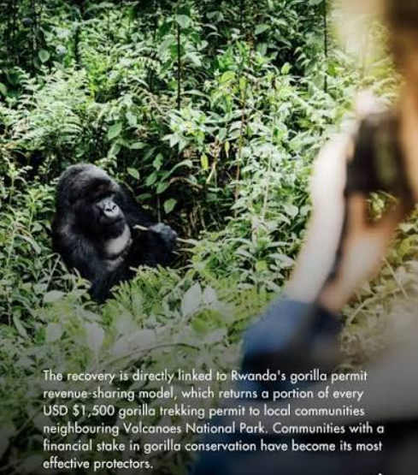
EQUITY IN PRACTICE
Rwanda: Gorilla revenue sharing
Policy: a share of national park revenue goes to neighbouring communities.
2017: share raised from 5% to 10%; gorilla permits rose to US$1,500.
Projects: schools, clinics, water, small enterprises.
Watch: who benefits within the community, and does it change behaviour?
Tourism and Local Development Cooperation | 40
Discover the world of EIIET
Notes:
Rwanda introduced tourism revenue sharing in 2005. Formula-based sharing makes benefits predictable and visible. Other benefit-sharing tools students should know: community funds from homestay income, local hiring quotas, preferential procurement, equity stakes in joint ventures and visitor levies earmarked for local projects. A good extension: the Iby'Iwacu Cultural Village near Volcanoes National Park, which offers former poachers alternative income through cultural tourism.

Slide 41
Assessing a CBT Initiative
Dimension | Key question | Example indicator
Economic | How much spend stays local? | % households earning
Social | Who decides, who is left out? | Women on committee
Cultural | Who controls what is shown? | Community-set rules
Environmental | Is the resource base protected? | Waste, water, wildlife
Governance | Are accounts open and fair? | Published fund reports
Viability | Can it survive without donors? | Occupancy, repeat visits
Tourism and Local Development Cooperation | 41
Discover the world of EIIET
Notes:
This framework is the backbone of the second assignment. Students should gather evidence for each dimension from reports, websites, academic studies and, where possible, interviews. Push them to find at least one measurable indicator per row. The final row matters most for development cooperation: many projects look successful while donor funding lasts and then fade. The GSTC indicators and Dangi and Jamal (2016) are useful for building further indicators.

Slide 42
Writing a Tourism Project Proposal
Proposal structure
Goal
Better livelihoods in the valley
Problem and context
Stakeholder analysis
Objectives and theory of change
Activities and timeline
Budget and funding
Risks and mitigation
Monitoring and exit plan
Outcome
Homestay income for 30 households
Outputs
Trained hosts, booking system
Activities
Training, marketing, community fund
Tourism and Local Development Cooperation | 42
Discover the world of EIIET
Notes:
The right-hand side is a simplified logical framework, read from bottom to top: if we carry out the activities, we deliver the outputs; if the outputs are in place, we achieve the outcome; and that outcome contributes to the goal. A full logframe also has columns for indicators, means of verification and assumptions. Most donors, including the EU and national agencies, expect this format. The example is hypothetical, so students should build their own from their chosen destination.

Slide 43



Coursework: Putting it into Practice
Stakeholder map
CBT assessment
Project proposal
In groups, map the stakeholders of a real destination using the power–interest grid.
Assess a community-based tourism initiative with the six-dimension framework.
Design a tourism initiative for an emerging or rural area, with a logframe.
Readings, templates and submissions are on the Virtual Campus.
Tourism and Local Development Cooperation | 43
Discover the world of EIIET
Notes:
Close with three takeaways. First, tourism is a tool, not a cure: it helps local development only when benefits are planned and shared. Second, cooperation is about power: who decides matters as much as how much money arrives. Third, heritage belongs to the community, and good products respect that. Then explain the three assignments. Encourage groups to choose destinations they can research properly, ideally with some personal connection.

Slide 44

Key Readings: Core Texts
Ashley, C., Roe, D. & Goodwin, H. (2001). Pro-poor tourism strategies: Making tourism work for the poor. ODI, IIED & CRT.
Butler, R. W. (1980). The concept of a tourist area cycle of evolution. Canadian Geographer, 24(1), 5–12.
Mitchell, J. & Ashley, C. (2010). Tourism and Poverty Reduction: Pathways to Prosperity. Earthscan.
Scheyvens, R. (2002). Tourism for Development: Empowering Communities. Prentice Hall.
Telfer, D. J. & Sharpley, R. (2016). Tourism and Development in the Developing World (2nd ed.). Routledge.
Tosun, C. (2006). Expected nature of community participation in tourism development. Tourism Management, 27(3), 493–504.
Tourism and Local Development Cooperation | 44
Discover the world of EIIET
Notes:
Core readings for the module. Scheyvens (2002) and Telfer and Sharpley (2016) are the best starting points for students new to the topic. Ashley, Roe and Goodwin (2001) and Mitchell and Ashley (2010) are essential for pro-poor tourism and value chains. Further reading: Murphy, P. E. (1985) Tourism: A Community Approach, Methuen; Spenceley, A. (Ed.) (2008) Responsible Tourism: Critical Issues for Conservation and Development, Earthscan; Hall, C. M. (2008) Tourism Planning: Policies, Processes and Relationships (2nd ed.), Pearson.

Slide 45
Key Readings: Frameworks and Cases
Global Sustainable Tourism Council (2019). GSTC Destination Criteria, Version 2.0. www.gstcouncil.org
Jamal, T. & Getz, D. (1995). Collaboration theory and community tourism planning. Annals of Tourism Research, 22(1), 186–204.
Mitchell, R. E. & Reid, D. G. (2001). Community integration: Island tourism in Peru. Annals of Tourism Research, 28(1), 113–139.
Tao, T. C. H. & Wall, G. (2009). Tourism as a sustainable livelihood strategy. Tourism Management, 30(1), 90–98.
UN Tourism (2026). World Tourism Barometer, January 2026 edition. UN Tourism.
UNWTO & UNDP (2017). Tourism and the Sustainable Development Goals – Journey to 2030. UNWTO.
Tourism and Local Development Cooperation | 45
Discover the world of EIIET
Notes:
Frameworks and case sources used in this deck. Further reading: Arnstein, S. R. (1969) A ladder of citizen participation, Journal of the American Institute of Planners, 35(4), 216–224; Stankey, G. H. et al. (1985) The Limits of Acceptable Change (LAC) System for Wilderness Planning, USDA Forest Service; Bramwell, B. & Lane, B. (Eds.) (2000) Tourism Collaboration and Partnerships, Channel View. Useful organisations: Global Sustainable Tourism Council (https://www.gstcouncil.org) and UN Tourism (https://www.unwto.org). Journals: Annals of Tourism Research, Tourism Management, Journal of Sustainable Tourism.

Slide 46




Discover the world of EIIET

