Slide 1
Planning and Management of Sustainable
European Institute of Innovation, Entrepreneurship and Technology
Lessingstraße 79, 13158 Berlin, Germany
Mahmoud Abdou| Berlin
      Lessingstraße 79,
      13158 Berlin, Germany
      Phone: +49 30 233618555
      Fax: +49 30 233618556
      Email: info@eiiet.com

Slide 2
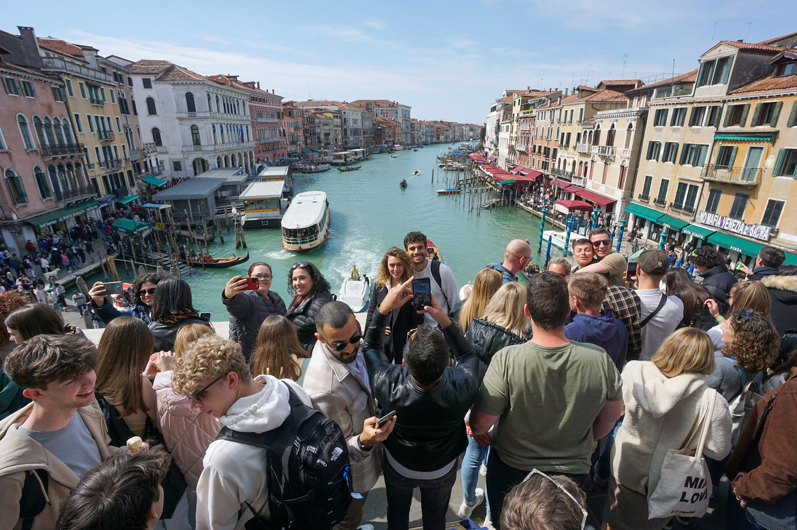
Index
Sustainable Tourism Development
Challenges of Sustainable Tourism
Tourism Spatial Planning

Slide 3
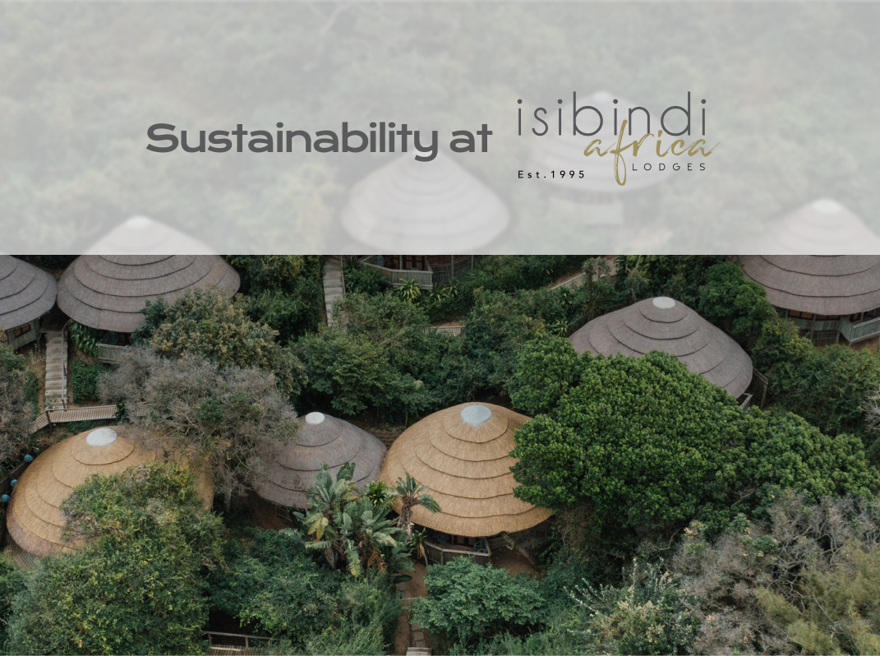
    1- Sustainable Tourism Development

Slide 4

1- What is Sustainable Development
      Sustainable Development is understood as:
      - “development that meets the needs of the present without compromising the ability of future generations to meet their own needs”.
      - Sustainable Development has 3 dimensions:
      Social Sustainability
      Economic Sustainability
      Environmental Sustainability

Slide 5
1- Sustainable Tourism Development
    Sustainable Tourism aims to:
    - Meet the needs of current tourists and host regions
    - Protect and enhance future opportunities
    Focus Areas:
Social equity | Economic viability
Environmental protection

Slide 6
1- Sustainable Tourism Development
    Key Principles
Socio-cultural respect | Economic sustainability
Environmental integrity | Stakeholder collaboration
Responsible tourism behavior

Slide 7

1- Sustainable Tourism Development
    A- UN Sustainable Development Goals:
    -17 global goals adopted by the UN in 2015 to tackle various aspects by 2030, for isntance:

Slide 8
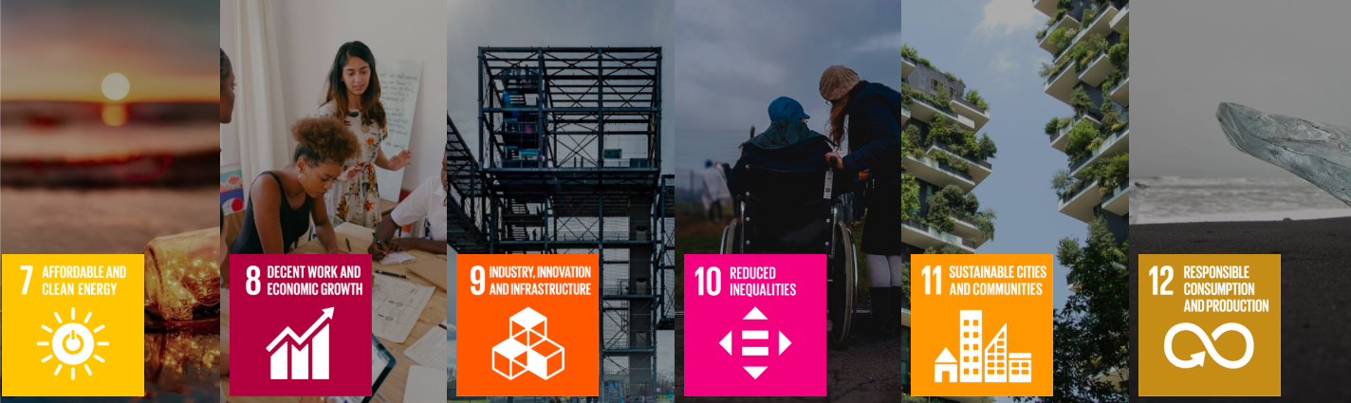
1- Sustainable Tourism Development
    A- UN Sustainable Development Goals:

Slide 9

1- Sustainable Tourism Development
    A- UN Sustainable Development Goals

Slide 10
1- Sustainable Tourism Development
    B- UN SDGs Related to Tourism
    - Tourism directly and indirectly contributes to several SDGs.
    Key ones include:
    - SDG 8: Decent Work and Economic Growth
    - SDG 11: Sustainable Cities and Communities
    - SDG 12: Responsible Consumption and Production
    - SDG 13: Climate Action:
    - SDG 14 and 15: Life Below Water / Life on Land

Slide 11
1- Sustainable Tourism Development
    C- Agenda 2030 and Tourism
    Framework
    - Integrates tourism into national and global sustainable development plans
    Key Objectives
    - Support poverty reduction, employment, and sustainable economic growth
    - Encourage resource efficiency and environmental stewardship
    - Ensure inclusive, participatory, and equitable tourism planning
    - Promote resilient tourism systems capable of adapting to crises

Slide 12

2- Challenges of Sustainable Tourism

Slide 13

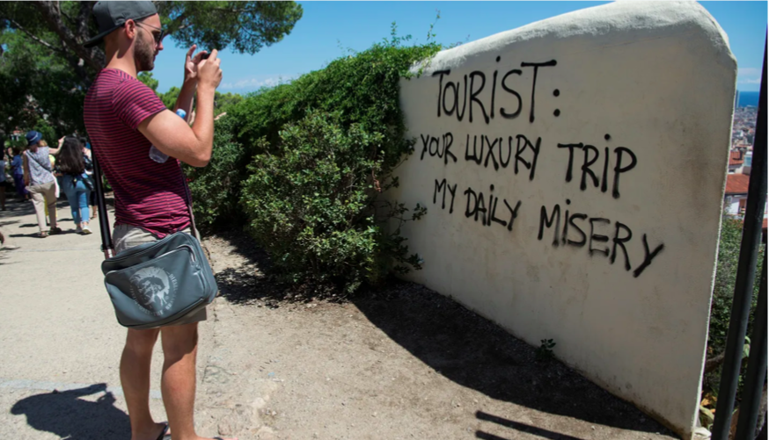
      2.1- Overtourism
      - Protests in Spain in Barcelo, Mallorca, Canaries against over - tourism:
      - Negative economic impacts (prices and rents).
      - Extensive pressure on infrastructure and environment.
      - Cultural Impact

Slide 14
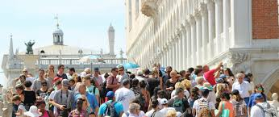

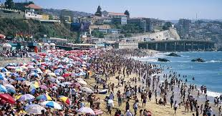
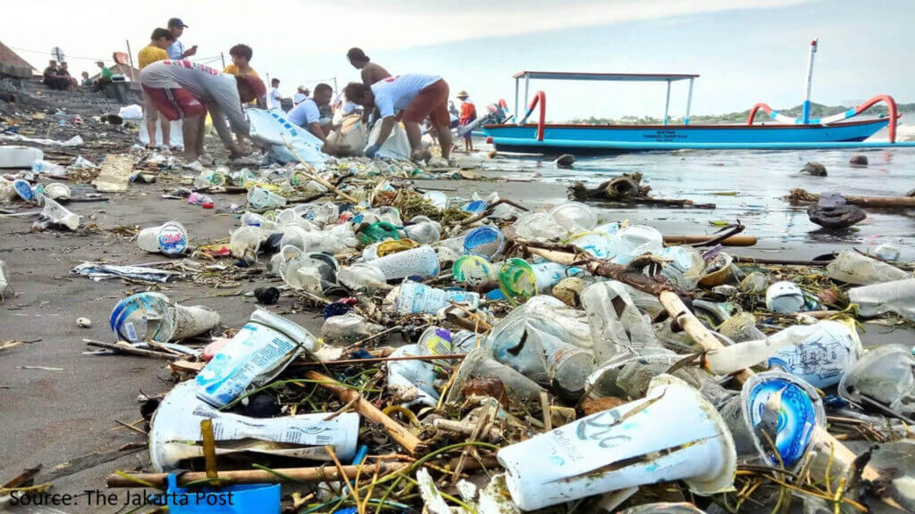

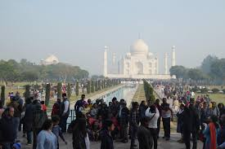

Slide 15
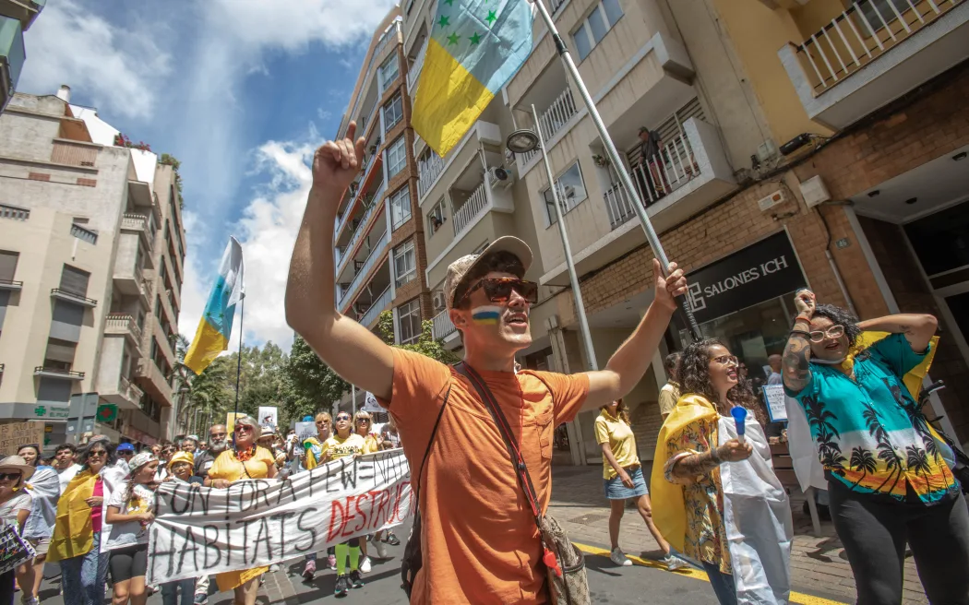
      2.1- Overtourism
      The Case of Canary Islands :
      The inappropriate tourist beavious:
      - The local community started
      demonstrations against the
      irresponsible tourist activities such
      as over drinking and violence

Slide 16
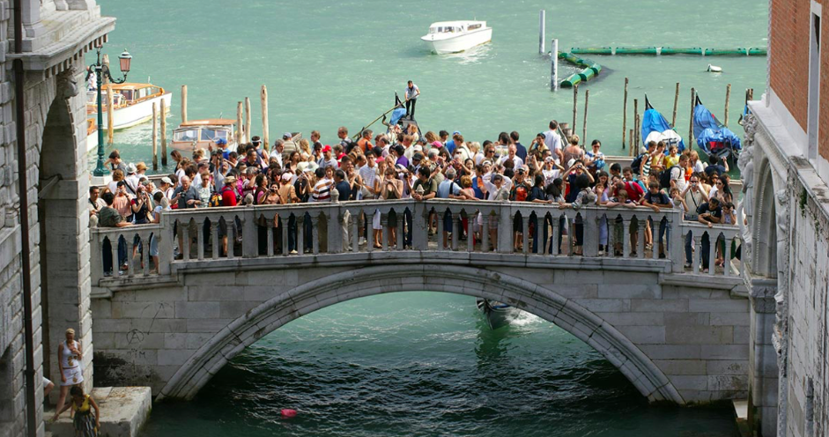
      2.1- Overtourism
      The Case of Venice:
      - Fewer homes and businesses
      - Crowding
      - Noise and disturbance

Slide 17

How can overtourism be controlled and managed?

Slide 18
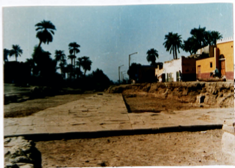
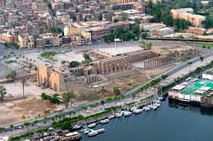
      2.2- Irresponsible Urban Development
      The case study of Luxor, Egypt:
      - The city witnessed different development plans since 1990.
      - The development plans sought to improve the city's infrastructure
      by expanding roads and demolishing certain residential buildings,
      restaurants, cafes, bazaars, and etc.

Slide 19
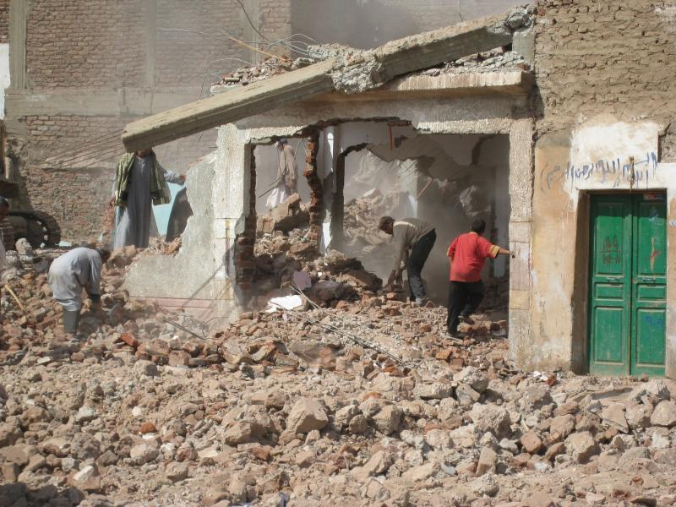
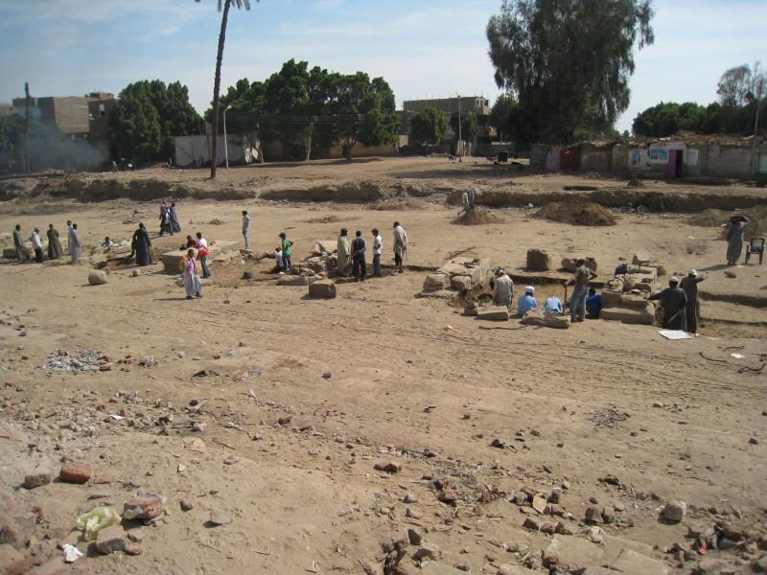
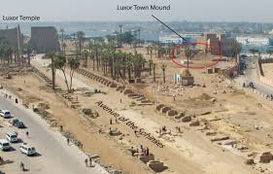
2.2- Irresponsible Urban Development

Slide 20
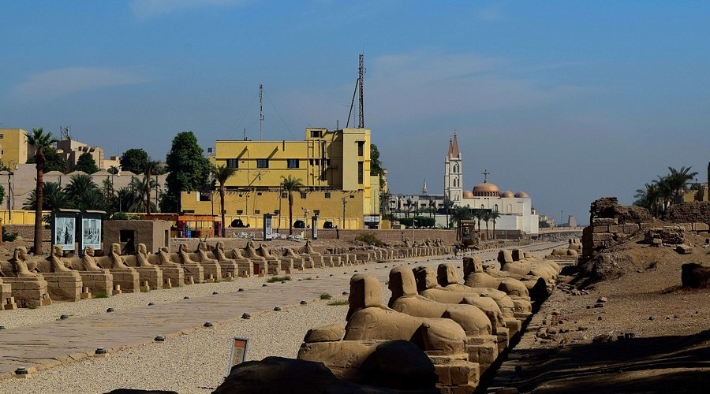
2.2- Irresponsible Urban Development

Slide 21

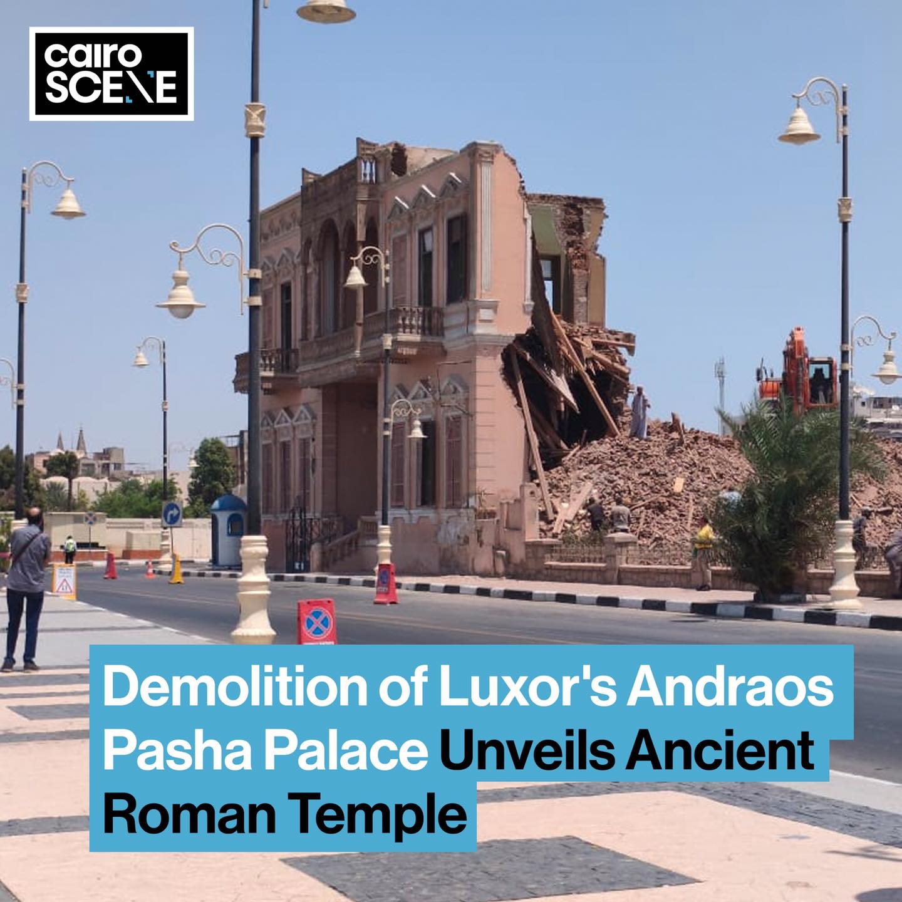
2.2- Irresponsible Urban Development
- The destruction of a 120-years old Andraos Palace in Luxor.

Slide 22
- How can we make urban tourism destination
rehabilitation projects more effective?

Slide 23
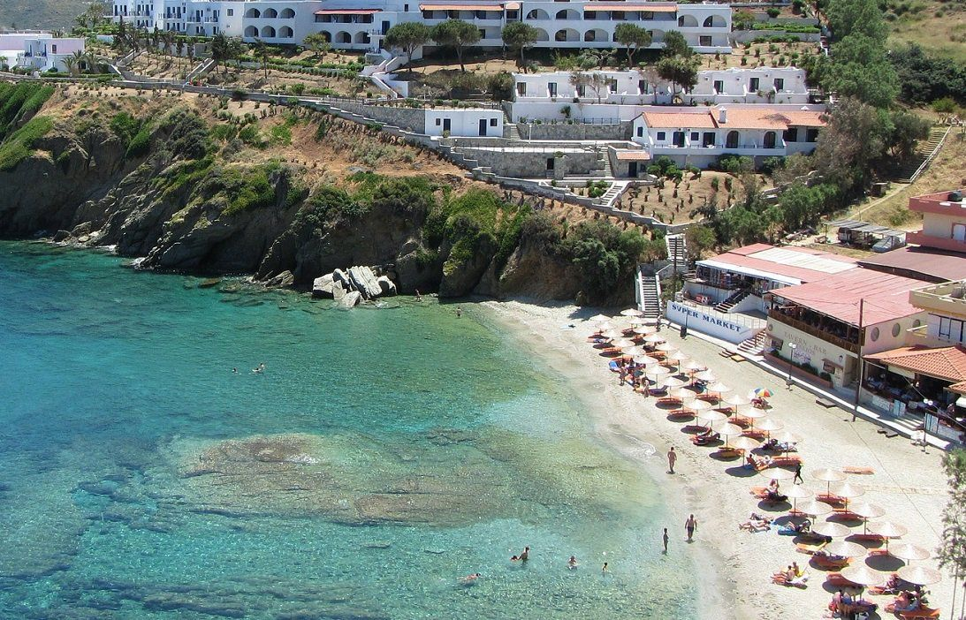
3- Tourism Spatial Planning

Slide 24
3- Tourism Spatial Planning
      - The process of organizing and managing the physical development of tourism destinations.
      It seeks to:
      Benefits:
Ensure sustainable growth | Maintain balanced land use
Protect cultural and natural resources
Prevent overcrowding | Reduce environmental degradation
Avoid conflicts with local communities

Slide 25
3- Tourism Spatial Planning
      National, Regional, and Local Tourism Planning Approaches
      A- National Tourism Planning
      Focus:
      - Broad policy and strategy development.
      - Integration of tourism with national development goals.
      Approach
      Top-down method:
      - Government bodies set overarching frameworks and policies for the entire country.

Slide 26
3- Tourism Spatial Planning
      A- National Tourism Planning
      Key Aspects
      Integration:
      - Align tourism with economic, land-use, and infrastructure plans.
      Market Analysis:
      - Study international markets to enhance growth and competitiveness.
      Strategic Vision:
      - Define tourism’s role in employment creation and foreign exchange earnings.
      Example: Egypt’s Vision 2030 for Tourism
      - Integrates tourism with cultural heritage preservation and economic diversification.

Slide 27
3- Tourism Spatial Planning
      B- Regional Tourism Planning
      Focus
      - More specific than national planning.
      - Targets logical development regions.
      Approach
      - Intermediate level between national and local planning.
      - Uses a mix of top-down and bottom-up methods.

Slide 28
- Tourism Spatial Planning
      B- Regional Tourism Planning
      Key Aspects
      Resource Management:
      - Develop and manage specific regional tourism attractions.
      Infrastructure Development:
      - Provide essential infrastructure to support tourism.
      Inter- and Intra-Regional Coordination:
      - Plan and coordinate tourism development between or within regions.
      - Examples: The European Alps (Alpine Convention)
      - Several countries coordinate to balance ski tourism, environmental protection, and local economies.

Slide 29
3- Tourism Spatial Planning
      C- Local Tourism Planning
      Focus
      - On-the-ground details of a specific destination, site, or community.
      - Approach
      - Driven by local community needs and attitudes.
      - Should align with broader national and regional plans.

Slide 30
3- Tourism Spatial Planning
      C- Local Tourism Planning
      Key Aspects
      Community Involvement:
      - Engage locals through consultative planning.
      Site-Specific Planning:
      - Address environmental and socio-cultural factors for individual sites.
      Sustainability:
      - Preserve local resources and authentic visitor experiences.
      Example: Venice, Italy
      - Local authorities introduced visitor caps, entry fees, and designated tourist routes to reduce overcrowding and protect heritage

Slide 31
      Discussion
      What are some other challenges facing sustainable tourism?

Slide 32
Thank you
      European Institute of Innovation, Entrepreneurship and Technology
      Lessingstraße 79,
      13158 Berlin, Germany
      Phone: +49 176 55524449
      Email: info@eiiet.com
Discover the world of eiIET

